Slide 1
Recover From Camera Reset Without Restarting IOC
Some sites want to be able to restart camera without restarting IOC
  Current EPICS settings should be downloaded to camera after reset
Implemented and tested with ADAravis
  Need to implement and test on other camera drivers
The asynPortDriver disconnect() and connect() methods will be used
  ADAravis current uses a special ResetCamera record, will be changed
Uses the autosave configMenu feature
  Manually save an autosave save_set when camera is reset
  Load the save_set when the reset is complete

Slide 2
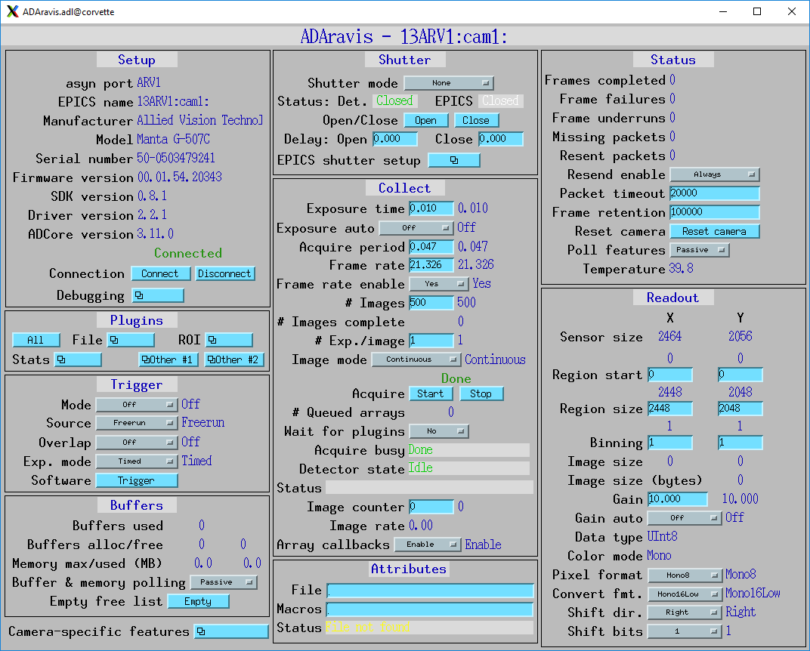
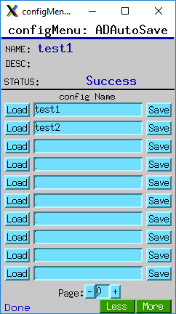
Recover From Camera Reset Without Restarting IOC
Required Steps
Power cycle the camera
Wait for camera to finish initializing, then press the "Reset camera" button on the ADAravis screen
ADAravis can now control the camera again, but many camera settings will no longer match the EPICS values.
Open configMenu screen from
Plugins/Other #2

Slide 3
Recover From Camera Reset Without Restarting IOC
Required Steps
Name the configuration to be saved (e.g. test1)
Press Save button for the configuration you want to save.
  Saves all of the camera and plugin settings to a file called ADAutoSave_test1.cfg.
  Creates a backup of the current settings before creating the new file with a name like ADAutoSave_test1.cfg_210628-133135 encoding current date and time.
Press the Load button for the same configuration you just saved.
  Downloads all of the EPICS camera settings to the camera.
  Also sets all of the plugin settings to the same values you just loaded, so they should not actually change.
This tool can also be used to save multiple configurations with different settings, for example different binning or camera.
  Provides a convenient way to then reload these configurations at a later date.
This mechanism is not specific to areaDetector, can be used with any EPICS device that is reset.

