Slide 1
Implementation and Current Status of KSTAR Control System
Mikyung Park
On behalf of KSTAR Control Team
July 27, 2009

Slide 2
Contents
Introduction
Machine Control & Discharge Control
Plant Control Systems
Data management & Visualization
Machine Interlock System
Improvement for Next Campaign
2

Slide 3
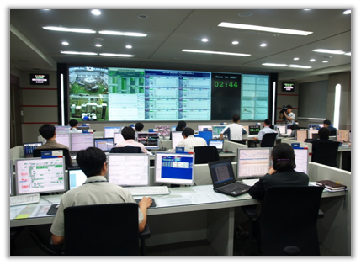
Introduction
3

Slide 4


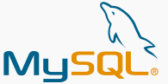
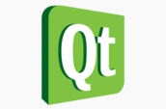
Features of KSTAR Control System
Missions of Integrated Control System
Integration of all plant system I&Cs
Development of schema for tokamak operation
Establishing the environment for real-time plasma F/B control
Achievement of synchronized operation
Machine protection
Network-based distributed control system
Communication standard and software framework
EPICS (Experimental Physics and Industrial Control System)
Using every possible open-source tools for development
Integration of heterogeneous local I&Cs such as VME, cPCI,
PXI, PCI, PLC, and cFP
Using Five Different Networks
Adapting Two Databases : EPICS Channel Archiver, MDSplus
4

Slide 5
Features of KSTAR Control System
Why EPICS ?
a performance proven tool used in the control systems for the large experimental facilities over 20 years
Provides communication protocol as well as many applications such as development tools, archiving & retrieving tools, drivers and so on.
Reduces development time by using many applications in community
An open-source tool
Also, we already have experience using EPICS
Why Open source ?
Guarantees the maintainability for the life time of KSTAR
No cost not only in development but also in maintenance
Easy to pick many applications from the development and user communities
Performance is still evolving through the active community
5

Slide 6
Comparison between KSTAR and ITER
 | KSTAR ICS |  | ITER CODAC
Structure | 2 Tier | Control --- Interlock+Safety | 3 Tier | Control --- Interlock --- Safety
 | 2 Layer | Central --- Local | 2 Layer | Central --- Local
Middleware | EPICS |  | EPICS
Operating system | Linux | Plant monitoring & control | Linux/RT Linux | Slow control
 | VxWorks | Feedback control |  | Fast control
H/W Platform | Slow control | PLC, cFP | Slow control | PLC (Siemens S7)
 | Fast control | VME, PXI, cPCI, PCI | Fast control | TBD (PCIe, ATCA)
Interface (Networks) | Machine | Plant monitoring & control/ Operational data storing (EPICS CA) | PON | Asynchronous interface btw plant system I&C and CODAC
 | Experimental Data | Shot-based data storing (MDSip)
 | Real-time | Feedback control (Reflective memory) | SDN | Real-time feedback control
 | Interlock | Machine protection | CIN | Interlock interface
 | Timing | Synchronized operation (Home-made) | TCN | Project-wide time synchronization
 |  |  | EDN, CSN, AVN
OPI | Qt (open source) | Home made | TBD
Data Managements | EPICS Channel Archiver | Low rate continuous operational data | TBD
 | MDSplus | High rate shot-based experimental data | TBD
6

Slide 7
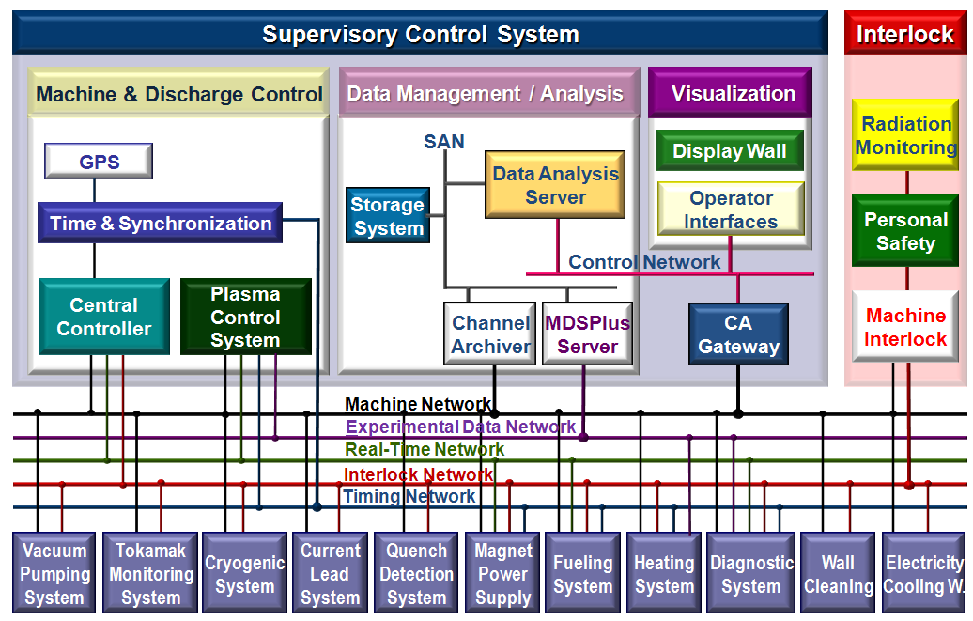
Configuration of KSTAR Control System
7

Slide 8
Machine & Discharge Control System
8

Slide 9
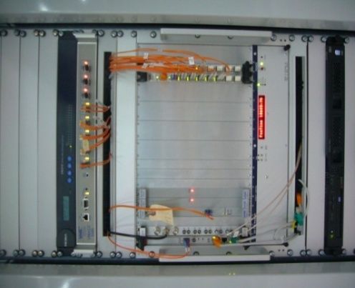
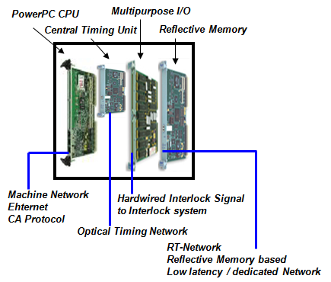
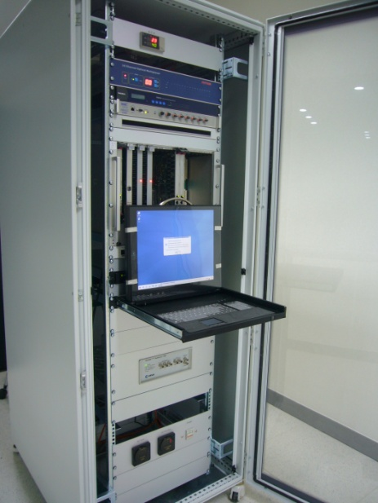
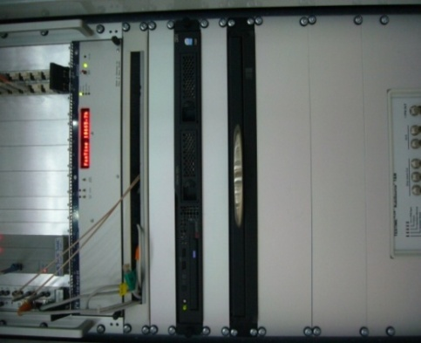
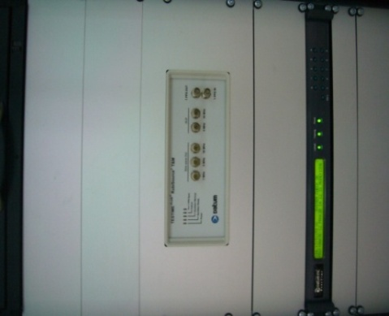
Central Controller
Functions : Supervision of plant operation, control of operation sequence,
interlock interface
Classification | Product name | Specification | Quantity
CPU Board | VMIVME-7050 | VME 6U, PowerPC 1GHz, Memory 1GB, 2 Gigabit Ethernet | 1 module
Timing Module (TSS) | In-house development | PMC type, Optical Network, GPS Time, 100MHz Master Clock, Time accuracy < 5usec | 1 module
Interface module for the interlock system | VMIVME-2534 | VME 6U, 32channel digital I/O | 2 modules
Reflective Memory Module (RFM) | VMIVME-5565 | VME 6U, Optical Network, 128MB Dual-Port Memory, Data Thru-put 176MB/sec, Delay 0.7usec/node | 1 module
RFM Module
Terminal Server
RFM Hub
Interlock Module
CPU 보드
Optical Distributer
VME Crate
CTU
CTU terminal
Console
Rb Atomic Clock
Migration Host
/ Console Host
GPS Receiver
9

Slide 10
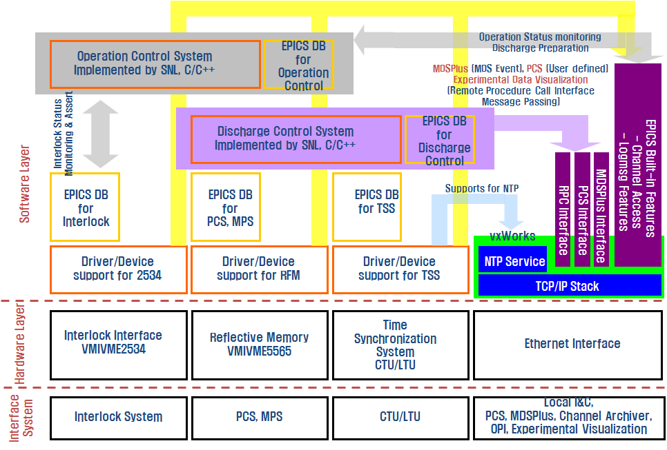
Central Controller _ Functional Block

Slide 11
Plasma Control System
Goal : to generate plasmas by reloadable & reproducible actuator scenarios
to maintain the plasma by active feedback
Real-time feedback control on Ip and Rz
Developed as a US-KSTAR collaboration
Sensors : 82 magnetic diagnostics,1 ch mm-wave interferometer
Actuators : 7 sets of PF Power Supply, a Gas control
Magnetic Control
PF current
Plasma current
Plasma radial position
(82 CH)
Kinetic Control
Pre-fill fueling
Line-integrated
electron density
(1 CH)
11

Slide 12
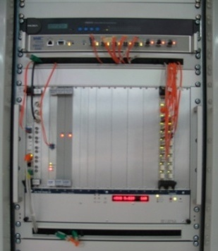
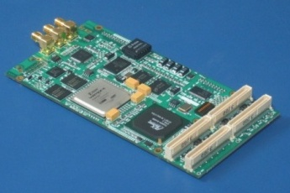
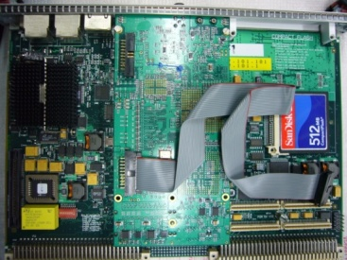

Time & Synchronization System
Functions
Providing accurate trigger signals for synchronized operation
All the systems operated with the same time referenced to the GPS time
Providing sampling clock signals for DAQ systems
Features
Timing Accuracy : 5μsec -> will be improved up to 100ns in the next version.
Hardware : PMC (PCIbus Mezzanine Card) using 33/66MHz, 64-bit PCI bus
 Platform-independent : can be used in any platform using PCI bus
Multiple outputs of trigger and clock : 4 independent triggers and clocks per a board
Waveform-type triggering : one trigger & clock output with 3 different pattern(scenario)
Integrated in EPICS
Timing Board
Timing Network
Timing
Board
Optical Switch
GPS Receiver
Assembled in a Controller board
12

Slide 13
Operation mode of KSTAR
KSTAR Operation Stage (long-term) : vacuum pumping, cool-down, current charge-up,
plasma experiments, and warm-up, maintenance
Machine Control Operation
Supervising the continuous operation of plant systems properly
Monitoring the operation status of the entire system
Discharge Control Operation
Related to plasma discharge shot operation / Divided into 3 steps
Pre-processing
preparation of the plasma discharge shot
configuring the Timing parameters & the PCS
check-up the entire system and configuration
Sequential operation
serial actions performed by the DCS
place PF MPS into the operation status
lock out the PCS
invest the control of PF MPS to the PCS
monitor the operation status of PF MPS and PCS
withdraw the control from PCS when the plasma discharge is terminated
perform watchdog process during the plasma discharge
fast shutdown when some critical failures are detected
Plasma Discharge
Post-processing
finishing the plasma experiments
monitor the diagnostics system and heating system to check completion of the data acquisition
transfer the data from local system to MDSPlus
Shot Sequence
13

Slide 14
Plant Control Systems
14

Slide 15
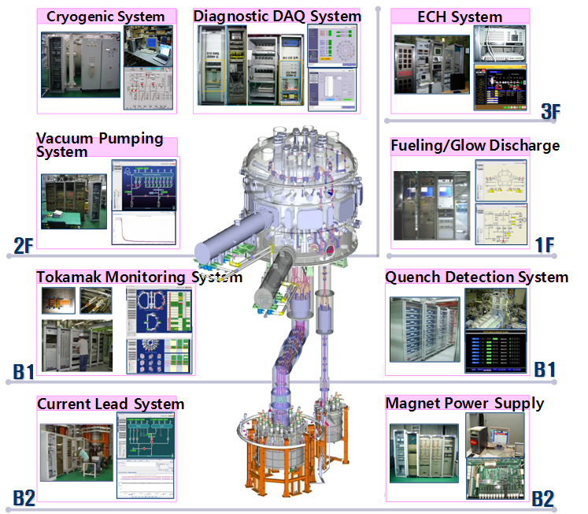

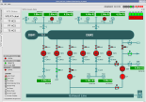
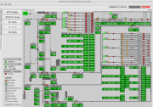
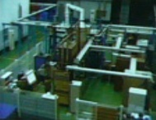
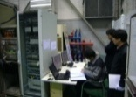
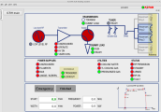
Plant Control Systems for the 1st Campaign
He Distribution System
ICRH System
15

Slide 16
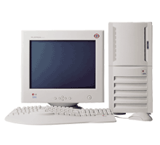



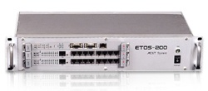

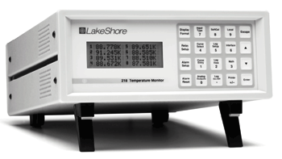
PLC-based System _ VMS, HDS
Relevant systems : Helium Distribution System, Current Lead System, Vacuum Pumping System
Integrated to the central control system using EPICS IOC
Basically, PLC-based system
Remote Operation
EPICS Host
EPICS IOC
Touch Screen
(Local OPI)
Machine Net/Ethernet
Interlock Net/CONTROLNet
AB PLC
(ether-ip)
ETOS-200
Serial Converter
AB PLC
(ether-ip)
Serial Converter
Valve control
He control
Mass flow monitoring
Temp. monitoring
RS232(485)
Hard-wired
RGA
Cryo-pump
Controller
Chiller, etc
GPIB
Vacuum
Gauge Controller
MFC
Vacuum gauge monitoring
Pumps monitoring
Chiller, etc. monitoring
Valve control
Pump control
Interlock
Sequence Operation
Ctrl. Valve
He Level
Pres. Transmitter
Voltage Tab
Cernox Sensors
Pt. Sensors
16

Slide 17
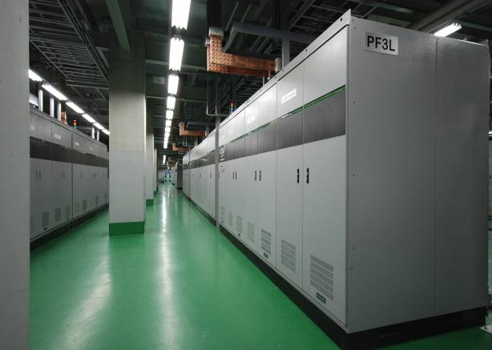
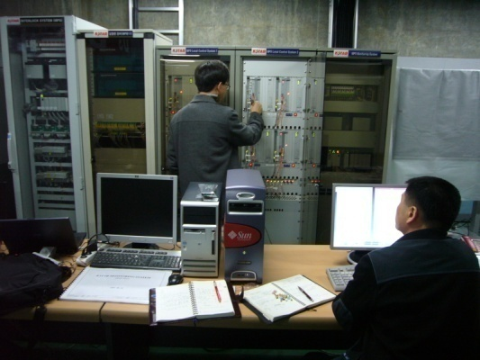
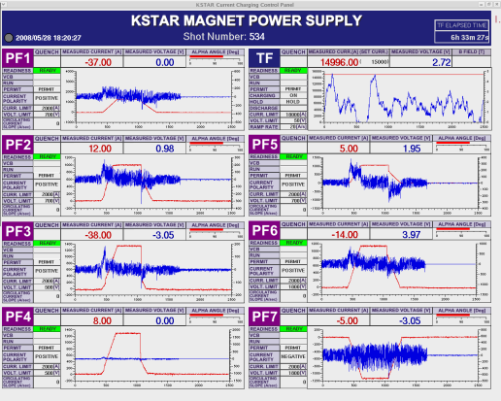
Magnet Power Supply System
Composed of 1 TF system and 7 PF systems
Local I&Cs implemented in VME system running in vxWorks real-time OS
EPICS IOCs embedded in VME systems
Interfaces :
Machine network for system control & status report
Real-time network for real-time feedback control by PCS
Timing network for synchronized operation
Interlock network for system protection
Additional hard-wired quench interlock signal from QDS
Current and voltage data archived to MDSplus by PCS in run-time
Channel Access : Status monitoring & Operation commands
Reflective Memory : fast feedback data from Plasma Control System with control cycle of 200μsec
17

Slide 18
PF MPS Local control system
CCS & TSS
PCS
QDS
SIS
M
C
M
L
Quench
Detection
System
Supervisory
Interlock
System
E
VME
E
M
I/O
T
M
T
cPCI system
O
Controller
O
R
U
R
U
Y
Y
Gigabit Ethernet
Real Time Network
Timing Network
Interlock Network
(4)
H/W(Interlock Event)
O/F
Local Control Room
Optical
Patch
Panel
O/F
M
L
Remote
PLC
Panel
O/F
E
VME
M
T
I/O
O
Controller
R
U
(1)
Ethernet
Y
(2)
(3)
(5)
(6)
LCS
Local Host Console
O/F (max 100m)
O/F (Trigger for blip)
H/W (E-stop)
O/F (max 150m)
(7)
Communication with LCS (16-bit 25word, 200us)
current feedback control in current mode
open loop in voltage mode
Digital I/O, Analog I/O, self-diagnostic
Blip switch, Bypass swtich, QP control & monitoring
DSP controller
Gating
Blip on/off
QP start
PF PS
18

Slide 19
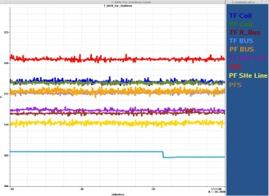
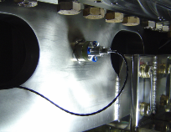
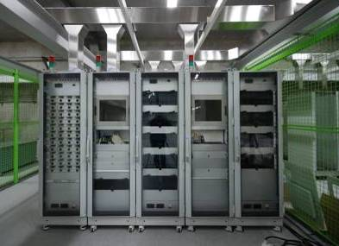
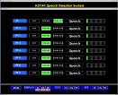
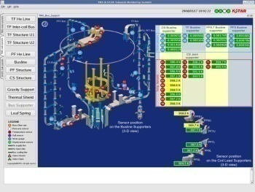

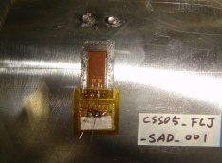
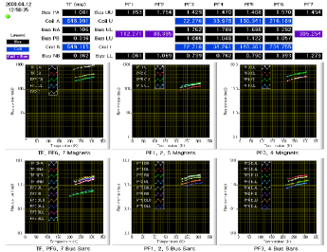
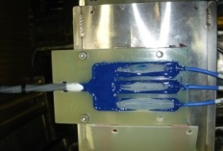
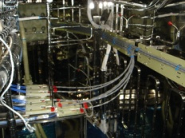
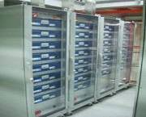
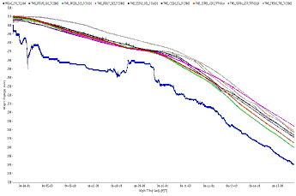
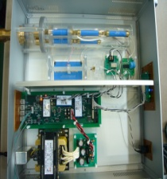
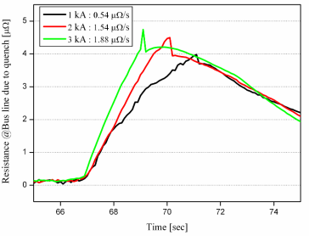
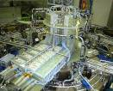
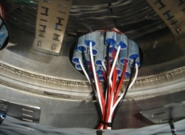
Tokamak Monitoring System & Quench Detection
INSTRUMENTATION
CRYOGENIC & STRUTURAL BEHAVIOR
OPI of Real Time Data
Temperature Sensor
Strain Gage
Displacement Sensor
AE Sensor
Hall Sensor
Total ~1000 numbers of sensor
→ T, strain, displacement, AE
PXI-based Hardware
Integration with EPICS middleware
Temperature
Strain & Displacement
Magnetic Field
Acoustic wave
TOKAMAX MONITORING SYSTEM
QUENCH DETECTION SYSTEM
INSTRUMENTATION(83ea)
SUPERCONDUCTING COIL
QUENCH PROTECTION
DATA RETRIEVE & ANALYSIS
Balanced Voltage tap
Co-wound Voltage tap
Temperature Analysis
Structural Analysis
Quench Analysis
R-Measurement of SC coil @ Cool-down
In-site Design and Manufacturing
Normal resistance measurement
15 kV GND/Conductor isolation
100 μV measurement resolution
19

Slide 20
Diagnostic DAQ System
11 types of diagnostics installed for the 1st plasma operation
Hardware platform of Diagnostic DAQ systems: VME, cPCI, PCI and cFP
Interfaces :
- Configuration & status monitoring : Machine network/Channel Access
- Pulsed data archiving : Experimental network/MDSip
- Synchronized operation : Timing network/home-made protocol
- Interlock interface : ControlNet
Diagnostics | CH | Measured Parameter | DAQ
Rogowski Coil | 3 | plasma current | DDS#1 (1 cPCI)
Flux Loop | 5 | loop voltage I
 | 5 | loop voltage II
Magnetic Field Probe | 64 | poloidal field
Diamagnetic Loop | 2 | plasma beta
Vessel Current Monitor | 3 | eddy current
mm-wave Interferometer | 4 | plasma density | DDS#2 (1 VME)
ECE Radiometer | 8 | electron temp.
H-alpha monitor | 30 | wall recycling
Visible Spectrometer | 2 | impurity density | PC-based
Filter Scope | 12 | impurity | PC-based
Visible/H-alpha TV | 3 | plasma shape/motion | PC-based
20

Slide 21
Diagnostic DAQ System
21

Slide 22
Data Management & Visualization
22

Slide 23
Data management System
Two database systems used
EPICS Channel Archiver : low rate continuous plant operation data (Machine network/Ethernet)
MDSplus : high rate shot-based experimental data (Experimental data network)
Obtained data for the first plasma operation : 1.3TB (plant data) / 260GB (experimental data)
Signals : 17911 PV (plant operation) / 233 CH (experimental data)
Control Network
Backup Storage
/SNFS1
/SNFS2
/InfoDB
EPICS IOCs
(Local Control Systems)
Web Clients
Display : ArchiveDataClient,
Archiveviewer, ArchiveSheet
Operational Data
ArchiveEngine
Channel Archiver
Server
(Operational DB)
OPIs
Backup Server
Archiving
/CA_NFS/
/SNFS2/
Storage Pool(SAN)
XML-RPC
HTTP
ArchiveDataServer.cgi
/CA_NFS/… /SNFS2/…
/CA_NFS/
Retrieving
MySQL DBMS
Data Analysis Server
MDSip
Archiving
Web Server
MDSPlus Server
(Experiment DB)
MDSip
OPIs
Experimental Data
Display :Jtraverse, Jscope
Diagnostics, PCS,
Heating, etc.
23

Slide 24
Operation Results of Data System
Operational Data management-
Archiving rate to be re-configured in accordance with the operation stage
To save storage, using repetitive archiving and event-driven with archiving dead-band
Max. archiving rate : 10Hz
Issue : A restriction to increase the archiving rate due to the mismatch between EPICS channel archiver and the file system what we used (GFS).
(2008. 8. 27.)
System | PV | Archive | Archiving Rate |  |  |  | Archiving area | Stored data
 |  |  | Cool-down | Coil-charge | Plasma-exp | Warm-up
TMS | 3949 | 2281 | Event | 1sec | 1sec | 300sec | /SNFS1/TMSArchivedData | 353GB
VMS | 570 | 570 | Event/60sec | Event/60sec | Event/60sec | 300sec | /SNFS1/VMSArchivedData | 6.1GB
CLS | 1456 | 1456 | Event/60sec | Event/60sec | Event/60sec | 300sec | /SNFS1/CLSArchivedData | 14GB
HDS | 4688 | 383 | Event/60sec | Event/60sec | Event/60sec | 300sec | /SNFS1/SHDSArchivedData | 1.7GB
HRS | 168 | 167 | Event/1sec | Event/1sec | Event/1sec | 300sec | /SNFS1/HRSArchivedData | 23GB
QDS | 1592 | 291 | Event/0.1sec | Event/0.1sec | Event/0.1sec | 300sec | /SNFS1/QDSArchivedData | 35GB
ECH | 190 | 141 | Event | Event | Event | 300sec | /SNFS1/ECHArchivedData | 164MB
ICRH | 239 | 20 | Event | Event | Event | 300sec | /SNFS1/ICRFArchivedData | 12.5GB
CCS | 544 | 433 | Event | Event | Event | Event | /SNFS1/ICSArchivedData | 13GB
ICS | 2018 | 288
FUEL | 106 | 106 | No Archive | No Archive | Event | No Archive | /SNFS1/FUELArchivedData | 121MB
DDS | 340 | 249 | No Archive | No Archive | Event | No Archive | /SNFS1/DDSArchivedData | 703MB
TSS | 378 | 336 | No Archive | No Archive | Event | No Archive | /SNFS1/TSSArchivedData | 1.1GB
MPS_WF | 67 | 38 | No Archive | No Archive | 10Hz | No Archive | /SNFS1/MPSArchivedData | 682GB
SUM | 17911 | 8365 |  |  |  |  |  | 1.142TB
Experimental Data mamagement-
Total Shot Number : 1283
No. of MDSplus nodes : 8485 (No. of data channel : 233)
Stored data : 257.5GByte (about 4.68GByte per day)
Interface : jScope, IDL, Matlab, Efit, Review Plus, C, Basic
24

Slide 25
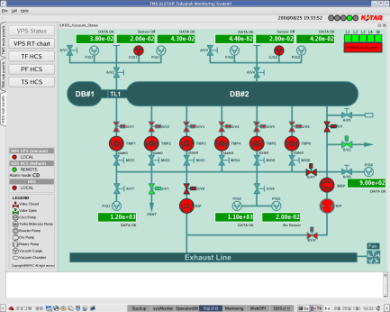
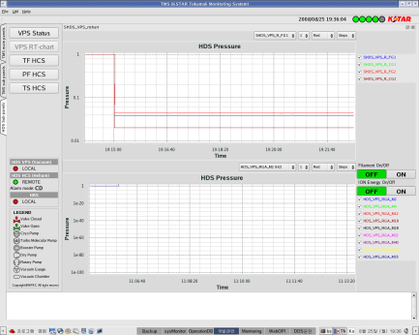
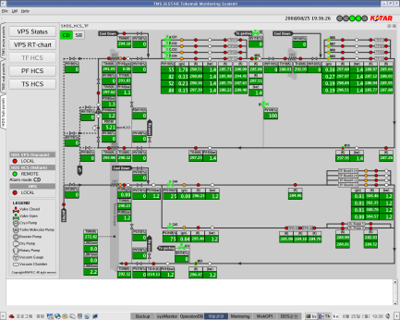
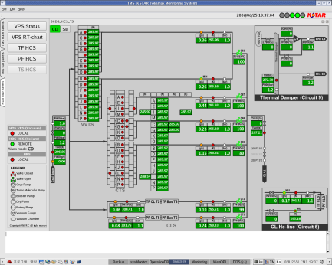
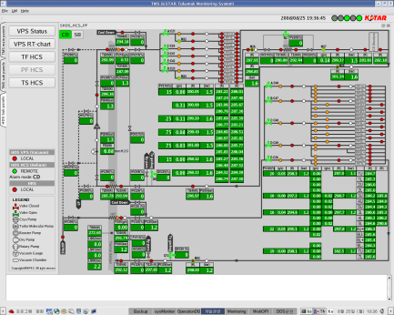
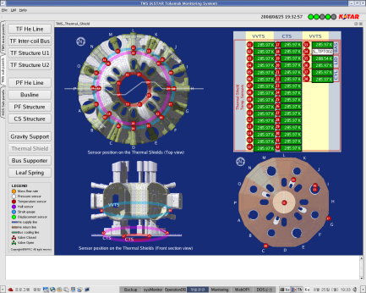
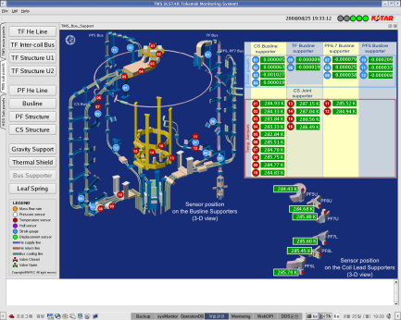
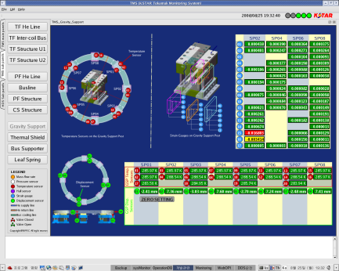
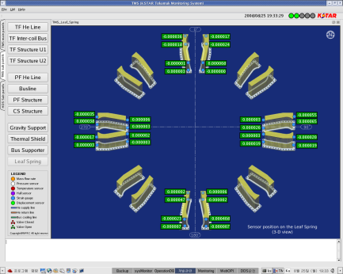
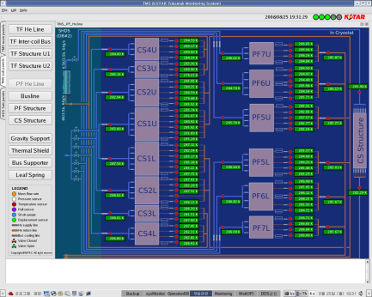











Data Visualization and Utilities
  Operator Interface
  Developed panels : 154 first the 1st campaign
  Development tool : Qt 4.3.1 Open source tool
  Data Visualization
  Run-time Data Display : SinglePlot, MultiPlot
  Experimental data display : jScope, Rtscope, Reviewplus, IDL/Matlab applications
  Utilities
  Shot Summary auto generation : SessionSummary
  Machine Fault List logging : FaultListSummary
  Web Interface : KSTAR_exp, Web_DVR, …
Shot Result
Fault List
Shot Summary
25

Slide 26
Machine Interlock Systems
26

Slide 27
Machine Interlock System
Four Interlock levels defined according to the severity
Level 1 : Fast discharge of TF current
Level 2 : Slow discharge of TF current
Level 3 : Experiment stop and fast discharge of PF current
Level 4 : Next shot inhibit
Interlock
(SIS)
VPS
/HDS
HRS
TF, PF
MPS
QDS
/TMS
PSI
/RMS
GEP
/ECH
ICRF
CCS
DLS
/Fuel
Sub-interlock
CLS
QDS
VPS
HDS
PSI
RMS
VPS
He
CR
VV
VPS
He
Actuator
TF, PF
CLS
Optical ControlNet
HRS
CWF
Passive Device
TMS
ICRF
ControlNet
CWF
Coaxial/ControlNet
Optical/ControlNet(STAR)
GEP
VCB
Optical/RT Network(STAR)
Optical ControlNet
CCS
PCS
ECH
Optical/Machine
Network(STAR)
RT
NET
QDS Interlock
DLC
FUEL
/GDC
TF
PF1
PF2
PF3
PF4
PF5
PF6
PF7
Real Time-Network
Multi-Conductor
Copper Cable
27

Slide 28
Interlock Action when quench detected
MPS (80~90msec)
Quench Protection
(BRIS)
PF Power Supply
MPS Local I&C
200 μsec
Plasma Control System
Reflective Memory
Machine Net
(Ethernet)
Sensors
Real-time Net
Hard-wired
(optical)
Quench
Signal
Quench Signal
Quench Signal
Quench Detection System
Interlock
(Scan time : 65msec)
Hard-wired
Central Control System
Interlock Net
(ControlNet)
Emergency Stop
28

Slide 29

Improvement fir Next Campaign
29

Slide 30
Improvements for the Next Campaign
Optimization of EPICS IOC programs to improve the stability and reliability in operation.
For high-speed diagnostics, development of highly accurate timing board
is planned.
Focus on the huge data management to cope with bunch of diagnostic data
Investment in computing infra for data storage, servers in redundancy and
environment of remote operation.
Optimization of IOCs
Multiple IOCs merged to single IOC
Diagnostic DAQ system
Optimize the data acquisition program
To improve the system stability
Reducing the time of data acquisition
Expansion of DAQ channels to about 400 for Magnetic Diagnostics
Implementation of the DAQ and interface for the new diagnostics such as Reflectmeter, Resistive bolometer, Reciprocation probe and XCS system
30

Slide 31
Improvements for the Next Campaign
Data management & Visualization
Modification of MDSplus tree structure for a longer pulse operation
To support long pulse operation and huge data management,
investigating a segmented MDSplus data put
adopting the data compression
changing the data structure stored
Web improvement to monitor the run-time EPICS data
To synchronize the start time information of DAQ systems with the blip time
Computing Infra
Servers operated with redundancy to have failover
- Continuously checked the health of network and applications running
Investigate several shared-file systems and have conclusion to change from SNFS/NFS to GPFS
Installation of the permanent data backup system, a tape library
Implement remote participating environment for remote operation and analysis
in collaboration with General Atomics
Development of Utilities to support operation and system administration
Improvement of system logging, operator’s logbook, and so on
Complement system error checking, fault analysis, version control, and so on
31

