Slide 1
Enhanced Directory Service
Ralph Lange
EPICS Collaboration Meeting
October 11, 2009

Slide 2
It’s a Flat Channel Name World
All Channel Access clients need to know all channel names beforehand
High Level Apps either need a full configuration or a framework-supplied directory
Portable generic applications are restricted to simple tasks

Slide 3
Idea: ChannelFinder Directory Service
Some background database
  Contains Channel Names and their
  Properties (list of Name/Value pairs)
  May dump/load contents for persistence
Web Service
  Matches property values and
  returns a list of channels on GET
  Creates/Updates entries on PUT/POST
  Data format: XML or JSON

Slide 4
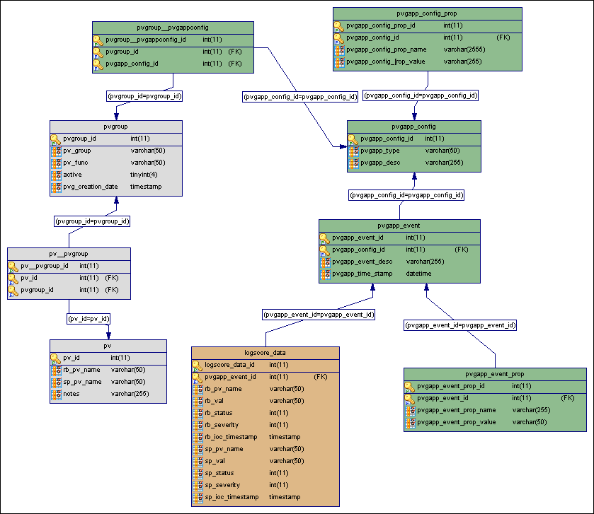
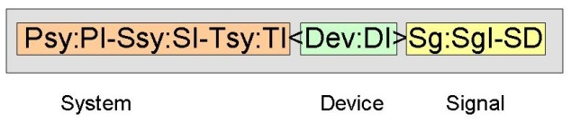
Filling the Directory
IRMIS or other RDB systems
  Geographical, hierarchical, engineering,
  physics data
DB file parser (PV names, attributes)
  If you have a good naming convention
Control room applications
  ”Joe’s favorite channels”

Slide 5
Querying the Directory
Client connects in three steps:
Query Directory Service
  Specify expressions for property match
  Get list of channels
Query Nameserver
  Specify list of channels
  Get channels’ IOCs
Connect and subscribe

Slide 6
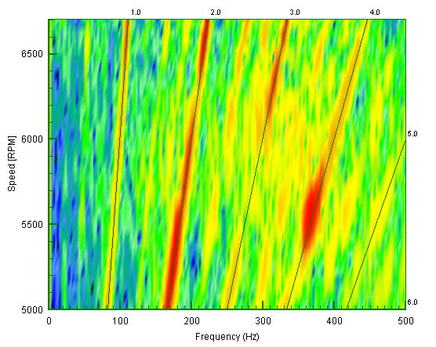
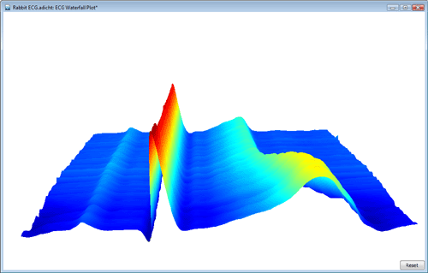
Application Examples
Waterfall Plots
Scripts
Generic applications
Table-style panels
Archive clients

Slide 7
Implementation Ideas
ChannelFinder
  PoP implementation
  Based on Java/Netbeans/JAXB/Glassfish/MySQL
  Test database contains 150k channels w/ 7 properties each
  Getting 2k channels w/ properties in ~0.1 sec
  JPA classes create inefficient SQL for matching requests, will switch to JDBC or use in-memory table

Slide 8
Implementation Ideas
Nameserver
  Develop the JLab (now APS) nameserver to
  Use a fast distributed network cache database (memcached) for persistence and redundancy
  Do block requests to the database (i.e. not use PCAS)
  Require minimal configuration
  Separate IOC shutdown detection

Slide 9
Project Status and Schedule
Currently in design phase
Work by Gabriele Carcassi, Don Dohan (IRMIS), Ralph Lange (Web Service), Kunal Schroff (Apps)
Expected to be working summer 2010

