Slide 1
Development status of KSTAR Widget Toolkit (KWT)
Sulhee Baek
shbaek@nfri.re.kr
KSTAR Research Center
Notes:
Good morning, everyone, let me start by introducing myself.
My name is Sulhee Baek, a member of the KSTAR Research Center and I’m in charge of development of the KSTAR operator interfaces and web applications.
I’d like to talk about development status of the KSTAR Widget Toolkit.
Some of you may be interested in KSTAR and others in Qt-CA interface.

Slide 2
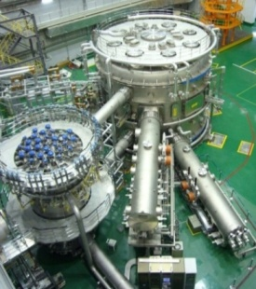
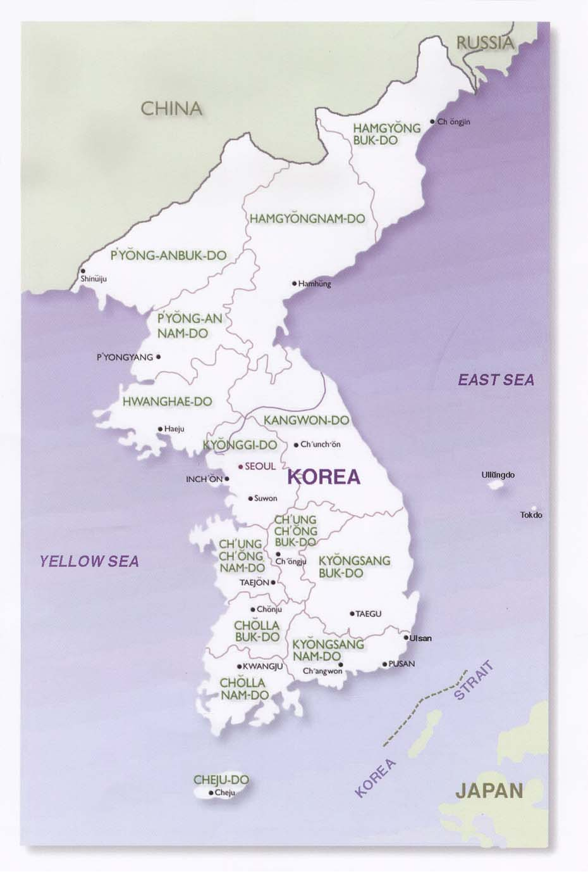
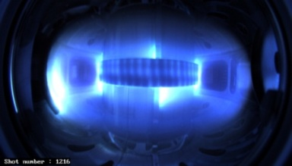
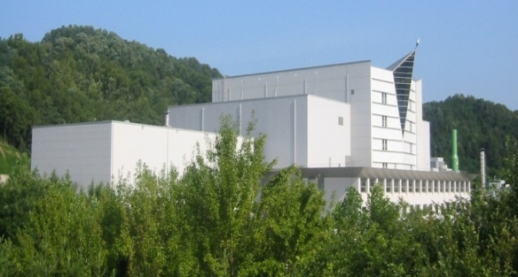
KSTAR Project
KSTAR - Korea Superconducting Tokamak Advanced Research
Missions -
Development of a steady-state-capable advanced superconducting tokamak to establish the scientific and technological base for an attractive fusion reactor as a future energy source.
History-
1995 : Project launched
1998 : Construction started
2007 : Completion of Assembly
2008 : Achievement of the 1st plasma
SEOUL
DAEJEON
POHANG
Major radius, R₀ / Minor radius, a Elongation, κ / Triangularity, δ Plasma volume Plasma surface area / cross section Plasma shape Plasma current, I_{P} Toroidal field, B₀ Pulse length β_{N} Plasma fuel Superconductor Auxiliary heating /CD Cryogenic | 1.8 m / 0.5 m 2.0 / 0.8 17.8 m³ 56 m² / 1.6 m² DN, SN 2.0 MA 3.5 T 300 s 5.0 H, D-D Nb₃Sn, NbTi ~ 28 MW 9 kW @4.5K
Notes:
KWT is a Qt-based graphic application development toolkit for EPICS and it was designed to develop operator interfaces to control KSTAR.
KSTAR is an acronym of Korea Superconducting Tokamak Advanced Research and it has been operated annually since 2008.
Thanks for giving me this opportunity to present KSTAR progress.
이 자료는 Tokamak operation 세션이나 Utilities 세션이냐 고민을 했었는데 Tokamak operation에 할당된 것을 보고 viewpoint를 조금 변경하였다.
KSTAR 운전과 연관을 지었을 때 그 가치가 상승하기 때문.
운전자들의 요구사항을 가능한 한 반영하려고 하였다. 토카막 운전자의 시각으로 KWT의 특성을 정리해 보았다.
간단하고 일관성이 있는 사용자인터페이스: CADisplayer-SinglePlot
일관성 있는 심볼의 형상(staticGraphic & CAGraphic)
운전자의 실수 방지(암호, 제어위젯의 Disabling 기능)
성능 최적화를 위한 기능: CAUItime
Qt 장점: Plug-in widget을 추가하는 방법이 비교적 간단하다.
Plug-in widget을 추가하는 방법
운전자들의 요구사항을 가능한 한 반영하려는 거창한 계획에서 출발하였다. 토카막 운전자의 시각으로 KWT의 특성을 정리해 보았다.
KWT 라이브러리를 KSTAR Control System 개발자들이 주로 C, C++ 언어에 익숙하다.
Qt는 Nokia에 의해 Commercial license와 GPL로 함께 운용한다.
Linux 배포판 중 KDE가 Qt를 기반으로 함을 볼 때 장기적인 open license 정책이 유지될 것으로 판단하였다.

Slide 3
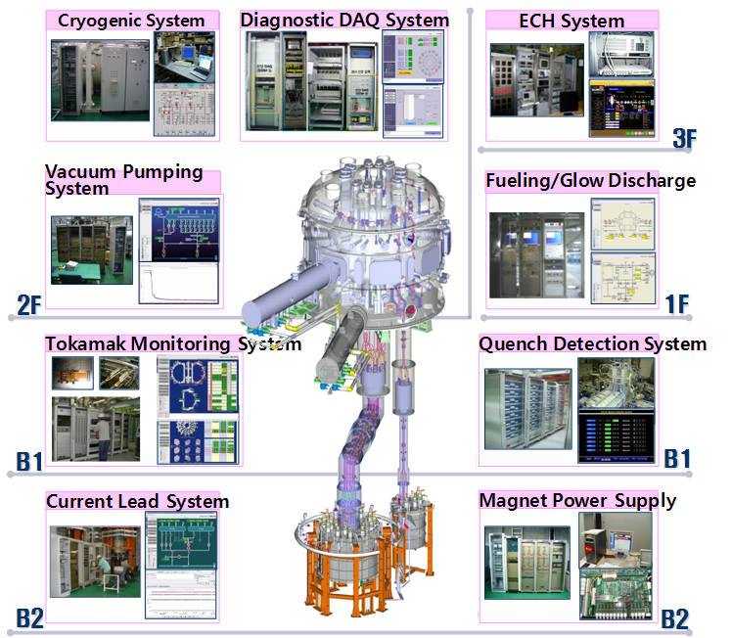
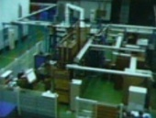
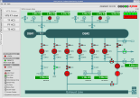
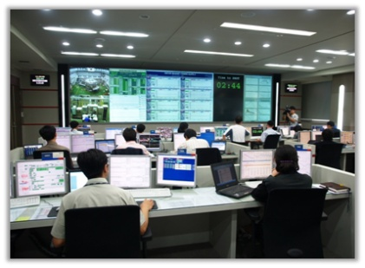
Plant Control System
ICRH System
He Distribution System
Main Control Room

Slide 4
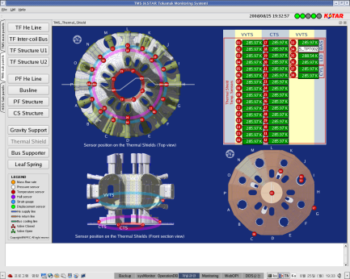
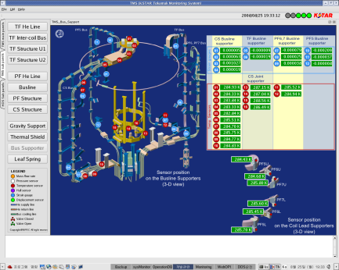
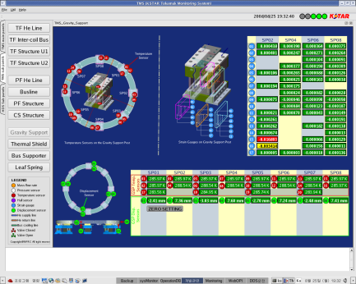
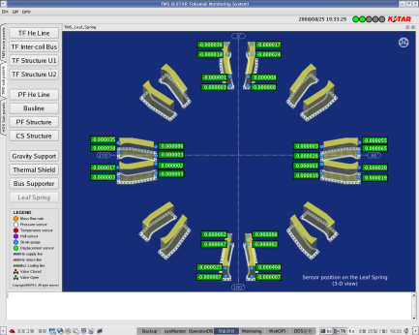
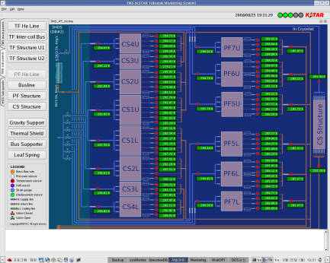
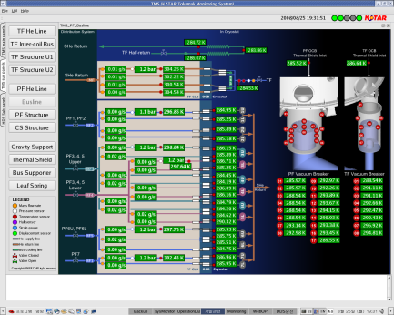
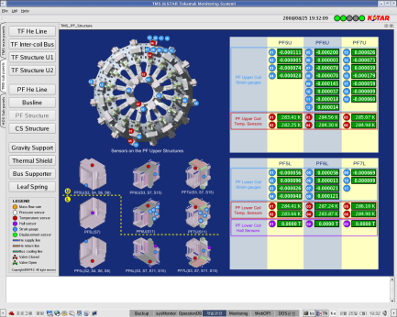
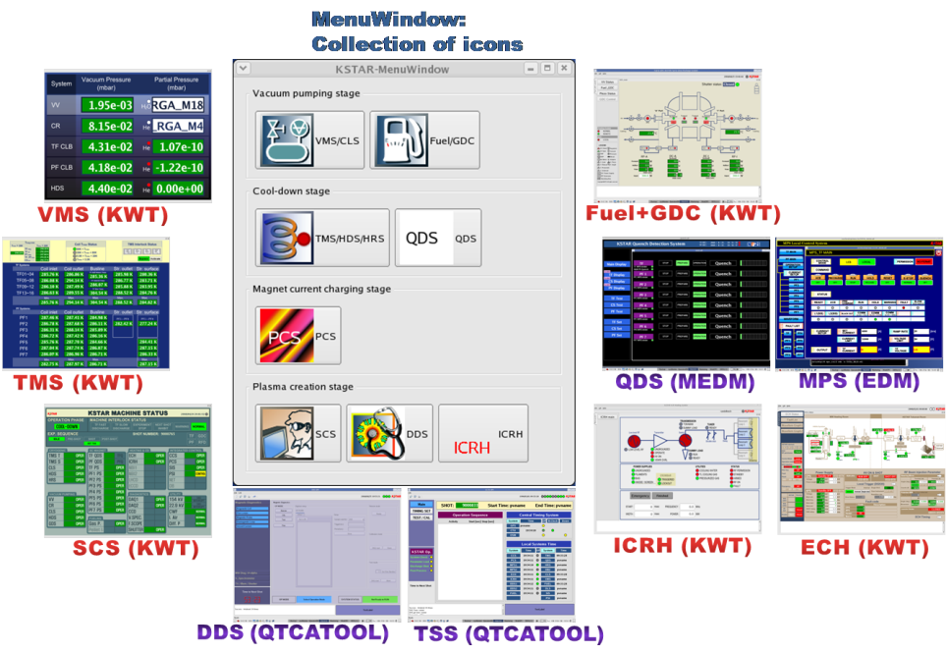
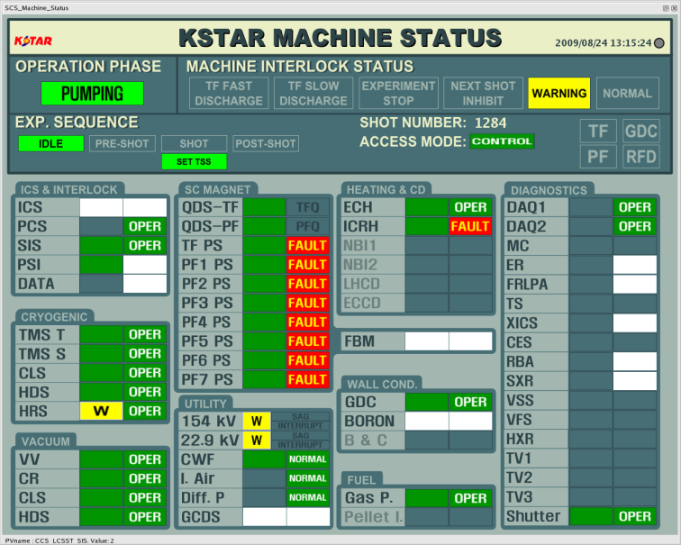
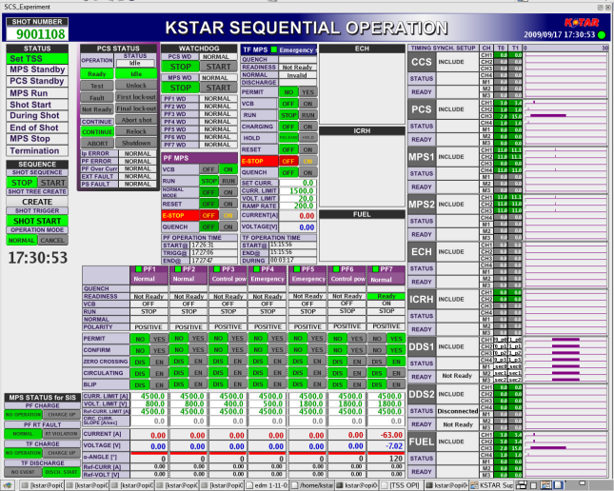
KSTAR Operator Interface
Development tools
Qt (KWT, QtCATool), MEDM, EDM
Total number of the panels
about 150 EA including sub-panels
Tokamak Monitoring System OPI
MenuWindow and Operator Interfaces for the KSTAR operation
Supervisory Control System OPI
Notes:
We investigated all EPICS extensions to find out which was the most proper tool to make KSTAR operator interfaces, but we couldn’t be satisfied with them. So, we developed a development tool-kit to make KSTAR OPIs.
KWT is the name of the tool-kit which means KSTAR Widget Tookit.
Most of the KSTAR OPIs were made using the KWT but some of them were made using EPICS extensions such as EDM or MEDM.
For the remote control of the machines, we made about 150 operator interface panels.
This figure shows OPIs and MenuWindow which is a collection of icons linked to each OPIs.
Figure at the upper-right position shows sub-panels of the TMS opi.
Figure at the lower-right position shows SCS opi.

Slide 5
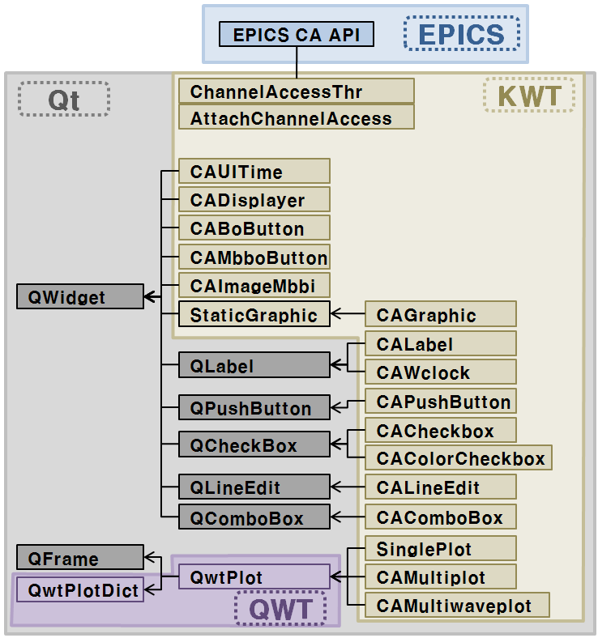
KWT
KWT
A Qt-based graphic application development toolkit for EPICS
It was designed to develop operator interfaces to control KSTAR.
KWT depends on
Qt -4.3.2
QWT-5.0.0rc1 (Qt Widgets for Technical Applications)
EPICS base-3.14.8.2
Requirements of KSTAR operator interface (OPI)
Performance
Stable EPICA CA communication
Easy & fast development
Usability
Consistency of appearance
Features of Qt library
Intuitive C++ class library
Portability across desktop and embedded operating systems
Integrated development tools with cross-platform IDE
High runtime performance and small footprint on
Library dependencies of KWT widgets
Notes:
KWT is a Qt-based graphic application development toolkit for EPICS and it was designed to develop operator interfaces to control KSTAR.
KSTAR is an acronym of Korea Superconducting Tokamak Advanced Research and it has been operated annually since 2008.
Thanks for giving me this opportunity to present KSTAR progress.
이 자료는 Tokamak operation 세션이나 Utilities 세션이냐 고민을 했었는데 Tokamak operation에 할당된 것을 보고 viewpoint를 조금 변경하였다.
KSTAR 운전과 연관을 지었을 때 그 가치가 상승하기 때문.
운전자들의 요구사항을 가능한 한 반영하려고 하였다. 토카막 운전자의 시각으로 KWT의 특성을 정리해 보았다.
간단하고 일관성이 있는 사용자인터페이스: CADisplayer-SinglePlot
일관성 있는 심볼의 형상(staticGraphic & CAGraphic)
운전자의 실수 방지(암호, 제어위젯의 Disabling 기능)
성능 최적화를 위한 기능: CAUItime
Qt 장점: Plug-in widget을 추가하는 방법이 비교적 간단하다.
Plug-in widget을 추가하는 방법
운전자들의 요구사항을 가능한 한 반영하려는 거창한 계획에서 출발하였다. 토카막 운전자의 시각으로 KWT의 특성을 정리해 보았다.
KWT 라이브러리를 KSTAR Control System 개발자들이 주로 C, C++ 언어에 익숙하다.
Qt는 Nokia에 의해 Commercial license와 GPL로 함께 운용한다.
Linux 배포판 중 KDE가 Qt를 기반으로 함을 볼 때 장기적인 open license 정책이 유지될 것으로 판단하였다.

Slide 6
Classes in KWT
Category | Name | Description
Qt designer plug-in interface | KSTAR Widgets group | CustomWidgetCollectionInterface to make widget group in Qt designer
Common library | AttachChannelAccess | Qt-CA interface (attach library)
 | ChannelAccessThr | Qt-CA interface (thread library)
 | Password | Password class for some control widgets
 | SinglePlot | Single channel plotting class using QWTPlot library
Update rate definition widget | CAUITime | Update rate definition widget (Periodic or Event-driven) Master PV defined in the ‘pvname’ property disables all control widgets.
Plot widgets | CAMultiplot | Multi-channel plotting class using QWTPlot library for AI record
 | CAMultiwaveplot | Multi-channel plotting class using QWTPlot library for Waveform record
 | CAColorCheckBox | A part of CAMultiplot or CAMultiwaveplot widget which displays color information and value
Simple graphic widget | StaticGraphic | Symbol library including vacuum devices, arrows, ellipse, rectangle, etc.
Status monitoring widgets | CALabel | Text indicator class
 | CAGraphic | Symbol library which changes its color by alarm status. It inherits StaticGraphic.
 | CAImageMbbi | Collection of multiple QLables for mbbi record
 | CAWclock | Text indicator for the timestamp record
 | CADisplayer | Text indicator class which displays numeric data with the corresponding alarm color. It pops SinglePlot up with right click.
Control widgets | CAPushButton | A QPushButton which sends operator’s command to the PV
 | CABoButton | A pair of QPushButtons
 | CACheckBox | A QCheckBox which sends operator’s command to the PV
 | CAComboBox | A QComboBox which sends operator’s command to the multi-bit PV
 | CAMbboButton | A collection of multiple CAPushButtons for EPICS mbbo record
 | CALineEdit | A QLineEdit which sends numeric data to the PV
Plug-in widgets

Slide 7
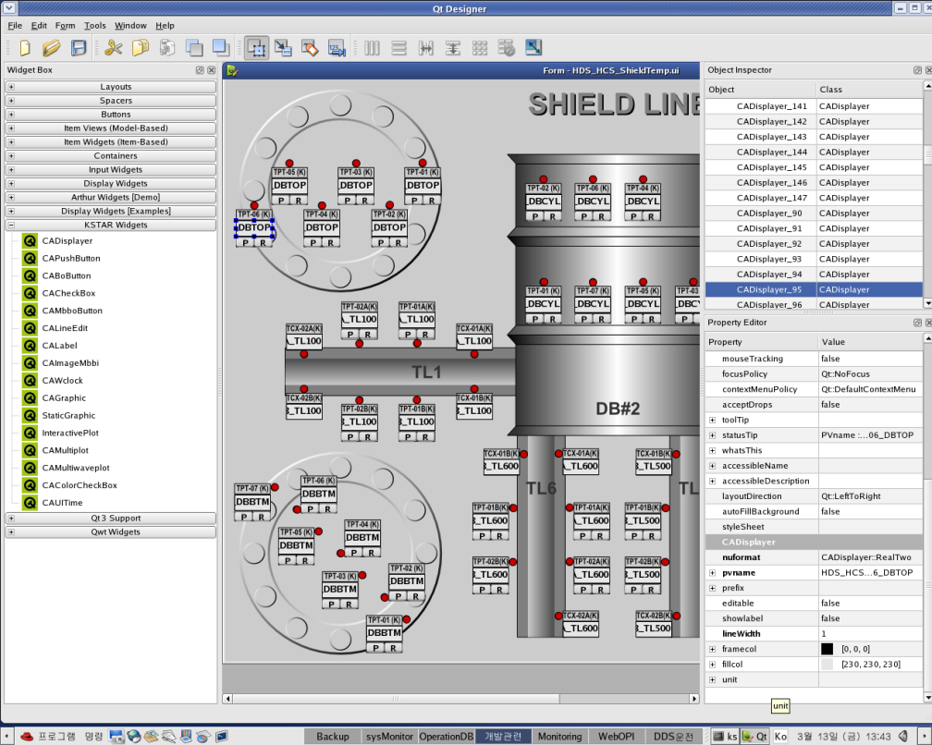
How to use it?
Write main method.
Make UI file.
Drag & drop a widget
Set properties
Save
Copy UI file to the target directory.
Execute.
#include <QtUiTools>
#include <QtGui>
#include “qtchaccesslib.h”
int main (int argc, char *argv[])
{
QApplication app(argc, argv);
AttachChannelAccess attach(“uifilename.ui, 1);
QWidget *pwidget = attach.GetWidget();
Pwidget->show();
Return app.exec();
}
1
Screenshot of the KWT IDE (Qt designer)
2
UI file: XML file generated by Qt designer
Refer to the example in the SVN repository. http://kwt.svn.sourceforge.net/viewvc/kwt/trunk/example/

Slide 8
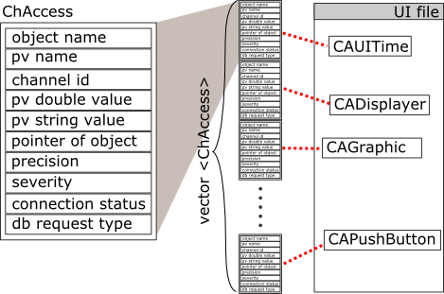
How does it work?
eventFilter
Mouse right click? and object is CADisplayer? → pop up Singleplot
Mouse right click? and object is CAGraphic and does it have popup property? → pop up linked panel
Does it have control property? caput
Structure of the hash table
workThread
Initialize
Get data from IOC at every monitor event or by user-defined period in the CAUITime
Disable all control widgets if the master pv in the CAUITime is false.
Update CA objects
Get QtObject from the loaded UI files or QWidgets
Qt Container?
Control property?
(control)
CAobject?
(pvname)
Register control objects
Yes
No
Yes
Yes
No
Insert the objects into hash table
Notes:
I prepared brief description of the data access interfaces.
EPICS CA API was used to access to live data.
XML-RPC was used to request and receive archived operation data. It’s a remote procedure call protocol which used XML to encode its calls and HTTP as a transport mechanism. And there are pre-defined archive data server’s calls to get data from Channel Archiver.
MDSplus API was used to archive and retrieve experimental data. The hierarchy of MDSplus data is defined in model tree and there are shot trees including data.

Slide 9
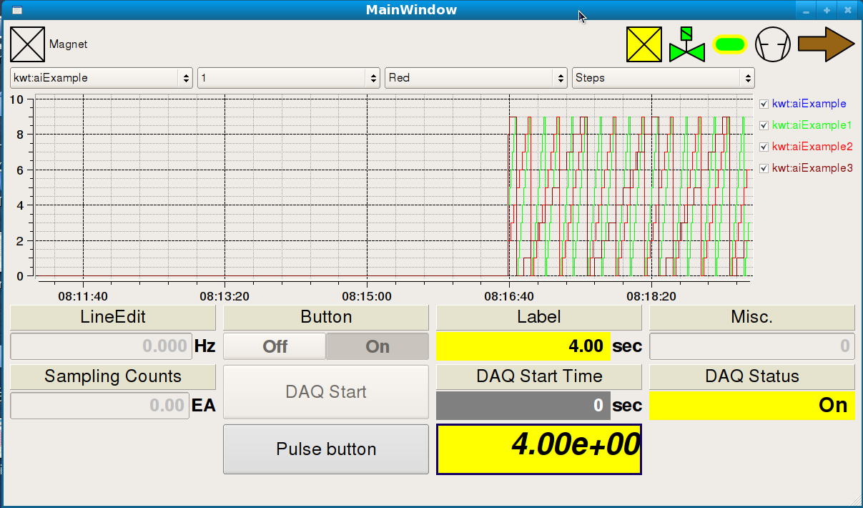
Feature of KWT
Usability & consistency:
CADisplayer & SinglePlot
staticGraphic & CAGraphic
Preventing operator’s error:
Disabling control widgets
Authentication and confirmation
Optimization:
Refresh rate definition in the CAUItime
PV information:
Status message display
Interface with Qt and QWT widgets
Signals and slots
1-b
2-a
2-a
1-a
3
5
4
Notes:
We investigated all EPICS extensions to find out which was the most proper tool to make KSTAR operator interfaces, but we couldn’t be satisfied with them. So, we developed a development tool-kit to make KSTAR OPIs.
KWT is the name of the tool-kit which means KSTAR Widget Tookit.
Most of the KSTAR OPIs were made using the KWT but some of them were made using EPICS extensions such as EDM or MEDM.
For the remote control of the machines, we made about 150 operator interface panels.
This figure shows OPIs and MenuWindow which is a collection of icons linked to each OPIs.
Figure at the upper-right position shows sub-panels of the TMS opi.
Figure at the lower-right position shows SCS opi.

Slide 10
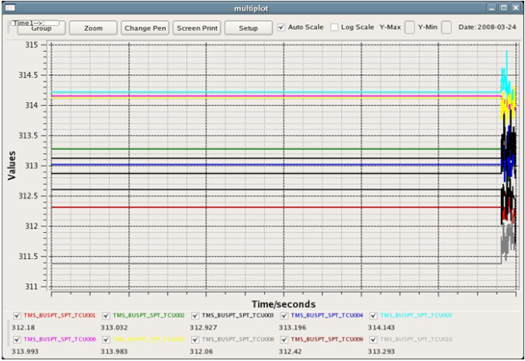
Plot widgets
Live data tools developed using KWT plot widgets
Multiplot: Plot 10 ch at a time, Application and Plug-in widget
Multiwaveplot: Plot 10 ch at a time, Application and Plug-in widget
Singleplot: Popped up at the mouse right-click on the CADisplayer
Multiplot application
Singleplot instance
StripTool
Notes:
Various EPICS extensions were used for the live data tools.
This slide shows the most preferred tools among them.
Even if the StripTool was terrific to monitor run-time trend, we customized it to be proper to the KSTAR control environment.
And we developed Multiplot to show multi-channel trend and Singleplot to show single-channel trend in the OPI panels. Since a singleplot was popped up at the mouse right-click in the OPI panels, operators didn’t need to know the exact pvname to use singleplot.

Slide 11
Known problems
KWT application dies when virtual channels are abnormal in CAS or gateway but it's reason was not clarified yet.
Use carefully
Segmentation fault of CAGraphic instance
CAGraphic widget has pop-up properties consists of popup, filename, and pvs.
Number of pv names in the ‘pvs’ should be same with the number of CA widgets in the template file. If there's a discordance, segmentation fault will be occurred.
ChannelAccessThr is not stopped.
The application including CA widgets has the problem that it can't exit normally because of the ChannelAccessThr's ‘ca_pend_event (0.0)’. You have to make applications kill the process manually. Refer to the example in the SVN repository regarding the problem.
Re-ordered pv list
Ca01
Ca02
ca900
void MainWindow::closeEvent(QCloseEvent *) {
kill (getpid(), SIGTERM);
}

Slide 12
License and release information
License: GPL license
Project management: http://kwt.sourceforge.net
Version Control
Subversion: svn co https://kwt.svn.sourceforge.net/svnroot/kwt kwt
Current version: V 1.0
Example
Environment set-up example (.kwtrc)
Example code and movies in YouTube (search YouTube with the keyword, ‘KWT V 1.0 Example’)
Documentation
LICENSE
INSTALL
README
KWT
Developers
Explanation of the KWT widget usage
Known problems
Future improvement plan
Announcement
EPICS tech-talk
2009 ICALEPCS(10/12~16, Kobe)
2010 EPICS Spring Collaboration Meeting (6/2~4)

