Slide 1
ChannelFinder Directory Service
Ralph Lange
EPICS Spring Collaboration Meeting, June 2010
Aix-en-Provence

Slide 2
Motivation and Objectives
A flat name space restricts seriously:
Clients need to know all channel names beforehand
Portable generic clients must be simple
Apps need full configuration or framework supplied service
Develop a Directory Service
Generic
No dependency on installation and local conventions
Simple and fast (enough)
Use standards wherever possible
Provides “query-by-functionality”

Slide 3
Directory Data
Set of Channels (unique names)
Each Channel has an arbitrary number of Properties (name/value pairs) and Tags (names)
Each Channel, Property, or Tag has an Owner (group) to allow basic access control
All names and values are strings

Slide 4
Typical Middle-Tier Design
REST style web service
URI specifies the data element to operate on
HTTP method specifies the operation
Payload (XML, JSON) contains object representation
Application Server
RDB
Contains directory data
Use LDAP to query user-group relations

Slide 5
Implementation
REST
Glassfish V3
MySQL
LDAP
Mercurial
SourceForge
Java EE 5
Netbeans 6.8
JDBC
PyUnit
XML
JAX-RS
Jersey
JNDI
Hudson
JSON
Maven 2
JAXB

Slide 6
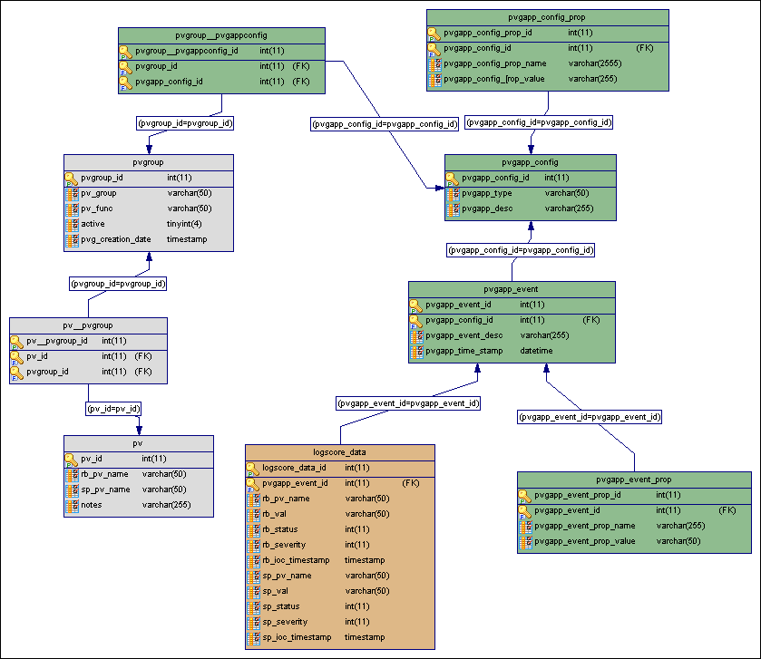
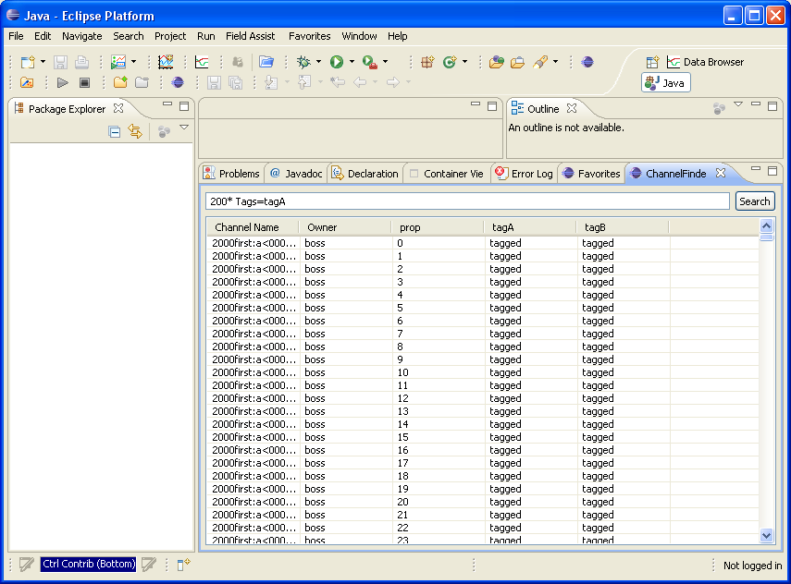
Directory Data Sources
IRMIS or other RDB systems
Geographical, hierarchical,
engineering, physics data
DB file parser (PV names, attributes)
Requires a good naming convention
Control room applications
”Joe’s favorite channels”

Slide 7
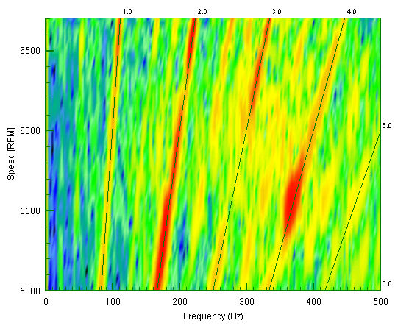
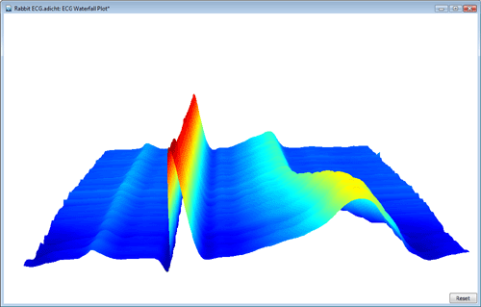
Targeted Applications
Waterfall Plots
Scripts
Generic applications
Table-style panels
Archive clients

Slide 8
First Performance Estimates
Test database contains 150k channels, with 7 properties each
Performance of getting channels with properties by property wildcard match: 1st call subsequent calls
1 ch (500B data) 0.47s 0.009s
2k ch (700kB data) 0.6s 0.13s
4k ch (1.5MB data) 1.4s 0.9s
(regular desktop machine, no optimization whatsoever)

Slide 9
Status
Small changes and bug fixes while first applications are being developed
Stabilizing, getting close to first release
Work by: Gabriele Carcassi (App/Build Servers, IRMIS), Don Dohan (IRMIS), Ralph Lange (Directory Service), Kunal Shroff (Client Applications)

