Slide 1
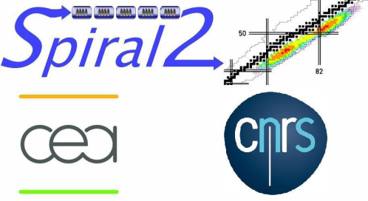
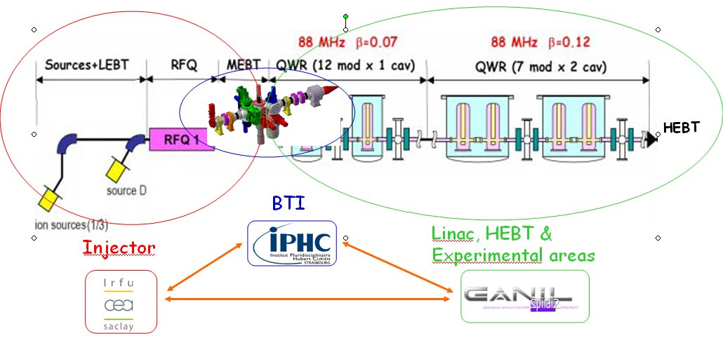
Report from the Spiral2 control system development
Notes:
So, good afternoon everybody. I am trying now to give you some news from the Spiral2 control system development.
Just before starting, I would like to remind you that t at least for the injector part of the machine, this control system development results from a collaboration between several institutes : CEA Saclay, IPHC Strasbourg and Ganil.

Slide 2
Outline
The Spiral2 project overview and status
Global overview
Planning
First beam tests
Control system introduction
Main options
Use of some specific tools
Equipment integration
Power supplies
Beam diagnostics
LLRF
High level applications
Use of a XAL based framework
Machine description and configuration database
IOC interface
Equipment database management
Introduction
Notes:
Now, the outline of the presentation will be the following.
As an introduction, I’ll give a short overview of the Spiral2 project, then say a few words concerning the global planning and lastly show the first results we got.
Then, moving to the control system itself, I’ll show the main options we adopted and list some specific tools we are thinking to use.
Therefore, concerning the equipment integration, I’ll briefly present our implementation for the power supplies, beam diagnostics and the LLRF integration.
Moving afterwards to software, I’ll explain our strategy concerning the high level applications and how we are trying to base our development from the Xal SNS framework Linked to this point, I’ll also present how we describe the machine in a specific configuration database.
An other point of interest will be the attempt to implement and to standardize the communication between the IOCs and the high level applications.
The last part of the presentation will be devoted to show how we are trying to set an equipment database upstream the standard Epics databases.

Slide 3
The Spiral2 facility beside the Ganil one
The Spiral2 project
Notes:
So, let us start by a short description of the facility. It will be installed beside the Ganil one we will reuse some parts of the installation such as the experimental areas or the existing CIME cyclotron to post accelerate the rare ion beam which will be produced by Spiral2.
The Spiral2 project is seen within two phases. The first one concerns the acceleration production system ; the particles will be either heavy ions, deuterons or protons. They will be first accelerated by a RFQ and the acceleration itself will be given by a superconducting Linac. At the output, the particles will be either sent to new experimental areas or to the radioactive ion beam production cave.
This is the second phase of the project.
A first 1+ radioactive beam will be therefore produced and to sent to a charge breeder to get a N+ beam which will be lastly transported to the existing machine.

Slide 4
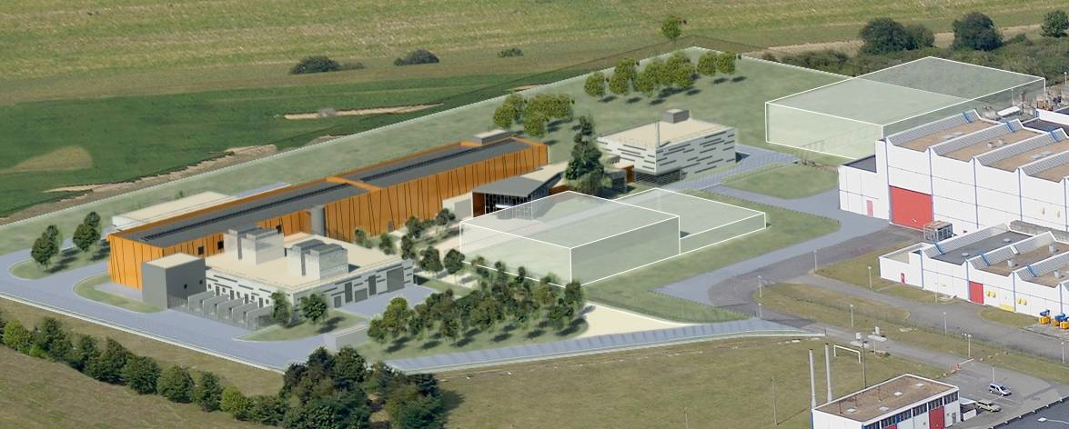
Planning
Existing Ganil facility
Phase 1 : Spiral2 Accelerator  First beam in 2012
Phase 2 : Spiral2 Production  First beam in 2013
The Spiral2 project
Notes:
Now a few words concerning the planning.
On the right here is the existing Ganil facility.
The Spiral2 accelerator will be first installed and the beam is expected by the beginning of 2012 ; at the moment we are waiting for the permit to build to be delivered.
The second phase of the project for the radioactive beam production is expected moreless one year later..

Slide 5
First beam tests
2010-2011
deuteron beam tests
IRFU Saclay
2009-2011
q/a=1/3 beam tests
LPSC Grenoble
The Spiral2 project
Notes:
As the machine construction results from the collaboration between several labs and to save time, the first parts of the machine have been installed and are in test in other places.
First the ion source and the associated ion beam line has been under test at LPSC Grenoble for two years. At the beginning of this year started the deuteron source test at CEA Saclay.
All these devices are planned to be dismounted and installed in the new buildings at Caen by middle of next year.

Slide 6
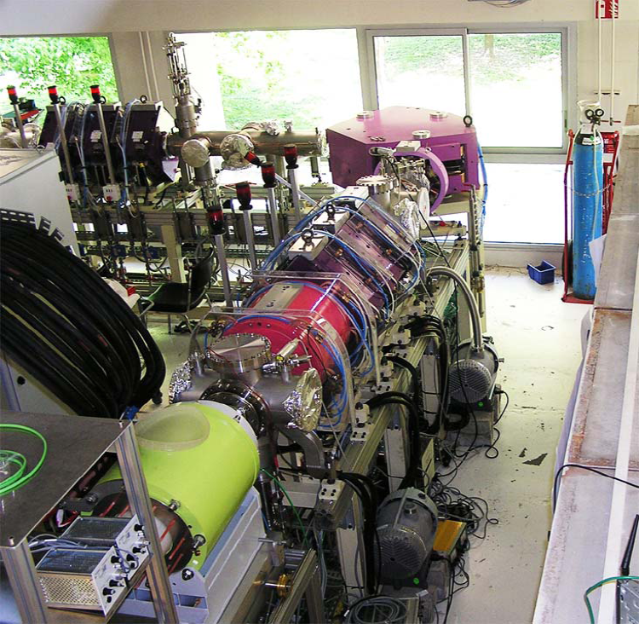
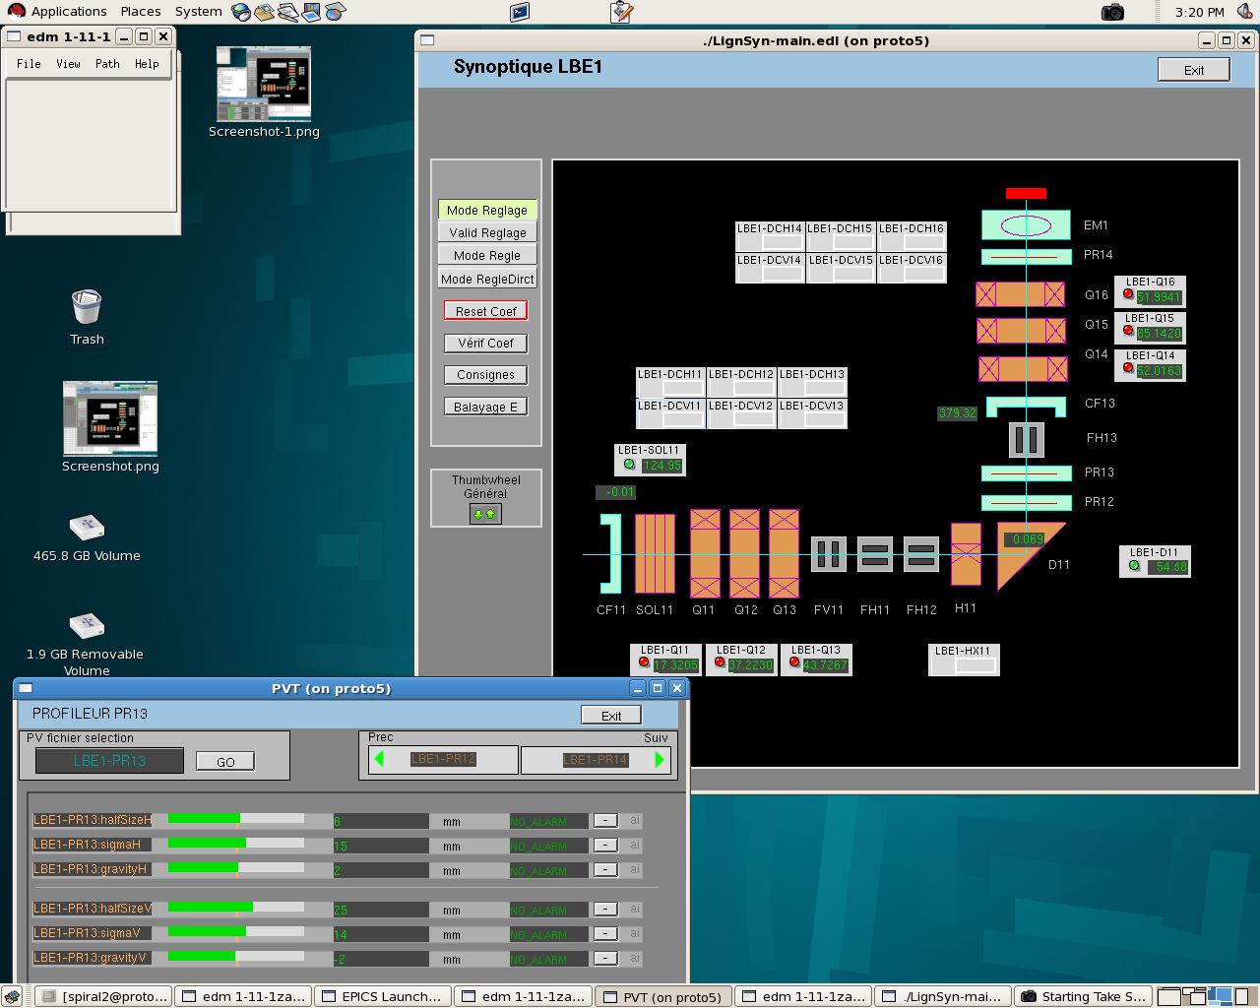
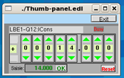
Q/A=1/3 beam tests (LPSC Grenoble)
The Spiral2 project
Notes:
From the control system point of view, the LPSC platform at Grenoble was the opportunity to validate the first components of the control system.
As an example, here is an EDM screen allowing to control the beam line analysis. A soft IOC is associated to define correlation factors so that all the magnetic elements are tuned according to the main dipole settings.

Slide 7
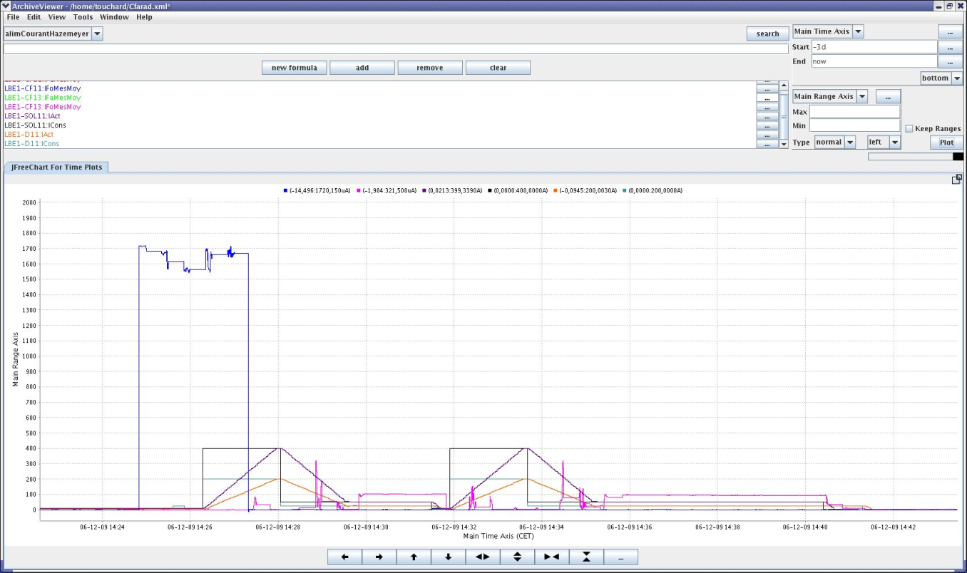
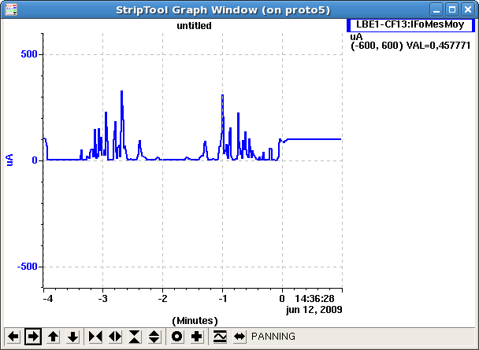
First results at LPSC (June 2009)
The Spiral2 project
Notes:
So it allowed people to get the first beam in June.
Here for example are some standard Epics screenshots showing the beam after the Farafay cup after the dipole.
Also, later, emittance measurements were performed using a specific system developed by IPHC, the graphic display here comes from a Java application they provided.

Slide 8
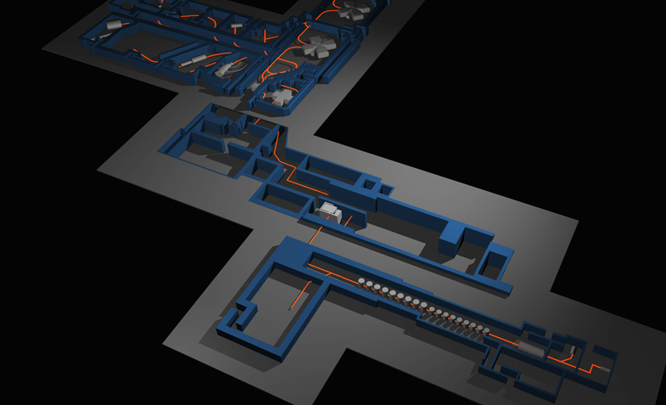
Control systems implementation
Spiral2 RIB production
Ada
Existing Ganil :
"Ganiciel" Ada based home made control system
Spiral2 Accelerator
Control system overview
Notes:
I would like now move to the control system itself.
First the Ganil facility is driven by the so-called Ganiciel home made control system entirely written in Ada.
Because of the project collaboration and its capabilities, Epics was chosen to be the basis for the Spiral2 accelerator control.
It was not so clear for the beam production control system as it has to be tightly coupled to the existing installation. Lastly, what we are planning to base it on Epics servers. Epics IOCS will be either reached by new java applications or by some existing Ganiciel applications. In this purpose, we validated the fact that these Ada applications will be able to address the Epics PVs using the Channel Access library with the appropriate Ada binding.

Slide 9
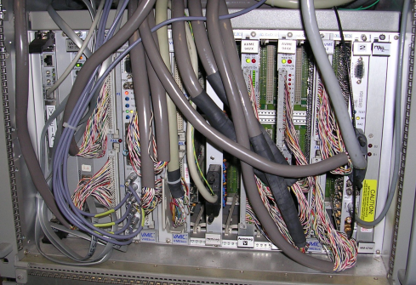
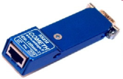
Main technical choices summary
● Soft IOCs
● Graphical User Interfaces :
 Epics tools
(editor, trends, plots …)
 Java Programming
● Databases servers
PC / Linux RHEL 5.4
3.14.9
Channel Access / Ethernet
IOCs
Epics database and sequencer
VME / VxWorks 6.7
Supervision
Siemens S7 PLC
Remote
I/Os
Power supplies
I/Os
Motorola 5500 CPU
VME I/O boards
Profibus or Profinet
Modbus-TCP / Ethernet
Modbus-RTU / RS485
CFs
DCCTs
ACCTs
Alarms
RF amplifiers
Stepping
motors
Profilers
Control system overview
Notes:
Now, I would like by this slide summarize the main technical choices for the Spiral2 control system.
IOCs are implemented within either Linux PCs or VME crates running the real time operating system VxWorks.
Interfaces with equipment will be achieved either by VME boards or by field buses such as the power supplies will be directly plugged on a Modbus/TCP network. Other equipment such as RF amplifiers, stepping motors and beam profilers will be connected through a Modbus/serial line with a gateway to the upper level.
An other major component of the system will be PLCs. For the injector, the Siemens S7 will be used, also interfaced using the Modbus/TCP protocol .
Clients and general servers will be Linux PCs,
Graphical user interfaces will be based on the standard Epics tools or by home-made applications written in Java.

Slide 10
Use of specific tools
LabView/Epics gateway
Use of the LabView2009 version as a LabView client for Epics servers
To allow existing LabView applications to interface with Epics IOCs (first use : ion source control at LPSC Grenoble)
Ok with some issues reported to National Instruments :
Missing datatypes : boolean, waveform ...
Ability to access to other fields than the .VAL one
CSS (thanks to Kay Kasemir !)
Evaluation of the archiving and restitution plot functionalities
Relying on a MySql database
Will be tested in parallel with the oldest archiver at the deuteron source bench test at CEA-Irfu Saclay
Use of this Eclipse based environment in operation ?
Irmis : cf. equipment data management topic
Control system overview
Notes:
Beside of those, we also use some specific tools.
The first one is the LabView/Epics gateway integrated into the 2009 LabView distribution. It allows to keep an existing LabView application for the beam analysis which was previously developed by people form this lab having good skills within this domain.
An evaluation of the LabView/Epics gateway was performed by D. Touchard who is attending this workshop. Having done some tests, he reported to National Instruments some problems or improvements to be provided such as some missing datatypes to be transferred or the wish to access to other fields than the standard . VAL one
D. Touchard is also working on the use of the archiver within CSS, thanks to Kay Kasemir who greatly helped him. Our test relies on a Mysql database and we are planning to run it in parallel with the oldest archive engine in the context of the deuteron production tests at Saclay.
One pending question is to find a way to keep a coherent and uniform interface for all operators by preventing them to use the customization features brought by the Eclipse environment.
Lastly, we are also using Irmis but I’ll go back on this point later.

Slide 11
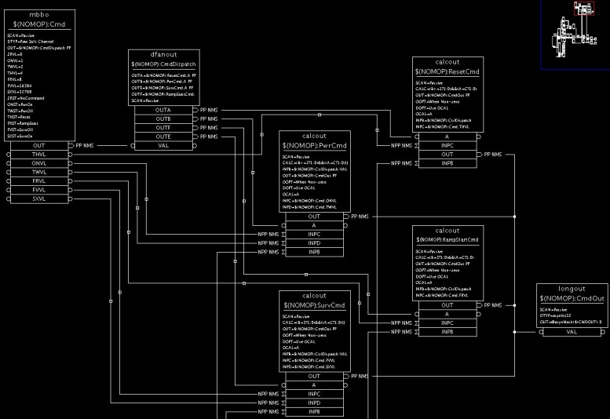
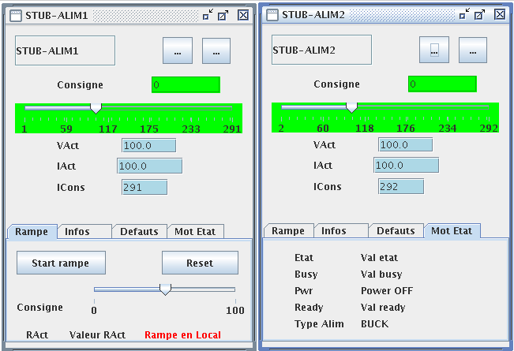
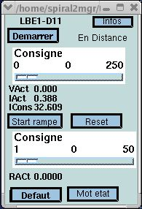
Power supplies
Use of the Modbus/TCP protocol using an interface
Provided by the manufacturer (current power supplies)
Home-made (voltage current supplies)
Software integration
Specific IOC database design
EDM screen
High level applications Java integration
Equipment interfaces
Notes:
I would like now briefly report on most of our equipment interfaces.
As said previously, power supplies will be integrated using the Modbus/TCP protocol.
This has been validated thanks to a dedicated database design and GUIs tools in EDM or Java applications.

Slide 12
Beam diagnostics interface
Name | Interface | Progress
Faraday cup slow acq. | VME ICV150 | To be validated
Faraday cup fast acq. | VME ICV178 & 108 | Under validation
DCCT | VME ICV … | Same as Faraday cups
ACCT | ? | Under discussion
Profilers | Modbus / RTU | Prototype mid-2010
BLM Beam Losses Monitors | ( NIPNE) ? | To be defined
BPM Beam Position Monitors | ( BARC) Specific VME board | To be defined
Time Of Flight (TOF) | Modbus / TCP | Under discussion
Packet length & FCT | Oscilloscope 3 GHz | Under discussion
Packet length (Linac) | ? | ?
Equipment interfaces
Notes:
This slide now summarizes most of all the beam diagnostics having to be interfaced with the control system.
Some interface will make use of VME boards, Modbus field buses or more specific developments in collaboration with other labs.
At the moment we are also starting an investigation to find and oscilloscope to perform the packet length measurement and easily able to integrate within an Epics environment.

Slide 13
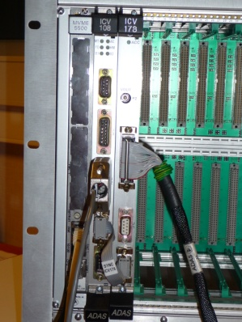
Fast triggered acquisition (CF, DCCT …)
Hardware : Adas VME boards
ICV 108 : External triggering (4 Mo buffer so 2 Msamples)
ICV 178 : 8 x16 bits inputs up to 1,2 Msamples/s
Software
Specific driver
EDM screen
See F. Gougnaud’s presentation
Equipment interfaces
Notes:
A specific point for the diagnostics interface concerns the use of a dedicated fast triggered acquisition system. It is based on a VME set of boards for which the software was specifically developed.
I invite you to attend F. Gougnaud’s presentation tomorrow for more details.

Slide 14
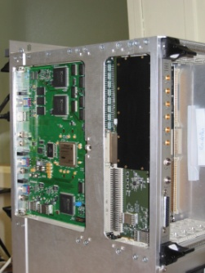
LLRF CC integration
Digital LLRF VME64x FPGA based board (CEA-Irfu)
Handles the pilot voltage to control the phase and amplitude
Controls automatically the startup
Monitors the multipactor phenomena
Provides to the control system the phase difference for the frequency fine tuning
Manages a circular buffer for post-mortem analysis
VME64x crates distribution
The control system (VME CPU within the VME64x crate, private Ethernet network to communicate with the reactive device,PLC) will have to provide the feedback loop for the frequency tuning : - temperature control of the cooling water for the RFQ, - cavity deformation or plunger and motor for the cavities
Equipment interfaces
Notes:
An important class of equipment to be integrated is the LLRF handling as it concerns the RFQ, the rebunchers and the cryogenic cavities.
The hardware is based on Saclay development consisting of a VME64x board with an embedded FPGA. For the control system, it provides the phase difference for the frequency fine tuning.
Therefore, the control system consisting of the VME CPU, a private Ethernet network and a PLC will have to provide the feedback loop.
Also, the system will have to transfer post-mortem buffers for analysis.
Y. Lussignol from Irfu Saclay wrote a specific record to handle this board and the application software has still to be developed.

Slide 15
High level applications framework specification
At the early days …
Java environment decided
Xal (SNS) framework ?
Many capabilities, concepts and powerful
Quite a large number of applications, packages
Ability to be adapted to fit our constraints
Limited manpower
Machine specificities (multiparticles, link with the CEA TraceWin simulation code …)
Integration within our Ganil database design approach
Evaluation (end-2007 ⇨mid-2009)
Use of standard Xal applications
Integration of some Spiral2 specificities within Xal existing ones
Evaluation of a Xal-derived application framework for Spiral2
New applications
Links with the environment (database, simulation code)
High level applications
Notes:
I would like now slightly move on the software side and start by the specification of framework for our high level applications.
At the beginning of the project, we decided to use Java as the standard programming language at this level. Then we wondered about the way to implement it.
May be some of you remember that some years ago I presented during a previous meeting a slide with many interrogations concerning the adaptation of the SNS Xal environment within our context.
It has many capabilities, is very powerful and comes with many applications and packages.
At that time we wondered about the feasibility to be able to fit it within our constraints : a limited manpower, the Spiral2 machine specificities which is a multiparticle type one and the integration into our existing Ganil approach. Also we had to integrate this environment with the use of an off line CEA simulation code named TraceWin.
So an evaluation was performed for 2 years and now allows us to use at least some standard Xal applications, to write new ones having defined our own framework derived form the SNS one.

Slide 16
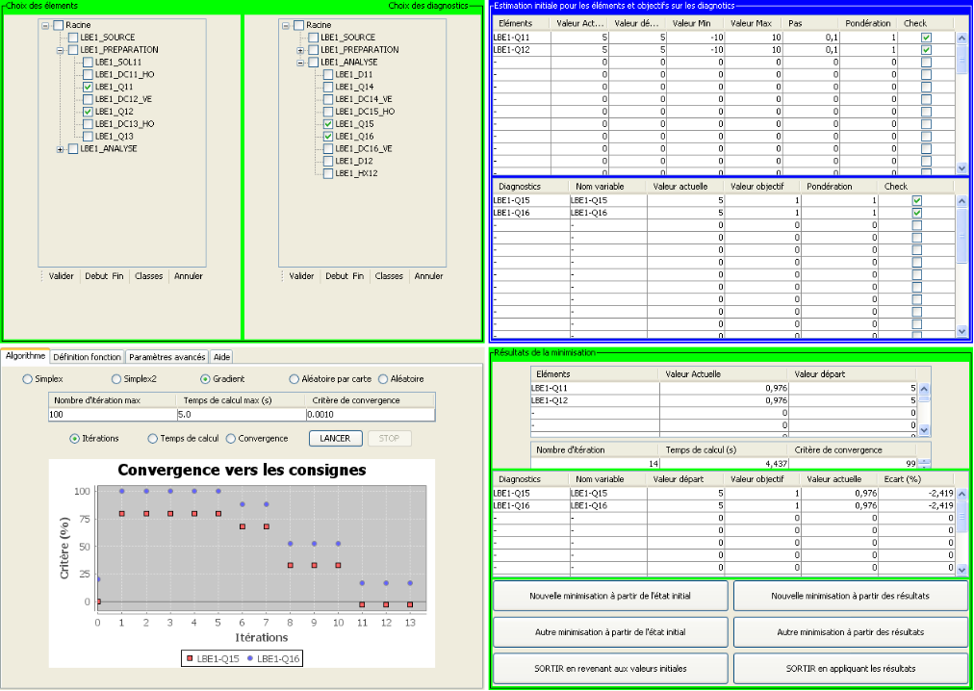
New applications within the Xal derived framework
Beam optimization
Beam profile viewer
High level applications
Notes:
These are now two examples of a new applications built within the Xal based framework and reusing some existing algorithms or methods.
The first one on the left allows to display beam profiles while the second one was designed to perform the beam optimization.

Slide 17
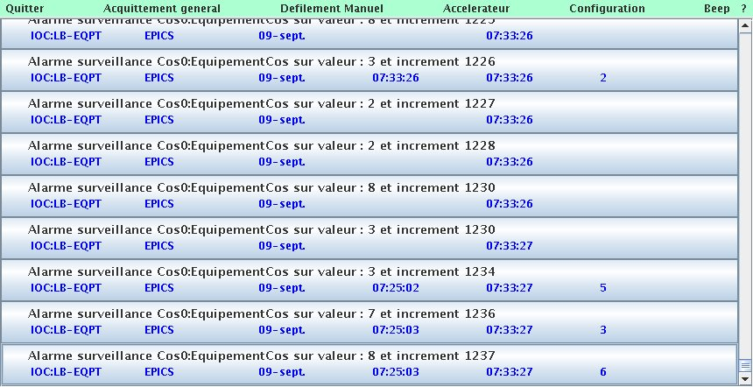
Development of an alarm manager
Display
⇨To provide a common alarm manager both for the existing Ganil machine and the future Spiral2 facility
⇨ Java / log4j based (+log4Ada)
Configuration alarm server database :
PV to be monitored
related display text data (static text, PV to get additional information …)
High level applications
Notes:
An other point now concerns an alarm manager.
The objective for this evaluation is to provide a common alarm display manager for both the existing Ganil machine and the future Spiral2 facility, having the same look and feel and archiving capabilities.
It is written in Java and internal communications are achieved using a specific implementation of the log4j logger. Alarms are displayed in a real-time way on different screens and are stored in a relational database.
The configuration of the alarm monitoring system is stored in a specific database. It first points to the PVs to be monitored and then includes related display data such as the alarm message itself or other PVS having to be read to constitute the definitive alarm text to be displayed.

Slide 18
Xal style use for Spiral2
Current status :
Used as a tool box
Spiral2 specificities integrated
Still some questions :
E-logging
Xml and database synchronization
Xal V logger / CSS archiving ?
Plans
First real tests this summer at Saclay : alarms, parameters management, beam profilers display, optimization
Adapt or develop new Xal style applications : alignment, cavity tuning, matching …
Warm thanks to the XAL community and the help we got
High level applications
Notes:
Let me now conclude for this point.
First we are now using it as a tool box and we are able to integrate the Spiral2 context. We have still some questions concerning the e-logging system and the way to synchronize xml Xal files and the databases, all these points were discussed during a recent Xal workshop hold at Oak-Ridge in May.
Our plans are to perform the first real tests at the deuteron Saclay test platform.
We therefore expect to adapt or develop new Xal style based applications in future.
Lastly, I would like to warmly thank people from the Xal community for the help we got from them.

Slide 19
Machine configuration management
Sequences
Handles
Nodes
PVs
Fits both the existing Spiral2 constraints and the Xal concepts
Machine configuration database
Notes:
Related to this point is the configuration database describing the machine. It is implemented within a relational database which fits both the Xal requirements and the Spiral2 constraints.
Therefore, an application has been designed allowing to manage the different machine configurations, being developed within the Xal framework.
Operators can select the beam, then machine level and beam path. Then the machine is divided into sequences finally linked to PVs using handles.

Slide 20
IOC interface (1/3)
Objective : High level applications would have to interface equipment always in the same way, independently from the IOC implementation and hardware
Codification project rules DDDDD-RRRRRRR[-CCCCCC]:SsssssSsssss EQPT Signal
Need to standardize the interface between the high level applications and the PVs
IOC specific database design
Enhanced codification rules
Settings ⇨ $(EQPT):ABCDCons
Readbacks ⇨ $(EQPT):ABCDAct
Measurements ⇨ $(EQPT):ABCDMes
IOC communication
Notes:
I would like now to move to an other topic we are just currently working on.
The objective is to define an homogeneous software interface from the IOCs applications to the GUI Java based applications so that high level applications always interface equipment in the same way, independently from the IOC design and hardware.
Obviously, it first starts by adopting the codification rules for equipment naming within the project.
Then as specific design is recommended for the IOC implementation to provide enhanced naming and codification rules.
This is typically the case for settings, readbacks and measurements.

Slide 21
IOC interface (2/3)
genSub record added to provide
Status
Current status word ⇨ $(EQPT):InterfaceRecord.VALa
Meaning of status bits set to ‘1’ (string array)
⇨ $(EQPT):InterfaceRecord.VALb
Meaning of status bits set to ‘0’ (string array)
⇨ $(EQPT):InterfaceRecord.VALc
Defaults
List of current defaults (string array)
⇨ $(EQPT):InterfaceRecord.VALd
List of all possible defaults (string array)
⇨ $(EQPT):InterfaceRecord.VALe
Commands
List of available commands (string array)
⇨ $(EQPT):InterfaceRecord.VALf
IOC communication
Notes:
Then a genSub record was added to present different types of data attached to any piece of equipment.
Concerning the status, it presents the value of the current status word and provides the signification of each bit either set to 0 or 1
For the equipment defaults, it gives the list of defaults currently set and also the list of all defaults being potentially able to be raised.
Lastly, this record provides the list of commands able to be sent to handle the device.

Slide 22
IOC interface (3/3)
Commands
$(EQPT):Cmd mbbo record to send any command (previously : $(EQPT):OnOff, $EQPT:Reset etc … according to the equipment class)
Current work status
First implementation for the power supplies interface
Validated for high level applications
To be checked for the standard Epics tools integration (EDM)
To be evaluated for other equipment types
IOC communication
Notes:
Therefore the idea for application is to send any command using an other mbbo record being able to process any of these commands.
For more details, you can ask to C. Haquin in the room attending this workshop who is the initiator of this approach.
The first implementation has been prototyped for the power supplies equipment class and validated with a first high level applications adopting this convention.
It has still to be checked within the context of the use of the Epics standard tools such as EDM, then to extend it to other equipment types.

Slide 23
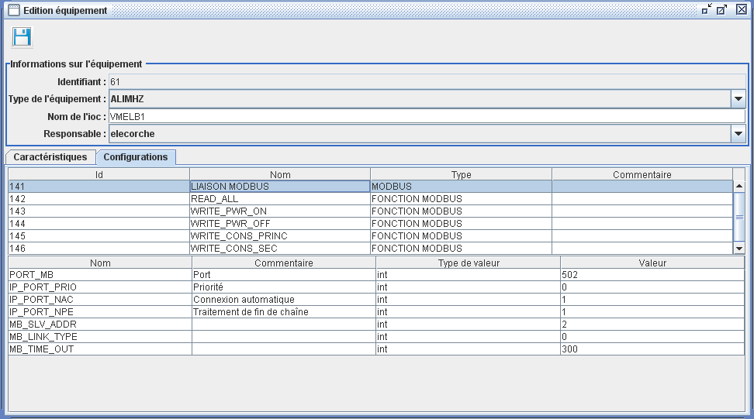
Equipment management
VDCT
Home made database user interface (Java)
Initialization and configuration commands - Substitutions for template files
(Sequences)
Template
Files
Relational
database
(Ingres)
.cmd

Irmis (v2)
genIOC Java generation procedures
 Epics IOCs
PV crawler
Equipment management
Notes:
The last part of the presentation will be devoted to present our work concerning the equipment management.
First obviously, we are using VDCT for the IOC database design. Then we are also using the Irmis version 2 package associated with the PV crawler to get a global view of the Epics installation. We plan to adopt the new GUI environment when it will become available as announced by Gabriele Carcese.
Using this approach is quite well but we estimate that is rather a tool for developers than for end users as it needs some Epics knowledge. So we are trying to implement an equipment database management upstream the standard Epics way and we will see that in the following slides.
The idea therefore is to use VDCT to generate templates for each class of equipment to be handled.
On the other hand, end-users have access to an equipment database without having to know anything about the Epics internals.
The so-called genIOC Java software extracts data from the relational database and generates the various files later embedded into the .cmd starting script as we are going to see now.
.

Slide 24
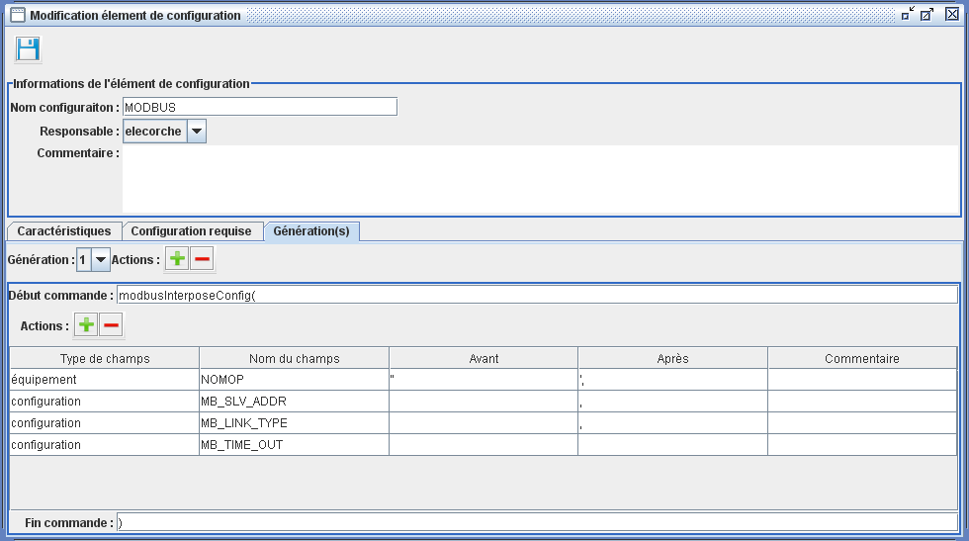
Definition of general configuration
Developer use only
Exemple : configuration of the Modbus communication
(2 command lines to be generated)
Command line beginning
Command parameters
Separators for file generation
Equipment management
Notes:
Let us briefly now how it works,
First, the developers have to specify the configuration types. As an example here, this is the interface for Modbus communication having two lines to be generated.
The command line is composed of the command name itself then with the parameters separated by the appropriate delimiters.

Slide 25
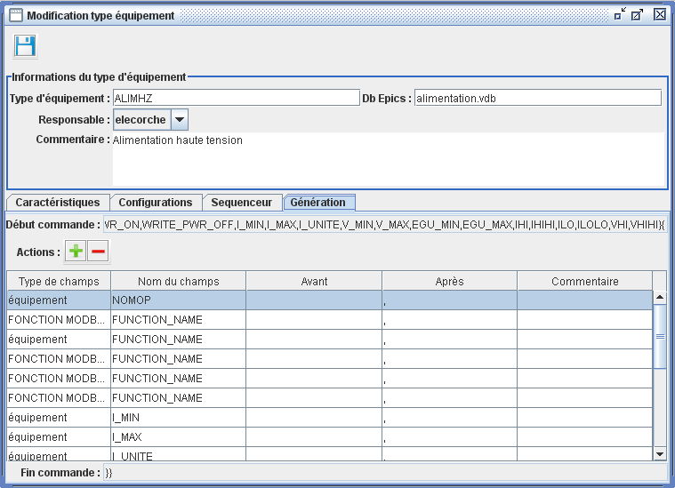
Définition of equipment type
Developer use only
Exemple : Definition of the power supply ALIMHZ type
Modbus function parameter
Substitution macros
Separators for file generation
Notes:
In the same way, developers define equipment types with several types of parameters, either to generate specific command lines inside the cmd script either for the macro variables specification.

Slide 26
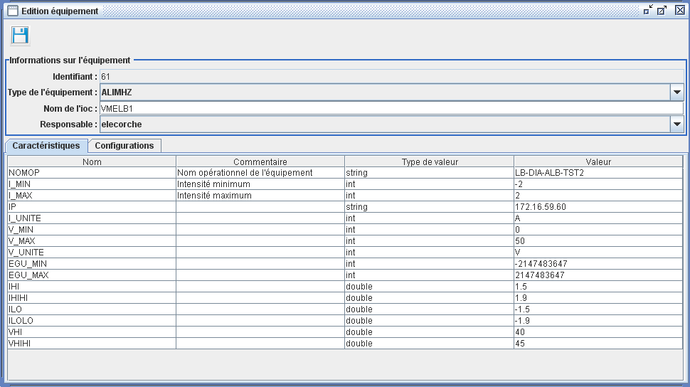
Equipment characteristics
End-user
Exemple : Configuration of a power supply (instance of an ALIMHZ equipment type)
Equipment management
Notes:
Lastly, this the screen to be proposed for the end user where people have to define equipment and according to the type the values specific for the equipment instance.

Slide 27
Generated configuration file
To be included into the .cmd script
From the equipment configuration type
From the equipment characteristics
Equipment management
Notes:
Therefore the genIOC program generates the initialization and configuration commands to be inserted into the .cmd file, here again in the context of a equipment linked to the control system using the Modbus-TCP protocol.

Slide 28
Generated substitution file
To be included into the .cmd script
From the equipment characteristics
Equipment management
Notes:
And the genIOC software generates the macro substitution files complying to the standard Epics rules.

Slide 29
Work in progress …
Three files to be generated and called from the .cmd file
Configuration file
Substitution file
Sequencer file : not yet implemented !
Next steps :
Test and validate the model with other equipment types
Faraday Cups measurements
Stepping motors for beam slits
…
Evaluate the integration of PLCs controlled equipment
Think to more complex equipment (emittancemeters …) ?
If necessary, define the links with other databases or tools (Irmis, alarms configuration, CSS archive engines configuration, beam parameters management …)
Equipment management
Notes:
So, that’s the current status for this part of the work. As you saw, we only validated up to now the procedure for the configuration and substitution files and we have still to validate it when a sequencer program is associated to a piece of equipment.
The next step will be to test and validate the model with other types of equipment such as the Faraday cups and then the stepping motors and more generally for the beam slits.
An other step will consist of integrating the PLC data and consider them as users devices.
In parallel, a study is envisioned to associate this approach with the other databases or tools involved into the control system : first of all, with the Epics database Irmis approach, then the alarms or CSS configuration and also the beam parameters database interfaced by the high level applications.

Slide 30
Thanks for your attention …
J.F. Denis, F. Gougnaud, J.F. Gournay, Y. Lussignol, P. Mattei
J.C. Deroy, P. Duneau, P. Gillette, C. Haquin, E. Lécorché, E. Lemaître, P. Lermine, J.M. Loyant, L. Philippe, J.F. Rozé, D. Touchard
P. Graehling, J. Hosselet, C. Maazouzi
Notes:
So that’s it, I only listed here the main contributors for this work and thank you for your attention

