Slide 1
EPICS and LCLS
LCLS
Linac Upgrade
LCLS-2

Slide 2
Topics Mentioned
SLAC pieces under discussion
Linac Coherent Light Source success
EPICS evolution in the LCLS
Linac Upgrade project
  Removing legacy system dependencies
The FACET interim
LCLS-2 planning
  Moving to micro-TCA
  No more CAMAC

Slide 3
Topics not mentioned
SSRL
Test Facilities
X-ray data analysis
But they all use EPICS at SLAC too

Slide 4
Pieces under discussion
Linac at SLAC is 3 km, split into 30 sectors
LCLS is using sectors 20-30, plus the old Beam Switchyard plus a new undulator hall and experimental halls
FACET will reuse sectors 0-19, with an experimental area in sector 20 (first part)
LCLS-2 will use sectors 10-20, bypass sectors 20-30, and have a new set of undulators

Slide 5
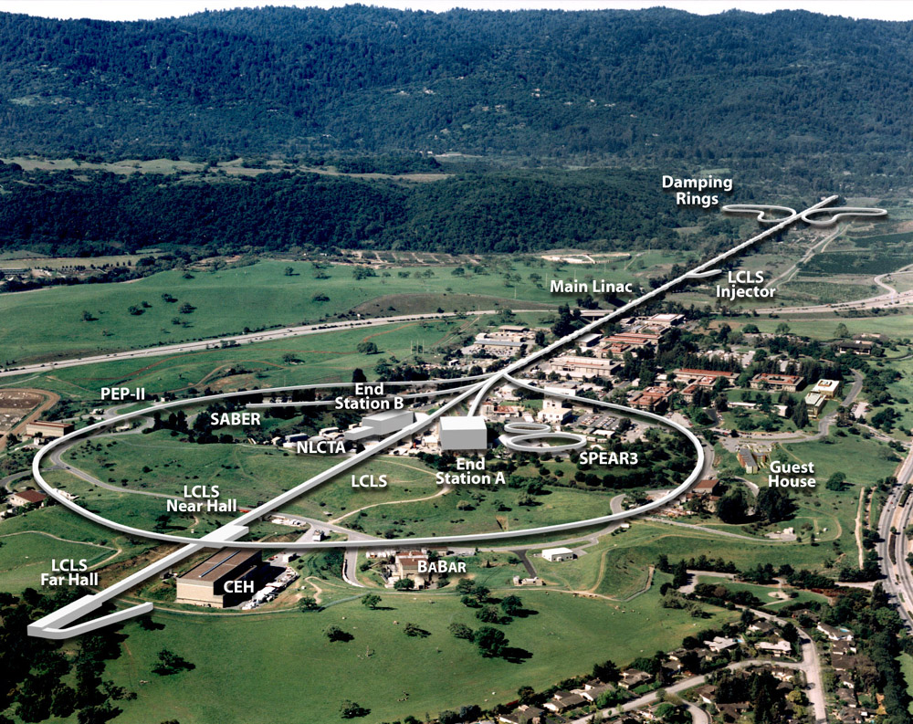

Slide 6
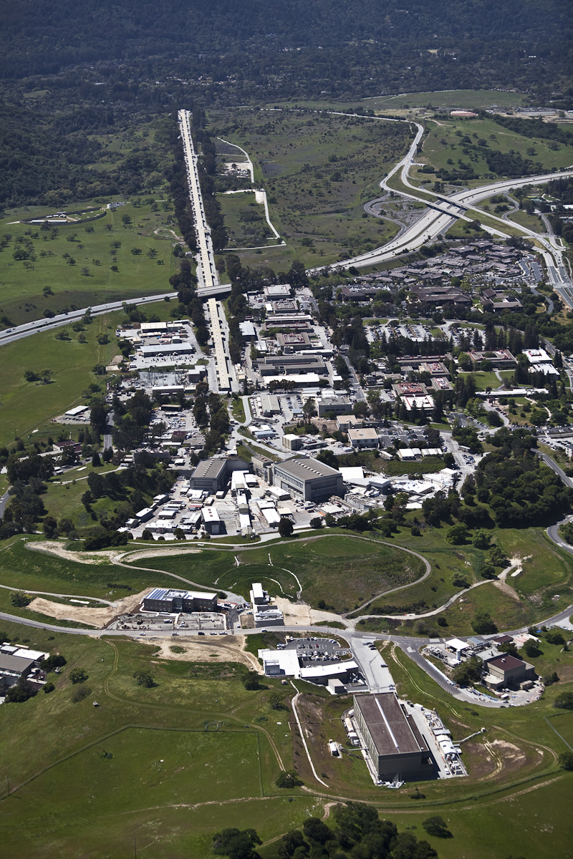

Slide 7
LCLS Success
(Controls point of view)
Control system ready on time
X-rays produced quickly
Great collaboration with operations and physicists
“Controls Deputy” coordinates all software issues with operations
All software changes are planned and approved
Reliability/Availability is high

Slide 8
Software Stability
Separate development and production areas
Well-obeyed naming convention
Well managed RTEMS, EPICS, and module releases
Strong systems infrastructure
Team: Ernest’s group + Systems group

Slide 9
Evolution of EPICS in LCLS
2008: Interesting mix of legacy and EPICS, both functionally and geographically
2009: Most BPMs and Magnets EPICS
2010: All BPMs and Magnets EPICS, Linac Upgrade underway, “one-of” legacy items replaced by EPICS, RF still mostly legacy.
May 19: 454 Total IOCs
  163 VME IOCs, 220 EIOCs, 71 Soft IOCs
  427,707 Process Variables

Slide 10
120 Hz Feedback
Isolated network
  No competing network traffic, more reliable data transport
Faster Network
  New, efficient FCOM protocol (T. Straumann)
  Multicast network allows diagnostic devices to send a single packet to many listeners
Feedback Team
  D Fairley, D Rogind, K Kim, and others

Slide 11
Pattern-Aware Control
Pattern-based Timing System
120Hz Operation and Timing System Patterns
Controlling Magnets and RF based on Timing Pattern
Real-time diagnostic devices measure every pulse
  Devices with an EVR and Beam-Synchronous-Acquisition
Each pulse matches with a timing pattern
  Timing system (EVG) generates a pattern at each fiducial
  Each pulse can be ‘labeled’ with the current timing pattern

Slide 12
Feedback Network
core
fb02
fb03
fb01
Controller IOCs
IN20
LI21
Li22
LI23
LI24
Li25
LI26
LI27
Li28
LI29
LI30
BSY
LTU
UND
DMP
BSY
bp01
BSY
bp02
LTU0
mg01
LTU1
mg01
DMP
bp01
bp01
bp02
rf01
rf01
bp02
bl01
10
27
5
4
LTU1
bp01
LTU1
bp02
8
UND
bpo1
UND
bp02
9
bp01
bp02
bl01
10
4
1
4
7
LTU0
bp01
LTU1
bp03
LTU1
bp04
UND
bp03
UND
bp04
7
6
1
RF EIOCs
7
4
6
9
9
3750 Network Switch Stack
Additional 3750 in switch stack for FNET
bp01
BPMS VME IOC (number of EIOCs indicated below)
7
mg01
MGNT VME IOC (no EIOCs)
rf01
RF VME IOC (with EIOCs)
fb01
Controller IOC (no EIOCs)
bl01
BLEN VME IOC (with EIOCs)

Slide 13
Linac Upgrade Project
Move existing CAMAC branch control from legacy system to VME module.
  Support all standard devices
    Hard modules were RF control and timing control
  Use real EPICS device support
Get all important applications off VMS and onto Linux
Huge team, led by T Himel; very large effort

Slide 14
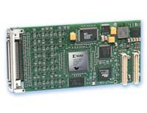
PSCD Implementation
  Embedded Board Products
PMC-DX502 / DX2002
FPGA Modules
Features
  32 bi-directional RS422/485 differential I/O lines
  Customizable FPGA with 6,912 or 24,192 logic cells (Xilinx Virtex-II XC2V500 or XC2V2000)
  FPGA code loads from PCI bus or flash memory
  256K x 36-bit SRAM memory
  Supports dual DMA channel data transfer to CPU
  Supports both 5V and 3.3V signaling
  Extended temperature option (-40 to 85°C)
Work done by M Browne, S Peng, and J Olsen

Slide 15
FACET Interim
Some new EPICS in Sector 20
Otherwise all legacy system
4-5 year lifetime
$14 M project; 1.4 M to Controls
Low duty cycle, low reliability requirement
Nonetheless – very important to accelerator researchers; unique facility, replacing “Final Focus Test Beam” (now the LCLS Undulator Hall)
Team: Legacy system folk, EPICS team, Hardware subsystem engineers

Slide 16
LCLS-2
Major upgrade to LCLS
Construction start probably 2014
Lots of R&D before that
Probably around $400M project
New undulators, new use of Linac
Goal is to support more users with reliable high-quality beam
Builds on the success of and demand for LCLS experimental time

Slide 17
LCLS-2 Layout
enclosure
exists at sector 10
3-7 GeV
RF
gun-2
RF
gun-1
undulator
3-7 GeV bypass line
L0′
L0
undulator
X
X
L1′
BC1′
L2′
BC2′
L3′
L1
BC1
L2
BC2
L3
3-15 GeV
FACET wall
existing
sector-11
sector-14
sector-21
sector-24
und-hall

Slide 18
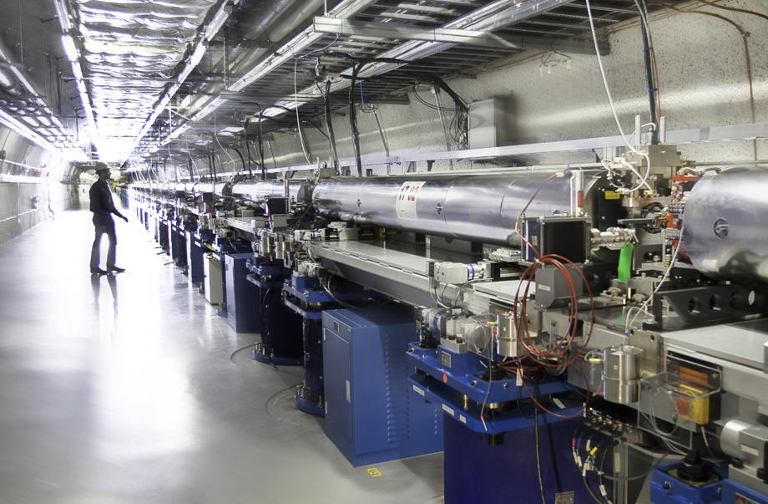

Slide 19
LCLS-2 and Controls
The current LCLS will be all EPICS and Linux by August or September
The LCLS-2 will essentially be a clone of the LCLS, just 10 sectors upstream
We have several years to develop a new platform and move completely away from CAMAC
Expected lifetime is 20-30 years

Slide 20
Current R&D Direction
Move to a micro-TCA platform
  Research already underway
Work with DESY on data acquisition cards
  Prototype card now available
Design and test controls for all items in a sector
  RF (funds for major upgrade available now)
  BPM, Timing, Magnets, Toroids, Movers, etc
Propose modern upgrade for LCLS-2 and later LCLS as well
Team: R Larsen, Q Yang, T Himel, and a cast of dozens

Slide 21
Philosophy and Goal
Use IOC, not “pizza boxes” where possible
If a modern solution already works, use it
Build reliability on hot-swap-ability, shelf management, and redundancy offered by TCA
Work with other labs to develop standard micro-TCA implementations
No more CAMAC; perhaps even no more VME
Provide a system to support 20-30 years of operations

Slide 22
Conclusion
EPICS is now assumed by everyone at SLAC for new projects
SLAC Controls is actively pushing for a viable long-term controls hardware solution
Thank you for your time

