Slide 1
CSS Developments at BNL / NSLS-II
Gabriele Carcassi
Feb 18 2010

Slide 2
Main goals for CSS at BNL
Use what’s there
NSLS-II distribution includes Data browser, Probe, pvTable, pvTree, BOY
Help improve what’s there
Add plug-ins intended for physics applications

Slide 3
Improve
Mainly on infrastructure (decrease the barrier to the entry)
SourceForge hosting (see Kay’s talk)
Repository structure (see Kunal’s talk)
Build system (see Kunal’s talk)
Headless build - from command line, no interaction
Continuous build based on Hudson
Update site on SourceForge
Feedback on BOY – Ralph’s big laundry list (see Kay’s talk?)

Slide 4
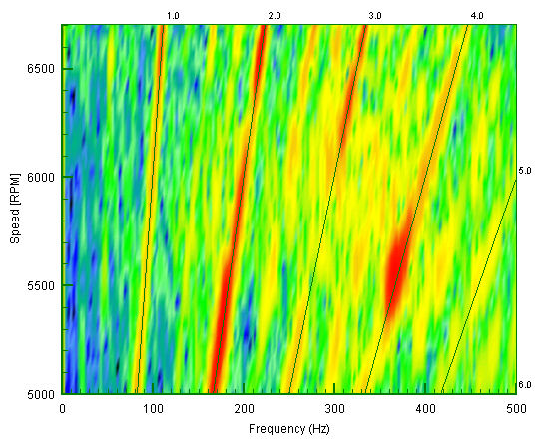
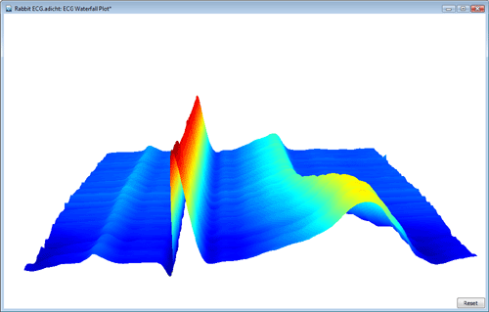
Add
Main goal is to create tools for high level physics applications.
Waterfall plots
Waveforms
Orbits
First need to develop some common “infrastructure”

Slide 5
ChannelFinder
We need to work with channels sets and metadata
Find all channels that represent BPMs on the ring, and order them by position
Need to store and retrieve this information from a service
The service needs to be populated from different sources (e.g. IRMIS, naming conventions, manual entry…)
ChannelFinder service allows to store channels together with properties (key/value pairs) and tags (see Ralph’s talk)
Service by Ralph, Java API by Kunal

Slide 6
PVManager
Need to collect data from different source and computing the data that needs to be displayed.
This is what the PVManager tries to address…
… plus many other things UI development requires

Slide 7
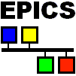
So you want to write a UI…
channel.addListener(new Listener() {
public void doSomething(Event evt) {
myWidget.setFoo(evt.getWhatever());
}
}
Toolkit is single threaded!

Slide 8
So you want to write a UI…
channel.addListener(new Listener() {
public void doSomething(Event evt) {
Toolkit.execute(new Runnable() {
myWidget.setFoo(evt.getWhatever());
}
}
}
Lack of synchronization!

Slide 9
So you want to write a UI…
channel.addListener(new Listener() {
public void doSomething(Event evt) {
Toolkit.execute(new Runnable() {
synchronized(evt) {
myWidget.setFoo(evt.getWhatever());
}
}
}
}
No change by another thread DURING/between notifications!

Slide 10
So you want to write a UI…
channel.addListener(new Listener() {
public void doSomething(Event evt) {
Toolkit.execute(new Runnable() {
synchronized(evt) {
myCopy = copy(evt.getWhatever());
myWidget.setFoo(myCopy);
}
}
}
}
Should not update UI at the same rate as data on the network!

Slide 11
Wish I could simply write
pv = PVManager.read( arrayOf(doublePvs(pvNames))) .atHz(scanRate);
pv.addPVValueChangeListener(new PVValueChangeListener() {
public void pvValueChanged() {
myWidget.setFoo( pv.getValue().getMoo());
}
} );

Slide 12
UI subsystem requirements
Single threaded
Notification must be done on event thread
Data objects must be changed on the event thread only (avoid inconsistencies and simplify responding to events)
Work must be offloaded to other threads as much as possible (to prevent unresponsiveness)
Refresh rate up to 50Hz (faster is useless and counter productive)

Slide 13
Channel Access
Multi threaded
Notification done on connection threads
Data objects changed on connection threads
Rate is not limited: aggregated can be KHz

Slide 14
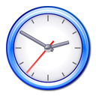
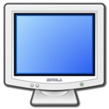
Collect, aggregate and notify
Notifier
Collector
Monitor
Need to collect the data at the line rate
Collector could be a queue, a cache, a timed cache
Aggregate the data at the UI rate, and notify on UI thread

Slide 15
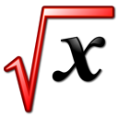
Transform and calculate
Notifier
Collector
Monitor
PV Function
PV Function
Cache
While we are on other thread, we compose and calculate what we need (single array for a table, FFT of a waveform, statistics, prepare synch’ed arrays, …)

Slide 16
UI or not UI
Everything you can do in the UI you should be able to do at the command line
PVManager can work without a UI (notification is simply done on the timer thread)
Command line clients
Logging/archiving
Republish the data through PVData/PVAccess
PVManager is a standalone library
pvmanager.sourceforge.net

Slide 17
3 APIs for the price of one
Expression API: define what you want to read
Internal DSL (Doman Specific Language), typesafe
Building blocks API: perform computation
API based on interfaces, you can add you pieces though the goal is to have most of them already there
Data interfaces: where to put the data
Decoupled from the other two. Needed so that the client can focus more on what he needs and can work with both EPICS V3 and EPICS V.

Slide 18
Status
Channel finder: 1.0 release before end of August
Service and client API implement. Missing error handling.
PVManager: 1.0 release before end of August
Prototyping of the API is done. It can support:
Different sources of data, different UI toolkits (Swing, SWT, no UI), different data types (primitive wrappers, collections, POJOs and JCA), pluggable functions, different collectors (queue, cache, timed cache)
10.000 simulated channels updating at 10Hz, collected in a table at 5Hz, each line showing the statistics of the samples collected
TODO: data type definitions and cleanup
First prototypes of widget by the end of the year.

