Slide 1
Investigating the Use of Control System Studio at APS Beamlines
An Eclipse Plug-in Perspective
John Hammonds, Ken Evans, Brian Tieman
Advanced Photon Source
Software Services Group

Slide 2
Motivation
We would like to develop an application to control area detectors using Mark Rivers’ areaDetector.
We would like to look at the path beyond MEDM
Don’t want this to be just another set of MEDM screens
This will involve more than just CSS (e.g., GDA, ties to analysis)
Need to look at setup, collection, monitoring, and the handoff to analysis

Slide 3
The big picture

Slide 4
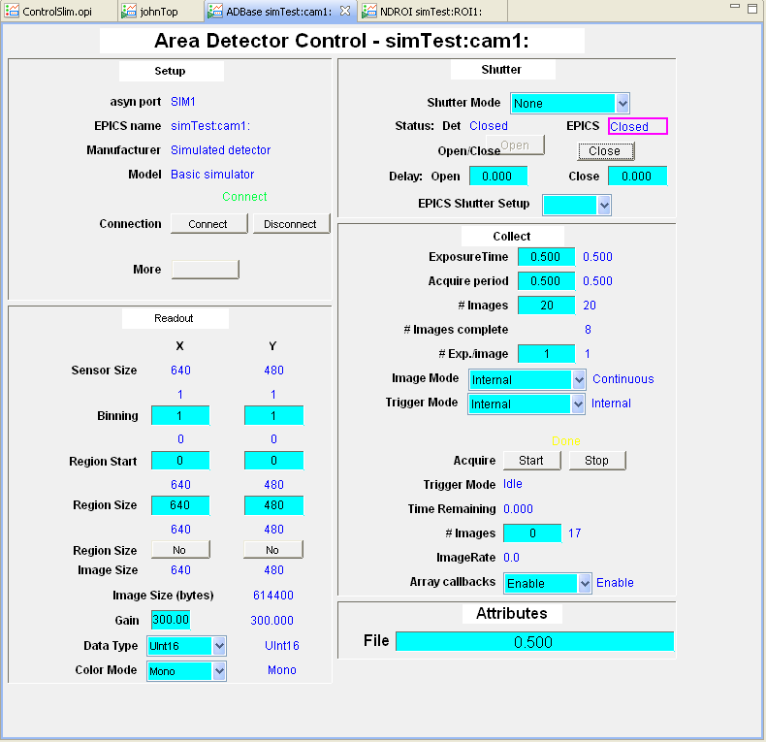
BOY (Best OPI Yet) - ORNL
Can we produce the same kind of control screens?

Slide 5
Throw together an example app
Mix elements from CSS with our own plugins

Slide 6
How will we convert all the MEDM screens?
Write a converter
ORNL had the start of an EDM->BOY converter
Still somewhat primitive
Ties between the conversion and the data model
DESY had an ADL->SDS converter
Fairly complete
Ties between ADL parsing and the data model
Could see a clean way to cut the tie between parsing and the data model
Start with the ADL->SDS converter
Cut the strings between parsing the ADL file and the SDS model
Create an adlParser plugin (org.csstudio.utility.adlParser)
Most of this was LIFTED from the ADL->SDS converter (org.csstudio.utility.adlConverter).
Took out references to SDS in the parser
Should be able to use this parser for all converters (ADL->SDS & ADL->BOY)
Create an ADL->BOY converter (org.csstudio.opibuilder.adl2opi)
Use the parser
Convert to the BOY data model (fairly straightforward)
Dump the file

Slide 7
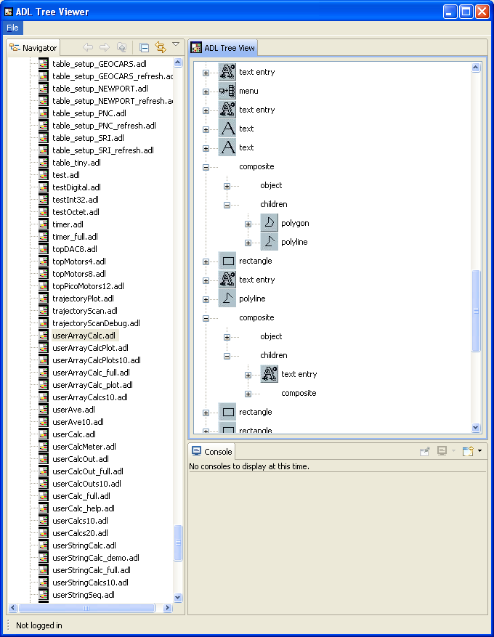
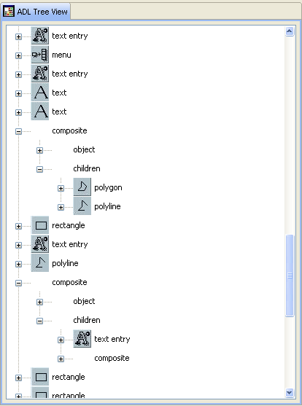
adlParser
Plugin contains an RCP applicaction to examine the detail inside the file

Slide 8
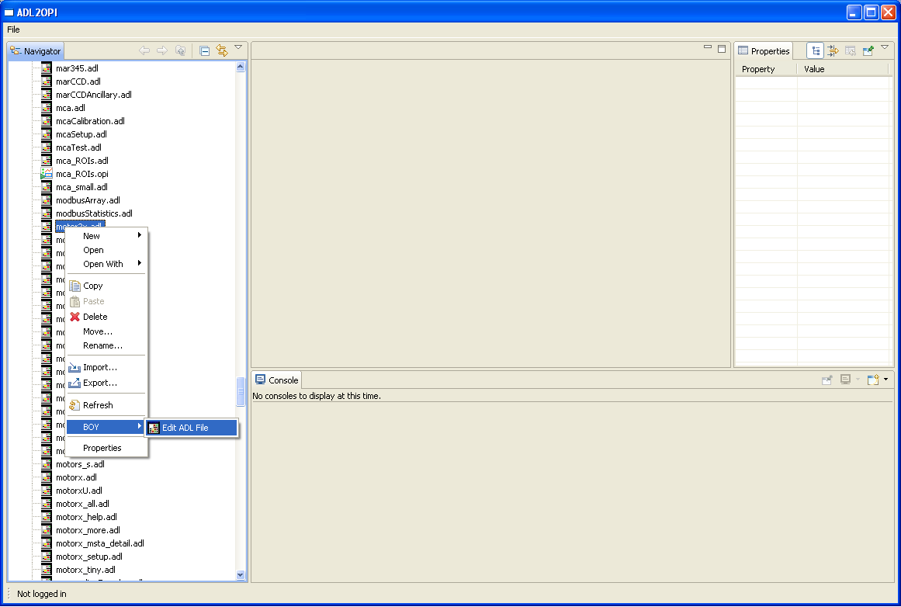
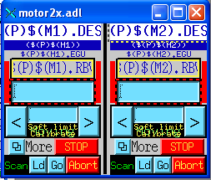
adl2boy
Plugin includes self contained application

Slide 9
adl2boy – What is missing?
Byte, Choice Button, Indicator, and Toggle Button – No good matches in BOY, many of these are on wish lists
No Dynamic properties – this is on the wish list
No way to specify location for related displays and images
Some MEDM files (pre version 020200) have attribute sections that follow the widget definition instead of inside of them; These are not currently handled

Slide 10
Taking a bite out of the big picture

Slide 11
Demo application

Slide 12
Acknowledgement
Matthias Claussen et al., DESY and Cosylab, for shepherding CSS
Kay Kasemir and Xihui Chen, ORNL, for their work on BOY and for their encouragement of the collaboration
Mark Rivers, University of Chicago, for the development of areaDetector
Ned Arnold for the big picture
Use of the Advanced Photon Source at Argonne National Laboratory was supported by the U. S. Department of Energy, Office of Science, Office of Basic Energy Sciences, under Contract No. DE-AC02-06CH11357.

