Slide 1
EPICS-based motion control and data acquisition system on hard x-ray microfocus beamline station
Yan Fen
Hard X-ray Microfocus beamline,
Shanghai Synchrotron Radiation Facility

Slide 2
Outline
Introduction of SSRF-BL15U1
Hardware structure for motion control and data acquisition
Experimental mode and results based on the hardware

Slide 3
Introduction of BL15U1-the scientific goals
Microbeam fluorescence analysis
Microbeam XAFS (transmission、fluorescence)
Microbeam X-ray diffraction、scattering
The components, chemical properties and structures of the materials
Materials science、biology、earth and environmental sciences and nano science

Slide 4
Introduction of BL15U1- design objective
Energy range of photon: 5 – 20keV
Energy range of fluorescence
detection: 1 – 20keV
Energy resolution (ΔE/E): 5×10⁻⁵ - 2×10⁻⁴
Minimum spot size (FWHM): <2μm K-B mirror
~100nm Zone Plate
flux@10keV: ~ 10¹¹photons/s (2μm)

Slide 5
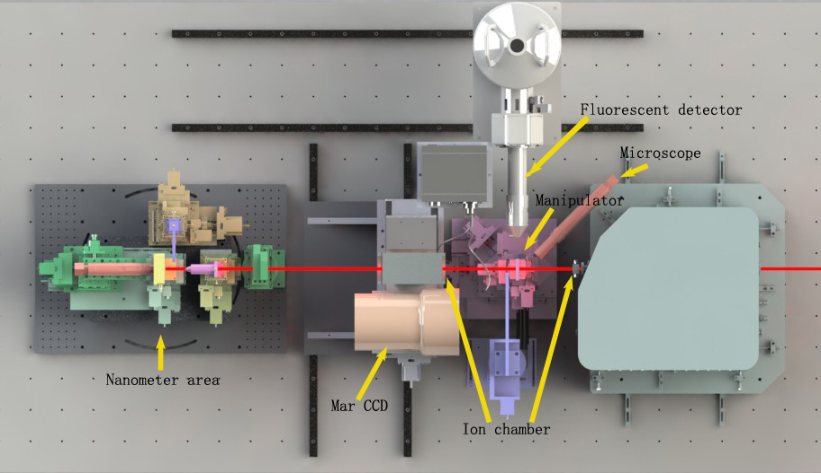
The Layout of Experimental Station

Slide 6
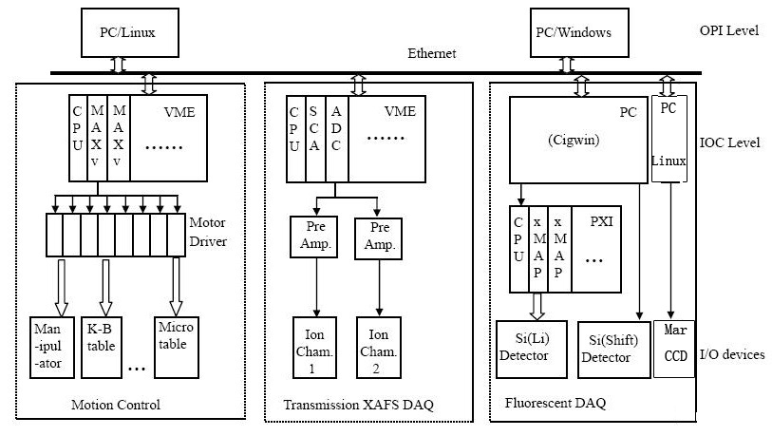
Hardware structure
XAFS
Fluorescent Mapping
XRD
Motion control
Flux
Fluorescent
Signal
Diffraction

Slide 7
Software Environments
IOC
  EPICS base 3.14.8.2 and 3.14.11
  OS：vxWorks5.5.1(MVME5500), Cygwin(PC)
  synApps：synApps-5-2、synApps-5-4和synApps-5-5
  Cross compiler：crossGCC-2.9.6（Linux）
OPI：
  OS：Scientific Linux4.4
  Interface development environment：edm-1-11, python

Slide 8
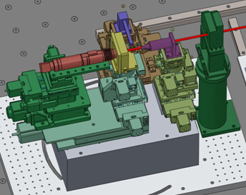
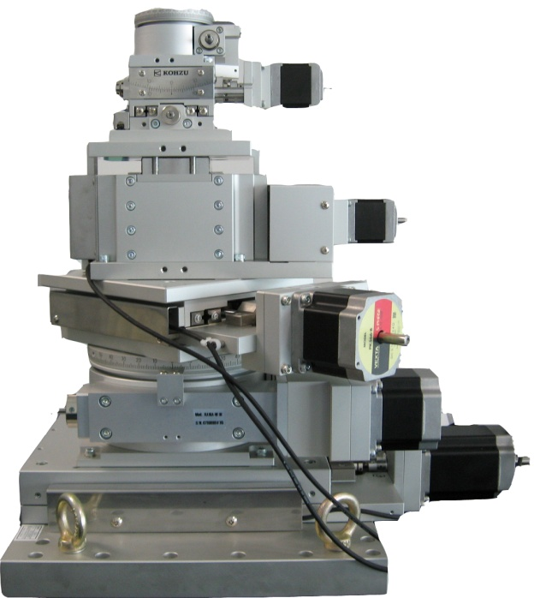
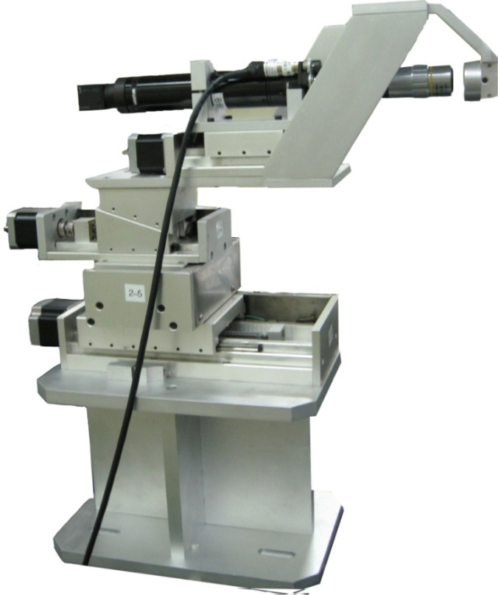
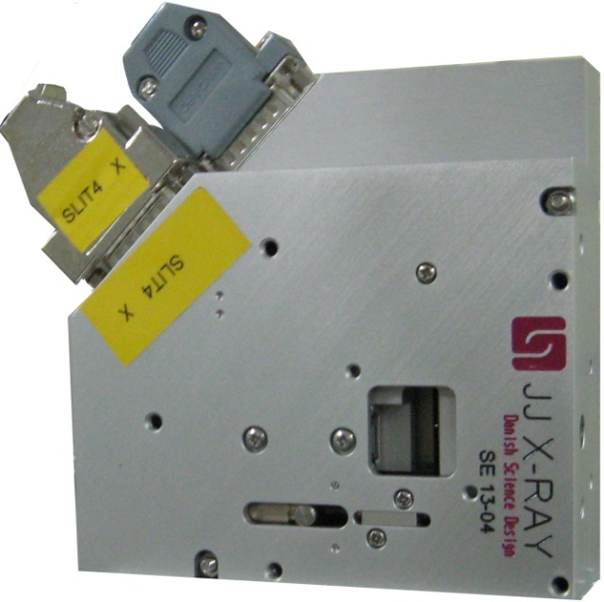
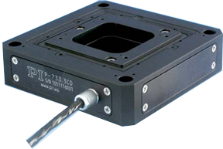
Controlled object (45 motors)

Slide 9
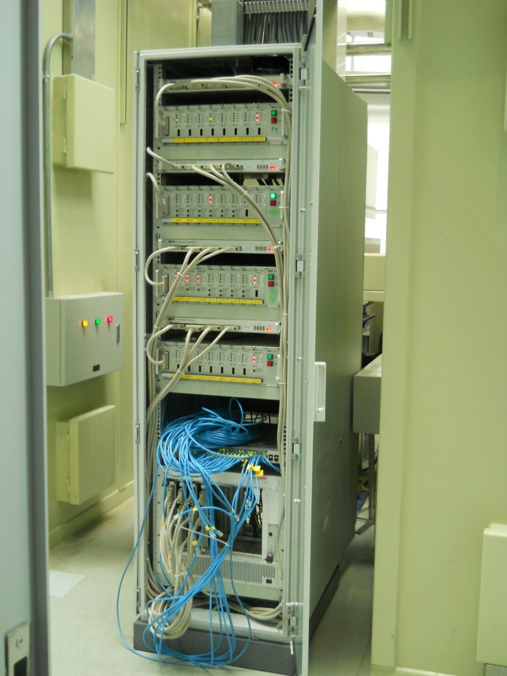
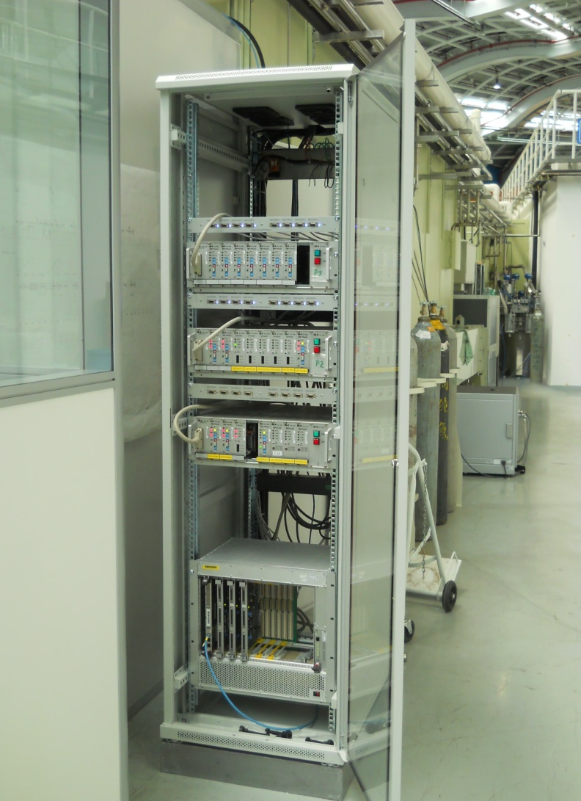
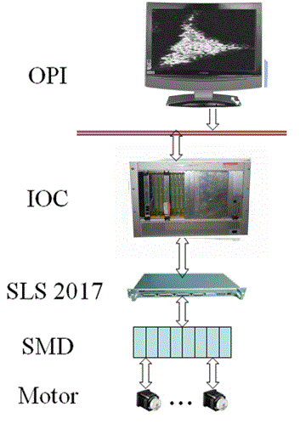
Basic structure for motion control

Slide 10
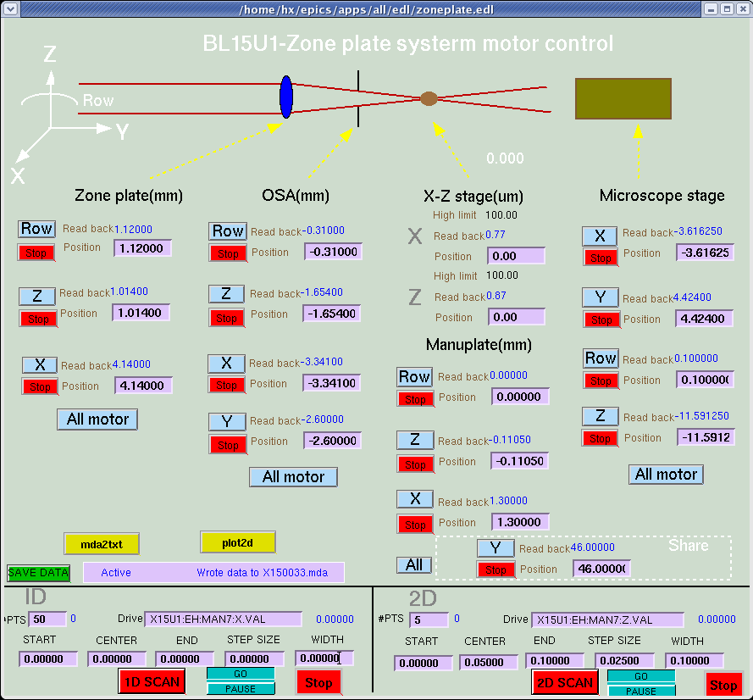
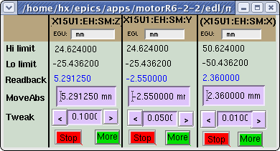
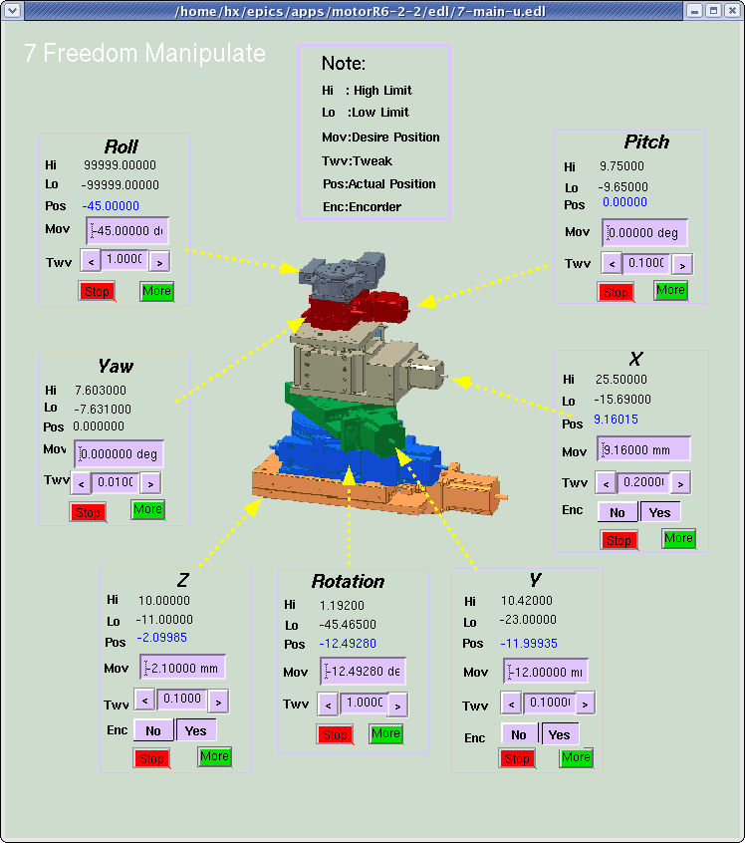
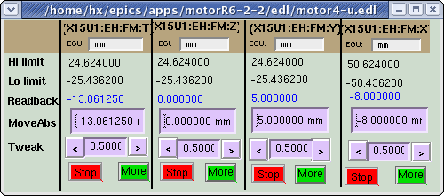
Interface for motion control

Slide 11
Hardware structure for Detect Beam Flux
ADC
Ion chamber
Pre amplifier
ADC
PC (Linux)
SCALAR
Ion chamber
Pre amplifier
V/F
Scalar
NIM crate
VME crate
Internet

Slide 12
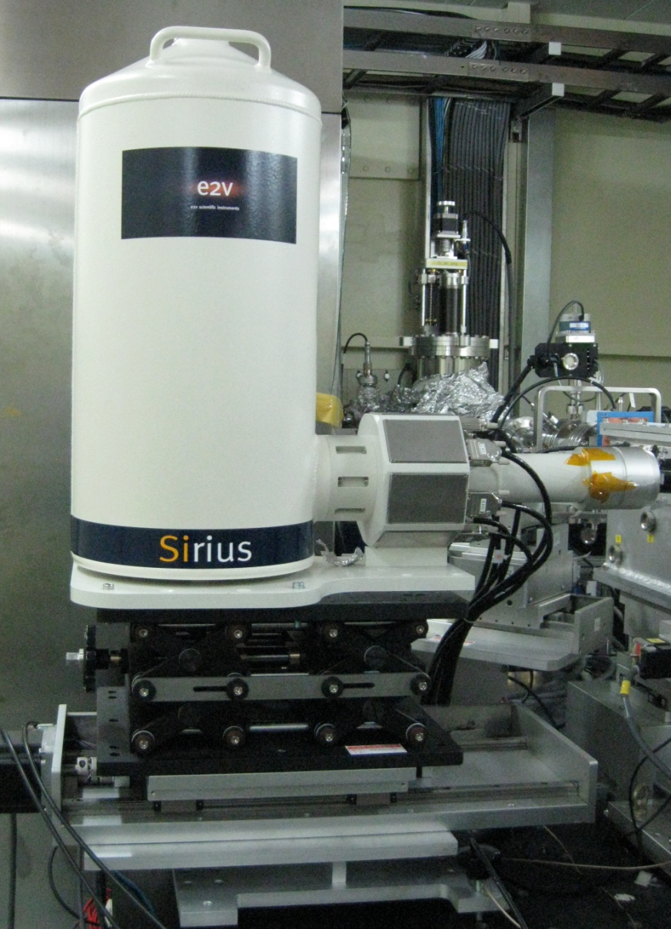
Si(Li) Detector for Fluorescent Mapping
1,000,000 counts/sec/channel
xMAP: PXI module for multi-element detectors. 4 detectors per PXI module. Faster than Saturn and DXP2X, and with high-performance features.

Slide 13
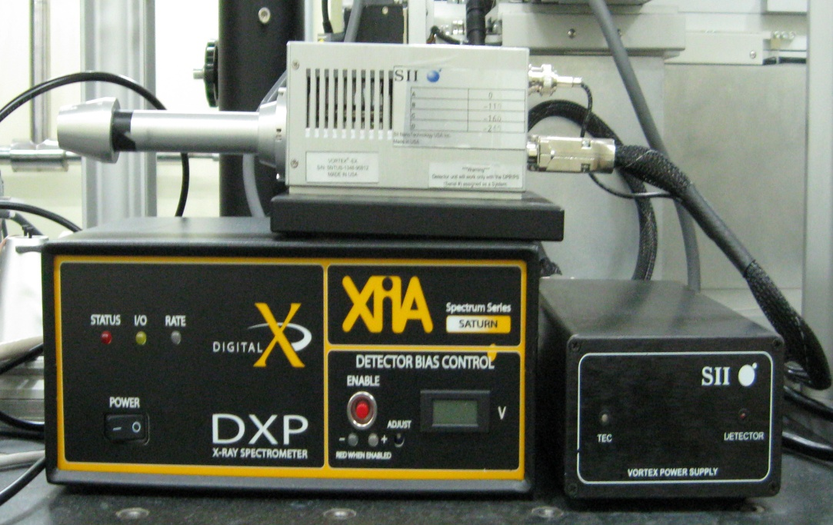
SDD detector for Fluorescent Mapping
Saturn: standalone unit for single-element detectors. This is also sold in an OEM version inside the Vortex electronics from SII

Slide 14
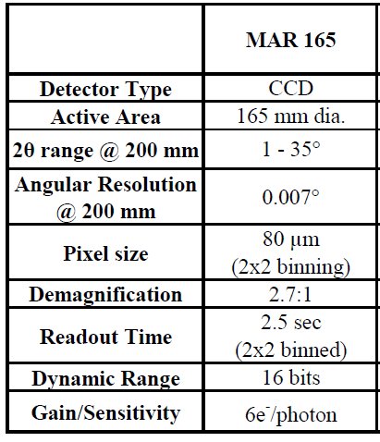
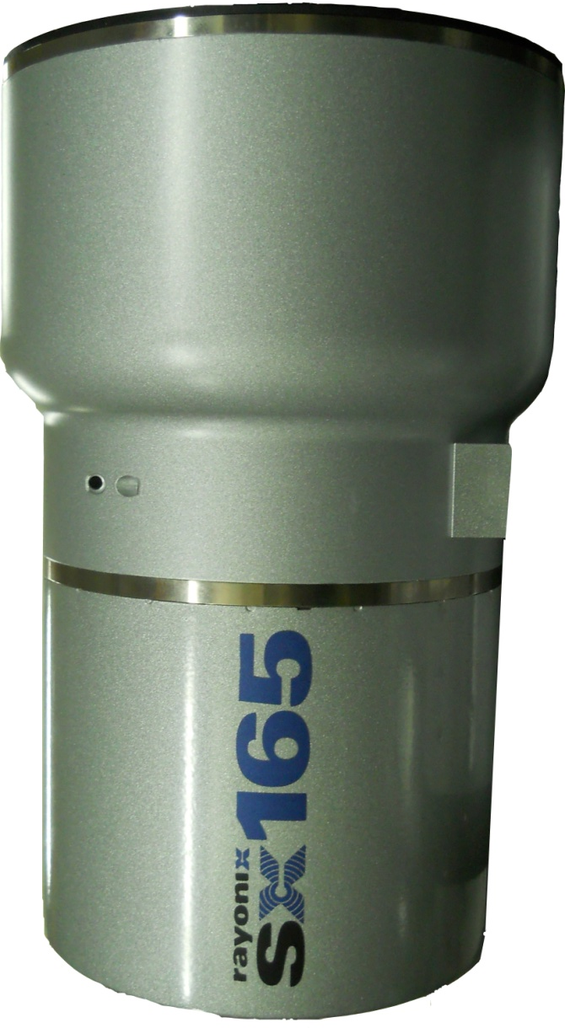
Array Detectors for Diffraction

Slide 15
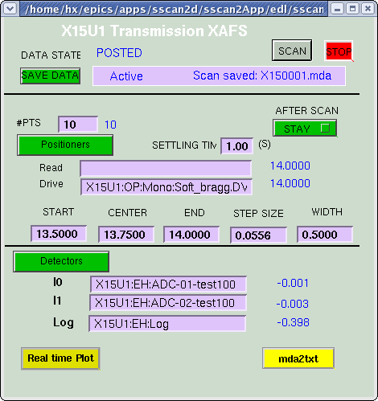
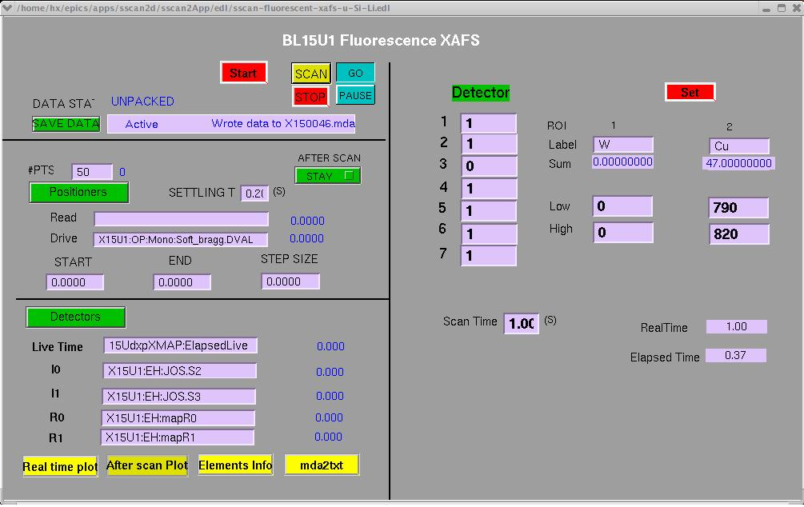
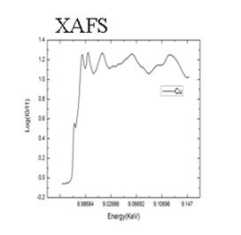
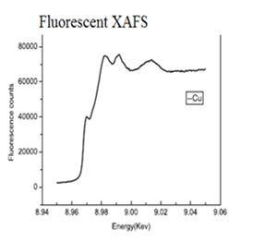
XAFS -- interface and results

Slide 16
Fluorescent Mapping --Scan Mode
Start position
On the fly
Step
by
step
Outer loop x
M pixel
Start position
Inner loop y
Outer loop x
Detector count
N pixel
M pixel
Inner loop y.N
Detector count
Inner end
No
Outer end
No
Yes
Outer end
No
Yes
End
Yes
End

Slide 17
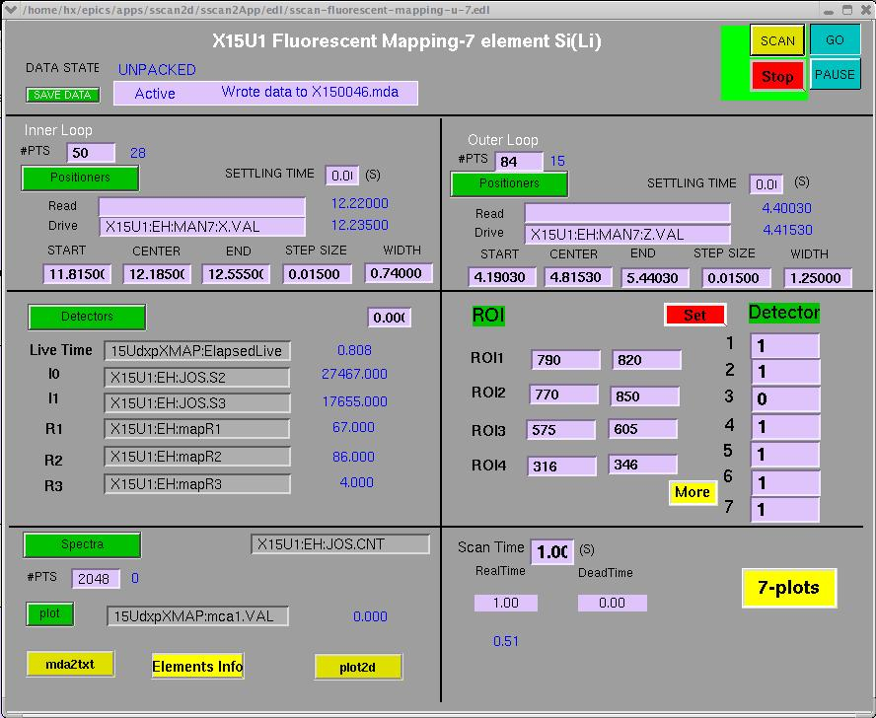
Fluorescent Mapping Results-- Step by Step
The distribution of As in the seed at different growth stage. Zhu Yongguan, New Phytologist. 2011(189): 200-209

Slide 18
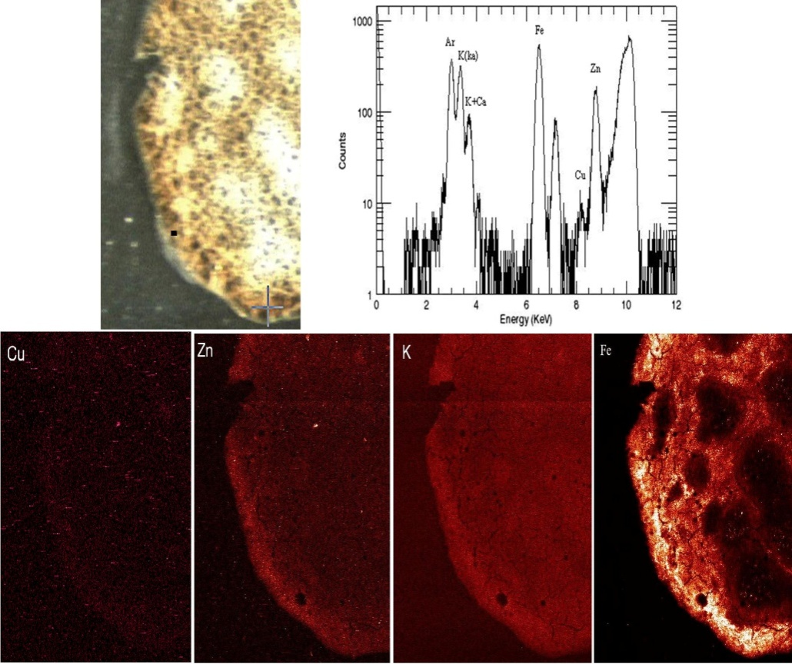
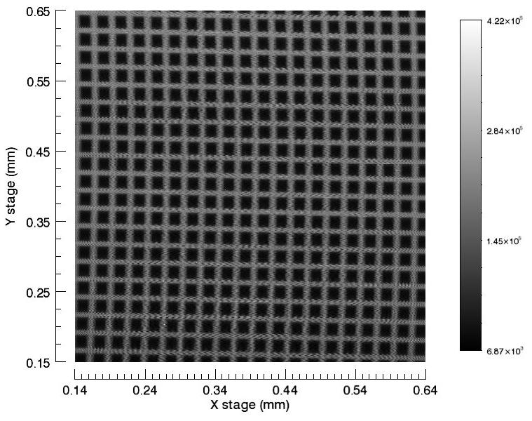
Fluorescent Mapping Results-- on the fly
Spleen of mouse
Pixel: 530*647
time: 2hours20minutes
Scan time/pixel: 0.02 second
1000 Nickel mesh
Pixel: 500*500
time: 38minutes
Scan time/pixel: 0.003 second

Slide 19
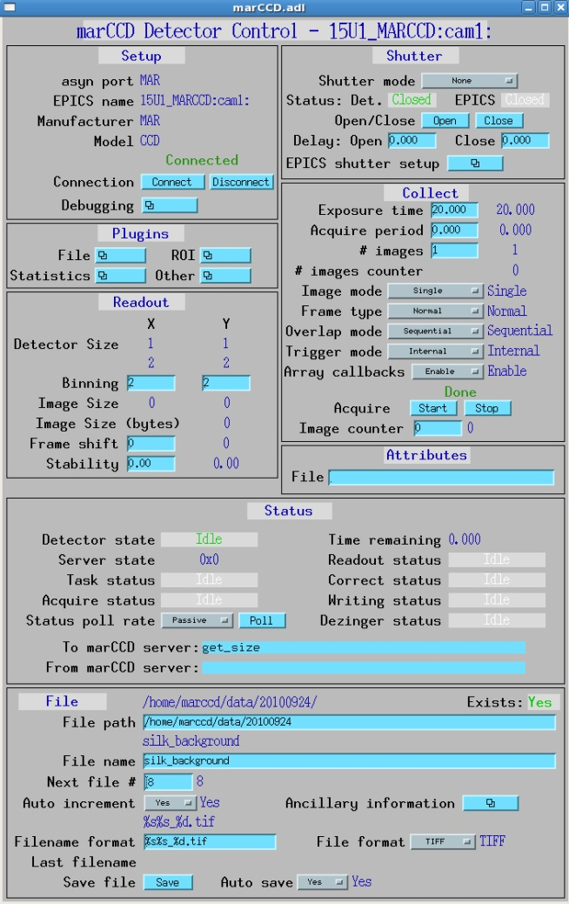
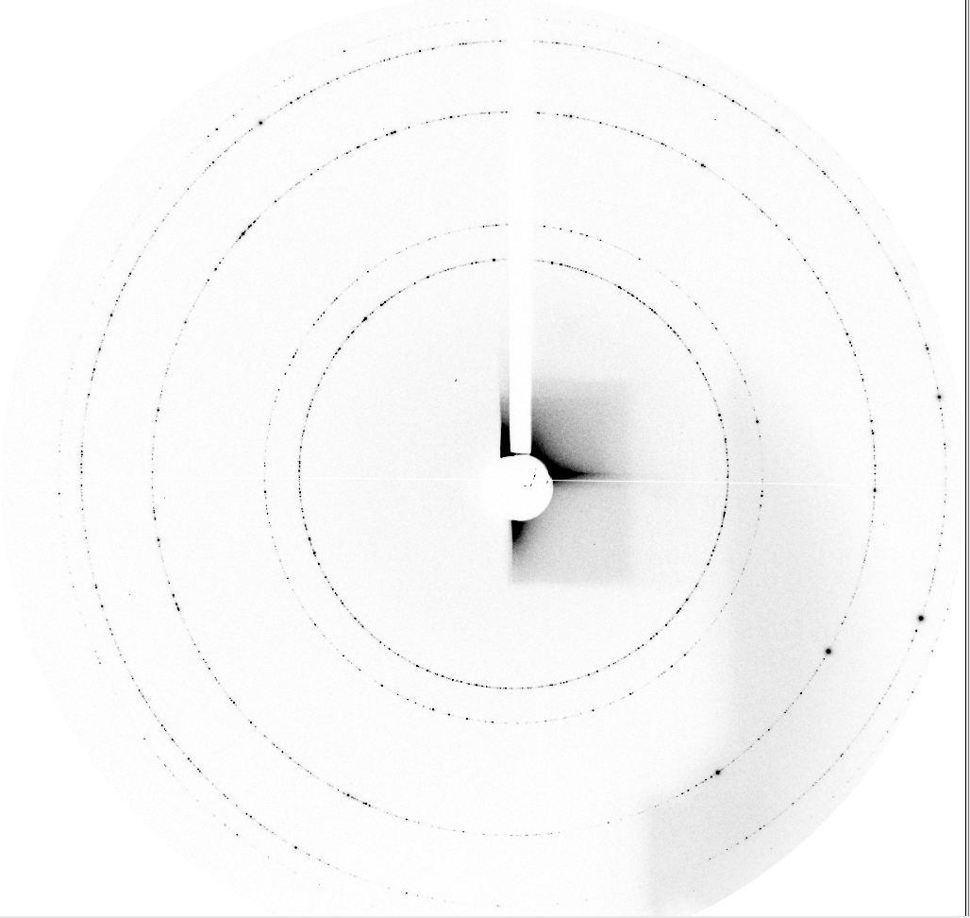
X-ray Diffraction Results
C_{e}O₂-diffraction pattern

Slide 20
Conclusion
All the hardware has been used under EPICS in BL15U1 station
Based on EPICS, many functionalities have been implemented, such as XAFS, fluorescent mapping and diffraction

Slide 21
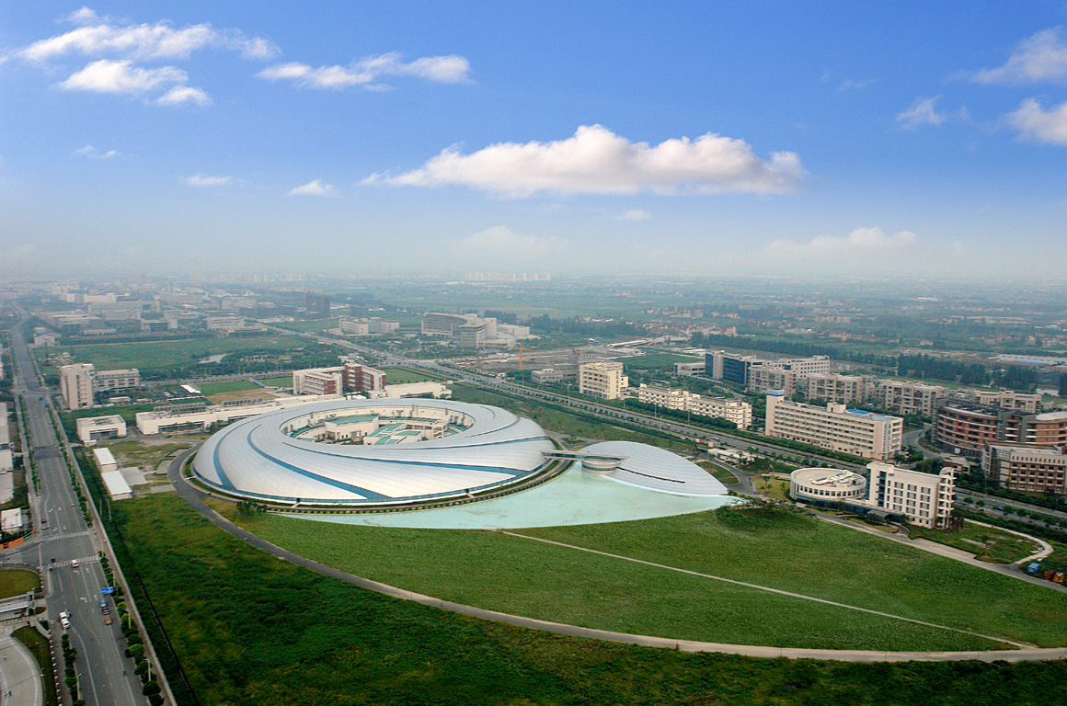
Thank you!

