Slide 1
Service-Oriented Architecture for High-level Applications
Paul Chu FRIB Controls Group Leader (Acting)

Slide 2
Outline
What is Service-Oriented Architecture (SOA)
Why SOA needed
Services in consideration
Possible communication protocols
Summary

Slide 3
What is SOA?
Service-oriented architecture (SOA) is a flexible set of design principles used during the phases of systems development and integration in computing. A system based on a SOA will package functionality as a suite of interoperable services that can be used within multiple, separate systems from several business domains.
-- Wikipedia
Everybody wants to be served, but not doing all the tedious work

Slide 4
Why SOA Needed?
Reliability improvement
Services are centrally controlled with rigorous requirements
Each service focused on very few functions (Modularized services)
Functionality distributed to various services – reduce complexity
Without GUI overhead
Performance improvement
Running on fast servers
Data always available to clients
Applications are thin clients – easy to code
Only “narrow” APIs defined
More portable
Service is not a new idea – been used for many years
SOA technology is transparent to clients – as long as APIs unchanged

Slide 5
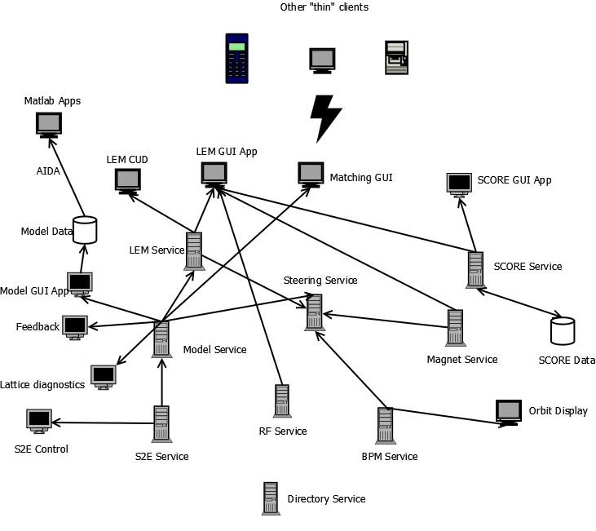
Services
Service-oriented architecture (SOA) example diagram

Slide 6
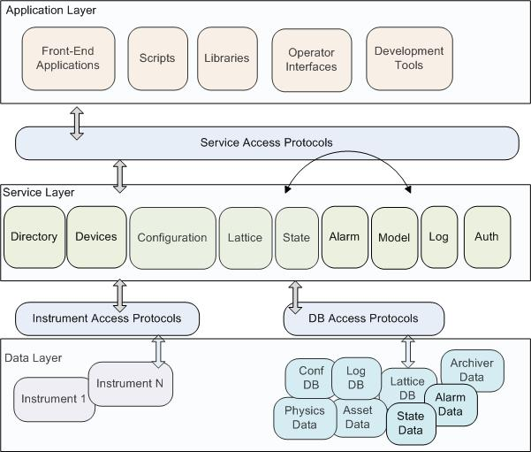
High-Level Controls Architecture
Courtesy V. Vuppala

Slide 7
Service Layer (V. Vuppala)
Directory Service: Information about the control system including its services
Device Service: Access and control of instruments (IOCs)
Configuration Service: Physical and logical information about the accelerator and its component systems: magnets, RFQs, detectors, solenoids, power supplies, geographical location etc
Lattice Service: Information about the accelerator lattice, that is the physical details about the optical elements
Model Service: Service that simulates the accelerator or its sub-systems
Log Book Service: To manage entries in the log book
State: To save/restore state of the accelerator or its sub-systems
Alarm Service: A service that provides access to alarm information (set changes, set/read mismatches, read alarms (e.g. temperatures or humidity that is too high, turbo pump currents, vacuum levels, etc.) and alarm configuration data.
Authentication Service: Authenticates users, and authorizes access to services, devices, instrument access, etc.

Slide 8
Service Example [1] (courtesy G. Shen)
A prototype of online model server service at NSLS-II
Use PVData to store machine setting, simulation configuration, and in-memory simulation results
Access the model server through PVAccess protocol
Presentation Client
Presentation Client
PVAccess
PVRecords (Model data & Setting)
Support code
Model run control
Interface Adaptor
Tracy
Elegant
...

Slide 9
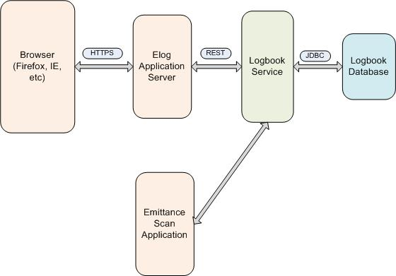
Service Example [2]
IRMIS E-log Service
A Java or web-based service for IRMIS database access
Database connection managed by service – no initial connection overhead
Reduce the total number of connection requests to the database – all client traffic via the service
No SQL knowledge required for application developers – all data access via API
Business logic at service, not in database
IRMIS E-log Architecture
Courtesy E. Berryman

Slide 10
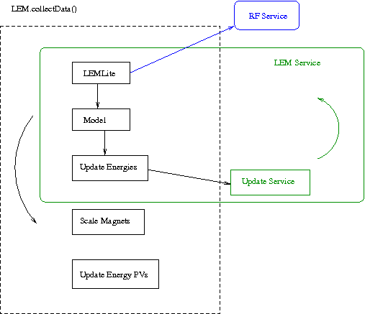
Service Example [3]
Linac Energy Manager
Constantly update the energy tracking information along the linac
Magnetic fields can be scaled accordingly to maintain same lattice
Run in an endless loop
Update energies in the service
“LEMLite” is to fudge klystron amplitude based on certain fixed energy reference points
This can be an “RF Service” by itself
At SLAC, currently using EPICS CA as the communication protocol

Slide 11
Possible Communication Protocols
Different services may have different requirements
E.g. data rate, data complexity, data amount…
EPICS (v.3) CA
EPICS (v.4) pvAccess
REST (Representational State Transfer)
SOAP (Simple Object Access Protocol)
JMS (Java Message Service)
XML-RPC
JSON-RPC
Web support is optional

Slide 12
Summary
SOA is the way to go
A list of first order services identified
Several services been implemented/prototyped
Collaboration
FRIB/MSU
BNL/NSLS-II
SLAC
Everyone is welcome

