Slide 1
FRIB Controls Plan
Paul Chu FRIB Controls Group Leader (Acting)

Slide 2
Outline
Overview
Global Timing System (GTS)
Machine Protection System (MPS)
Low-level controls
Global database and naming convention
User interface
High-level applications
Summary

Slide 3
Overview
FRIB facts
FRIB – Facility for Rare Isotope Beams
Provide intense beams of rare isotopes to be used for cutting edge nuclear science research
Total project cost of $614.5M fixed
CW machine
Superconducting cavities for acceleration, superconducting solenoids
A Re-accelerator (ReA) to accelerate rare isotope beams produced by NSCL Coupled Cyclotron Facility
EPICS based control systems
CD-4 milestone
Accelerate multiple charge states of a heavy ion beam of ⁸⁶Kr
Measure FRIB driver linac beam with energy larger than 200 MeV/nucleon and beam current larger than 20 pμA

Slide 4
Project Status
Supported by U.S. Department of Energy and Michigan State University
CD-1 – Aug. 2010
CD-2 – Apr. 2012
CD-4
Early finish date – end of FY2018
Mid 2020
Currently under preliminary engineering design phase

Slide 5
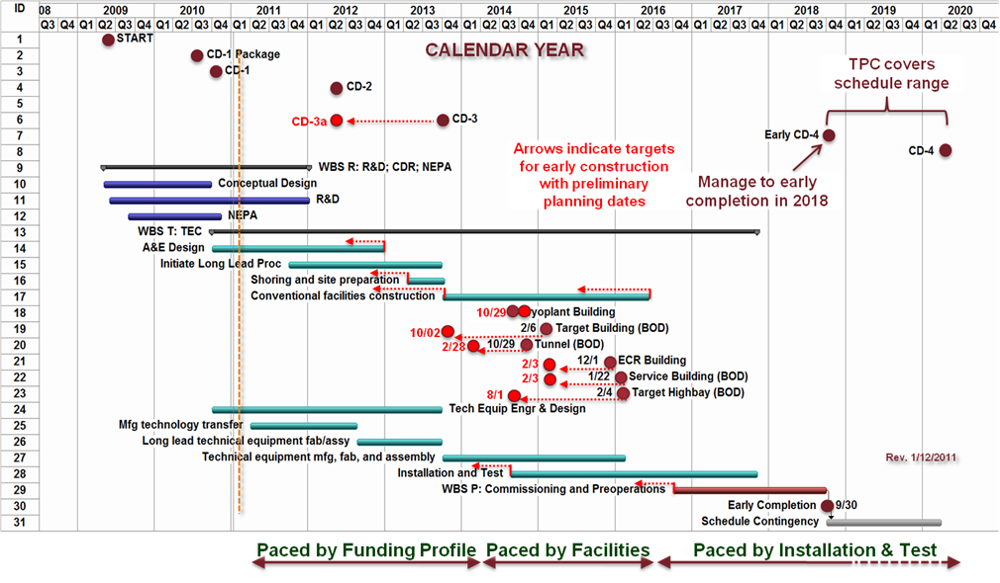
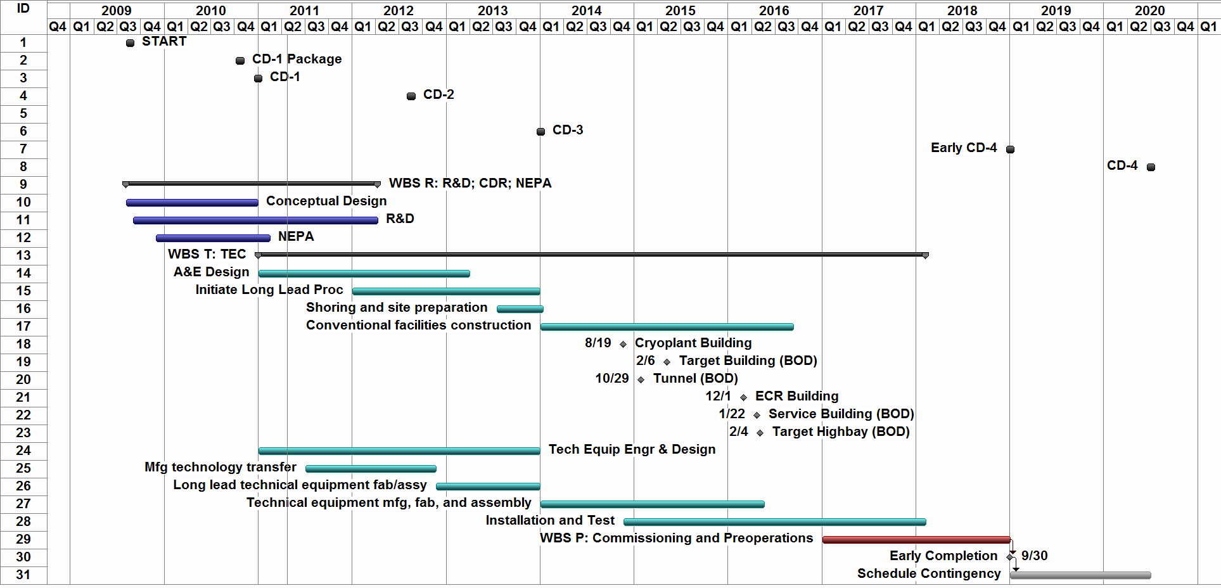
High Level Project Schedule
FY
FY
FY
FY
FY
FY
FY
FY
FY
FY
FY
FY
GOVERNMENT FISCAL YEAR
TPC covers schedule range
CD-3a
Arrows indicate targets for early construction with preliminary planning dates
Manage to early completion in 2018
10/29
10/02
2/28
2/3
2/3
8/1
Rev. 1/24/2011

Slide 6
Facility Layout
uranium values given

Slide 7
Driver Linac

Slide 8
Controls Architecture
High-level control
High-level apps
UI
Message logging
MPS and timing
Alarm
Data Archive
E-log
Global DB
Global Controls
Diagnostics
Device Controls (mag, RF, cryo…)
ESD
Low-level control

Slide 9
Top-level Requirements
Consistent look and feel among user interfaces
35 μs machine protection mitigation
Global timing system
Remote/manual control of devices/detectors
Model-based control
Integrated control room toolkit (e.g. snapshot/restore, alarm handler)
High availability as user facility
Notes:
Must scale support 40k physical I/O connections and 300k process variables.
Fast BLM digitized at 100 kHz, i.e. up to 10 μs of detecting time and 40 μs of response time for MPS.
Diagnostics data taken at 10 Hz rate.

Slide 10
Controls Highlights [1]
Global database
User interface
High-level applications
Central message logging
E-log
IRMIS based e-log
Machine Protection System (MPS)
Global Timing System (GTS)
Low-level Control

Slide 11
Controls Highlights [2]
Personal Protection System
Document traveler system
Software Configuration Management system
Source repository
Deployment system
Bug report/track
Online document/help
Software development and test system

Slide 12
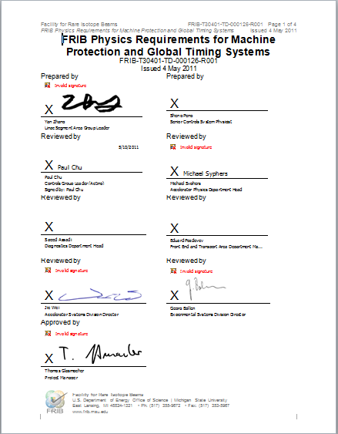
Global Timing System
GTS status
Internal review held on 4/6/2011
There will be one clock system (RF) and one timing system (triggers, real time data, and recovered clock when needed)
Timing requirement has to meet Diagnostics needs
Physics requirements defined

Slide 13
Machine Protection System
MPS status
Internal review held on 4/6/2011
Physics requirements defined
MPS requirements
Total MPS time budget = 35 μs
15 μs for BLM detection and decision making
10 μs for MPS system reaction
10 μs for mitigation in place
The interface between MPS and other subsystems is binary interface
Diagnostics will generate binary OK/NOK signal with its internal knowledge
MPS (Run Permit System and Fast Protection System) works closely with GTS to manage machine mode and beam mode

Slide 14
Action Items from MPS Review
MPS and Timing detailed schedule including prototype (prior to procurement), field test etc. due by June review
Physics studies
Fault study: If single cavity trips, what MPS reaction should be taken?
Requirements from ESD (target) system for run permit system such as re-start scenarios
Timing system requirements – resolution and jitter
Physics requirements
Surface damage calculation
PRD due Apr. 30.
Inform other CAMs that BOEs must include MPS interface
Establish beam measurement requirements that define timing system needs; resolve multiple timing systems

Slide 15
Low Level Controls Topology
Low Level Controls
Courtesy K. Davidson, J. Priller
Sensors
Instruments
Machine Protection System Interlocks
PLC Controllers
Devices
High Level Controls & Processes
EPICS
Soft IOC’s
Support Servers
> 200K
~ 50K
Hierarchical PV’s
Level 1 PV’s

Slide 16
Network Topology
Outside World
FRIB Facility
High Level Controls
Low Level Controls
Maintenance PCs
Firewall
Control
PCs
Firewall
Office
PCs
Firewall
Support
Servers
IOCs
PLCs
Servers
Servers
Devices
Courtesy K. Davidson, J. Priller

Slide 17
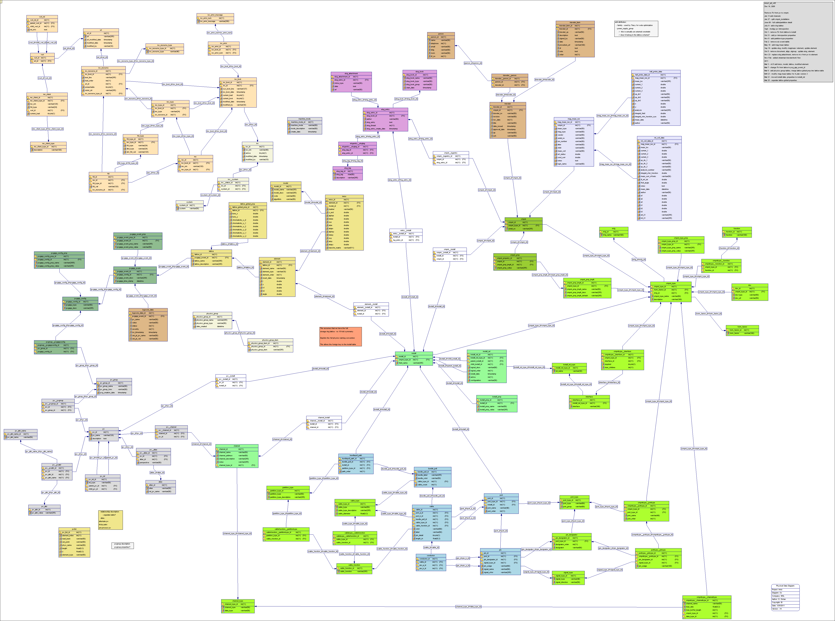
Global Database
SNS vs. IRMIS based approach
In favor of IRMIS
Up to date technology
Better community support
Fit our needs
IRMIS
Device/Element tables modified from SNS schema
API based access, no need direct SQL query
Database access via service
Collaborate with BNL
IRMIS 3 Schema

Slide 18
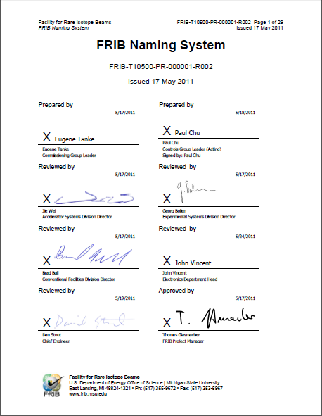
Naming Convention
FRIB Naming Convention documented
FRIB and ReA should follow the naming rules
Signal name rules defined
Cable naming not defined yet
Naming will be enforced in DB

Slide 19
Database Related Development
An IRMIS based e-log system prototyped
Requirements collected
E-log work planned
Electronic Document Traveler System
Work flow control program
SRF, Magnet and QA teams need this system
Requirements collected
Evaluating technologies and implement strategy

Slide 20
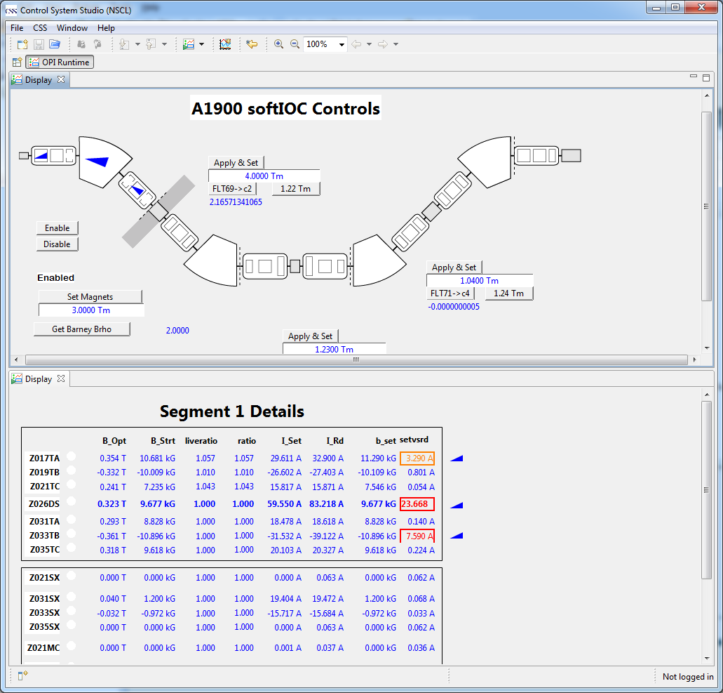
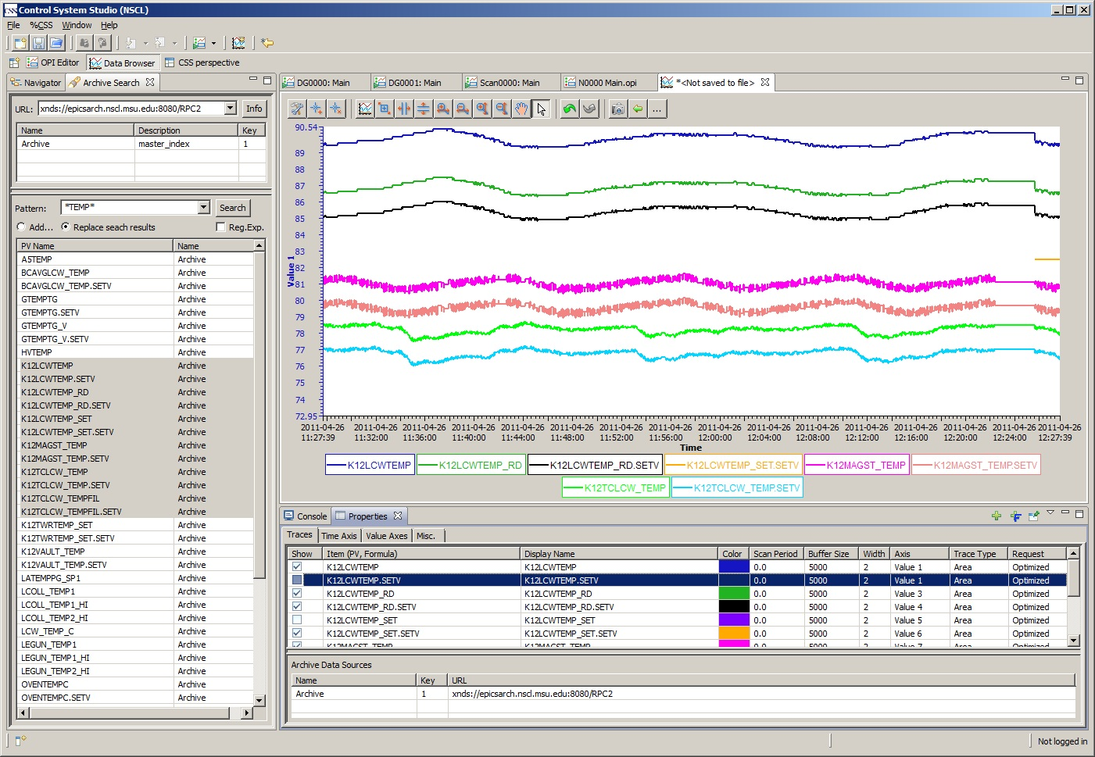
User Interface
Eclipse base CSS is the choice for display manager
In-house expertise and full support from CSS colleagues around the world
CSS/BOY
CSS/Data Browser

Slide 21
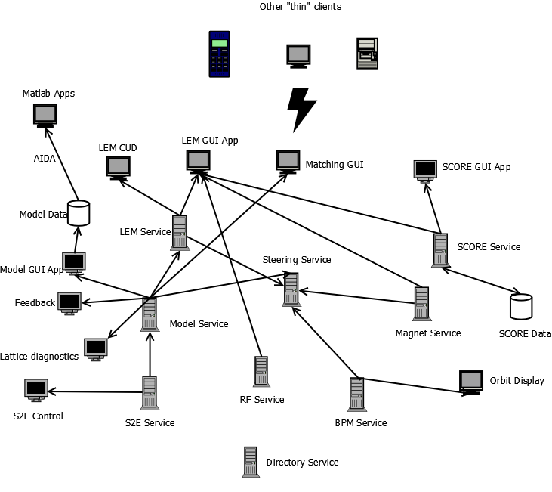
High-Level Applications (HLA)
Global and local coordinate systems for physics model
XAL based data structure
Data integration in DB
Online model support
Better FRIB online model needed
Work with Accelerator Physics for specs and detail plan
Software for commissioning and operation
Service-oriented architecture (SOA)
SOA example for HLA

Slide 22
Summary
MPS and GTS PED in progress
Low-Level Control PED in progress
Database work started
E-log prototyped
E-traveler
High-level application and Online Model work planned

