Slide 1
areaDetector Developments
Ulrik Pedersen, Jon Thompson, Tom Cobb and Nick Rees

Slide 2
Introduction
History
Driver developments
PCO cameras.
Medipix 3 camera.
Plugin developments
HDF5 NDFilePlugin
NDFilePlugin modifications
adOpenCV

Slide 3
History
Originally, all Diamond area detector data was to be handled by our upper level acquisition software (GDA).
However, speed wasn’t great (Java) and there was no consistent framework.
Consequently, GDA team selected EPICS area detector as their detector framework.
Now the EPICS team has taken this over and most of our new development is creating areaDetector plugins.
Big advantage is that it has three data streams:
Compressed video via ffmpeg for interactive visualisation
Uncompressed frame data via CA for on-the-fly analysis
High speed data streaming to disk

Slide 4
Driver developments

Slide 5
PCO Camera’s
PCO make a large range of Science Grade CCD and CMOS detectors.
Diamond has
PCO1600: 1.6k x 1.2k x 14 bit CCD.
PCO4000: 4k x 2.6k x 14 bit CCD with 4 Gbyte frame memory
PCO dimax: 2k x 2k x 12 bit x 1300 fps CMOS with 36 Gbyte frame memory.
All come with a Windows API and Silicon Software CameraLink frame grabber cards.
Driver development at SLAC and APS as well as at Diamond.
Have Windows drivers for all cameras now, but still adding features.
Plan to use Silicon Software Linux drivers to create Linux areaDetector driver, so we can get better write performance.
There aren’t any high speed clustered Windows file systems.

Slide 6
Excalibur
Excalibur is an internal Diamond/STFC development of the high speed direct detection Medipix 3 system.
Sensor array is 8x6 Medipix 3 devices, each 256x256 pixels, for a total frame size of 2048x1536 twelve bit pixels.
Medipix 3 has advantages over Pilatus since it has smaller pixels and pixel voting logic, which eliminates non-linearity's near pixel boundaries.
Diamond has some other developments based on the same detector.

Slide 7
Excalibur Hardware
10 GigE Network
Each row of 8 devices (a stripe) is read out by separate Front End Modules (FEMs) into a Linux readout node over a 10G bit Ethernet link.
The readout nodes stream the stripes independently to a Lustre file server in HDF5 format over the external 10 GigE network.
At the maximum data rate of 100 frames per second, each stripe generates 840Mbps, a total rate of just over 5Gbps to the fileserver.
A master node provides synchronization, real time (low rate) summary image, global configuration, etc..

Slide 8
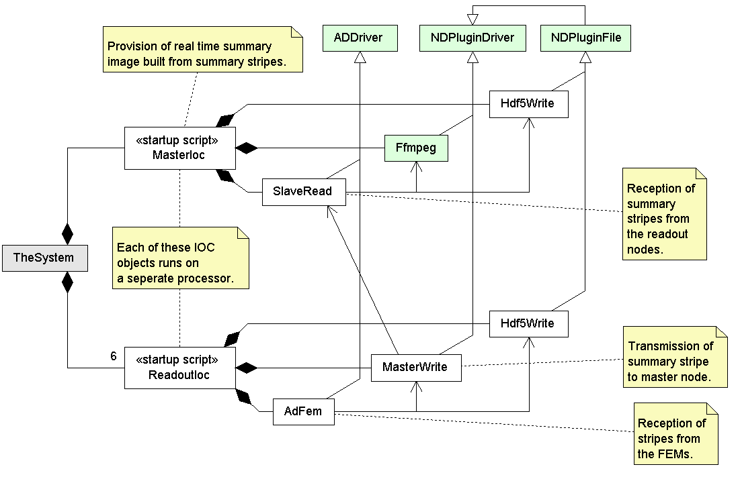
Excalibur Software
New plugins required for Front End Module (Fem) readout, Master/Slave communications and HDF5 file writer.
Many existing area detector processing plugins (statistics, region of interest, etc) are not shown.

Slide 9
Plugin developments

Slide 10
HDF5 file format and libraries
HDF5 file format and libraries supported by the HDF group www.hdfgroup.org/HDF5
Open source and distributed at no cost
Unix and Windows platforms supported
Designed for NASA to store large datasets
Self describing binary file format
Hierarchical data structures can be browsed like a directory tree
Multi dimensional imaging data
Instrumentation metadata can be stored as simple or complex data types
Long term support for accessing archived data
Parallel file IO access on supported storage systems including Lustre
Requires MPI and MPI I/O e.g. Open-MPI
Multi node streaming to disk
Fast processing using HPC cluster systems
Access selected sections of datasets across dimensions in “hyperslabs”
Efficient disk IO when post processing across multiple frames like tomography reconstruction
Several language bindings to the C libraries
C++, fortran and Java bindings provided by the HDF group
Python, Matlab, IDL and several others...

Slide 11
HDF5 and Nexus
Nexus is:
A definition of keywords and data structures implemented as an HDF5 file.
An API which creates Nexus files using the HDF5 library, but not giving access to advanced HDF5 features.
So a Nexus file is an HDF5 file, but an HDF5 file is not necessarily a Nexus file.
However, if you need access to advanced HDF5 features, you can still write a Nexus file if you abide by the Nexus definitions.
One driver is to provide increased performance
Want to be able to write at 1 Gbyte/sec on a PC with a 10 GigE interface.

Slide 12
AreaDetector HDF5 plug-in
NDFileHDF5 inherits the areaDetector NDFilePlugin class
Operated like other AD file plug-ins so client interface is common
Works on Linux and Windows
File hierarchy is formatted in a Nexus compatible way
Allow files to be opened directly in Nexus readers like GDA
User can select disk IO “chunk” size by number of rows to optimise for disk IO speed or post processing performance depending on application
Lustre file system perform best with 1MB chunk sizes
Tomography reconstruction is simple with chunks of 1 row per frame
Works with HDF5 supported compression libraries
Lossless SZIP provided as a separate library from the HDF group
Lossless Z compression
Bit packing for cases where there are only few valid data bits per word
Continuing development
Parallel write plug-in for Excalibur project where 6 parallel nodes will write image stripes into a single HDF5 file
AreaDetector HDF5 file reader to use areaDetector plug-ins for post processing
Test framework to check disk system performance in different configurations

Slide 13
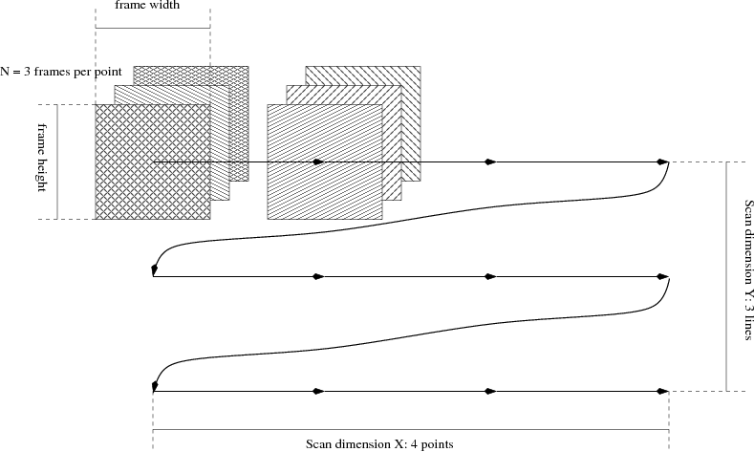
X-Y scanning
Can have two additional “virtual” dimensions for X-Y scanning:

Slide 14
NDFilePlugin
Problem:
Filename defined in NDFilePlugin over-rode filename specified in the detector driver plugin.
If file writing got behind and the control software changed the file name pattern, buffered old data got written with the new name pattern.
Solution:
NDFilePlugin now can run in a mode where the filename is obtained from the NDArray parameters.
Name is set at the time the data is taken, not when it is written.

Slide 15
adOpenCV Plugin
Experimental plugin based on Open Source Computer Vision (OpenCV) library
OpenCV is a C/C++ library originally developed by Intel and now supported by Willow Garage. http://opencv.willowgarage.com/wiki/Welcome
Mainly aimed at real time computer vision.
Free for use under the open source BSD license.
Plugin can be used for:
Sample detection and alignment.
Collision detection.
Generic filtering of images
Contains base classes to convert between the areaDetector and OpenCV data structures
Need to ensure that image recognition is relatively simple, so manage lighting and contrast levels.

Slide 16
Summary
areaDetector has major benefits for beamlines.
However, with this flexibility comes increasing demands for more features and greater driver support.
Diamond is now spending more on areaDetector development than any other beamline work.

