Slide 1
EtherCAT Driver for Remote I/O
James Rowland, Ronaldo Mercado and Nick Rees

Slide 2
Original Diamond EPICS systems
Display Manager
Alarm Handler
EPICS Archiver
GDA Server
Ethernet
EPICS IOC Server VxWorks/VME
VME Bus
Hytec IP modules
Hytec IP module
PMAC VME
Firewire PMC
Analogue & Digital I/O
RS232 & RS485
Motors
Cameras

Slide 3
Future Diamond EPICS systems
Display Manager
Alarm Handler
EPICS Archiver
GDA Server
Ethernet
EPICS IOC Server x86/Linux
Ethernet
Rem. I/O Modules
Terminal Servers
PMAC GeoBrick
GigE Protocol
Analogue & Digital I/O
RS232 & RS485
Motors
Cameras

Slide 4
Drivers for using a field bus
Cabling saving
  Can use existing Cat6 cables
Flexibility
  Extra I/O doesn’t require cabling through the shield walls.
Modularity
  Everything not concentrated in a single VME IOC
I/O can be located close to the equipment
Can use commodity hardware for the PC.
Can manage commodity CPU hardware obsolescence problem by separating I/O from CPU.
However:
  Need good performance if VME is to be replaced

Slide 5
EtherCAT
Relatively open PLC fieldbus from Beckhoff
Open source Linux drivers exist
No special hardware required for Fieldbus master
High performance (if controller O/S supports it)
  256 digital I/O in 11 μs
  1000 digital I/O distributed to 100 nodes in 30 μs
  200 analog I/O (16 bit) in 50 μs, 20 kHz Sampling Rate
  100 Servo-Axis (each 8 Byte IN+OUT) in 100 μs
  12000 digital I/O in 350 μs
System wide synchronisation to << 1 μs

Slide 6
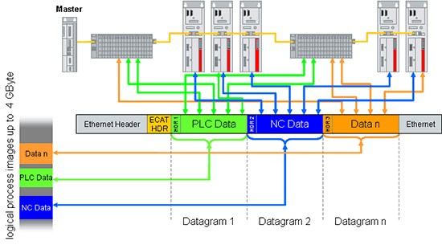
Data multiplexed on Ethernet frame

Slide 7
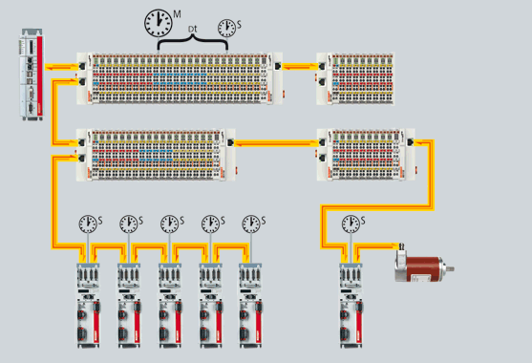
Synchronisation
Each EtherCAT network is actually a linear segment.
Last device reflects the packet back to the master.
Each device has a timer and measures the time between the outgoing and returning packet and so works out its time relative to other modules.

Slide 8
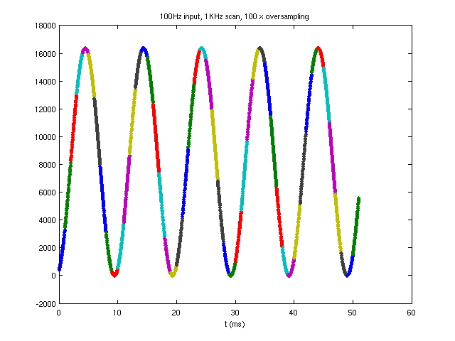
“Oversampling” Modules
Device sends N samples per bus cycle
Clock PLL synchronizes acquisition with master and other devices

Slide 9
EPICS software components
Linux Host
Device Type XML
+
Scanner
=
IOCs
Device List XML
EtherCAT Master
Ethernet MAC

Slide 10
Linux host software
Use Linux PREEMPT_RT kernel
  RHEL5 MRG 2.6.24 SRPM
  10 μs mean, outlier of 40 μs maximum latency
  Uses Posix calls: clock_nanosleep, mlockall, SCHED_FIFO, PRIO_INHERIT
  Mainline Kernel absorbing patches
We feel it is the best real-time kernel because
  It is closest to the mainline kernel.
  It can be used by a non-privileged user in userspace.

Slide 11
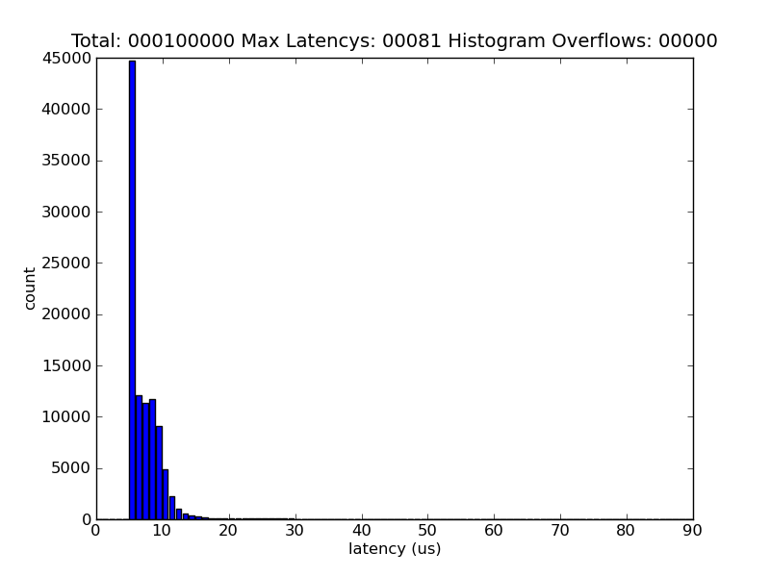
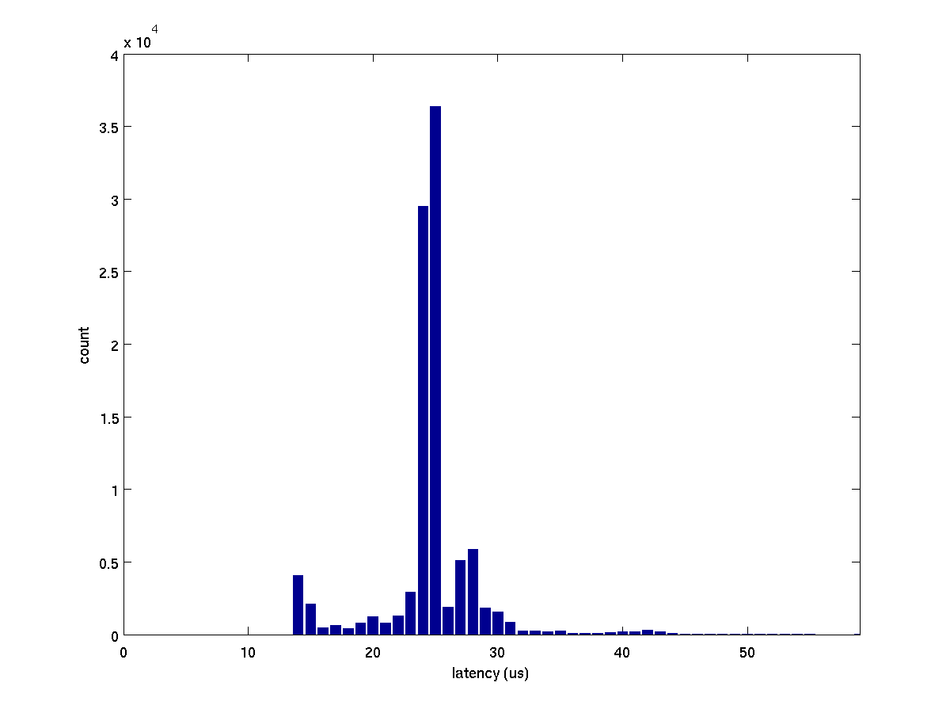
PREEMPT_RT performance
Timer latency
EtherCAT scan time

Slide 12
EtherCAT Master
EtherCAT master from http://www.etherlab.org
Kernel Driver with near identical user and kernel space APIs
(L)GPL license.
Has PF_PACKET generic network driver
  some network drivers also supported explicitly.
FMMU setup and slave state machine control
Create your own bus scan timer and configuration files
Uses dynamic kernel module support (DKMS) RPM
All our development done entirely in user space with generic network driver.

Slide 13
Scanner
1KHz cyclic task
  Cycle time can be varied.
Pre-threaded UNIX socket server
Reads configuration XML
Merges writes from multiple source into a single EtherCAT transmission.
Distributes reads from a EtherCAT response to all who are interested.

Slide 14
Device Type XML
Device type XML is a standard format provided by the vendor. It can be:
  Downloaded from the vendor and stored in a library or
  Queried directly from the device.
Contains lots of information, but the important values for an example analog input (EL3201) are:
Direction | Register | Bits | Index | Subindex
TX | Underrange | 1 | 0x6000 | 0x01
TX | Overrange | 1 | 0x6000 | 0x02
TX | Limit 1 | 2 | 0x6000 | 0x03
TX | Limit 2 | 2 | 0x6000 | 0x05
TX | Error | 1 | 0x6000 | 0x07
TX | State | 1 | 0x6000 | 0x0F
TX | Value | 16 | 0x6000 | 0x11

Slide 15
Device List XML
Custom XML definition specific to our scanner
Contains each device on the bus with:
  Device type name
  Bus position
  Device name – also used as the name of the Asyn port.
  Oversampling rate
<chain>
<device type_name="EK1101" revision="0x00110000" position="0" name="COUPLER" />
<device type_name="EL3702" revision="0x00020000" position="1" name=“VACUUM" oversample="11" />
<device type_name="EL3201" revision="0x00100000" position="2" name=“TEMP" />
</chain>
Type | Position | Name | Oversample
EK1101 | 0 | COUPLER
EL3702 | 1 | VACUUM | 11
EL3201 | 2 | TEMP

Slide 16
IOC’s
Intention is that an IOC can be a functional control unit that is independent of other IOCs using the same EtherCAT network.
  Each Linux system can have multiple scanners (typically 1 per Ethernet interface)
  Each scanner can communicate with multiple IOCs.
  Scanner can be restarted independently of its IOCs.
  IOCs can be restarted independently of their scanner.
IOC’s communicate with their scanner through an asyn driver.

Slide 17
EtherCAT asyn driver
Based on asynPortDevice
Asyn port names ports from Device List XML
Different registers created as asyn parameters, named as they are in the Device Type XML.
Special “MASTER” port for bus status
Pluggable waveform support for ADCs
Templates generated from Vendor XML
Need I/O Intr alarm support in ASYN to signal bus problems.

Slide 18
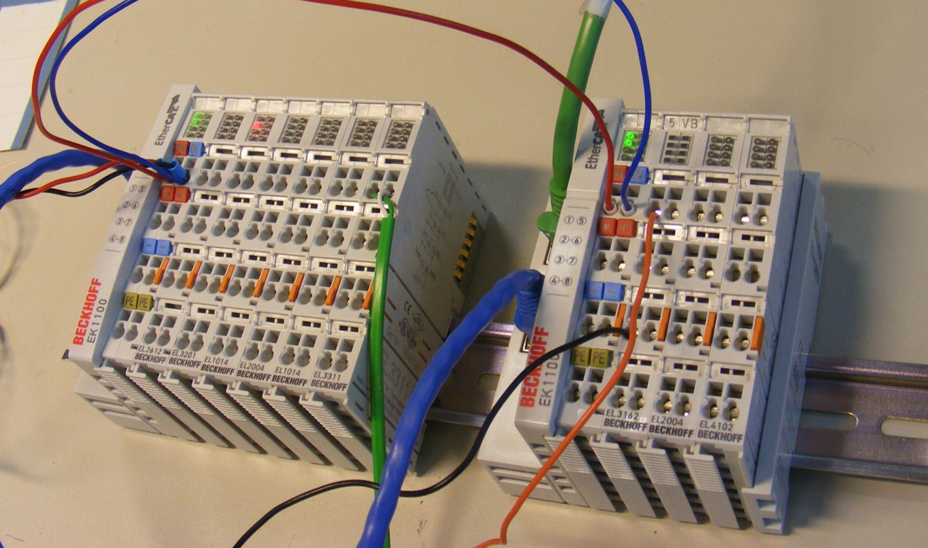
Some Devices
Name | Type
EL3202 | 2 channel 4-wire PT100 with calibration tables
EL3702 | 2 channel oversampling ADC up to 100KHz
EL1014 | 4 channel digital input, 10us filter
EL3314 | 4 channel thermocouple

Slide 19
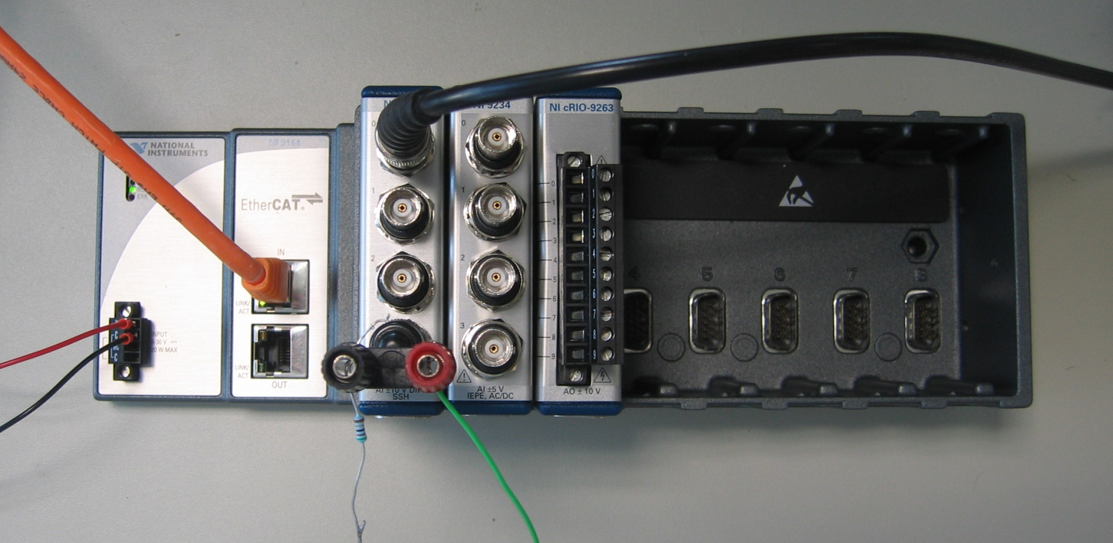
Other Devices
National Instruments has a 8-slot Compact Rio EtherCAT chassis.
Gives access to robust, science grade modules.
Has embedded FPGA that can potentially be used.

Slide 20
Conclusions
EtherCAT is a powerful control fieldbus protocol well suited to EPICS I/O.
The protocol and software is open and vendor independent (but heavily promoted by Beckhoff).
Limitation compared to VME I/O are:
  Large data arrays (use some other Ethernet protocol)
  Latency in loops < 1 ms. Workarounds are:
    Can increase scanner loop cycle time
    Could use National Instruments FPGA.
We now have reasonably solid EPICS support.
A good alternative to VME I/O in many areas.

