Slide 1
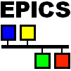
Connecting EPICS with Easily Reconfigurable I/O Hardware
EPICS Collaboration Meeting
Fall 2011
Notes:
This presentation covers recent developments aimed at facilitating the integration of Reconfigurable I/O (FPGA-based) hardware with EPICS. The Linux driver available for National Instruments Reconfigurable I/O (NI-RIO) hardware provides the interface between the FPGA firmware and the host controller. The FPGA programming of these devices is accomplished using LabVIEW and can include custom VHDL code if needed. Support is currently available for basic record types, including waveform, and we will discuss briefly the implementation details as well as future possible improvements.

Slide 2
EPICS and FPGA-based Devices
LabVIEW FPGA strategy is to empower domain experts to leverage FPGA technology
  No VHDL / Digital Design training
For VHDL experts
  CLIP / IP Integration nodes to integrate IP (minimal LV FPGA required during development)
EPICS device driver support implemented in C
Generic FPGA interface, to be customized based on the application and specific hardware module

Slide 3
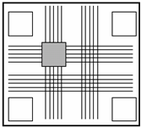
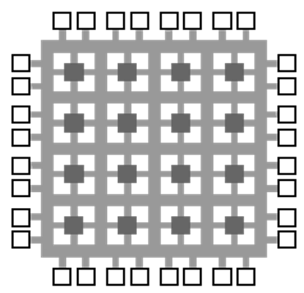
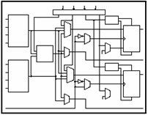
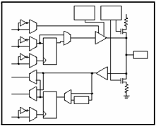
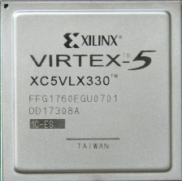
FPGA Technology
Programmable
Interconnects
Logic
Blocks
I/O Blocks
Notes:
FIELD PROGRAMMABLE GATE ARRAY
Logic Blocks are programmed to perform digital logic functions, AND, OR, NAND, XOR, etc
-programmable interconnects – programmable switching matrix
Can also connect to i/o blocks – pins on chips
Combination is a custom circuit / programmable breadboard

Slide 4
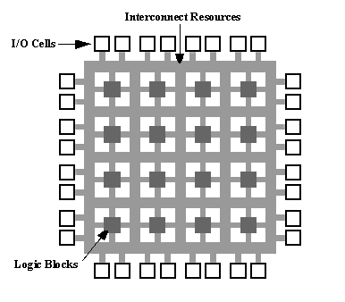
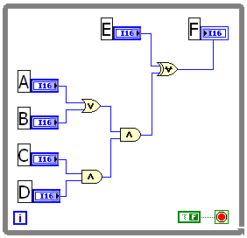
FPGA Logic Implementation
Implementing Logic on FPGA: F = {(A+B)CD} ⊕ E
LabVIEW FPGA Code
E
F
AB
CD
Notes:
-When we compile our LV code…
-logic blocks are configured to implement the digital logic functions
-and the interconnects <click> are configured to wire each logic block together.
- Your LV code actually becomes a circuit on the FPGA. You have done the job of a digital designer!

Slide 5
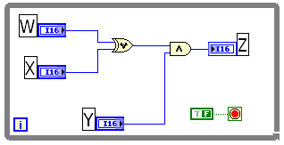
True Parallelism
E
F
AB
CD
Z
W X
Y
Notes:
To show the benefit of parellism, lets go back to our previous example and add a parallel loop
When we add a parallel path that implements a different set of logic, it runs completely independent of other logic
This is where LV becomes well suited for FPGAs b/c it can naturally represent parallelism
With text-based languages that execute sequentely, it is extremely difficult to implement code that runs things in parallel

Slide 6
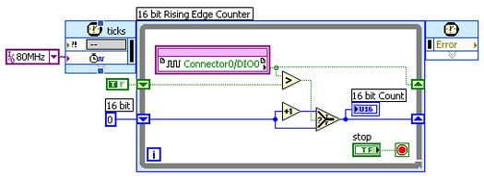
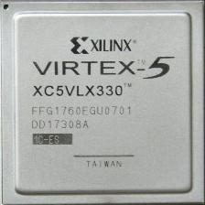
LabVIEW FPGA Module
FPGA
LabVIEW code is translated to hardware circuitry implemented on the FPGA
Natural representation of FPGA logic
Custom VHDL code can be included
Notes:
To program FPGAs with LabVIEW we use the LabVIEW FPGA module
The LabVIEW FPGA Module converts your block diagram to hardware circuitry implemented on the FPGA
LabVIEW is well suited for FPGA programming because the graphical representation of code naturally reflects the actual implementation of circuitry on the FPGA

Slide 7
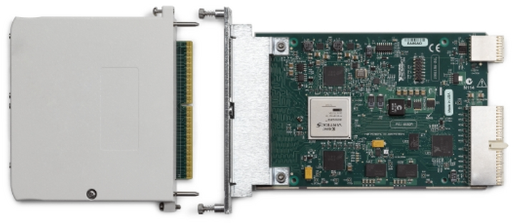
Hardware Example: FlexRIO
FlexRIO Adapter Module
Interchangeable I/O
Customizable by users
Adapter Module Development Kit
FlexRIO FPGA Module
Virtex-5 FPGA (LX and SX)
132 single-ended I/O lines
Up to 512 MB of DDR2 DRAM
Notes:
7

Slide 8
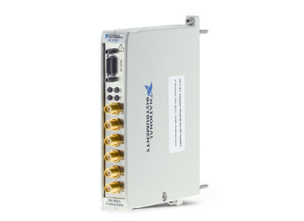
Option 1: NI Developed Adapter Modules
Complete Integration with LabVIEW FPGA and NI-RIO
No HDL experience required
Variety of analog and digital modules
  16 channels, 14-bit, 50 MS/s
  4 channels, 14-bit, 250 MS/s
  2 channels, 16-bit, 250 MS/s
Notes:
8

Slide 9
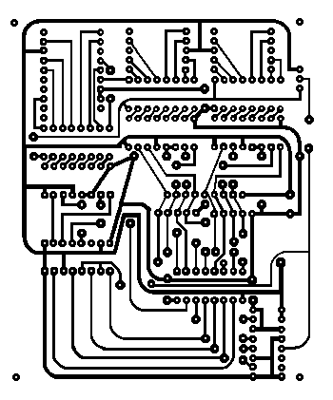

Option 2: Custom Module Development
Xilinx Virtex 5 FPGA
…
CLIP
CLIP
CLIP
Socketed CLIP
PXI Bus
Custom Front-End
LabVIEW FPGA VI
Socketed CLIP
Socketed CLIP
DRAM Memory
DRAM Memory
Notes:
9

Slide 10
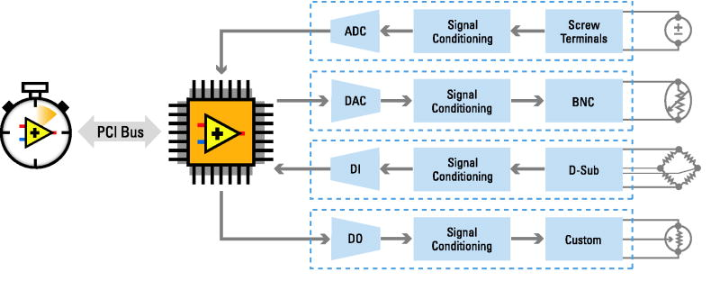

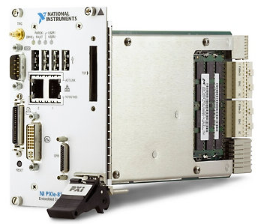
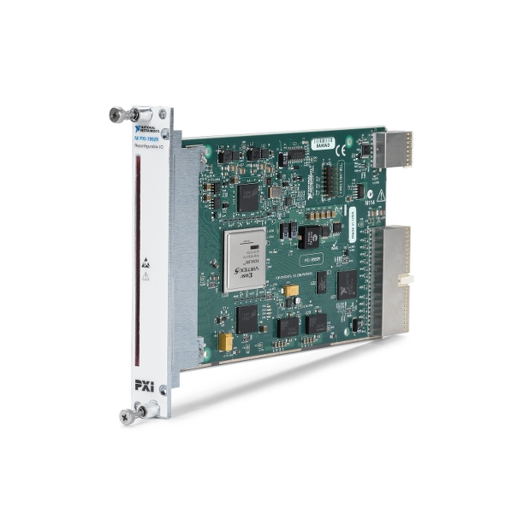
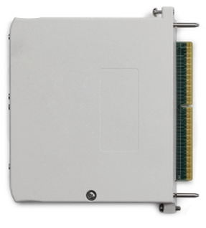
PXI RIO Architecture
Processor
FPGA
I/O Modules
NI
Custom

Slide 11

FPGA Interface C API and Linux
Use RIO devices from C/C++ applications running on Linux
Generate C header file from Windows development machine, then use C compiler of choice on Linux
Development System Requirements for LabVIEW FPGA:
  Windows XP (or later)
  NI-RIO 3.5.0 (or later)
  FPGA Interface C API 1.2 (or later)
  LabVIEW FPGA 2009 (or later)
Deployment System Requirements:
  32-bit Red Hat Enterprise Linux 5.x or 32-bit Scientific Linux 5.x
  NI-RIO 3.5.0 for Linux (or later)
Notes:
As of NIWeek, customers will be able to directly interface with LabVIEW FPGA applications running on devices like R Series or FlexRIO modules – from either Red Hat Enterprise Linux or Scientific Linux.
Note that we aren’t talking about programming the FPGA with C code here; customers still need to use LabVIEW FPGA to program their FPGA bitfiles. However, once those bitfiles have been created and are running on FPGA devices, C applications running on Linux communicate back and forth with them.
The FPGA Interface C API for Linux isn’t new; it can be used with Windows or LabVIEW Real-Time already. However, the NI-RIO 3.5.0 driver is now supported with Linux and it, combined with the FPGA Interface C API, enables customers to directly communicate with FPGA devices from C applications on Linux.

Slide 12

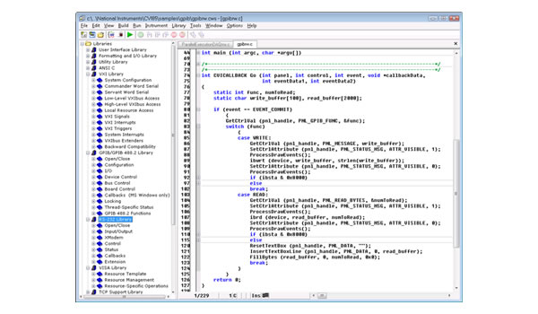
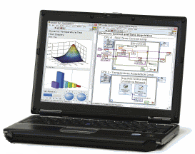
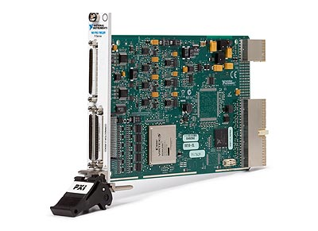
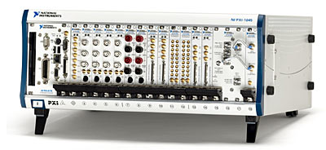
FPGA Interface C API on Linux
Generated
Header and Source Files
C API
LabVIEW FPGA Development
(Windows)
Linux Deployment
Linux Development
RIO Device
Develop LabVIEW FPGA VI, compile bitfile, and generate C API.
Develop and build C application with generated C API.
Deploy built application and bitfile to Linux target and run.
Notes:
Using the FPGA Interface C API requires a few steps that we will take a minute to walk through here.
First, you program an FPGA bitfile using the LabVIEW FPGA Module on a Windows PC. In most cases the bitfile is actually copied to the Linux system and then deployed to the FPGA at runtime, but this process isn’t shown here for simplicity. In addition, you generate a header file based on the FPGA application in LabVIEW.
Next, this header file must be loaded in the C host application (in whatever development environment you are using). Using the header file, you can write and read to and from FPGA controls and indicators from the host application.
Finally, after your C application has been compiled for Linux, the application can be run to start communicating with one or more FPGA devices. At the beginning of execution, the C application may download the FPGA bitfile that you generated in the first step.
Note: the Windows development PC must have NI-RIO 3.5.0 and the FPGA Interface C API 1.2 installed. The Linux system must have NI-RIO 3.5.0 for Linux installed.

Slide 13
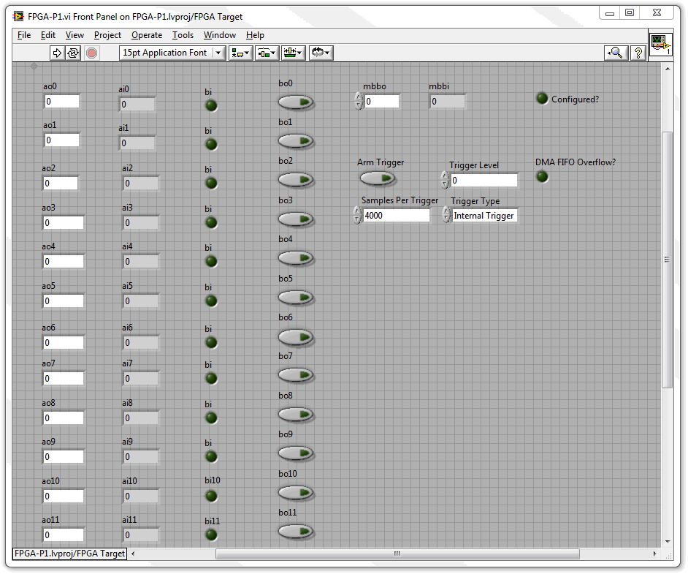
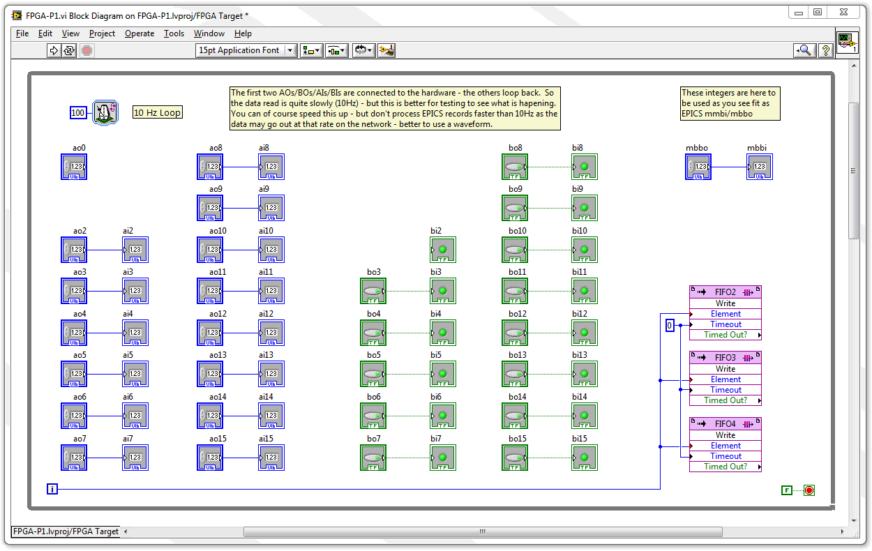
LabVIEW Interface
Communication between host program and FPGA code
  Via front panel controls
  Via DMA transfer (16 DMA channels in PXI Express)
Current template includes 16 analog inputs and outputs, 16 binary inputs and outputs, 1 mbbi, 1 mbbo, and
4 DMA FIFOs

Slide 14
LabVIEW Interface
Custom logic can easily be implemented to control data transfer via DMA (waveforms)
  Continuous acquisition
  Periodic “snapshots”
  External triggering
  Intelligent triggering

Slide 15
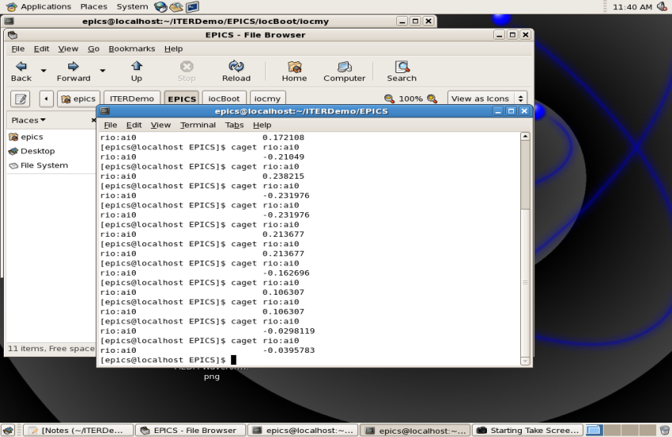
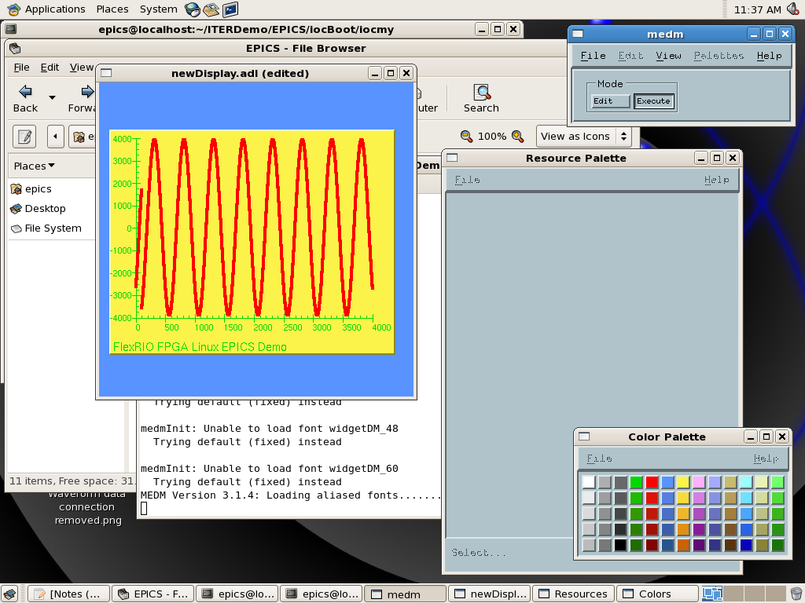
EPICS Interface
EPICS record types supported
  Binary in
  Binary out
  Analog in
  Analog out
  Waveforms
Linux 32bit RHEL 5.5
EPICS 3.14.11

Slide 16
Questions

