Slide 1

Using COTS Hardware with EPICS Through LabVIEW – A Status Report
EPICS Collaboration Meeting
Fall 2011
Notes:
Many commercial-off-the-shelf (COTS) hardware need custom driver development for use with EPICS. With LabVIEW having drivers for many of the COTS hardware, the research community has been implementing interfaces for EPICS and LabVIEW over the years. This presentation is a status report of the development work done by National Instruments and covers different methods of interfacing EPICS with LabVIEW. Both configuration-based and programmatic method of implementation will be covered. The different operating systems that the options cover along with advantages and limitation will also be discussed.

Slide 2


Presentation Scope
LabVIEW
I/O Server
EPICS CA
Client or Server
LabVIEW RT
on cRIO
Shared Memory
EPICS IOC
on VxWorks
LabVIEW RT
on PXI
Hypervisor
Shared Memory
EPICS IOC
on Linux
Linux on PXI
Device Support
Linux Driver
EPICS IOC
on Linux

Slide 3
Why Integrate EPICS and LabVIEW ?
LabVIEW as a Client
  Presentation
  Analysis
  Control
EPICS Client
EPICS Client
LabVIEW as a Server
  Interface to hardware
  Real-time control
  Access to FPGA
IOC
(I/O Controller)
IOC
(I/O Controller)
I/O HW
I/O HW

Slide 4
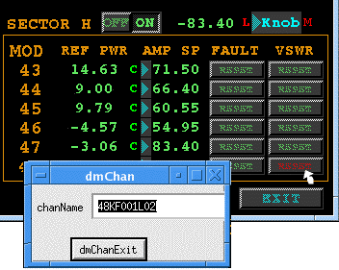

Concept
The EPICS CA Server and EPICS CA Client are implemented as plug-ins to the I/O Server
In both cases the interface in LabVIEW is implemented via the Shared Variable
The interface to EPICS is via Channel Access
Process Variables (PVs)
I/O Server
Shared Variables

Slide 5
LabVIEW EPICS CA Server

Slide 6
Architecture Comparison
Network Traffic (Channel Access protocol)
Channel Access
Protocol Server
Sequencer
(Finite State Machine)
LV EPICS Server
I/O Server
EPICS Database
LabVIEW Shared Variable Engine
Database
Engine
LabVIEW Application
Hardware
Hardware

Slide 7
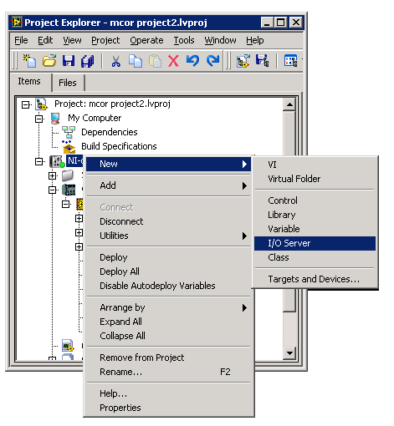
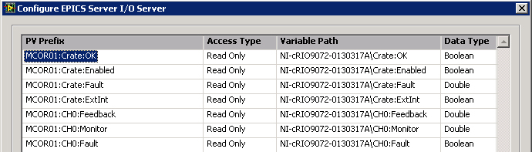
LabVIEW EPICS CA Server
Runs on LabVIEW for Windows and LabVIEW Real-Time
Implemented as an I/O Server
Interfaced via Shared Variable
Provides Channel Access functionality only

Slide 8
Implementation – CA Server
Start by creating the Shared Variables you want to publish on the EPICS network
Then create an EPICS CA Server I/O Server
Define the PV names and associate them with the Shared Variables
Read or write to the Shared Variables in LabVIEW to access the associated PVs

Slide 9
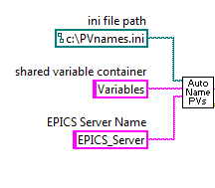
Programmatic Access to CA Server
Simple implementation is configuration-based
New feature since LabVIEW 2010 allows to programmatically:
  Create an EPICS CA Server
  Create the Process Variables
  Bind Process Variables to Shared Variables
Benefits
  Easily handles large number of PVs
  Greatly facilitates deployment

Slide 10
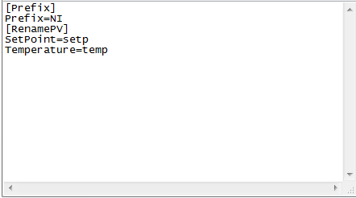
Possible Implementation
Create PVs programmatically and use an ini file to modify the names of the PVs
Each unique system can use the same application where the only difference is a text file

Slide 11
LabVIEW EPICS CA Client

Slide 12
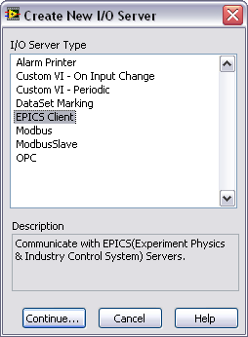
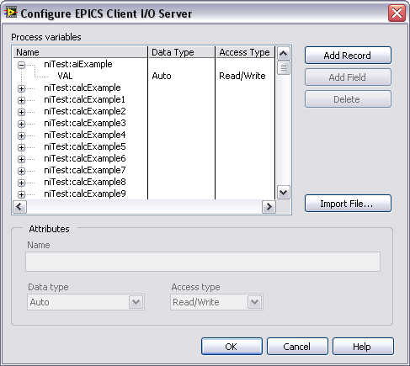
LabVIEW EPICS CA Client
Runs on LabVIEW for Windows and LabVIEW RT
Implemented as an I/O Server
Interfaced via Shared Variable

Slide 13
Implementation – CA Client
Create an EPICS CA Client I/O Server
Define the PVs you want to monitor, either manually or by importing a .db file
Create the associated Shared Variables and bind them to each PV
Read or write to the Shared Variables in LabVIEW to access the associated PVs

Slide 14
Programmatic Access to CA Client
New Feature in LabVIEW 2011
Allows user to programmatically
  Create an EPICS CA Client
  Connect to existing Process Variables
  Bind Process Variables to Shared Variables
Benefits
  Easily handle large numbers of variables
  Generic UI can dynamically connect to specific PVs

Slide 15
Available Fields
EPICS CA Server
  On Windows, when using alarming with LabVIEW DSC, the corresponding fields (HIHI, HHSV, SEVR, etc.) are supported
  On RT targets, the EPICS CA Server only allows you to set the VAL field
EPICS CA Client
  Any field can be accessed, but a Shared Variable will have to be created per field

Slide 16

Distribution
 | Windows | Real-Time OS | Linux
CA Server | LabVIEW DSC | LabVIEW RT | X
CA Client | LabVIEW DSC or Free download | LabVIEW RT | X
EPICS CA Server and CA Client available in LabVIEW 2011, via the DSC module for Windows and the RT module (PXI and cRIO)
EPICS CA Client is also available as a free download
No support for Linux

Slide 17
Questions

