Slide 1
ITER Tools
Franck Di Maio, Lana Abadie
CHD/CSD/CODAC
ITER Organization

Slide 2
Content
Configuration Tools (SDD)
Maven commands
N.I PXI/PXIe drivers
IOC extensions for tuning on Linux/multi-core
Dynamic symbols for BOY

Slide 3



The ITER Instrumentation & Control Architecture before Integration
Architecture

Slide 4
CODAC Core System
Definition & scope
Architecture
A software package for the development and test of the plant system I&C
Developed and issued by the CODAC, applying the PCDH standards
Based on EPICS
Complete software
Development tools and standard components
Standard components for integration
Notes:
As of today, what we call Core system, as the implementation of the CODAC core functions, consists in a software package that includes the PSH and mini-CODAC software as well as the environment for the development of the plant system I&C in a way that complies with the ITER requirements.
The CODAC section is developing it as incremental releases applying the PCDH standards.
For plant system I&C nodes, it includes the complete software for Mini-CODAC and PSH, development tools and standard components for fast controllers and standard components for PLCs.

Slide 5
Mini-CODAC
Architecture
A local system directly connected to the plant-system I&C. A Linux PC that can be a rack-mounted industrial PC or a desktop PC.
Implementing a reduced set of the CODAC services for the development and tests of the plant system I&C.
Human Machine Interface (HMI)
Alarms Handling (storage, display)
Data Archiving & Retrieval
Errors & Trace Logging
Automatic Sequencing / Supervision
Plant specific software
Tools to configure (SDD), build, test and deploy the software.
Local storage (local database, data files)
Notes:
5
As of today, what we call Core system, as the implementation of the CODAC core functions, consists in a software package that includes the PSH and mini-CODAC software as well as the environment for the development of the plant system I&C in a way that complies with the ITER requirements.
The CODAC section is developing it as incremental releases applying the PCDH standards.
For plant system I&C nodes, it includes the complete software for Mini-CODAC and PSH, development tools and standard components for fast controllers and standard components for PLCs.

Slide 6
Plant System Host
Architecture
A standard system supplied by the ITER Organization that is a part of the plant system I&C. Rack-mounted Linux industrial PC.
Implementing CODAC services and some plant system level supervision in a platform maintained by the CODAC group.
Plant System I&C monitoring
Slow controllers (PLC) gateway
Standard operation interface support
Automatic sequences & state machines
Notes:
6
As of today, what we call Core system, as the implementation of the CODAC core functions, consists in a software package that includes the PSH and mini-CODAC software as well as the environment for the development of the plant system I&C in a way that complies with the ITER requirements.
The CODAC section is developing it as incremental releases applying the PCDH standards.
For plant system I&C nodes, it includes the complete software for Mini-CODAC and PSH, development tools and standard components for fast controllers and standard components for PLCs.

Slide 7
Plant System Slow Controller (PLC)
Architecture
SIMATIC S7 PLC
Programmed with STEP-7 engineering software from a Windows PC with a network connection to the controller.
Exchanging data and commands with the Plant System Host through Ethernet.
Tools to build and deploy the interface with CODAC (data and commands)
The distribution also includes the standard software components that need to be used in PLCs
Notes:
7
As of today, what we call Core system, as the implementation of the CODAC core functions, consists in a software package that includes the PSH and mini-CODAC software as well as the environment for the development of the plant system I&C in a way that complies with the ITER requirements.
The CODAC section is developing it as incremental releases applying the PCDH standards.
For plant system I&C nodes, it includes the complete software for Mini-CODAC and PSH, development tools and standard components for fast controllers and standard components for PLCs.

Slide 8
Plant System Fast Controller
Architecture
One of the ITER supported hardware platform.
  Industrial PC controlling PXI/PXIe I/O.
With ITER software distribution (RH Linux, EPICS, …)
Framework for the control software (EPICS)
Software components to support the ITER standards: drivers, HPN interfaces…
Notes:
8
As of today, what we call Core system, as the implementation of the CODAC core functions, consists in a software package that includes the PSH and mini-CODAC software as well as the environment for the development of the plant system I&C in a way that complies with the ITER requirements.
The CODAC section is developing it as incremental releases applying the PCDH standards.
For plant system I&C nodes, it includes the complete software for Mini-CODAC and PSH, development tools and standard components for fast controllers and standard components for PLCs.

Slide 9
Content
Configuration Tools (SDD)
Maven commands
N.I PXI/PXIe drivers
IOC extensions for tuning on Linux/multi-core
Dynamic symbols for BOY

Slide 10
Self-Description Data (SDD)
DB centric configuration management
SDD
Four main components
The SDD editor to enter and update configuration data
The SDD translator to generate EPICS files, configuration files for the CODAC services (alarms, archiving) and Step-7 files.
The SDD web application to view configuration details and get PLC configuration files
The configuration model library, which allows storing/ retrieving data into/from a local database on Mini-CODAC.
SDD synchronization tools will be added to allow synchronizing the distributed Mini-CODAC databases with the central I&C database at IO.

Slide 11
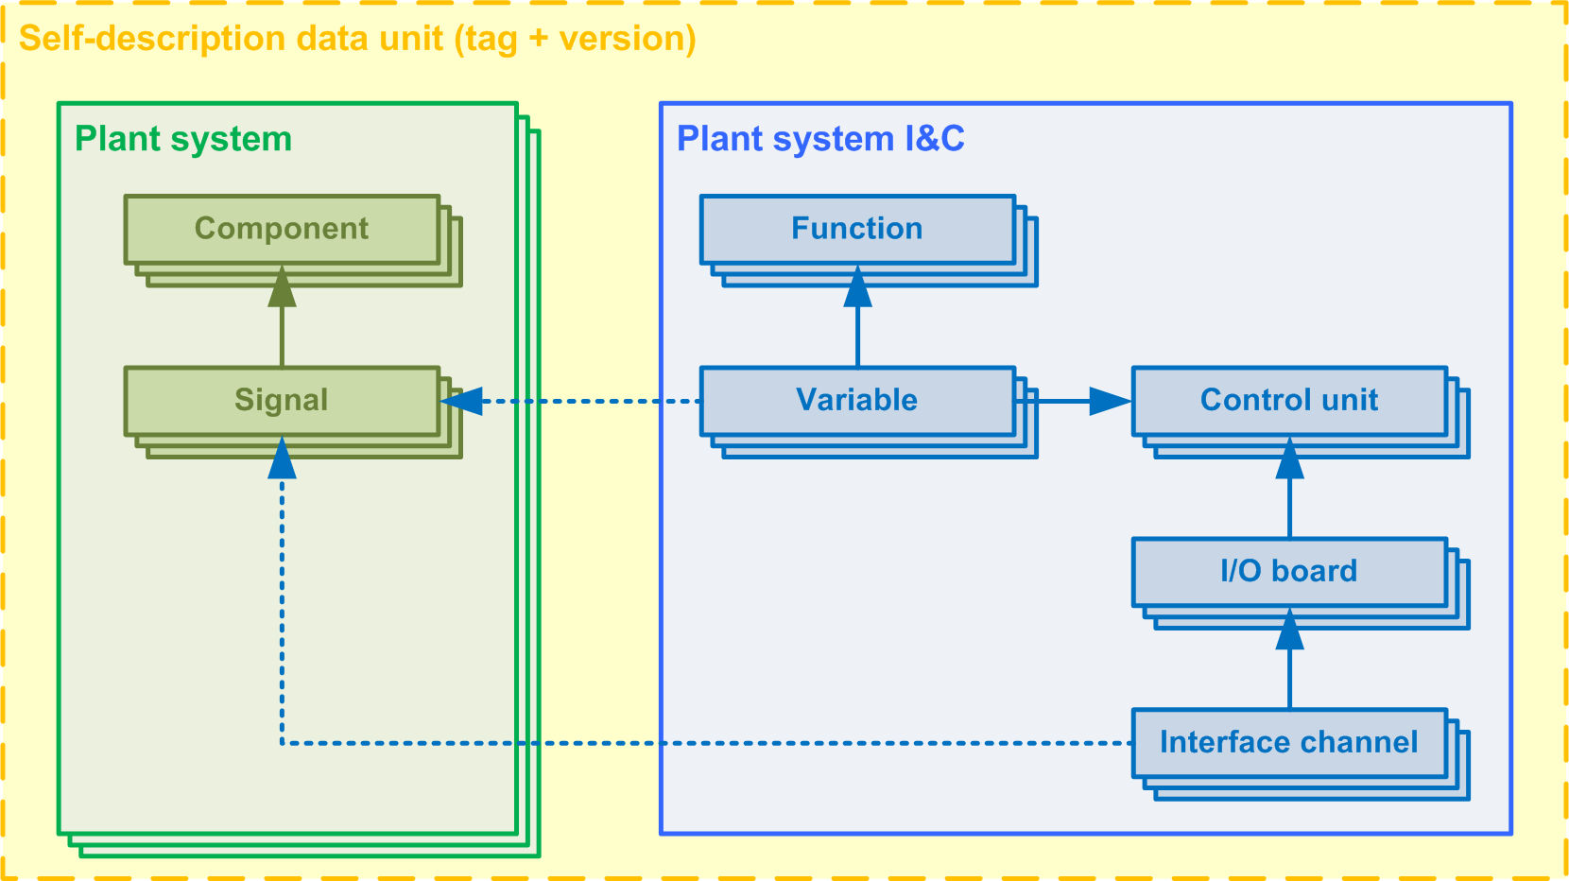
Self-description data model and terminology
A Plant System is composed of components that have signals
A plant System I&C implements a set of functions.
The plant system I&C interface is composed of variables and commands associated with the plant system I&C functions.
The control units are the PSH and the controllers of the plant system I&C.
Variables and commands are deployed on control units.
Control units (controllers, actually) can have I/O boards to which signals are connected via I/O interface channels

Slide 12
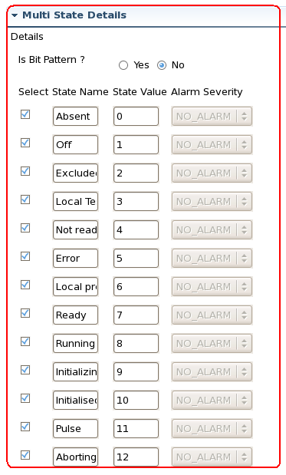
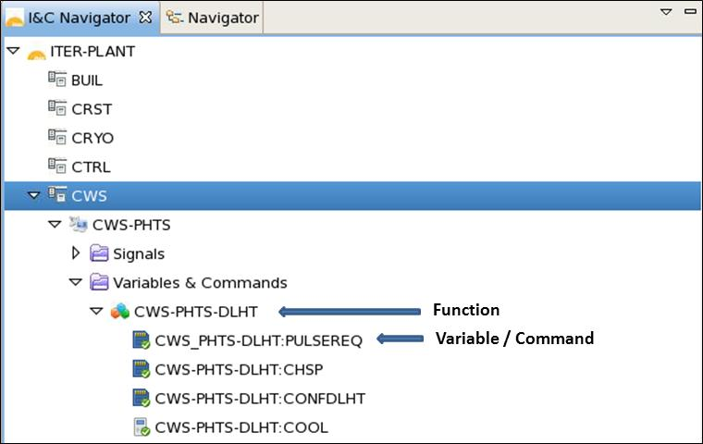
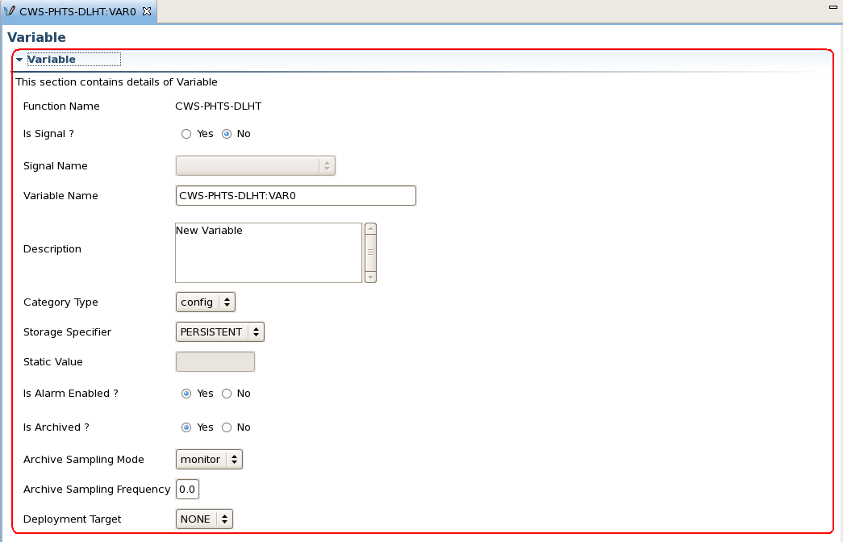
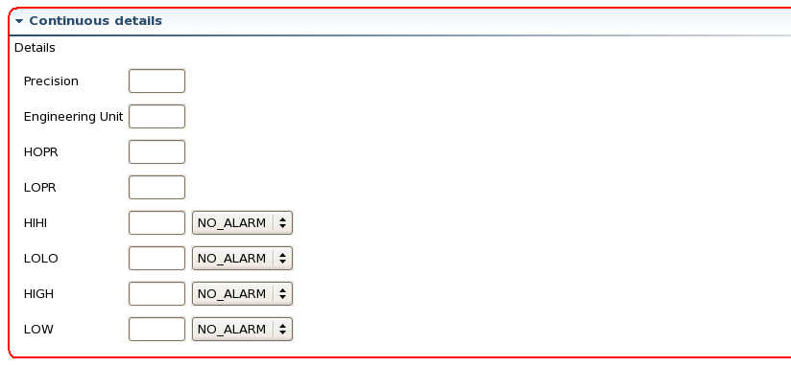
Create/Edit Variables with the SDD Editor
SDD

Slide 13
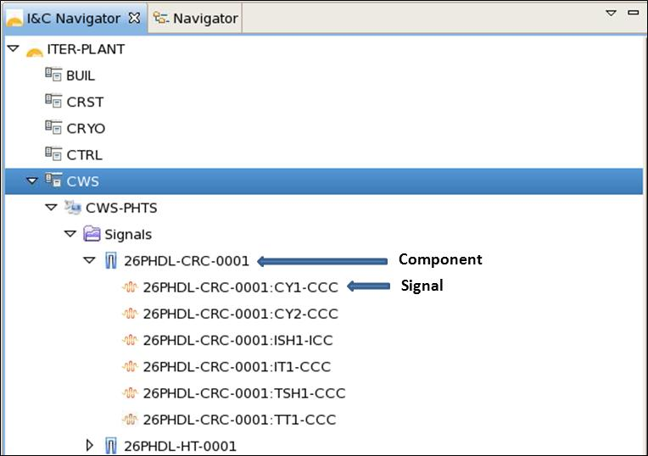
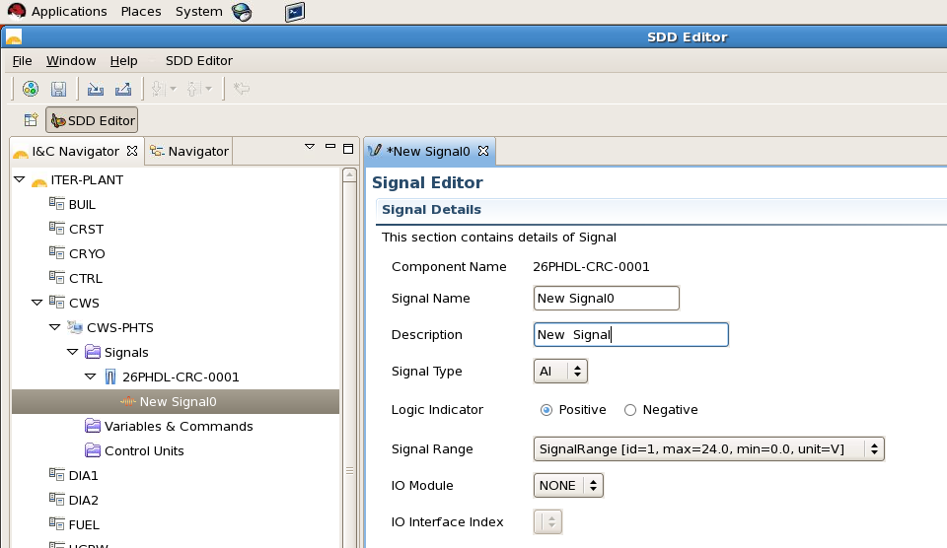
Edit Signals
SDD

Slide 14
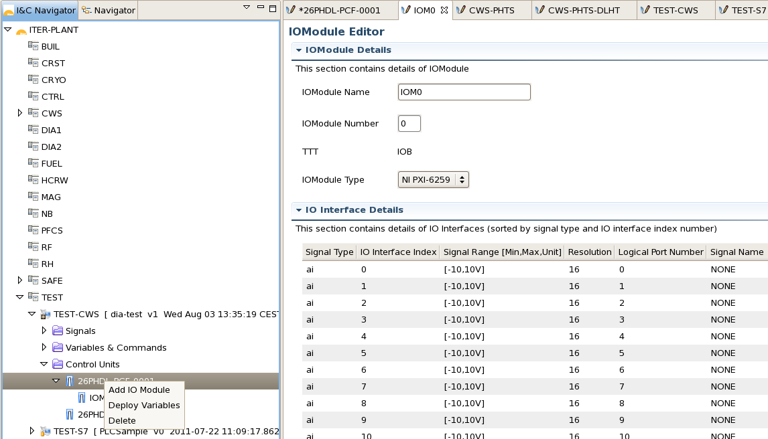
Add IO Module
(generates device support parameters)
SDD
IO Module: cards to which hw signals are connected

Slide 15
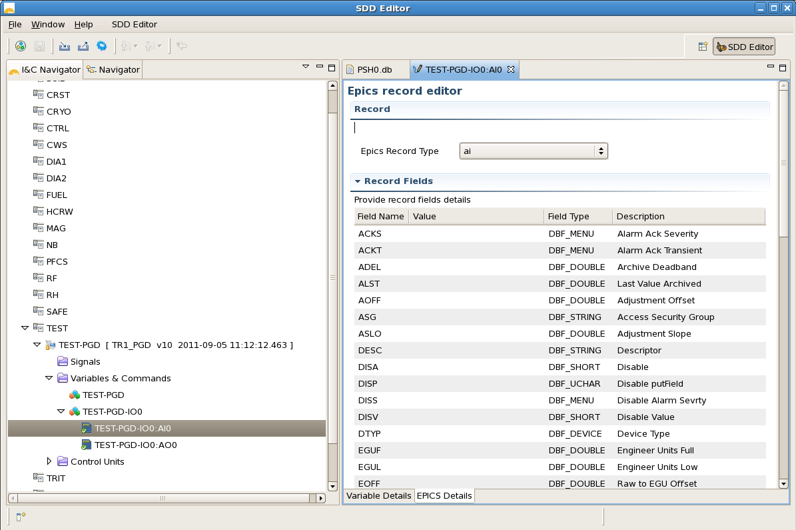
Edit Record fields
SDD

Slide 16
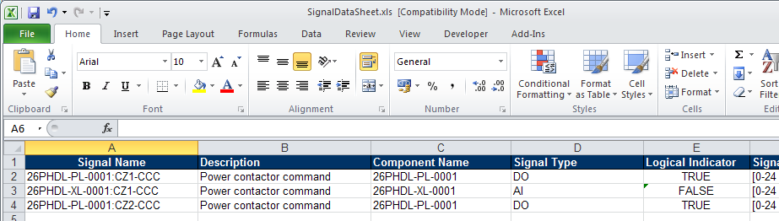
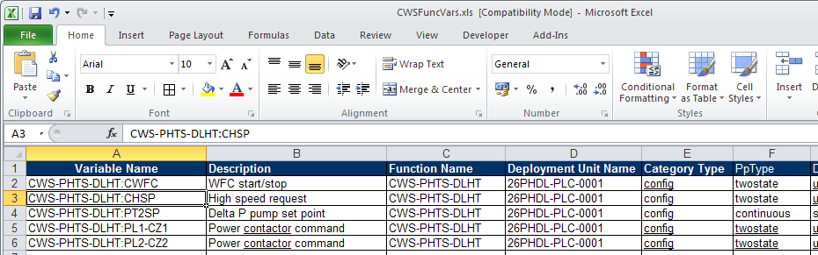
Export / Import Excel List
SDD
Signals List
Variables List

Slide 17
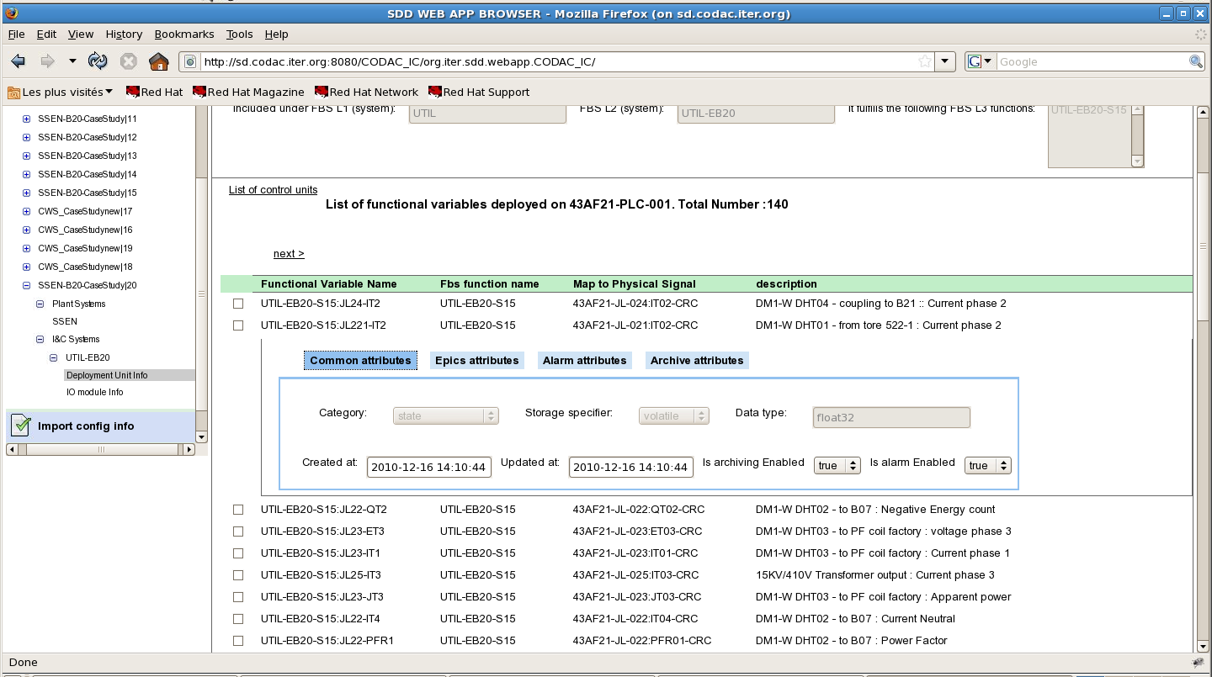
Browse Variables (Web Application)
SDD

Slide 18
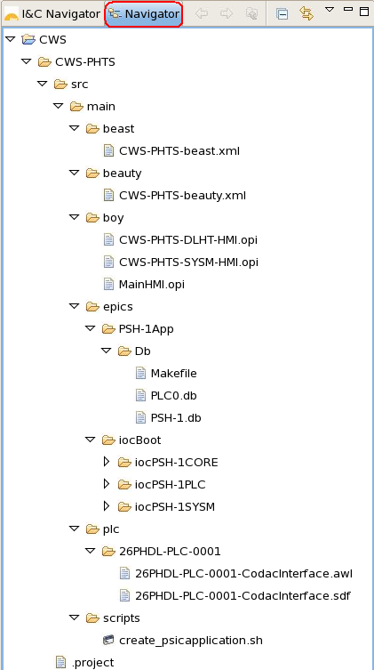
Generate Configuration Files
SDD
Alarms Configuration
Archives Configuration
Generated HMI
EPICS records
EPICS IOC files
STEP-7 files

Slide 19
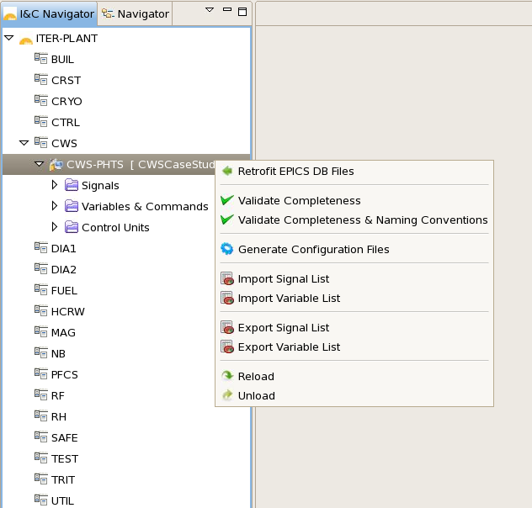
User-edited db files can be parsed to retrofit changes into the DB.
SDD
Work in progress

Slide 20
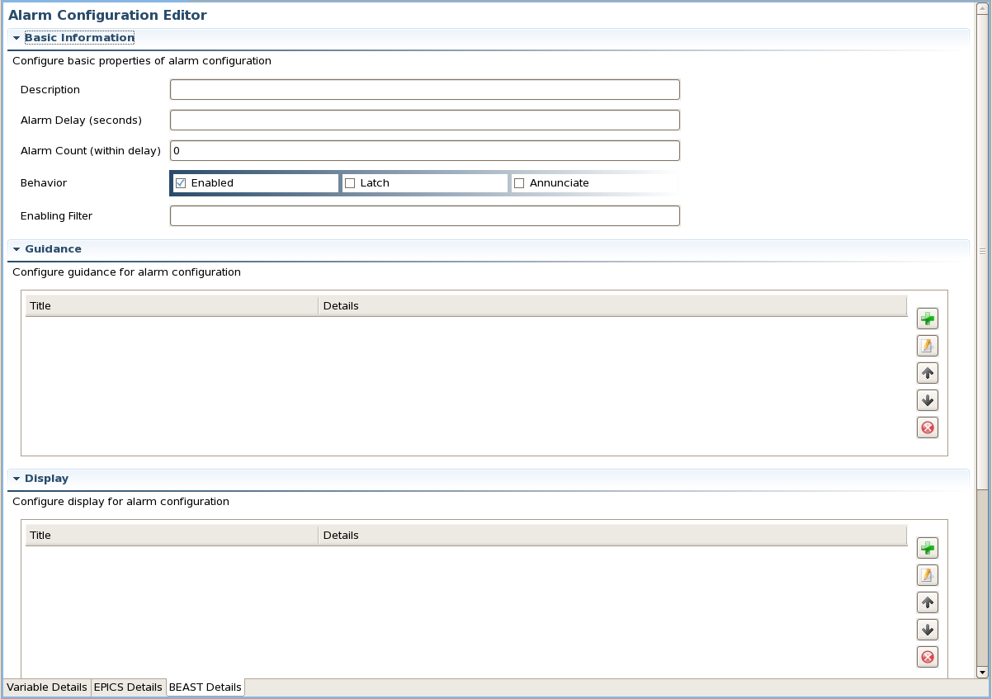
Adding BEAST configuration in SDD editor & database.
SDD

Slide 21
Plant system I&C Data Flow
Development workflow
Create / Edit
plant system I&C definition
SDD DB
(control units, functions/variables, signals)
EPICS Configuration files
CSS
Configuration files
STEP7
Configuration files
Generate configuration files
EPICS sequences, logic/treatment
Operator displays, data plots
STEP7
programs
Develop application files
Build software packages
EPICS
packages
CSS packages
PLC programs
Notes:
The plant system I&C definition includes the definition of the control units (PSH, the fast controllers, the PLCs…) and of all variables implemented by these units.
From the definition in the local database, configuration files are generated for EPICS, Control System Studio and the PLC development environment (Step-7).
These files are incorporated into software units with user-developed software: EPICS sequences and treatment,, OPI display (etc., as on picture) to build the software packages: EPICS, Control System Studio and PLC..

Slide 22
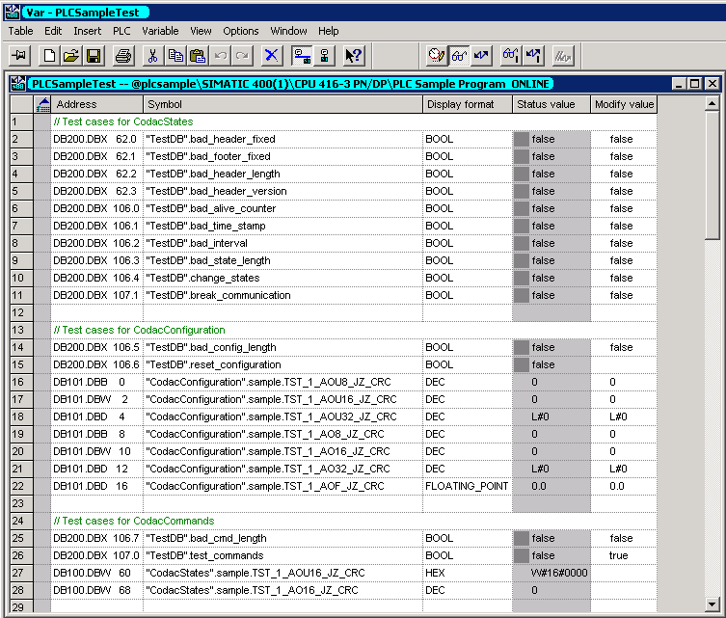
Variables and Commands in the PLC
PLC

Slide 23
Content
Configuration Tools (SDD)
Maven commands
N.I PXI/PXIe drivers
IOC extensions for tuning on Linux/multi-core
Dynamic symbols for BOY

Slide 24
Maven commands (1)
Create/edit software units
MVN
m-TEST-RTST-PLC
|-- pom.xml
`-- src
|-- main
| |-- epics
| | |-- Makefile
| | |-- PSH0App
| | | |-- Db
| | | | `-- Makefile
| | | |-- Makefile
| | | `-- src
| | | |-- Makefile
| | | `-- PSH0Main.cpp
| | |-- configure
| | `-- iocBoot
| | |-- Makefile
| | `-- iocPSH0PLC
| | |-- Makefile
| | |-- PSH0-plcConfig.cfg
| | |-- PSH0-saveRestore.cmd
| | |-- PSH0PLC.req
| | |-- README
| | `-- st.cmd
| `-- scripts
| |-- PSH0PLC-ioc
| `-- unitenv
`-- test
`-- epics
mvn [iter:]newunit –Dunit=<unit_name>
  Create a new software unit
mvn [iter:]newapp –Dapp=<app_name> -Dtype=[psh|pcf|mc]
  Add an EPICS application
mvn [iter:]newioc –Dioc=<ioc_name> -Dapp=<app_name> -Dtype=[softioc|plc|psh|sysm]
  Add an EPICS IOC.
mvn newunit -Dunit="TEST-RTST-PLC“
[INFO] UNIT 'm-TEST-RTST-PLC' CREATED
cd m-TEST-RTST-PLC
mvn newapp -Dapp="PSH0" -Dtype="psh“
[INFO] EPICS APPLICATION 'PSH0' CREATED
mvn newioc -Dioc="PSH0PLC" -Dtype="plc" -Dapp="PSH0“
[INFO] EPICS IOC 'PSH0PLC' CREATED
[INFO] IOC 'PSH0PLC' INCLUDED FOR PACKAGING

Slide 25
Maven commands (2)
Build/run/test/package
MVN
mvn [iter:]compile [-Dioc=<ioc_name>]
  Compiles the current unit.
mvn [iter:]run [-Dioc=*] [-Dbuild=false] [-Ddaemon=false]
  Starts the specified IOC or all IOCs if ioc is not provided.
mvn [iter:]status [-Dioc=<ioc_name>]
  Queries the status of the specified IOC or all IOCs if ioc is not provided.
mvn [iter:]stop [-Dioc=<ioc_name>]
  Stops the specified IOC or all IOCs if ioc is not provided.
mvn [iter:]package [-DspecOnly=true]
  Package the unit into RPMs.

Slide 26
Content
Configuration Tools (SDD)
Maven commands
N.I PXI/PXIe drivers
IOC extensions for tuning on Linux/multi-core
Dynamic symbols for BOY

Slide 27
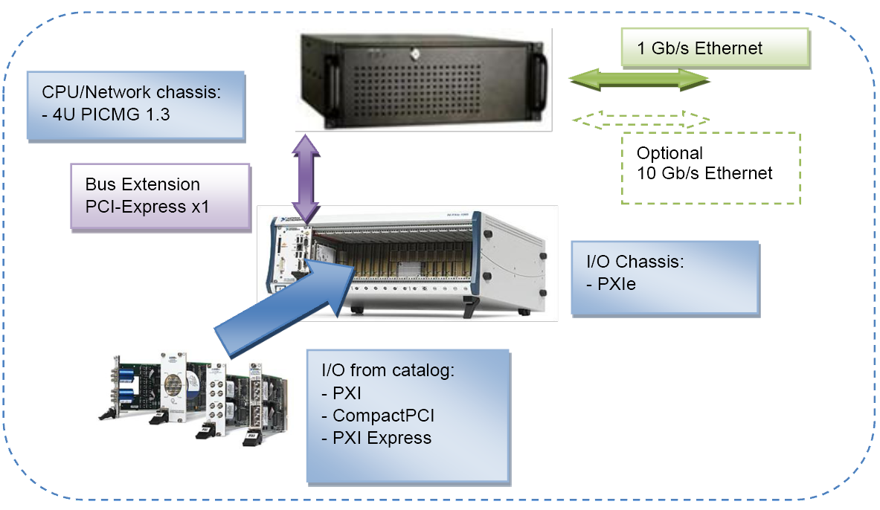
ITER Fast controllers
PXI

Slide 28
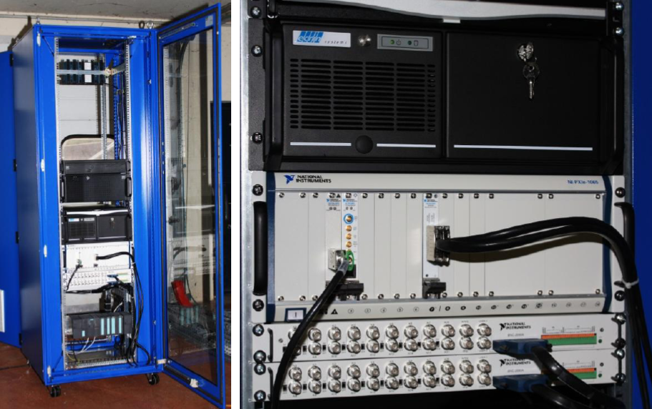
Standard FC is available to ITER users
PXI
CPU/Network/Disks
PXIe rack
PCIe to PXIe
link
TCN & Timing card
Multi I/O
Multio I/O to signal
concentrator link
Signal concentrator

Slide 29
Standard Boards Support
PXI
The ITER software distribution (CODAC Core System) will include the software for the ITER standard I/O boards (defined in the ITER catalog)
  Linux device driver (RHEL 6.1)
  EPICS device support
  SDD integration (not for all)
Currently:
  NI PXI-6682 : Synchronization and timing (IEEE1588-2008 / PTP)
  NI PXI-6259: multi-function data acquisition
    16b analog input channels (16/32)
    16b analog output channels (4)
    16b digital input/output channels (48)
    32b counters (4)
Prepared for 2012:
  NI PXIe-6368: higher range multi-function data acquisition board (16 simultaneous analog inputs at 2 MS/s)
  NI PXI-6528: digital I/O board (24 input, 24 output, optically isolated)
  NI FlexRIO boards (FPGA) with adapter boards: PXI-7951R with 6581 (digital) and 5781 (analog) adapters.

Slide 30
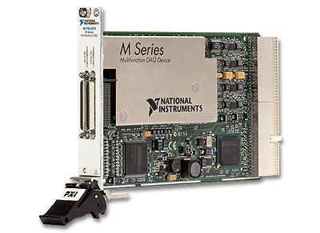
Specification of the NI PXI-6259 board
PXI
AI Channels
Channels : 32 Single-Ended Channels
or 16 Differential Channels
Sample rate : 1.25 Ms/s single channels
1 Ms/s multi channels (all)
Resolution: 16 bits
AO Channels
Channels : 4
Update rate : 2.8 Ms/s per each channel
Resolution: 16 bits
Digital I/O
Bidirectional Channels : 48
Counters
Channels: 4
Resolution: 32 bits

Slide 31
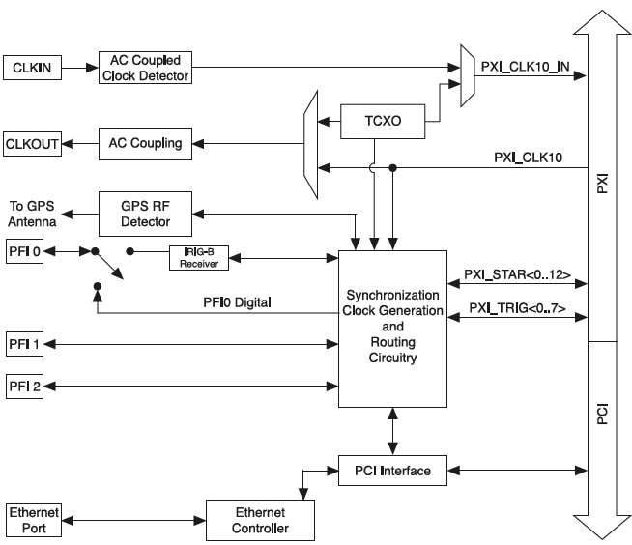
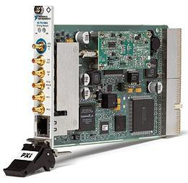
Specification of the NI PXI-6682 board
PXI
NI PXI-6682 features:
  Synchronization (50 ns)
  Absolute time provider
  Trigger generation
  Signal timestamping
  Clock export (10 MHz)

Slide 32
Content
Configuration Tools (SDD)
Maven commands
N.I PXI/PXIe drivers
IOC extensions for tuning on Linux/multi-core
Dynamic symbols for BOY

Slide 33
Real time tuning on multi-core Linux
RT
Real time tuning on multi-core Linux (both RHEL & RHEL-MRG realtime) requires, for each thread, the control of:
  The priority
  The scheduling policy
  The CPU affinity (assignment to a set of cores)
Can be done with:
  Configuration files that distinguish threads from the command tat start them (limited)
  Linux commands (taskset, chrt) using threads id (lightweight process ID)
  IOC shell commands (new)

Slide 34
Proposed new IOC commands
RT
Set the CPU affinity:
  epics> epicsThreadSetCPUAffinity
  epicsThreadSetCPUAffinity: you need 2 arguments.
  string id: EPICS thread ID
  string affinity: CPU affinity
  epics> epicsThreadSetCPUAffinityByName
  epicsThreadSetCPUAffinityByName: you need 2 arguments.
  string name: Thread name
  string affinity: CPU affinity
Set the scheduling policy and priority level:
  epics> epicsThreadSetPosixPriority
  epicsThreadSetPosixPriority: you need 3 arguments.
  string id: EPICS thread ID
  number priority: POSIX priority value
  string policy: POSIX scheduling policy
  epics> epicsThreadSetPosixPriorityByName
  epicsThreadSetPosixPriorityByName: you need 3 arguments.
  string name: Thread name
  number priority: POSIX priority value
  string policy: POSIX scheduling policy

Slide 35
Modified epicsThreadShow(All)
RT
CPU affinity
Lightweight process ID
Scheduling policy

Slide 36
Variables controlling the patch for Linux
RT
SHOW_LWP: if set to YES, the LWP ID column will be shown by epicsThreadShowAll. This function is supported only on Linux platform (i.e., it is not POSIX-compatible).
USE_PTHREAD_AFFINITY_NP_FUNCTIONS: if set to YES, functionality for setting CPU affinity becomes available. This capability should be portable across POSIX platforms (tested only on Linux).
USE_PR_SET_NAME: if set to YES, the name of the thread’s process will be set to match the name passed to epicsCreateThread.

Slide 37

RHEL / RHEL-MRG scheduling policies & priority levels
RT
Policies:
  SCHED_OTHER/SCHED_NORMAL: usual Linux scheduling policy; dynamic priority: processes that get denied from execution get a priority boost
  SCHED_FIFO: when process finishes, it is put at the end of the list for its priority level. If a higher-priority process becomes ready, it preempts a lower-priority one immediately.
  SCHED_RR (round-robin): as SCHED_FIFO, but allows preemption.
Levels: from -20 to 99. Higher number means higher priority.
Propose a patch to change the current EPICS-POSIX mapping:
  EPICS 0,1 are POSIX 1, others are identical.

Slide 38
Content
Configuration Tools (SDD)
Maven commands
N.I PXI/PXIe drivers
IOC extensions for tuning on Linux/multi-core
Dynamic symbols for BOY

Slide 39
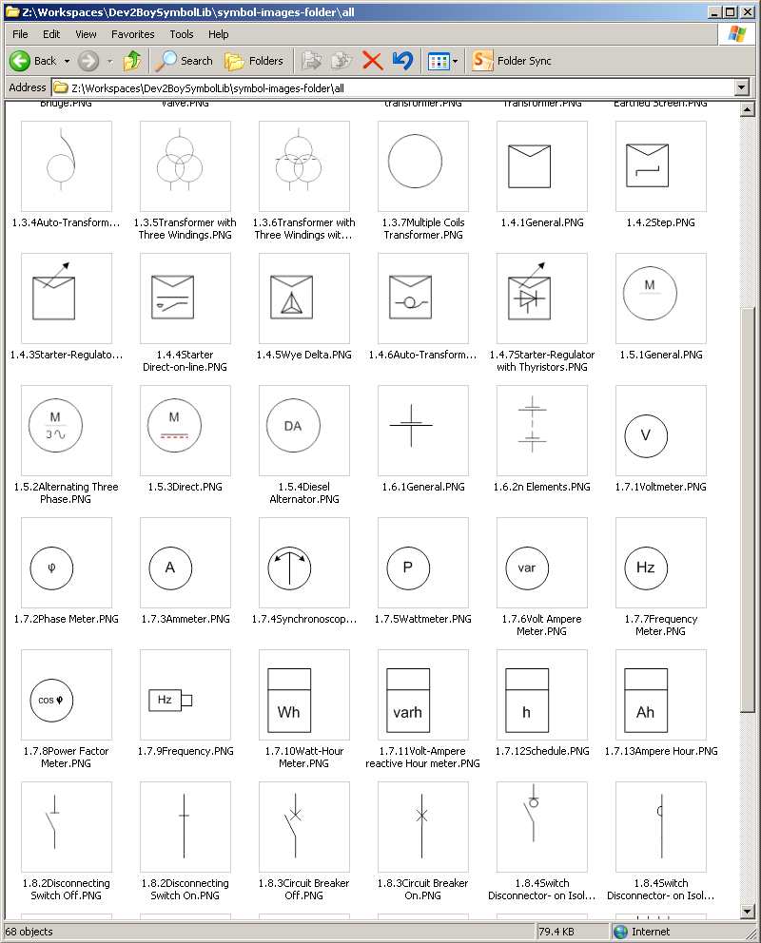
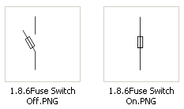


Motivation
Standardisation of Operator Interface with a Library of Industrial Symbols such as pump, valve, relay or circuit breaker
Boolean representation of the symbol in position open/ close or 0/1
On/Off colors

Slide 40
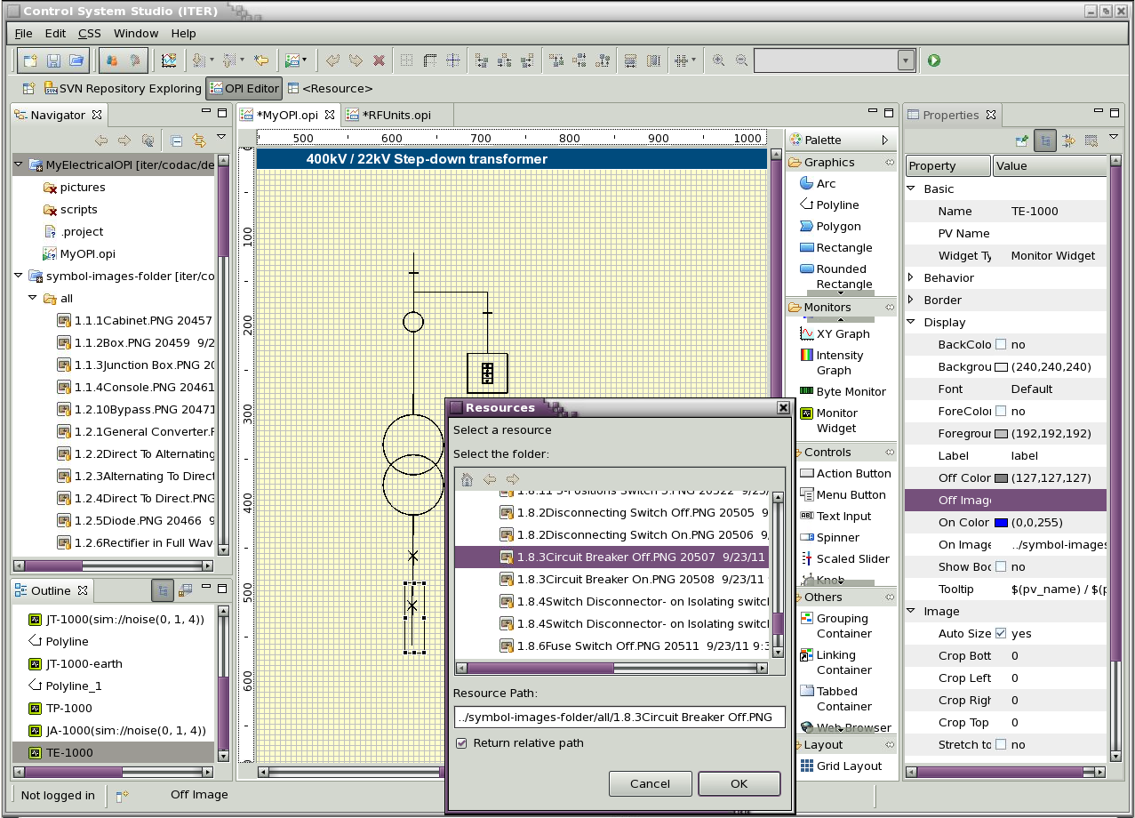
Boolean Symbol Widget
2
ON/OFF Images are Black/White images
1
Specific properties
3
Accessible from the Palette

Slide 41
Contacts
Configuration Tools (SDD)
  lana.adadie@iter.org
Maven commands
  denis.stepanov@iter.org
N.I PXI/PXIe drivers
  petri.makijarvi@iter.org
IOC extensions for tuning on Linux/multi-core
  franck.dimaio@iter.org
Dynamic symbols for BOY
  nadine.utzel@iter.org

