Slide 1
ChannelFinder
Directory Service
Ralph Lange
EPICS Fall Collaboration Meeting, October 2011
PSI

Slide 2
Motivation and Objectives
A flat name space restricts seriously:
  Clients need to know all channel names beforehand
  Portable generic clients must be simple
  Apps need full configuration or framework supplied service
Develop a Directory Service
  Generic
    No dependency on installation and local conventions
  Simple and fast (enough)
    Use standards wherever possible
  Provides “query-by-functionality”

Slide 3
Directory Data
Set of Channels (unique names)
Each Channel has an arbitrary number of
Properties (name/value pairs) and
Tags (names)
Each Channel, Property, or Tag has an Owner (group) to allow basic access control
All names and values are strings

Slide 4
Typical Middle-Tier Design
REST style web service
  URI specifies the data element to operate on
  HTTP method specifies the operation
  Payload (XML, JSON) contains object representation
Application Server
RDB
  Contains directory data
Use LDAP to query user-group relations

Slide 5
Implementation
REST
Glassfish V3
MySQL
LDAP
Mercurial
SourceForge
Java EE 5
Netbeans 6.8
JDBC
PyUnit
XML
JAX-RS
Jersey
JNDI
Hudson
JSON
PAM
Maven 2
JAXB

Slide 6
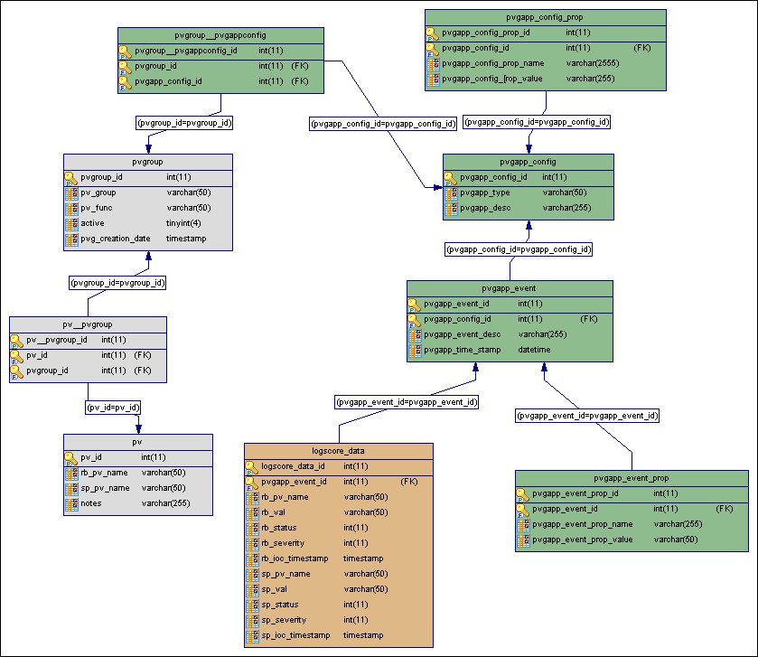
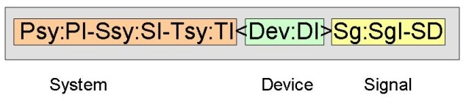
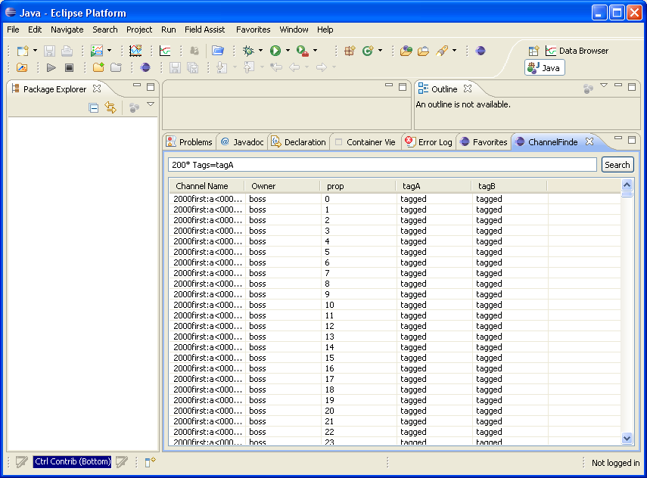
Directory Data Sources
IRMIS or other RDB systems
  Geographical, hierarchical,
  engineering, physics data
IOC Uploader or DB file parser
(PV names, attributes)
  Requires a good naming convention
Control room applications
  ”Joe’s favorite channels”

Slide 7
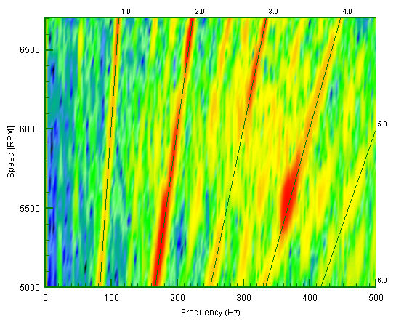
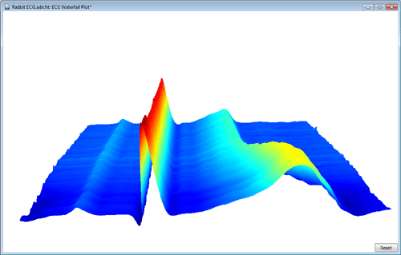
Targeted Applications
Waterfall Plots
3D Plots
Scripts
Generic applications
Table-style panels
Archive clients

Slide 8
First Performance Estimates
Test database contains 150k channels, with 7 properties each
Performance of getting channels with properties by property wildcard match:
1st call subsequent calls
  1 ch (500B data) 0.47s 0.009s
  2k ch (700kB data) 0.6s 0.13s
  4k ch (1.5MB data) 1.4s 0.9s
  (regular desktop machine, no optimization whatsoever)
mySQL could be changed to in-memory DB

Slide 9
Status
Stable, v1 released
Performance test suite (still) in preparation
First applications developed using client libraries for Java and Python (see CSS session)
Acknowledgements:
  Gabriele Carcassi (App/Build Servers, IRMIS)
  Kunal Shroff (Client Library and Applications)
  Supported by Helmholtz-Zentrum Berlin / BESSY II

