Slide 1


Slide 2

LabVIEW and EPICS Workshop
EPICS Collaboration Meeting
Fall 2011

Slide 3
Agenda
Overview
Channel Access (CA) support
  LabVIEW EPICS CA Server
  LabVIEW EPICS CA Client
Programmatic access to LabVIEW EPICS CA Server
Additional information
Questions and answers

Slide 4
Overview

Slide 5

What is LabVIEW?
Graphical system design environment
Application Areas:
  Acquiring data and processing signals
  Automating test and validation systems
  Instrument control
  Embedded monitoring and control systems
  Academic teaching

Slide 6
EPICS Overview
Experimental Physics and Industrial Control System (EPICS)
Used to develop and implement distributed control systems to operate large experiments
SCADA architecture that uses client/server and publish/subscribe
Input/Output Controller (IOC) collect experiment and control data
Operator Interface (OPI) display data and control experiments
Channel Access (CA) is a Ethernet protocol used to distribute the data
Process Variables (PVs) are unique data items on CA protocol
Notes:
SCADA – Supervisory Control and Data Acquisition

Slide 7
EPICS Software Architecture
Distributed Clients (OPI – Operator Interface) and Servers (IOC – I/O Controllers)
Network protocol: Channel Access (CA) with Process Variables (PVs)
OPI
(Operator
Interface)
OPI
(Operator
Interface)
CA (Channel Access)
IOC
(I/O Controller)
IOC
(I/O Controller)
IOC
(I/O Controller)
IOC
(I/O Controller)
I/O HW
I/O HW
I/O HW
I/O HW
Analog I/O, Digital I/O, Motion Control, Image Acquisition, etc.

Slide 8
IOC Software Architecture
Network Traffic (Channel Access protocol)
Channel Access Protocol Server
  Publishes values from the database onto the network using Channel Access protocol
Sequencer
  Controls timing for when to update values
EPICS Database
  Contains the record definition and values
Database Engine
  Writes I/O values to the database
Channel Access
Protocol Server
Sequencer
(Finite State Machine)
EPICS Database
Database
Engine
Hardware

Slide 9
Why Integrate EPICS and LabVIEW ?
LabVIEW as a Client
  Presentation
  Analysis
  Control
EPICS Client
EPICS Client
LabVIEW as a Server
  Interface to hardware
  Real-time control
  Access to FPGA
IOC
(I/O Controller)
IOC
(I/O Controller)
I/O HW
I/O HW

Slide 10
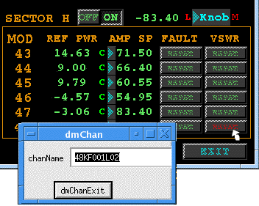

Concept
The EPICS CA Server and EPICS CA Client are implemented as plug-ins to the I/O Server
In both cases the interface in LabVIEW is implemented via the Shared Variable
Process Variables (PVs)
I/O Server
Shared Variables

Slide 11
Hands-on Exercises
Exercise 1 – Hardware setup
Exercise 2 – Simple temperature control
Exercise 3 – Create an EPICS CA Server
Exercise 4 – Create an EPICS CA Client
Exercise 5 – EPICS CA Server programmatic API

Slide 12
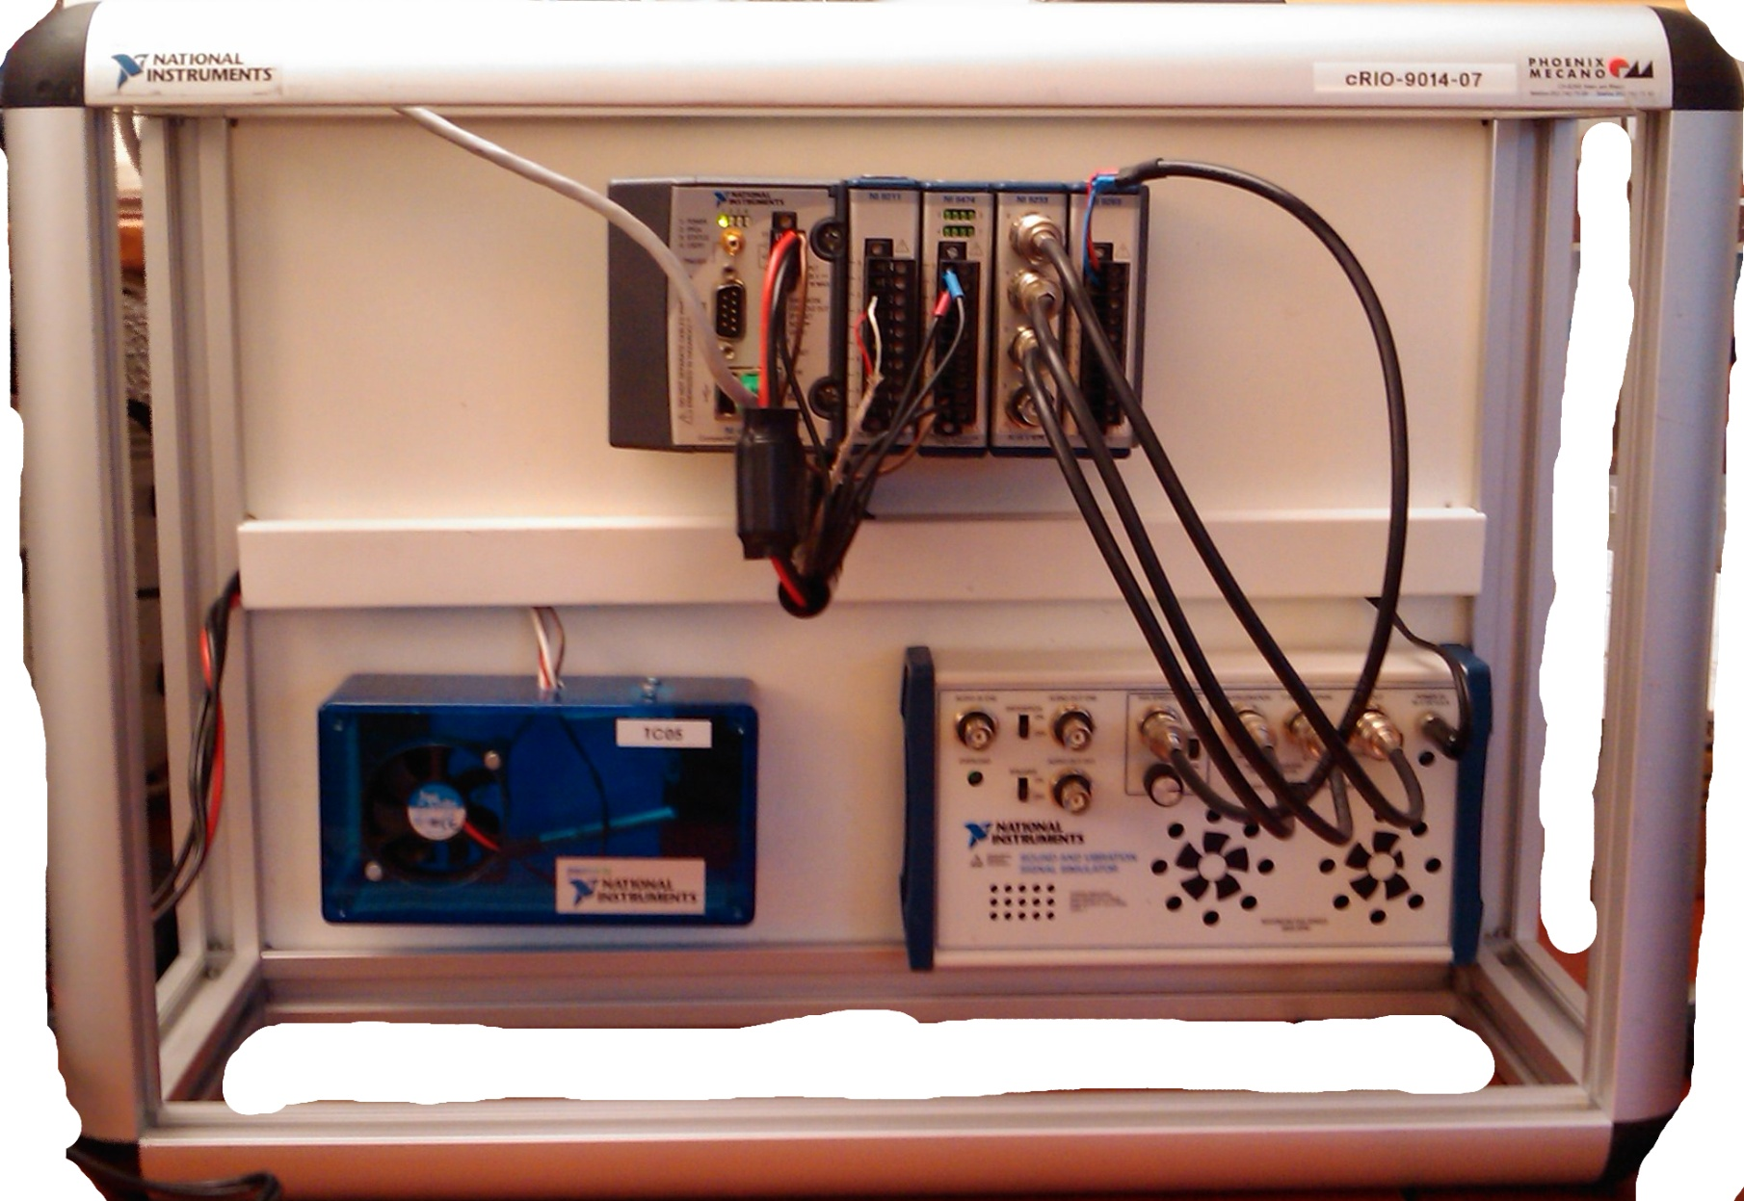
cRIO-9103
cRIO-9014
NI 9211
Acquires temperature from chamber
NI 9474
Sends digital signals to toggle the fan and the light in the chamber
Temperature chamber
(fan and light bulb)
Sound and vibration simulator
(not used)

Slide 13
LabVIEW EPICS CA Server

Slide 14
LabVIEW EPICS CA Server
Network Traffic
(Channel Access Protocol)
LV EPICS Server
I/O Server
EPICS Client
LabVIEW Shared Variable Engine
Channel
Access
Server
LabVIEW Application
I/O HW
Hardware

Slide 15
Architecture Comparison
Network Traffic (Channel Access protocol)
Channel Access
Protocol Server
Sequencer
(Finite State Machine)
LV EPICS Server
I/O Server
EPICS Database
LabVIEW Shared Variable Engine
Database
Engine
LabVIEW Application
Hardware
Hardware

Slide 16
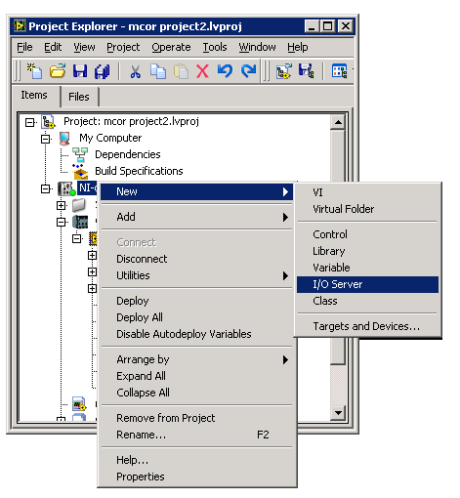
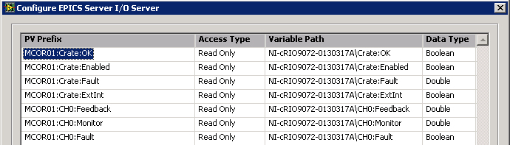
LabVIEW EPICS CA Server
Runs on LabVIEW for Windows and LabVIEW Real-Time
Implemented as an I/O Server
Interfaced via Shared Variable
Provides Channel Access functionality only

Slide 17
Implementation – CA Server
Start by creating the Shared Variables you want to publish on the EPICS network
Then create an EPICS CA Server I/O Server
Define the PV names and associate them with the Shared Variables
Read or write to the Shared Variables in LabVIEW to access the associated PVs

Slide 18
Hands-on Exercises
Exercise 1 – Hardware setup
Exercise 2 – Simple temperature control
Exercise 3 – Create an EPICS CA Server
Exercise 4 – Create an EPICS CA Client
Exercise 5 – EPICS CA Server programmatic API

Slide 19
LabVIEW EPICS CA Client

Slide 20
LabVIEW EPICS CA Client
Network Traffic
(Channel Access Protocol)
LV EPICS Client
I/O Server
EPICS Client
LabVIEW Shared Variable Engine
IOC
(I/O Controller)
LabVIEW Application
I/O HW

Slide 21
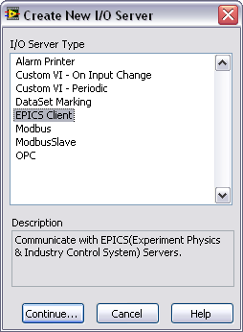
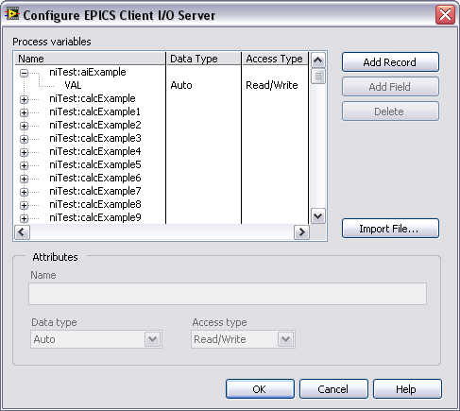
LabVIEW EPICS CA Client
Runs on LabVIEW for Windows and LabVIEW RT
Implemented as an I/O Server
Interfaced via Shared Variable

Slide 22
Implementation – CA Client
Create an EPICS CA Client I/O Server
Define the PVs you want to monitor, either manually or by importing a .db file
Create the associated Shared Variables and bind them to each PV
Read or write to the Shared Variables in LabVIEW to access the associated PVs

Slide 23
Hands-on Exercises
Exercise 1 – Hardware setup
Exercise 2 – Simple temperature control
Exercise 3 – Create an EPICS CA Server
Exercise 4 – Create an EPICS CA Client
Exercise 5 – EPICS CA Server programmatic API

Slide 24
Summary
The EPICS CA Server and EPICS CA Client are implemented as plug-ins to the I/O Server
In both cases the interface in LabVIEW is implemented via the Shared Variable
Process Variables (PVs)
I/O Server
Shared Variables

Slide 25
Programmatic Access to
LabVIEW EPICS CA Server

Slide 26
Programmatic Access
Simple implementation is configuration-based
New feature since LabVIEW 2010 allows to programmatically:
  Create an EPICS CA Server
  Create the Process Variables
  Bind Process Variables to Shared Variables
Benefits
  Easily handles large number of PVs
  Greatly facilitates deployment

Slide 27
Duplicating Systems

Slide 28
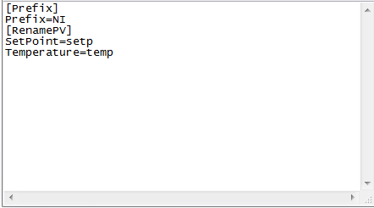
Possible Implementation
Create PVs programmatically and use an ini file to modify the names of the PVs
Each unique system can use the same application where the only difference is a text file

Slide 29
Writing Application to Run on Multiple Targets
Implement the following steps – more information on each step in the coming slides
  Use an ini file to modify the names of the PVs
  Use relative paths for ini file, server, and library
  Make the shared variables “Target Relative”

Slide 30
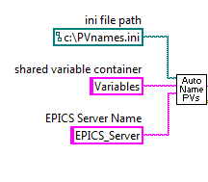
Use relative paths for ini file, server, and library
Use path to local root directory for ini file path
Use “localhost” for the computer name in the server path
Build the shared variable library path
            “Pvnames.ini” is the name of the file
            “Variables” is the name of the shared variable library to be published on EPICS
            “EPICS_Server” is the name of the EPICS Server

Slide 31
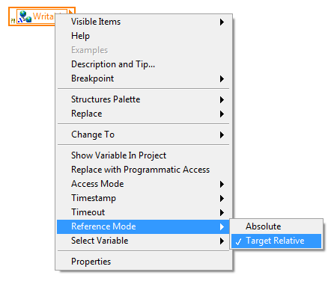
Make the shared variables “Target Relative”
  Right click and select Reference Mode >> Target Relative

Slide 32
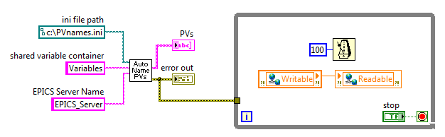
Details – Simple Example

Slide 33
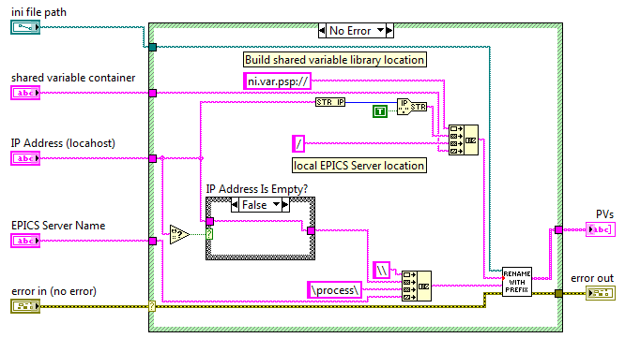

Details – SubVI – Auto Name PVs

Slide 34
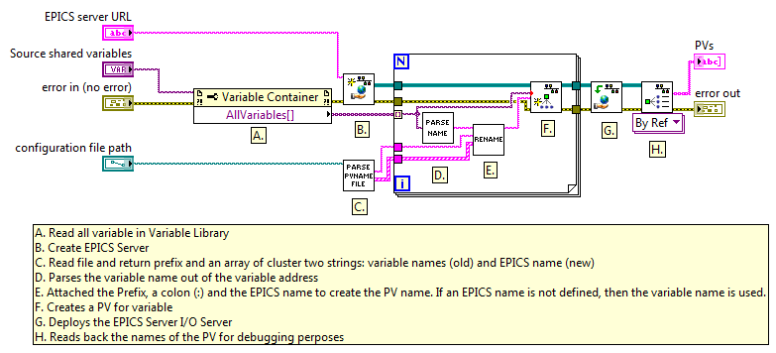

Details – SubVI – Rename With Prefix

Slide 35
Hands-on Exercises
Exercise 1 – Hardware setup
Exercise 2 – Simple temperature control
Exercise 3 – Create an EPICS CA Server
Exercise 4 – Create an EPICS CA Client
Exercise 5 – EPICS CA Server programmatic API

Slide 36
Additional Information

Slide 37
Additional Information
Supported data types
Available fields
Deployment
Tips and tricks

Slide 38
Supported Data Types
Shared Variable Data Type | PV Type | Data Type Description | PV Category
Single | DBF_FLOAT | Single-precision floating-point number | Numeric
Double | DBF_DOUBLE | Double-precision floating-point number
Int8 | DBF_CHAR | 8-bit integer
UInt8 | DBF_UCHAR | Unsigned 8-bit integer
Int16 | DBF_SHORT | 16-bit integer
UInt16 | DBF_USHORT | Unsigned 16-bit integer
Int32 | DBF_LONG | 32-bit integer
UInt32 | DBF_ULONG | Unsigned 32-bit integer
Boolean | DBF_ENUM | True or False logical value | Logical
String | DBF_String | A sequence of characters representing readable text | String
Array of Single | DBF_FLOAT | Array of single-precision floating-point numbers | Array
Array of Double | DBF_DOUBLE | Array of double-precision floating-point numbers
Array of Boolean | DBF_ENUM | Array of True or False logical values
Array of Int8 | DBF_CHAR | Array of 8-bit integers
Array of UInt8 | DBF_UCHAR | Array of unsigned 8-bit integers
Array of Int16 | DBF_SHORT | Array of 16-bit integers
Array of UInt16 | DBF_USHORT | Array of unsigned 16-bit integers
Array of Int32 | DBF_LONG | Array of 32-bit integers
Array of UInt32 | DBF_ULONG | Array of unsigned 32-bit integers

Slide 39
Available Fields
EPICS CA Server
  On Windows, when using alarming with LabVIEW DSC, the corresponding fields (HIHI, HHSV, SEVR, etc.) are supported
  On RT targets, the EPICS CA Server only allows you to set the VAL field
EPICS CA Client
  Any field can be accessed, but a Shared Variable will have to be created per field

Slide 40
Deployment
To a Windows target
  Requires the LabVIEW DSC run-time engine, or
  Requires a full copy of LabVIEW DSC
To a Real-Time target (PXI, cRIO, sbRIO)
  Requires that the EPICS CA Server support is included

Slide 41
Tips and Tricks
When you import Process Variables from a .db file, LabVIEW imports only the VAL field
Use EPICS commands (caget, caput, cainfo, etc.) to dissociate EPICS issues from LabVIEW issues
Use the Distributed System Manager to monitor the status of any LabVIEW EPICS I/O Server (you can even create one from DSM)

Slide 42
EPICS CA Server Benchmarks

Slide 43

Distribution
 | Windows | Real-Time OS
CA Server | LabVIEW DSC | LabVIEW RT
CA Client | LabVIEW DSC or Free download | LabVIEW RT
EPICS CA Server: available in LabVIEW 2011, via the DSC module for Windows and the RT module (PXI and cRIO)
EPICS CA Client: available in LabVIEW 2011, via the DSC module for Windows and the RT module (PXI and cRIO)
EPICS CA Client: also available as a free download

Slide 44
Questions

