Slide 1


Slide 2

EPICS IOC on CompactRIO
EPICS Collaboration Meeting
Fall 2011

Slide 3
Agenda
EPICS Overview
CompactRIO Overview
EPICS IOC on CompactRIO
Questions and Answers

Slide 4
EPICS Overview

Slide 5
EPICS Overview
Experimental Physics and Industrial Control System (EPICS)
Used to develop and implement distributed control systems to operate large experiments
SCADA architecture that uses client/server and publish/subscribe
Input/Output Controller (IOC) collect experiment and control data
Operator Interface (OPI) display data and control experiments
Channel Access (CA) is a Ethernet protocol used to distribute the data
Process Variables (PVs) are unique data items on CA protocol
Notes:
SCADA – Supervisory Control and Data Acquisition

Slide 6
EPICS Software Architecture
Distributed Clients (OPI – Operator Interface) and Servers (IOC – I/O Controllers)
Network protocol: Channel Access (CA) with Process Variables (PVs)
OPI
(Operator
Interface)
OPI
(Operator
Interface)
CA (Channel Access)
IOC
(I/O Controller)
IOC
(I/O Controller)
IOC
(I/O Controller)
IOC
(I/O Controller)
I/O HW
I/O HW
I/O HW
I/O HW
Analog I/O, Digital I/O, Motion Control, Image Acquisition, etc.

Slide 7
IOC Software Architecture
Network Traffic (Channel Access protocol)
Channel Access Protocol Server
  Publishes values from the database onto the network using Channel Access protocol
Sequencer
  Controls timing for when to update values
EPICS Database
  Contains the record definition and values
Database Engine
  Writes I/O values to the database
Channel Access
Protocol Server
Sequencer
(Finite State Machine)
EPICS Database
Database
Engine
Hardware

Slide 8
CompactRIO Overview

Slide 9
CompactRIO Features at a glance
PowerPC CPU 400 – 800MHz
VxWorks
256 – 512MB RAM
2 – 4GB flash storage
Ethernet (1 or 2 ports), Serial port, USB port
I/O chassis (4 or 8 slots)
FPGA (Virtex-5 LX 30 – LX 110)
LabVIEW Real-Time

Slide 10

What is LabVIEW?
Graphical system design environment
Application Areas:
  Acquiring data and processing signals
  Automating test and validation systems
  Instrument control
  Embedded monitoring and control systems
  Academic teaching

Slide 11

CompactRIO Architecture
Flexibility and determinism of RT programming
Speed and reliability of FPGA programming
I/O Card
I/O Card
LAN
LabVIEW Real-Time
LabVIEW FPGA
I/O Card
PCI
VxWorks
Xilinx FPGA
I/O Slots
CompactRIO Architecture

Slide 12
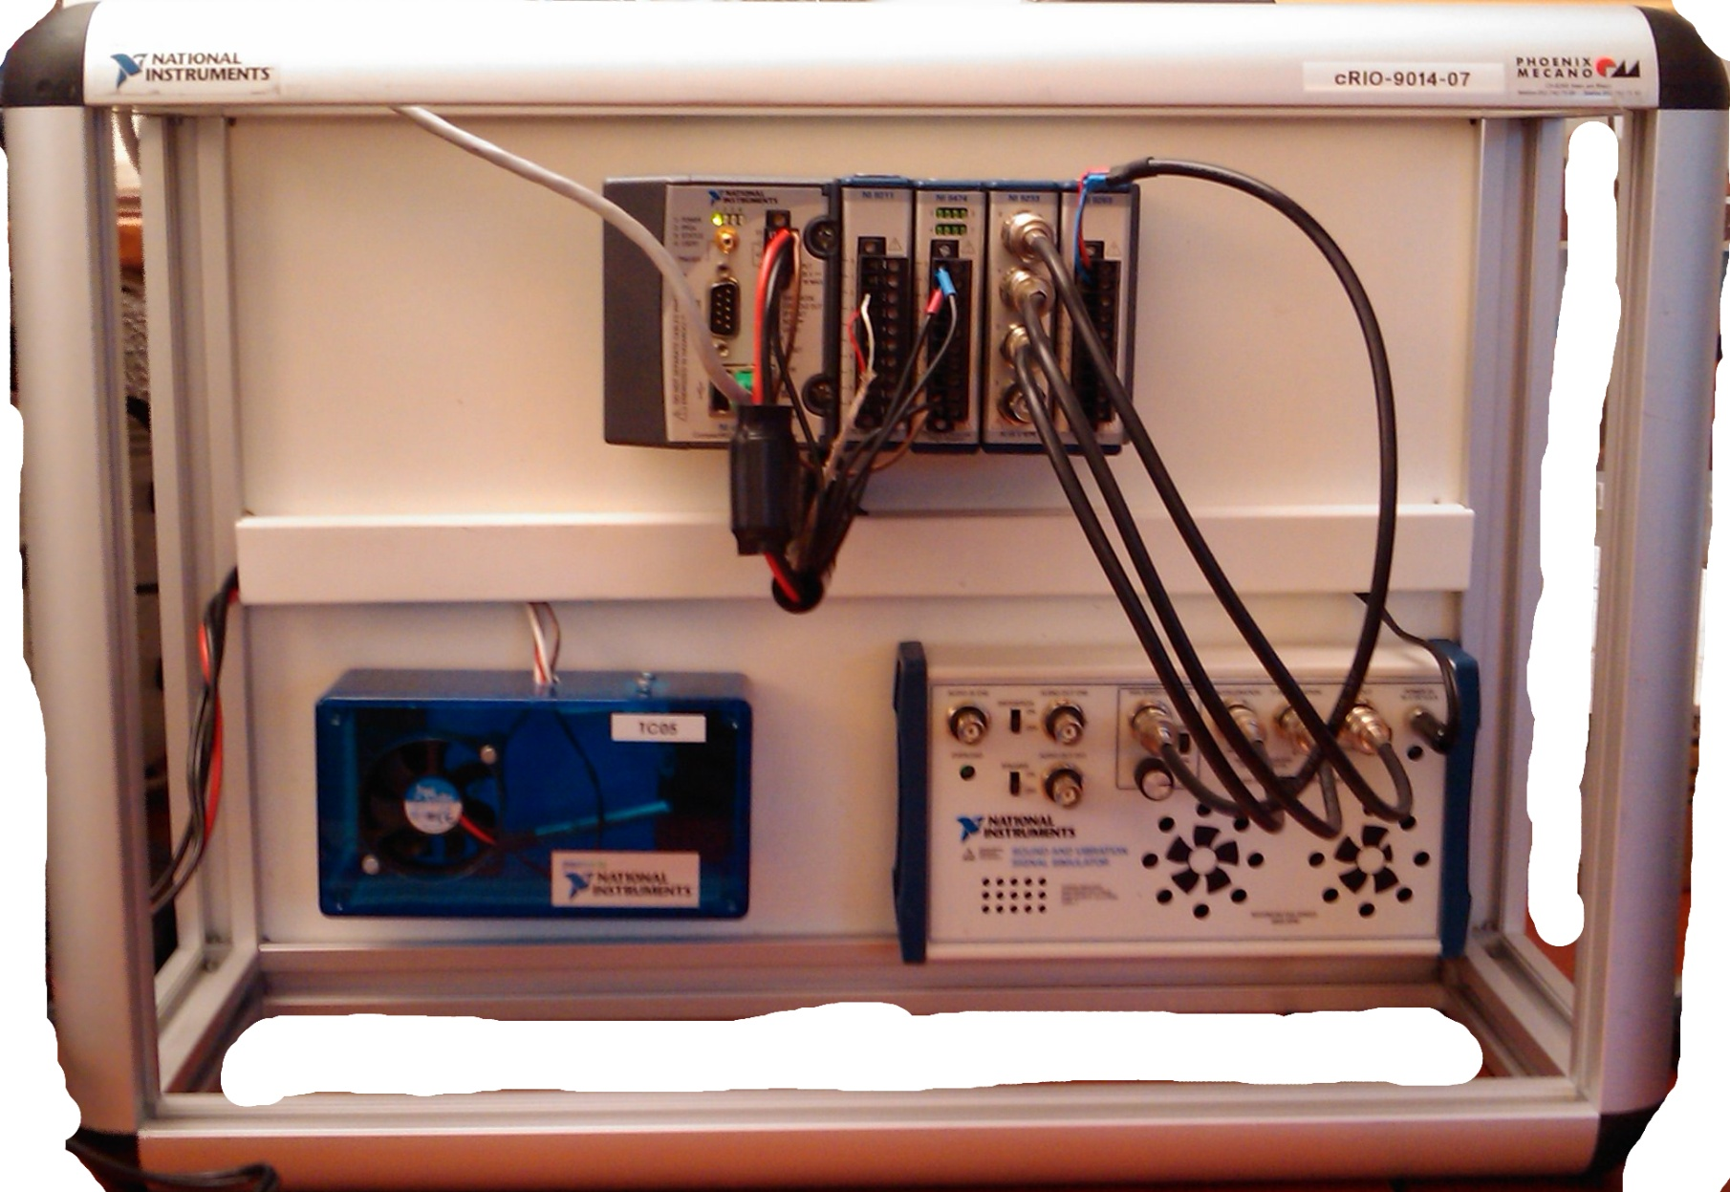
cRIO-9103
cRIO-9014
NI 9211
Acquires temperature from chamber
NI 9474
Sends digital signals to toggle the fan and the light in the chamber
Temperature chamber
(fan and light bulb)
Sound and vibration simulator
(not used)

Slide 13
Hands-On
Exercise 1: Verifiying and configuring setup
Exercise 2: Setup a simple temperature control VI

Slide 14
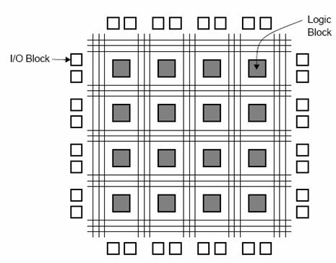
LabVIEW FPGA
Allows domain experts to use FPGA technology
Requires no HDL skills

Slide 15
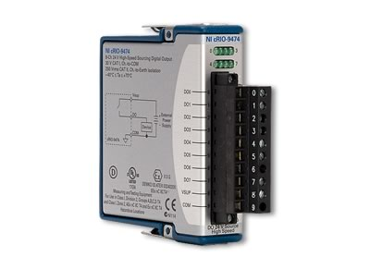
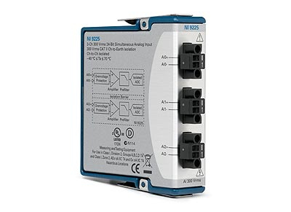
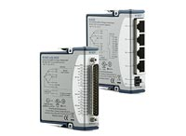
C-Series I/O Modules
100s of modules of many different types: ai, ao, dio, motion, relay, CAN, RS232, profibus, temperature
Plug and Play functionality over Scan Engine with many of them

Slide 16
What can I do with an FPGA?
Loop speeds of 40MHz or more
Custom triggering
Custom acquisition/generation
Offload CPU intensive tasks
True parallelism
Integrate HDL IP
Encryption

Slide 17
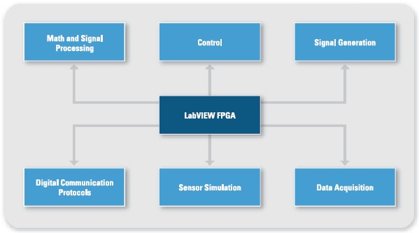
LabVIEW FPGA Applications

Slide 18
Hands-On
Exercise 3?: I don’t think an FPGA exercise makes much sense here. It will introduce too many notions with no time to explain them. Maybe just build a little more over the previous 2 exercises instead.

Slide 19
EPICS IOC on CompactRIO

Slide 20
CompactRIO Architecture
Flexibility and determinism of RT programming
Speed and reliability of FPGA programming
I/O Card
I/O Card
LAN
LabVIEW Real-Time
LabVIEW FPGA
I/O Card
PCI
VxWorks
Xilinx FPGA
I/O Slots
CompactRIO Architecture

Slide 21
Embedding EPICS IOC on CompactRIO
EPICS IOC and LabVIEW Real-Time running simultaneously
Take advantage of FPGA platform with CompactRIO
I/O Card
I/O Card
CA
LabVIEW FPGA
EPICS IOC
I/O Card
LabVIEW Real-Time
PCI
VxWorks
Xilinx FPGA
I/O Slots
CompactRIO Architecture

Slide 22
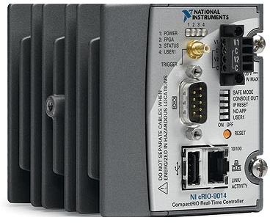
IOC Server on CompactRIO
Network Traffic
(Channel Access Protocol)
Channel Access
Protocol Server
Sequencer
(Finite State Machine)
Publishes values from the database onto the network using Channel Access protocol.
Reads values from the database to drive state changes in the IOC control application.
EPICS Database
Shared Memory
Database
Engine
LabVIEW
Application
Hardware

Slide 23
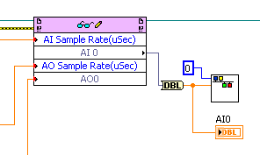
IOC Server on CompactRIO
CompactRIO controller runs VxWorks
Implemented via shared memory
Interface to hardware via LabVIEW RT and FPGA
Can be used with Scan Engine
Requires a custom VxWorks kernel (LV 2010 SP1 and earlier)
Requires special .out files (LV 2011)
Limited EPICS Device Support
# Read a double from shared memory
record(ai,"$(NAME):AI0") {
# field("Read a double from SM")
field(DTYP,"SM Device")
field(INP,"@0")
field(SCAN,".1 second")
}

Slide 24
Shared Memory Benchmarks – LV 8.5 – 9014
Arrays – Maximum transfer of 1 to 5 MB/s
Integers – Maximum transfer of about 10 to 12 kB/s

Slide 25

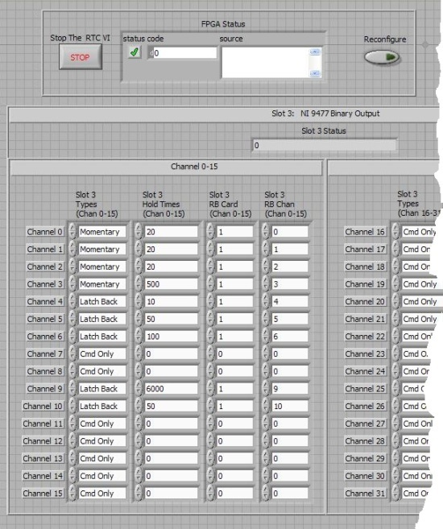
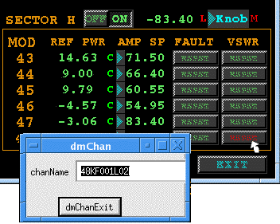
Example – Los Alamos LANSCE
Migration to a cRIO with embedded EPICS
  12 binary outputs
  36 binary inputs
  12 analog inputs
  5 stepper motor channels
Full IOC functionality allows access to all record fields and EPICS utilities
Maximum flexibility for partitioning the problem
  LabVIEW for beam diagnostic
  EPICS for industrial control

Slide 26


Options for EPICS and NI Hardware
1
2a
2b
3
LabVIEW
I/O Server
EPICS CA
Client or Server
LabVIEW RT
on cRIO
Shared Memory
EPICS IOC
on VxWorks
LabVIEW RT
on PXI
Hypervisor
Shared Memory
EPICS IOC
on Linux
PXI
(No LabVIEW)
Linux Driver
Device Support
EPICS IOC
on Linux
Notes:
Uses I/O Server that is already built into LabVIEW for other protocols like Modbus and OPC
2a is cRIO running RT and shared memory talking to a full IOC running on VxWorks. 2b is in the work but is Hypervisor with LabVIEW RT, shared memory, and IOC running in Linux
Is a PXI solution running Linux. It has no LabVIEW, and it talks directly to a limited set of hardware from IOC.

Slide 27
Hands-On
Exercise 3: EPICS IOC on cRIO

Slide 28
Demo

Slide 29
3rd Party Options

Slide 30
Other Options for Integrating EPICS and LV
SNS – Shared memory interface
SNS – Native CA support in LabVIEW
Observatory Sciences

Slide 31


SNS - EPICS Shared Memory Interface
ReadData()
WaitForInterrupt()
GetIndexByName()
CreateDBEntry()
EPICS Channel Access
EPICS Database
Shared Memory DLL
WriteData()
SetInterrupt()
LabVIEW Application
(Wire scanner, BPM, etc)
EPICS IOC

Slide 32
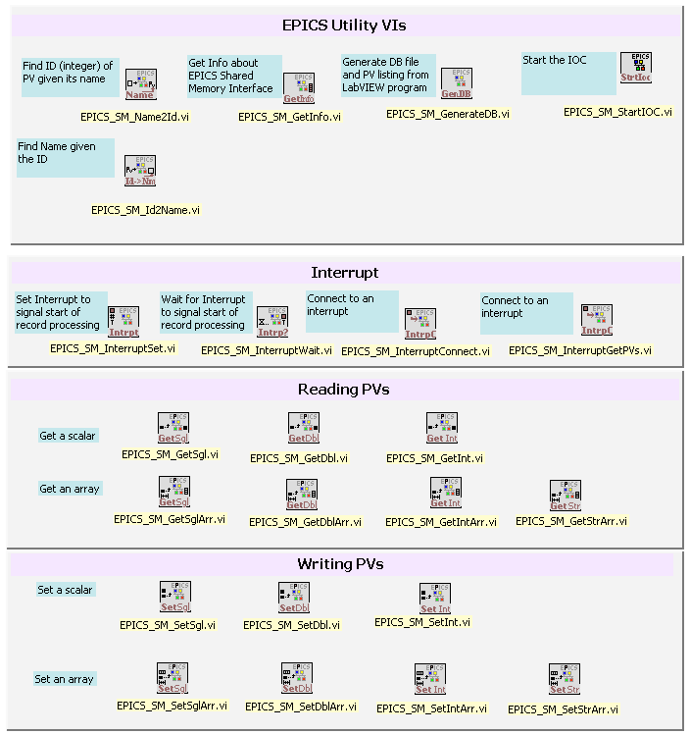
Shared Memory IOC
Integration with the control system
The Shared Memory IOC allows us:
Support additional processes
Use records as placeholder of data but no function
Not worry about buffering data
Respond to events
Be compatible with other IOCs
Functions:
Create, find and destroy variables
Read from and write to variables
Set and receive events
Retrieve information about variables
Create IOC database
Notes:
Why use IOC?
Reliable (unlike CA portable at that time)
No protocol documented
Compatible with Controls Group
Expert available
Why Shared Memory?
Initial model proposed by LANL to also support additional processes
Use records as placeholder of data but no function

Slide 33
Pros and Cons
Advantages
You have full IOC and everything that comes with it (including record processing)
All EPICS tools will work by default
Challenges
Linux and RTOS support would require considerable efforts
Need to support 2 infrastructures for EPICS IOC and for LabVIEW program deployment is complicated.

Slide 34
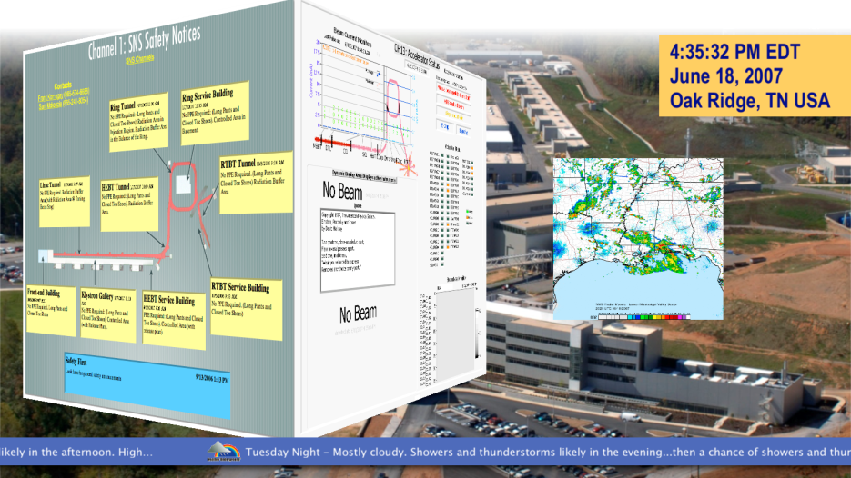
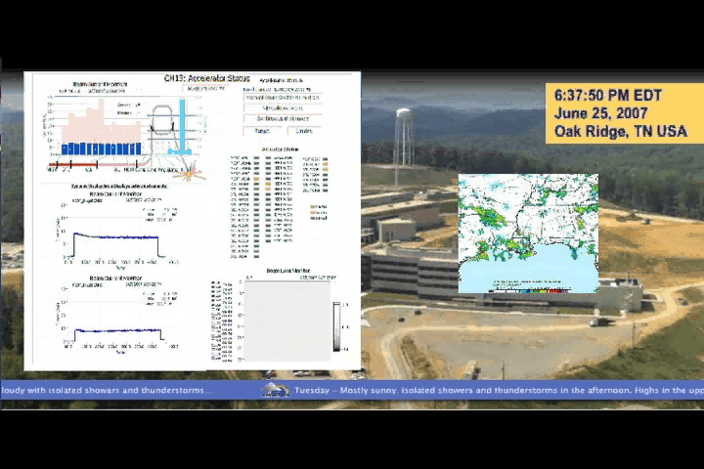
Example – SNS Facility
Instrumentation
  Measure beam parameters such as position, transverse profile, current, etc
Off-line Data Analysis
  Statistics, performance
Testing Equipment
  Calibration
  Prototyping
  Test electronics
Simulation
  Electron scanner
  Ion profiles

Slide 35
SNS - Native CA Support In LabVIEW
When using EPICS IOC only for
Channel Access communication
  Record processing can be done in LabVIEW
To be compatible with all platforms LabVIEW runs on
  Windows, Linux, Mac, VxWorks, Pharlap
To connect to EPICS clients

Slide 36
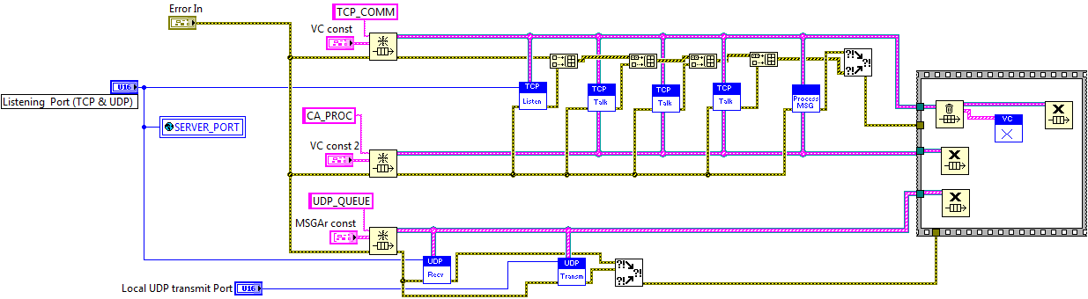
LabVIEW CA Server Structure
Launch UDP listener (for search requests)
Launch TCP listener (for new VC connections)
Launch several “threads” for communication
Launch one (or several) “threads” for message processing
Three queues responsible for data transfer and data locking
VC can be in either processing state or in communication state
“Records” are guarded differently

Slide 37

Observatory Sciences
Programmatic Channel Access Client
Functionality equivalent to caget, caput, and camonitor
Built on top of TCP and UDP support in LabVIEW
Supported data types: double, int32, and string

Slide 38
Questions

