Slide 1
GDA - Generic high speed data collection with EPICS
Paul Gibbons
Data Acquisition Team Leader
Diamond Light Source
Notes:
Good morning. I am going to speak to you today about GDA. The Generic Data Acquisition software developed at Diamond. It is used on nearly all its beamlines as the interface between the scientists and the complexity of the beamline components presented by EPICS.
I will first spend a few minutes on a status report, before moving on to the main topic “Generic high speed data collection with EPICS”.

Slide 2
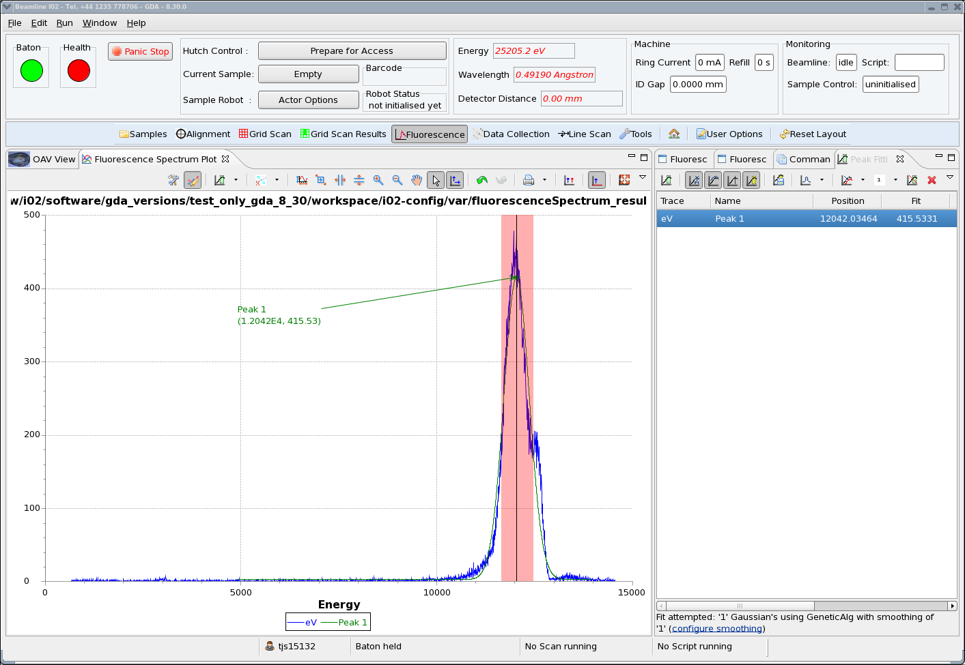
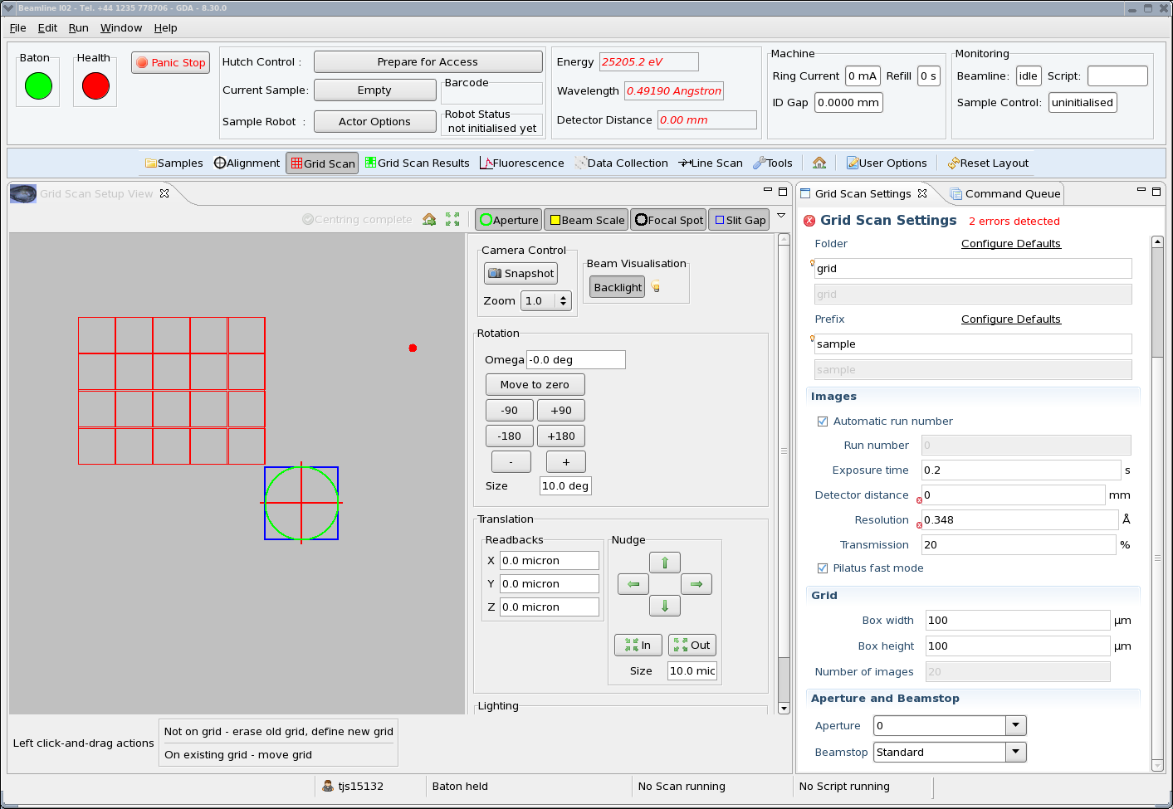
Protein Crystallography
Notes:
The status report will be a description of the range of experiments GDA supports at Diamond.
For each experiment type I will present a slide like this one displaying a collection of the GDA Eclipse perspectives contained in that experiment’s GUI and a few pertinent facts. I will not go into much more detail and I am simply trying to convey the richness and comprehensiveness of the GDA software.
The first and most prominent beamline type at Diamond is protein crystallography.
There are 5 beamlines at present devoted to this, each dedicated to either high throughtput, tunability, or high resolution. A sixth long wavelength beamline is under construction.
Do not be deceived by the nice graphics of the GUI. Behind it lies a highly automated beamline running flyscans using the latest, fastest detector such as the Pilatus 6M running at 100Hz. That’s 600MB per second. Analysis of the results is run on clusters attached to Diamond’s central storage as the data is being collected. Both the metadata of the data collection and the analysis results are recorded in a site wide database and displayed on the GDA GUI within minutes of completing a scan.

Slide 3
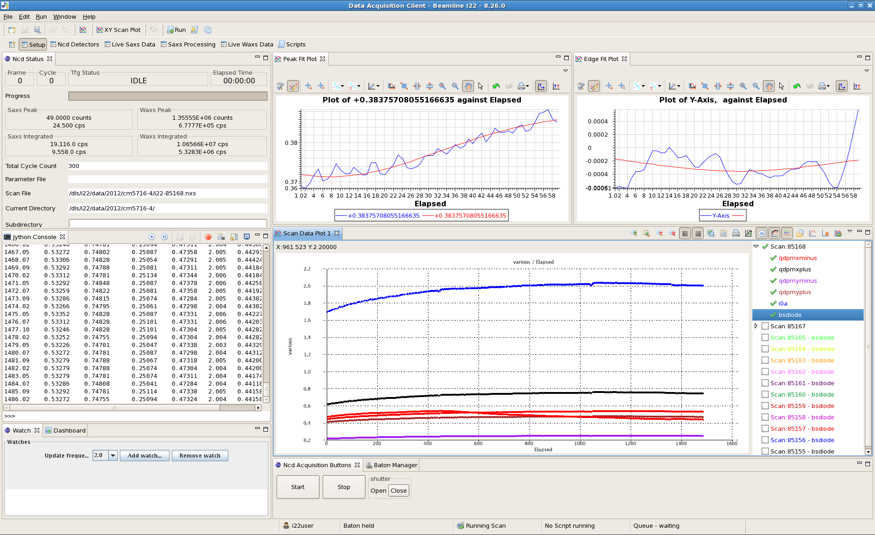
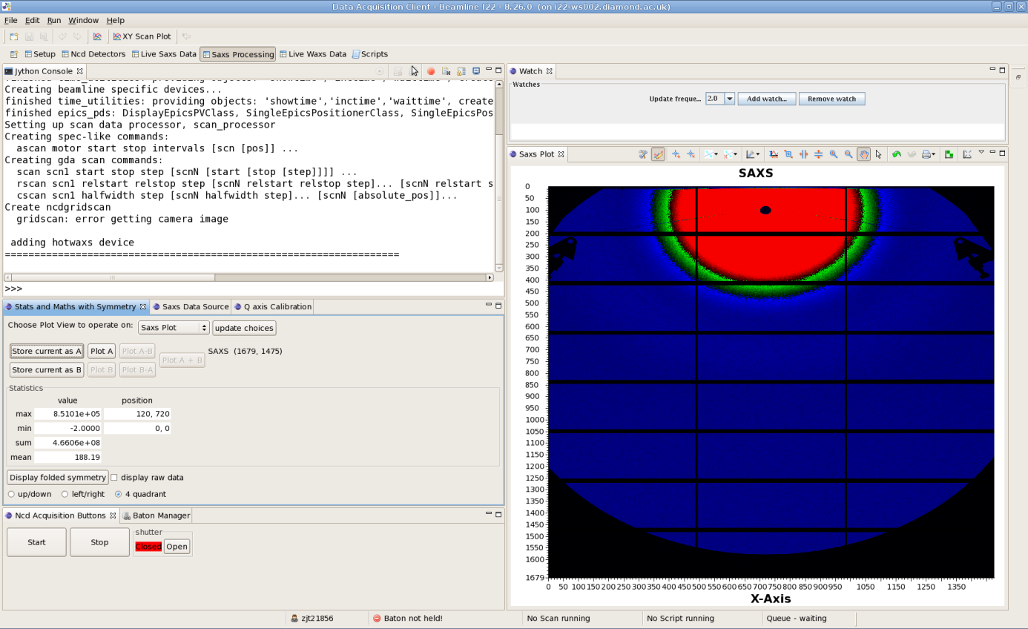
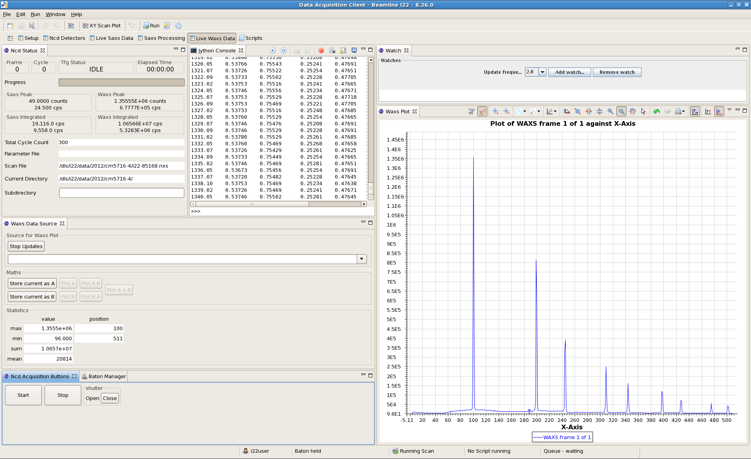
Small Angle Scattering
Notes:
The two Scattering beamlines at Diamond likewise have a dedictated GDA configuration and set of perspectives.
The detectors on these beamlines are triggered by a sophicated multi-time frame generator allowing time resolved experiments to be performed.
Recently a Pilatus 2M was successfully used on the beamline running at 250Hz – 500MB/s

Slide 4
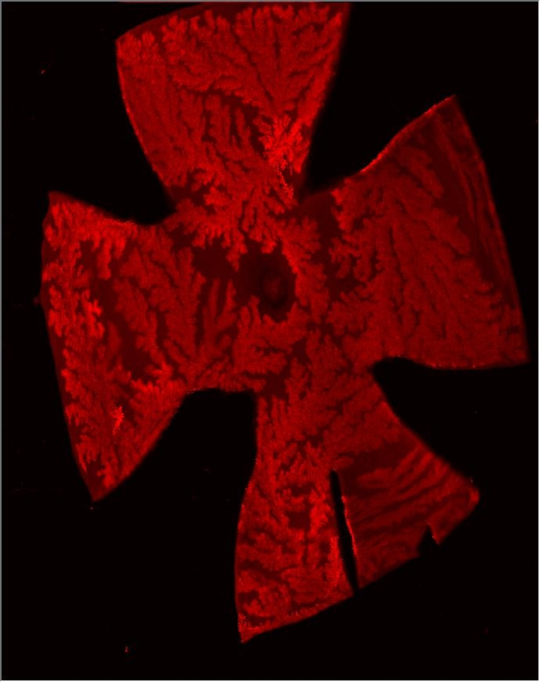
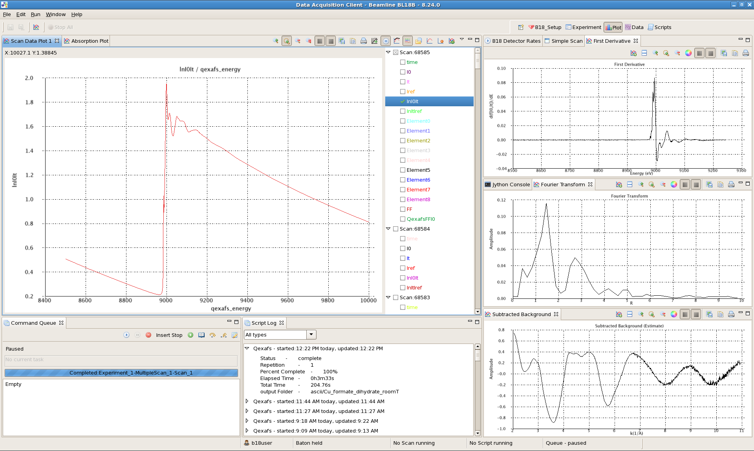
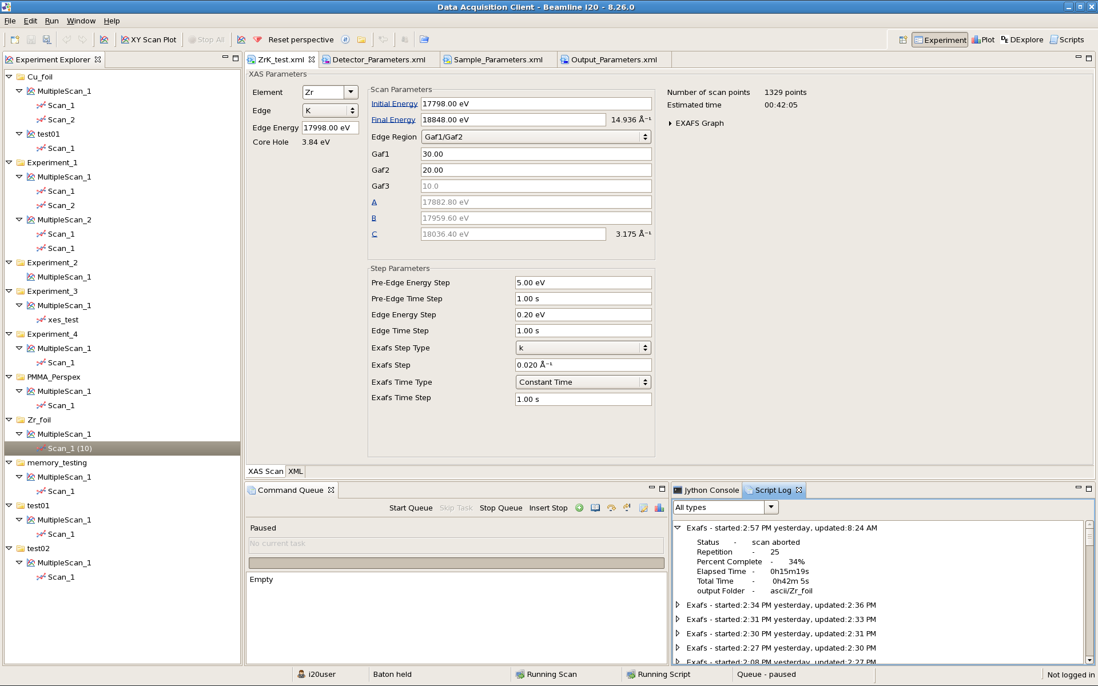
Spectroscopy
Notes:
Spectroscopy used to be a small data rate technique but that now changed with the introduction of new multi-cell detectors, the desire to keep whole spectra and perform raster scans over samples such as the image on the right hand screen shot.
A recent raster scan produced 10 GB in 2 hours recording 34pts/s.

Slide 5
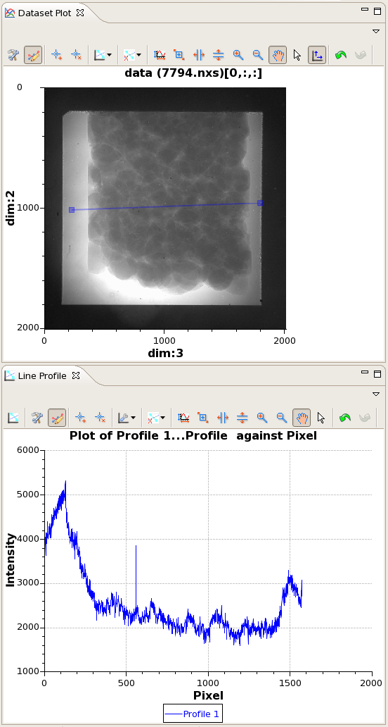
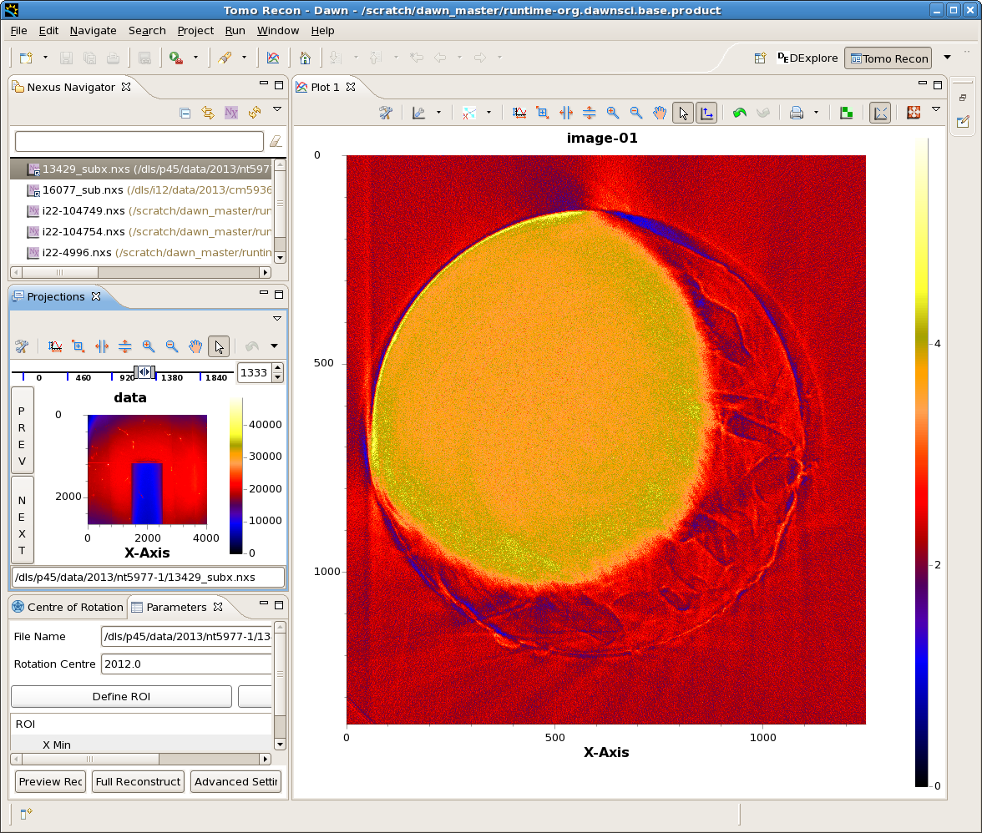
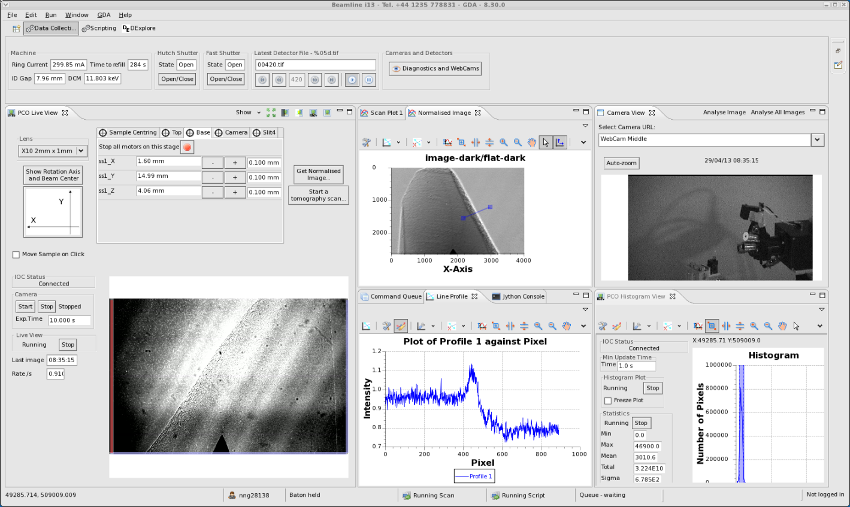
Tomography
Notes:
Diamond’s 2 Tomography beamlines also have dedicated perspectives to perform sample alignment, data collection definition and monitoring and reconstruction.
In flyscan mode a whole set of 1800 tomography images can be taken in 10s as the image rotates 180 degrees. That is a data acquisition rate of
1.4GB/s.

Slide 6
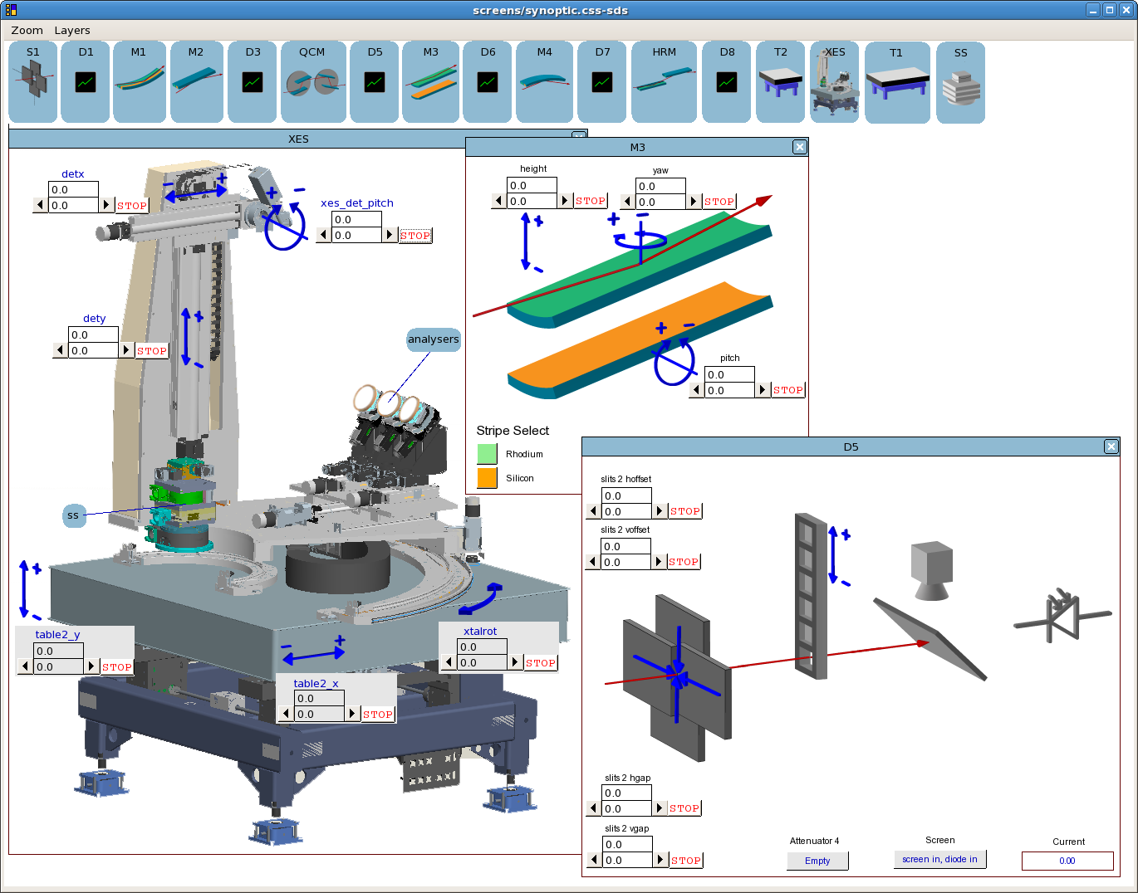
Others:
Electron Spectroscopy
Powder Diffraction…
Notes:
There are another 9 beamlines which run GDA at Diamond. Some perspectives have been developed specifically for these but most of them use the GDA client out of the box with differently configured control objects and scripts on the server.

Slide 7
www.dawnsci.org
Notes:
The Scientific Software team at Diamond develop another Eclipse product called DAWN with provides data visualisation and analysis through a rich set of features and plugins. Many of those plugins are used within GDA clients and server code so it is essential I recognise the major input they have made to the success of GDA.

Slide 8
www.opengda.org
Notes:
If you want to know more about GDA please grab me or go to www.opengda.org.

Slide 9
> scan motor 0. 1000. 1. det 1 process
Time
1
2
3
motor
det
process
Command Thread
Task threads and Publish Thread
Notes:
So after that brief status report I will move onto a short but hopefully illuminating description of scanning in GDA.
At Diamond a scan is a series of measurements of a set of variables over one or more dimensions of some other dependent variables.
So for example a series of measurements of the number of xrays passing through a material as the material is rotated.
The result of a scan is a collation of these measurements along with some metadata. Normally the collation takes the form of 1 or more data files.
In the slide I present a simple command to perform a scan of a motor from 0. to 1000. in steps of 1. At each position the detector is to be exposed for 1 second. The resulting image is then processed by the task called process..
The bottom section of the slide tries to represent the different actions in time that GDA takes to perform this scan. In step 1 the motor is moved to the first position. Next the detector is exposed. After exposure you see 2 actions take place simultaneously. The next motor move and detector exposure takes place whilst at the same time the readout of the detector and its processing also takes place. So you see, although this is a simple step scan GDA does not waste time waiting for the detector readout and processing.

Slide 10
Task executing pipeline
scna:10 scnb:20
det:task
scna: 1
scnb: 2
scnc:25
Terminal
View
Move Motor
Expose Det
Plot View
Pipeline
scna
scnb
(NeXus)
det
Executor
Service
Command Thread
Publish Thread
Notes:
This slide attempts to show the multithreaded nature of the GDA scan system.
The motor moves and detector exposures take place in the command thread.
For each position a set of task objects is generated and put onto a pipeline . As each set of task completes the resulting data is sent to the file writer and clients for display

Slide 11
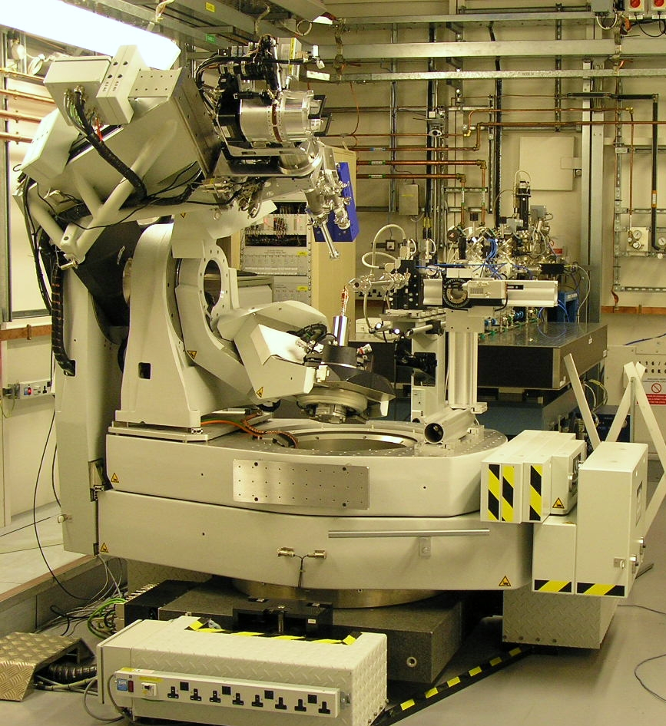
Fly scans
Big stages take ~500ms to settle but exposure time is <100ms, so:
Constant velocity
Trajectory
Trigger image
2D detector
Motor controller
Trigger Generator
Advance bin
MCS
MCS
Notes:
So GDA scans do not waste time. But if we think back to the time line of the step scan we see that whilst the motor is moving the precious xrays are being ignored. For exposure times that are long compared to the move time this may not be a concern but where the exposure time is of order 10ms and motor settle time is of order 100ms it is a big concern. For these types of measurements we need to change from step scans to flyscans in which the motor moves continuously.
In a flyscan data is generated too fast for it to be read and captured to disk using the request mechanism used in step scans. Instead the data from the detectors needs to be sent to a store automatically from which it can be read asynchronously by the pipeline. Also the signal to expose cannot be software generated during the scan. Instead it must be generated using hardware based on a preconfigured algorithm.
The basic scan framework described for step scans, can still be used for these types of scans if we change it slightly.

Slide 12
Tomography Scan
>scan m 0. 180. 0.1 det .005
5ms per point.
8MB per point.
Whole scan 10s. 14GB per scan

Slide 13
Task executing pipeline
Populate Pipeline with tasks for
Motor and detector for each point
scna:10 scnb:20
det:task
scna: 1
scnb: 2
scnc:25
Terminal
View
Features of the Data Acq.
Plot View
Pipeline
scna
scnb
(NeXus)
det
Executor
Service
Command Thread
Publish Thread
Notes:
If we simply change the Command thread action in the step scan so that instead of moving the motors it ‘pretends’ to move the motors then we end up with a collection of tasks on the pipeline for each point of the scan. No task can complete however until the actual move takes place later as indicated by the recording of data in the detector data store.

Slide 14
Task executing pipeline
Configure and arm trigger generator
and detector
scna:10 scnb:20
det:task
scna: 1
scnb: 2
scnc:25
args
Terminal
View
Features of the Data Acq.
Plot View
Pipeline
scna
scnb
Terminal
Logger
det
Executor
Service
(NeXus)
Command Thread
Publish Thread
Notes:
As well as populating the pipeline with future tasks the trigger generator and detector are configured and armed.

Slide 15
Task executing pipeline
Start motor and monitor the data stores
scna:10 scnb:20
det:task
scna: 1
scnb: 2
scnc:25
args
Terminal
View
Features of the Data Acq.
Plot View
Pipeline
scna
scnb
Terminal
Logger
det
Executor
Service
(NeXus)
Command Thread
Publish Thread
Notes:
Then we can start the motor move. As it moves the detectors will be triggered. The data stores will receive data, and the future tasks on the pipeline will detect this and complete; allowing data to be sent to file writers and clients as before.

Slide 16
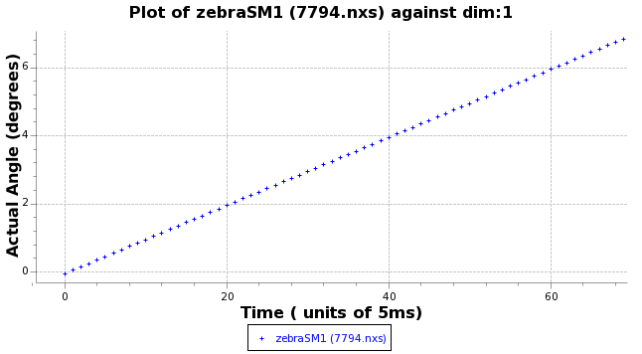

Slide 17
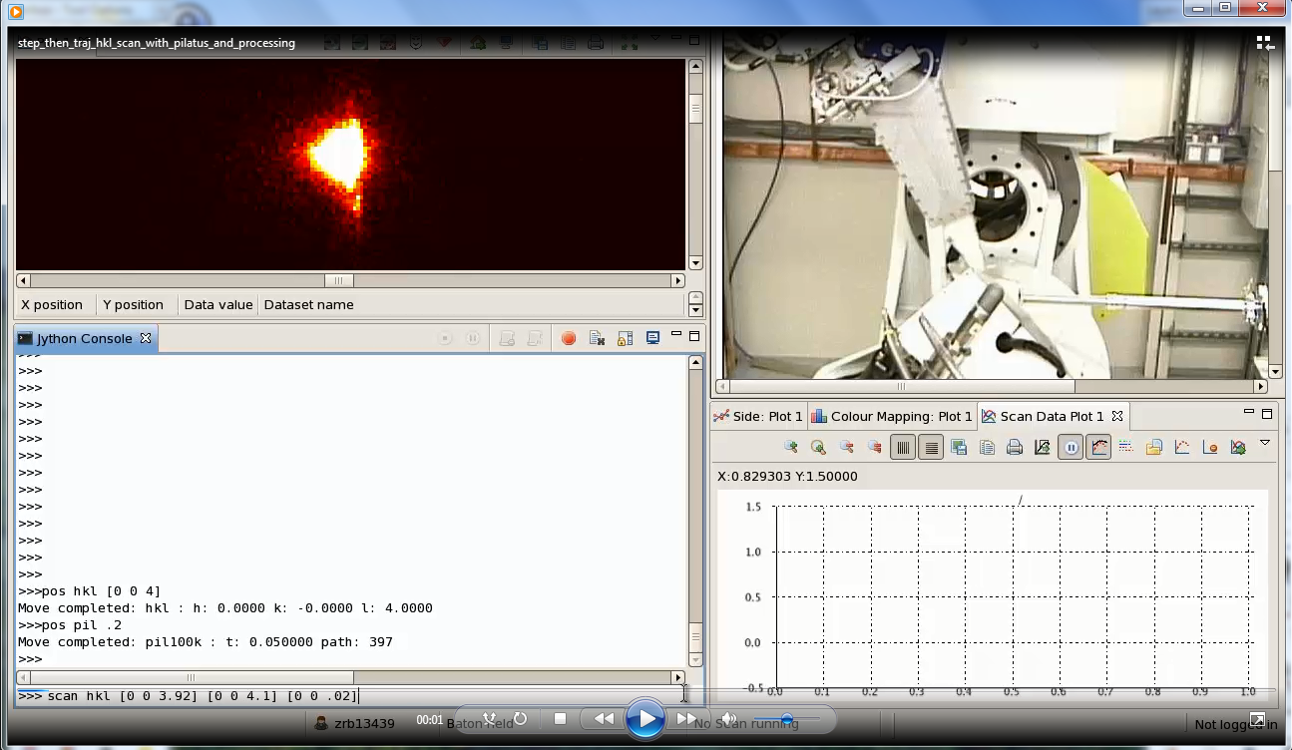
Part 1 Step Scan: 10 points. 200ms exposure
>scan hkl [0,0,3.92] [0,0,4.10] [0,0,.02] pil .2 max2d
Part 2 TrajScan: 200 points. 50ms exposure.
>trajscan hkl [0,0,3.92] [0,0, 4.1] [0,0, .001] pil .05 max2d
Notes:
So now for a quick movie showing the scanning in action on a 6 circle diffractometer.
Two scans are performed. First a step scan and then a flyscan.
The scans are over the same path in reciprocal space.
The window at the top left shows the image recorded by the 2d detector.
The window in bottom left is where commands are entered and scan results are printed.
The top right window is a webcam of the equipment. The beam comes from the right and the detector is on an arm that rotates around the sample.
For each point the image is written to file. Then in a processing task it is read and the total counts within a region of interest in the middle of the image is evaluated and reported.
The window on the bottom right displays the total counts at each step.
Note that the first scan has 10 points each of .2s exposure whilst the flyscan has 200 points each of 50ms exposure.
The bottom right is a plot of the results of the scan.

