Slide 1
Acquisition of Long Waveform using Yokogawa SL1000
Shuei YAMADA
KEK / J-PARC
Notes:
May 02, 16:30 10min + 5min

Slide 2
Contents
J-PARC
Long-waveforms in J-PARC MR
Yokogawa SL-1000
Summary

Slide 3
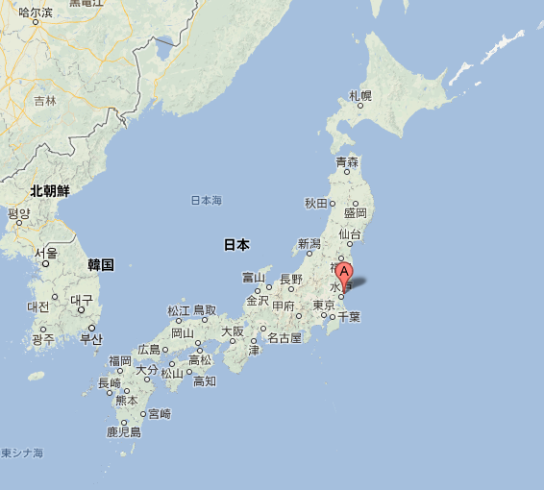
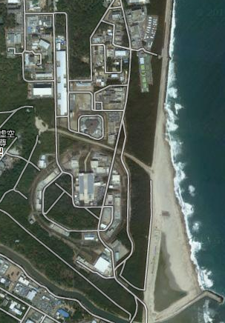
Japan Proton Accelerator Research Complex : J-PARC
Tokai village, Ibaraki 130km from Tokyo 80km from Tsukuba
Tsukuba
Tokyo
Notes:
130km away from tokyo

Slide 4
J-PARC Facilities
Neutrino Experiment Facility
Materials and Life Science Facility
LINAC 180MeV/c 25Hz
Hadron Experiment Facility
RCS 3GeV/c 25Hz
Main Ring 30GeV/c 2.48 sec (FX) 6.0 sec (SX) In operation since 2008
N
©google
Pacific ocean
Notes:
An aerial photo of J-PARC

Slide 5
J-PARC Main Ring
MW-class High Power Proton Synchrotron for Particle Physics and Hadron Physics
T2K neutrino oscillation experiment
Hadron experiments (e.g. Kaon rare decays)
Future experiments (e.g. μ-e conversion)
Slow-Cycle Machine
Accelerate from 3 GeV to 30 GeV
Fast Extraction 2.48 s [0.12 (inj) + 1.4 (acc) + recovery]
Slow Extraction: 6.0 s [0.12 (inj) + 1.9 (acc) + 2.9 (sx) + recovery]
Need to monitor entire cycle, in cycle-by-cycle
➔ Long Waveforms are Important
©google
Notes:
An aerial photo of J-PARC

Slide 6
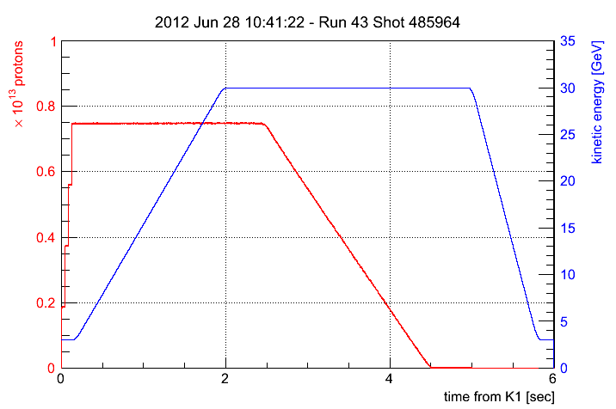
Example of a Long Waveform: MR Beam Intensity
MR cycle (6 sec, Slow Extraction)
Record each cycle
Requirements from Machine Operation
Estimators of Beam Loss, Slow Extraction quality
5sec @ 100kHz for waveform
1sec for data transfer
Notes:
2013.Sep 受注終了

Slide 7
Yokogawa WE7000
30-40 Units being used in J-PARC MR
DCCT, BPM, Magnet Power Supplies, etc.
Many experiences
15 years old
Small memory size: few MWords (depends on A/D module)
Slow data transfer: 1800 kB/s (WE7000 → EPICS IOC)
Discontinued
Notes:
Data size: 3.64s * 100kHz * 2bytes/ch * 2 = 1456000 bytes = 1421.875 kB
1421.875 kB / 1.6s (UDP 1.4kbytes packet) 890 kB/s
1421.875 kB / 0.765s (UDP 32kbytes packet) 1860 kB/s
1998年に登場

Slide 8
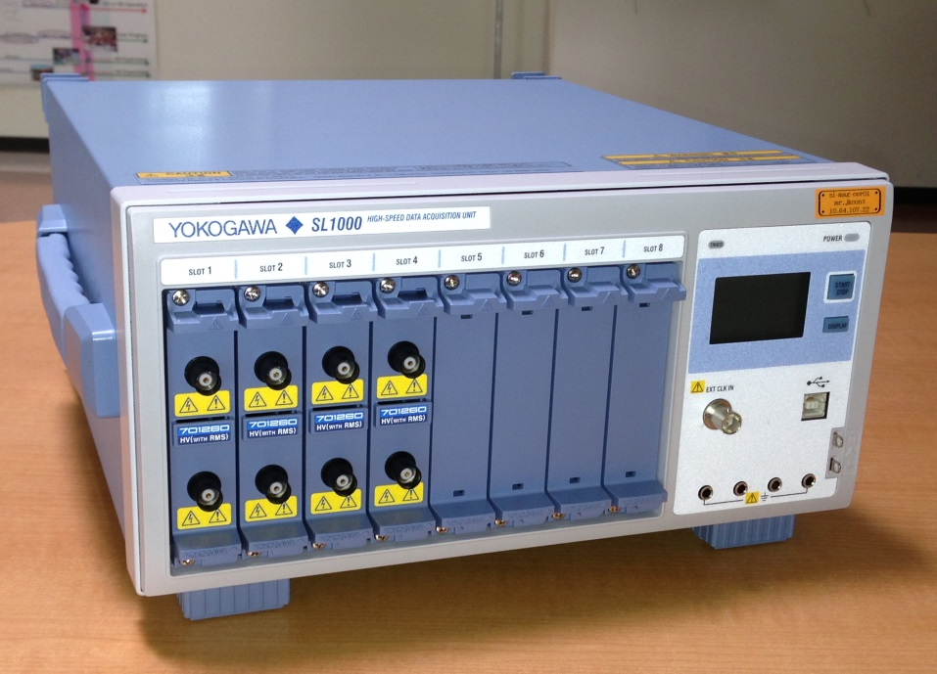
Yokogawa SL1000
Modular-type DAQ system
Replacement of WE7000
16 channels (2ch * 8slots)
Isolated inputs (850V)
Various A/D modules (100MHz12bit - 100kHz16bit)
Data transfer rate: 5900 kB/s (SL1000 → IOC, preliminary)
Max. record length: 100MW/unit
VXI-11 (1000Base-T) & USBTMC
EPICS Device Support
Notes:
5 sec * 10kHz * 6ch * 2bytes / 1024 = 590 kBytes
590 kB / 0.1s = 5900 kB/s

Slide 9
SL1000 Device Support
Yokogawa’s reference Implementation
Oscilloscope (# of samples: 1-2-5 sequence)
Decimated waveform per channel
Single raw waveform record shared by all channels
KEK / J-PARC in-house ver.
Based on Yokogawa’s
Arbitrary number of samples
Raw waveform per channel
Testing in SX operation
http://www-linac.kek.jp/cont/epics/sl1000/

Slide 10
Summary
 | WE7000 | SL1000
 | Modular-type DAQ system | Modular-type DAQ system
Life | 1997-2013 (discontinued) | 2007Dec-
EPICS Device Support | By KEK (2002-2012) | By Yokogawa (oscilloscope, db + OPI) By KEK (2012-, in J-PARC)
Data transfer rate | 1800 kB/s | 5900 kB/s (preliminary)
# of units in use | J-PARC MR 30-40 J-PARC LI …10 | Few (in test phase)

Slide 11
Notes:
11

Slide 12
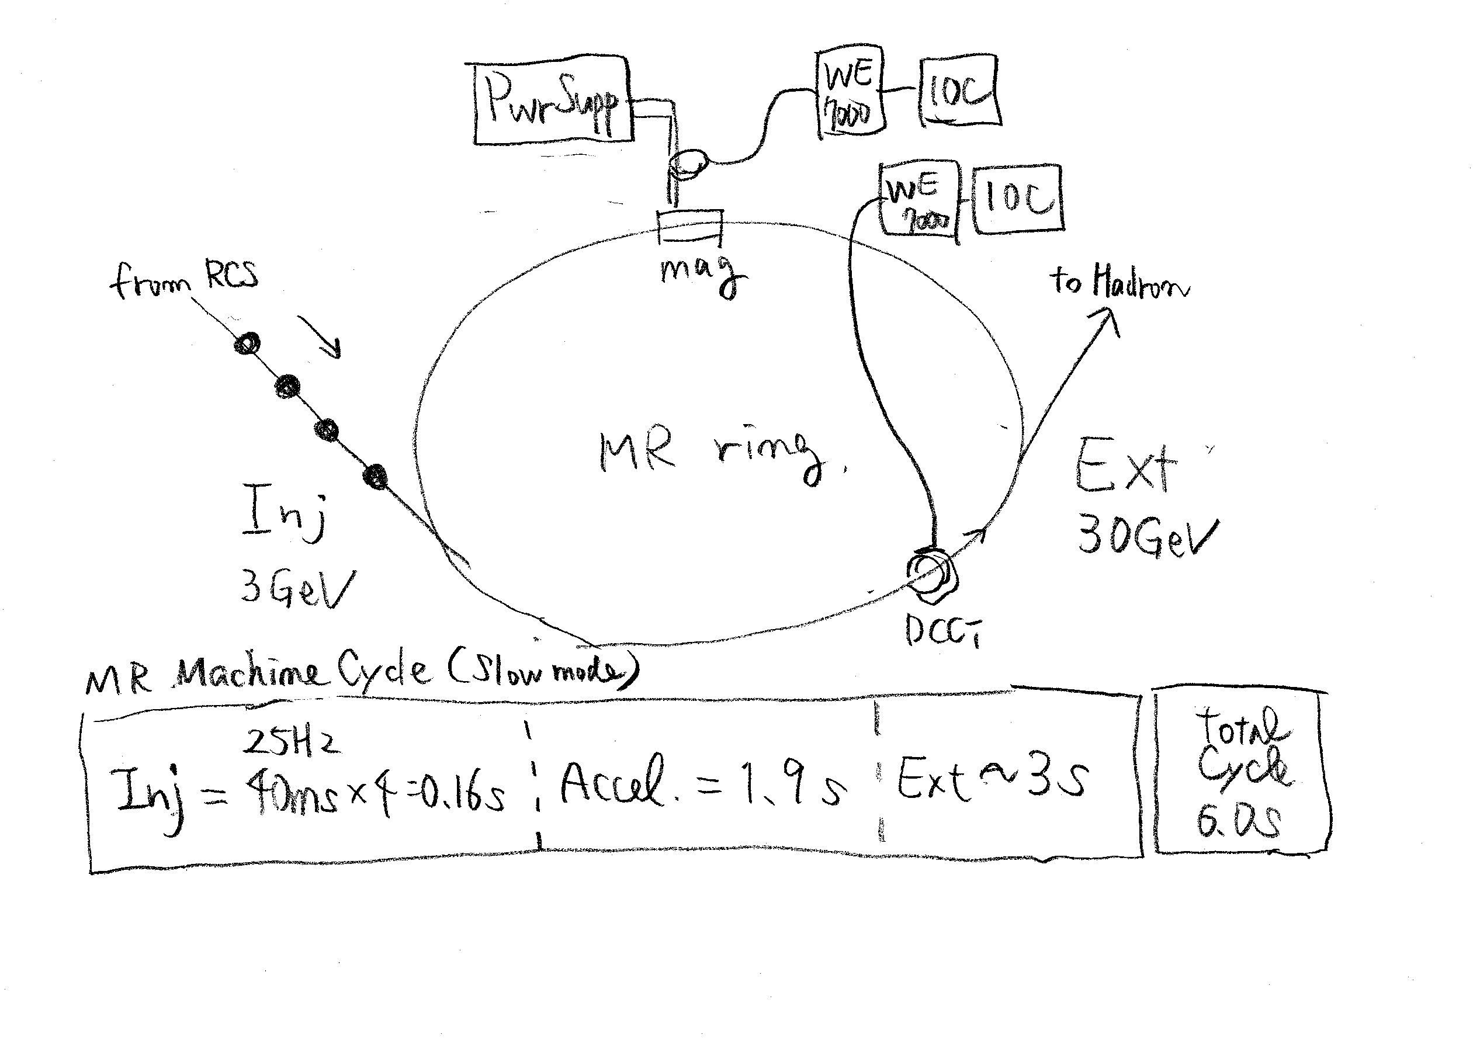

Slide 13
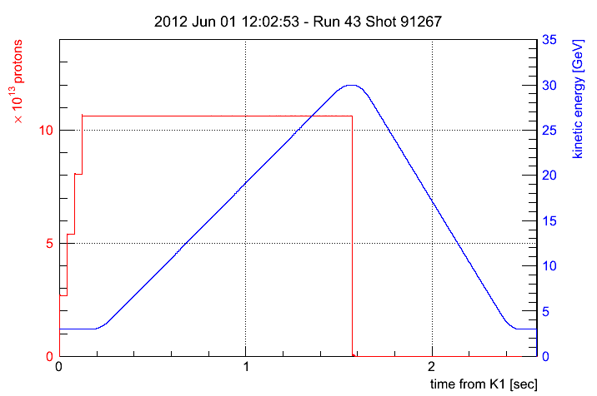
MR Operation Modes
Fast Extraction
Slow Extraction

Slide 14
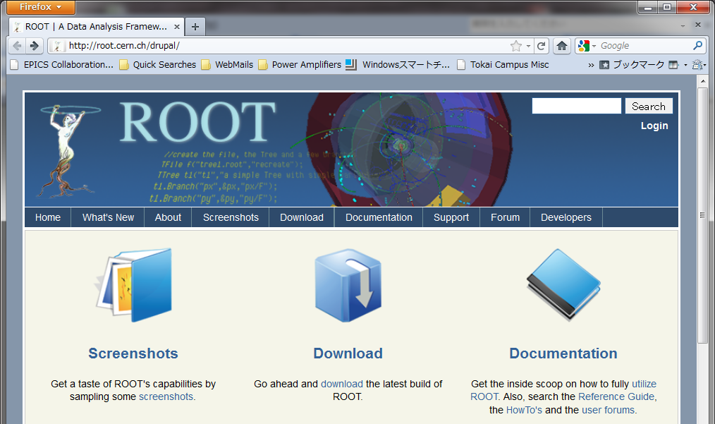
Data Size in J-PARC MR : 400GB/week
Operation of MR and data taking started in 2008
MR cycle : 3 sec (FX), 6 sec (SX)
Record all waveform data each cycle
As many waveform as possible
3-50BT BPM
MR Injection Error Monitor
MR BPM
MR DCCT
SX Spill
Notes:
400GB / w = 2.4GB/day

Slide 15
ROOT in J-PARC MR
EPICS record
EPICS record
EPICS record
ROOT-based
data acquisition tool : cadump
Collects data from EPICS-records each MR cycle
Save as ROOT-file
ROOT-file
Self describing
- Definition of data classes written in file
Backward and forward compatible
- Files created in 2010 should be readable in 2020
Data analysis using ROOT
cadump
trigger
ROOT-file
storage
Offline Analysis
Online Monitor

