Slide 1
Motor A recipe for driver implementation using the C++ asyn motor API
Jon Thompson
For the 2013 EPICS for experiment control workshop,
Diamond Light Source, April 2013.

Slide 2
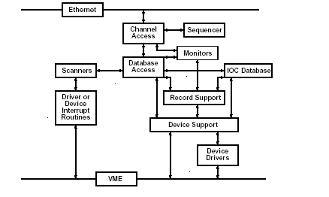
Introduction
Standard EPICS interface between device support and drivers is only loosely defined
The motor record did define an API for device support but was hard to extend.
Using asyn for motor support provides extensibility and all the standard I/O.
The C++ API builds on the asynPortDriver API.

Slide 3
The C++ API
The asynMotorController base class represents the controller.
uses ‘parameters’ to communicate motor commands.
Define further ‘parameters’ to extend.
The asynMotorAxis base class represents a single motor.
Override the motor control functions to send commands to the hardware.
Connect to a port driver to communicate with the device.

Slide 4
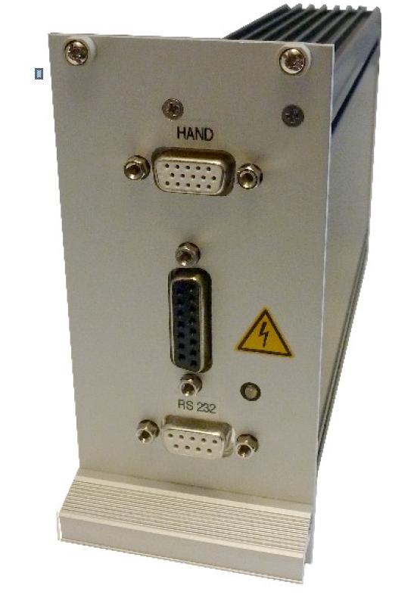
An Example
Smaract piezo motor modular control system.
The protocol consists of messages with the following syntax:
‘:’ <command> <param> [ ‘,’ <param> ] ‘LF’
SCLS <chan>,<speed> -> E-1,0 | Set the axis velocity
MPA<chan>,<pos>,<holdT> -> E<chan>,<err> | Move to absolute position
GP<chan> -> P<chan>,<pos> | Get current position
GS<chan> -> S<chan>,<status> | Get status
FRM<chan>,<dir>,<holdT>,<autoZ> -> E<chan>,<err> | Find reference mark (home)
S<chan> -> E<chan>,<err> | Stop a channel’s motion
SP<chan>,<pos> -> E<chan>,<err> | Set the position
CS<chan> -> E<chan>,<err> | Calibrate the sensor
GIV -> IV<verHigh>,<verLow>,<build> | Get version information

Slide 5
An Example
Derive from asynMotorController
Implement poll
Override writeInt32 to provide extensions
Derive from asynMotorAxis.
Implement motor control functions.

Slide 6
Code Required
Dependency definition in the ‘RELEASE’ file.
C++ code in the ‘src’ directory.
Database template code in the ‘Db’ directory.
smaract
smaractApp
src
Db
configure
RELEASE
mcsController.template
mcsController.h
smaract.dbd
Makefile
Makefile
mcsController.cpp
mcsAxis.h
mcsAxis.cpp
mcsAxis.template

Slide 7
Controller Class Declaration
class mcsController : public asynMotorController
{
friend class mcsAxis;
private:
// Constants
enum {RXBUFFERSIZE=200, TXBUFFERSIZE=200, RESBUFFERSIZE=30, CONNECTIONPOLL=10};
public:
mcsController(const char *portName, int controllerNum,
const char* serialPortName, int serialPortAddress, int numAxes,
double movingPollPeriod, double idlePollPeriod);
virtual ~mcsController();
// Overridden from asynMotorController
virtual asynStatus poll();
virtual asynStatus writeInt32(asynUser *pasynUser, epicsInt32 value);
Constants.
Constructor and overrides.
Notice similarity with asynPortDriver.

Slide 8
Controller Class Declaration
private:
/* Methods for use by the axes */
bool sendReceive(const char* tx, const char* txTerminator,
char* rx, size_t rxSize, const char* rxTerminator);
bool command(const char* cmd, const char* rsp, int* a, int* b, int*c);
bool command(const char* cmd, int p, int q, const char* rsp, int* a, int* b, int*c);
bool command(const char* cmd, const char* rsp, int* a);
bool command(const char* cmd, int p, const char* rsp, int* a);
bool command(const char* cmd, int p, int q, const char* rsp, int* a);
bool command(const char* cmd, int p, const char* rsp, int* a, int* b);
bool command(const char* cmd, int p, const char* rsp, int* a, int* b, int* c);
bool command(const char* cmd, int p, int q, const char* rsp, int* a, int* b);
bool command(const char* cmd, int p, int q, int r, const char* rsp, int* a, int* b);
bool command(const char* cmd, int p, int q, int r, int s, const char* rsp, int* a, int* b);
Protocol transceiver helper functions

Slide 9
Controller Class Declaration
Parameter indices.
Private member data.
protected:
int FIRST_PARAM;
int indexVersionHigh;
int indexVersionLow;
int indexVersionBuild;
int indexConnected;
int indexActiveHold;
int indexCalibrateSensor;
int LAST_PARAM;
private:
/* Data */
asynUser* serialPortUser;
int controllerNum;
int connectionPollRequired;
};

Slide 10
Axis Class Declaration
class mcsAxis : public asynMotorAxis
{
public:
mcsAxis(mcsController* ctlr, int axisNum, bool rotary);
virtual ~mcsAxis();
// Overridden from asynMotorAxis
virtual asynStatus move(double position, int relative,
double minVelocity, double maxVelocity, double acceleration);
virtual asynStatus moveVelocity(double minVelocity,
double maxVelocity, double acceleration);
virtual asynStatus home(double minVelocity,
double maxVelocity, double acceleration, int forwards);
virtual asynStatus stop(double acceleration);
virtual asynStatus setPosition(double position);
virtual asynStatus poll(bool *moving);
// Used by mcsController
void calibrateSensor(int yes);
private:
/* Data */
mcsController* controller;
int axisNum;
int curPosition;
};
Override standard motor control functions
Functions that implement extensions.

Slide 11
Asyn Parameter Names
#define indexVersionHighString "VERSION_HIGH"
#define indexVersionLowString "VERSION_LOW"
#define indexVersionBuildString "VERSION_BUILD"
#define indexConnectedString "CONNECTED“
#define indexCalibrateSensorString "CALIBRATE_SENSOR“
#define NUM_PARAMS(&LAST_PARAM - &FIRST_PARAM - 1)
Define the extension parameter names.
Just the same as asynPortDriver example.

Slide 12
Controller Class Constructor
mcsController::mcsController(const char* portName, int controllerNum,
const char* serialPortName, int serialPortAddress, int numAxes,
double movingPollPeriod, double idlePollPeriod)
: asynMotorController(portName, numAxes, NUM_PARAMS,
/*interfaceMask=*/0, /*interruptMask=*/0,
/*asynFlags=*/ASYN_MULTIDEVICE | ASYN_CANBLOCK, /*autoConnect=*/1,
/*priority=*/0, /*stackSize=*/0)
, controllerNum(controllerNum)
, connectionPollRequired(0)
Pass in the name and address of the serial asyn port.
Parameters to the base class constructor
The number of asyn parameters we are going to define
Define which asyn interfaces we are using. Note that the base class ORs in all the necessary bits.
Various flags
Initialise members

Slide 13
Controller Class Constructor
createParam(indexVersionHighString, asynParamInt32, &indexVersionHigh);
createParam(indexVersionLowString, asynParamInt32, &indexVersionLow);
createParam(indexVersionBuildString, asynParamInt32, &indexVersionBuild);
createParam(indexConnectedString, asynParamInt32, &indexConnected);
createParam(indexCalibrateSensorString, asynParamInt32, &indexCalibrateSensor);
setIntegerParam(indexConnected, 0);
setIntegerParam(indexCalibrateSensor, 0);
setIntegerParam(indexVersionHigh, 0);
setIntegerParam(indexVersionLow, 0);
setIntegerParam(indexVersionBuild, 0);
Create the extra asyn parameters
Usually one per PV.
Binds the name to the parameter.
Returns an integer handle to the parameter.
Initialise parameters if necessary.

Slide 14
Controller Class Constructor
// Connect to the serial port
if(pasynOctetSyncIO->connect(serialPortName, serialPortAddress,
&serialPortUser, NULL) != asynSuccess)
{
printf("mcsController: Failed to connect to serial port %s\n",
serialPortName);
}
// Create the poller thread
startPoller(movingPollPeriod, idlePollPeriod, /*forcedFastPolls-*/10);
}
Connect up to the asyn serial port.
Start the polling thread (but we don’t have to create it this time).

Slide 15
Polling Controller State
asynStatus mcsController::poll()
{
bool ok = true;
int verHigh, verLow, verBuild;
ok = command("GIV", "IV", &verHigh, &verLow, &verBuild);
if(ok)
{
setIntegerParam(indexVersionHigh, verHigh);
setIntegerParam(indexVersionLow, verLow);
setIntegerParam(indexVersionBuild, verBuild);
setIntegerParam(indexConnected, 1);
}
else
{
setIntegerParam(indexConnected, 0);
}
callParamCallbacks();
}
This function only needs to poll controller wide information.
Called with the lock already taken.
Useful to determine controller connection state.
Note the transmit receive function ‘command’.

Slide 16
Handling PV Writes
asynStatus mcsController::writeInt32(asynUser *pasynUser, epicsInt32 value)
{
int a;
int b;
int function = pasynUser->reason;
mcsAxis* axis = dynamic_cast<mcsAxis*>(getAxis(pasynUser));
if(axis != NULL && function == indexCalibrateSensor)
{
// Calibrate the sensor of the specified axis
axis->calibrateSensor(value);
}
return asynMotorController::writeInt32(pasynUser, value);
}
Base class writes parameter and does call backs.
We just send information to the axis.

Slide 17
Communicating With the Device
Same principles as the asynPortDriver example.
In this example, a set of ‘command’ functions provide easy access to the smaract command set.
Exact details will vary depending on the device.

Slide 18
The Axis Class
Just a matter of sending the correct commands for each of the motor control functions.
The poll function should get the current state of the axis; position, limits, etc.

Slide 19
Explaining to EPICS
static const iocshArg mcsControllerConfigArg0 = {"port name", iocshArgString};
static const iocshArg mcsControllerConfigArg1 = {"controller number", iocshArgInt};
static const iocshArg mcsControllerConfigArg2 = {"serial port name", iocshArgString};
static const iocshArg mcsControllerConfigArg3 = {"serial port address", iocshArgInt};
static const iocshArg mcsControllerConfigArg4 = {"number of axes", iocshArgInt};
static const iocshArg mcsControllerConfigArg5 = {"moving poll period (ms)", iocshArgInt};
static const iocshArg mcsControllerConfigArg6 = {"idle poll period (ms)", iocshArgInt};
static const iocshArg *const mcsControllerConfigArgs[] =
{
&mcsControllerConfigArg0, &mcsControllerConfigArg1,
&mcsControllerConfigArg2, &mcsControllerConfigArg3,
&mcsControllerConfigArg4, &mcsControllerConfigArg5,
&mcsControllerConfigArg6
};
static const iocshFuncDef mcsControllerConfigDef =
{"mcsControllerConfig", 7, mcsControllerConfigArgs};
static void mcsControllerConfigCallFunc(const iocshArgBuf *args)
{
mcsControllerConfig(args[0].sval, args[1].ival, args[2].sval, args[3].ival,
args[4].ival, args[5].ival, args[6].ival);
}
static const iocshArg mcsAxisConfigArg0 = {"controller port name", iocshArgString};
static const iocshArg mcsAxisConfigArg1 = {"axis number", iocshArgInt};
static const iocshArg mcsAxisConfigArg2 = {"a rotary stage", iocshArgInt};
static const iocshArg *const mcsAxisConfigArgs[] =
{
&mcsAxisConfigArg0, &mcsAxisConfigArg1, &mcsAxisConfigArg2
};
static const iocshFuncDef mcsAxisConfigDef =
{"mcsAxisConfig", 3, mcsAxisConfigArgs};
static void mcsAxisConfigCallFunc(const iocshArgBuf *args)
{
mcsAxisConfig(args[0].sval, args[1].ival, args[2].ival);
}
static void mcsRegister(void)
{
iocshRegister(&mcsControllerConfigDef, mcsControllerConfigCallFunc);
iocshRegister(&mcsAxisConfigDef, mcsAxisConfigCallFunc);
}
epicsExportRegistrar(mcsRegister);
Mostly Boilerplate
Two IOC shell commands this time.

Slide 20
And a DBD File
registrar(“mcsRegister")
Connects EPICS to the driver.

Slide 21
Database Template
# Communications state indication
record(bi, "$(P)$(R):CONNECTED")
{
field(SCAN, "I/O Intr")
field(DTYP, "asynInt32")
field(VAL, "0")
field(INP, "@asyn($(PORT),0,$(TIMEOUT))CONNECTED")
field(ZNAM, "Disconnected")
field(ONAM, "Connected")
}
record(longin, "$(P)$(R):VERSIONHI")
{
field(SCAN, "I/O Intr")
field(DTYP, "asynInt32")
field(VAL, "0")
field(INP, "@asyn($(PORT),0,$(TIMEOUT))VERSION_HIGH")
}
Often two templates, one for the controller.

Slide 22
Database Template
record(bo, "$(P)$(R):CALIBRATE")
{
field(SCAN, "Passive")
field(DTYP, "asynInt32")
field(VAL, "0")
field(OUT, "@asyn($(PORT),$(AXIS),$(TIMEOUT))CALIBRATE_SENSOR")
field(PINI, "1")
field(ZNAM, "Idle")
field(ONAM, "Calibrate")
}
And another for an axis.
All standard axis fields are connected to a motor record.
Extensions need their own records.

Slide 23
Using – The Startup Script
cd "$(INSTALL)"
dbLoadDatabase("dbd/example.dbd")
example_registerRecordDeviceDriver(pdbbase)
drvAsynIPPortConfigure(“smaract1_ser", "localhost:9015", 100, 0, 0)
mcsControllerConfig("smaract1", 1, "smaract1_s", 0, 3, 1000, 1000)
mcsAxisConfig("smaract1", 0)
mcsAxisConfig("smaract1", 1)
mcsAxisConfig("smaract1", 2)
dbLoadRecords("db/example.db")
iocInit
Note the chaining of an IP asyn port to the Smaract controller.
Definition of each axis that the controller is to support.

Slide 24
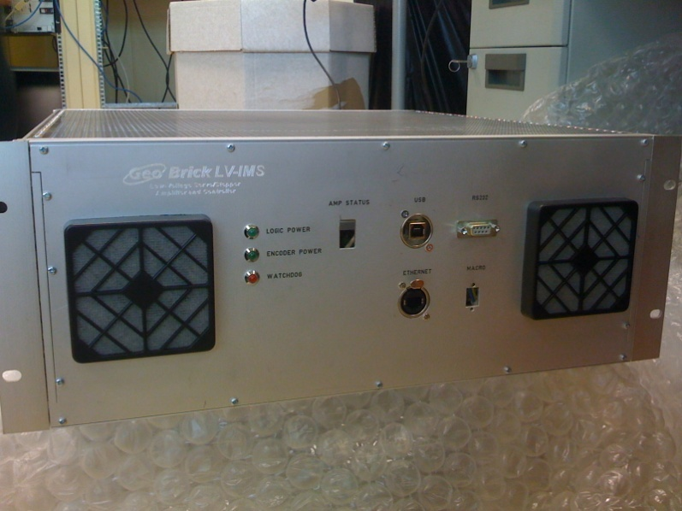
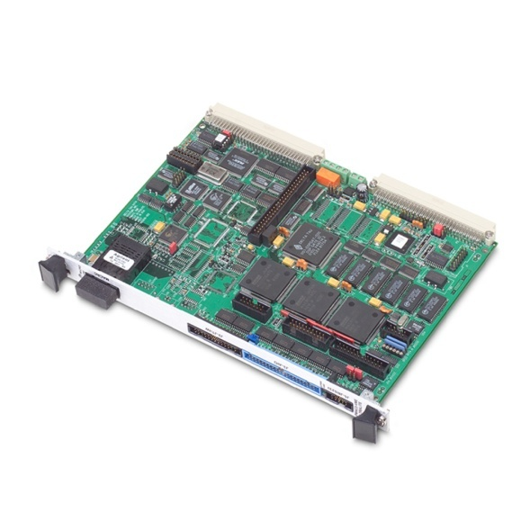
Motion at Diamond
VME PMAC Turbo 2
+ separate UMAC and
Amplifiers crates
Geobrick LV IMS
Integrated amplifiers
4U box
Ethernet comms
Also have about 10 Newport XPS.
Plus a few one-off controllers.
24 operational beamlines.
>1000 motorised axes

Slide 25
Coordinated Motion
1. High level software at the motor record level.
Set VAL in two or more motor records as quick as you can.
caput {motor1}.VAL 1.0
caput {motor2}.VAL 2.0
Not very synchronized. Motors start and stop at different times. Simple.
2. Queue up move commands in the driver (‘deferred moves’).
caput {controller}:DEFER 1 (turn on deferred moves)
caput {motor1}.VAL 1.0
caput {motor2}.VAL 2.0
caput {controller}:DEFER 0 (turn off deferred moves – motor start moving).
A little more synchronized (best effort by the driver).
Motors start and stop at different times.
Makes client app more complicated because multiple threads are sometimes needed.

Slide 26
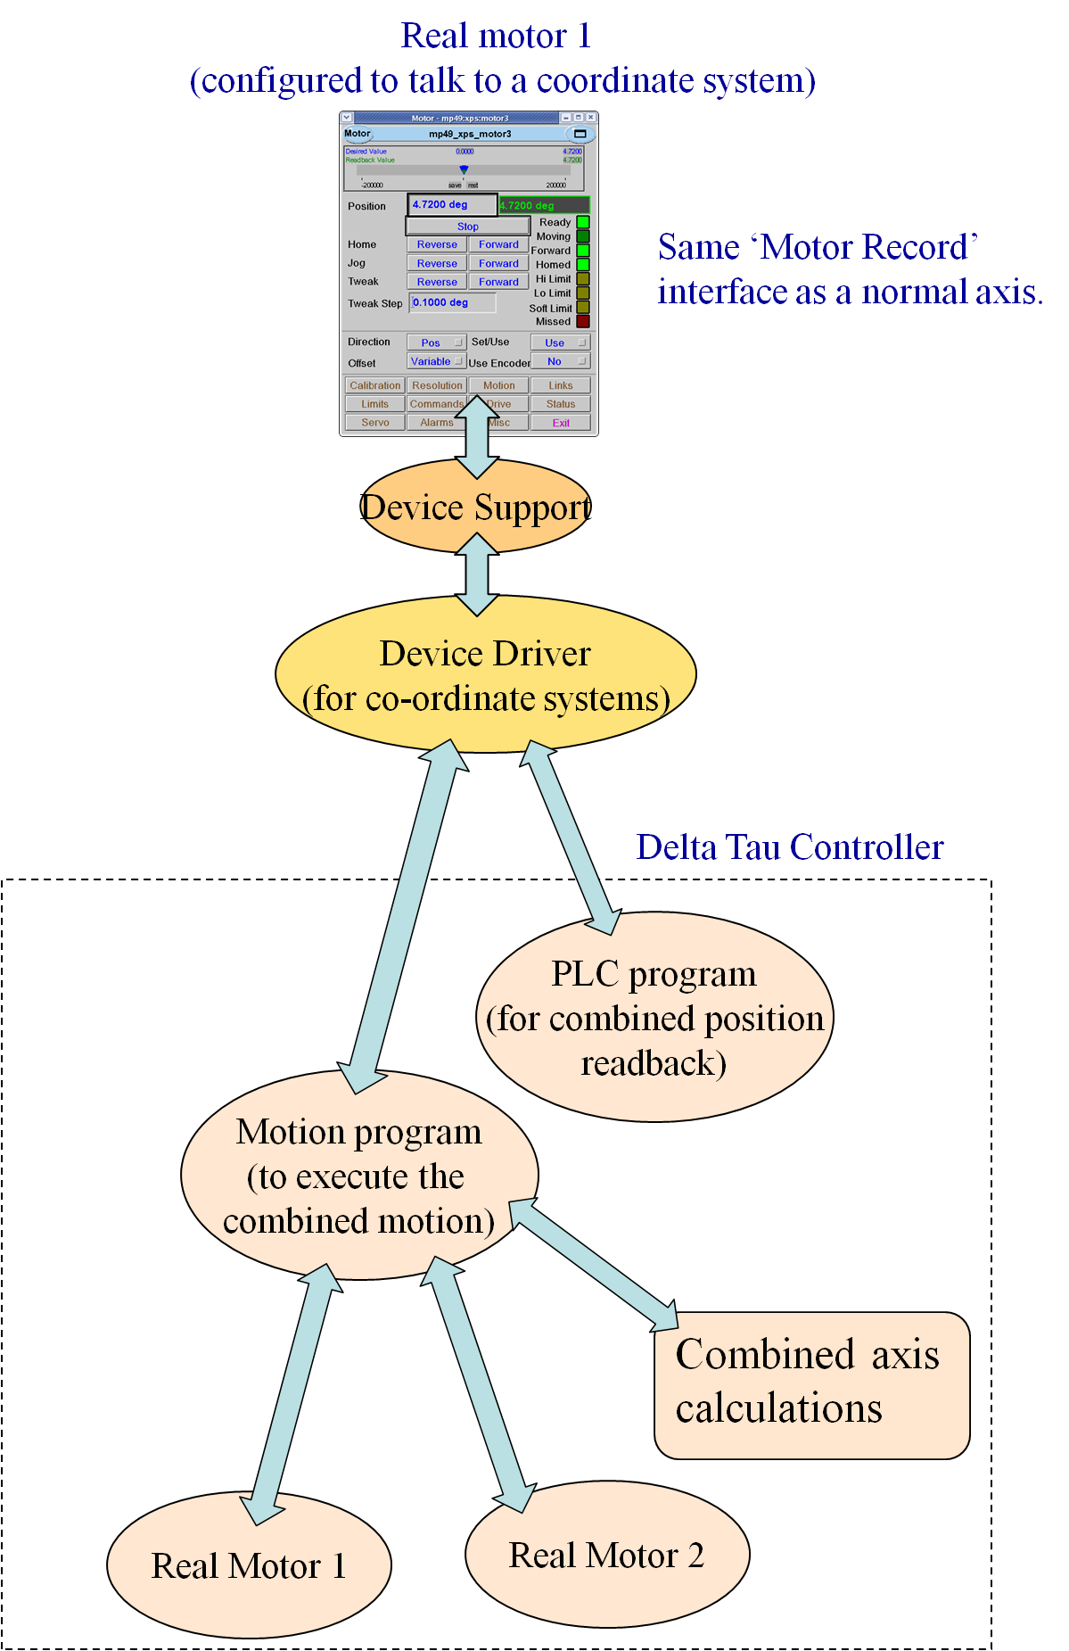
Coordinated Motion
3. Use controller co-ordinated, or group, moves.
For PMAC:
New driver for co-ordinate systems
PLC running on controller
Controller motion program
True synchronized motion – axes start and stop
at the same time. More complicated. More code.
For XPS:
Group axes into a MultipleAxis group.
Do a group move on 1 or more axes.
Complexity hidden in XPS firmware. EPICS driver
can do this using deferred moves.

Slide 27
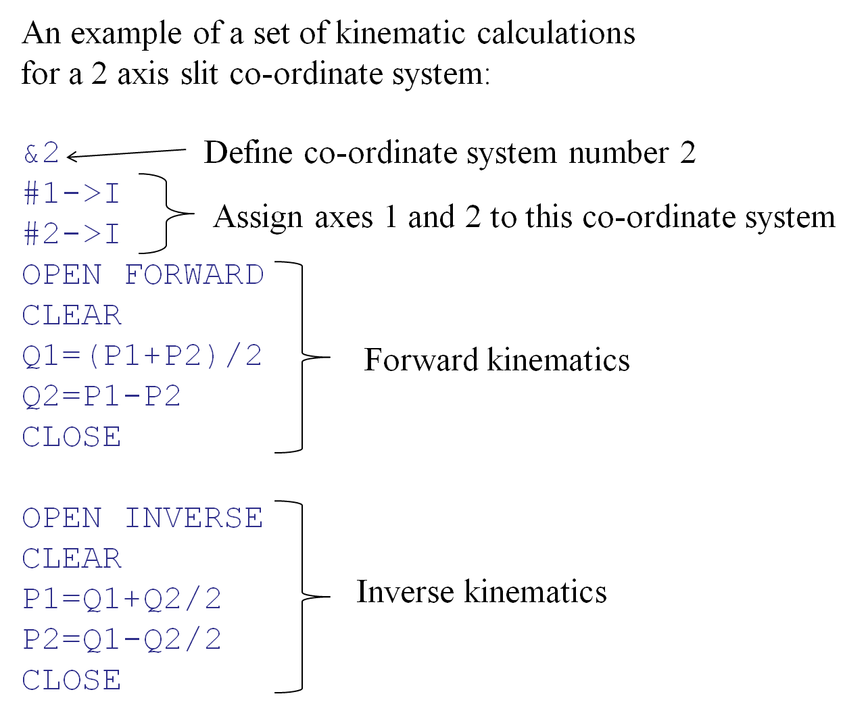
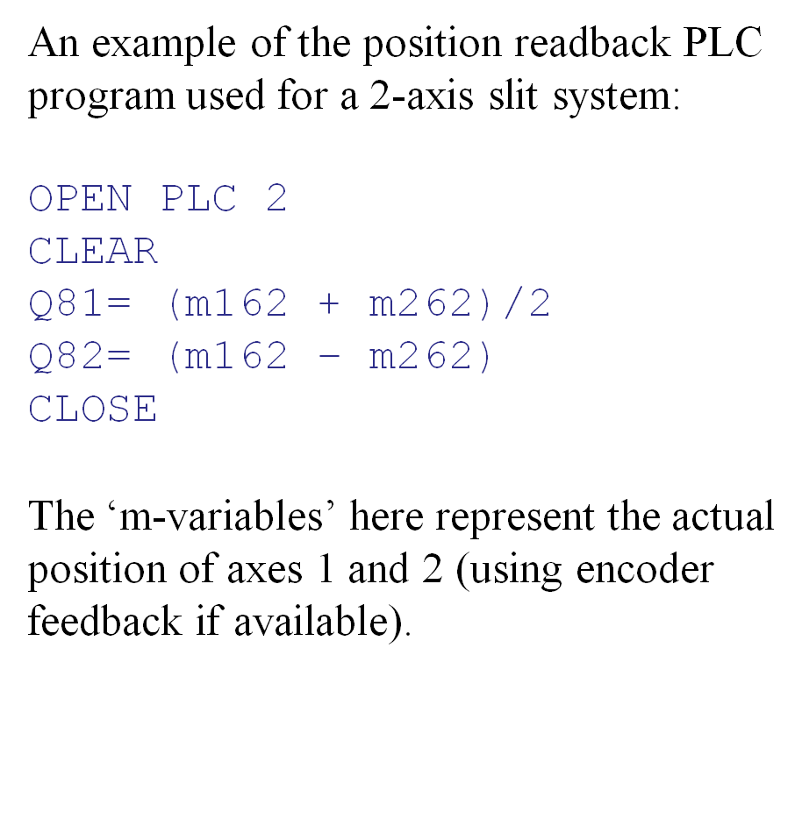
Coordinated Motion
PMAC co-ordinate system example:

Slide 28
Trajectory Scanning
Trajectory, or continuous, scanning.
-> moving 1 or more axes (synchronized), outputting gate and trigger signals
PMAC
Position compare.
Define a start/stop/step.
Gate and trigger output.
NOTE: unreliable – we developed
a custom hardware to do it for us.
No trajectory scanning support
unless done at the PLC level.
XPS
Position compare (same as PMAC).
Time flasher mode (time based pulses).
Trajectory scanning with time based pulses.
Axis positions at each point are stored.
Note: mostly the requirement is to trigger off one axis only, but
move multiple axes together. This can be done using PMAC or XPS position compare
and moving the axes doing normal coordinated motion.

