Slide 1
EPICS @ DESY/ XFEL An Overview
EPICS Collaboration Meeting
San Francisco, October 5th, 2013
Matthias Clausen, DESY
Cryogenic Control Group

Slide 2
Overview
Control Systems for the XFEL
News from Cryogenic Controls
CSS Developments
Trent Plotter
Synoptic Display Studio (SDS)
CAJ – deadlocks
DAL -> DAL-II
Alarm System
Archiver
IOC Redundancy

Slide 3
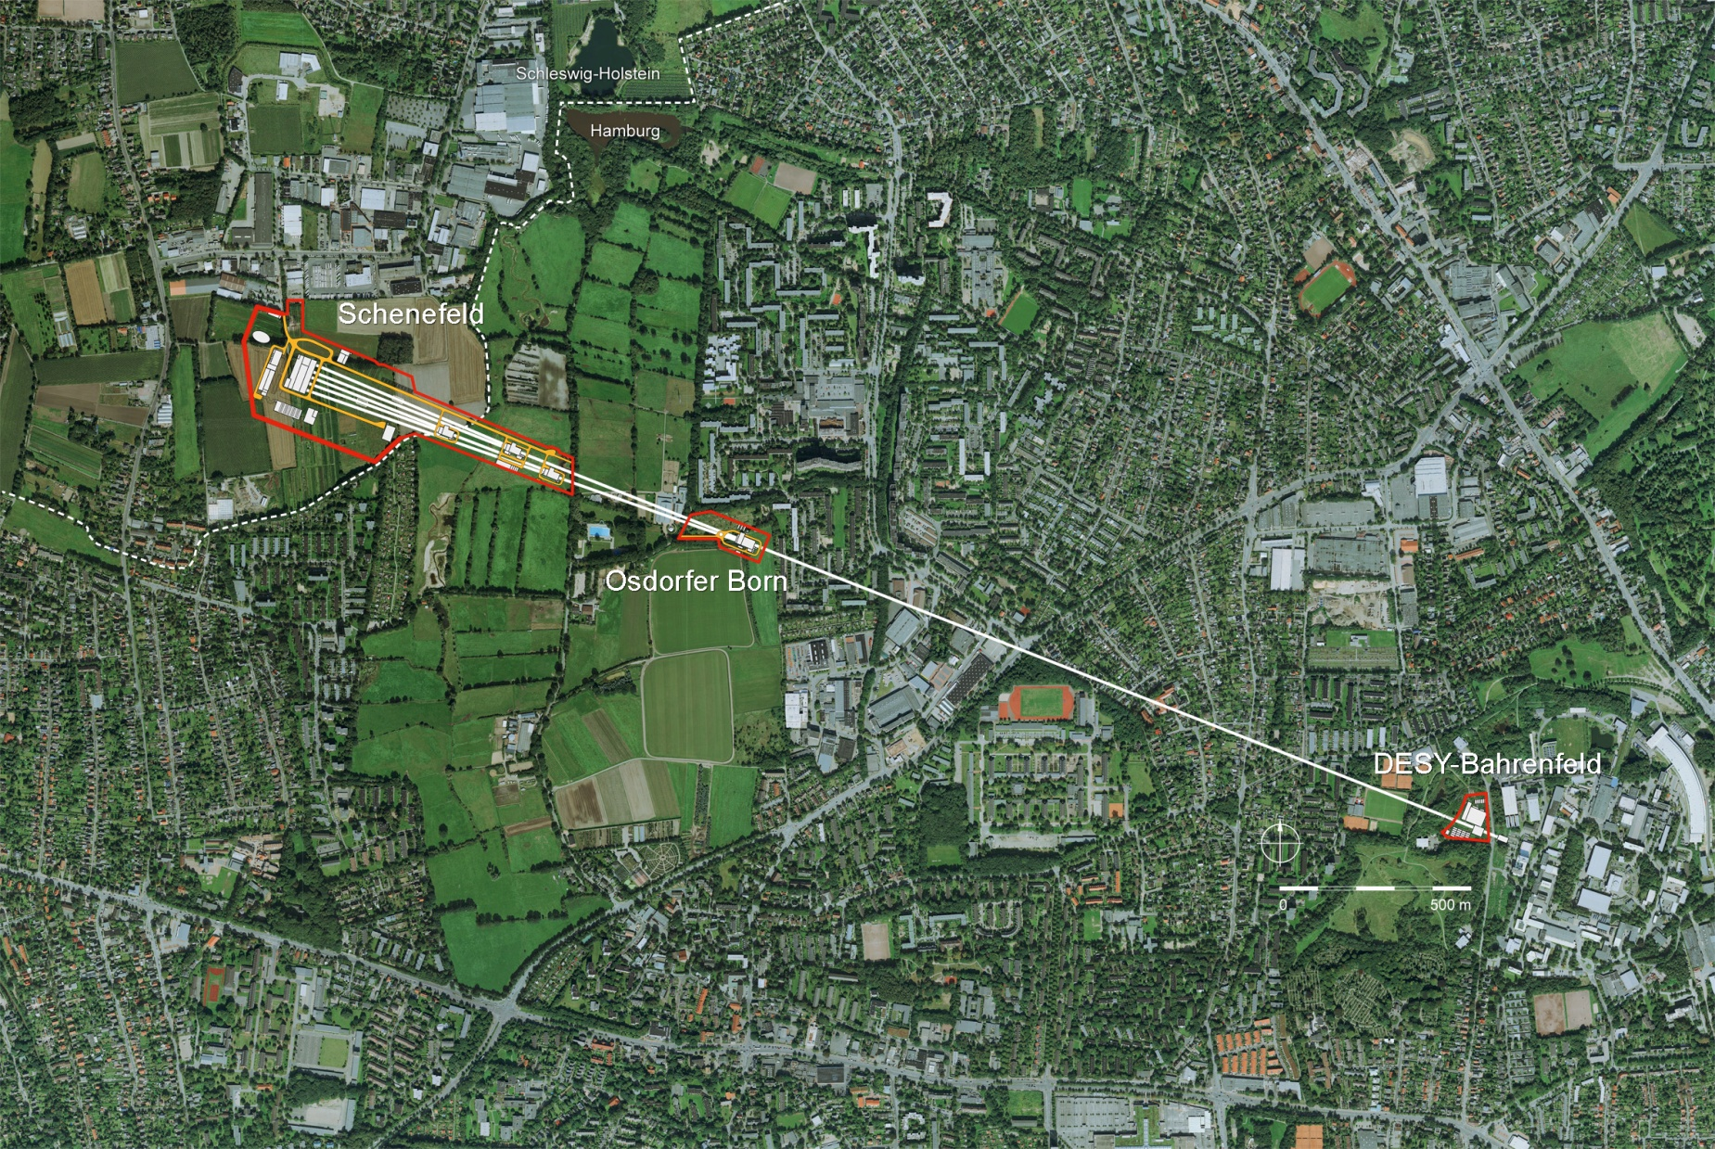
XFEL: One Machine/ Three control systems
Schenefeld:
Science with X-ray flashes
DESY-Bahrenfeld:
Start of the3,4 km long XFEL
Osdorfer Born:
first split of the tunnel
Creating X-ray Flashes
Elektron-Accelerator

Slide 4
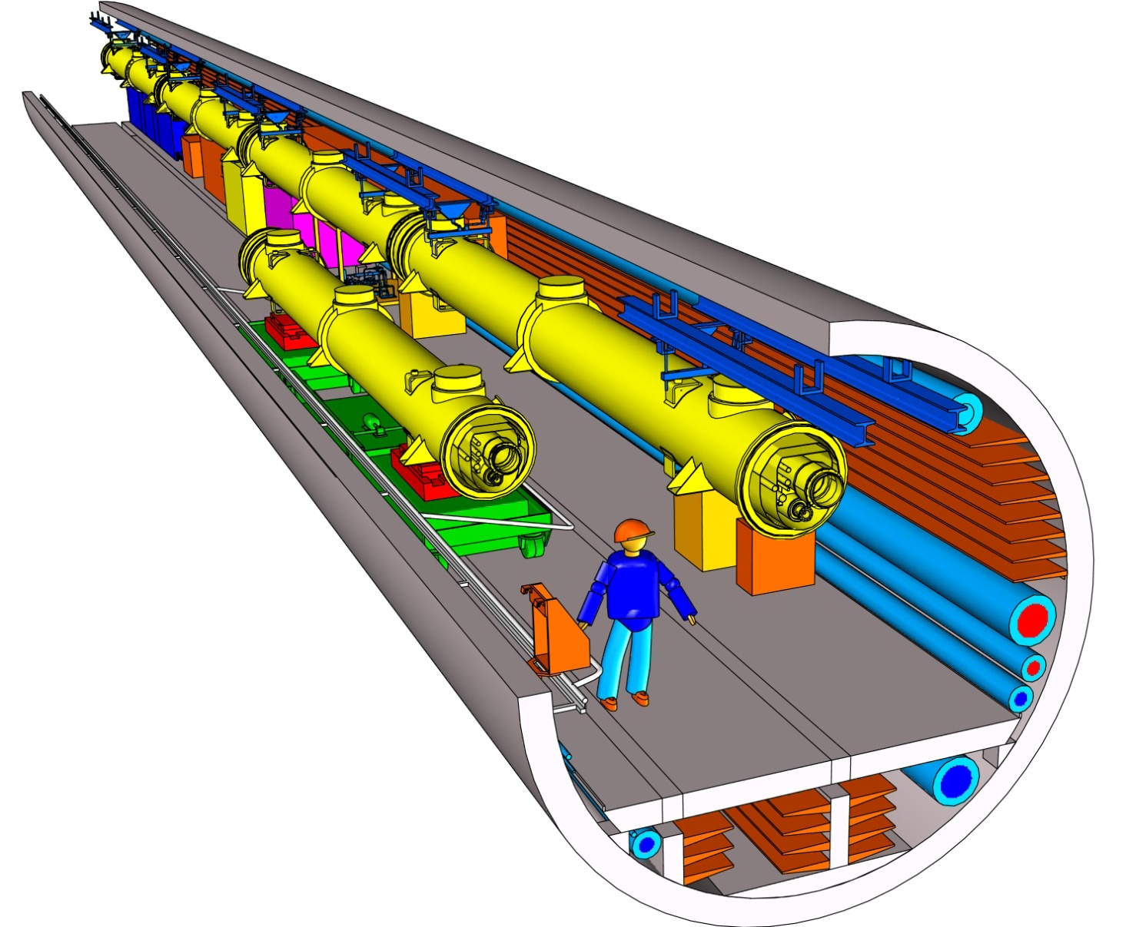
The XFEL Tunnel

Slide 5
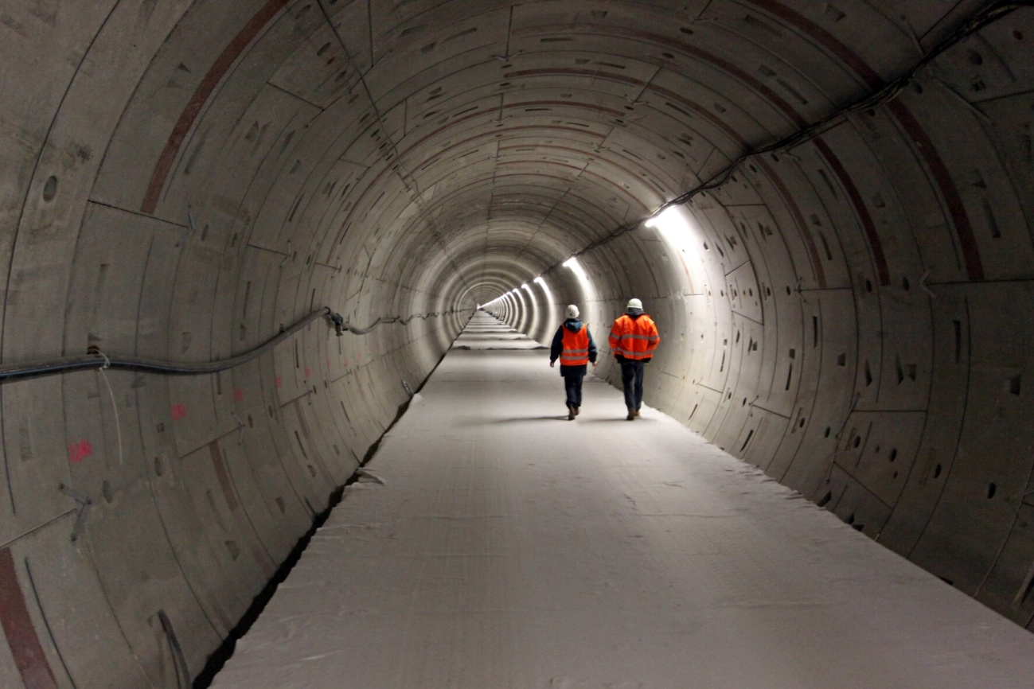
The real XFEL Tunnel

Slide 6
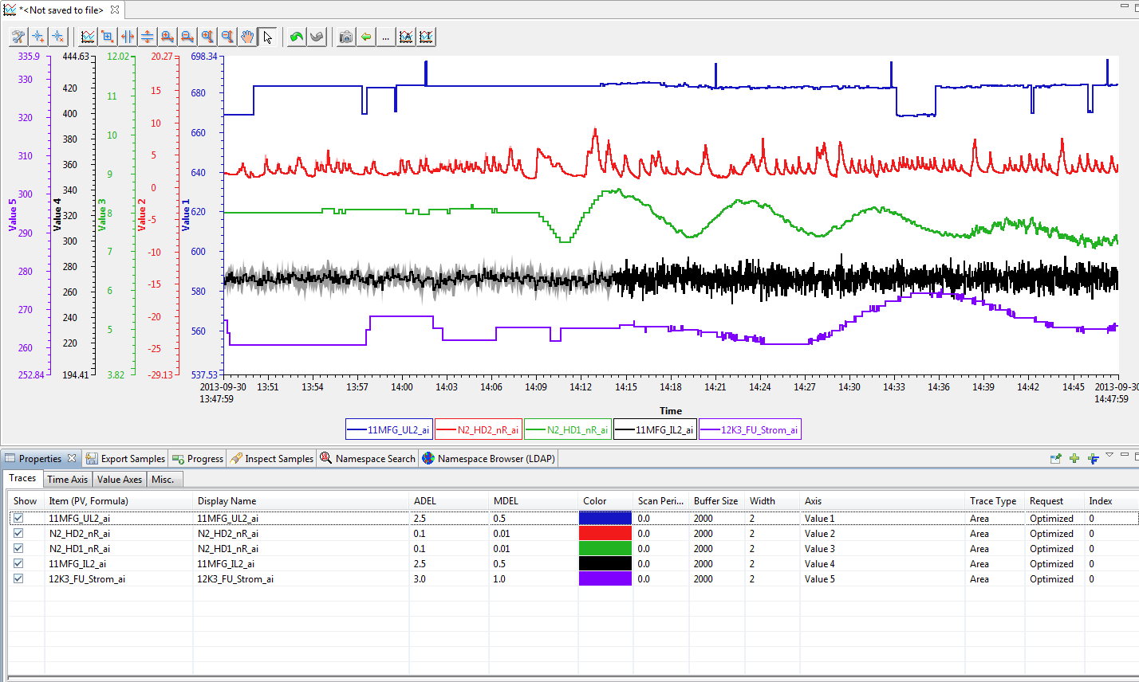
CSS Developments: Trend Plotter
Adding new features to Trend Plotter
Displaying archive deadband for each channel (Monitor Deadband for online/ live channel)
Interface to MySql Database

Slide 7
CSS Developments: New SDS Widget: X/ Y Plot
Exyample of Cold Compressor Characteristic Diagramm

Slide 8
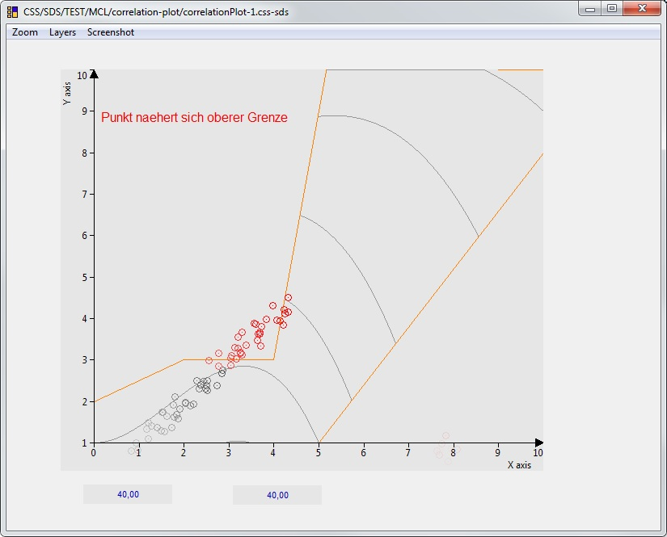
CSS Developments: New SDS Widget: X/ Y Plot
Prototype of Cold Compressor Characteristic Diagramm

Slide 9
CSS Lessions Learned: CAJ - deadlocks
CSS is running in the control room as primary operator interface
Over the last two years CAJ deadlocks were causing a lot of trouble
Communication with Matej improved:
Prepared fixes make it into the code
New bug fixes are distributed faster

Slide 10
CSS Lessions Learned: DAL -> DAL-II
Lessions learned from DAL:
DAL is necessary to interface to several control system protocols
Support for metadata/ characteristics for several protocols requires a common interface
DAL-I was overloaded with too much functionality
Redefining requirements to the basic needs
A complete rewrite of the DAL layer is on the way

Slide 11
Alarm System
Everything is a message
(alarm-; systemLog-; putLog-;snlLog;log4JLog…)
Messages are all transported as JMS messages
Messages can be displayed in tables (and trees)
Messages get written to Oracle (jms2Ora)
Messages become Alarms when processed in the Alarm Management System (AMS)

Slide 12
Alarm System
Developments:
DAL2JMS – (now using DAL-II)
Channel-Lists get monitored and written to JMS (as Message)
Configuration similar to alh
Synchronized Alarm-Table/ Alarm-Tree
Alarm Tree similar to alh Alarm Tree
AMS – Continuous improvement driven by control room
Time based message filterns Generate alarm when state is active for more then ?seconds
Attach alarm details to message and forward on different topic

Slide 13
Archiver
Running in full production mode since March 2013
Basic requirements
Data retrieval for any interval takes no more than 3 sec
Display archive deadband for every channel
Implementation:
MySql Database on Sun Cluster
In addition to the ‚raw‘ data, we store mean values on a hourly and minute basis
Define ‚related‘ channels which archive the deadband of the main channel
Replace pvManager by DAL-II (1Q 2014)

Slide 14
Redundancy
First mentioned during the EPICS Meeting at Argonne 2006:
2006 – Presentation:
From the preamble of the design specification:
… last and most importantly one major design goal must be matched:
Any redundant implementation must make the system more reliable than the non redundant one. Precaution must be taken especially for the detection of errors which shall initiate the failover. This operation should only be activated if there is no doubt that keeping the actual mastership will definitely cause more damage to the controlled system than an automatic failover.

Slide 15
Redundancy: initial states
IOC-A pref Master
IOC-B pref Slave
C
P
U
Prof-I
Prof-II
is:??
is:??
C
P
U
Prof-I
Prof-II
Profibus - I
private link
Profibus - II
Ethernet
A
Ethernet
B
Ethernet
Ethernet
File Server

Slide 16
Redundancy: Startup
IOC-A pref Master
IOC-B pref Slave
C
P
U
Prof-I
Prof-II
is: booting
is: booting
C
P
U
Prof-I
Prof-II
Profibus - I
private link
Profibus - II
Ethernet
A
Ethernet
B
Ethernet
Ethernet
File Server

Slide 17
Redundancy: Running
IOC-A pref Master
IOC-B pref Slave
C
P
U
Prof-I
Prof-II
is: Master
is: Slave
C
P
U
Prof-I
Prof-II
Profibus - I
private link
Profibus - II
Ethernet
A
Ethernet
B
Ethernet
Ethernet
File Server

Slide 18
Redundancy: Master CPU Failure
Master CPU failure
Watchdog reset
IOC-A pref Master
IOC-B pref Slave
C
P
U
Prof-I
Prof-II
is: Master
is: Slave
C
P
U
Prof-I
Prof-II
Profibus - I
private link
Profibus - II
Ethernet
A
Ethernet
B
Ethernet
Ethernet
File Server

Slide 19
Redundancy: Master CPU Failure – Slave detects failure
Master CPU failure
Watchdog reset
Reset Profi I + II
IOC-A pref Master
IOC-B pref Slave
4. Slave detect master failure
C
P
U
Prof-I
Prof-II
is: Master
is: Slave
C
P
U
Prof-I
Prof-II
Profibus - I
private link
Profibus - II
Ethernet
A
Ethernet
B
Ethernet
Ethernet
File Server

Slide 20
Redundancy: Master CPU Failure – Slave taking mastership
7. Master CPU booting
IOC-A pref Master
IOC-B pref Slave
Slave detect master failure
Start Master
Start Profibus I+II
C
P
U
Prof-I
Prof-II
is: booting
is: Slave
C
P
U
Prof-I
Prof-II
Profibus - I
private link
Profibus - II
Ethernet
A
Ethernet
B
Ethernet
Ethernet
File Server

Slide 21
Redundancy: Master CPU Failure – Slave active/ pref master passive
7. Pref Master CPU booting
8. Pref Master detect Master
9. Become Slave
IOC-A pref Master
IOC-B pref Slave
Slave detect master failure
Start Master
Start Profibus I+II
C
P
U
Prof-I
Prof-II
is: booting
is: Slave
C
P
U
Prof-I
Prof-II
Profibus - I
private link
Profibus - II
Ethernet
A
Ethernet
B
Ethernet
Ethernet
File Server

Slide 22
Redundancy: Master CPU Nettask Crash
1. Nettask crash
Detect ‚special nettask case‘
Find existing Profi ‚stand by master‘
Stop Watchdog
Reset CPU and Profibus I+II
IOC-A pref Master
IOC-B pref Slave
Detect Master is OFF
Profi Master still active
Cannot take over
C
P
U
Prof-I
Prof-II
is: Master
is: Slave
C
P
U
Prof-I
Prof-II
Profibus - I
private link
Profibus - II
Ethernet
A
Ethernet
B
Ethernet
Ethernet
File Server

Slide 23
Redundancy: Master CPU Nettask Crash
1. Nettask crash
Detect ‚special nettask case‘
Find existing Profi ‚stand by master‘
Stop Watchdog
Reset CPU and Profibus I+II
IOC-A pref Master
IOC-B pref Slave
Detect Master is OFF
Profi Master still active
Cannot take over
9. Take over
C
P
U
Prof-I
Prof-II
is: booting
is: Slave
C
P
U
Prof-I
Prof-II
Profibus - I
private link
Profibus - II
Ethernet
A
Ethernet
B
Ethernet
Ethernet
File Server

Slide 24
Redundancy
The current implementation is running since three years in three IOCs in production.
Production:
6kW@4K Helium plant
3MW primary compressor power
All (PID) control loops running in the IOC
SNL programs controlling sequences and supervisory control loops
PLCs only used for hardware interlock
➔helped us to survive 6 nettask crashes

