Slide 1
Database Workshop Report
Vasu Vuppala, Ph.D.
FRIB-NSCL,
East Lansing, Michigan, USA.

Slide 2
V4 – DISCS Distributed Information Services for Controls System

Slide 3
DISCS – Scope I

Slide 4
DISCS – Scope II

Slide 5
DISCS Vision
To Develop Collaborating Services That Any Experimental Physics Facility Can Easily Configure, Use, And Extend For Its Design, Commissioning, Operation, And Maintenance

Slide 6
DISCS Architecture
Application layer
Operator interfaces
High-level applications
Libraries
Service layer
Access to data
Programming Interface
Data layer
Managed data
Instrument data
No direct access

Slide 7
DISCS Collaborators
Brookhaven National Lab, USA
Cosylab, Slovenia
European Spallation Source, Sweden
Facility for Rare Isotope Beam, USA
Institute for High Energy Physics, China

Slide 8
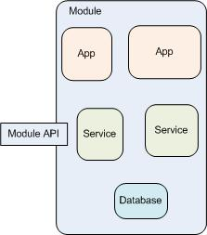
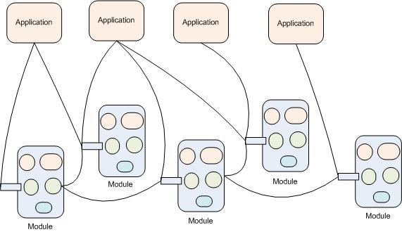
DISCS Modules
Module: An Implementation Of A Domain

Slide 9
Technologies

Slide 10
DISCS Status
Domain | Team | Status
Configuration | FRIB,ESS,Cosylab | In Production At FRIB
Cables | FRIB | Under Development
eTraveler | FRIB | In Production At FRIB
Lattice-Model | BNL, FRIB, ESS | Prototypes At FRIB and BNL
Logbook | BNL, FRIB | In Production At FRIB & BNL.
Inventory | FRIB | Under Development
Naming System | FRIB | In Production at FRIB
Operations | FRIB | Under Development
Save/Restore | BNL | In Production at BNL
Security | ESS, Cosylab, FRIB | Under Development
Signals (PV) | BNL | In Production at BNL, FRIB (ChannelFinder)
Unit Conversion | BNL | Under Development

Slide 11
Presentations

Slide 12
Logbook: Web Client

Slide 13
Logbook: CSS Client

Slide 14
Logbook: pyOlog

Slide 15
eTraveler – List of Travelers

Slide 16
eTraveler – Devices Integration with Configuration Module

Slide 17
Configuration: Component Tree

Slide 18
Configuration: Magnet Measurement

Slide 19
Configuration: Live Signals (PV)

Slide 20
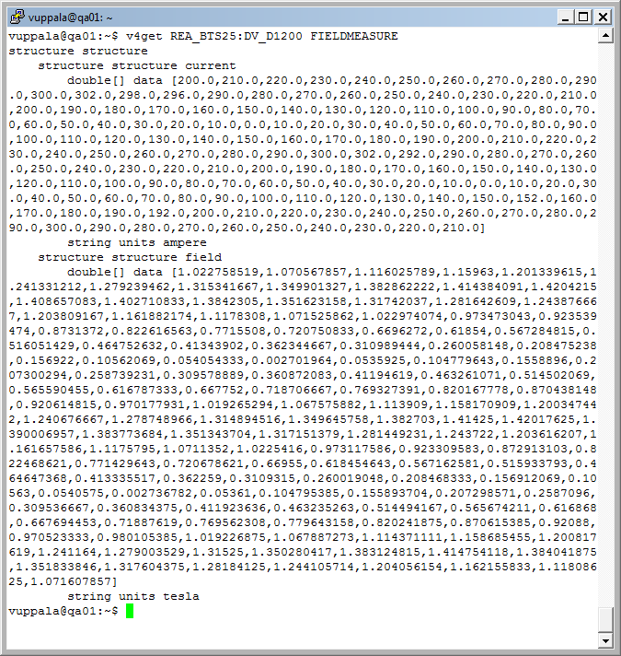
Configuration Module: V4 Service

Slide 21
Configuration: Component Relationships

Slide 22
Configuration: Component Relationships

Slide 23
Configuration: Lattice

Slide 24
Lattice-Model: Beamlines

Slide 25
Naming Convention – Name Elements
Name Elements Are Parts of A Name: System, Subsystem, Device Type etc

Slide 26
Naming Convention – Submit Requests
Submit Requests to Add, Modify, or Delete Name Elements

Slide 27
Naming Convention – Process Requests

Slide 28
Naming Convention - Reports

Slide 29
Screenshots – Unit Conversion

Slide 30
Save/Restore: Multiple Selections

Slide 31
Save/Restore: Results

Slide 32
Cables – Normal View

Slide 33
Cables – Manager View

Slide 34
Cables - Types

Slide 35
Next Quarter Goals
Online Model API
Services Portal (from last meeting)
Web Site (from last meeting)
APIs and Domain Integration
RBAC Prototype
Cables, Operations, Calibration Releases
Configuration Versioning, Lattice Design
V4/CSS Integration
Software Engineering: Requirements Backlog, Status

Slide 36
Conclusion
Made Good Progress In Logbook, Traveler, Unit Conversion, Configuration, Lattice-Model, Naming
Many Modules Under Development (Cables, RBAC, Calibration)
Challenges
Integration Among Modules
Standard APIs
Not Ready for General Users
DISCS Website: http://discs.openepics.org

Slide 37
Thank you!
“Software is like entropy. It is difficult to grasp, weighs nothing, and obeys the 2nd law of thermodynamics i.e. it always increases..”
– Norman Augustine

