Slide 1
Display Builder Update
Kay Kasemir,
Megan Grodowitz,
Amanda Carpenter (SNS),
Claudio Rosati (ESS)
May 2017 EPICS Meeting KURRI, Japan

Slide 2
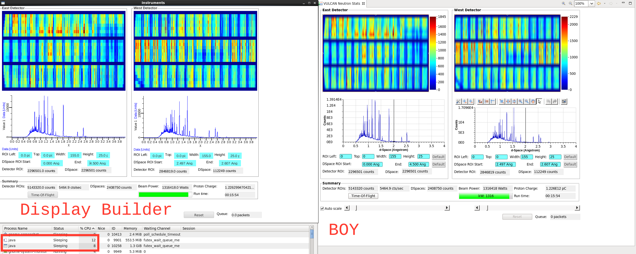
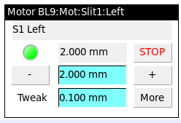
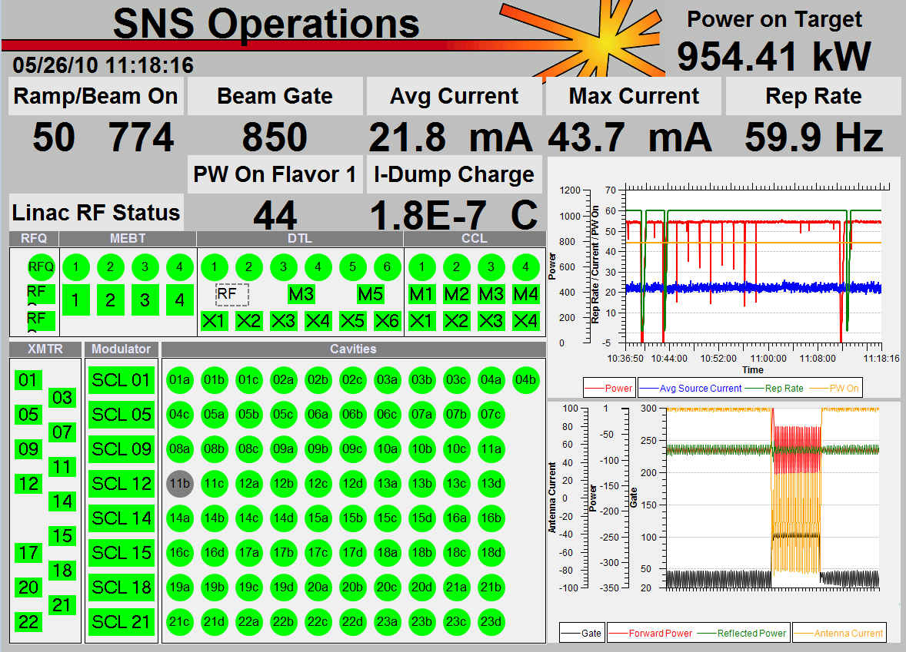
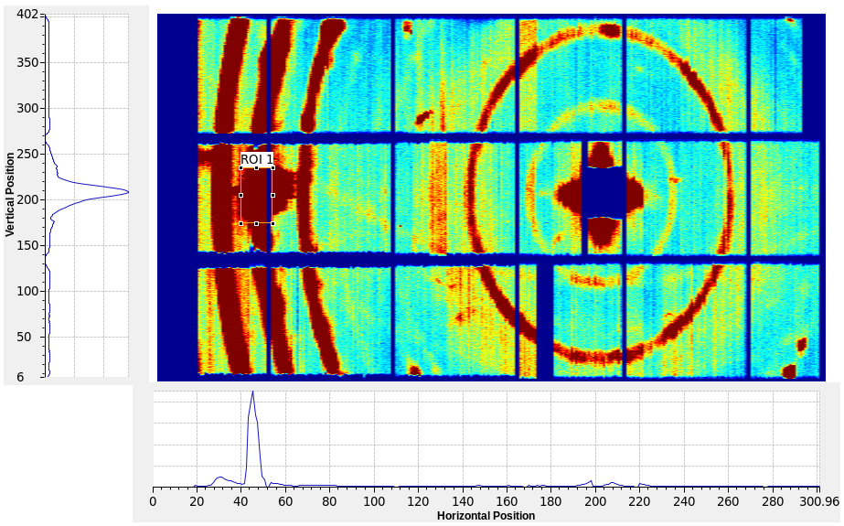
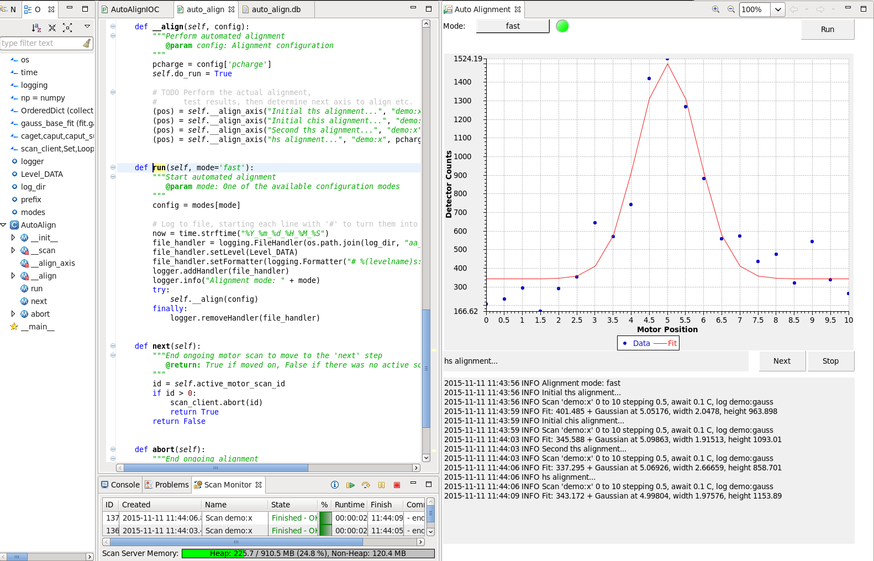
CS-Studio ‘BOY’
Great tool,
but internal limitations
(UI thread, modularity)

Slide 3
Display Builder
Editor
Runtime
PV
Modular code
Load files, handle PV updates & scripts off the UI thread
Compatible w/ *.opi files
Representation
JavaFX
Model
BOY
Display Builder

Slide 4
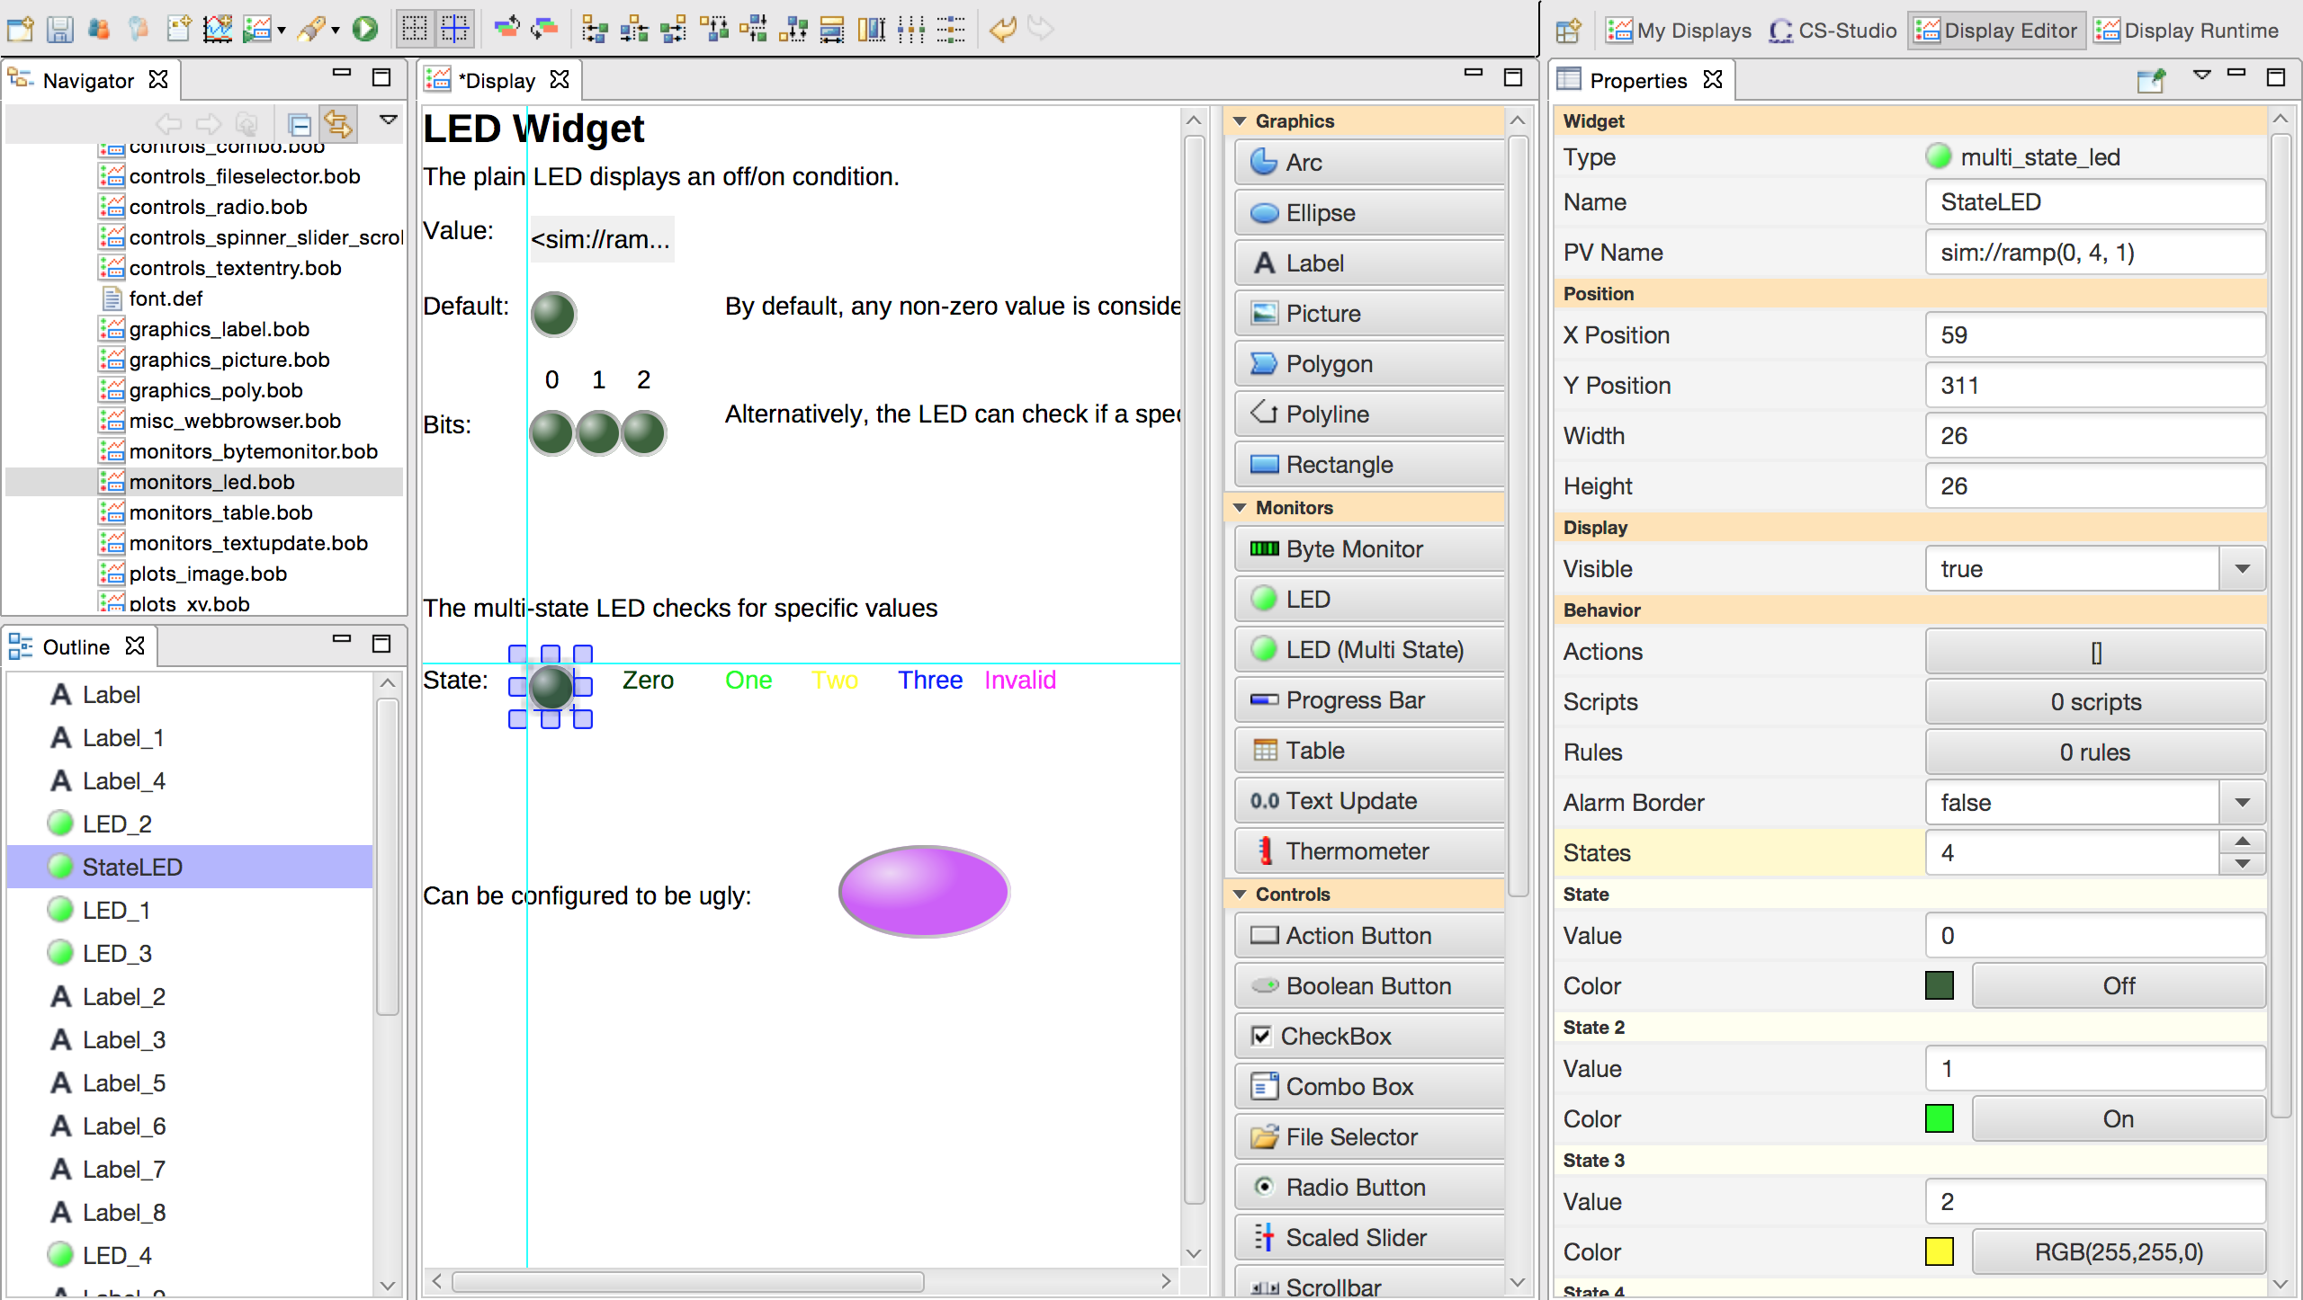
Editor

Slide 5
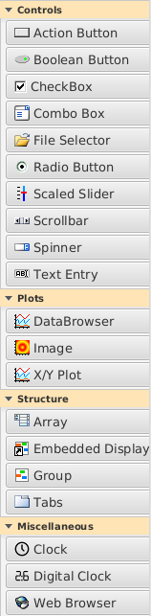
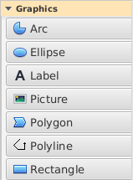
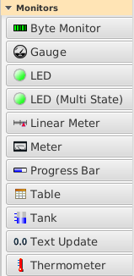
Widgets
Handles most “BOY” widgets and their key properties.
Implemented by 4 different contributors.
  Missing:
  Knob, Thumb Wheel
  Symbol

Slide 6
Refine and Consolidate Widgets
Picture
  Rotate by any angle
Rectangle, Rounded Rectangle
  Rectangle w/ corner width, height
LED with different PV behavior
  LED for binary PV or ‘bit’
  MultiStateLED for N states

Slide 7
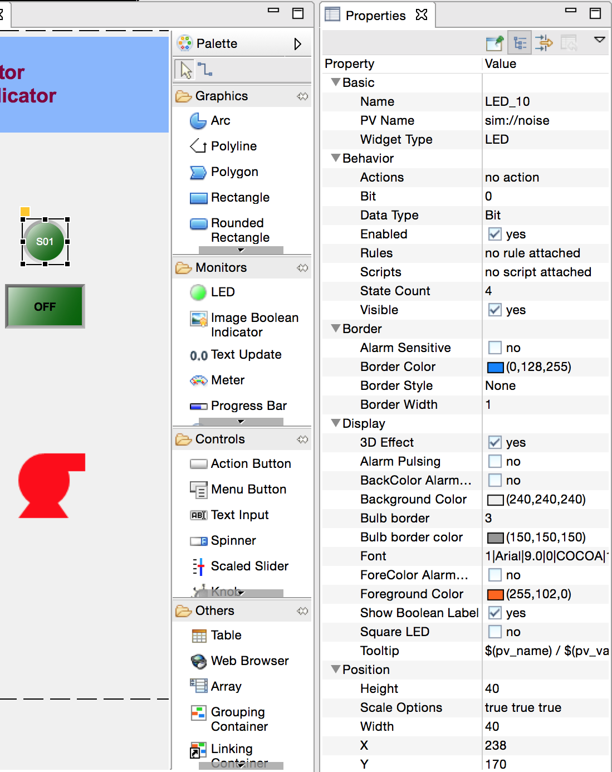
Editor Comparison

Slide 8
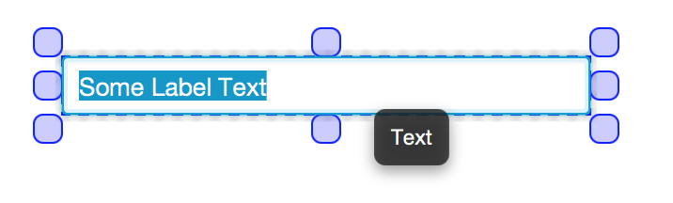
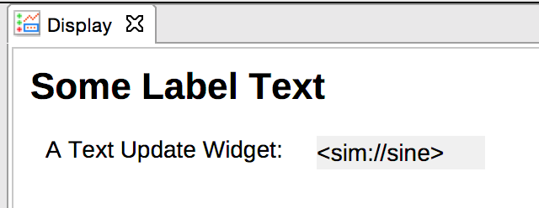
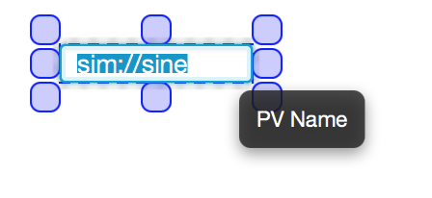
Inline Editor for Key Properties
In editor, Double-click widget for
  PV Name (Any widget with PV)
  Text (Label Widget)

Slide 9
Properties: Arrays and Structures
“state_0_color”, .., “state_value_3”
  Actual arrays and structures:
  “states[0].color”, “states[3].value”
  Array size only limited by memory

Slide 10
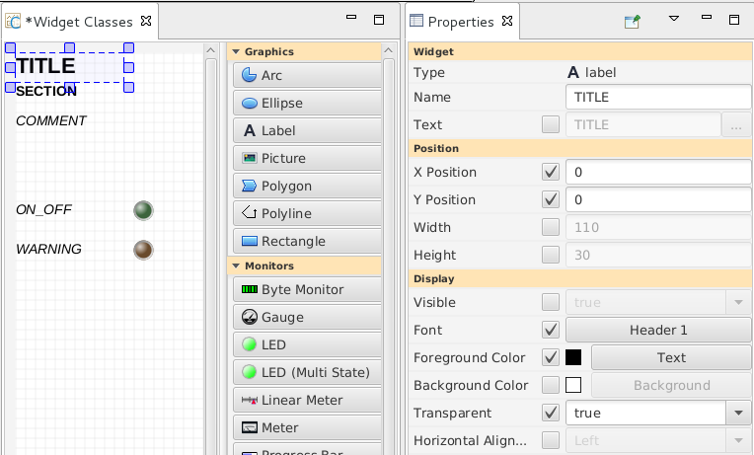
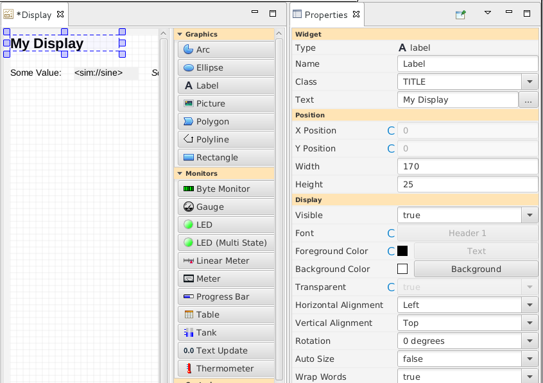
Widget Classes
Definition
  Class Name
  Selected Property Values
Use
  Select Class

Slide 11
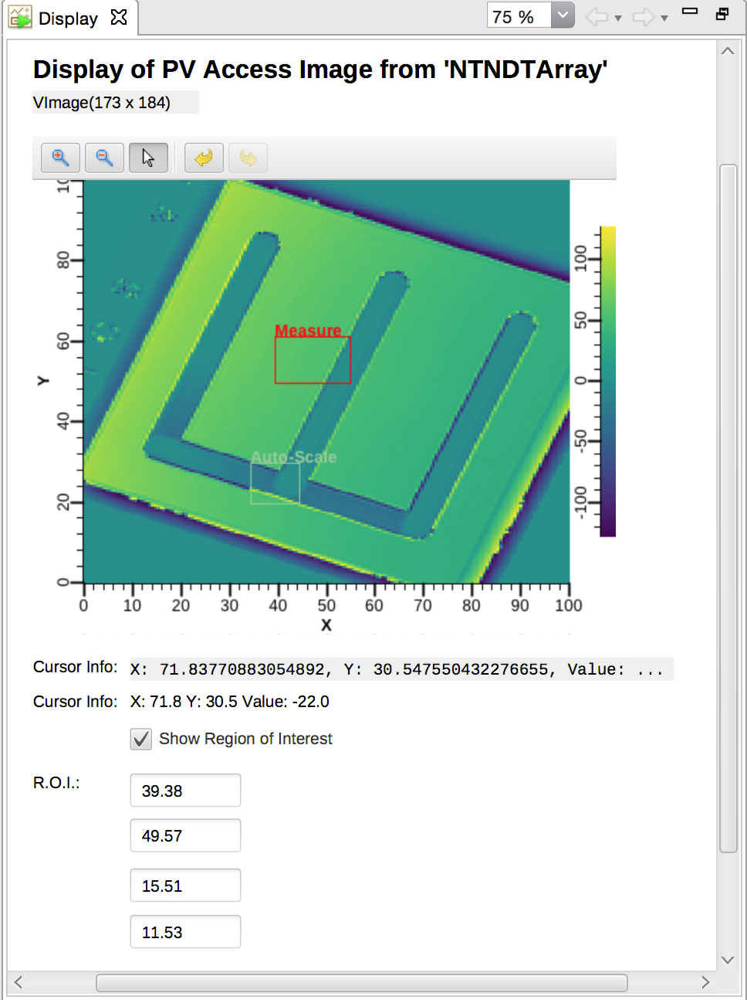
Image Widget
PVs:
ca://waveform + width + height
pva://image
ROIs
Colormaps

Slide 12
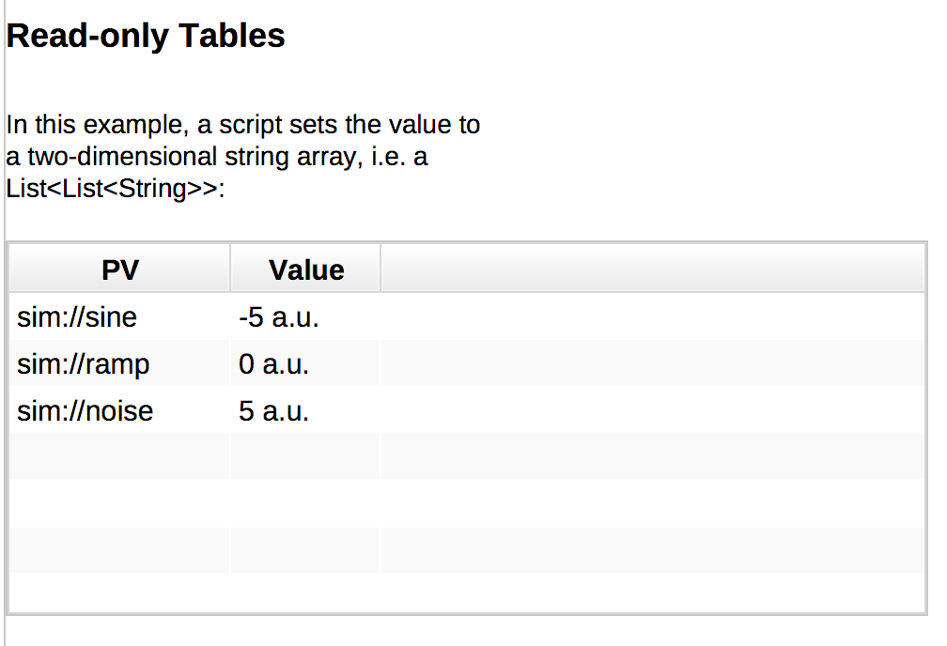
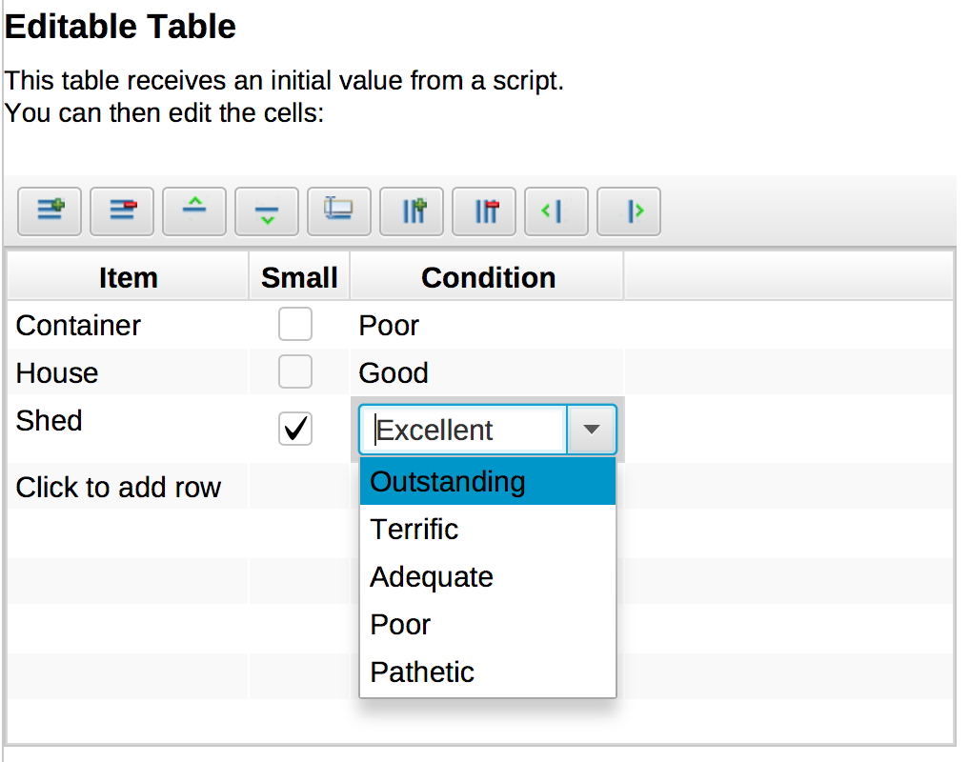
Table Widget
Data:
VTable PV
(read-only)
String[][]
(read, write)
Toolbar:
Add/remove row, column
Move row/column
Publish selected cells in VTable PV

Slide 13
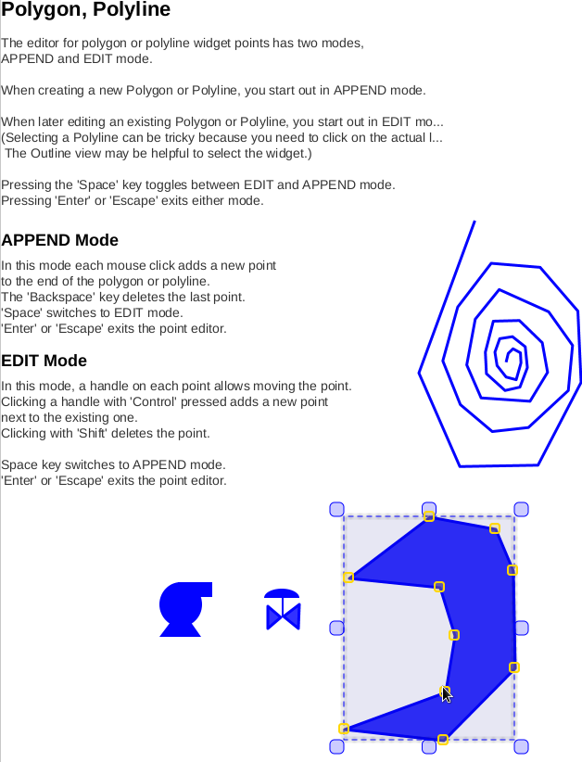
Poly Editor
‘Append’ Mode
  Add points
  Delete last point
‘Edit’ Mode
  Move
  Add
  Delete points
Toggle between modes

Slide 14
Macros
String Properties
  PV Name “$(S):XYZ”, Text “Hello, $(NAME)”
Numeric, Boolean Properties
  Width $(WIDTH), Visible $(SHOW)
  as long as value is numeric resp. “true”/”false”
Default values
  $(S=Test), $(WIDTH=100)

Slide 15



Alarm-sensitive Border
Space-efficient,
distinguishable
Minor:
Single-line
Major:
Double-line
Invalid/Disconnected:
Broken line
.. now without widget body resize

Slide 16
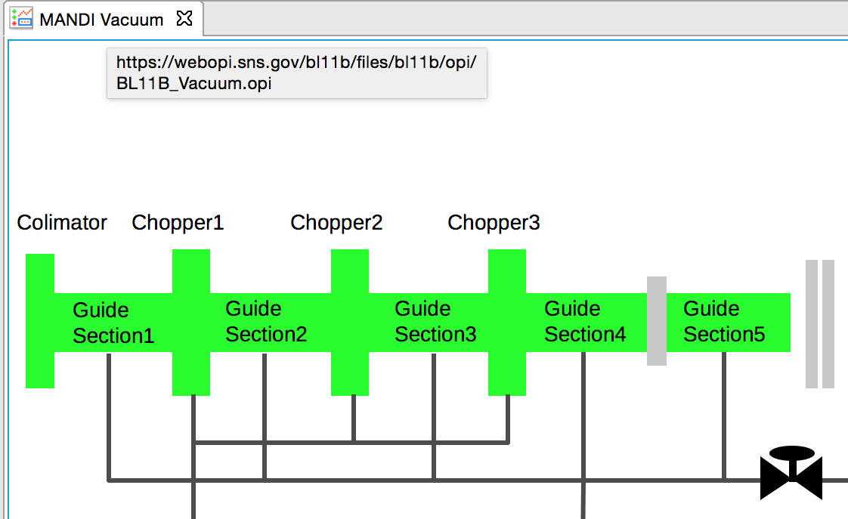
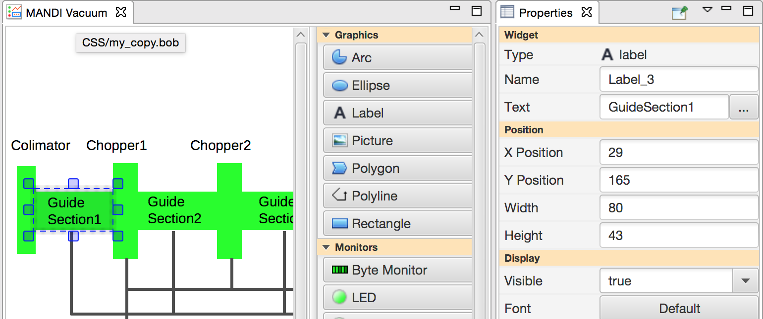
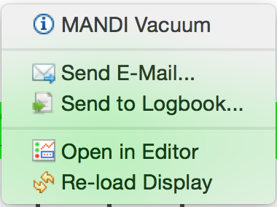
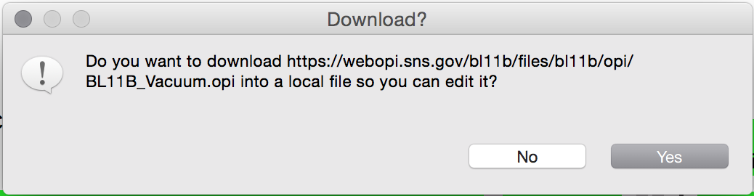
Open Editor from Runtime

Slide 17
Upgrade Path for *.opi Files
“Open abc.opi!”
  Actually loading abc.bob, if present
  Editor always saves as *.bob file
➔ Leave most *.opi in place,
only manually update to *.bob as needed:
  Fine-tuning of layout
  Scripts, some rules
  Tables
  Plots

Slide 18
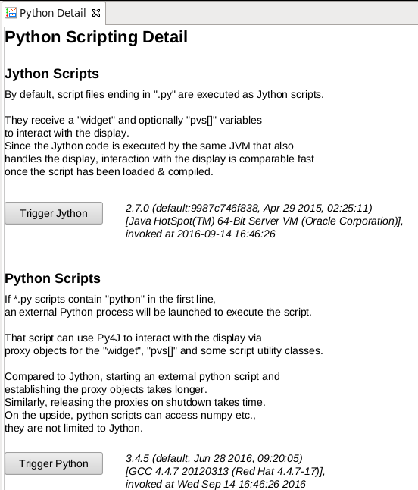
Scripts
Execute in background
JavaScript
Jython
C-Python

Slide 19
Minimal script compatibility
  val = PVUtil.getDouble(pvs[0])
  pos = 100 + 20*val
  widget.setPropertyValue(“x”, pos)
Convert x.opi into x.bob, then use new scripts
Keep existing x.opi and update just the scripts:
try:
# Use new API
from org.csstudio.display.builder.runtime.script import ScriptUtil
except:
# Fall back to old API
from org.csstudio.opibuilder.scriptUtil import ScriptUtil

Slide 20
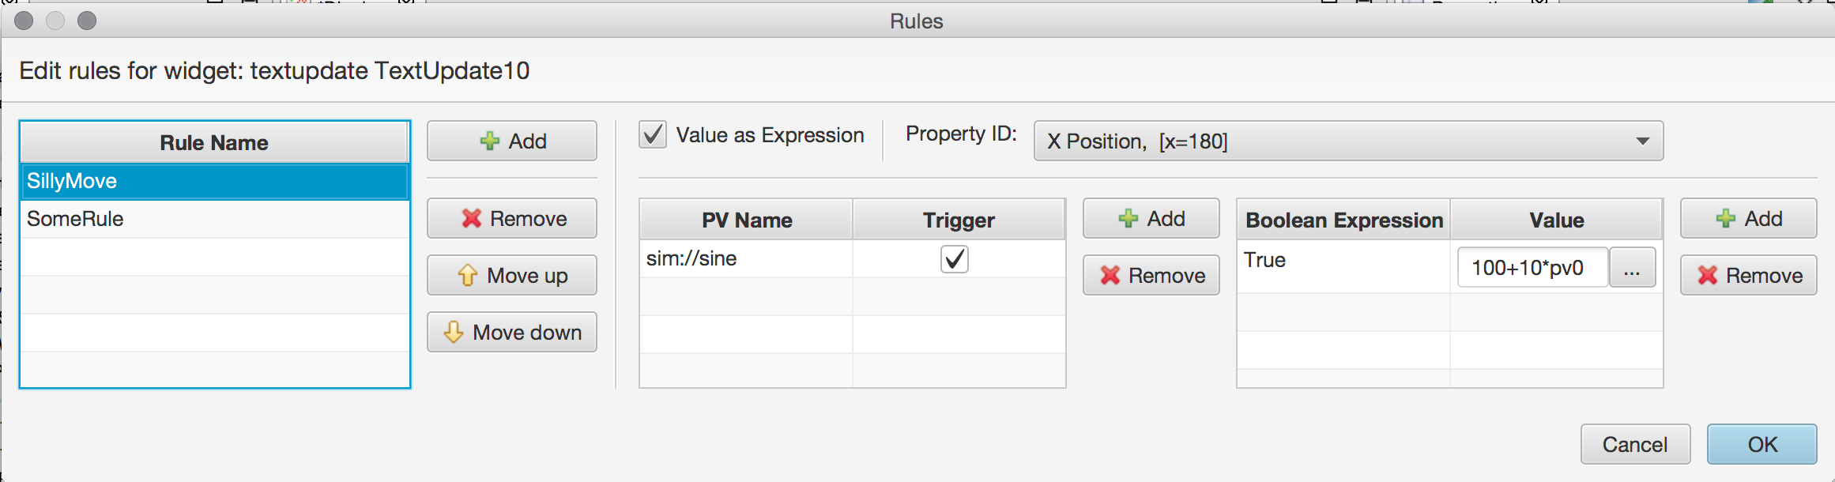
Rule & Script Dialog Streamlining
All rules of a widget in one dialog

Slide 21
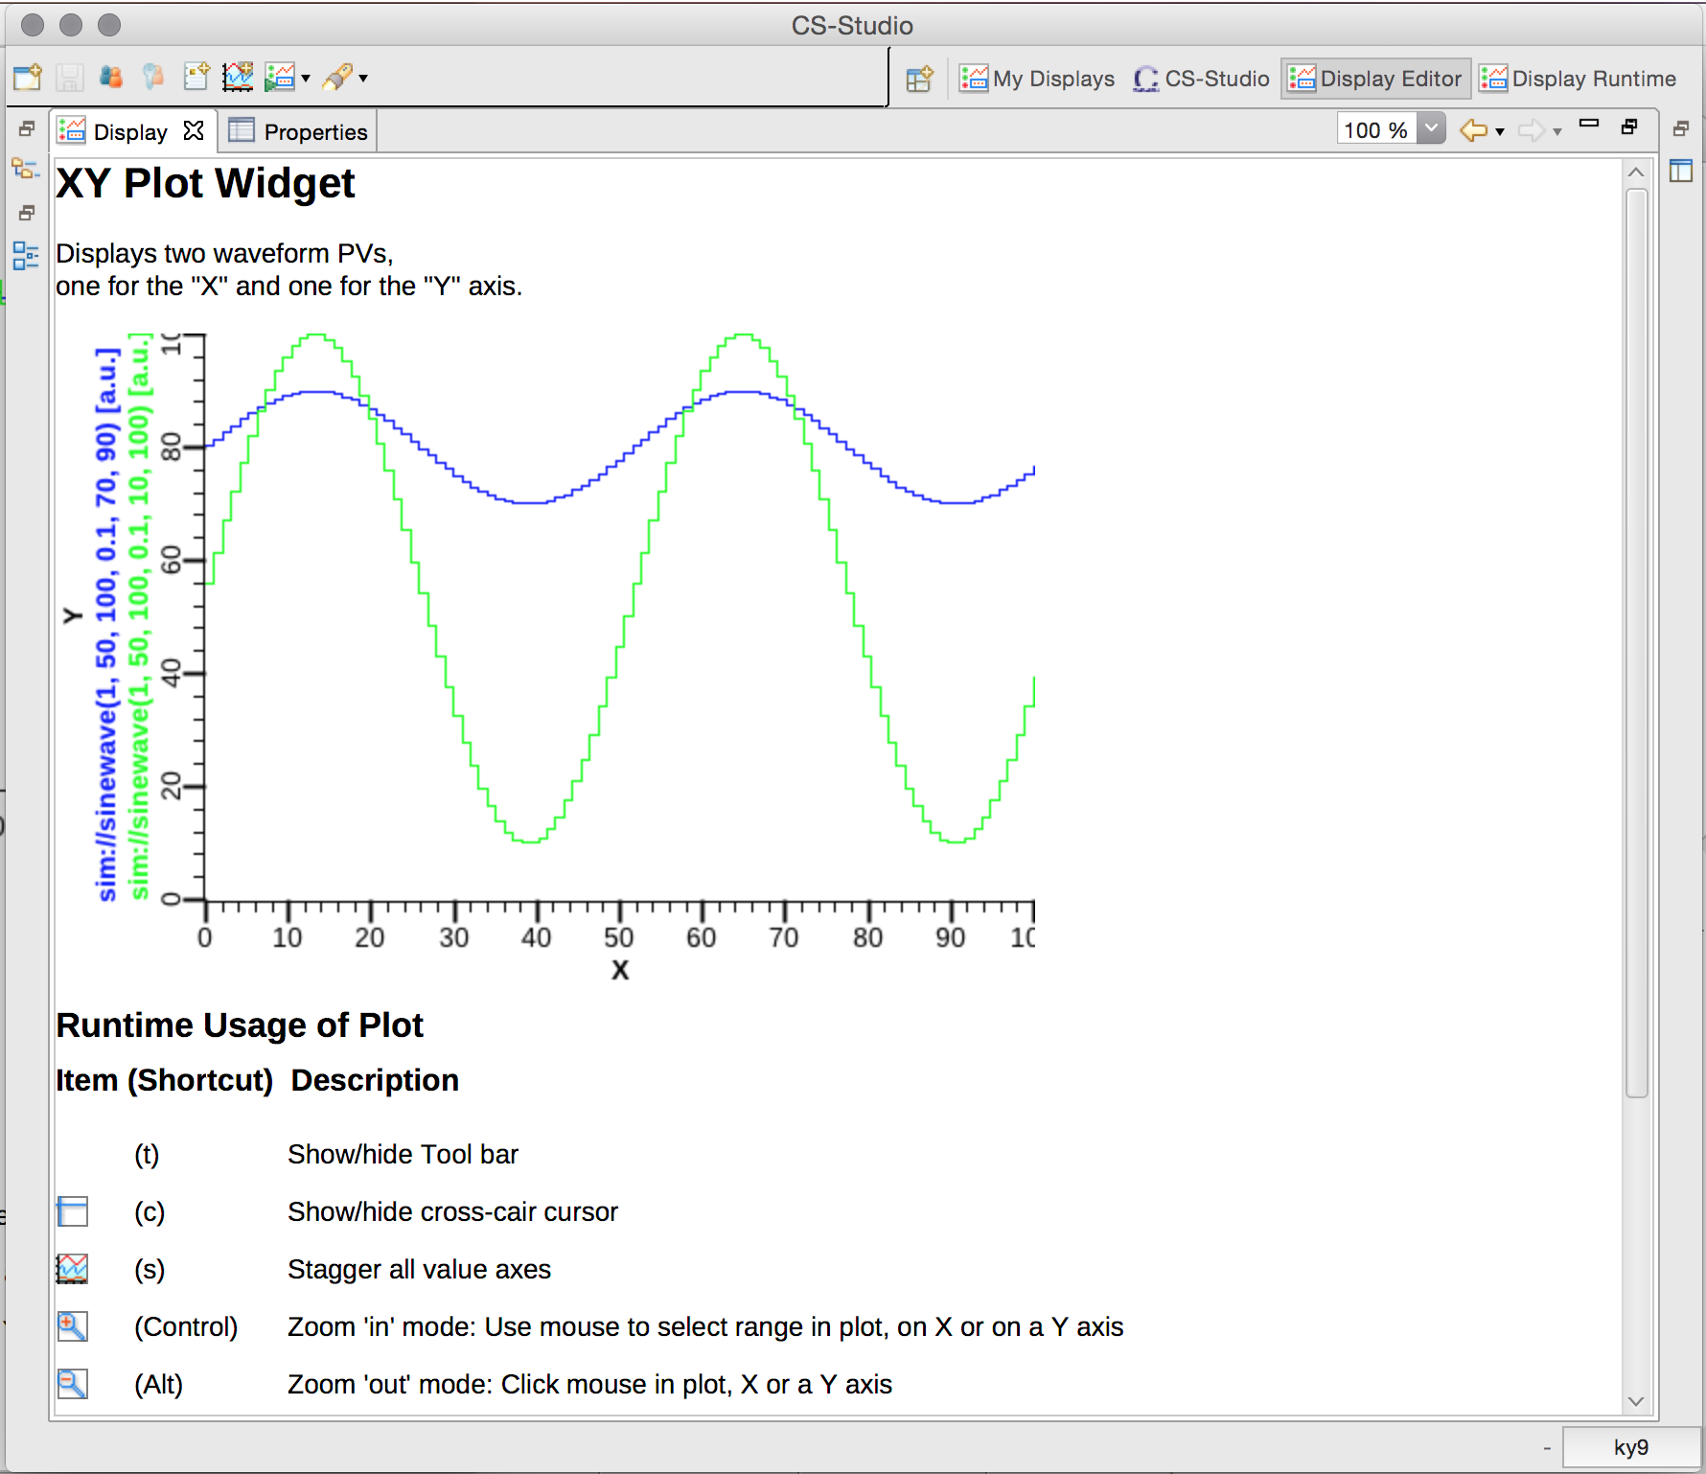
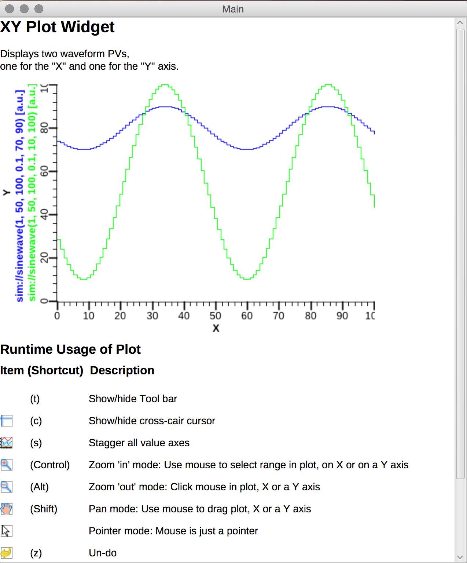
Standalone Runtime
“Like EDM”
  DisplayRuntime –options .. /path/to/display_file

Slide 22
Standalone vs. Integrated in CS-Studio
Startup from scratch: 3 seconds | Start CS-Studio, restore display: 8 sec
Uses *.opi from command line | Open files via Navigator, “Top Displays” menu
Standalone Window | Pane/Tab within Workbench Window
- | Toolbar: Back/Forward; Zoom
- | Open Widget’s PV in Tree, Data Browser, …
- | Email screenshot, or send to Logbook
Full JavaFX speed | SWT FXCanvas bottleneck
Preference file for CA Addr list etc. | Preference file & UI, Online help
Close Window → Start over | Persists window state

Slide 23
Performance (Linux)
BOY
UI freeze when loading display, executing script, ..
Speed
JFX/FXCanvas remote via ssh
Display Builder (FXCanvas, in CSS)
No UI freeze ..
Display Builder (JFX, standalone)
No UI freeze!
.. remote via
Cendio ThinLic,
or ssh options for weak encryption, compression

Slide 24
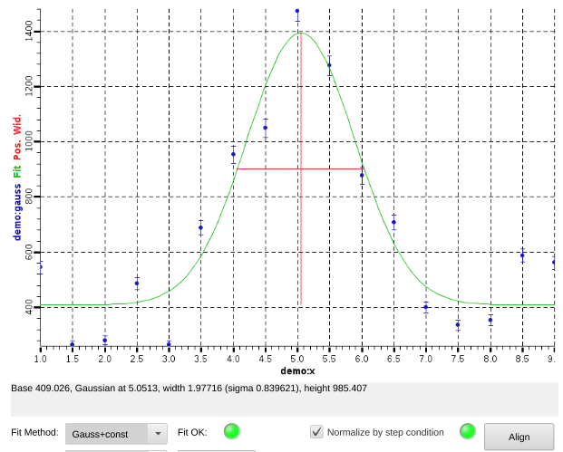
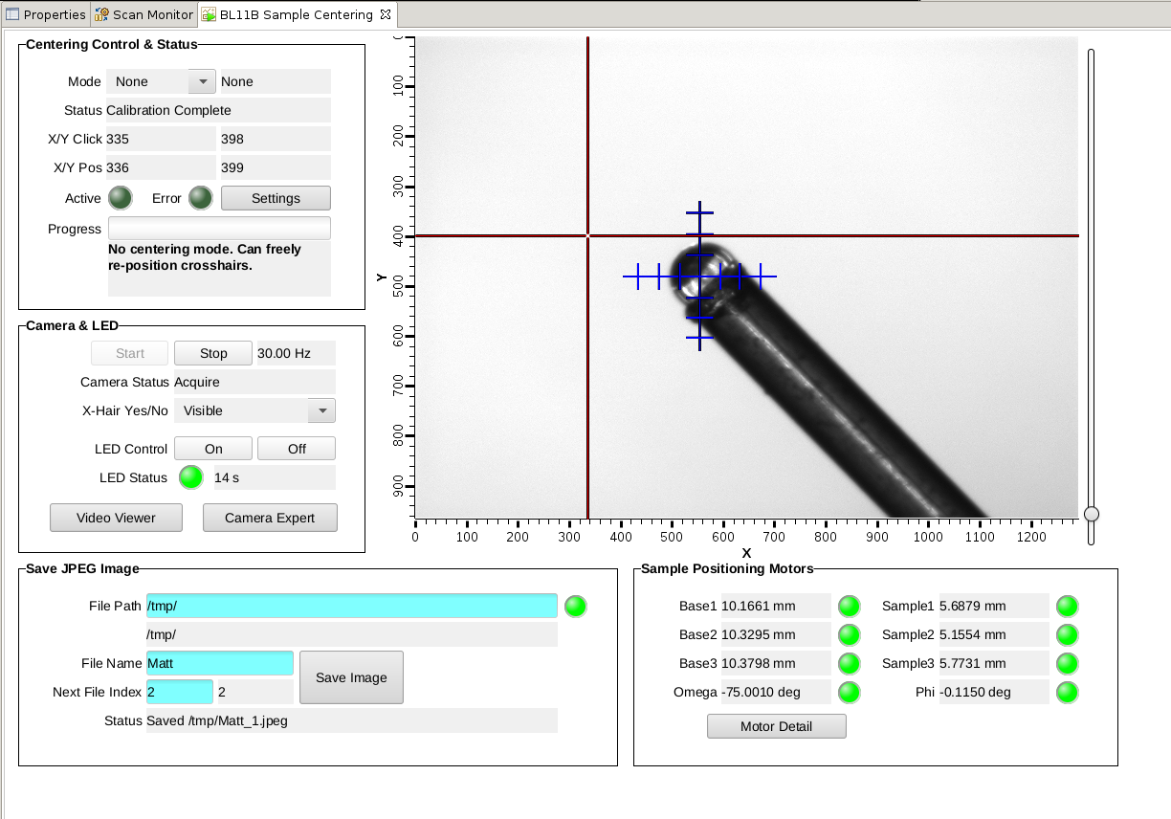
SNS Beam Lines
2 beam lines use display builder
  Existing *.opi
  Plots with error bars
  Interactive sample centering on ‘click’
3 more updated this summer

Slide 25
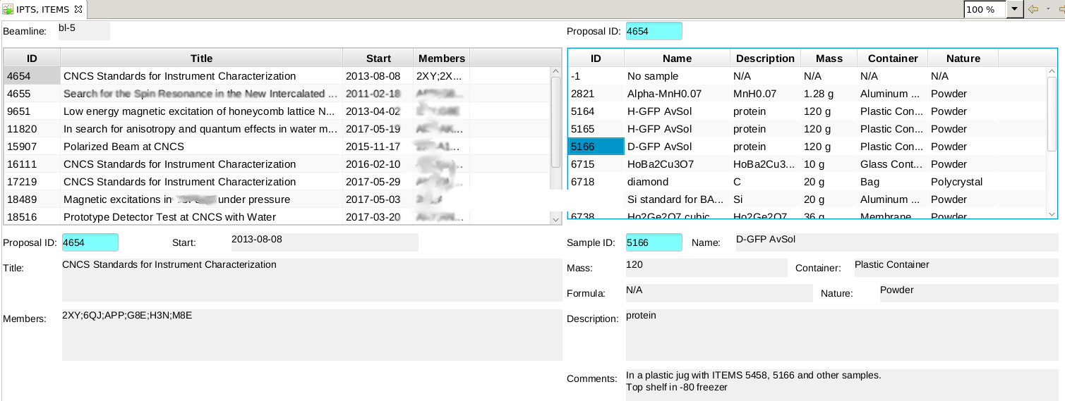
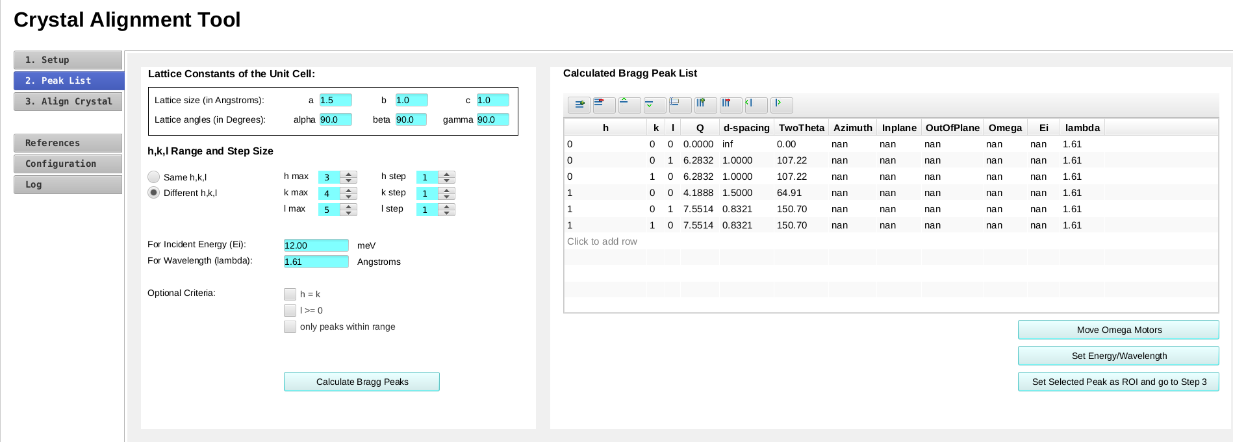
SNS Beam Lines

Slide 26
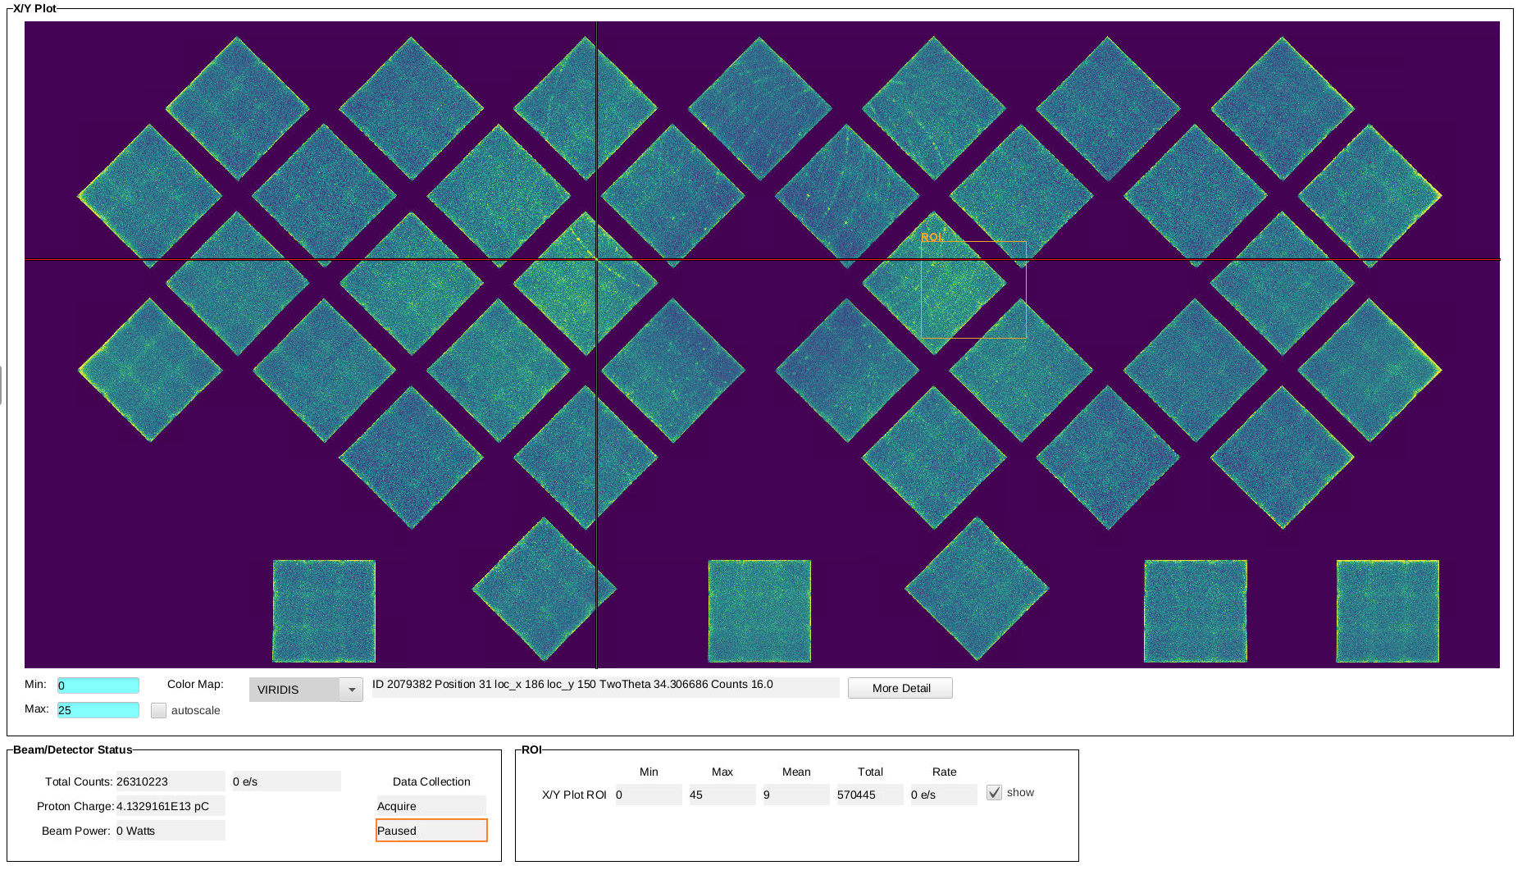
SNS Beam Line Detector Display
Capable of displaying the full-size X/Y histogram
(4500x1800 pixel)
Interactive zoom & pan

Slide 27
Boy, Only Better
  Operational on
  SNS Beamlines
  Background threads,
  faster,
  less freezing
  Reads existing files
    Scripts, tables, plots
    require adjustments
  To try:
  Seminar on Friday
  SNS or ESS products
  https://github.com/kasemir/org.csstudio.display.builder

Slide 29

Edit Time Data Flow
Add Widget,
Set Property
Editor
Present
current state
of Model
Update
File
Save
Representation
Model
JFX
Notify of changes

Slide 30
Runtime Data Flow
Runtime
PV
Scripts, (Rules)
UI Event
Present
current state
of Model
Enter Text,
Push Button
File
Update
Load
Representation
Model
JFX
Notify of changes

Slide 31
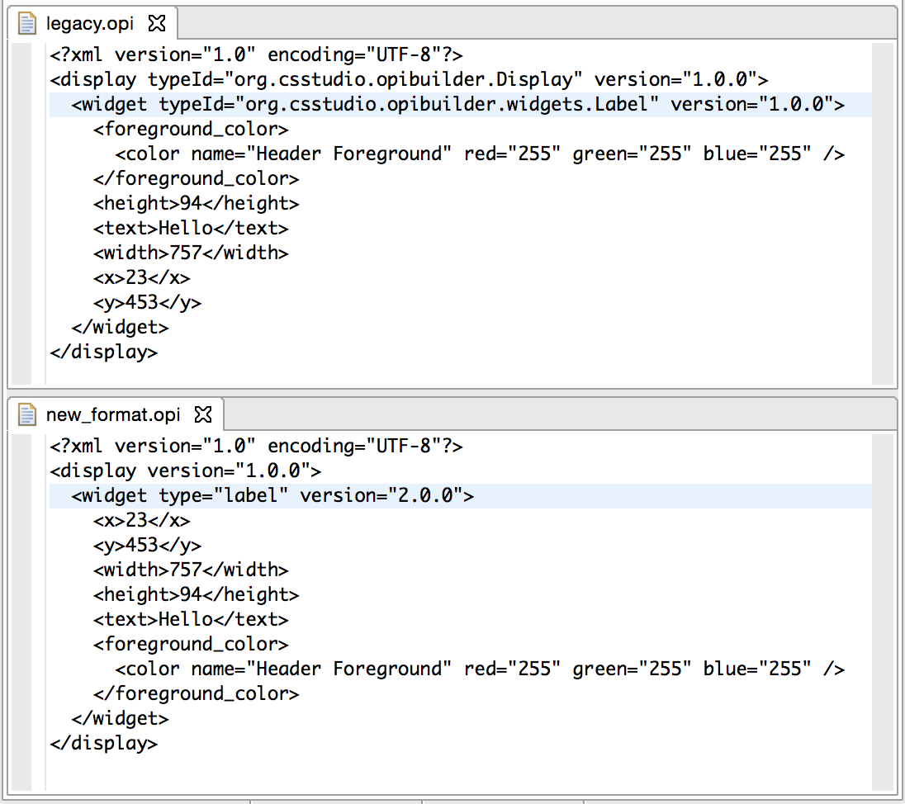
File Format
Similar, yet
Concise
Useful
order
.bob

