Slide 1

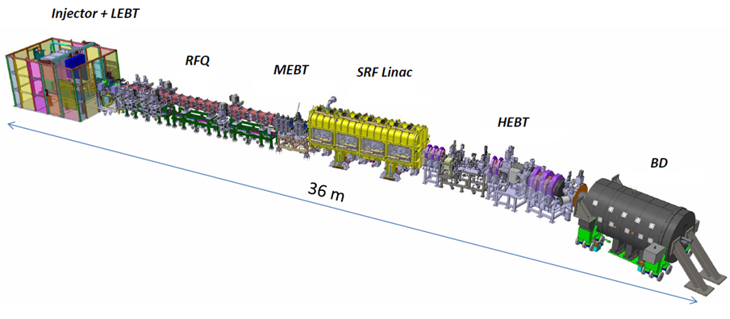
LIPAc project
EPICS integration experience
Alvaro Marqueta (F4E)
EPICS Collaboration Meeting
KURRI, Japan
16-18 May 2017

Slide 2
  What is LIPAc?
LIPAc = Linear IFMIF Prototype Accelerator
★
Rokkasho

Slide 3
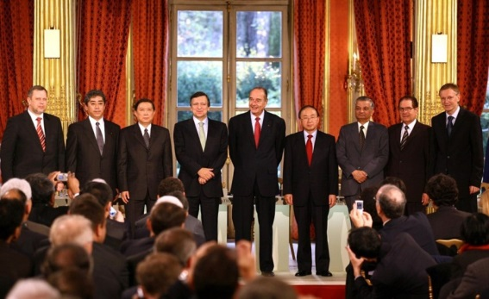
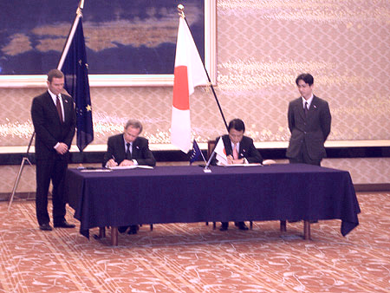
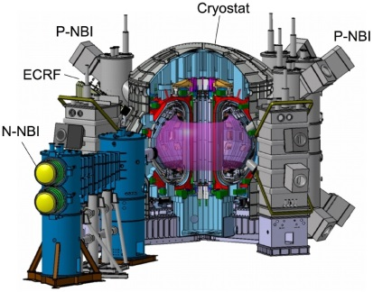
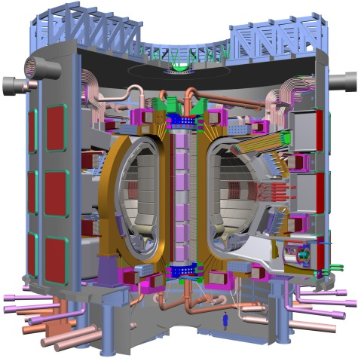
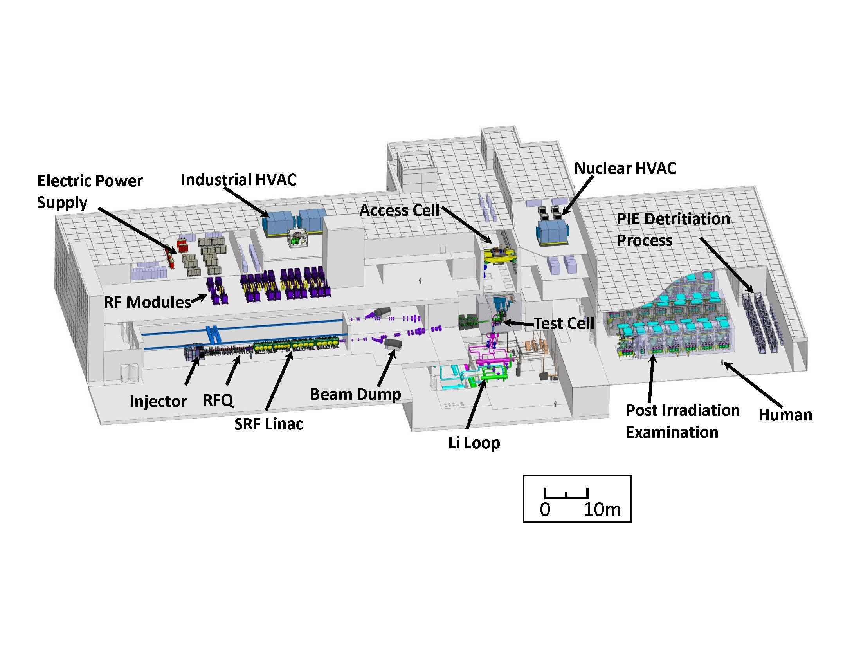
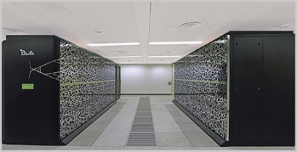
Introduction to IFMIF/EVEDA
A bit of history…
ITER
Agreement
Broader Approach
Agreement
21 November 2006
1 June 2007
JT60-SA
ITER
IFERC
IFMIF/EVEDA

Slide 4

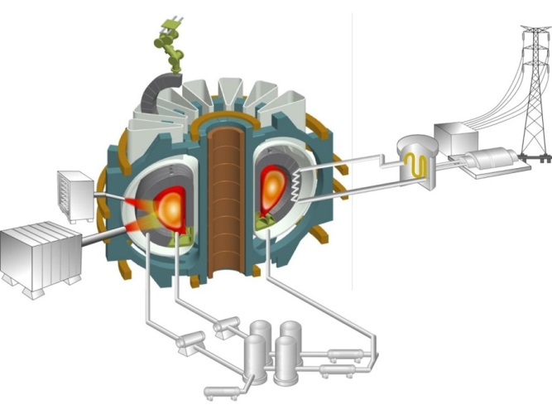
Introduction to IFMIF/EVEDA
Main contributors to DEMO design
JT60-SA
ITER
DEMO
IFERC
IFMIF/EVEDA

Slide 5
Introduction to IFMIF/EVEDA
IFMIF -> International Fusion Materials Irradiation Facility
(the fusion relevant neutron source)

Slide 6
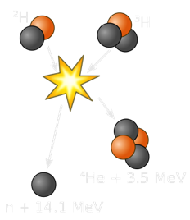
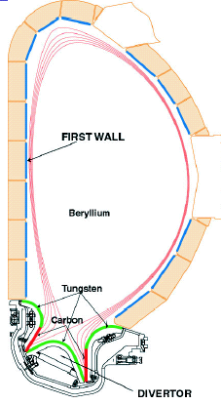
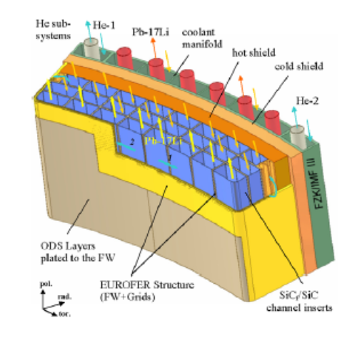
Introduction to IFMIF/EVEDA
IFMIF -> International Fusion Materials Irradiation Facility
(the fusion relevant neutron source)
ITER first wall will present
<2 dpa at the end of its operational life
In a Fusion power plant
~150 dpa within 5 years are expected
Existing neutron sources do not provide the needed answers

Slide 7
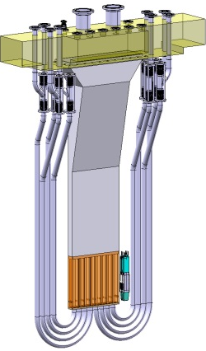
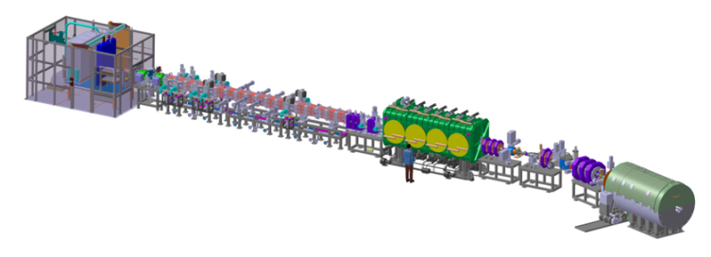
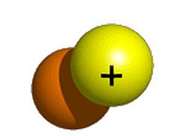
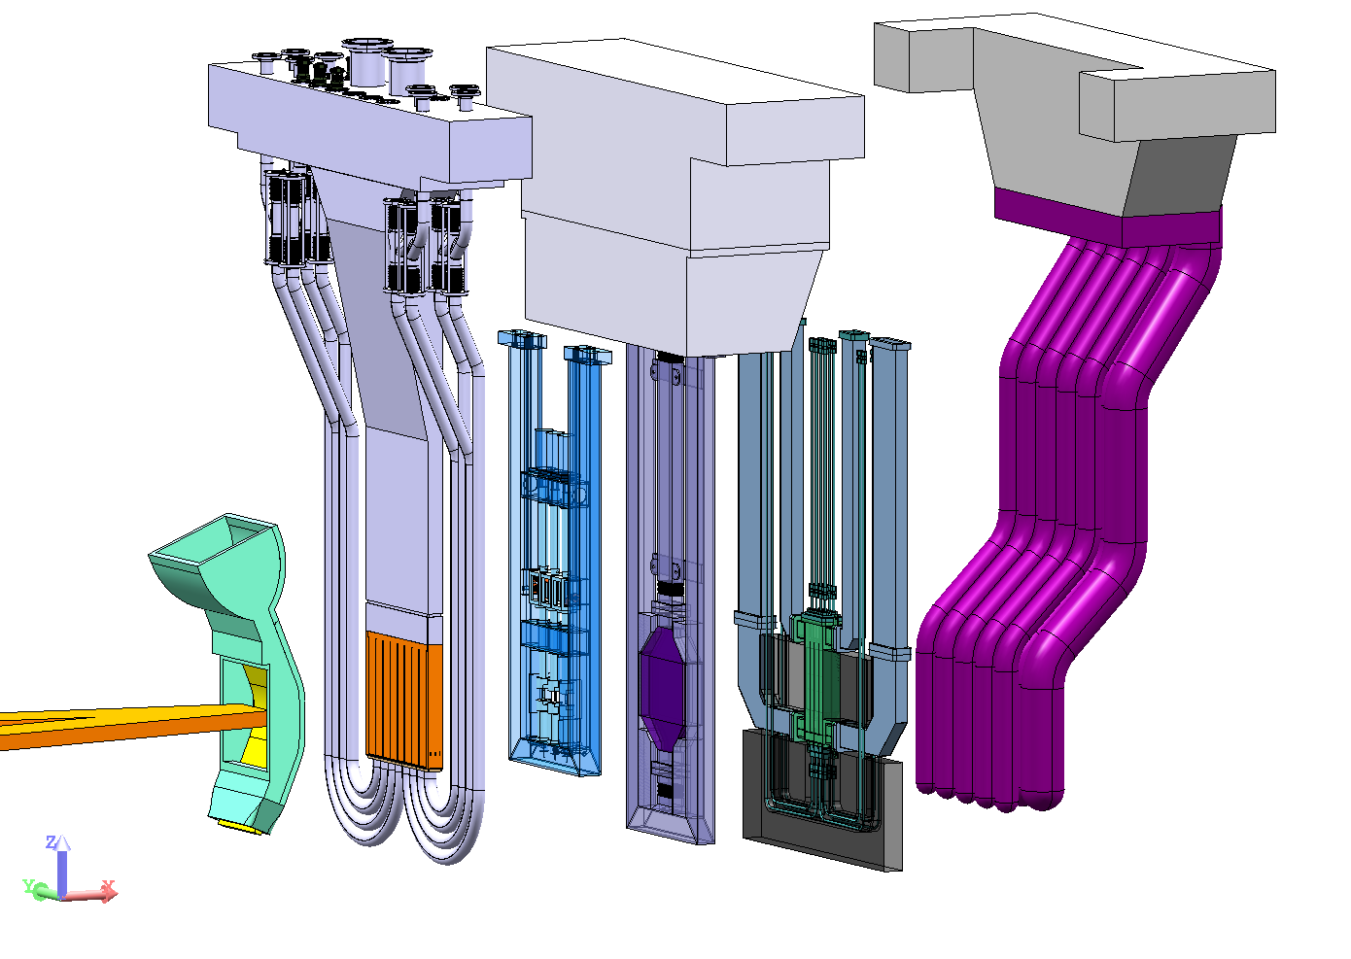
Introduction to IFMIF/EVEDA
IFMIF -> International Fusion Materials Irradiation Facility
(the fusion relevant neutron source)
  Li loop:
  250ºC, 15m/s, ±1mm amplitude stability
lithium
deuteron
n
  D⁺ Accelerator:
  40 MeV, 125 mA CW
  5 MW
  Test facility:
  Withstand dpa levels

Slide 8

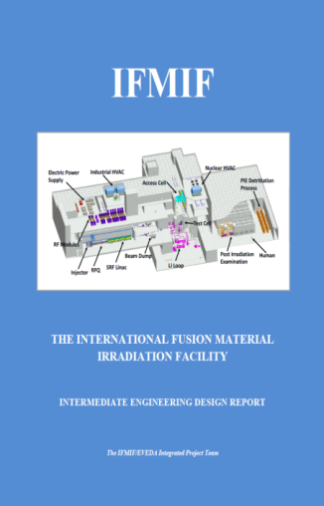
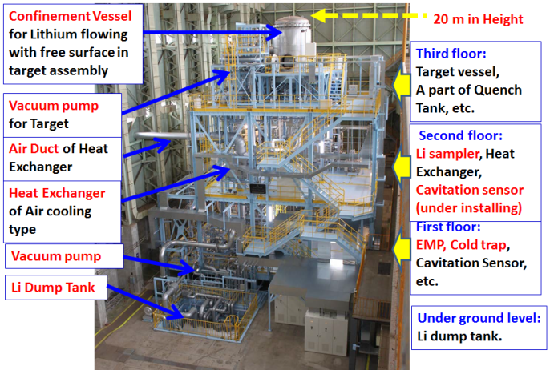

Introduction to IFMIF/EVEDA
IFMIF -> International Fusion Materials Irradiation Facility
(the fusion relevant neutron source)
EVEDA -> Engineering Validation and
Engineering Design Activities
Test Facility
EVA phase:
EDA phase:
LIPAc (Accelerator Facility)
9MeV, 125mA CW
Target Facility
IFMIF II-EDR

Slide 9
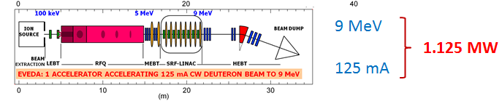
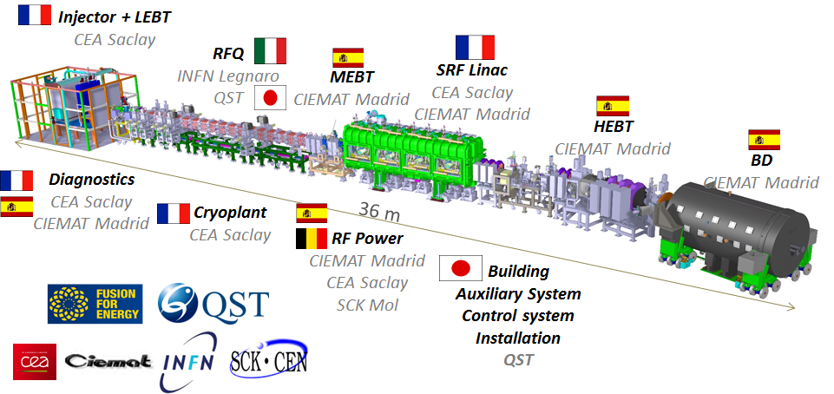
Breakdown of contribution for LIPAc
★
Rokkasho

Slide 10
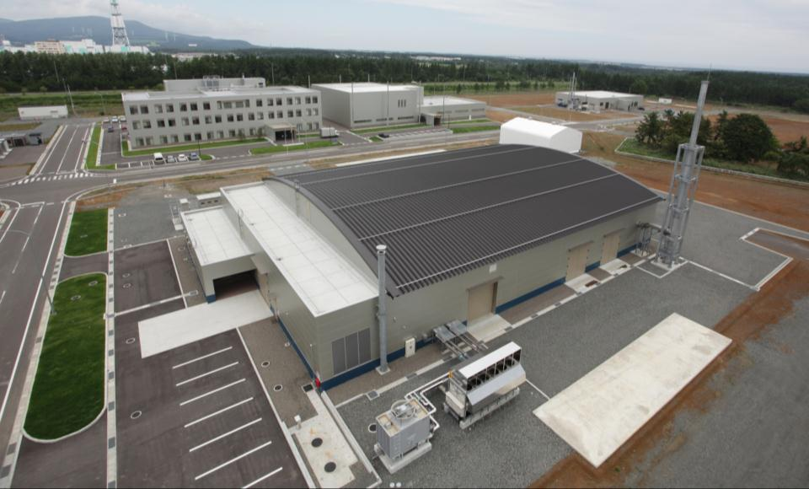


Conventional facilities
Administration &
Research Building
Computer Simulation &
Remote Experimentation Building
DEMO R&D Building
IFMIF/EVEDA
Accelerator Building

Slide 11
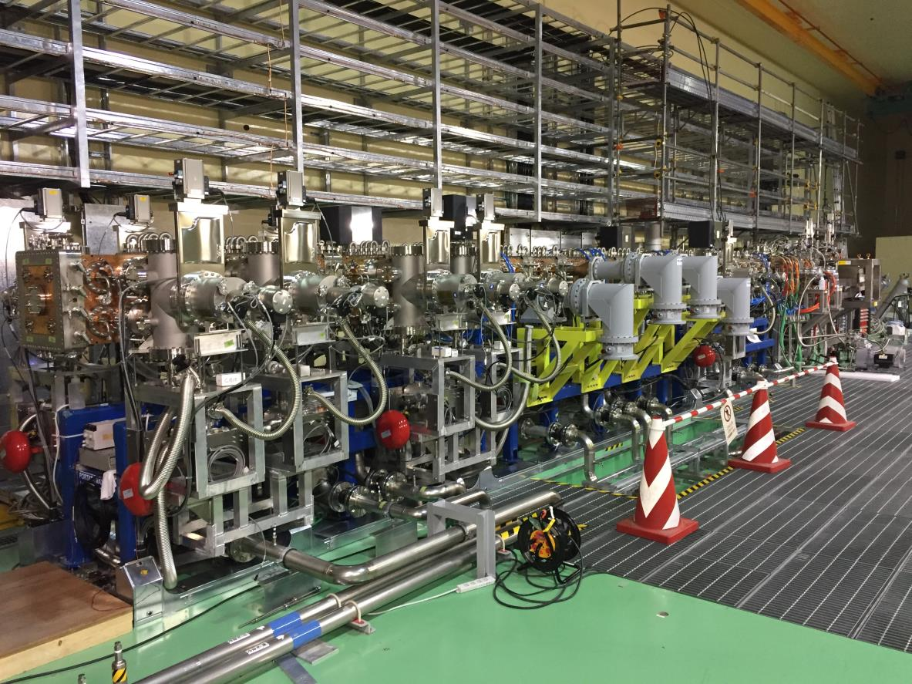
RFQ/MEBT/D-Plate in line

Slide 12
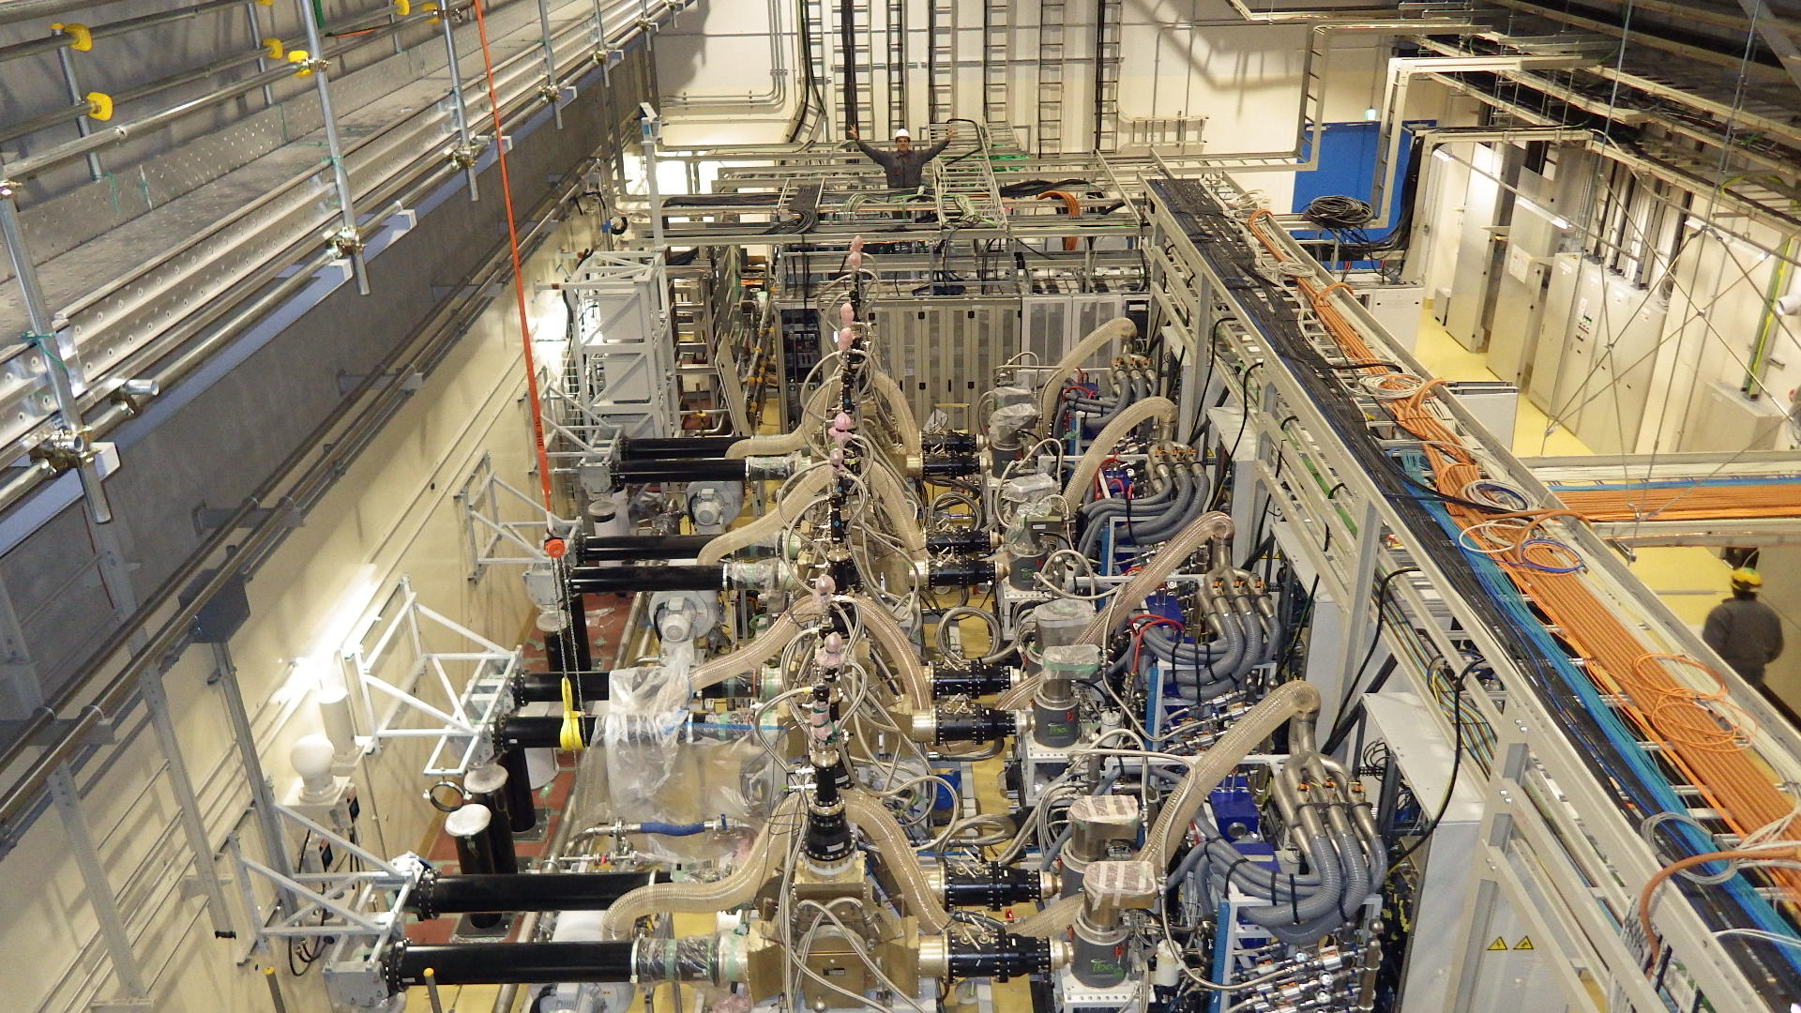
RF system installation

Slide 13
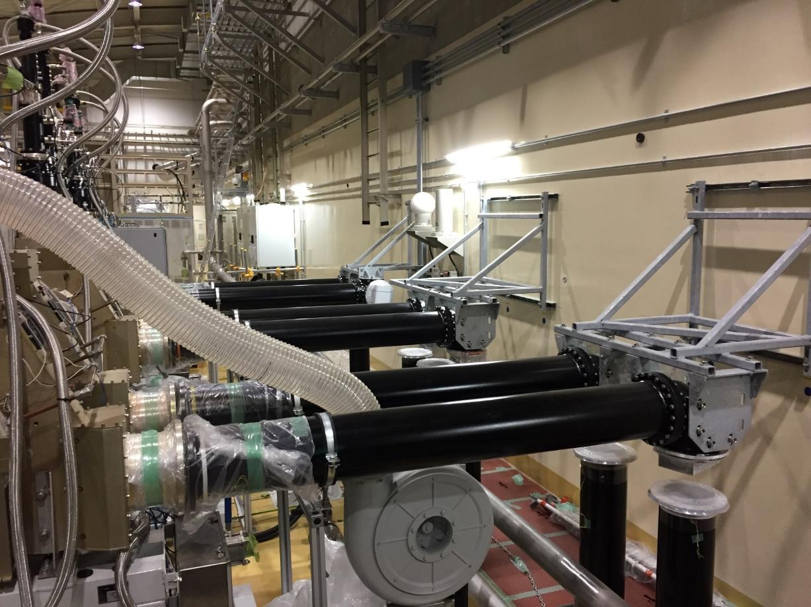
Coaxial waveguide installation

Slide 14
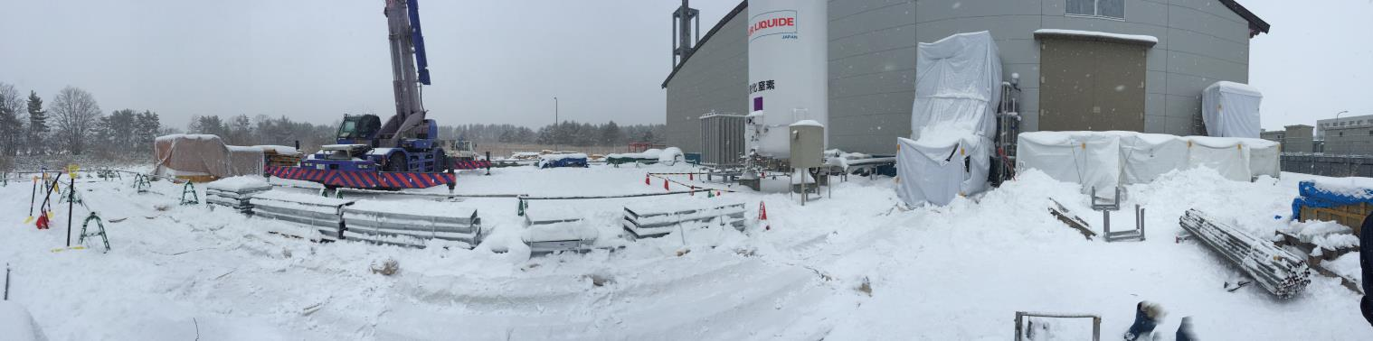
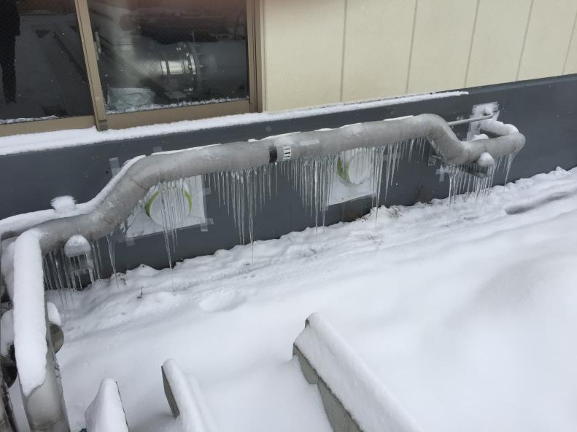
Works outside

Slide 15
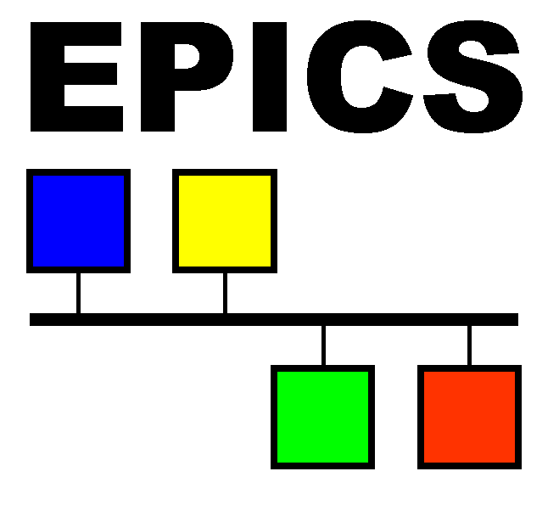
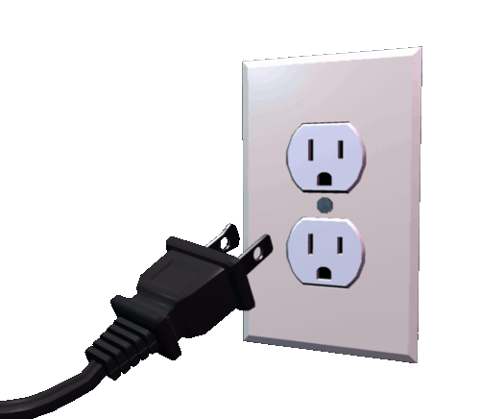
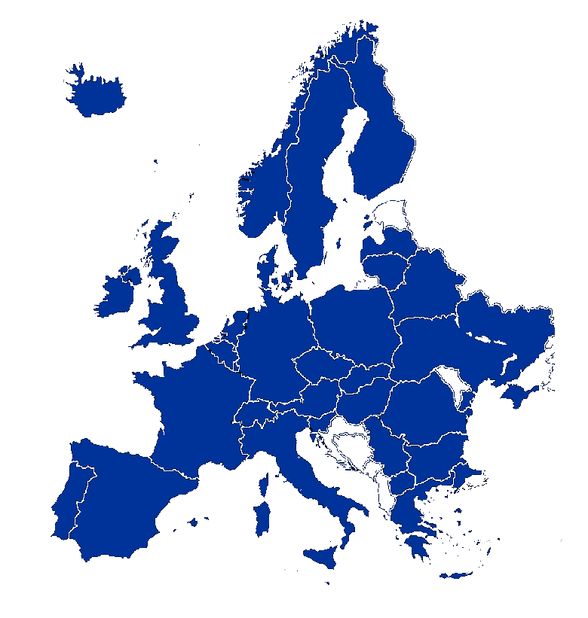
An in-kind contribution
★
EU Contribution:
Control of local subsystems (devices, loops, screens)+EPICS integration
Rokkasho
JA Contribution:
Provision of central services (protection, beam synchronization, data management)

Slide 16
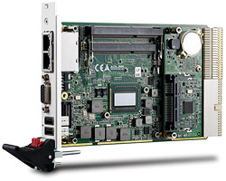
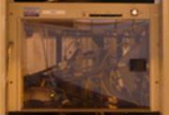
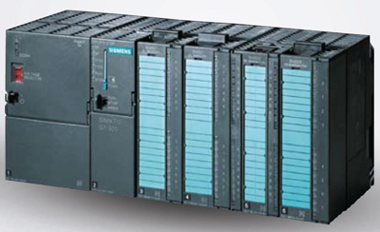
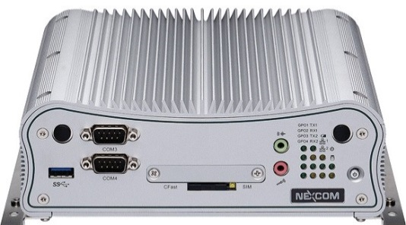
EPICS organization
LIPAc in figures:
Around 50 IOCs -> Distributed among 8 main subsystems
More than 40,000 PVs
VME+ADAS
& MODBUS
SIEMENS PLC
-> IOC on s7PLC drv
(formerly, OPC)
cPCI & Intel i7 + ADC-DAC
for LLRF, BPMs
+ a number of other specific devices

Slide 17

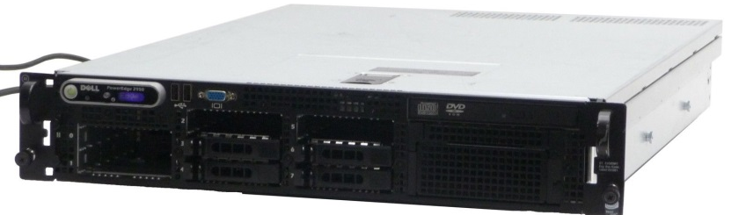

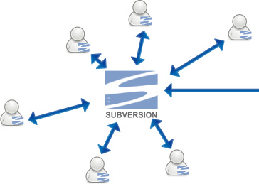
EPICS organization
Common EPICS distribution (curr.3.15.3) & development guidelines (templates, drivers, etc)
Top repositories centralized – IOCs distributed
  topIFMIF_INJ
  topIFMIF_RFQ
  topIFMIF_MEBT…

Slide 18

EPICS integration
Central services (to be provided by QST…):
Archiving system: currently SQL based, aiming at archiver appliance
Alarm system: currently OPI based, aiming at CSS-BEAST
E-logbook, backup&restore…
Integration framework developed by F4E.

Slide 19
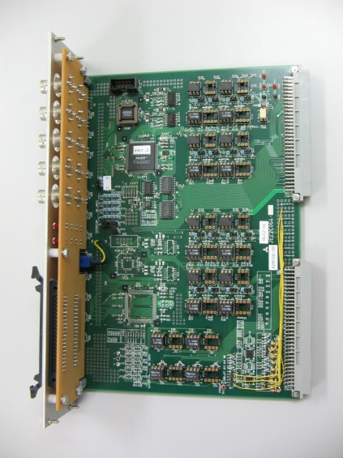
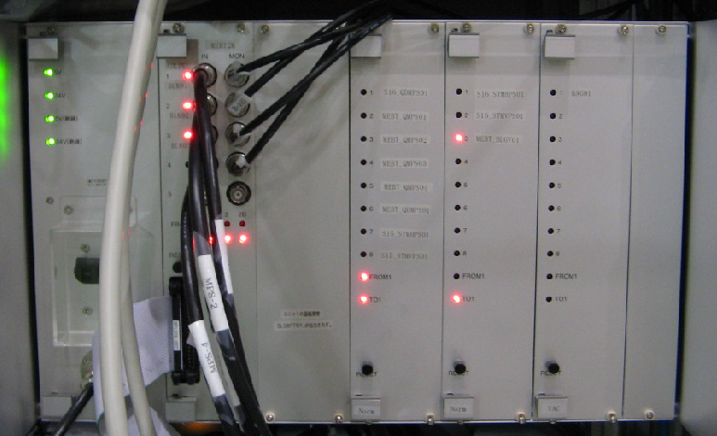
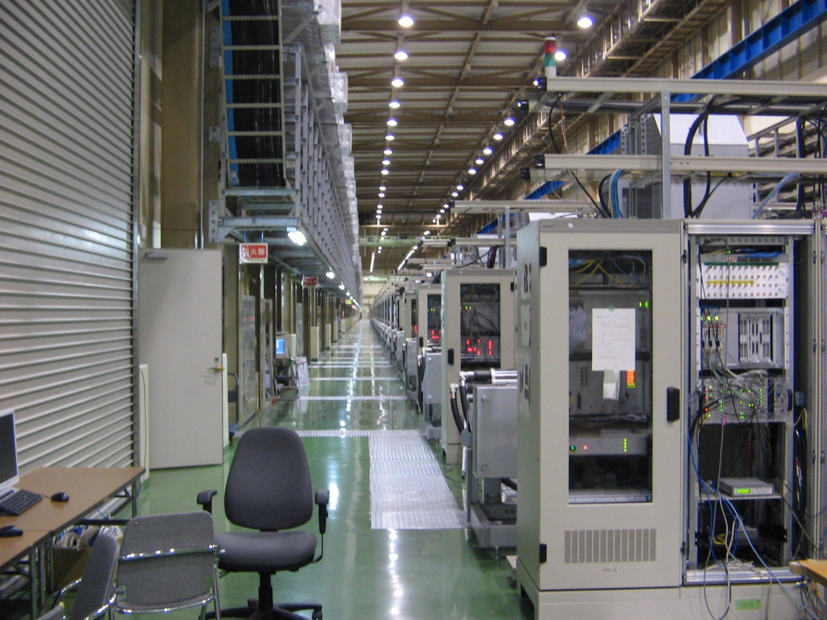
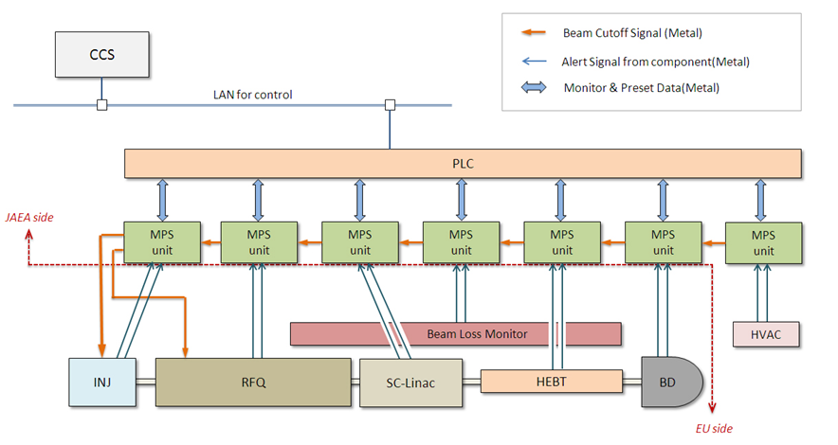
LIPAc MPS: basic architecture
Gathers all signals from subsystems for beam stop
Independent of CCS in the decision-making process
Interfaces CCS for operation (display & function reset)
Very fast beam inhibit (up to 30 µs)
Based on proven-in-use technology (derived from J-PARC)
Module
Unit

Slide 20
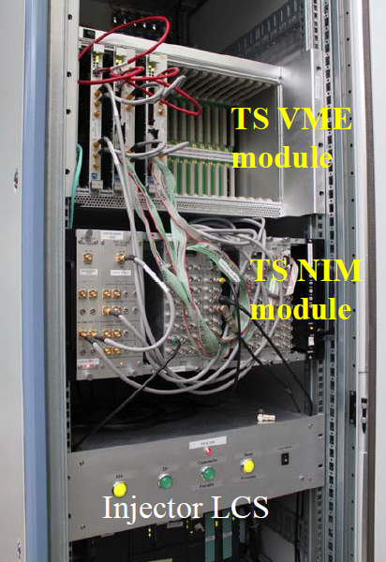
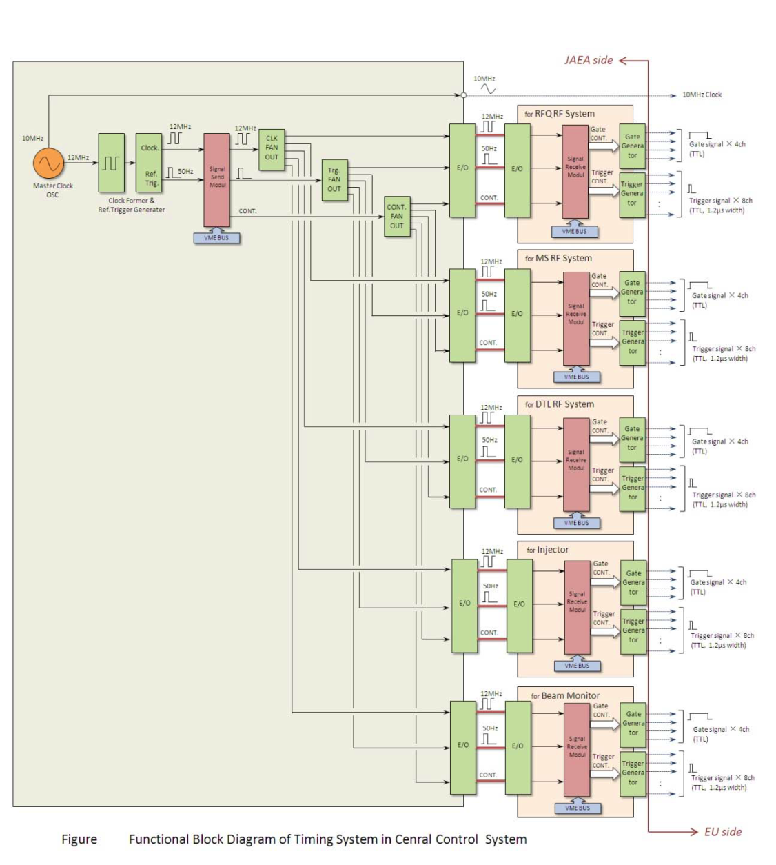
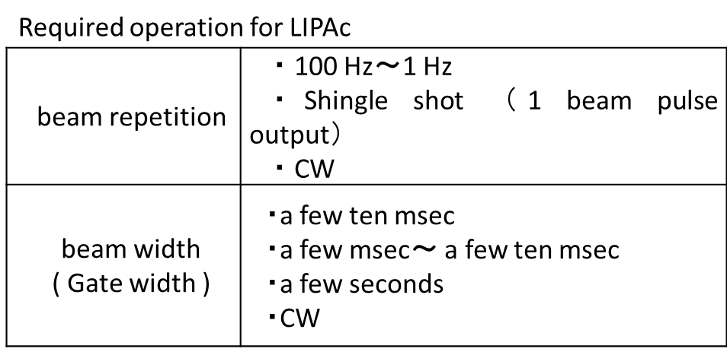
LIPAc Timing System
VME and NIM modules, Master Clock Generator
Timing signal interface specification, 5V/50Ω
Using proven technology (obsolete? -> J-PARC)

Slide 21
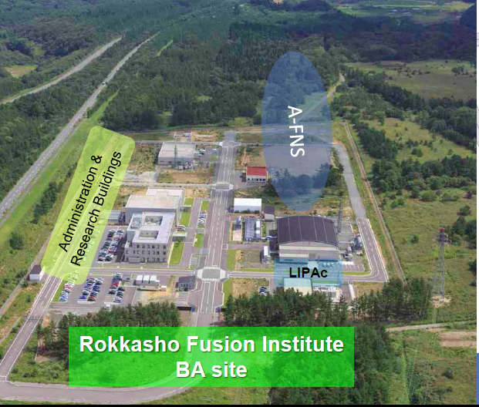
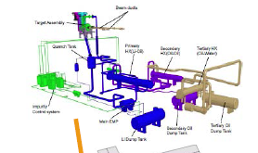
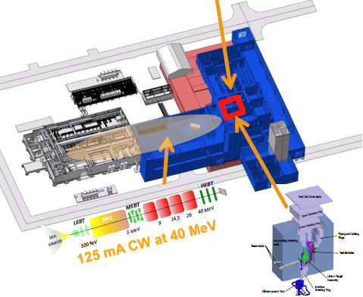
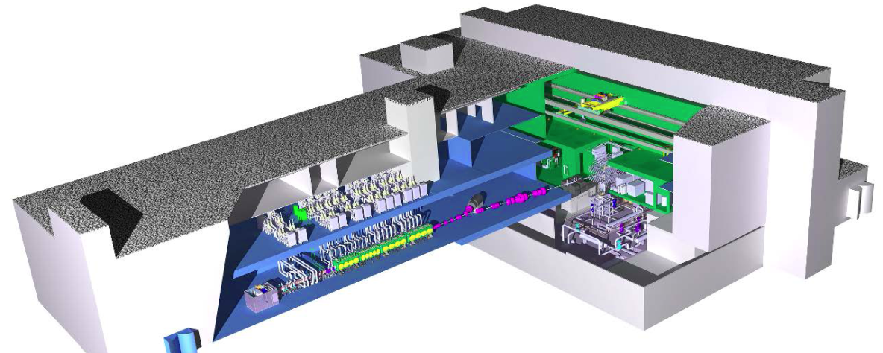
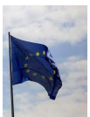
Next steps
A-FNS
Plans are to construct it in Rokkasho
14 MeV neutrons
available by 2027
DONES
125 mA at 40 MeV

Slide 22
Thank you
Thank you!

