Slide 1
Plan to use EPICS in home security service
TOSHIAKI AOYAMA
Kanto Information Service

Slide 2
Kanto Information Service (KIS) is …
An Information division of Kanto Railway Co., Ltd.
Kanto Railway is a private railway company in Ibaraki Prefecture
KIS has been in charge of development, operation and maintenance of epics-based control systems (KEKB, J-PARC/KEK) since 1994

Slide 3


Idea for Home Security
・Use Raspberry-Pi + EPICS
The device support "epics - devgpio" is used for GPIO controls. It is available online:
URL “https://github.com/ffeldbauer/epics-devgpio”
・ Camera module for Raspberry-Pi
A camera module of Raspberry PI is used with a surveillance camera.

Slide 4
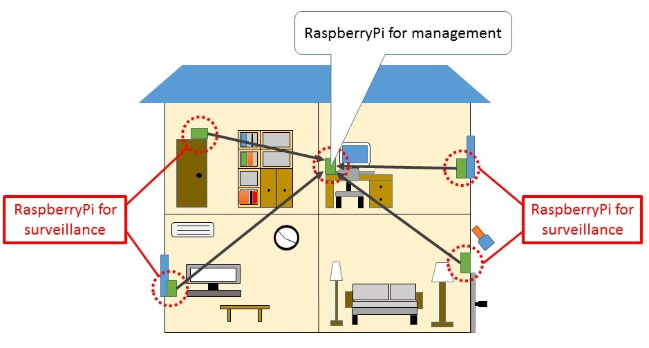
System overview
・Home security and surveillance system using EPICS
- multiple Raspberry-Pi pieces (for surveillance) communicate
to a Raspberry-Pi (for management) using EPICS CA
- prevention of criminal intruders to house

Slide 5
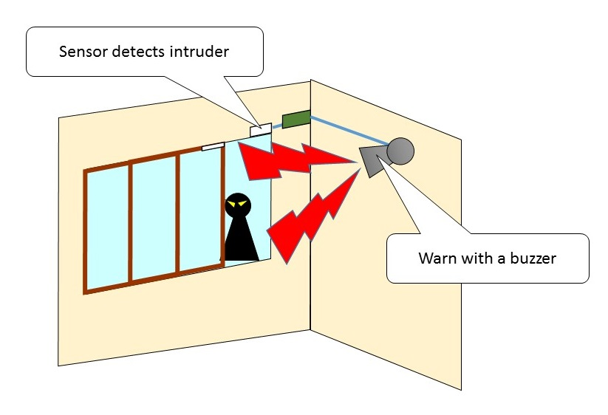
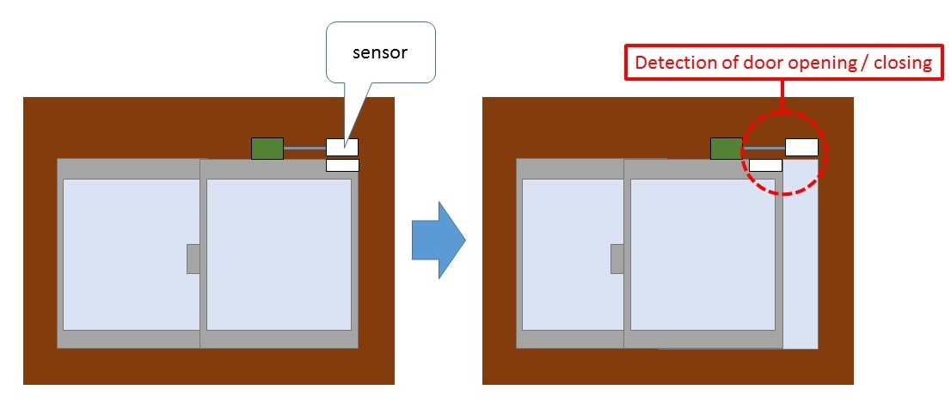
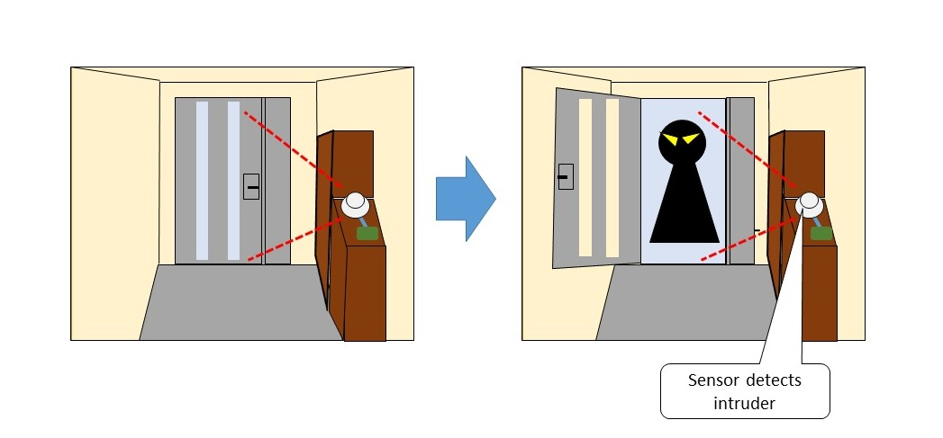
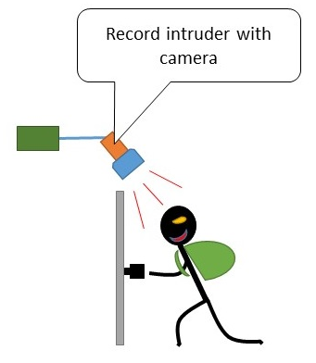
Raspberry-Pi for surveillance
・Raspberry-Pi watches at doors and windows, which are intrusive routes of suspicious individuals
・Raspberry-Pi with switch, sensor, camera, buzzer, can detect and record intruders

Slide 6
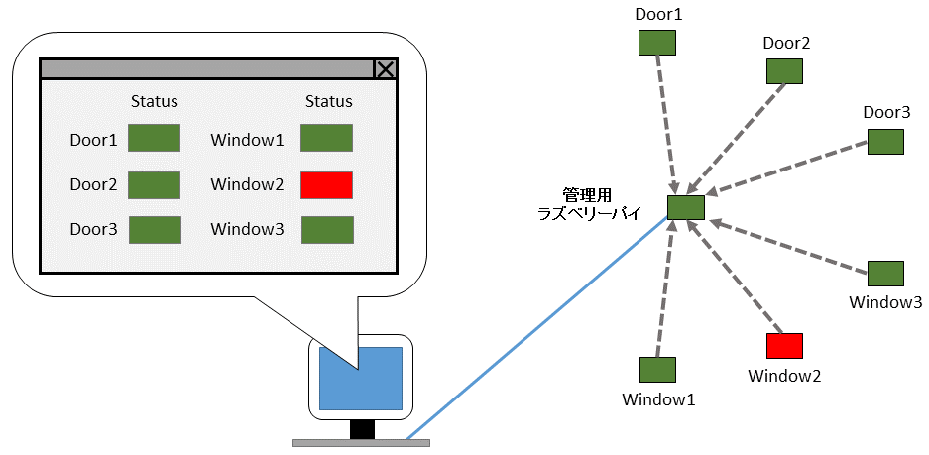
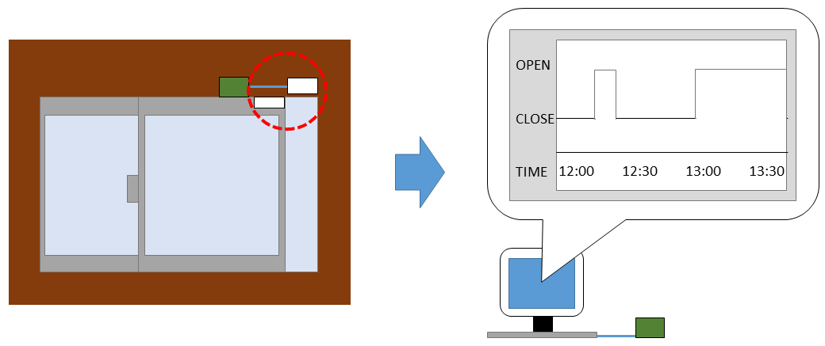
Raspberry-Pi for management
・The information detected by surveillance Raspberry-Pi pieces is
transmitted to the management Raspberry-Pi
・The management Raspberry-Pi checks the doors and windows, as well as video recorded.
・The Raspberry-Pi for management is monitoring whether the
whole system is working properly.
・ Network connections, live checks of surveillance Raspberry-Pi pieces
are always monitored.
dead
RaspberryPi for
management
Open / Close history
Detect abnormality

Slide 7
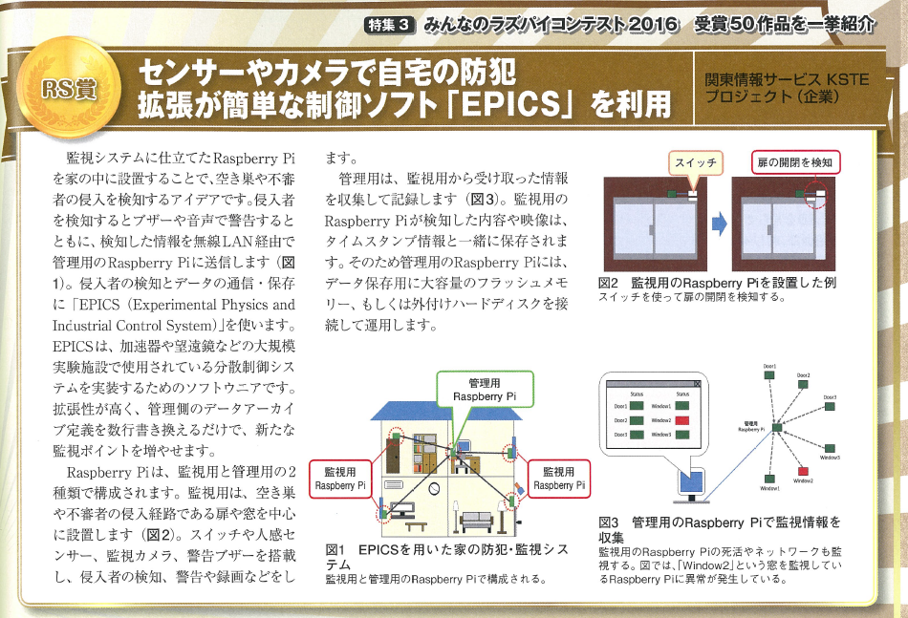
Idea => Demonstration
・The idea was awarded by a Japanese magazine “Nikkei Rasp-pi Magazine Monthly, Feb. 2017”
- “EPICS” appeared in bookstores
・We decided to develop a demonstration kit
- 1 surveillance Raspberry-Pi to detect door open
- 1 Raspberry-Pi for management
- Two Raspberry-pi pieces are linked by CA protocol
・Demonstration here !

Slide 8
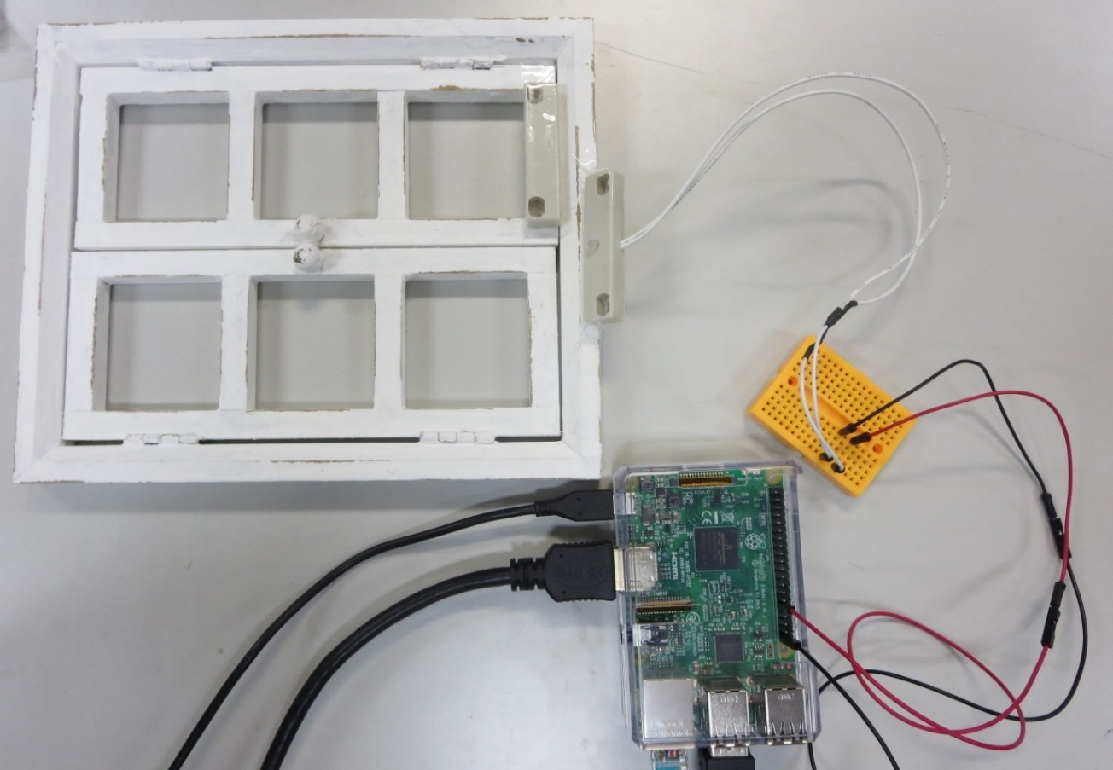
EPICS control surveillance Pi
sensor
・db file contents
SWITCH (door status check)
record(bi,"SWITCH_READ")
{
field(DTYP, "devgpio")
field(SCAN, "I/O Intr")
field(INP, "@J8-31 H")
field(FLNK, "BUZZER_OUT")
}
record(bo,"BUZZER_OUT")
{
field(DOL, "SWITCH_READ")
field(OMSL, "closed_loop")
field(OUT, "BUZZER_SET")
}
To manage-ment Pi

Slide 9
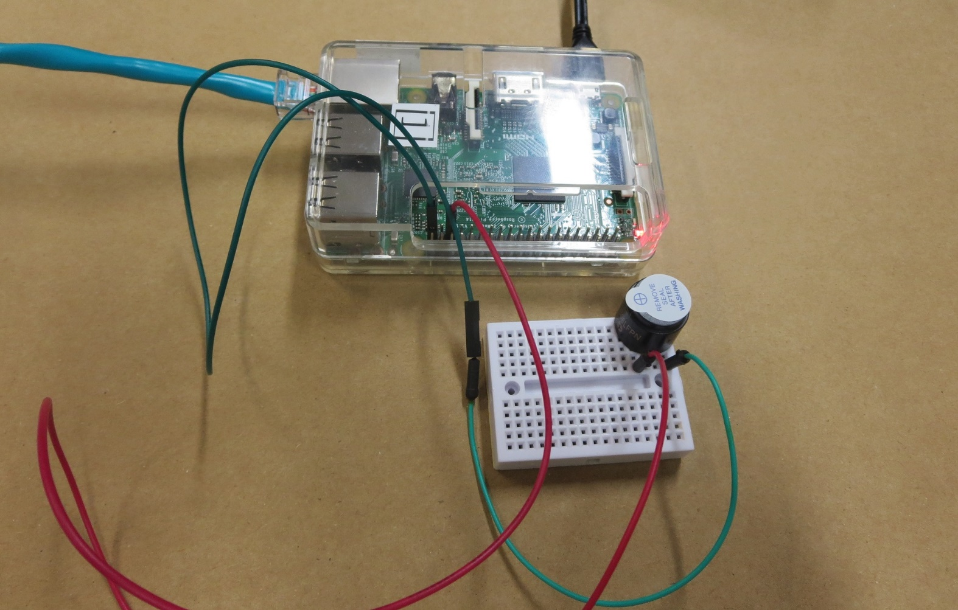
EPICS control
Management Pi
・db file contents
BUZZER
record(bo,"BUZZER_SET")
{
field(DTYP, "devgpio")
field(OUT, "@J8-35 H")
}
buzzer
From surveillance Pi

Slide 10
Discussion
・ EPICS - Excellent scalability
- easy to add sensors for doors, windows
- EPICS tools (Archiver, CSS) can be introduced if needed.
・ Raspberry-Pi - Low-cost and variety of I/O
- cost is considerably low
- many I/O devices in the market

Slide 11
Summary
・Combination of EPICS and Raspberry-Pi
growing widely (only for hobby ?)
succeeded to demonstrate for home security service
・Currently it is still in the experimental phase, so we have not
done commercial deployment yet.

