Slide 1
Status of Migration from Channel Archiver to Archiver Appliance in J-PARC MR
Shuei YAMADA (KEK / J-PARC)
shuei@post.kek.jp

Slide 2
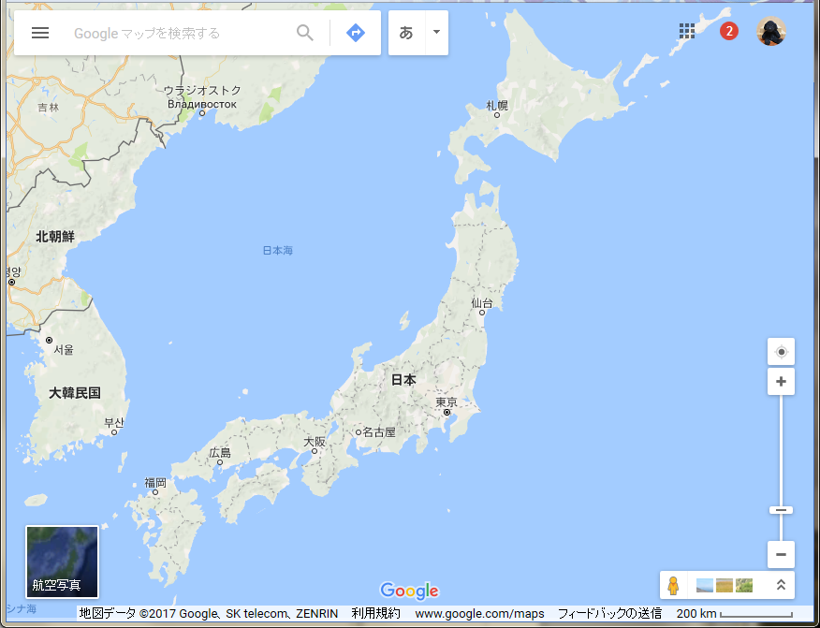
J-PARC
J-PARC
KEK
KURRI

Slide 3
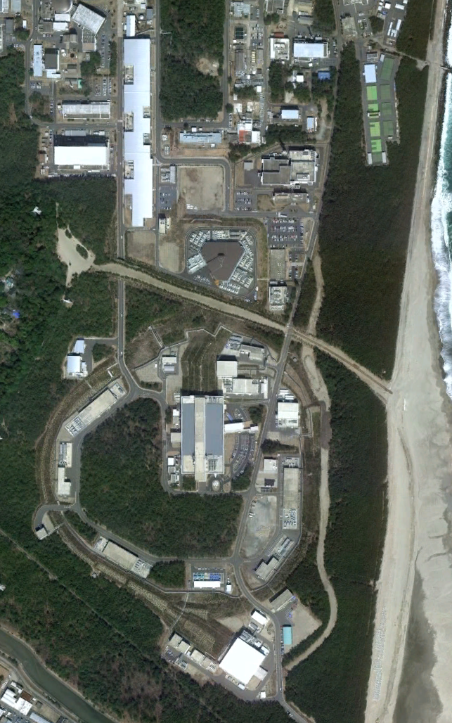
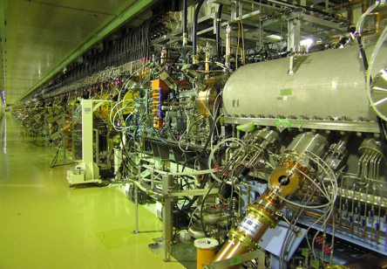
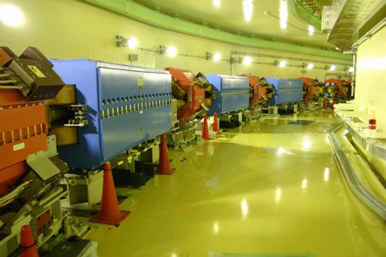
J-PARC
LINAC
400 MeV/c
@ 25Hz
Japan Proton Accelerator
Research Complex
Joint project of
KEK (High Energy
Accelerator Research
Organization)
and
JAEA (Japan Atomic
Energy Agency)
RCS
3 GeV/c
@ 25Hz
Neutrino
Experiment
Facility
Main Ring
30 GeV/c
@ 2.48 sec (FX to NU)
→ 1.32 sec in
@ 5.52 sec (SX to HD)
In operation since 2008
Materials and
Life Science
Facility
Hadron
Experiment
Facility
©google

Slide 4
Outline
Archiver Appliance
Installation of Archiver Appliance
Data Retrieval
Migration from Channel Archiver to Archiver Appliance

Slide 5
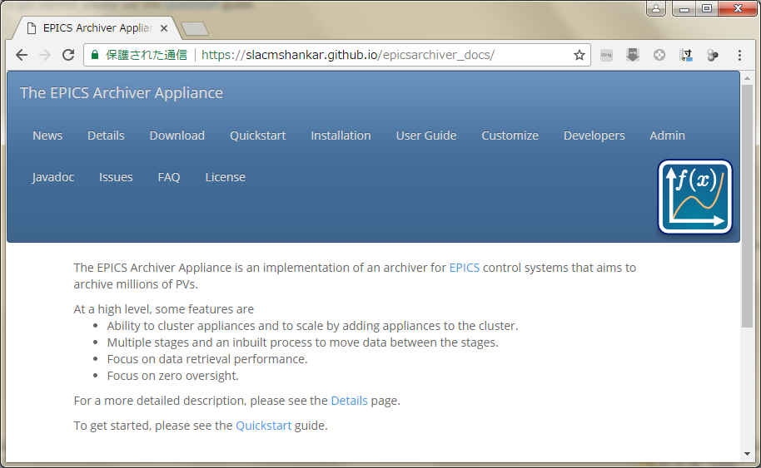
Archiver Appliance

Slide 6
Archiver Appliance
Distributed archive system for EPICS
Focus on data retrieval performance
Focus on zero-oversight
Per PV archiving parameters
  No concept of Engine/Group in Channel Archiver or CSS Archiver
Support for alias
Data file per PV, per time partition
  No index file
  3 stages of storage : short term, medium term, long term
    5min/15min/30min/1hour/1day/1month/1year
    Automatic transfer : STS → MTS → LTS
    Data processing/reduction during transfer

Slide 7
Channel Archiver
Started operation in 2008
  ～ 24000 PVs in total
  ～ 20 engines, some PVs archived in 2 (or 3) engines
  Data stored on NFS
  Data rate : 1.3 TB / year
Difficulties after 8 years of operation:
  Not maintained anymore
  Limit of 2 GB in file size
  Management of keys and index files
  Restart archiver every day to deal with corruption of index file
  Missing data for ～minutes during restart
  Retrieval of a PV in multiple keys
Possible alternatives:
  CSS Archiver
  (Cassandra Archiver)
  Archiver Appliance

Slide 8
CSS Archiver
2015
  Started evaluation of CSS Archiver
  VM for engine and PostgreSQL server
  Data stored on NFS
2016
  PosgtgreSQL sever moved to from VM to real machine,
  NFS to local disk
  Conversion from pgsql 9.2 to 9.5
    Dumped 11.8 TB of data, restored to 9.3 TB
    Dumped in 2 weeks, restored in 3 weeks
Issues:
  Large data rate : 5.8 TB/year for 24000 PVs
  Many PVs remain disconnected at startup
  Slow data retrieval

Slide 9
Experience in Archiver Appliance
20170116
  Started evaluation of Archiver Appliance
20170131
  Imported all PVs from Channel Archiver and CSS archiver
No major problems so far
  Data rate : ～ 1.4 TB/year
    1/4 of CSS Archiver data rate
  No “disconnected” records after recovering from unplanned blackout

Slide 10
Installation Procedure
Download
  Archiver Appliance binary + source
    Sample scripts are included in the source
  tomcat 8.5.11 binary
  Mysql (5.1.73, rpm for SL6), mysql-connector-java
    For persistent configuration
Read documentation carefully
Read documentation carefully
Just do the installation
  Prepare schema for Mysql
  Run installation script which comes with Archiver Appliance
  Edit configuration files to match with accelerator control network

Slide 11
Decisions to Make Before Production
Granularity of time partition
  We chose 1 hour/1 day/1 month for STS/MTS/LTS
  All the storage on local disk
    We may move LTS to NAS afterwards
Mapping from record name to path of data file
  “:” and “-” becomes directory separator by default:
  MRMON:DCCT_073_1:VAL:MRPWR
  → MRMON/DCCT_073_1/VAL/MRPWR:2017_02.pb

Slide 12
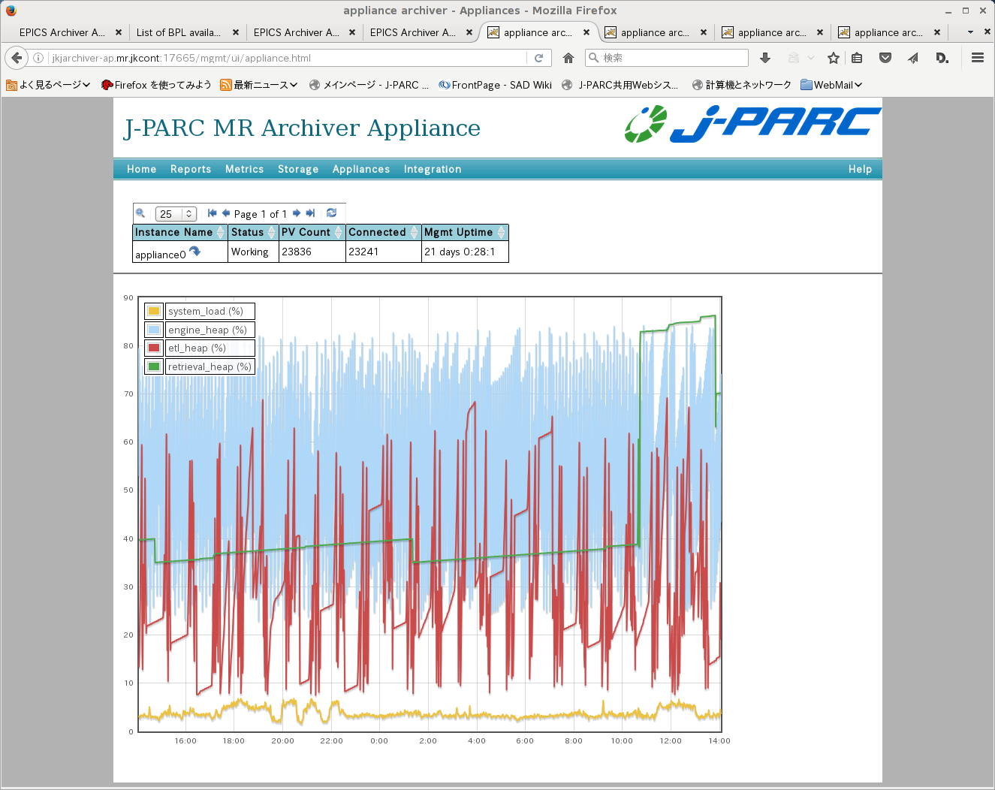

Slide 13
Data Retrieval
API
  http://jkjarchiver-ap.mr.jkcont:17668/retrieval/data/getData.txt
  ?pv=MRMAG:SIOC_MAG_D3MAIN01:VAL:LOAD
  &from=2017-01-19T0:0:0Z&to=2017-01-19T1:0:0Z
  Available formats: txt, csv, json, raw, svg, mat
CS-Studio 4.3 or later
  4.4.1 (KEK version)
    Thanks to: Hirose-san (KIS), Sasaki-san (KEK)
Java Archive Viewer
In-house web-interface
  PHP + Perl
  UI similar to web-interface for Channel Archiver

Slide 14
Naive benchmark
Retrieve whole sample (a PV @ 1Hz) within given period
1 hour
 | CSS Arch | Arch Appl
#1 | 1.236s | 0.136s
#2 | 0.019s | 0.013s
#3 | 0.013s | 0.012s
24 hours
 | CSS Arch | Arch Appl
#1 | 24.229s | 0.150s
#2 | 0.309s | 0.068s
#3 | 0.310s | 0.068s
3 days
 | CSS Arch | Arch Appl
#1 | 637.408s | 2.408s
#2 | 0.909s | 0.180s
#3 | 0.900s | 0.981s

Slide 15
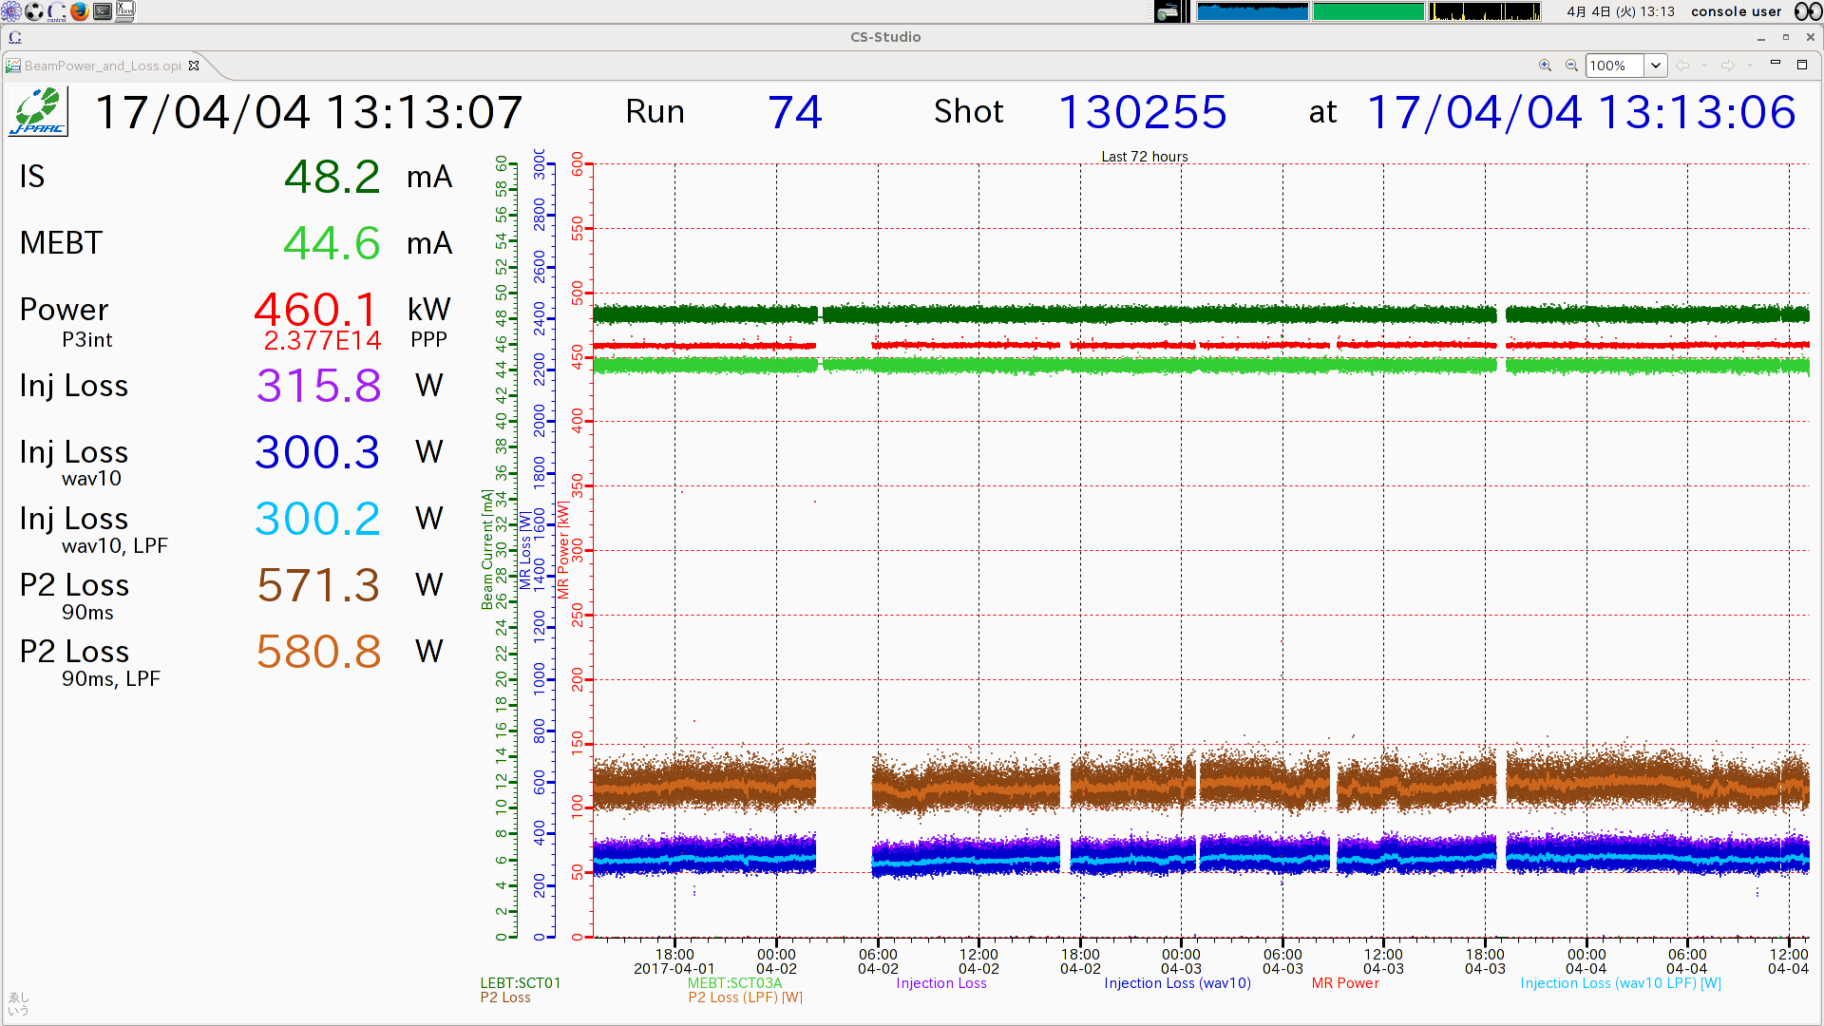
CS-Studio

Slide 16
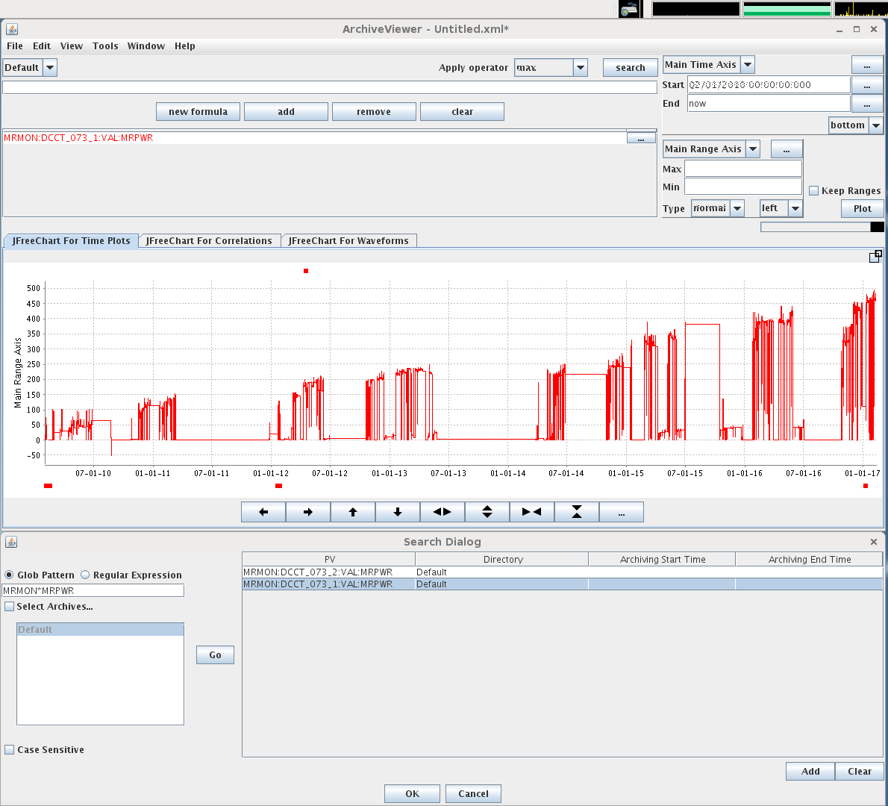
JAVA Archiver Viewer

Slide 17
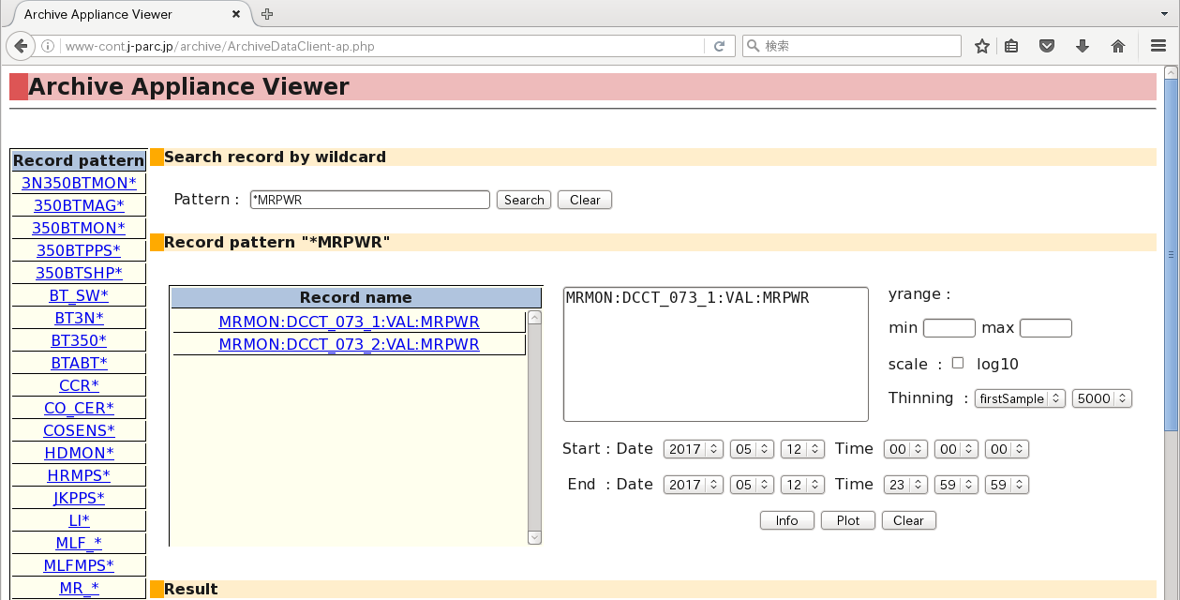
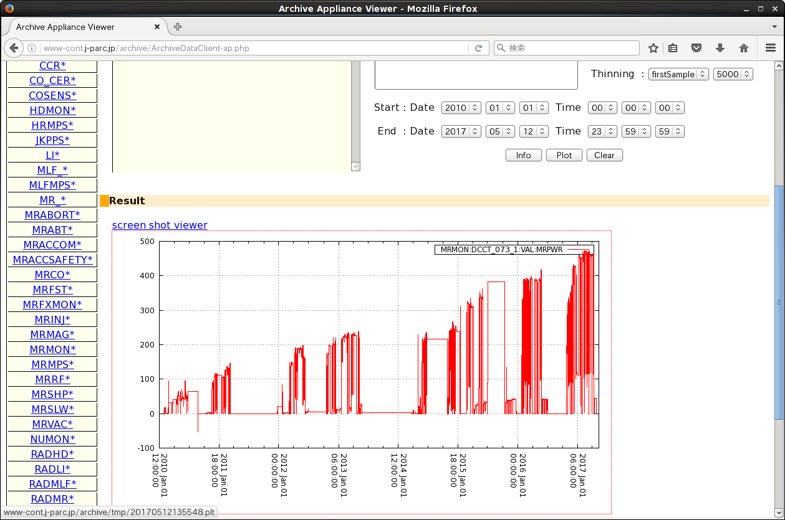
Web interface (PHP+Perl)

Slide 18
Data conversion from Channel Archiver to AA
“Archiver Appliance at NSLS2”, Michel Davidsaver (2015 Spring EPICS meeting)
  https://indico.fnal.gov/materialDisplay.py?contribId=82&sessionId=5&materialId=slides&confId=9718
arget -E pbraw ...
  XMLRPC client written in Python 2.7 + twisted
  Configurable granularity
  Retrieves a PV stored in multiple keys
ca2aa
  C++ program which reads Channel Archiver data file
  Seems to be abandoned in middle of development
    Granularity fixed to 1 year
    Lack of documentation

Slide 19
Summary
Channel Archiver is in operation since 2008 in J-PARC MR
Archiver Appliance was deployed and evaluated
AA is in operation since 2017Jan31,
no major problem so far.
  Channel Archiver will be stopped in summer shutdown 2017
    Will server data retrieval for >1 year
    CSS Archiver will be stopped too
Data conversion from Channel Archiver to AA underway

Slide 21
Hardware
Lenovo x3630
  Purchased in 2012
  24 TB (2TB x12 near-line SATA)
  24GB memory
  Xeon E5-2407v2 (2.4GHz 4c4t) x2
  Redundant Power supply

