Slide 1
Introduction of
Device and Driver Support for Yokogawa F3RP71
Shuei YAMADA (KEK / J-PARC) shuei@post.kek.jp

Slide 2
Outline
F3RP71 (and F3RP61)
Development and Runtime environment
F3RP71 Device/Driver support
Release Plan

Slide 3
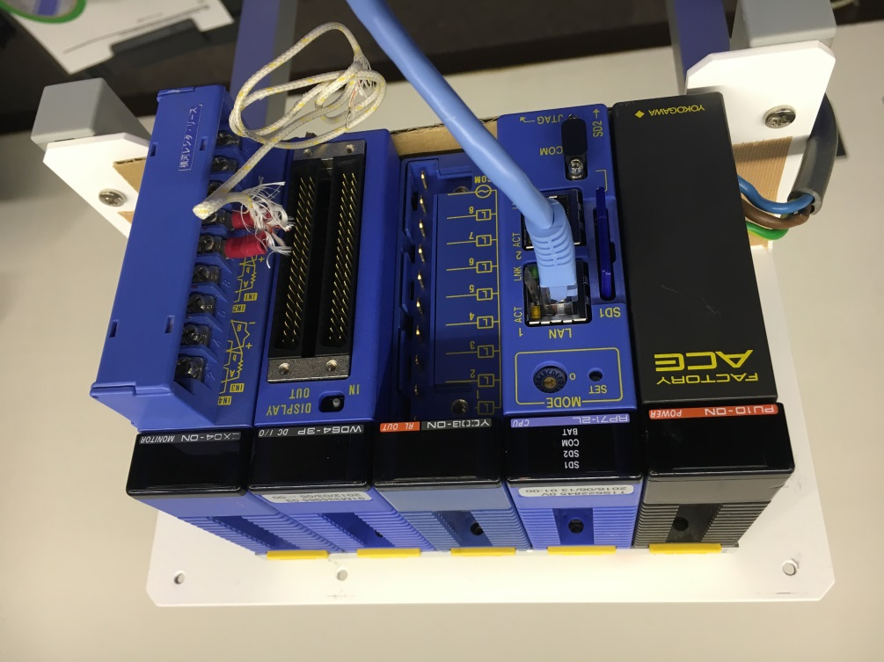
F3RP71 (and F3RP61)
Linux CPU module for Yokogawa PLC (FA-M3 series)
  Successor of F3RP61
  35-40 F3RP61 in operation
  @ J-PARC MR
  Evaluating one F3RP71
Notes:
softfp

Slide 4
Development & Runtime Environment
Yocto + Xilinx SDK + F3RP71 Board Support Package
  Bootable SD card based on user-land by Yokogawa
Make use of Plain GNU toolchain + Makefile
  Cross development on Scientific Linux 6 (RHEL6 clone).
EPICS base, modules and IOC products located on NFS
  For easy replacement of CPU module
Available APIs for IO module access
  Library functions.
  F3RP61 compatible ioctl(2) functions.

Slide 5
F3RP71 support
Porting stated with F3RP61 v1.3.0
  F3RP61 support originally developped by Odagiri-san (KEK)
  F3RP61 v1.2.1 in operation at J-PARC MR
(almost) source code compatible with F3RP61 support
  Make use of F3RP61 compatible API
  Minor modifications are needed in:
    Macro for ioctl() request code
    Path to header files
    Device file for Ladder CPU
A minimum test has been carried out
  Blinking LEDs on DO module (F3WD64) thru caput.
  More test is needed (DO, AI/AO, Ladder CPU, …)
Merging F3RP71 support with F3RP61 is desirable

Slide 6
Release date : TBD
Decisions to make:
  DTYP field, DBD name, library name, …
    Use “F3RP61” for both 71 and 61
      No need to modify db; Might be a bit confusing as DTYP for F3RP71
    Introduce new DTYP, e.g, “eRT3” or “FAM3”
      Need to modify EPICS db, Makefile, … etc.
    Individual DTYP for each: “F3RP71” and “F3RP61”
      Need to modify EPICS db, Makefile, …etc.
  HOST-ARCH
    linux-f3rp71
      F3RP61 uses linux-f3rp61
    linux-arm
      May conflicts with other arm-based IOCs … ABI for 71 is armel
Reorganization of F3RP61 support is needed
  v1.3.0 ... https://github.com/EPICS-F3RP61/epics-f3rp61
  v1.6.0 ... http://www-linac.kek.jp/cont/epics/f3rp61
NIC hangs up on heavy network traffic
  Expecting a bug-fixed kernel by August
  Close contact with Yokogawa

Slide 7
Summary
Device support for F3RP71 was ported from F3RP61
A minimum test has been carried out
Release data TDB

