Slide 1
The EPICS running envirionments in the five accelerator projects
Qingru Mi
Shanghai Institute of Applied Physics
May 16, 2017

Slide 2
Contents
Introduce of the five accelerator projects
  DCLS
  SXFEL
  Sirius Linac
  SAPT
  SSRF Phase-II Beamline Project
The general EPICS running environment

Slide 3
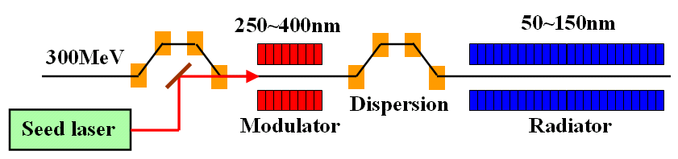
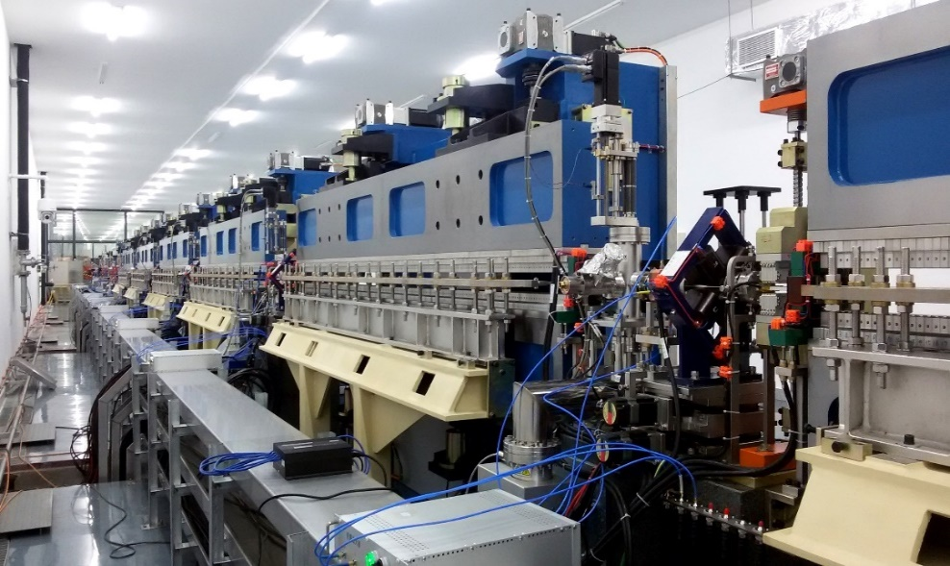
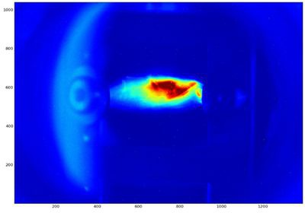
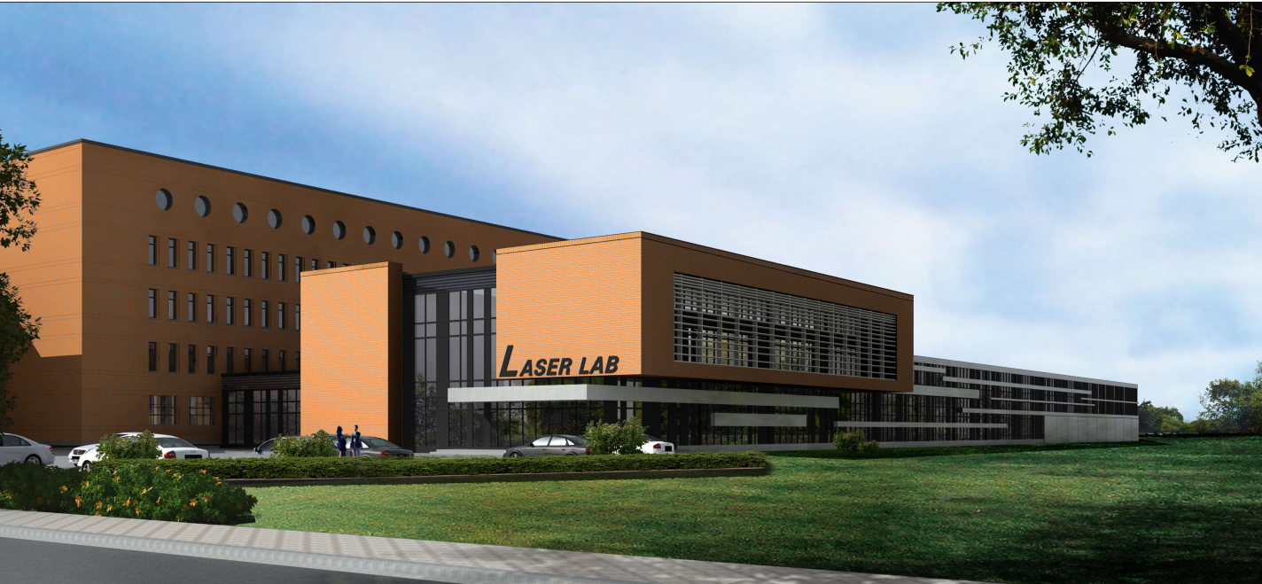
Dalian Coherent Light Source(DCLS)
Joint proposal by DICP(Dalian Institute of Chemical Physics) - SINAP since 2009
Funded by NSFC(National Nature Science Foundation of China), December, 2011
Carried out jointly by DICP (experimental end stations) and SINAP (Linac + FEL)
Seeded FEL(HGHG), 50 - 150nm tunable, 50Hz rep rate.
fs - ps pulse lengths
in parallel to SXFEL, similar technology
First Light in September, 2016

Slide 4
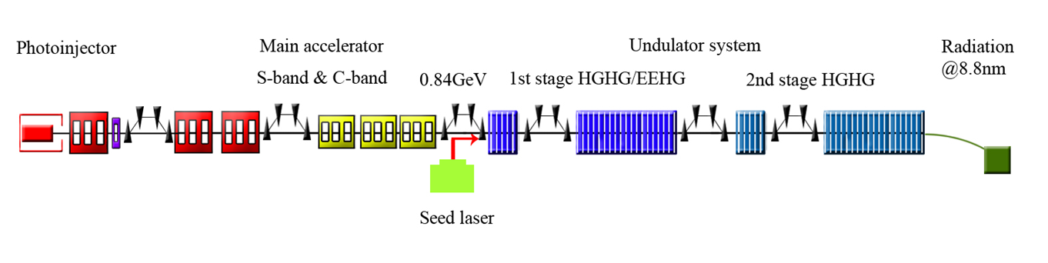
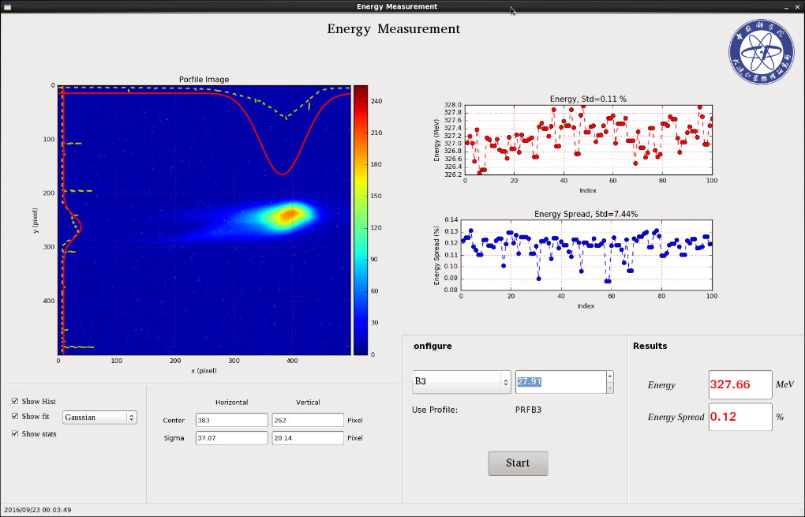
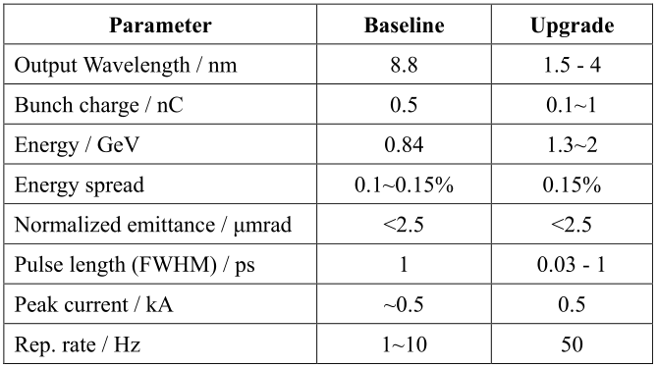
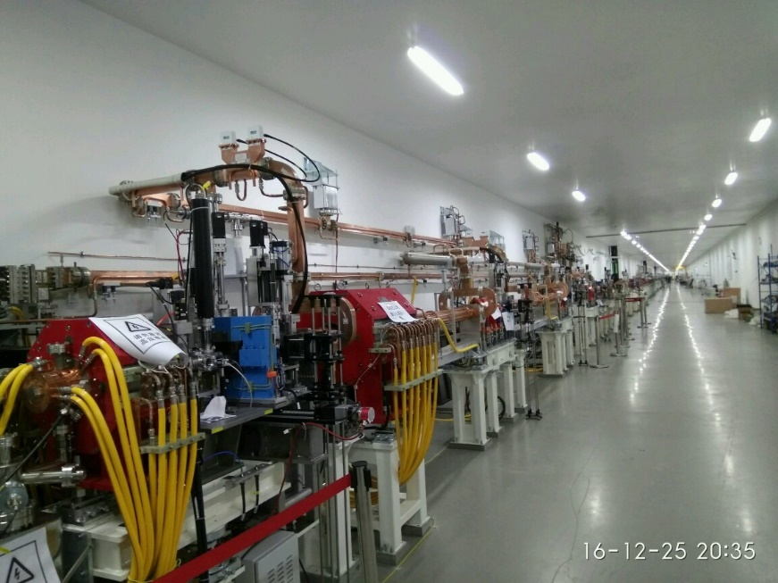
Soft X-ray Free Electron Laser(SXFEL)
Located beside SSRF in Shanghai.
Construction 2014-2016
Commissioning 2016-2017
First Light on December 31, 2016

Slide 5
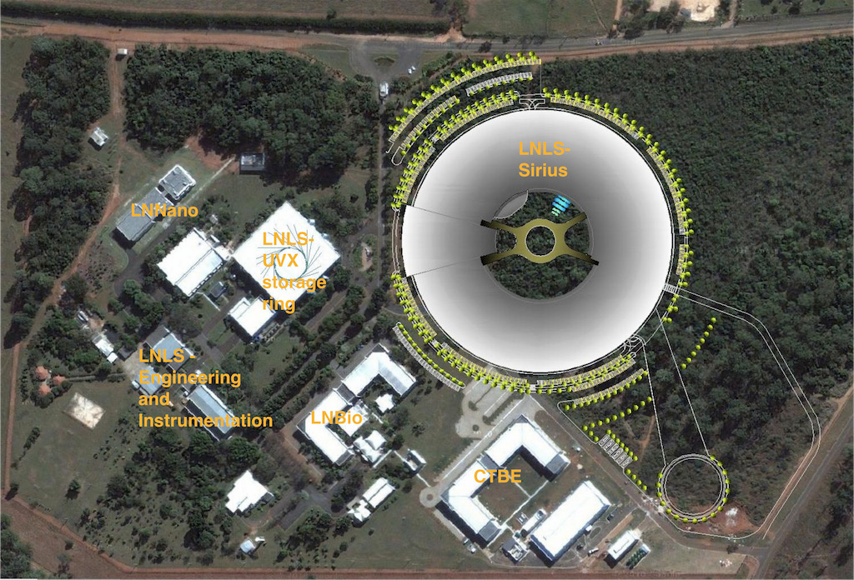
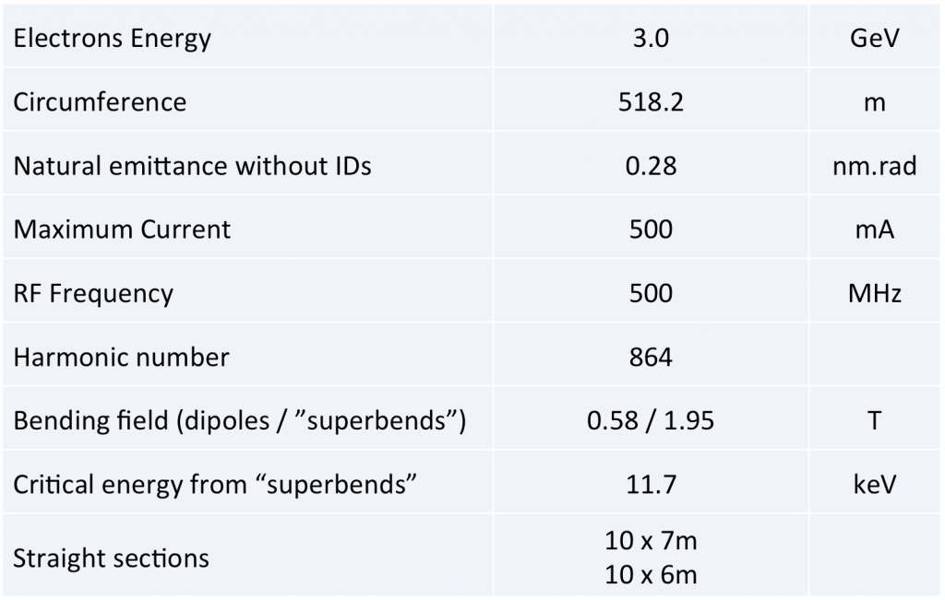
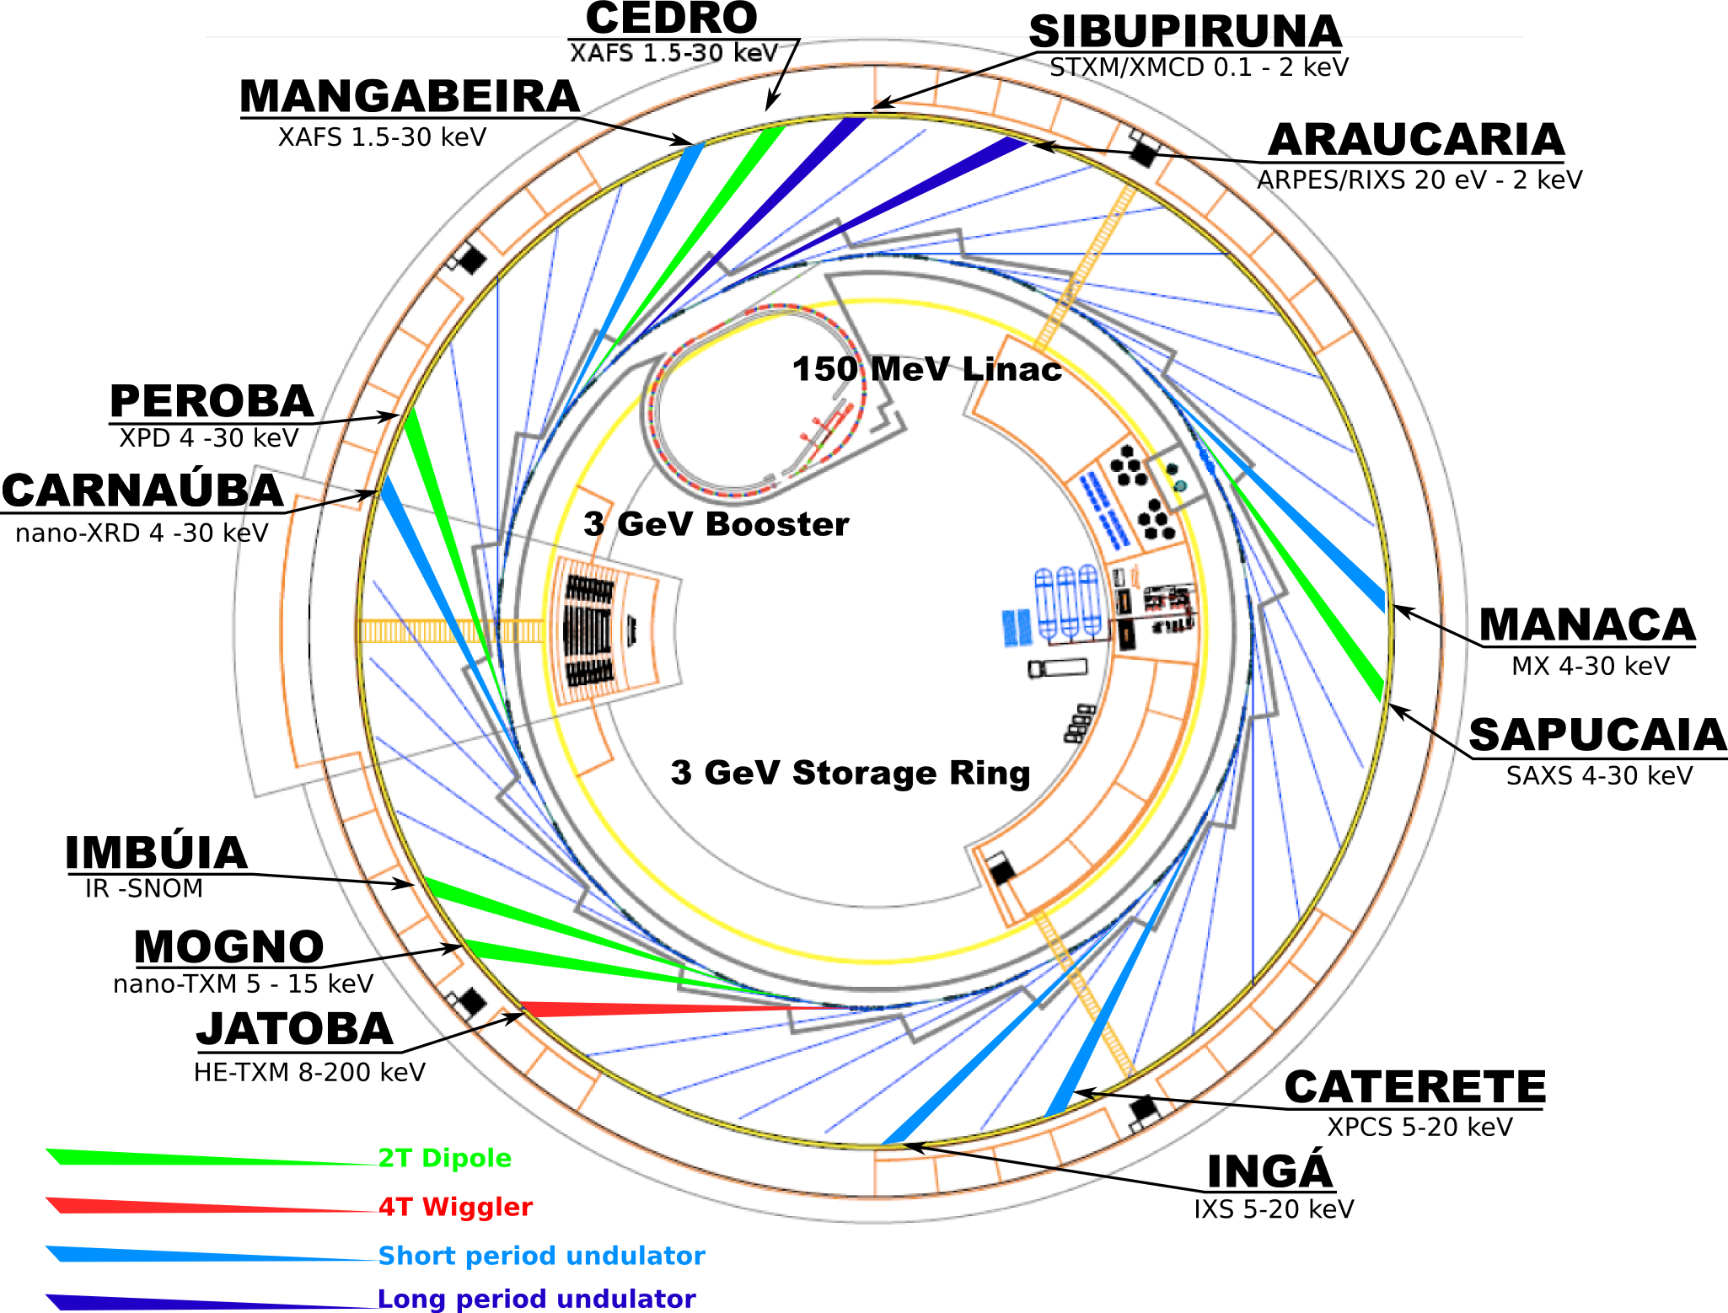
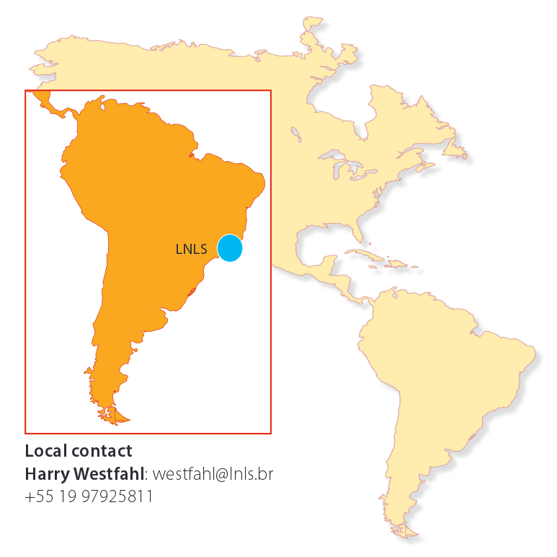
Brazil Sirius Source Linear Accelerator
(Sirius Linac)
In Framework for technical cooperation with CNPEM(Brazilian center for research in energy and materials)
All Devices have been shipped to Brazil, and will be installed in October, 2017.

Slide 6
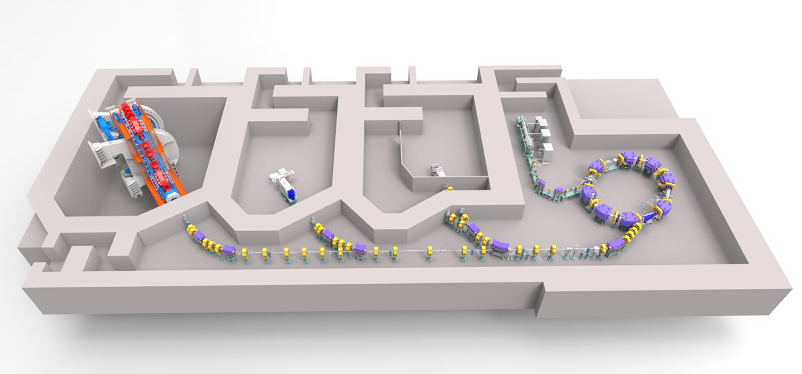
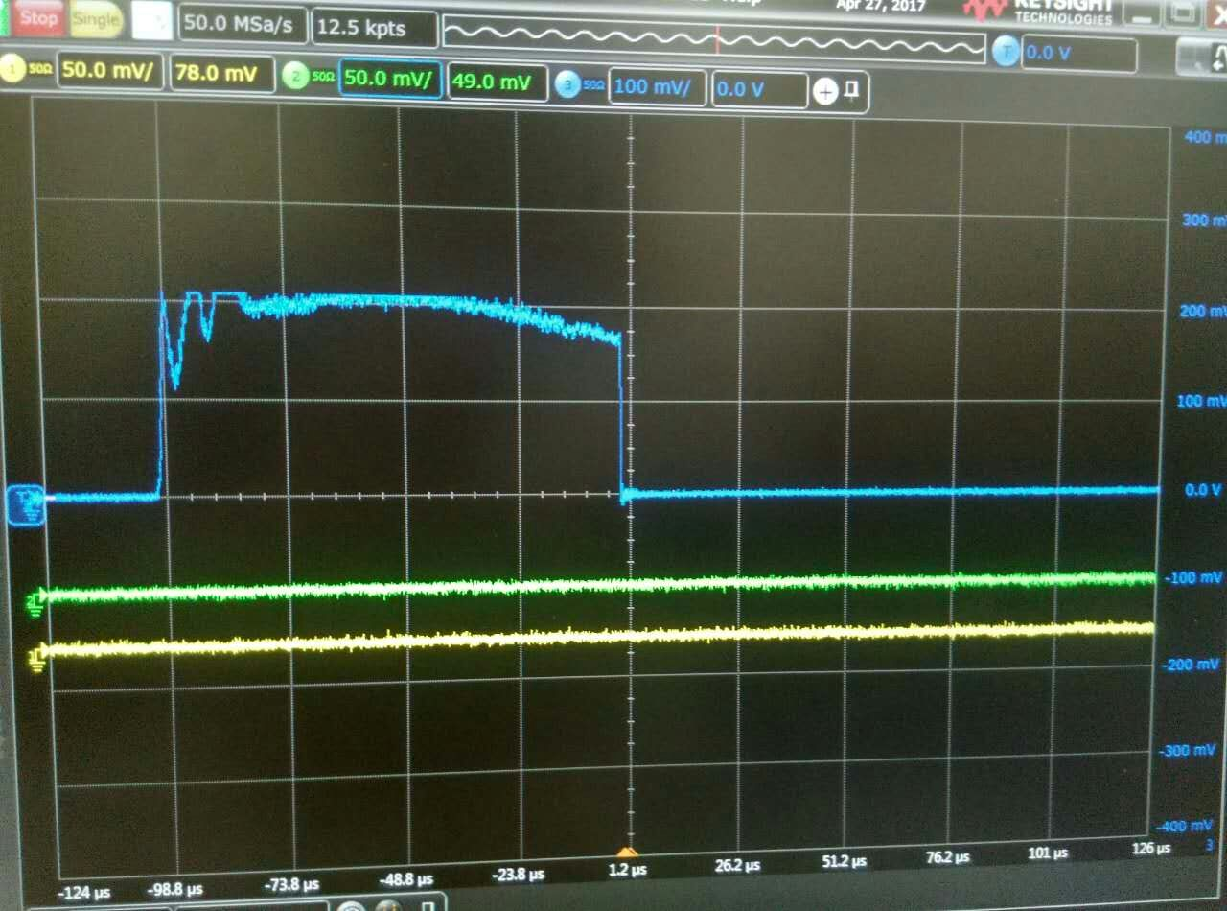
Shanghai Advanced Proton Therapy Facility (SAPT)
Cooperated with Shanghai Ruijin Hospital and SINAP.
Approved in 2012.
Accelerator + Fixed beam therapy room+ Rotating beam therapy room + Eye beam therapy room.
Proton synchrotron + Slow extraction system
Spot scanning mode currently, progressive scan mode in the future.
Extracted Energy | 70~250 | MeV
Injected Energy | 7 | MeV
Extracted Particle Beam | 4-8*10¹⁰ | ions/beam
Repeating Frequency | 0.5 | Hz
Dosimetry | 2 | Gy/min

Slide 7
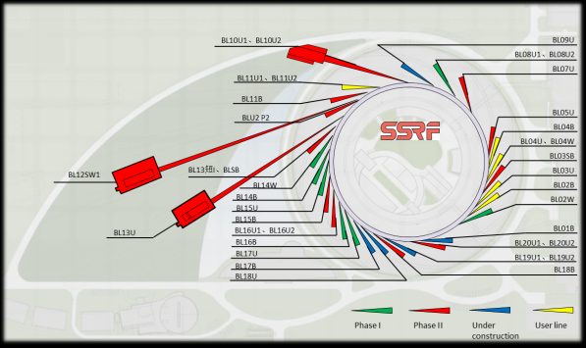
Shanghai Synchrotron Radiation Facility(SSRF)
Phase-II Beamline Project
16 Beamlines are in construction.
Upgrade accelerator control
  Remotely control and feed forward insert device.
  Add new device control for RF, power supply, vacuum, beam instrumentation, etc.
  Update the machine protection system.
  Upgrade the database system.
  Update the running envirionment
Commission will be in 2020.
Black: phase-I beamlines(7+1)
Red: protein beamlines and dreamline
Pink: phase-II beamlines
Green: beamlines of users

Slide 8
General architecture of the running environments
Five projects use a general architecture of the running environments.
A few OPIs located in the control center run graphical user interface and applications used for commissioning and physics.
The OPIs share the EPICS directory and the work files from the server, authenticate the user account from the account server and mount the home directory.
IOCs and IOC servers have their own account and run the running database accessing the devices.
All servers and devices get the date and time from ntp server, and install or upgrade the system software from the yum server.
YUM server downloaded all system software from the mirror sites by rsync.
Control Center
OPI
Physics software
Commission software
Upper Layer
Control Ethernet
EPICS directory (NFS)
NTP+YUM+DNS
NIS/LDAP+NFS
Archiver
elog
Alarm
Middle Layer
IOC
IOC
IOC Server
IOC Server
A/D
D/A
I/O
Ethernet
Device
Device
Device
Device
Device Layer

Slide 9
Services used in the five projects
Service | Sirius Linac | DCLS | SXFEL | SAPT | SSRF Phase-II Beamlines
Server | IBM | DELL | DELL | Virtual System | Virtual System
Linux distribution | CentOS 6.5 | ScientificLinux6.4 | CentOS7.2 | CentOS7.2 | CentOS7.2
EPICS version | 3.14.12 | 3.14.12 | 3.14.12.5 | 3.14.12.5 | 3.14.12.5
Account management | NIS | NIS | NIS | LDAP | LDAP
Host name manamgement | /etc/hosts | /etc/hosts | /etc/hosts | DNS | DNS
Time synchronization | NTP | NTP | NTP | NTP | NTP
YUM repository | None | None | CentOS7、EPEL | CentOS7、EPEL | CentOS7、EPEL
Language used for commissioning | PYTHON | PYTHON | PYTHON | MATLAB/PYTHON | MATLAB/PYTHON
IOC Hardware | Advantech ARK | MOXA DA662 | MOXA DA662 | Virtual Machine | Virtual Machine
Archive | Channel Archiver | CSS RDB/PostgreSQL | CSS RDB/PostgreSQL | Channel Archiver | To be determined

Slide 10
Thank you for your attention!

