Slide 1
Using InfluxDB for Control System Data Storage and Retrieval
Megan Grodowitz,
Kay Kasemir
May 2017 EPICS Meeting
KURRI, Japan

Slide 2

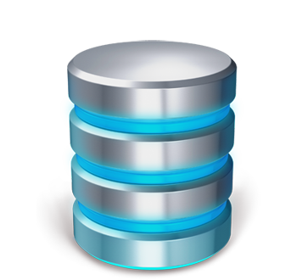
EPICS Channel History Storage
Requirements (Needs)
  Reliable, Available, Maintainable
  Compatible with multiple languages
  Long term data storage
  Performant enough…
Requirements (Wants)
  Much better performance than current minimal requirement
    Better user experience from clients reading data
    Room to add many more channels to archives than we are currently doing
  Ease of use (installation, querying)
  External tools availability

Slide 3

History of Control System Data Storage at SNS
In the beginning: Channel Archiver (2000-2009)
  Custom solution -> fast
  C++ access only, unmaintainable file structure
Oracle RDB (2009-present)
  Very reliable
  Slow
  Quirks
    Picked TIMESTAMP w/o TIMEZONE (hard to correct w/ existing data)
    Inefficient SQL to obtain sample at-or-before start time
    Purging time ranges requires special consideration in data layout

Slide 4

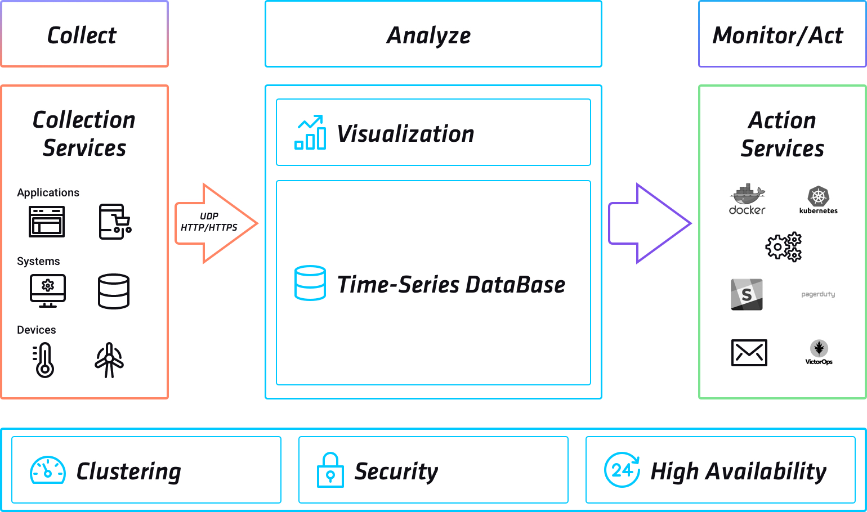
InfluxDB
https://www.influxdata.com/
Time series database
  NoSQL
  Each sample in a series is identified by a unique timestamp
REST API interface with query language
  Reachable from any language or script that can make HTTP requests
  Responses in JSON format
Designed to be one component in a set of interoperable services
  Does not try to do everything in one package. Just stores and retrieves time series data as efficiently as possible
Use cases:
  IoT: gather data from sensors and make decisions from data analysis
    https://spiio.com/ (plant irrigation monitoring and planning)
    http://www.bboxx.co.uk/ (solar energy devices deployed to remote locales)
  Datacenter monitoring
    Replace tools like Nagios/Elasticsearch to keep large numbers of computer systems up and running

Slide 5
InfluxDB Database concepts
Measurements ➔ ‘PV’, ‘Channel’
  Sort of like an RDB table, top level structure
  Example measurement: Temperature
Tags
  How data is indexed and searched, always a string key/value pair
  Example tag: location=Northwest corridor
Fields
  What data is stored, string key with value of long, double, bool, or string type
  Example field: degrees=78.8
Retention Policy
  How long to keep data, and what to do with it as it ages
  Example retention policy:
    Create retention policy “one_day_by_hour” duration 1d shard duration 1h
    Hold onto this data for one day, make a new shard of data for each hour
Series
  A unique set of measurement + tags + retention policy
  Contains samples with unique time stamps and arbitrary field data
Tags should not have a large number of distinct values
Fields are values that are being monitored and take on many different values
Retention policies can be used to set up continuous downsampling, since values are searchable by retention policy name
The larger the number of series, the more hardware resources are required

Slide 6
 | Custom | RDB | InfluxDB
Reliability, Uptime | DIY | High | High?
Speed | Fast | Slow | Fast
Access from Java, C, Python, .. | DIY | Yes | Yes
Web Access | DIY | DIY | Yes
Query Language | DIY | Yes | Yes
Data Retention, Decimation | DIY | DIY partitioning can help | Yes
Patch existing Samples | DIY | Yes | Yes
Insert/Remove older Samples | DIY | Yes | Yes
Rename Channel | DIY | Yes | Same as copying samples
Store Images, large Waveforms | DIY | No | No
Used beyond ‘EPICS Archive’ | No | Yes | Yes

Slide 7
Archive Engine using InfluxDB
Archive Engine
Archive Engine
PV
RDB Config
RDB Writer
PV
XML Config
Influx Writer
RDB
XML
InfluxDB

Slide 8
Sources
https://github.com/ghmegan/influxdb-java
  InfluxDB library for Java
https://github.com/ghmegan/archive-influxdb
  archive.config.xml, archive.writer.influx and .reader.influx
https://github.com/ControlSystemStudio/cs-studio
  CS-Studio branch “influxdb-archive-app”
https://github.com/ControlSystemStudio/org.csstudio.sns
  Archive Engine
Binaries on http://ctrl-ci.sns.gov/snapshot/css-nightly
.. about to be merged into main cs-studio repository..

Slide 9
EPICS-Specific Storage in InfluxDB
Two databases
‘data’: samples with values stored in fields labeled by type and index
  A typical EPICS PV (double type) uses one field, called “double.0”, along with tag values for status, severity, NaN flag
  An array PV uses fields with names “double.0”, “double.1”, etc… and can change array size dynamically for each sample
‘meta’: logs a new entry each time the PV type changes
  Typical case, the metadata store contains one entry the first time the PV was logged – tracks the initial date the PV was added to the archive
  Suppose a PV changes from a double to string type, just add a new metadata entry when it changes, and the old samples can be maintained without any changes

Slide 10
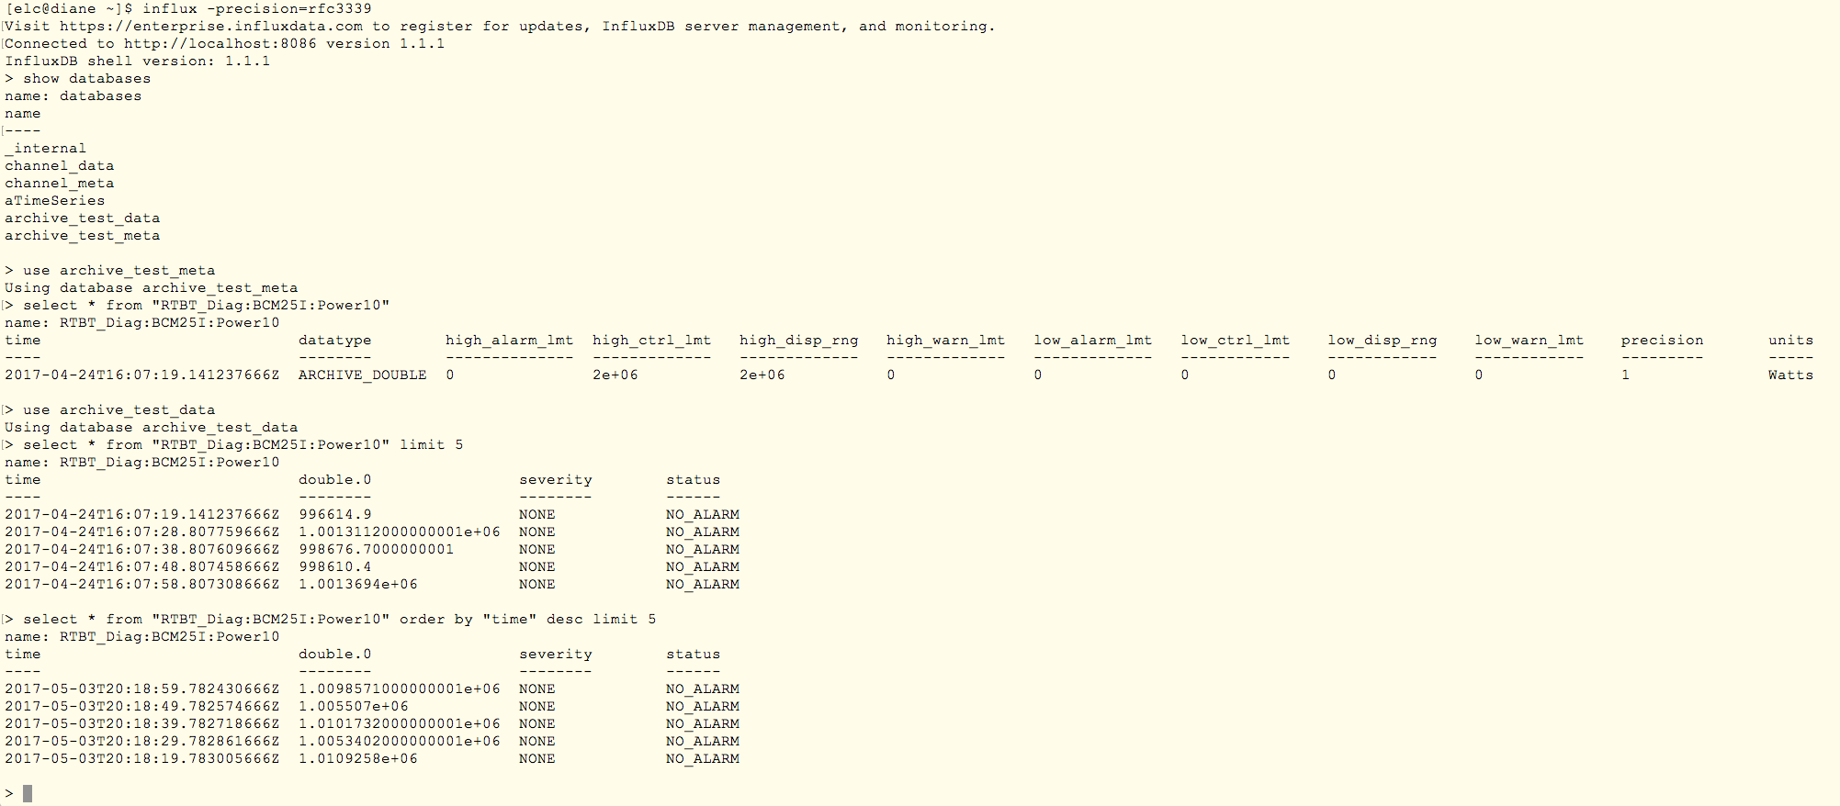
Free/Open source InfluxDB instance for testing
2 databases in use for our test system
Metadata timestamp shows this PV was added at 4pm GMT on 4/24
Select earliest five samples stored
Select most recent 5 samples stored
PV value in double.0 is a field, and takes on many different values. Severity and status are tags, few values, used as indexes.
Tags are not stored over and over again for the same value

Slide 11
EPICS PV Storage: Speed Tests
RDB Setup:
  PostgreSQL 9
  Intel Core Duo 3GHz, Windows 7
  250gb 7200 RPM SATA Disk
InfluxDB Setup:
  InfluxDB ver. 1.1
  Intel i7 3.6GHz, RHEL 7
  500GB 7200 RPM SATA Disk
Read Test Setup
  Read PV values from a given time range, up to a max of 1 million values
    Includes initial sample, i.e. last sample at-or-before requested start time
    Reading this initial sample can at times add a large delay to reading from RDB (*)
Write Test Setup
  Write as many samples as possible in 60 seconds
 | RDB | InfluxDB
Read | ~96K samples/sec (*) | ~353K samples/sec
Write | rewriteBatchedStatements=false: ~7K samples/sec rewriteBatchedStatements=true: ~21K samples/sec | flushCount=10K (recommended) ~110Ksamples/sec flushCount=200K (less reliable) ~185K samples/sec

Slide 12
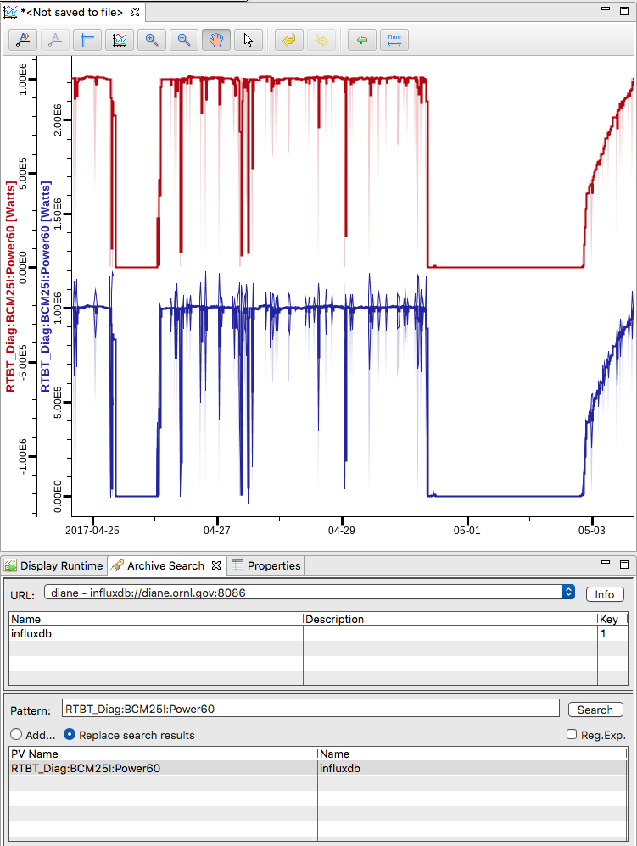
CSS Databrowser
Oracle and influxDB data sources for the same PV over 9 days
  InfluxDB retrieval plugin does not do server side downsampling yet, so the lower graph includes spikes indicating the std deviation of the data points being averaged on the client side
InfluxDB is added as a datasource, with the URL:port for the server

Slide 13
Non-EPICS data access in CSS
During work on the influxDB plugins, we connected with other people at SNS using influxDB to log non-EPICS data
  Python scripts doing analysis and dumping samples into various schemas on various systems
  Using tools like grafana to view data
  Wanted CS-Studio databrowser functionality for their data
Single environment with EPICS and non-EPICS data…
  Can we support both? How?
Created a separate plugin for raw access to influxDB through CS-Studio
  No metadata required, it is all generated with default values
  User indicates “influxdb-raw” data source, then notates PVs with influxDB http request protocol: database name, measurement name, tags, field
Any data stored in influxDB in any format is now viewable in CS-Studio

Slide 14
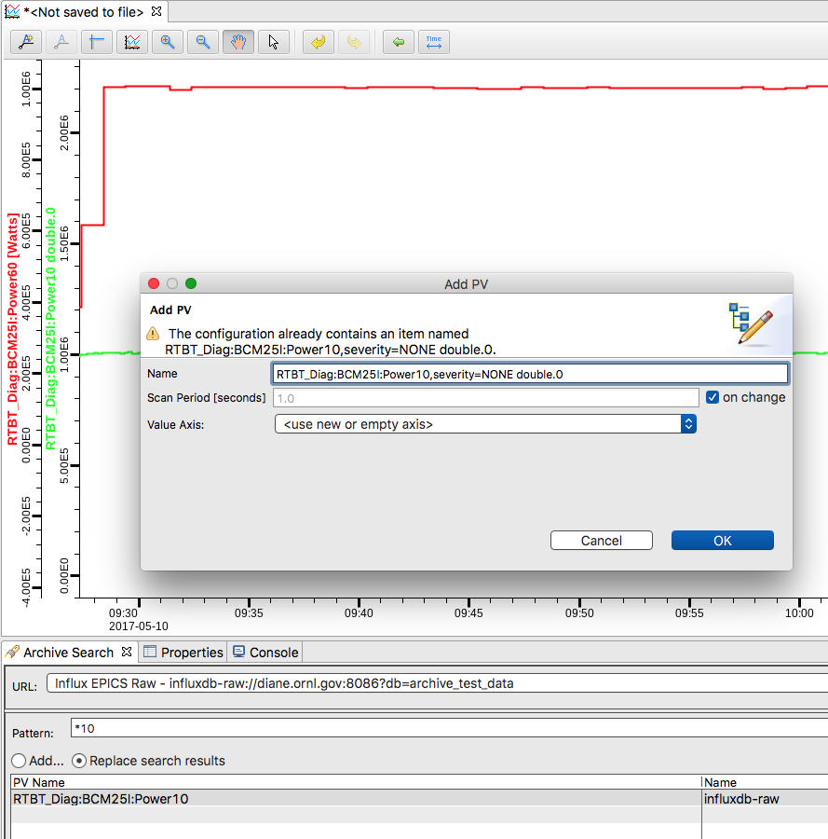
Data Browser for Generic InfluxDB
EPICS schema
Data Source influxdb://host.site.org:8086
PV “MyRecord”
Any schema
Data Source
influxdb-raw://host.site.org:8086?...
db=archive_test_data&
user=..&password=..
PV “measurement,tag=value field”
Measurement
Tags (optional)
Field
RTBT_Diag:BCM25I:Power10,severity=NONE double.0
Drag search results

Slide 15
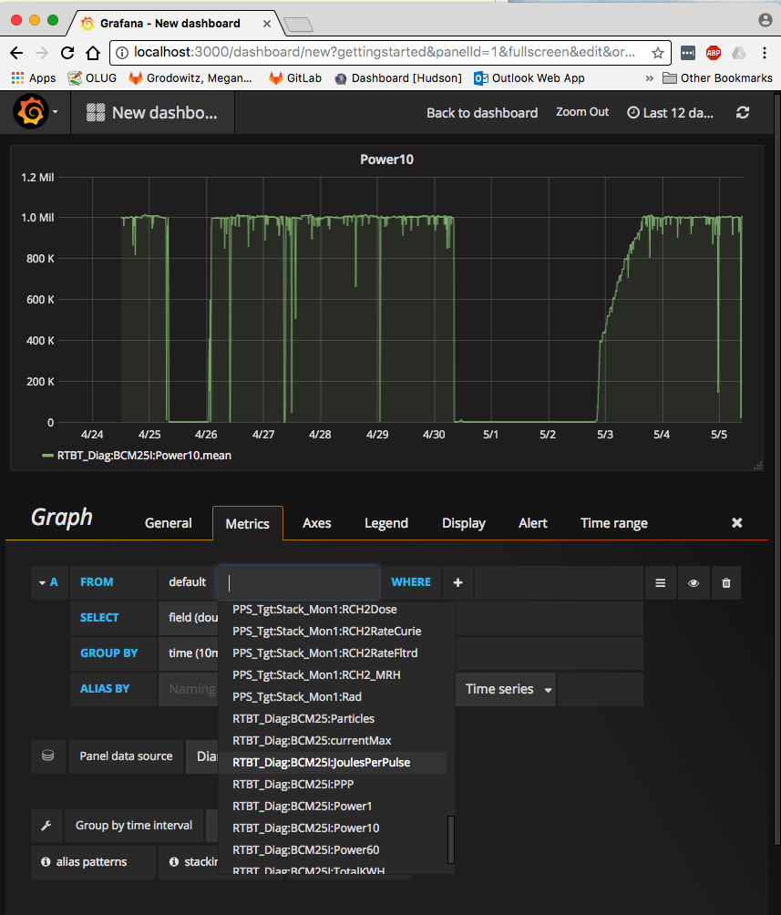
Grafana
Generic InfluxDB data viewing tool
  https://grafana.com/
  Free on Windows/Mac/Linux
  This graph took 5 minutes to setup
    Add data source for our InfluxDB server
    Set archive_test_data as the database
    Use the dropdown menu in the panel creator to select from a list of PVs in the database
    Use the time range selection at the upper right to set the range to graph
    Click and edit titles, axes, …

Slide 16
InfluxDB
Time-series database
Ideal for logging EPICS PVs
Faster than RDB
Supported by
  CS-Studio Archive Engine
  Data Browser
Pending tests
  Archive Engine w/ SNS configs
  Synthetic data for longer time range based on actual site config files
Checking free vs. commercial license
  support & multi-node installation

