Slide 1

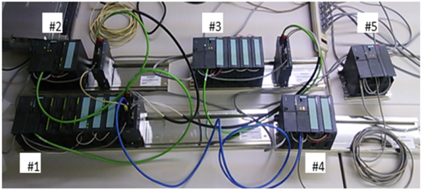
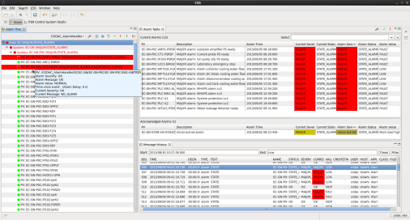
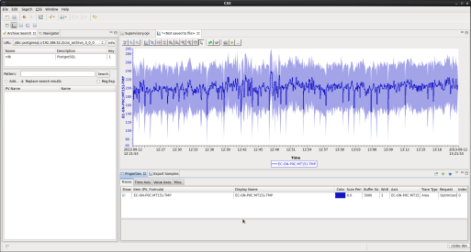
Development of local control system for ITER Gyrotron using EPICS
Y. Hashimoto, Y. Odaª, T. Yamamoto
Japan EXpert Clone Corp.
ª National Institutes for Quantum and Radiological Science and Technology
Spring 2017 EPICS Collaboration Meeting
Research Reactor Institute, Kyoto University (KURRI), Japan
17 May 2017
The views and opinions expressed herein do not necessarily reflect those of the ITER Organization.

Slide 2
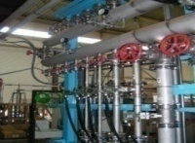
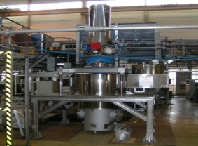



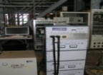



Outline of talk
Introduction
Overview of Gyrotron Local Slow Controller System
Development of Gyrotron Local Slow Controller System
3.1. Function block diagram of gyrotron local slow controller system
3.2. HMI (Main Screen, Communication with Arcing Interlock Device)
3.3. Communication with Arcing Interlock Device using sub record
Issue and Solution
Current Status of Actual Equipment Development
Conclusion
MHVPS
Anode SW
DC PS
APS
-
CCW system
BPS
Gyrotron
SCM, Stand, and oil tank
SCM PS
AUX PSs
Ion pump PS
C-Coil PS
Heater PS

Slide 3
1. Introduction
ITER electron cyclotron heating and current drive (EC H&CD) system is designed to inject 170 GHz radio frequency (RF) up to 20 MW into plasma with 24 gyrotrons as RF power source [1]. Japan Domestic Agency (JADA) is responsible for development of eight gyrotrons and an equatorial port launcher [3].
JADA developed a prototype of the local control system of power supplies and super-conducting magnet system for the gyrotron operation [2,3] complying the ITER standards and guidelines [4]. PLCs (programmable logic controllers) were selected to monitor and control auxiliary devices such as chillers and vacuum systems.
We developed the gyrotron local slow controller using EPICS (Subroutine record, autosave etc), and validated that CODAC Core System (CCS) has enough functionalities to develop the local control system for gyrotron system.
We also found issues of CCS during the prototyping and resolved the issues discussing with the ITER CODAC staff. We will report our experience and the issues in our development of gyrotron local slow controller system.
[1] J. How, et al (ed) Plasma stability and control ITER 2009 Baseline: Plant Description (PD) (France: ITER Organization) chapter 4.6, http://www.iter.org, 2009.
[2] Y. Oda et al., "Development of ITER CODAC Compatible Gyrotron Local Control System and Its Operation“, J. Plasma Fusion Res. Vol.90., No7 (2014) 365-373
[3] K. Ohshima et al., JAEA-Technology 2015-061 (2015)
[4] ITER Organization, Plant Control Design Handbook (27LH2V)

Slide 4
Overview of Gyrotron Local Slow Controller System
Architecture of the local slow controller system.
We developed the IOC (Input/ Output Controller), human machine interfaces (HMIs) in slow controller host and the communication functions between slow controller host and slow controller CPU (Siemens S7-300 PLC) in 2013.

Slide 5
Overview of Gyrotron Local Slow Controller System
Functions of slow controller host.
IOC for the gyrotron local slow controller is
deployed in the slow controller host (SCH).
SCH communicates with the slow controller
CPU and Arcing Interlock Device (AID).
Auxiliary devices and high voltage power supply
system are controlled using HMI remotely.
The upper/lower thresholds of alarms can be
configured from HMI.
The configuration parameters of arc detection
system can be set to Arcing Interlock Device
from HMI via IOC.
HMI notifies an alarm raised in slow controller
CPU to plant operator.
Reset interlock by an operator
Monitor of gyrotron local slow controller system.

Slide 6
Overview of Gyrotron Local Slow Controller System
Functions of slow controller CPU (Siemens PLC).
Control of operation status.
Slow-speed interlock for gyrotron protection.
- Chillers.
- Vacuum system.
- Status of auxiliary devices.
- If the slow controller CPU detects alarms,
it stops the operation of gyrotron automatically.
Slow-speed data acquisition.
- Cooling water flow and temperature.
- Loss power measurement.
Communication with the slow controller host.
The slow controller CPU has total 530 variables.
(PLC address types: PIW, I, Q, M, MD, MW)

Slide 7
Development of Gyrotron Local Slow Controller System
Part of JADA requirements are:
Configuration parameters of Arcing Interlock Device (FPGA module) shall be configured by the plant operator.
Operation parameters such as upper/lower threshold of alarm shall keep the last values configured by the plant operator.
The plant operator shall monitor and operate the auxiliary devices using HMI.
Detailed design
We select the subroutine (Sub) record for setting parameters to Arcing Interlock Device.
We use the EPICS Autosave function for save/restore the latest process variables (PVs).
HMI was developed using Control System Studio (CSS).
Installation of communication functions with slow controller host in slow controller CPU.

Slide 8
3.1. Function block diagram of gyrotron local slow controller system
We designed the following functions:
- HMI for the plant operator.
- EPICS request file (*.req) for saving/restore PVs.
- Part of communication functions using STEP 7 Standard version.

Slide 9
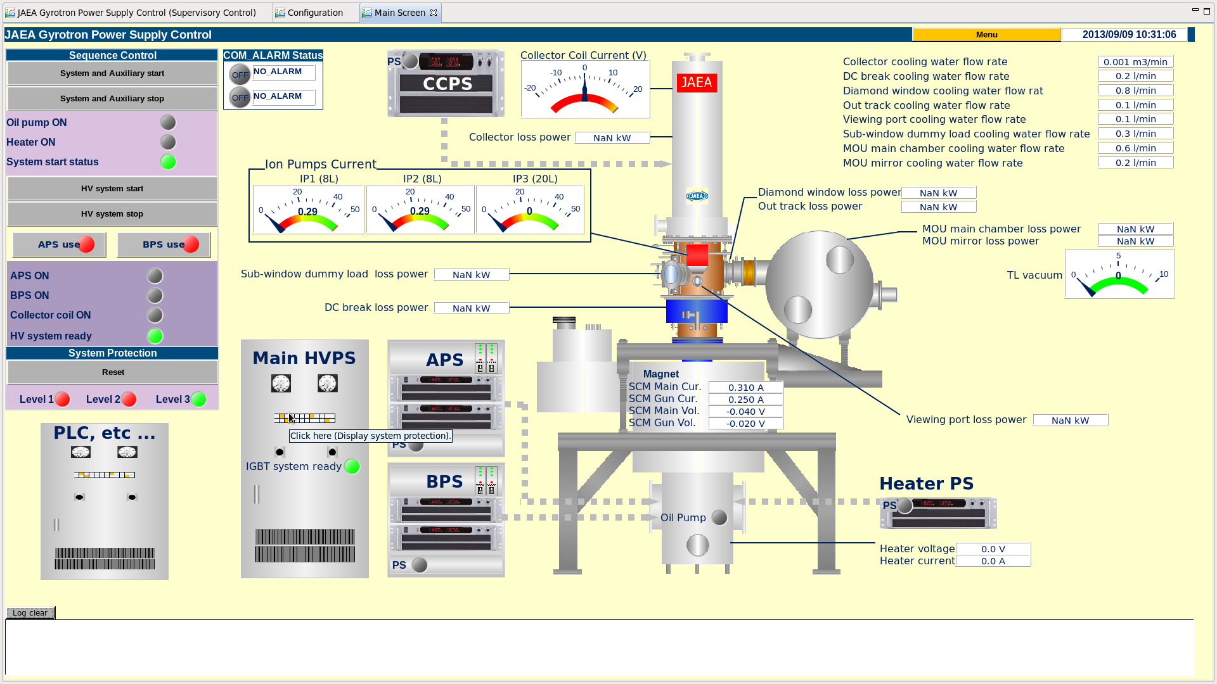
3.2. HMI (Main Screen)
Our design allows the plant operator to recognize the current operating status intuitively.
This OPI provides the auxiliary device start/stop, high voltage start/stop interfaces etc.

Slide 10
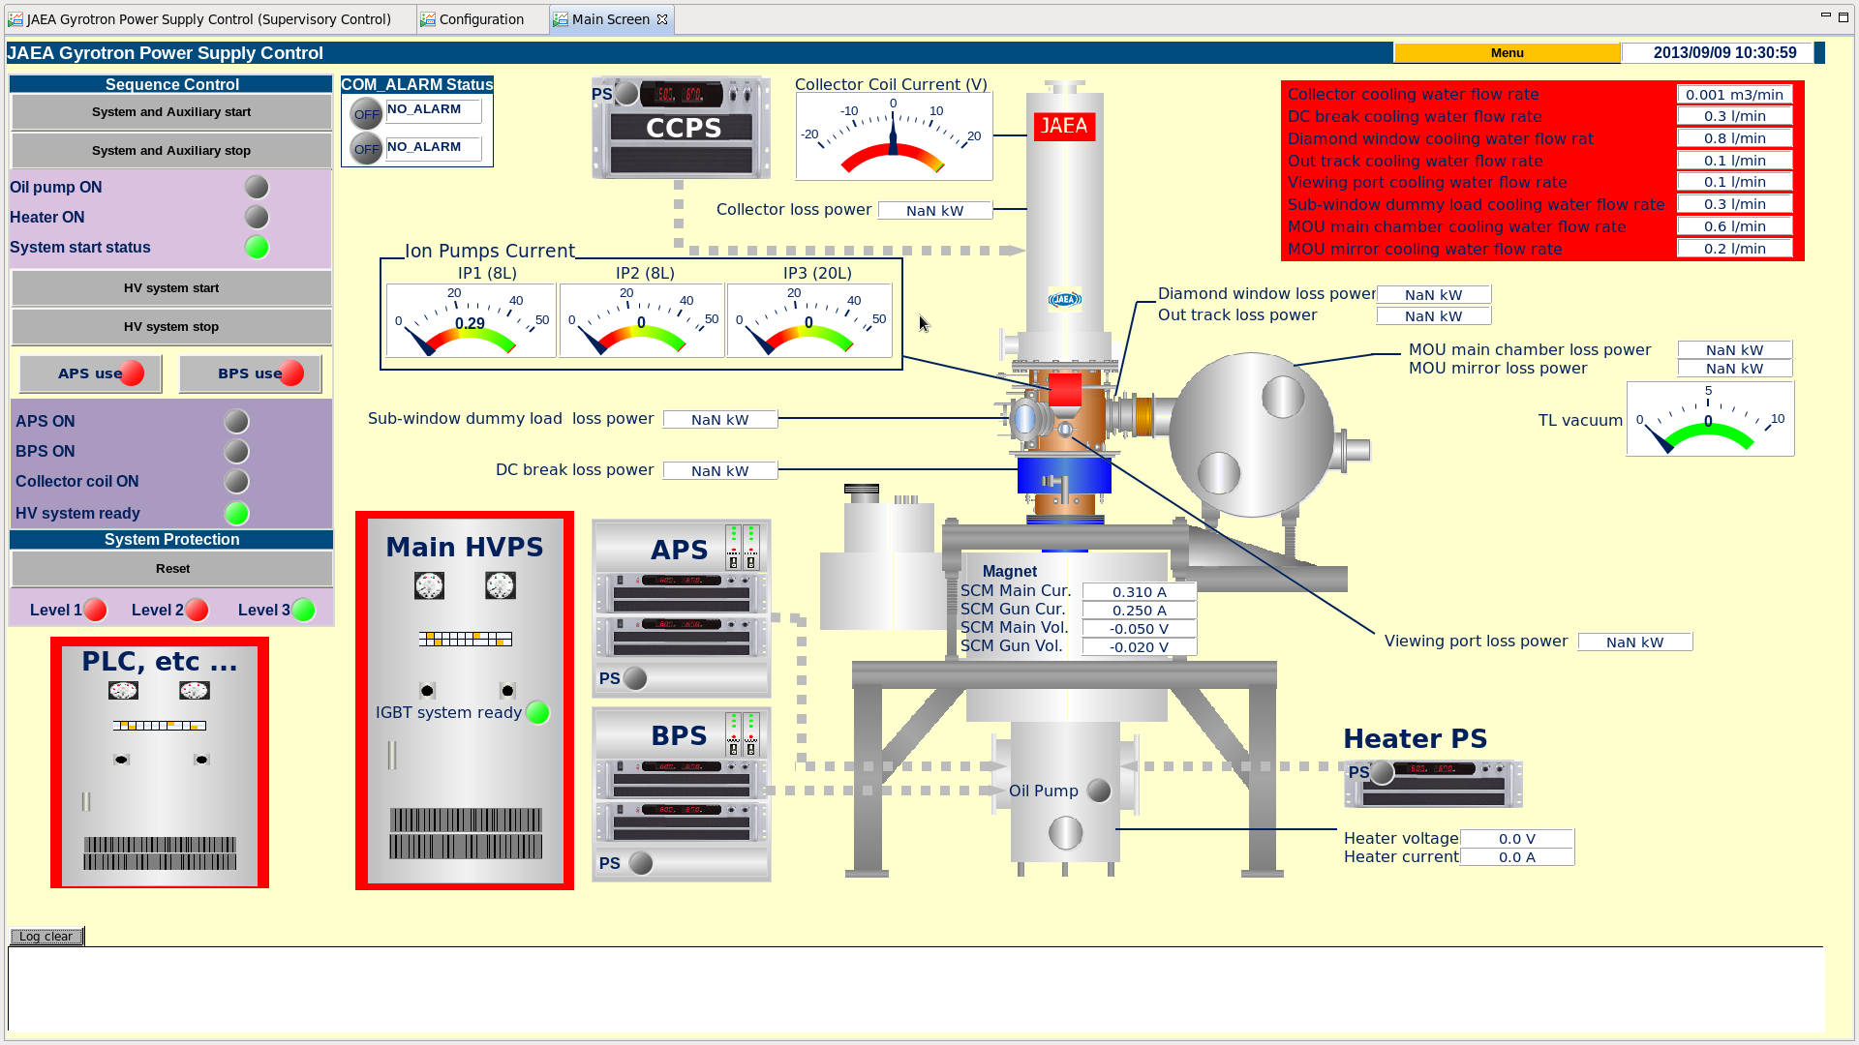
3.2. HMI (Main Screen) (Cont.)
This OPI notifies the alarms to the plant operator, when the slow controller CPU raise alarms.
A device which raise alarm is highlighted on the screen to identify the device immediately.

Slide 11
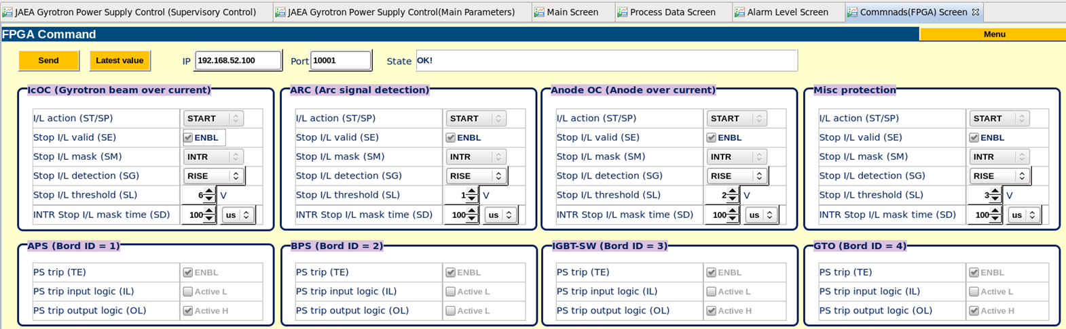
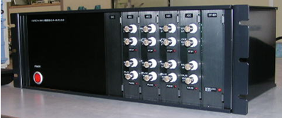
3.2. HMI (Communication with Arcing Interlock Device) (Cont.)
This OPI provides the interface for AID configuration parameters such as IcOC (Gyrotron beam over current), Anode OC (Anode over current), IGBT-SW, miscellaneous protection etc [3].
IOC
Arcing Interlock Device (AID) (FPGA Module)

Slide 12
3.3. Communication with Arcing Interlock Device using sub record
We select Sub record for setting parameters to AID, which is implemented using FPGA. AID should be configured by TCP/IP communication.
1st step: Development of communication with Arcing Interlock Device (C socket programming).
2nd step: Definition of the communication function into the database definition file (*.dbd).
3rd step: Definition of the communication function such as PV into the database file (*.db).

Slide 13
3.3. Communication with Arcing Interlock Device using sub record (Cont.)
4th step: Definition of the C language source file name and dbd file name into the Makefile, and execute make command to generate the IOC.
Make command execute “mvn compile” (Maven tool), which is recommended by ITER organization.
Terminal
_
X
[codac-dev@]$ mvn compile
make -C ./configure install make[1]: Entering directory `/home/codac-dev/GyrotronProject/m-JADA_Gyrotron_Slowcontroller/target/main/epics/configure'perl/…
................
[INFO] COMPILATION COMPLETED
[codac-dev@]$

Slide 14
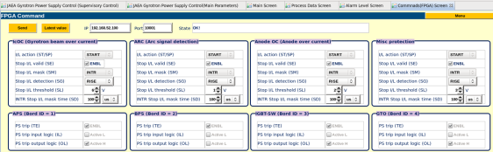
3.3. Communication with Arcing Interlock Device using sub record (Cont.)
Definition of Sub record for communication with Arcing Interlock Device.
record (sub,"EC-GN-P0C:IOB1-CR1-PRC"){
field(DESC, "Send commands to FPGA")
field(INAM, "initCommands")
field(PINI, "YES")
field(SNAM, "sendCommandsToFPGA")
field(VAL, "1")
}
This record sends the following parameters to Arcing Interlock Device:
- Initial parameters, when the IOC reboots.
- Configuration parameters, when the plant operator requests
from HMI.
IOC
HMI
Arcing Interlock Device (FPGA Module)

Slide 15
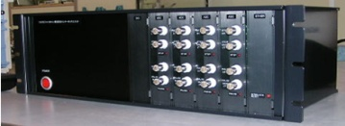

3.3. Communication with Arcing Interlock Device using sub record (Cont.)
Save/Restore PVs using autosave function.
We create the EPICS request file (*.req), and defined the following PVs into this file to apply the autosave function.
- Upper/lower threshold of alarms which
slow controller CPU uses.
- Initial parameters which Arcing Interlock
Device uses.
When the value of PV defined in request file is changed, IOC stores the latest value and PV name into save file (*.sav) automatically.
When IOC is rebooted, IOC loads the last values stored into save file, and restores each PV.
EC-GN-P0C:MT111-TinHiSP
EC-GN-P0C:MT111-ToutHiSP
EC-GN-P0C:MT112-TinHiSP
EC-GN-P0C:MT112-ToutHiSP
EC-GN-P0C:MT113-TinHiSP
EC-GN-P0C:MT113-ToutHiSP
EC-GN-P0C:MT114-TinHiSP
EC-GN-P0C:MT114-ToutHiSP
      ・
      ・
      ・
EC-GN-P0C:MT115-TinHiSP
EC-GN-P0C:MT115-ToutHiSP
EC-GN-P0C:MT121-TinHiSP
EC-GN-P0C:MT121-ToutHiSP
EC-GN-P0C:MT122-TinHiSP
EC-GN-P0C:MT122-ToutHiSP
EC-GN-P0C:MT123-TinHiSP
IOC
FPGA Module
HMI
Definitions of PVs into *.req file.
*.req
*.sav
S7-300 PLC

Slide 16


Issue and Solution
Issue
Communication Alarm (COMM_ALARM) was happened periodically about every 60 seconds.
Screenshot of OPI when communication error occurred.
Detailed message
The slow controller host cannot communicate with the slow controller CPU. So, the plant operator cannot grasp the state of the system correctly.

Slide 17
Issue and Solution
Solution
We discussed with ITER CODAC staff to solve this issue at ITER organization, and resolved this communication problem.
First approach, ITER CODAC staff propose that download the latest communication function to the slow controller CPU to identify the problems.
We cannot download SCL files into slow controller CPU. JADA did not have STEP 7 Professional version (We used Standard version at that time.)
Next approach, ITER CODAC staff propose that cycle time of PLC OB34 change 200 ms (Default) into 50 ms such as interim measures.
We re-validated the communication trouble in Japan, and it was solved. We reported to the ITER organization that this system is operating normally.
We experienced that it is very important that we should take the consistency of the development environment to use in the project.
We should migrate CODAC Core System (CCS) version 4 to version 5 in the manufacturing phase. CCS migration manual requires to update CCS manually. We strongly wish to do migration automatically .

Slide 18
Current Status of Actual Equipment Development
JADA are manufacturing the Slow Controllers for ITER Gyrotron under the procurement arrangement with the ITER organization.
JEX is also participating in this development work.

Slide 19
Conclusion
We developed the slow controller host based on EPICS for the slow controller CPU.
- Analyzed necessary functions for the slow controller host and slow
controller CPU .
- Designed PV names and signal names according to the ITER naming
convention.
- Development of HMI for the plant operator.
- Communication with the slow controller CPU and Arcing Interlock
Device via IOC.
- Save / Restore PVs using the EPICS autosave function.
We cooperated with the ITER organization staff and solved the communication trouble.
JADA is manufacturing actual Slow Controllers for ITER Gyrotron. JEX is also participating in this development work.

Slide 20
Thank you very much.
Japan EXpert Clone Corp. URL http://jex.co.jp

