Slide 1
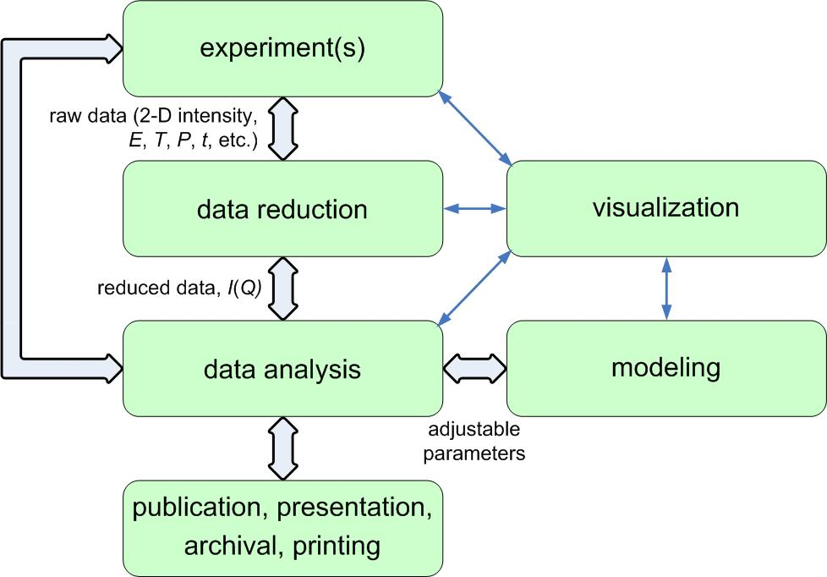

Bluesky Satellite workshop at
2018 EPICS Collaboration Meeting
erhtjhtyhy
Bluesky (et al.) at the APS
Pete Jemian
BCDA group
X-ray Science Division
Advanced Photon Source
Argonne National Laboratory
measurement workflow
2018-06-11
Notes:
1

Slide 2
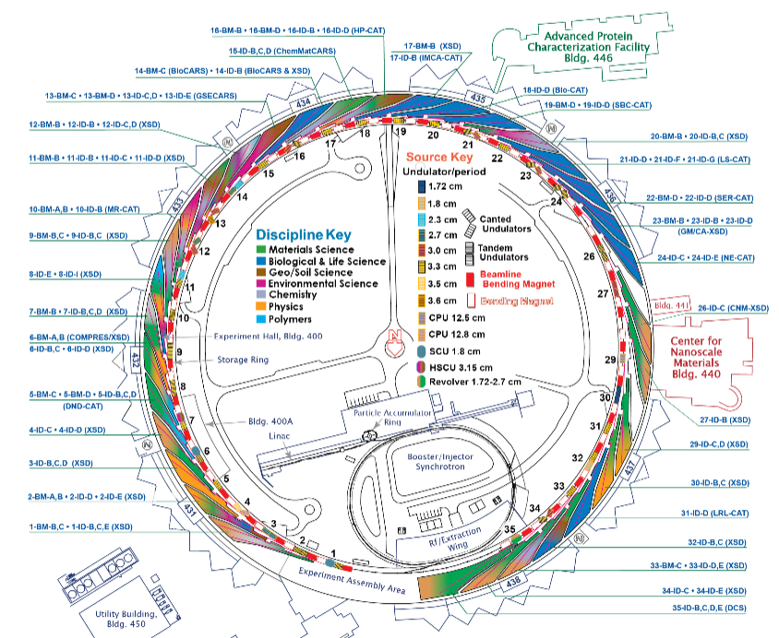
Topics
Bluesky (et al.) at the APS
APS beam line control environment
Bluesky software installation
User operating environment
Results from 2018-06-07 beam time
Conclusion
2

Slide 3
APS beam line control environment
APS is very diverse
More than 60 beam lines in operation
More than half are facility-managed
EPICS used at most, not all, beam lines
Data acquisition code is diverse
  Multiple tools used together, segmented decisions, deep investment
Data retention policies are diverse
Yet: Facility is operating and publishing
New software should be compelling and provide what is not already possible (or easy). Be easy to use. And, most important, without any flaws. A tall order.
APS-U upgrade offers ripe opportunity to advance the data acquisition code suite
Early demos of Bluesky capabilities are most persuasive

Slide 4
Bluesky software installation
Database
  One mongodb server for each sector or beamline
  Will monitor disk usage
  Q: Any advantage to coordinate these servers?
Common Python software managed by BCDA support group
  Common read-only installation for all beam lines
  (updated via nightly rsync same as other beam line control software)
  Local installation for exceptional needs
  Don’t rely on virtual environments
  Install additional tools as needed
  Keep public HISTORY.txt file of all updates
Instrument-specific software
  Default ipython profile
  Jupyter notebooks to document or build tutorials

Slide 5
GitHub use
Use GitHub organizations to provide version control for beam line configurations.
Naming convention
  Create a GitHub organization with name like: APS-SSS-GGG
    SSS: sector, beam –line, and station (such as 2BM)
    GGG: operating group (such as MIC for the Microscopy group)
  Within each organization, create a repository: ipython-username
    ipython: the text ipython
    username: instrument account, such as instruser
Consistent naming makes similar work easier to locate
  facilitates sharing of common code
Similar to pattern established by NSLS-II DAMA team
https://github.com/BCDA-APS/use_bluesky/wiki

Slide 6
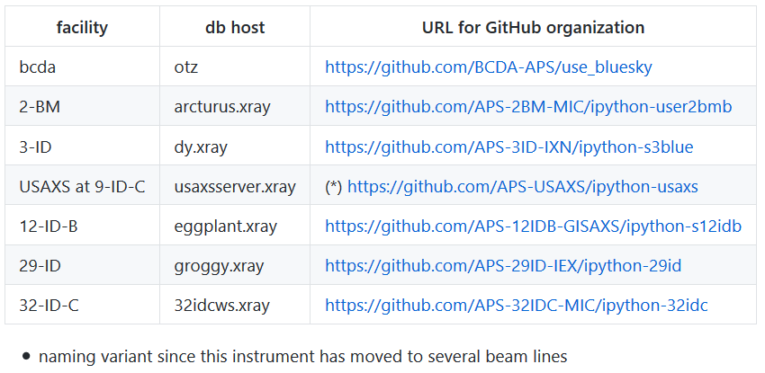
GitHub APS beam line organizations

Slide 7
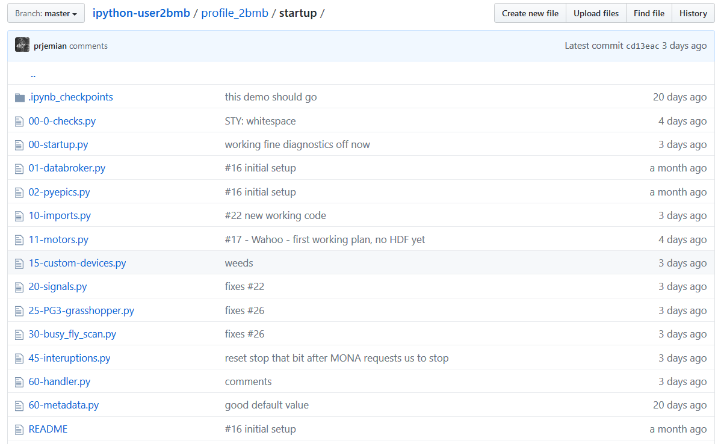
Typical ipython layout

Slide 8
User operating environment
Challenging
  Deploying new ipython profiles
  Keeping existing ipython profiles consistent with updates
Using common tools for new deployments
  https://github.com/BCDA-APS/use_bluesky

Slide 9
APS Bluesky tools
Starter script: use_bluesky.sh [profile] for interactive use
  Runs Python software and correct ipython profile
  https://github.com/BCDA-APS/use_bluesky/tree/master/bin
Common code for APS:
  Caveat: Much of this existing code needs to be update for ophyd v1.0
  Code: https://github.com/BCDA-APS/APS_BlueSky_tools
  Docs: http://aps-bluesky-tools.readthedocs.io
  Devices: shutters, attenuation filters, APS info (e.g., SR current)
  Callbacks: write scan data to SPEC file
  Plans: TuneAxis so each motor can know how to be tuned
  https://github.com/APS-USAXS/ipython-usaxs/blob/master/profile_bluesky/startup/29-axis_tuning.py

Slide 10
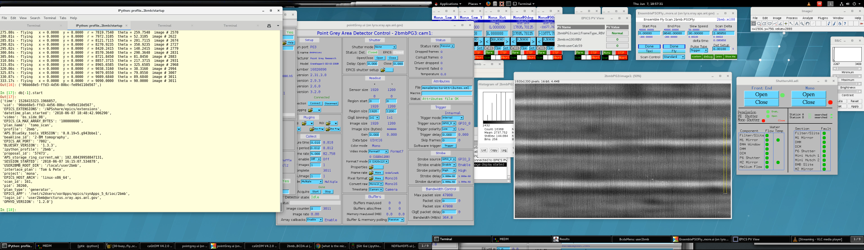
Example Bluesky session
various GUIs
ipython
console
caQtDM
MEDM
PyQt
ImageJ
text editor (minimized)

Slide 11
2-BM-B tomo

Slide 12
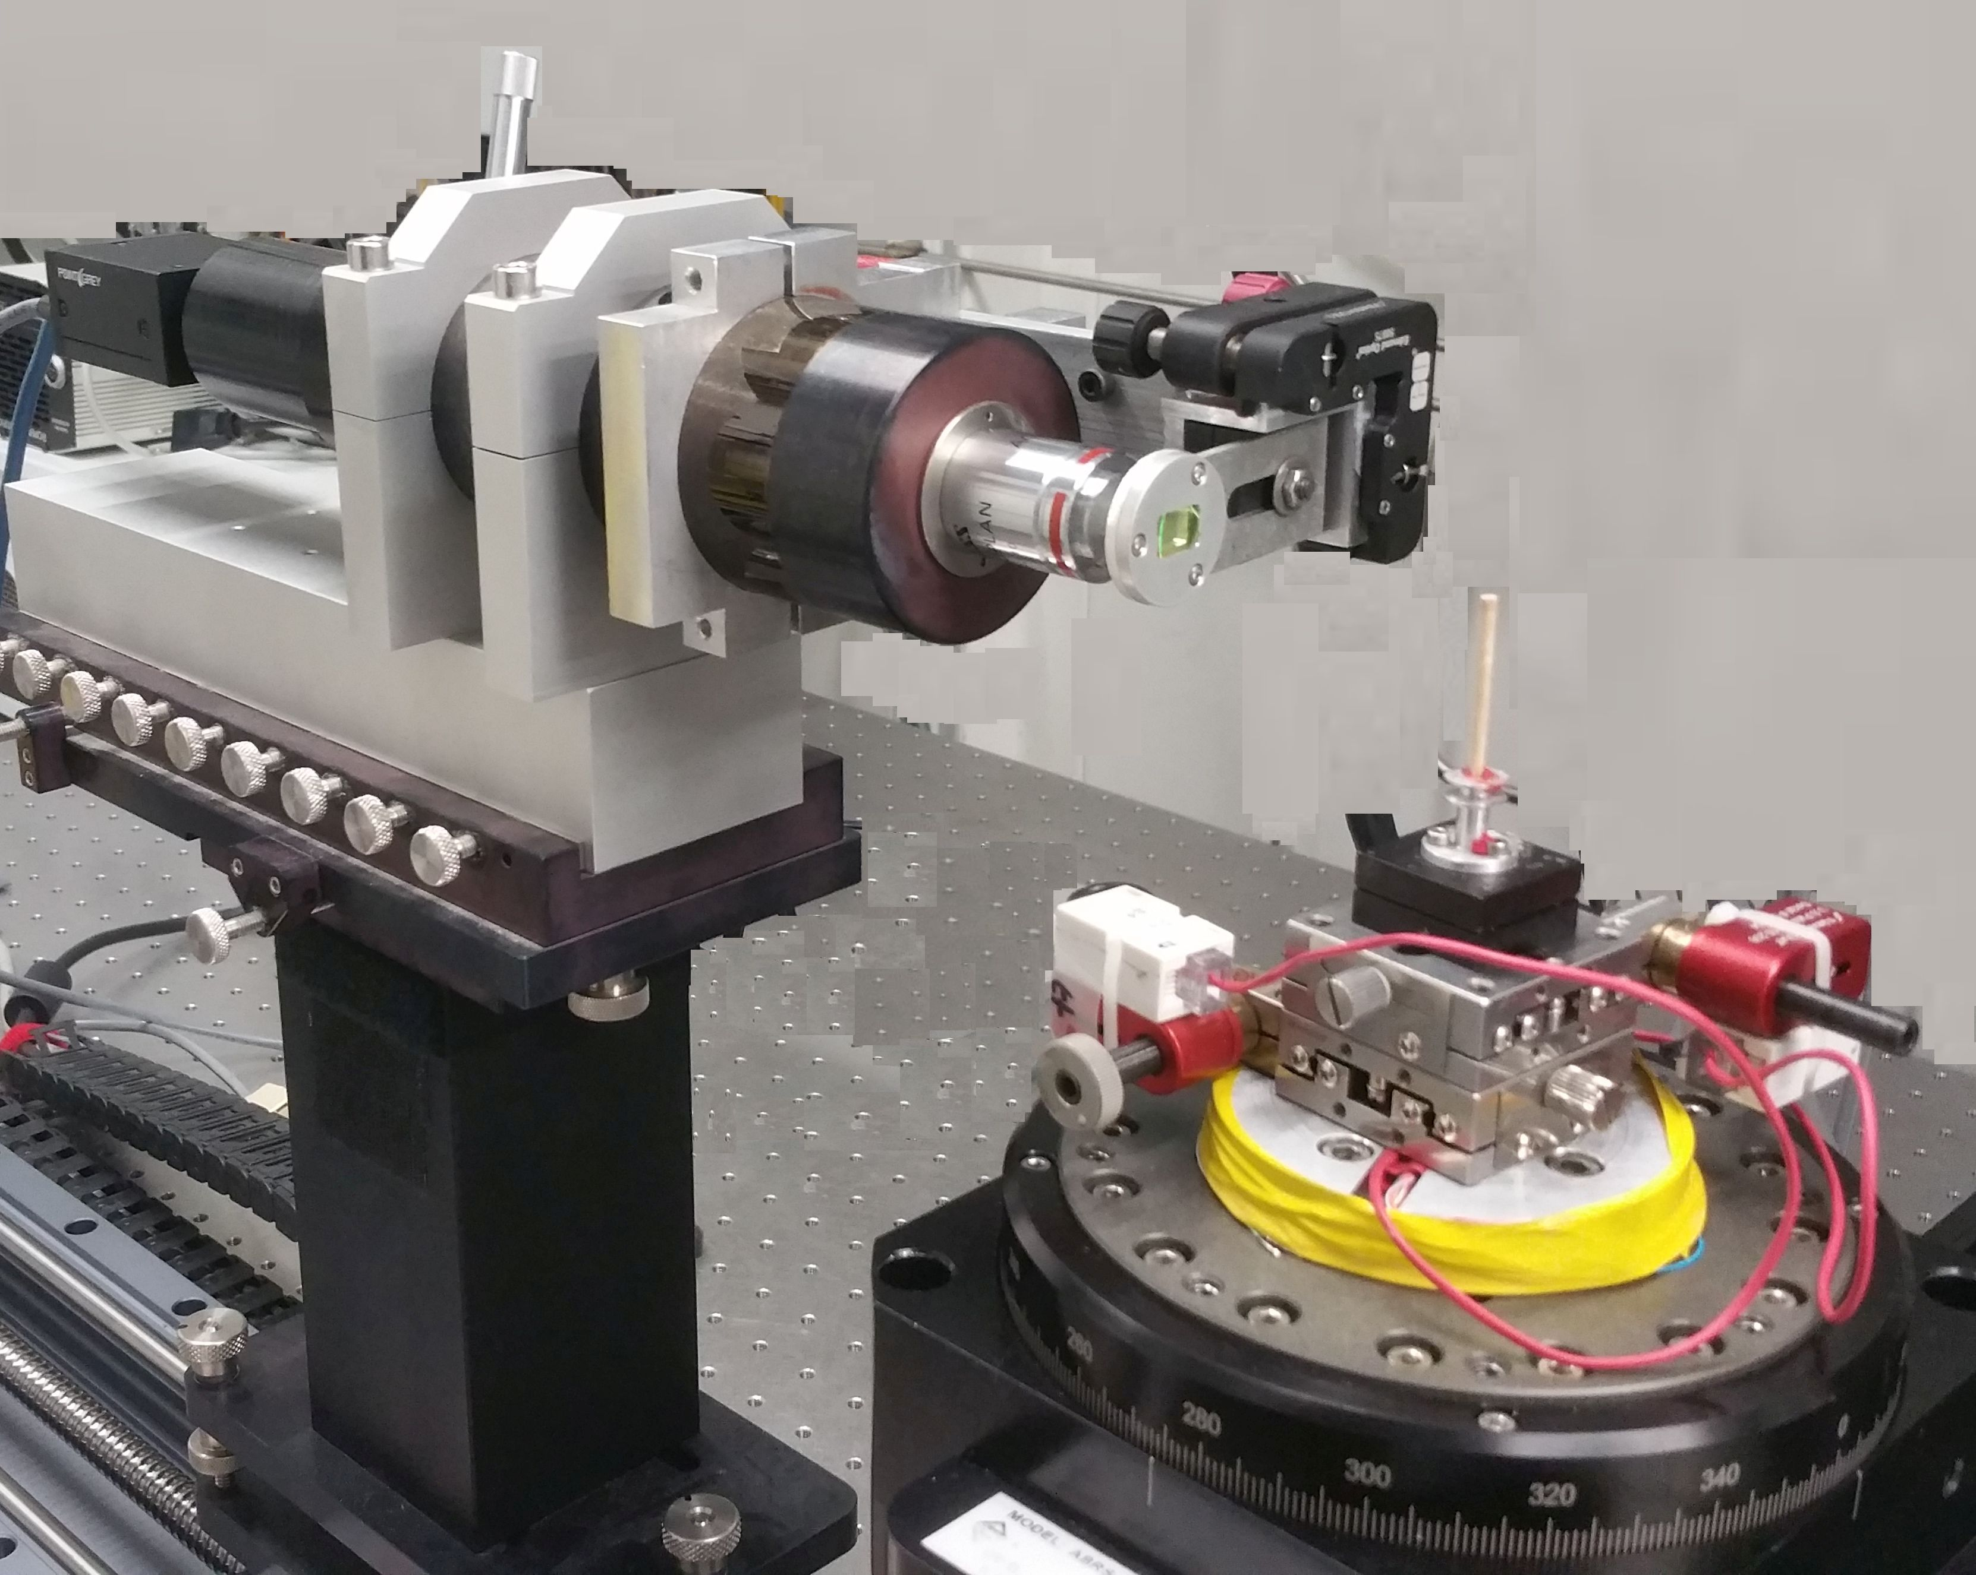
2018-06-07 beam time at 2-BM-B
MONA project
Monitor, Optimize, Navigate and Analyse experimental conditions and progress on-the-fly
Interlaced Fly Scan Tomography
with real-time data streaming to QA, reconstruction, and visualization
Bluesky directs the measurement
Motor controller triggers camera via FPGA
Images as EPICS 7 PVaccess structures
Images also written to local HDF5 file (one file)
QA code can stop experiment if data bad
Reconstruction code on remote cluster (ALCF)
Sinogram visualization
24 rotations, 12.5s per full rotation
10 ms per image, 1920x1200, 16-bit
95.6 ms & 2.8695° between images
30°/s, 3011 images
PointGrey Grasshopper3, USB
Aerotech Ensemble motor controller
softGlueZynq FPGA

Slide 13
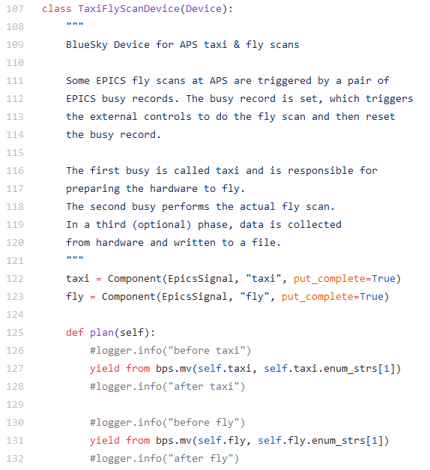
APS Fly scans in Bluesky
Only core components shown
  Data typically recorded externally
  Each busy record calls one or more sseq records which perform sequence of data acquisition steps
Fly scans are often hardware-assisted and unique to each instrument
Bluesky must interface to existing code
Awkward to implement as ophyd Flyer
(data collected externally)
We’re still learning

Slide 14
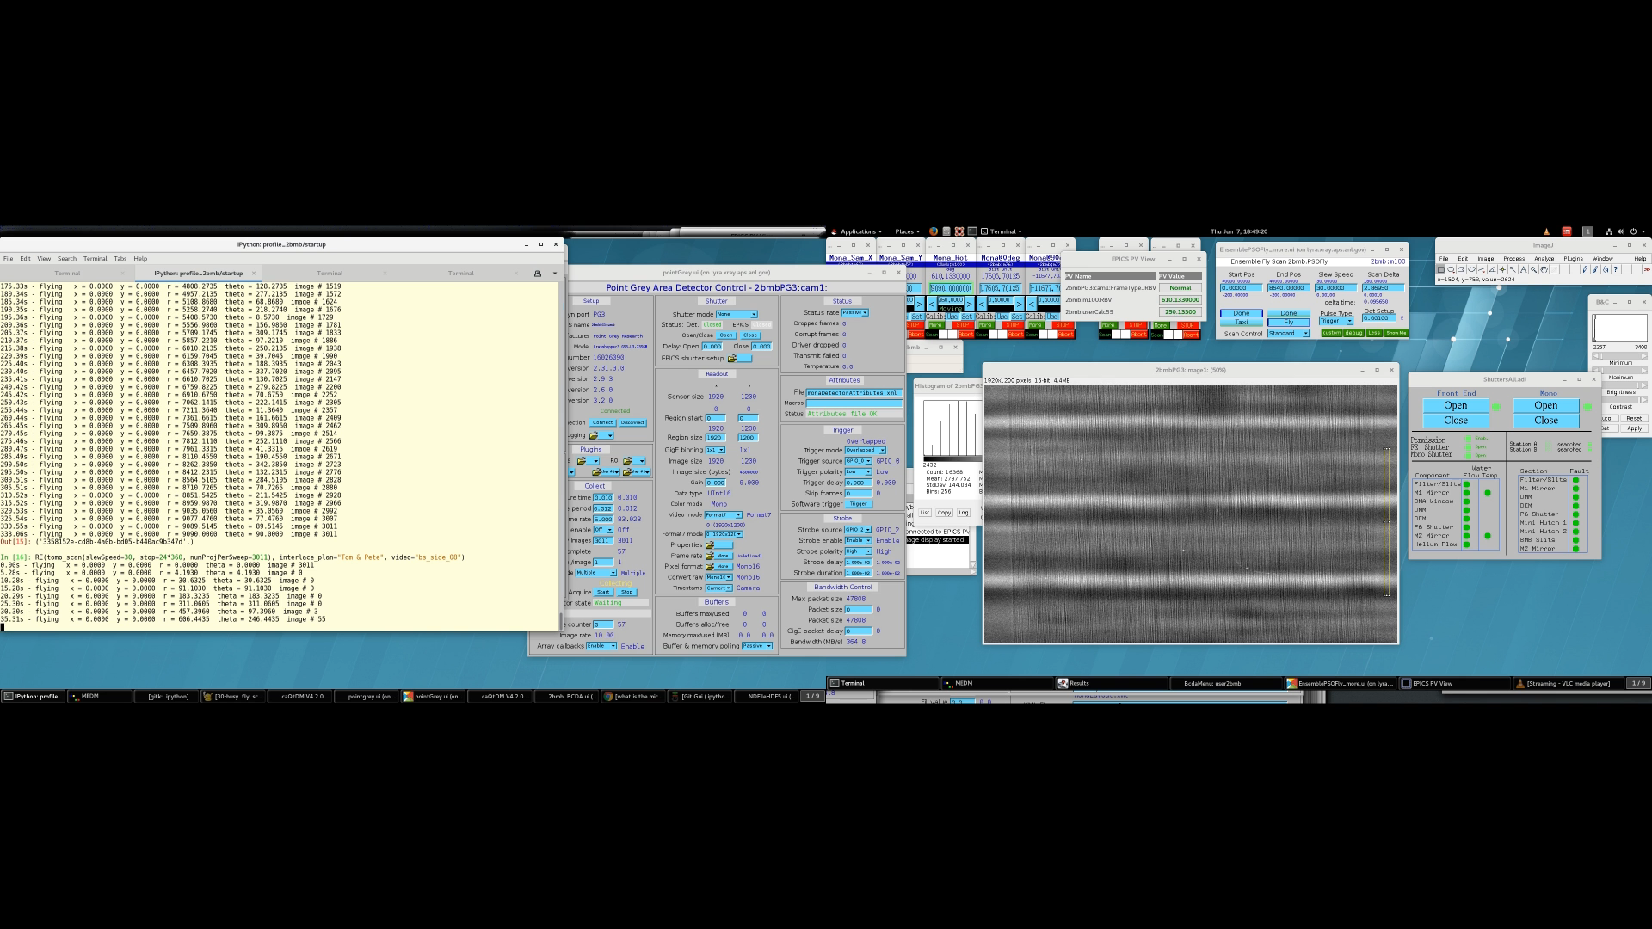
Console session, 16x
30s preparation phase
300s fly scan, 3011 frames
~120s finish writing HDF5 data

Slide 15
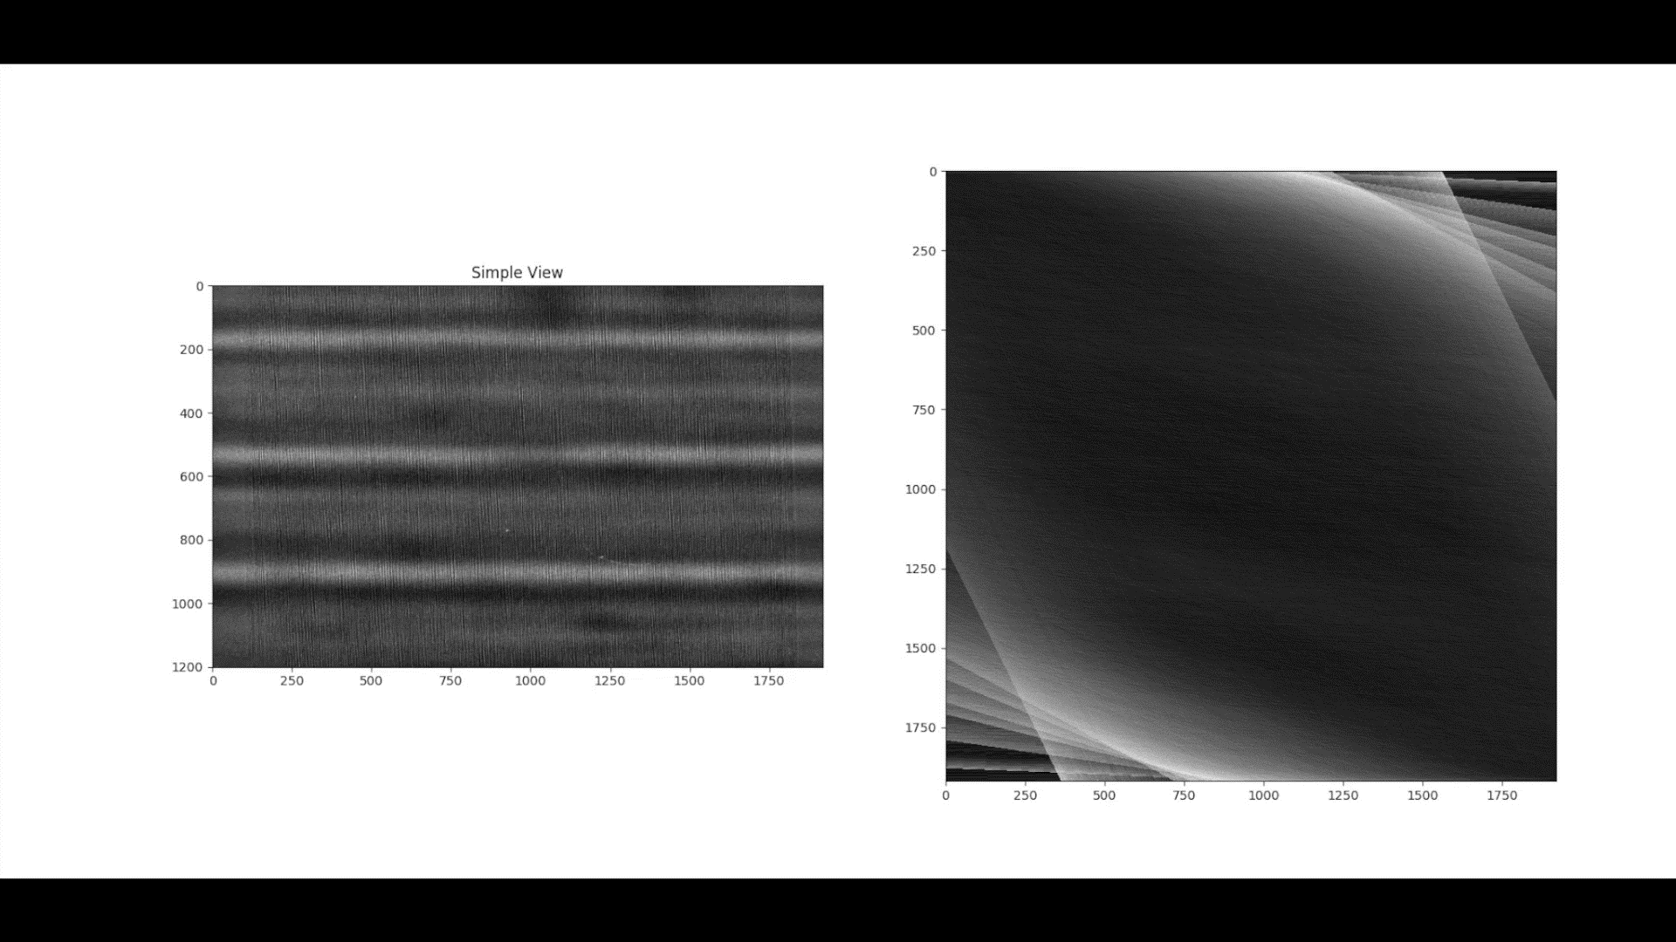
Reconstruction, 16x
300s fly scan, 3011 frames
1 sinogram shown

Slide 16
MONA team acknowledgements
APS MONA team
  Doga Gürsŏy,
  project lead
  Tekin Bicer
  Barbara Frosik
  Arthur Glowacki
  Pete Jemian
  Nicholas Schwarz
2-BM-B Tomo Instrument
  Xianghui Xiao
  Pavel Shevchenko
  Francesco de Carlo
APS support
  Fred Carter
  Mark Engbretson
  Patricia Fernandez
  Troy Lutes
  Tim Mooney
  Kevin Peterson
  Giampiero Sciutto
  Roger Sersted
  Ron Sluiter
  Stefan Vogt
Argonne ALCF
  William Scullin
LBL
  Harinarayan Krishnan
  Dinesh Kumar
  Ronald Pandolfi
  Dilworth Parkinson
  James Sethian
NSLS-II DAMA
  Dan Allan
  Tom Caswell
  Julien Lhermitte
  Maksim Rakitin

Slide 17

Conclusion

Slide 18

Thank you for your attention
http://sas2018.anl.gov

