Slide 1
areaDetector CSS opi screens deployment at NSLS2 beamlines by K. Gofron
AreaDetector Workshop @ EPICS Collaboration Meeting
APS, Argonne, IL
June 11-15, 2018
June 11, 2018

Slide 2
areaDetector deployment
Over 500 AD Detectors
GigE, Pilatus, Eiger, PCO, Andor3, XMAP, PE, Merlin, Lambda, Zebra/PanDaBox -> Pizza/‘Tiger’ box
Base: R3.14.12.6, 7.0.1.1;
areaDetector versions installed
AD 1-9 (most installations)
ADCore 3-2 (newer installs)
Other versions (2.1, 2.6, …)

Slide 3
areaDetector CSS screens
NSLS2 has ‘100s of beamline AD devices
different AD ioc versions
how to minimize number of copies of opi screens?
adl -> opi converter works well
adl screens are flat – one folder (or set of folders)
many detector screens depend on
ADCore
other modules (asyn, iocStats, …)
GOAL: minimize CSS AD screen maintenance

Slide 4
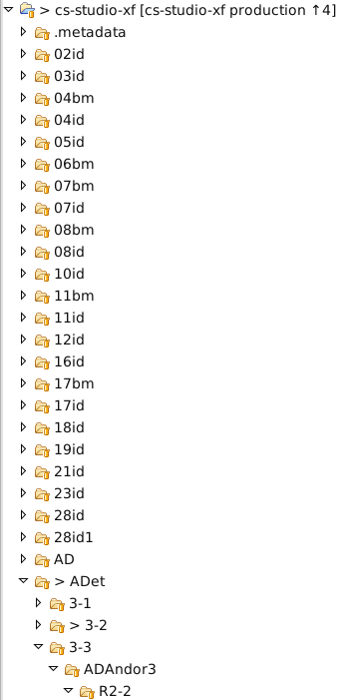
NSLS2 beamline CSS opi
~26 branches/beamlines + accelerator
Folder |  | Comment
Flat | Common | Not every AD ioc upgraded
Flat | Each beamline | 75 -125 {beamlines x (5)AD versions}
Not flat | Each beamline | ?
Not flat | Common | ??
Flat structure leads to many ‘identical’ screen folders –> maintenance ‘nightmare’ X
Not flat – how to use new capabilities of css?

Slide 5
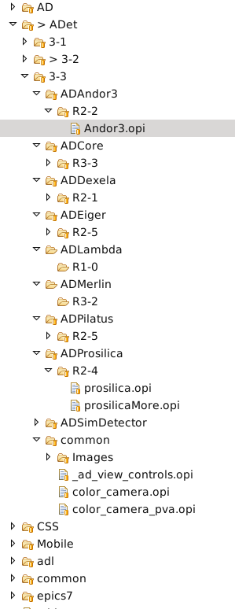
AD opi screen file structure
Flat
Folder
kgofron@xf10id-ws1:~/src/gitlab/cs-studio-xf/AD$ ls
ADAttrFile.opi NDFileNexus.opi NDTimeSeriesAll.opi
ADBase.opi NDFileNull.opi NDTimeSeries.opi
ADBuffers.opi ND_File.opi ND_TimeSeriesPlot.opi
ADCollect.opi NDFile.opi ND_Transform.opi
ADDriverFile.opi NDFileTIFF.opi NDTransform.opi
ADEpicsShutter.opi NDOverlay8.opi ND_Transform_Single.opi
ADPlugins.opi _ND_OverlayN_Line.opi PerkinElmerCollect.opi
ADReadout.opi ND_Overlay_N.opi PerkinElmerCorrections.opi
adsc.opi NDOverlayN.opi PerkinElmerInit.opi
ADSetup.opi ND_Overlay.opi PerkinElmer.opi
ADShutter.opi NDOverlay.opi pilatusAncillary.opi
ADTop.opi ND_Overlay_Single.opi pilatusDetector.opi
Andor.opi NDPlot.opi pixiradLV.opi
BIS.opi NDPluginBase.opi pixirad.opi
commonPlugins.opi _ND_Plugin_Setup.opi pointGreyFrameRate.opi
EPICS_ShutterControl.opi ND_PluginTimeSeries.opi pointGrey.opi
firewireFeatures.opi ND_Process.opi pointGreyPixelFormat.opi
firewire.opi NDProcess.opi pointGreyProperties.opi
firewireVideoFormats.opi ND_Pva.opi prosilicaMore.opi
mar345.opi NDROI4.opi Prosilica_More.opi
marCCDAncillary.opi _ND_ROIN_Line.opi prosilica.opi
marCCD.opi ND_ROIN.opi PSL.opi
ND_ColorConvert.opi ND_ROI.opi pvCam.opi
NDColorConvert.opi NDROI.opi RoperFile.opi
NDFFMPEG.opi NDStats5.opi Roper.opi
ND_FFTFreqSpectrumPlot.opi _ND_StatsN_Line.opi scan_more.opi
ND_FFT.opi ND_StatsN.opi simDetector.opi
_NDFile_Control.opi ND_Stats.opi simDetectorSetup.opi
NDFileHDF5.opi NDStats.opi title.opi
NDFileJPEG.opi ND_Stats_Plot.opi URLDriver.opi
NDFileMagick.opi ND_StdArray.opi URLDriverSetup.opi
NDFileNetCDF.opi NDStdArrays.opi

Slide 6
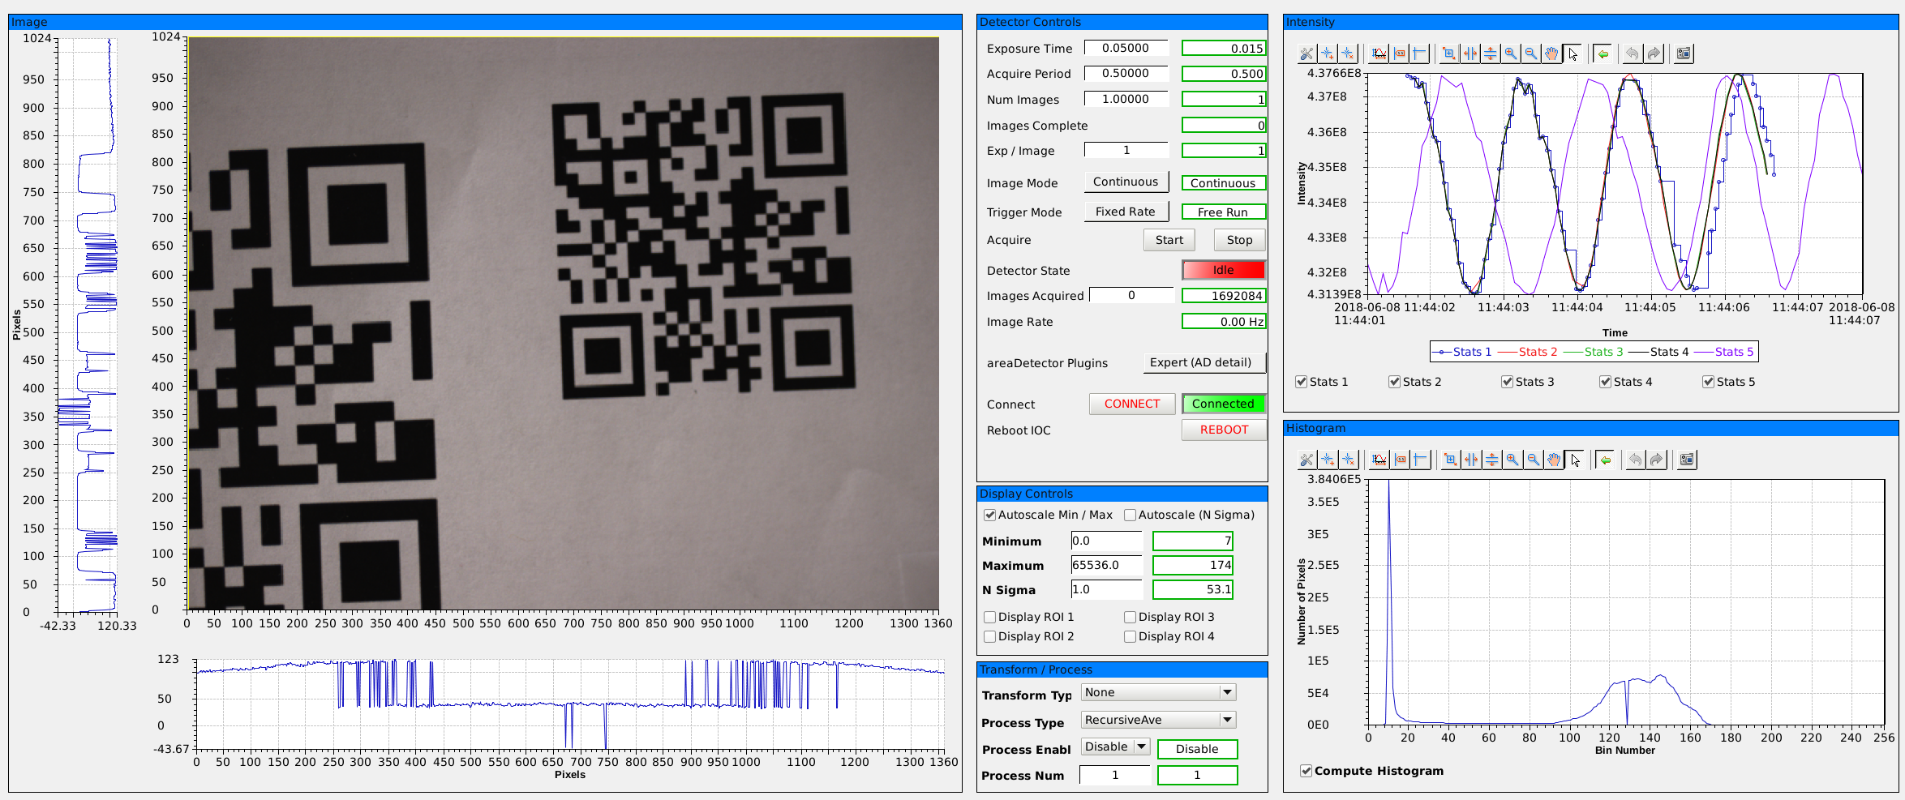
Prosilica main screen (@ NSLS2)

Slide 7
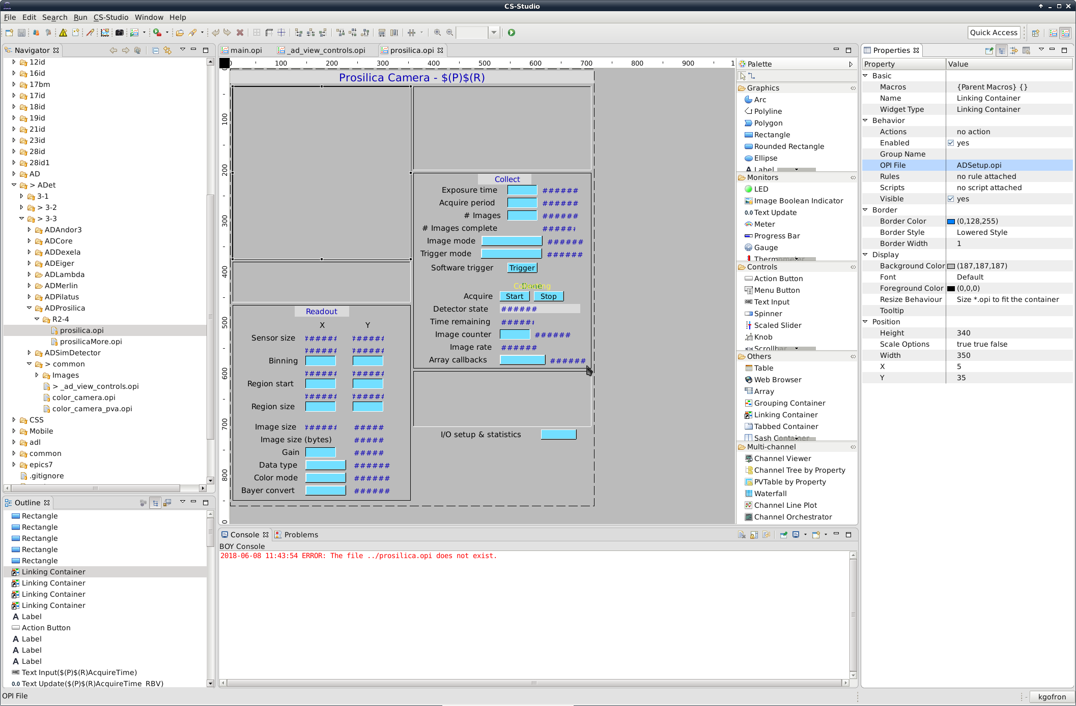
Autoconverted screens do not work in folder structure

Slide 8
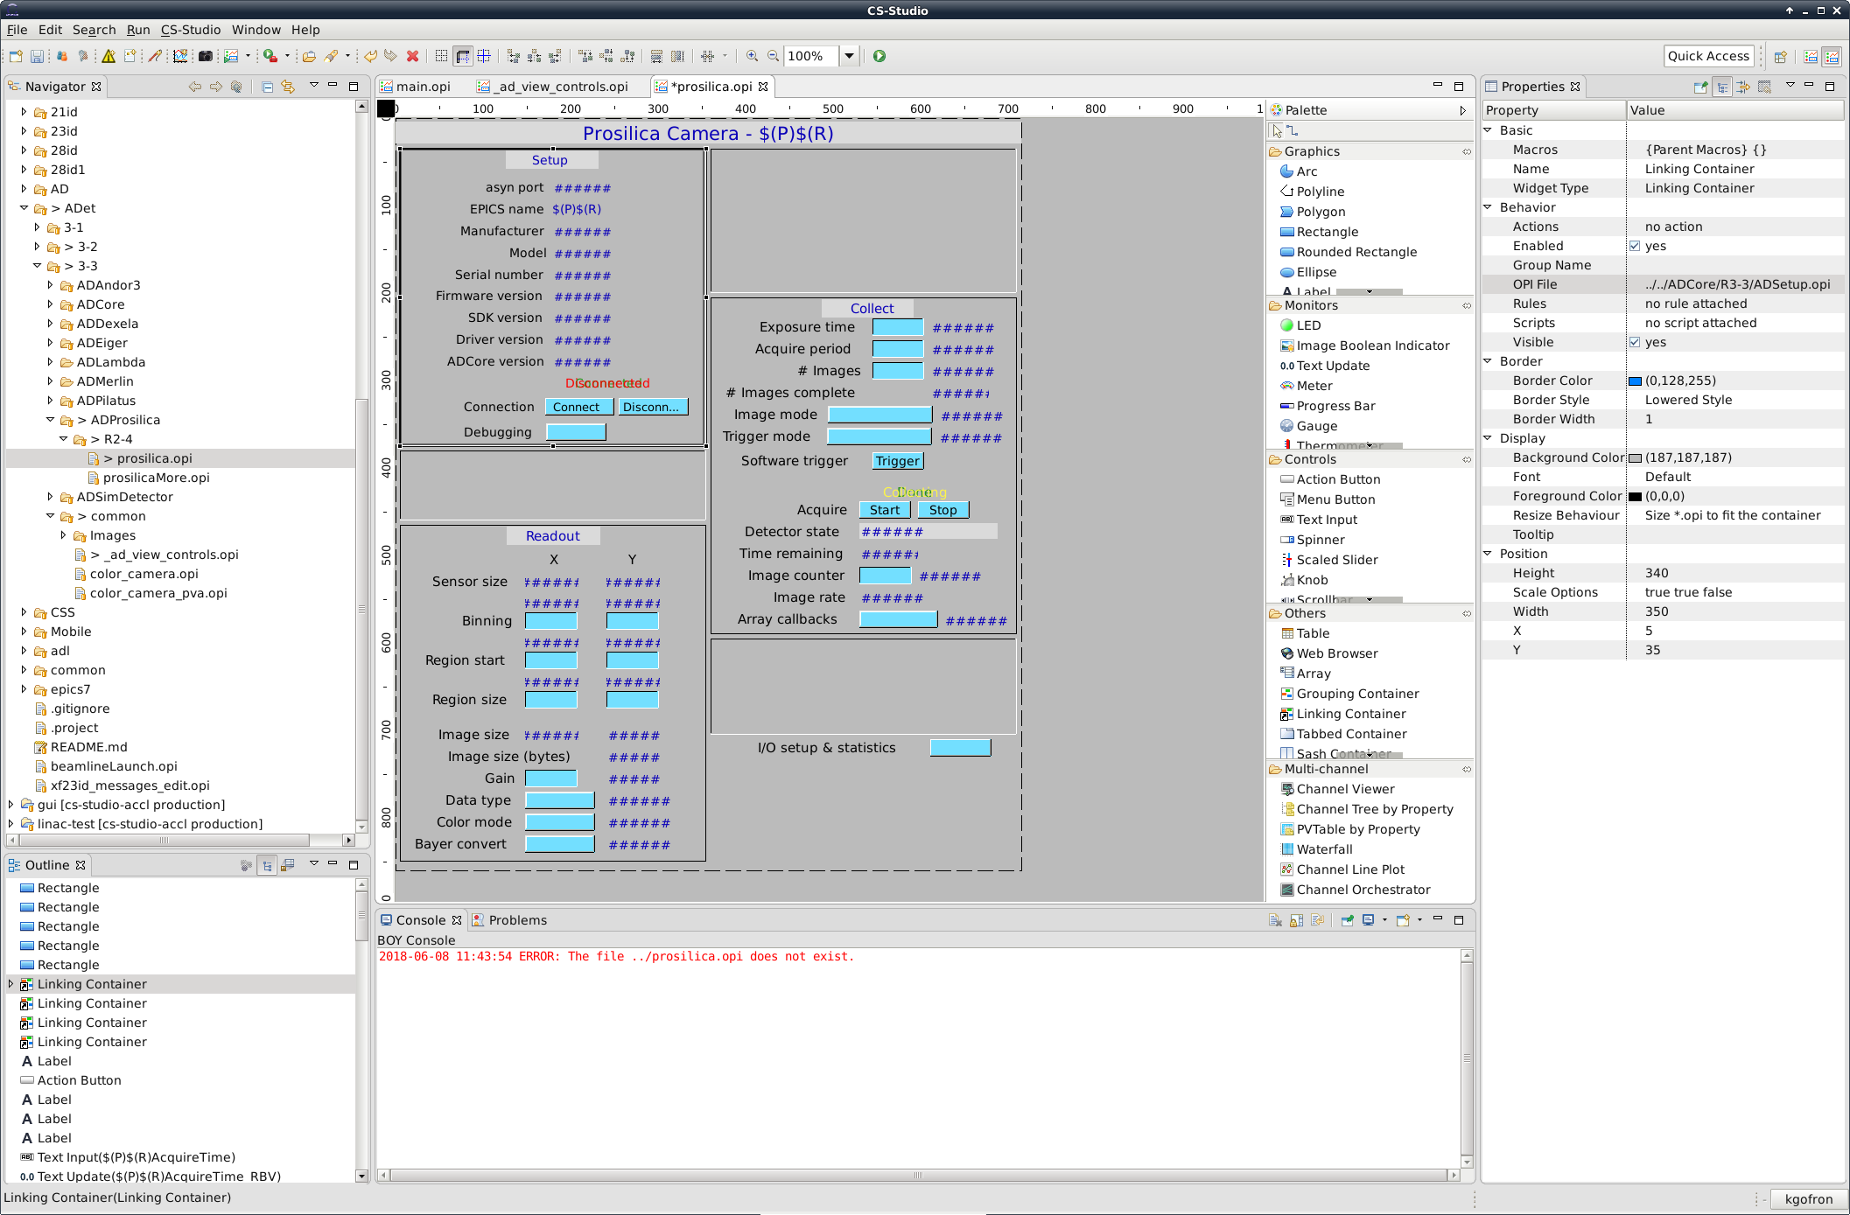
Provide relative path to ADCore

Slide 9
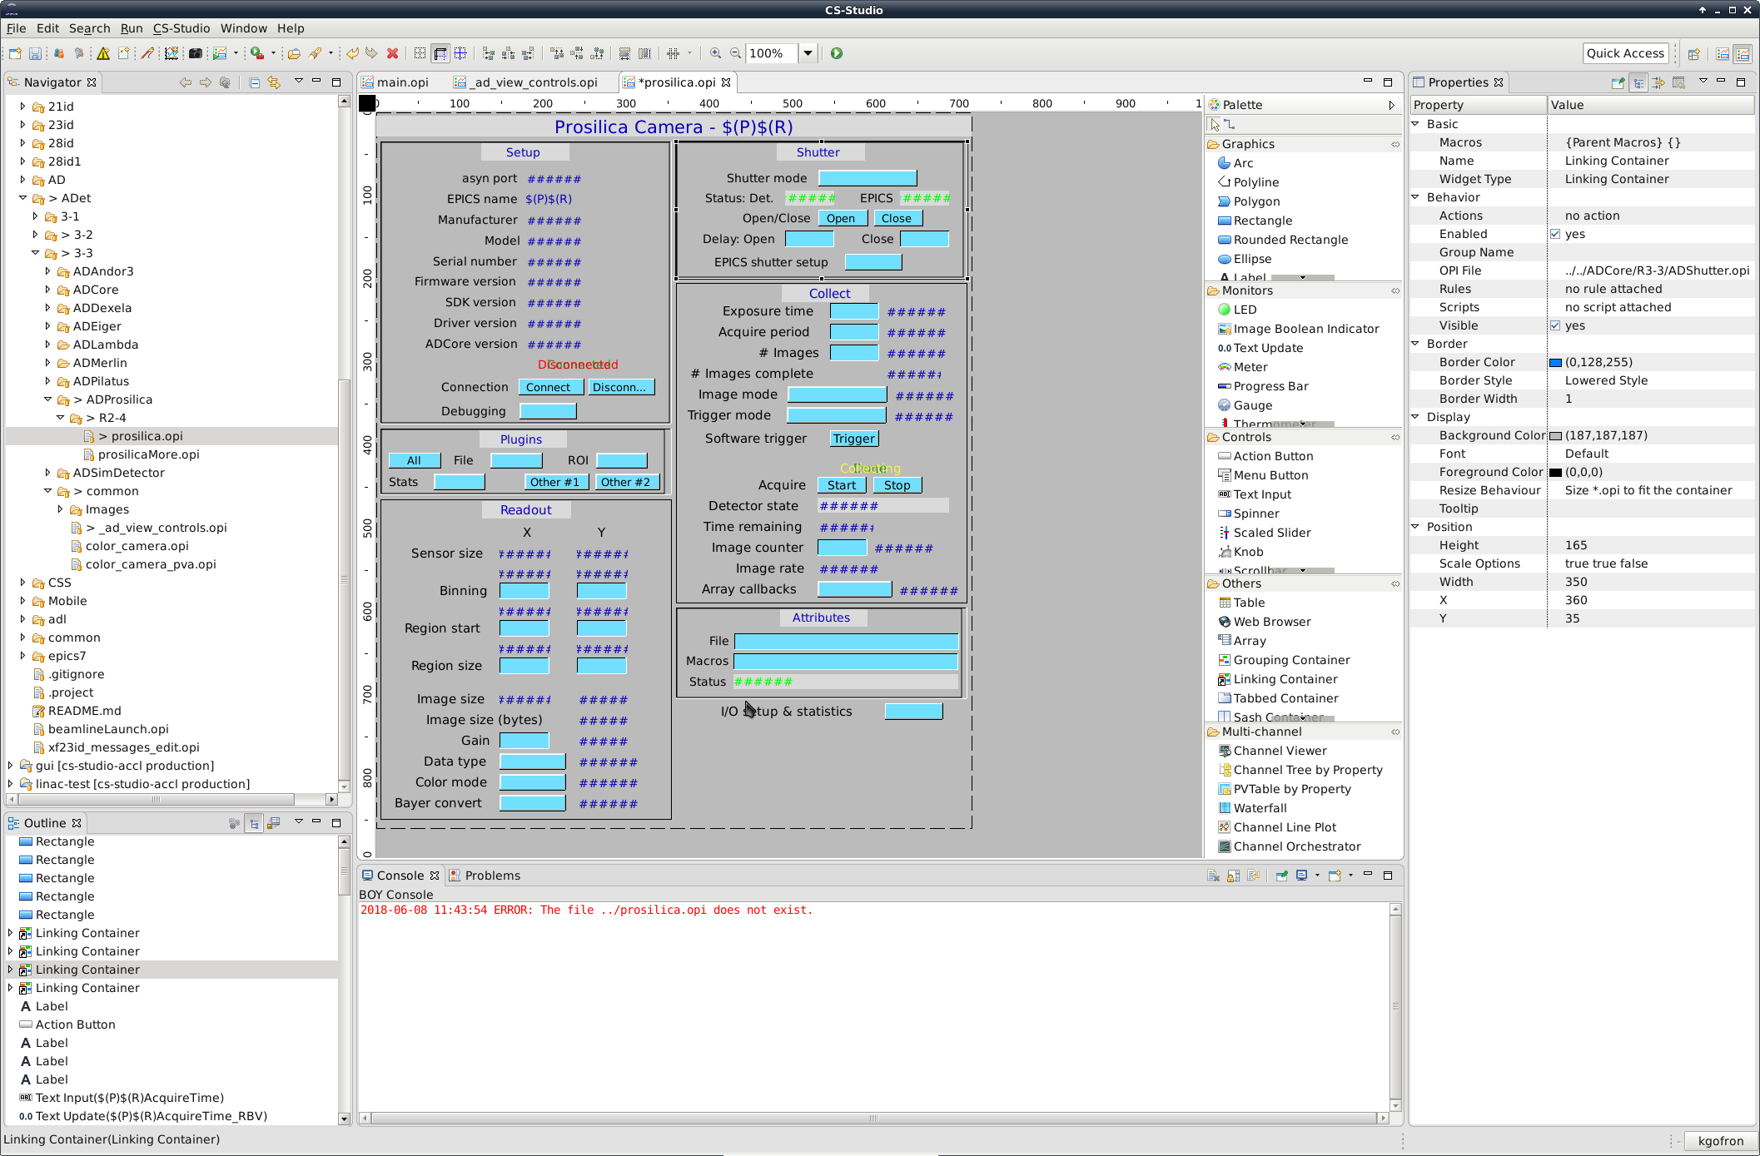
Provide relative path to ADCore

Slide 10
Non flat opi folder structure
Relative path resulted in one fixed configuration of areaDetector opi screens
No improvement over flat folder
{same number of multiple screen folders}

Slide 11
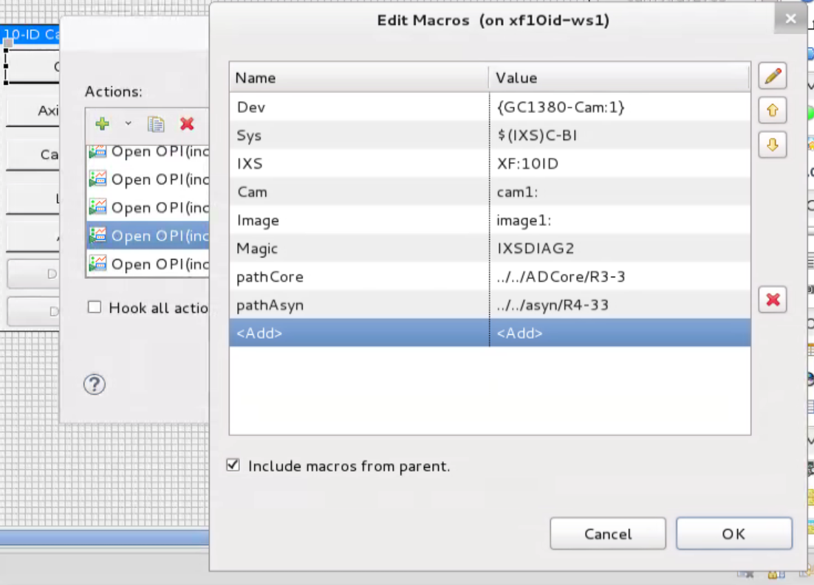
Run-time macro substitution
Relative Path
choose ADCore verson at runtime

Slide 12
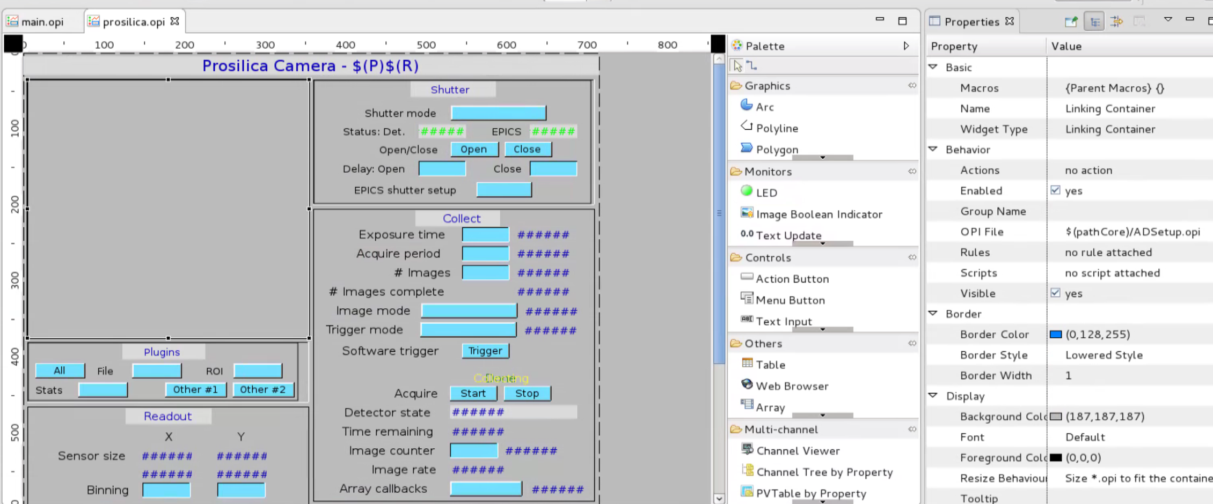
Prosilica run-time macro substitution
Provide macro substitution to choose ADCore verson at runtime

Slide 13
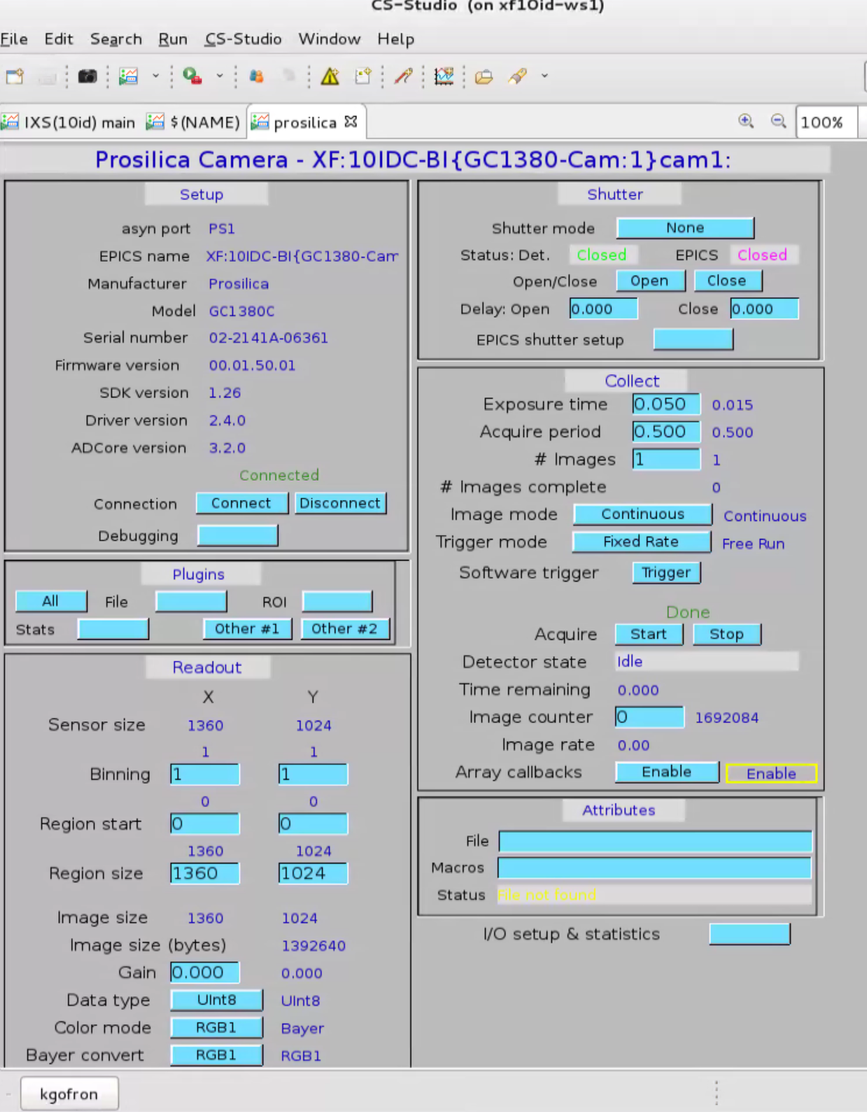
Prosilica runtime with pathCore
Relative path
one copy of areaDetector opi screens
copy of folder still works (individual specific beamlines)
Easier maintenance than multiple copies of flat legacy medm screens

Slide 14
Macro substitution for modules
Relative path to modules
one copy of areaDetector opi screens
Major improvement over multiple copies of flat folder opi
Use Macro substitution for module Paths
Replace relative path to ADCore with CSS macro
Relative paths for other modules
pathCore, pathAsyn, pathIocStats,…
Use script to insert path Macro in opi files
Generate any run-time combination of the ADCore, asyn, other modules from one set of AD opi screens

Slide 15
Relate to mdm, edm, caQtDM
No need to change the autoconverted screens
Medm
EPICS_DISPLAY_PATH {folder(s) where screens are}
Runtime
No need to change autoconverted screens
Edm
Real time choice
Ioc and screens are co-located
caQtDM
??

Slide 16
areaDetector ioc @ NSLS2
kaz@xf10id-is1:/epics/iocs/cam-GC1380$ ls -l
drwxrwxrwx 4 kaz kaz 4096 Oct 2 2017 as
-rw-r--r-- 1 kaz kaz 71 May 2 16:42 config
-rw-r--r-- 1 kaz kaz 1457 May 2 17:07 envPaths
-rwxr-xr-x 1 kaz kaz 4855 May 2 17:15 st.cmd

Slide 17
Conclusions
Use one set of areaDetector opi screens to support any version of the AD ioc.
Opi screen placed in common CSS area
pathMacro substitution to select releases of
ADCore,
asyn,
etc.

