Slide 1
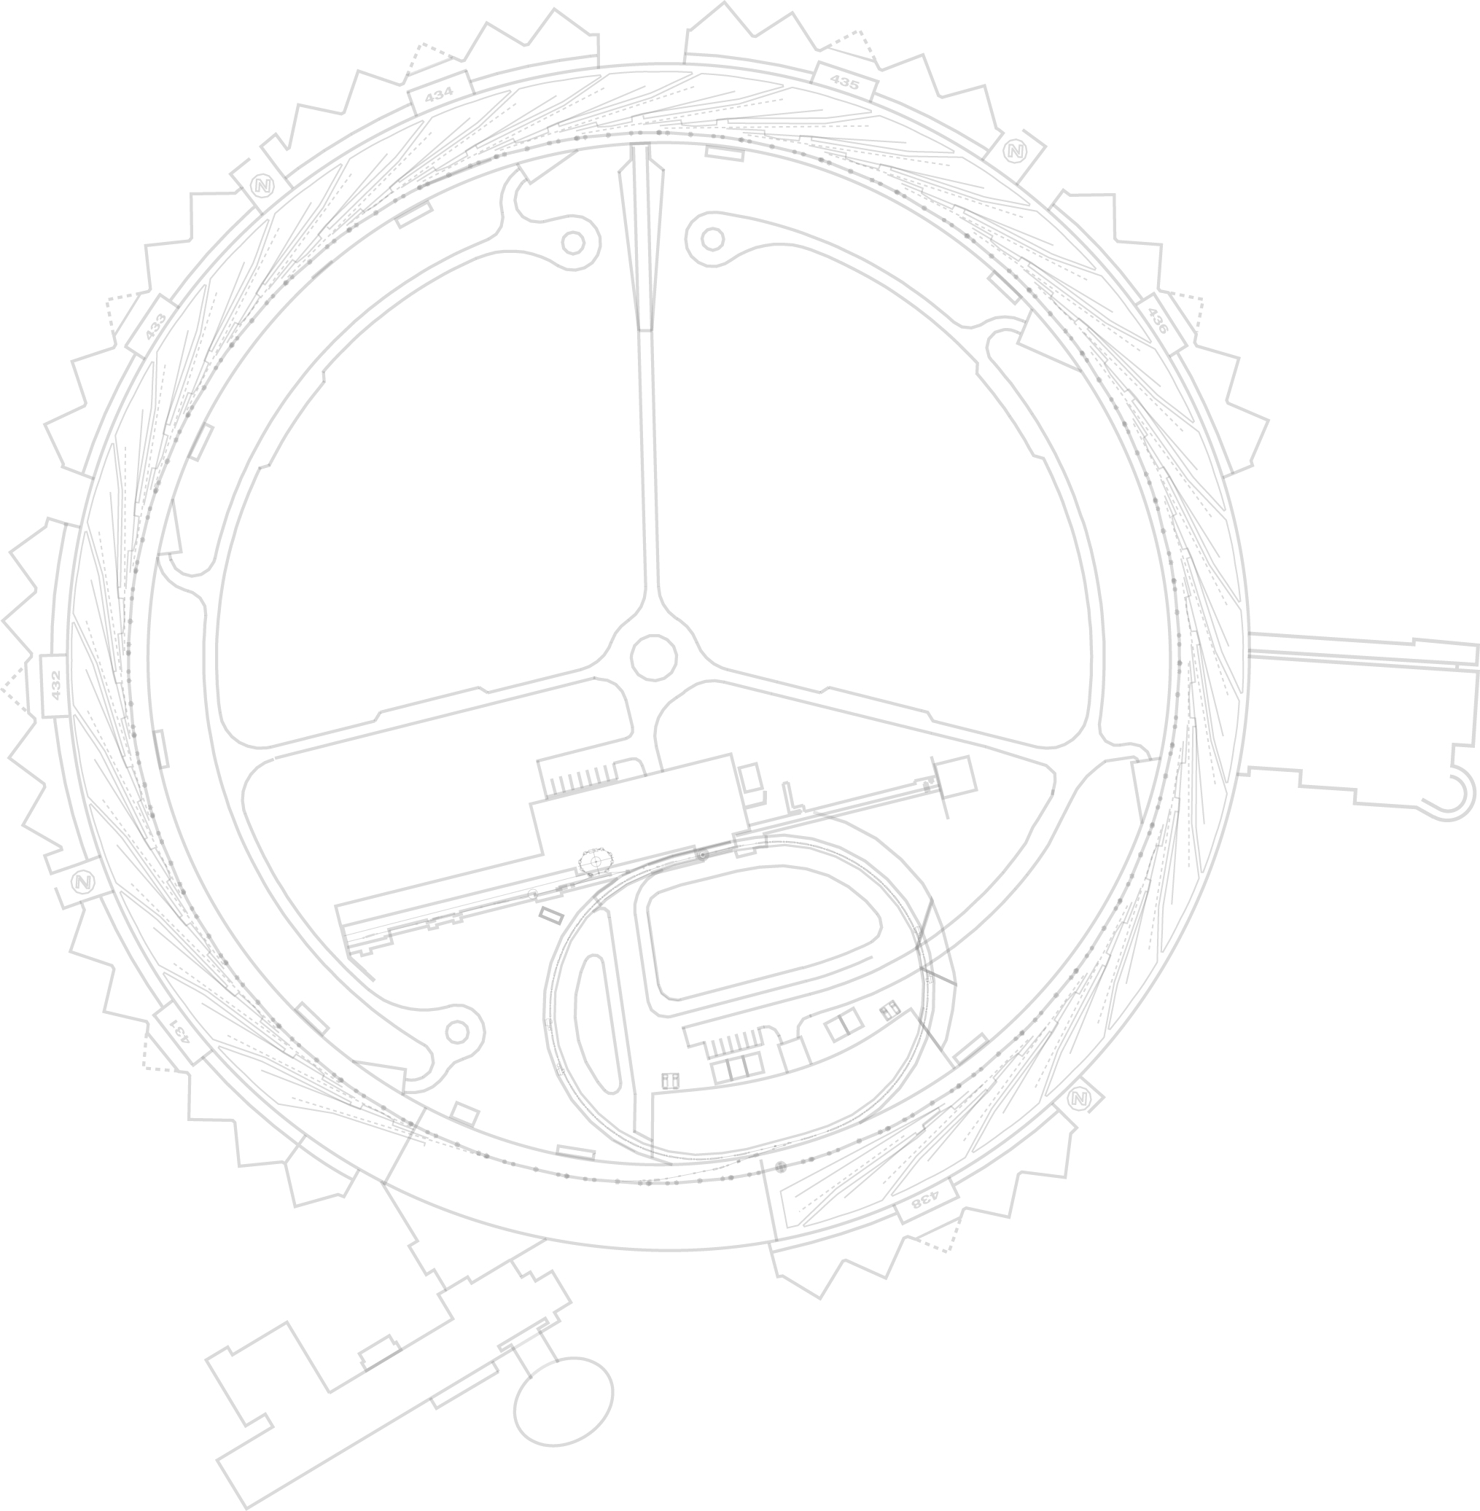
Using Area Detector As A General Purpose Processing Framework
Ned Arnold
Siniša Veseli
Argonne National Laboratory EPICS Collaboration Meeting June 2018
EPICS Collaboration Meeting - June 2018

Slide 2
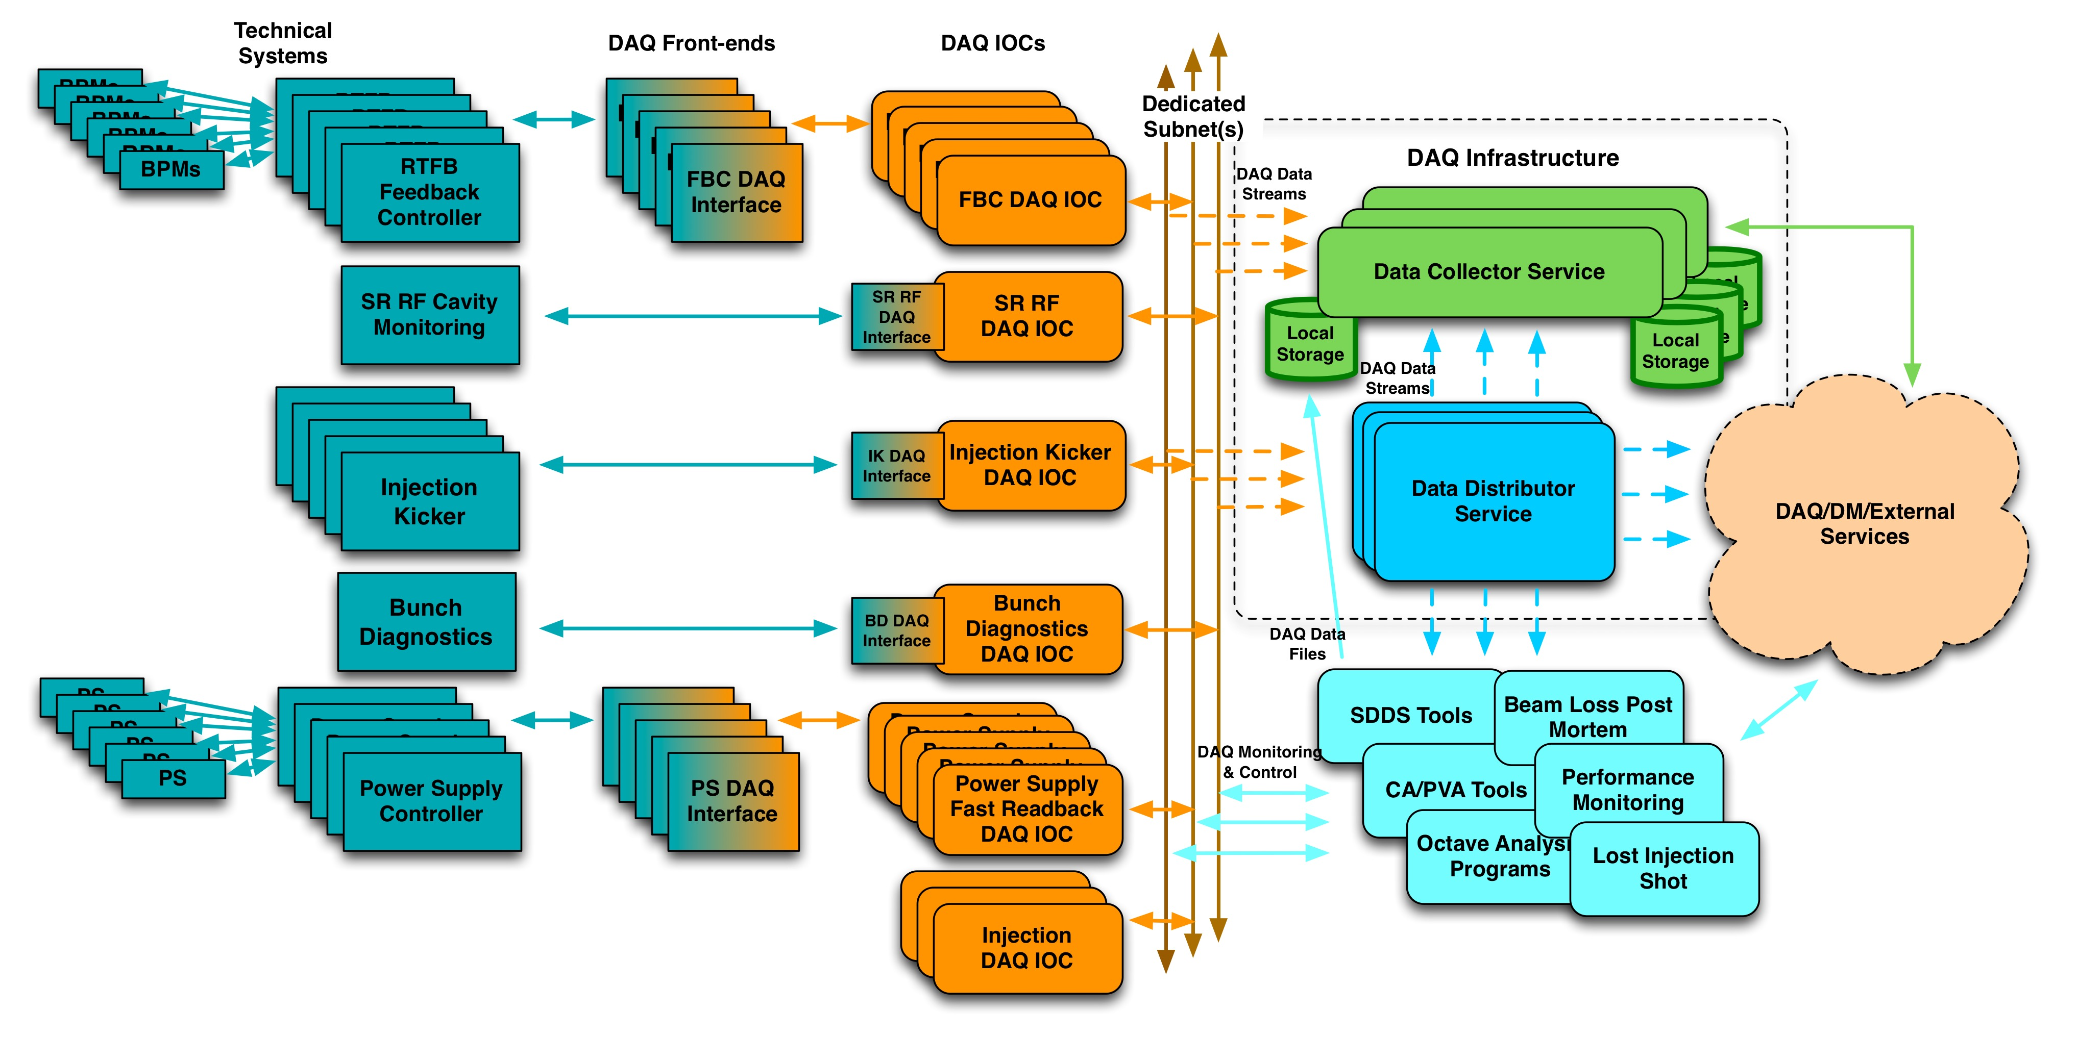
APSU Data Acquisition System
Provides time correlated/synchronously sampled data
Can be used for commissioning, troubleshooting, performance monitoring and early fault detection
Separated from operational systems to allow troubleshooting during user operations
Can acquire data from several subsystems at various sample rates
Supports continuous/triggered acquisition, static parameters, slow (in development) and fast data
Scalability
Ability to route data to any number of applications
EPICS Collaboration Meeting - June 2018
2
Notes:
The DAQ software interfaces with several technical subsystems to provide time-correlated and synchronously sampled data that can be used for commissioning, troubleshooting, performance monitoring and early fault detection. The key features of the system include capability to acquire data from multiple subsystems at various sample rates, support for continuous data acquisition, and ability to route the data to any number of applications.
Go to ”Insert (View) | Header and Footer" to add your organization, sponsor, meeting name here; then, click "Apply to All"
2

Slide 3
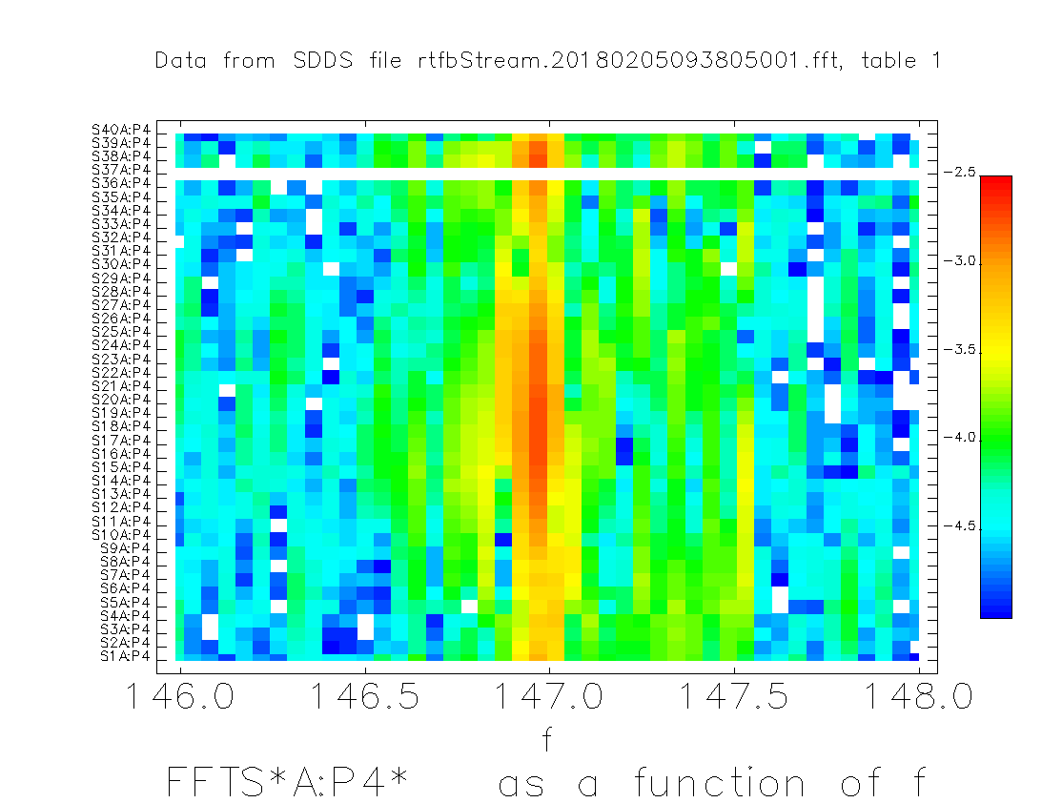
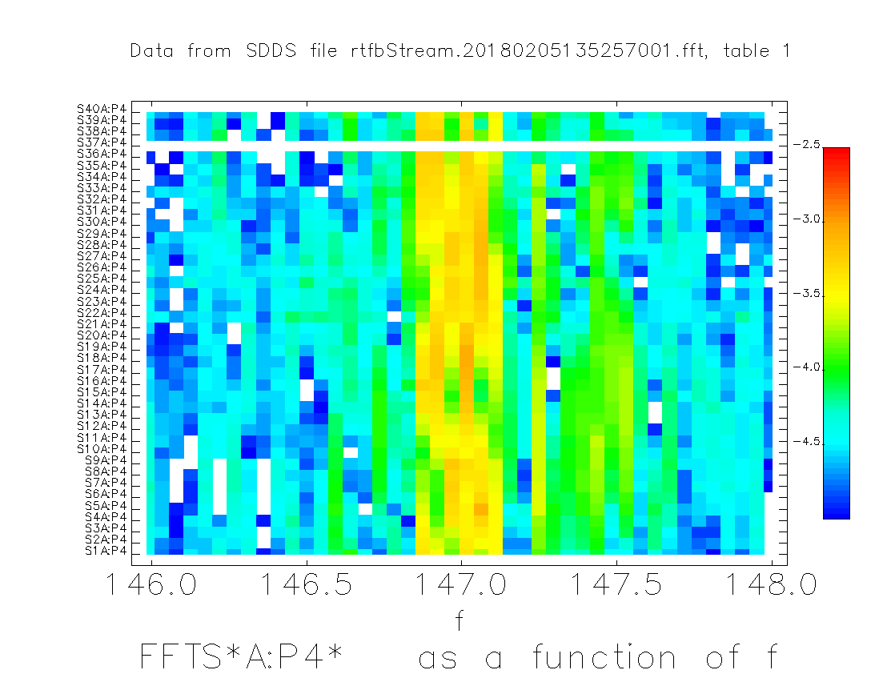
DAQ Usage Example (L. Emery)
Suppression of 147Hz vibration source in the ring using the DAQ system + post-processing with FFT
Vacuum chamber was vibrating and introduced a Bx field; shims were inserted between poles and vacuum chamber (S37AQ3, S37AQ2)
Identification of the nearest quadrupoles required 400 channels, 20 seconds of continuous DAQ data to get 0.5Hz precision
This allowed separating line frequencies of 20 pumps
Figure on the top is showing data before shimming, while the one on the right is showing results after shimming
EPICS Collaboration Meeting - June 2018
3
Notes:
Go to ”Insert (View) | Header and Footer" to add your organization, sponsor, meeting name here; then, click "Apply to All"
3

Slide 4
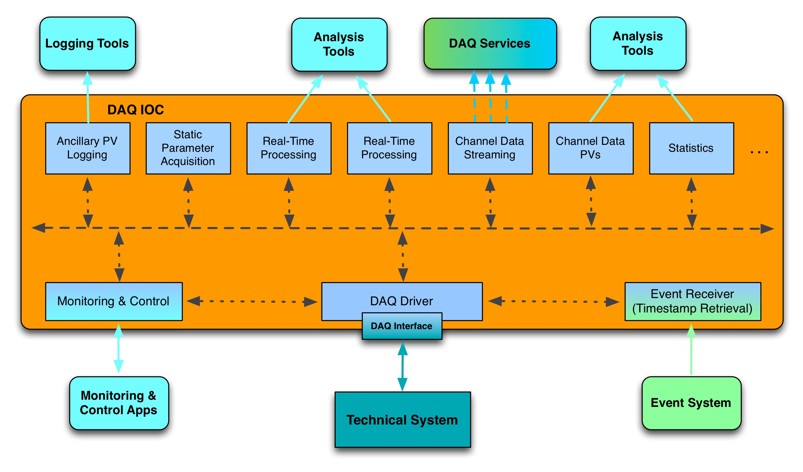
Prototyped several options:
Custom TCP
EPICS V4 PVA
AMQP (QPID)
DAQ IOC
Uses Asyn/AD Framework:
Data is packed into ND Arrays
Varies by technical system:
MRF Event Receiver
APS Event Receiver
NTP/PTP
EPICS Collaboration Meeting - June 2018
4
Notes:
Go to ”Insert (View) | Header and Footer" to add your organization, sponsor, meeting name here; then, click "Apply to All"
4

Slide 5
Asyn/AD Framework Usage: Initial Approach
Use Asyn/AD Framework to collect and process data from technical subsystems
Driver packs channel data into ND Arrays, and passes it to real-time processing plugins
ND Array attributes describe the content (i.e., what data is in ND Array, how is it packed)
Communication plugin streams ND Arrays to remote Data Collector service where it is unpacked, stored, and (possibly) forwarded to the Data Distribution Service (Message Broker)
DAQ Data Packet
List of Parameters (NDArray Attributes)
(including list of channels that follow)
Block of Time-series Data
…
Timestamp
Channel 1
Channel 2
Channel 3
Channel 4
Channel N
.
.
.
.
.
.
.
.
.
.
.
.
.
.
.
.
.
.
EPICS Collaboration Meeting - September 2016
Since absolute timestamps are recorded, plotting channels from different files/systems against “Timestamp” provides immediate time-correlated plots .
EPICS Collaboration Meeting - June 2018
5
Notes:
Go to ”Insert (View) | Header and Footer" to add your organization, sponsor, meeting name here; then, click "Apply to All"
5

Slide 6
Challenges
How do we pack data?
ND Array was designed for homogeneous data; DAQ must handle multiple data types
Timestamps are doubles, channel data may not be
DAQ channels may have different data types
How do we handle runtime configuration changes?
Must be able to turn on/off different channels without restarting various system components
Configuration changes result in ND Array packing scheme changes
How do we provide DAQ users with easy access to individual channel data?
Cannot be done without custom clients that know how ND Array was packed
How do we handle slow vs fast data?
Must avoid significant overhead in memory/network bandwidth
How do we efficiently access/process channel data in real-time DAQ processing plugins?
Unpacking ND Array data in plugins themselves is very inefficient
Possible Solution
Modify AD framework to pass DAQ structures through plugins; those could then be easily exposed as EPICS v4 structures over PV Access protocol
EPICS Collaboration Meeting - June 2018
6
Notes:
Go to ”Insert (View) | Header and Footer" to add your organization, sponsor, meeting name here; then, click "Apply to All"
6

Slide 7
DAQ AD Core Extension
Goals:
Minimal modification of AD core code that allows us to pass arbitrary data through processing plugins (without having to pack/unpack ND arrays in plugins themselves)
Backwards compatibility: no existing AD plugins need to change
Ability to retrieve data from IOC via standard PVA APIs and tools like pvget
Strategy: use NDArray/NDArrayPool as base classes for extending the AD Core functionality
AD Core modifications: 6 lines of code in NDArray.h and about 25 lines of code in NDArrayPool.cpp:
New NDArrayPool class methods for management of extended ND arrays
Modifications to keep track of ELL node offset
Custom DAQ Code:
RtfbNDArray (derived from NDArray, incorporates custom v4 structure) and RtfbNDArrayPool classes (derived from NDArrayPool, manages RtfbNDArrays)
Driver code uses custom pool and manipulates RtfbNDArray
RtfbNDPluginPva exposes RtfbNDArray via PV Access channel (plugin uses dynamic cast to convert NDArray pointer to RtfbNDArray pointer)
EPICS Collaboration Meeting - June 2018
7
Notes:
# Prototype is based off AD Core v4-plugin branch (July 2016)
# AD Core Changes in NDArray.h (6 lines)
bluegill1> diff ./ADApp/ADSrc/NDArray.h ./ADApp/ADSrc/NDArray.h.orig
94c94
< virtual ~NDArray();
---
> ~NDArray();
101c101
<
---
>
152,155d151
< protected:
< virtual NDArray* createArray();
< virtual void onAllocateArray(NDArray *pArray);
< virtual void onReleaseArray(NDArray *pArray);
164d159
< size_t ellNodeOffset;
# AD Core Changes in NDArrayPool.cpp (25 lines)
bluegill1> diff ./ADApp/ADSrc/NDArrayPool.cpp ./ADApp/ADSrc/NDArrayPool.cpp.orig
10d9
< #include <dbDefs.h>
43,54d41
< NDArray* NDArrayPool::createArray()
< {
< return new NDArray;
< }
< void NDArrayPool::onAllocateArray(NDArray *pArray)
< {
< }
< void NDArrayPool::onReleaseArray(NDArray *pArray)
< {
< }
<
<
84,88c71
< ELLNODE* ellNode = ellFirst(&freeList_);
< pArray = NULL;
< if (ellNode) {
< pArray = (NDArray *)((char*)ellNode-ellNodeOffset);
< }
---
> pArray = (NDArray *)ellFirst(&freeList_);
98,102c81
< //pArray = new NDArray;
< pArray = this->createArray();
< if (numBuffers_ <= 1) {
< ellNodeOffset = (char*)(&(pArray->node)) - (char*)pArray;
< }
---
> pArray = new NDArray;
187d165
< onAllocateArray(pArray);
285d262
< onReleaseArray(pArray);
Go to ”Insert (View) | Header and Footer" to add your organization, sponsor, meeting name here; then, click "Apply to All"
7

Slide 8
DAQ AD Core Extension
Advantages:
Approach is completely backwards compatible (no need to change existing plugins)
Requires minimal modifications to AD Core
No loss in performance due to packing/unpacking ND Arrays in plugins
Custom plugins can expose data as v4 structures easily; those can be accessed using standard client tools:
$ pvget rtfb_ext_ndarray
rtfb_ext_ndarray
structure
uint ArrayId 0
double[] TimeStamp []
float[] PosX_0 []
float[] PosY_0 []
float[] PosX_1 []
float[] PosY_1 []
…
Drawbacks:
Custom plugins that use classes derived from NDArray must downcast (performance hit)
Design not quite suitable for a general purpose processing framework
Better solution would require AD Core refactoring/redesign, and would not be backwards compatible
EPICS Collaboration Meeting - June 2018
8
Notes:
Go to ”Insert (View) | Header and Footer" to add your organization, sponsor, meeting name here; then, click "Apply to All"
8

Slide 9
Final Comments
Current DAQ production code:
Uses EPICS 3.15.x, AD Core 2.5
Mixture of old (use NDArray) and new (use DAQ extension) style IOCs
DAQ development will transition to EPICS7, AD Core 3.2
PR #324 for DAQ AD Core (merged recently): will allow us to keep up with AD Core changes
EPICS Collaboration Meeting - June 2018
9
Notes:
Go to ”Insert (View) | Header and Footer" to add your organization, sponsor, meeting name here; then, click "Apply to All"
9

