Slide 1
Odin Detector DAQ Framework and areaDetector Integration
EPICS areaDetector Working Group Meeting
APS, June 2018
Ulrik Pedersen
Head of Beamline Controls

Slide 2
Odin
“Control and data acquisition framework
for parallel detector systems”
DLS – STFC Collaboration
Started: Late 2014

Slide 3
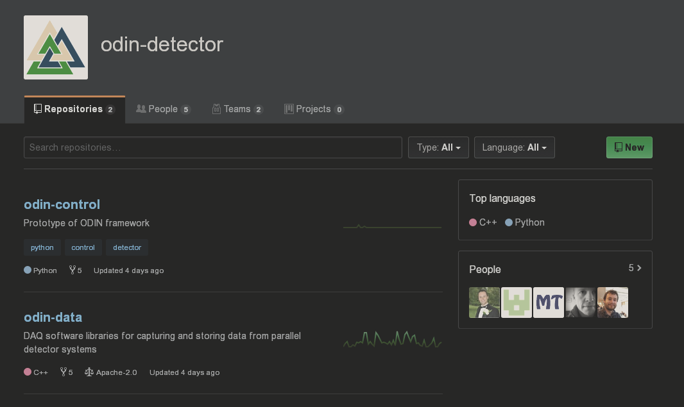
GitHub
Collaborators
Logo
Cryptic Name
odin-detector

Slide 4
Odin Detectors
In-house or collaborative detector development
Different hats: detector system vendor & system integrators
Collaboration agreement: control system agnostic
Scalable, but simple to control
Modular detector systems, multiple readout channels
Single point of control of distributed system
DAQ system, not a processing pipeline
But … descrambling pixels *is* processing

Slide 5
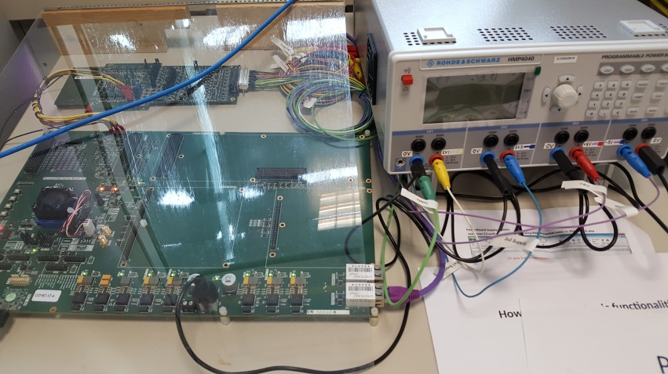
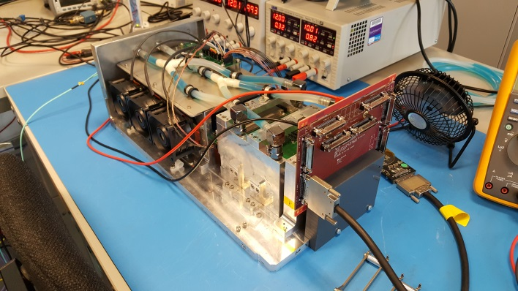
Odin Detectors
Excalibur
Percival
Tristan
Eiger…

Slide 6
Odin
Control and data acquisition framework for parallel detector systems
OdinControl
Special Access
OdinData
Python HTTP control server
C++ data acquisition and file writing stack
ZMQ JSON
FrameReceiver
FrameProcessor
Control
Data stream gatherer
Data processor and file writer

Slide 7
ADOdin
Thin AreaDetector wrapper API
Tristan
RESTful API
TCP
Percival
OdinControl
Excalibur
OdinData
Python HTTP control server
C++ data acquisition and file writing stack
C++ data acquisition and file writing stack
ZMQ JSON
Control
Data

Slide 8
RESTful API
ADEiger
Eiger X 4M
AreaDetector for detector control
Custom Python Client
OdinData
C++ data acquisition and file writing stack
C++ data acquisition and file writing stack
ZMQ JSON
Control
Data

Slide 9
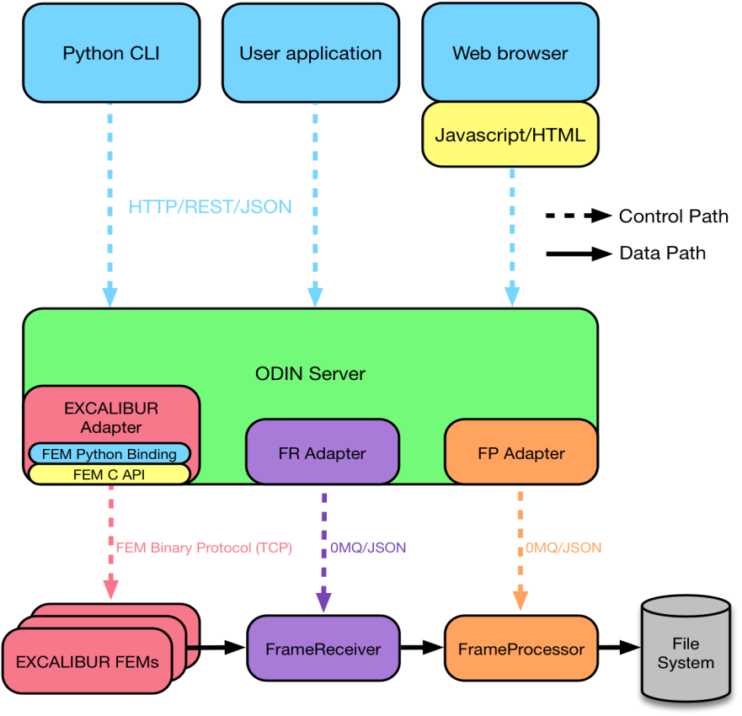
OdinControl
Generic HTTP server
Adapters provide functionality for each device
Server generates RESTful API from arbitrary Adapter attributes and methods
Control through simple webpages or client app

Slide 10
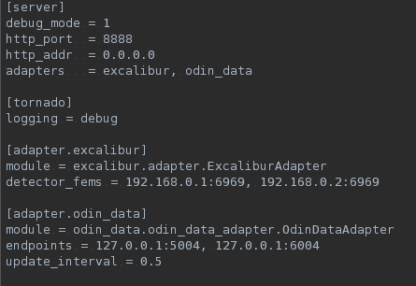
OdinControl Server Configuration
Configure
server address
Load Adapter libraries
Configure
specific Adapters

Slide 11
OdinData
FrameReceiver gathers data from UDP or ZeroMQ stream
Decoder plugin validates data packets and constructs a single frame
Passes data frame to FrameProcessor through shared memory

Slide 12
OdinData
FrameProcessor receives message with frame pointer
Process plugin performs relevant processing to produce an image
Descrambling detector specific data
Detector agnostic FileWriterPlugin writes pre-chunked data directly to HDF5 dataset
Notes:
Excalibur rotates sections and interpolates physical gaps
Dimensions, data type and compression configured by client control

Slide 13
OdinData
Write data using Direct Chunk Write
Only the raw dataset for best performance
A single, live, view of the data produced using Virtual Dataset and SWMR functionality
Notes:
Less processing and handles pre-compressed data
Metadata is published on a ZeroMQ stream

Slide 14
OdinData
Handle errors gracefully throughout
Missing packets
Missing full frames
Random ordering
Frames stored in correct order in HDF5
Notes:
Less processing and handles pre-compressed data
Metadata is published on a ZeroMQ stream

Slide 15
areaDetector Integration - ADOdin
Beamlines require areaDetector
Integration through GDA and/or Malcolm for scanning
Utilize the public HTTP/REST API
Just like any other control system from our collaborators
Same idea as ADEiger and ADPilatus
Control and status monitoring
External servers/processes handle data stream

Slide 16
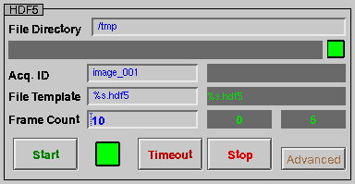
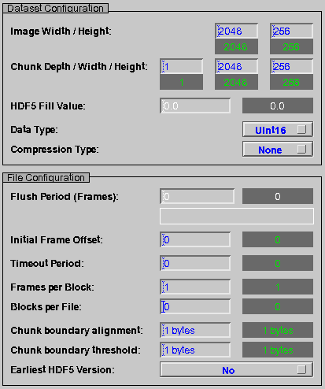
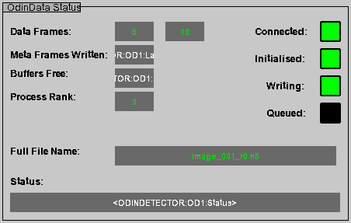
areaDetector Integration - ADOdin
Advanced HDF5 Configuration
OdinData Configuration
OdinData Status (One for each process)
Notes:
Thin AreaDetector API as a client to an OdinServer
Integrates the Odin framework within the EPICS control system
Provides familiar API to both controls engineers and GDA

Slide 17
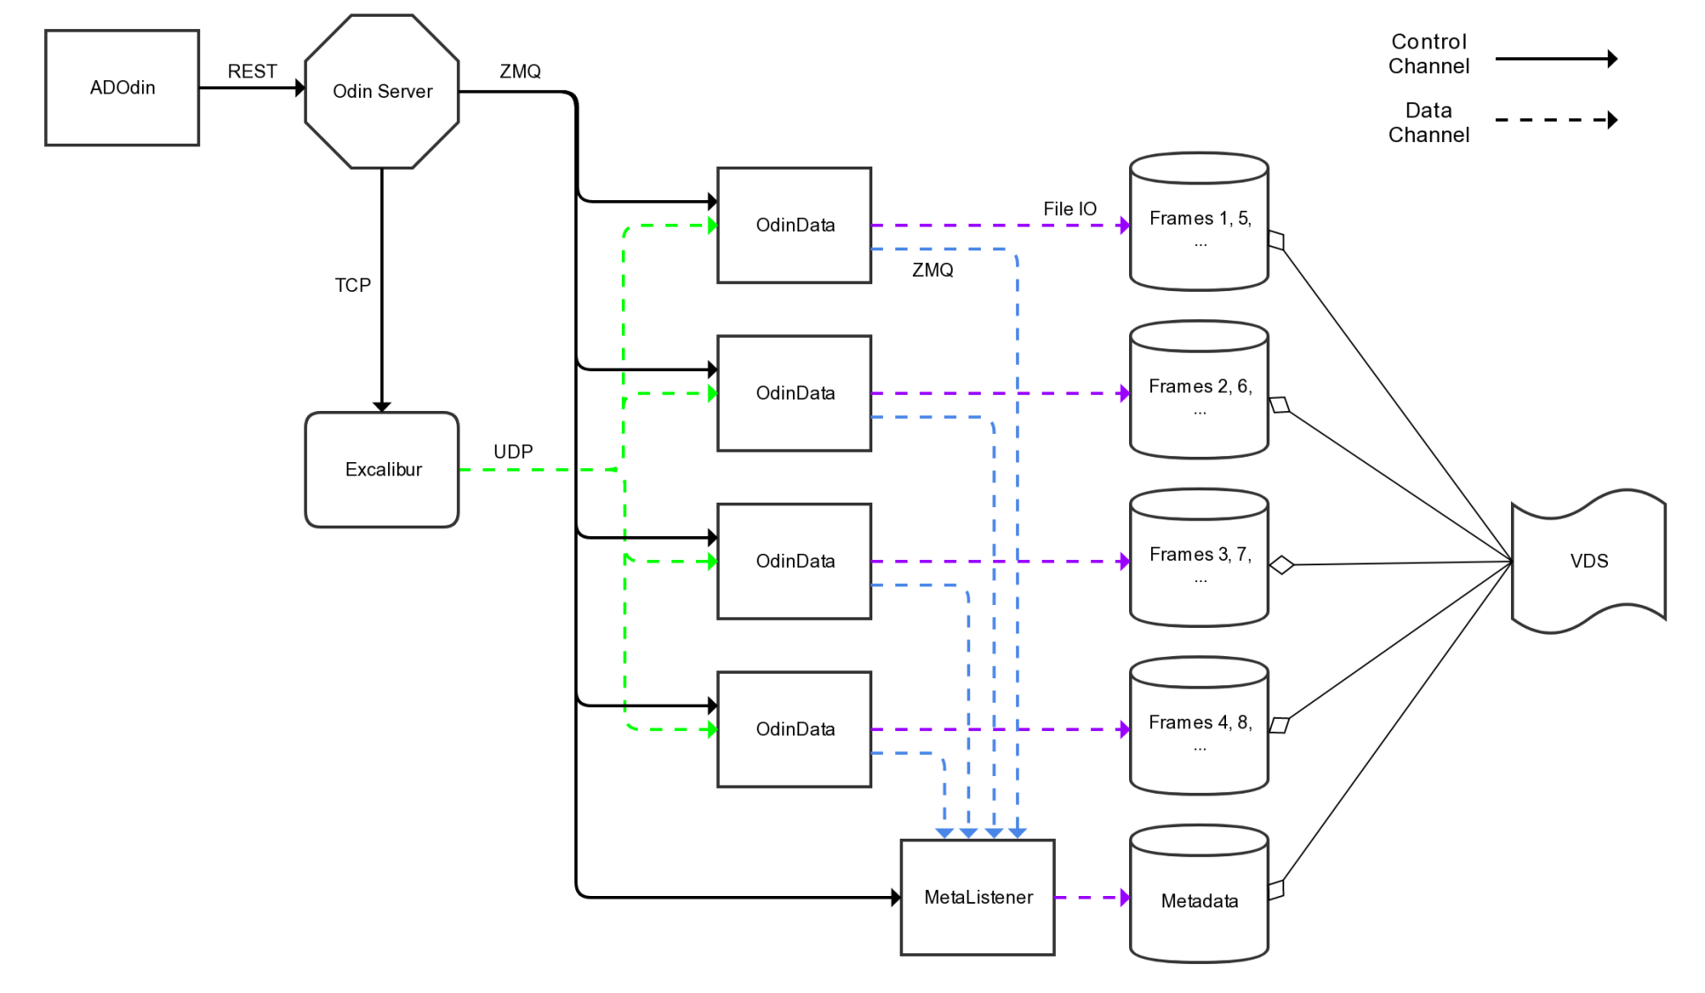
Excalibur
Notes:
Excalibur is parallel by design
Firmware fans frames out to each OdinData process round-robin

Slide 18
VMXi Eiger X 4M
Notes:
Eiger requires separate fan-out process to emulate the parallel Odin structure
Necessary to cope with high frame rate (up to 750Hz)

Slide 19
In Summary…
Odin is a control system agnostic single point of control
Integrates with areaDetector for beamline application
WIP but used on 2 detector systems
Excalibur
Eiger 4M
Odin is our Detector Control & DAQ backend for in-house and collaborative detector systems

Slide 20
Thanks
Questions?
Gary Yendell (Diamond)
Tim Nicholls (STFC)
Alan Greer (Observatory Sciences/Diamond)
Matthew Taylor (Diamond)

