Slide 1
areaDetector at Diamond
Reporting use and recent developments at DLS
EPICS/areaDetector developers meeting
APS, June 2018
Ulrik Pedersen
Head of Beamline Controls

Slide 2
areaDetectors at DLS
GigE cameras using aravisGigE
Pilatus
Eiger
PCO
Andor
XMAP
electronAnalysers
dtaq ADCs

Slide 3
DLS in-house developments and collaborations
Excalibur
Percival
Merlin
Xspress
PanDaBox
Not really an areaDetector but with an areaDetector driver!

Slide 4
DLS Environment
RHEL6
EPICS Base R3.14.12.3
areaDetector 1-9 (!)
But it just works…
ADCore
2-2, 2-3, 2-4, 2-6
RHEL7 (transitioning)
EPICS Base R3.14.12.7
.. Followed by EPICS 7
ADCore 2-6
.. Followed by 3-x

Slide 5
HDF5 SWMR
Single Writer Multiple Reader
Process data while it is being written to file
New data elements…
Writer
Reader
HDF5 File
…that can be read by a reader…
with no IPC necessary.
… are added to a dataset in the file…

Slide 6
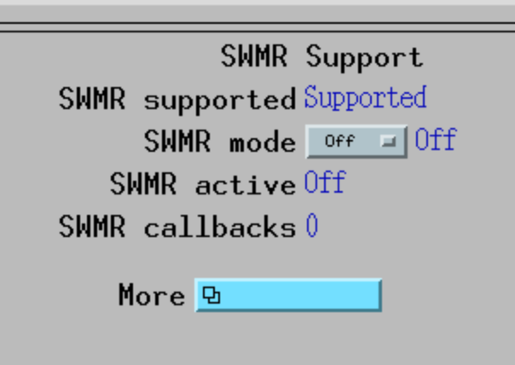
areaDetector NDFileHDF5
Now with SWMR support
Only available with HDF5 >= 1.10
Optional enable/disable
SWMR only works on POSIX file systems – not NFS/Samba/CIFS
Multiple dimensions in addition to the 2+1D
Arrange data by scan dimension

Slide 7
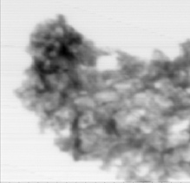
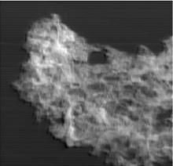
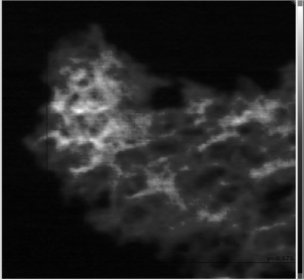
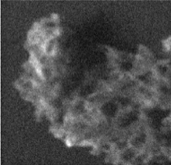
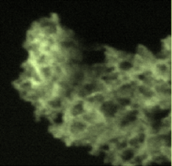
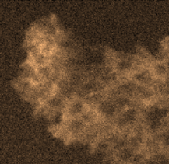
Mapping Project
Basic ‘mapping’ is simple: 2D raster-scan
Add multiple dimensions
Non-linear scans
Performance using hardware triggers
Continuous scans
Zebra or Panda
Live viewing through HDF5 files
Images, spectra
Live processing of HDF5 files
Pipelines triggered on scan start
Abs
DPC
DF
1 μm
C
O
C
O
Fe

Slide 8
Mapping Project

Slide 9
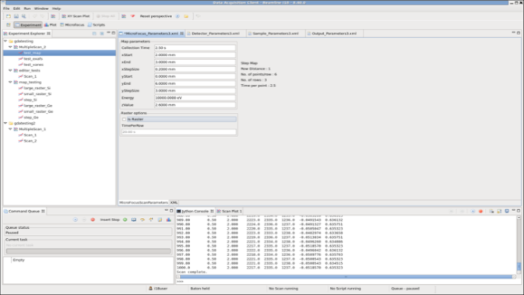
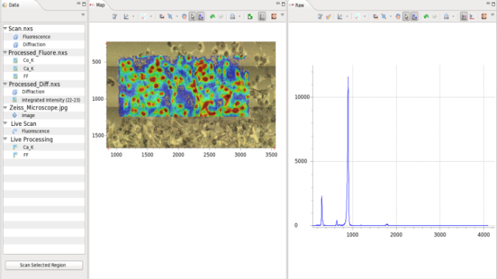
Mapping Project
GDA/DAWN visualisation
GDA Mapping Client
GDA9 Scanning
HDF5 SWMR
Messaging
Data
DAWN Processing
EPICS/ Malcolm Middleware

Slide 10
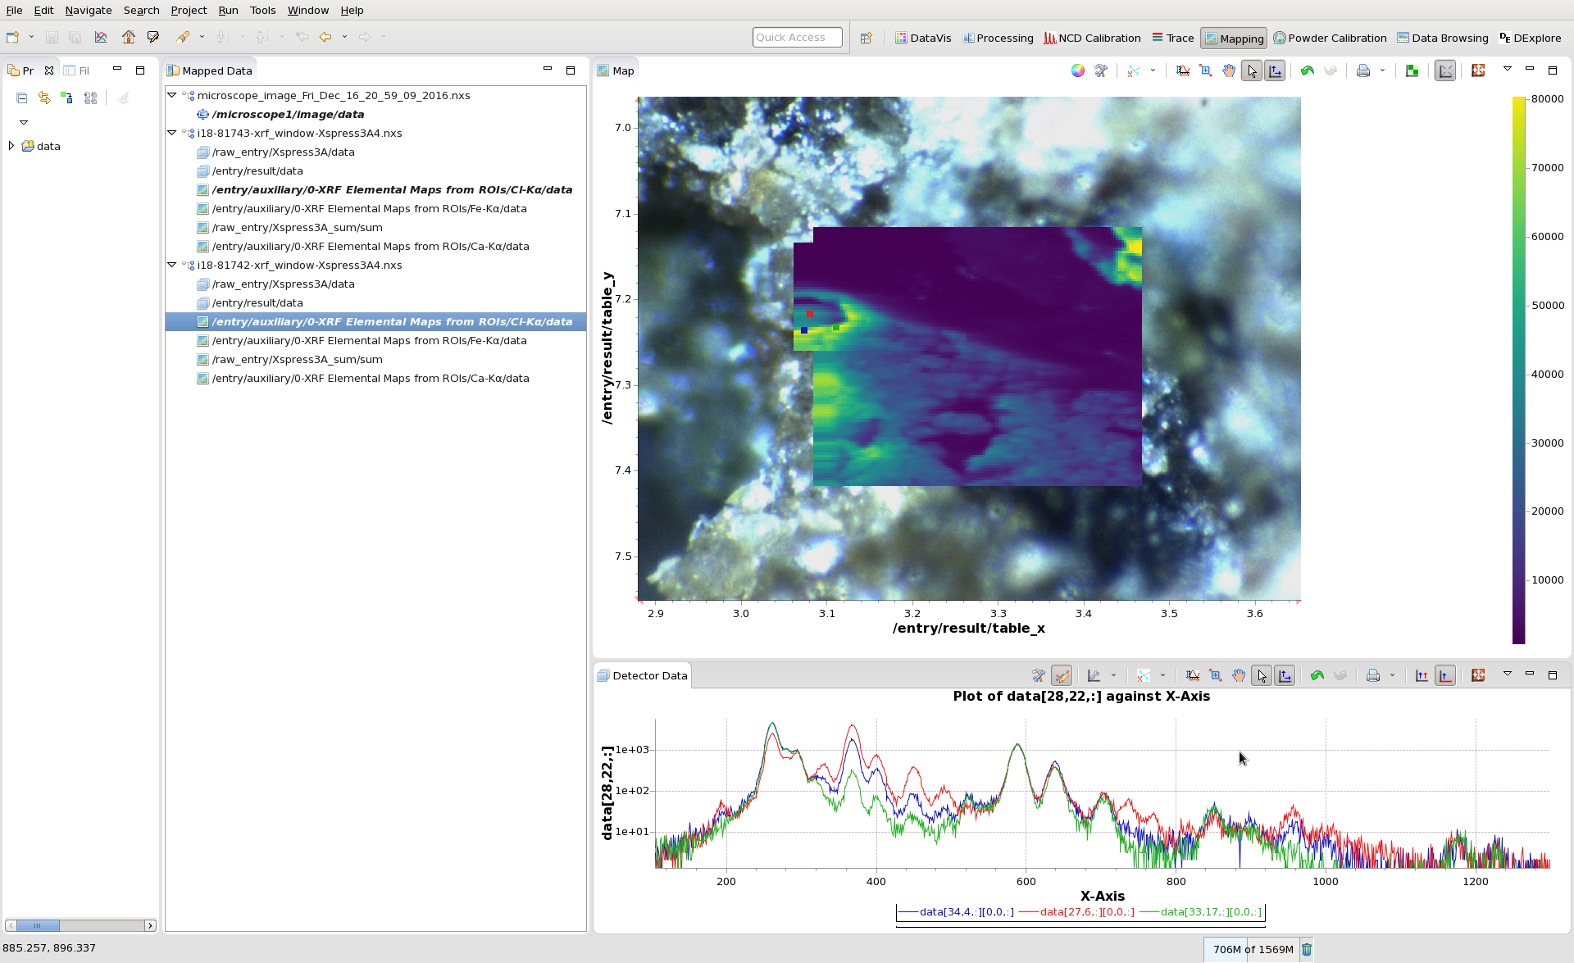
Mapping Project

Slide 11
Position Plugin
Detector Driver
NDArray
NDArray
Snake scan
Write data in snake pattern
Leave gaps for dropped frames
Rewind and overwrite data
Monitor HDF5 for live updates
Position Labelling Plugin
XML
positions
X:0 Y:0
X:1 Y:0
Other plugins here
HDF Writing Plugin
XML
layout
HDF5 file

Slide 12
Future
Even faster detectors…
Increased use of beamtime == larger datasets
Compression?
Blosc filter already on HDF5 file writer (Xiaoqiang Wang, PSI)
NDArray support for compressed frames?
New ways of storing and processing?
Object Storage – S3 File Writer plugin?
Streaming to in-house or external cloud?

