Slide 1
Embedded Event Receiver at PSI
Roger Biffiger :: Software Engineer :: Paul Scherrer Institut
180612 :: EPICS collaboration meeting :: Open Hardware Workshop

Slide 2
PSI – large research facilities has a new structure
PSI
Large Research Facilities
Electronics and Control Systems
Digital Signal Processing
FPGA development
Embedded Software

Slide 3
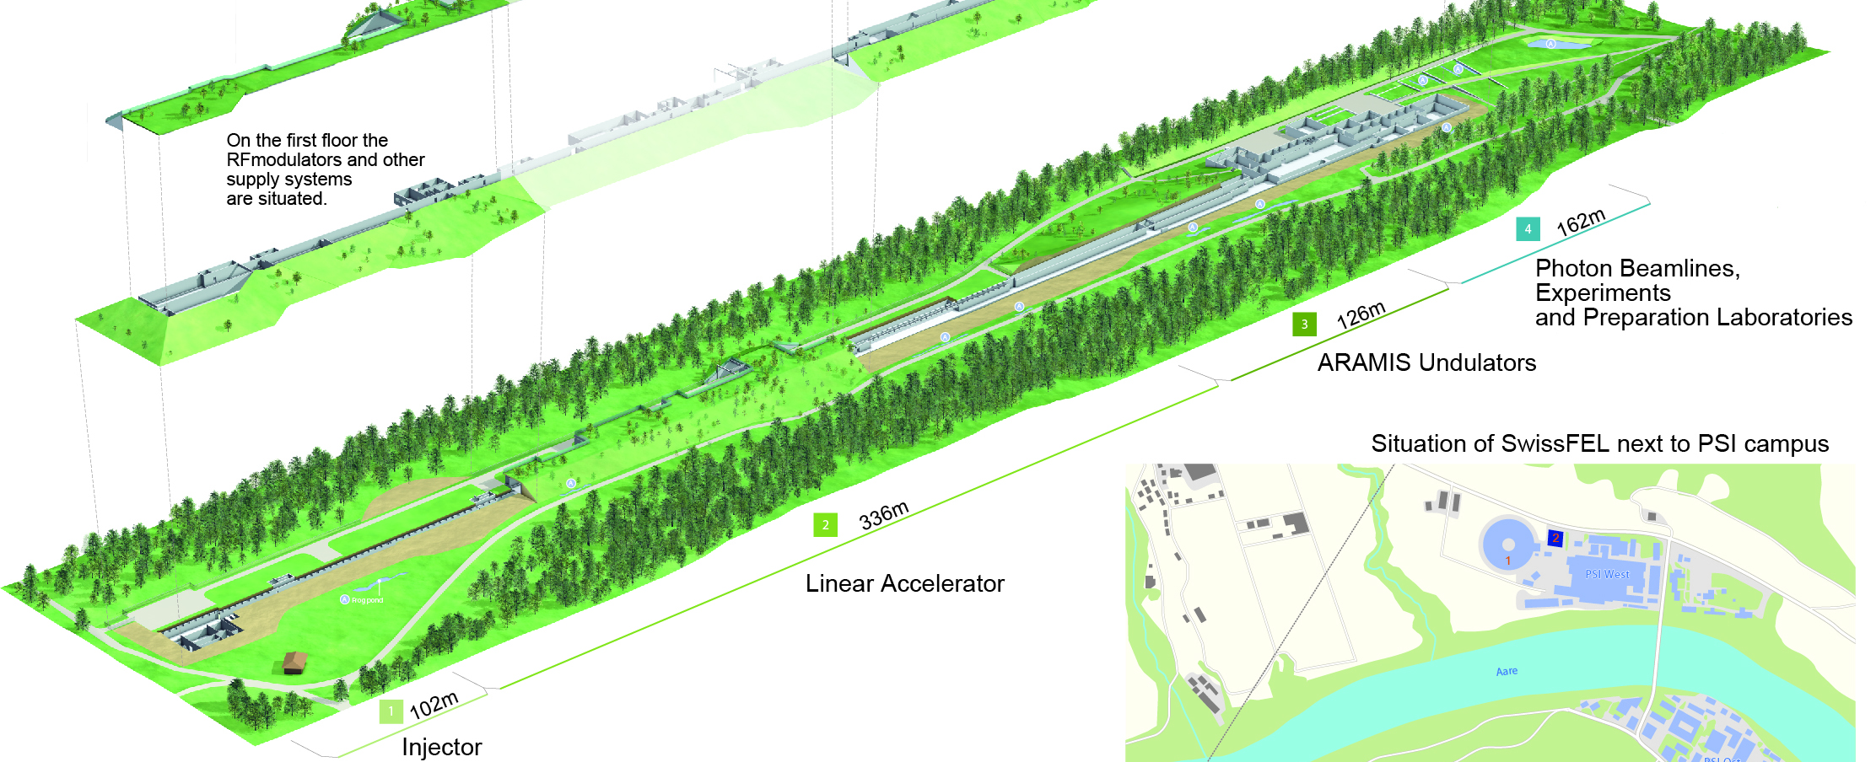
SwissFEL
1st phase 2013-16
2nd phase 2018-19?
Athos 0.7-7nm
Photocathode
RF gun
Linear accelerators
C-Band technology
user
stations
2.6-3.4 GeV
Injector
Linac 1
Linac 2
Linac 3
BC1 0.38 GeV
BC2 2.1 GeV
3.0 GeV
3.0-5.8 GeV
Aramis 0.1-0.7 nm
740m
SwissFEL parameters
Wavelength from 1 Å - 70 Å
Photon energy 0.2-12 keV
Pulse duration 1 fs - 20 fs
e⁻ Energy 5.8 GeV
Repetition rate 100 Hz

Slide 4
EEVR at PSI
EEVR functionality was developed in 2014 at PSI from protocol specification
Motivation
Standalone systems without possibility of installing a hardware EVR.
Some systems needed only limited timing functionality. 1 or 2 triggers for the FW or SW and the data buffer containing the machine pulse id was sufficient.
Some applications need a specific functionality not provided in the standard EVR.
Available as
VHDL component with TOSCA IF
EDK Pcore with PLB
Vivado IP Core with AXI Bus

Slide 5
EEVR current state

Slide 6
EEVR applications
The EEVR is used in various applications:
BPMs
LLRF system
photon diagnostics
experiments
The EEVR is used on different HW boards:

Slide 7
Strategies for code reuse and collaboration
Modular design
Source code for standard features provided by MRF
Source code for custom features provided by collaboration
Features selection by compilation parameters (generics)
EEVR - common VHDL components for all applications
Wrappers are tool dependent and contain bus interfaces
MGT is part of user application
MGT is FPGA dependent
MGT reference clock configuration is application dependent
Standardized interface between MGT and EEVR

Slide 8
Collaboration in action

Slide 9
Wir schaffen Wissen – heute für morgen
My thanks go to
Waldemar Koprek
Patric Bucher
Babak Kalantari

