Slide 1
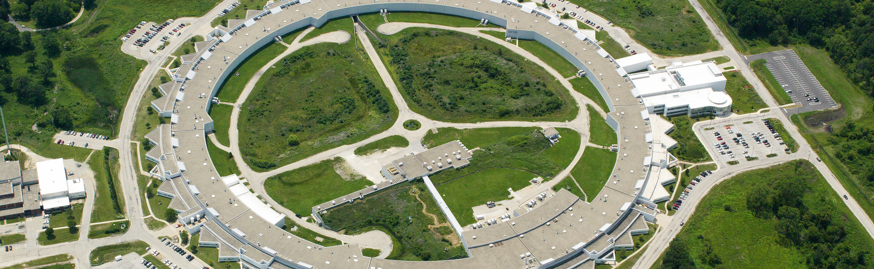

Welcome to the advanced photon source
www.aps.anl.gov
John MAclean
Associate Division Director
APS Engineering Support Division
Notes:
Welcome to the Argonne and the APS
Good to see a large turnout. Thanks you for coming. I hope you enjoy the meeting
I will tell how Argonne got started, what the lab and APS does today

Slide 2
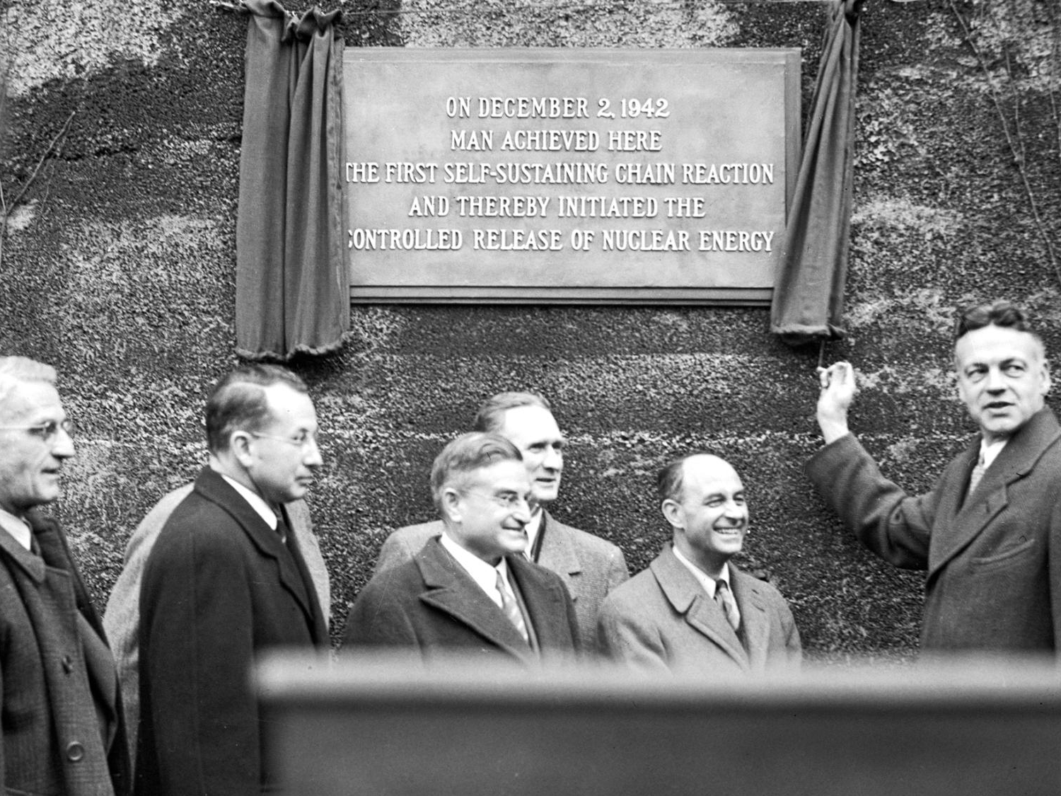
2
Notes:
Argonne National Laboratory was founded in 1946 as the direct outgrowth of Enrico Fermi's heroic work a few years earlier to build the first nuclear reactor. Argonne's first mission was to fulfill the enormous challenge of harnessing the energy of the atom to meet the needs of a growing nation.
First national lab in the country

Slide 3
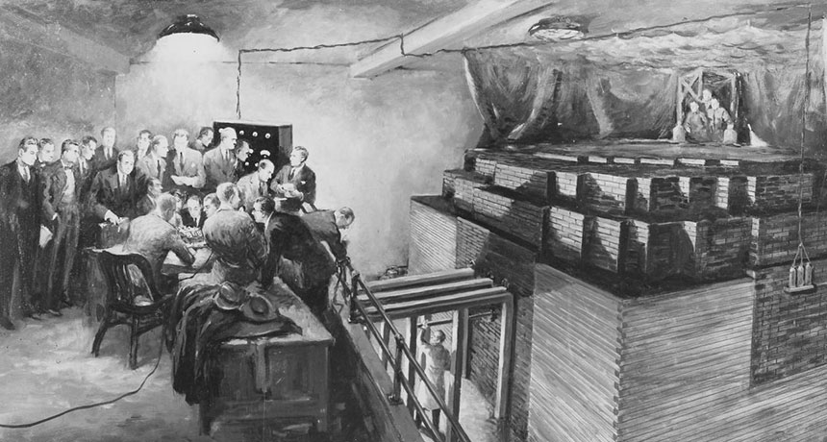
Notes:
Chicago pile 1 – first self sustaining chain reaction
In squash court, under the seats at UofC football field
No cameras – secret, so all we have are paintings, but..

Slide 4

STORY OF CHICAGO PILE-1 TOLD VIA LEGO ANIMATION
https://youtu.be/mTPiTJ2bKS0 or search for “chicago pile lego”

Slide 5


Slide 6
The Advanced Photon Source at Argonne supports the mission of the U.S. Department of Energy Office of Science by operating a technologically sophisticated, outstanding synchrotron radiation research facility that provides researchers in nearly every scientific discipline with high-brightness, high-energy, highly penetrating x-ray beams for studying the structure, chemistry, and behavior of the materials, both physical and biological, that comprise our world.
Notes:
The Advanced Photon Source is a national synchrotron X-ray user facility at Argonne. It was funded for construction and now for operation by the U.S. Department of Energy's Office of Science, and is managed by the Scientific User Facilities Division of the Basic Energy Sciences Program Office.

Slide 7
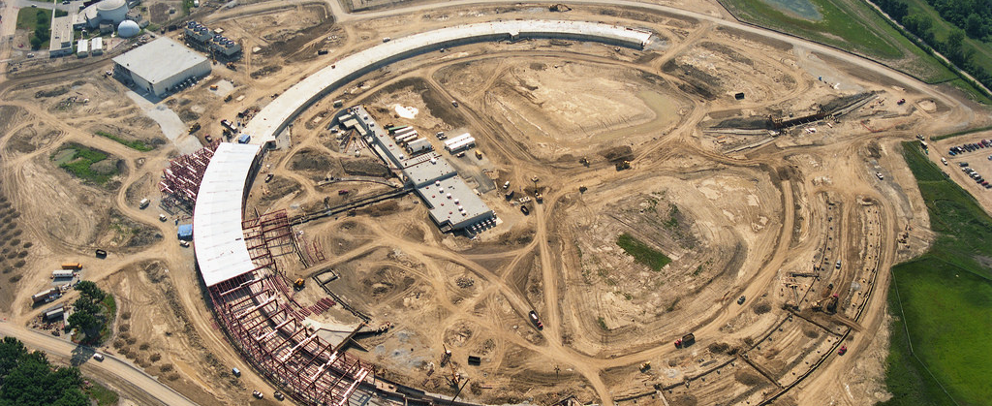
EPICS and APS histories intertwine
EPICS collaboration born when Marty Kraimer visited Los Alamos for 6 months in October 1989 to work on GTACS
2nd ever EPICS collaboration meeting held at APS in 1994
First ever meeting held in A5000 (executive meeting room)
EPICS collaboration is older than this building

Slide 8

Quick Facts about the Advanced Photon Source
66 Independent experiment stations – most running EPICS
More than 2,000 conventional electromagnets & 16 pulsed electromagnets
More than 700 electron beam-position monitors, 600 magnets, & 80 computer systems to monitor & correct beam orbit and steer x-ray beams onto experiment samples to micron-size tolerances
X-ray beam-position monitors to provide beam stability that is equivalent to firing a stream of bullets through the bull's-eye of a target from several miles away
More than 120 computers, monitoring more than 25,000 signals, for personnel protection systems
APS beam diagnostics that control 66 x-ray beams simultaneously
A control system of more than 450 IOCs + 155 soft IOCs, more than 10,000 replaceable hardware components, & over 100,000 I/O points monitoring or controlling more than 500,000 process variables

Slide 9
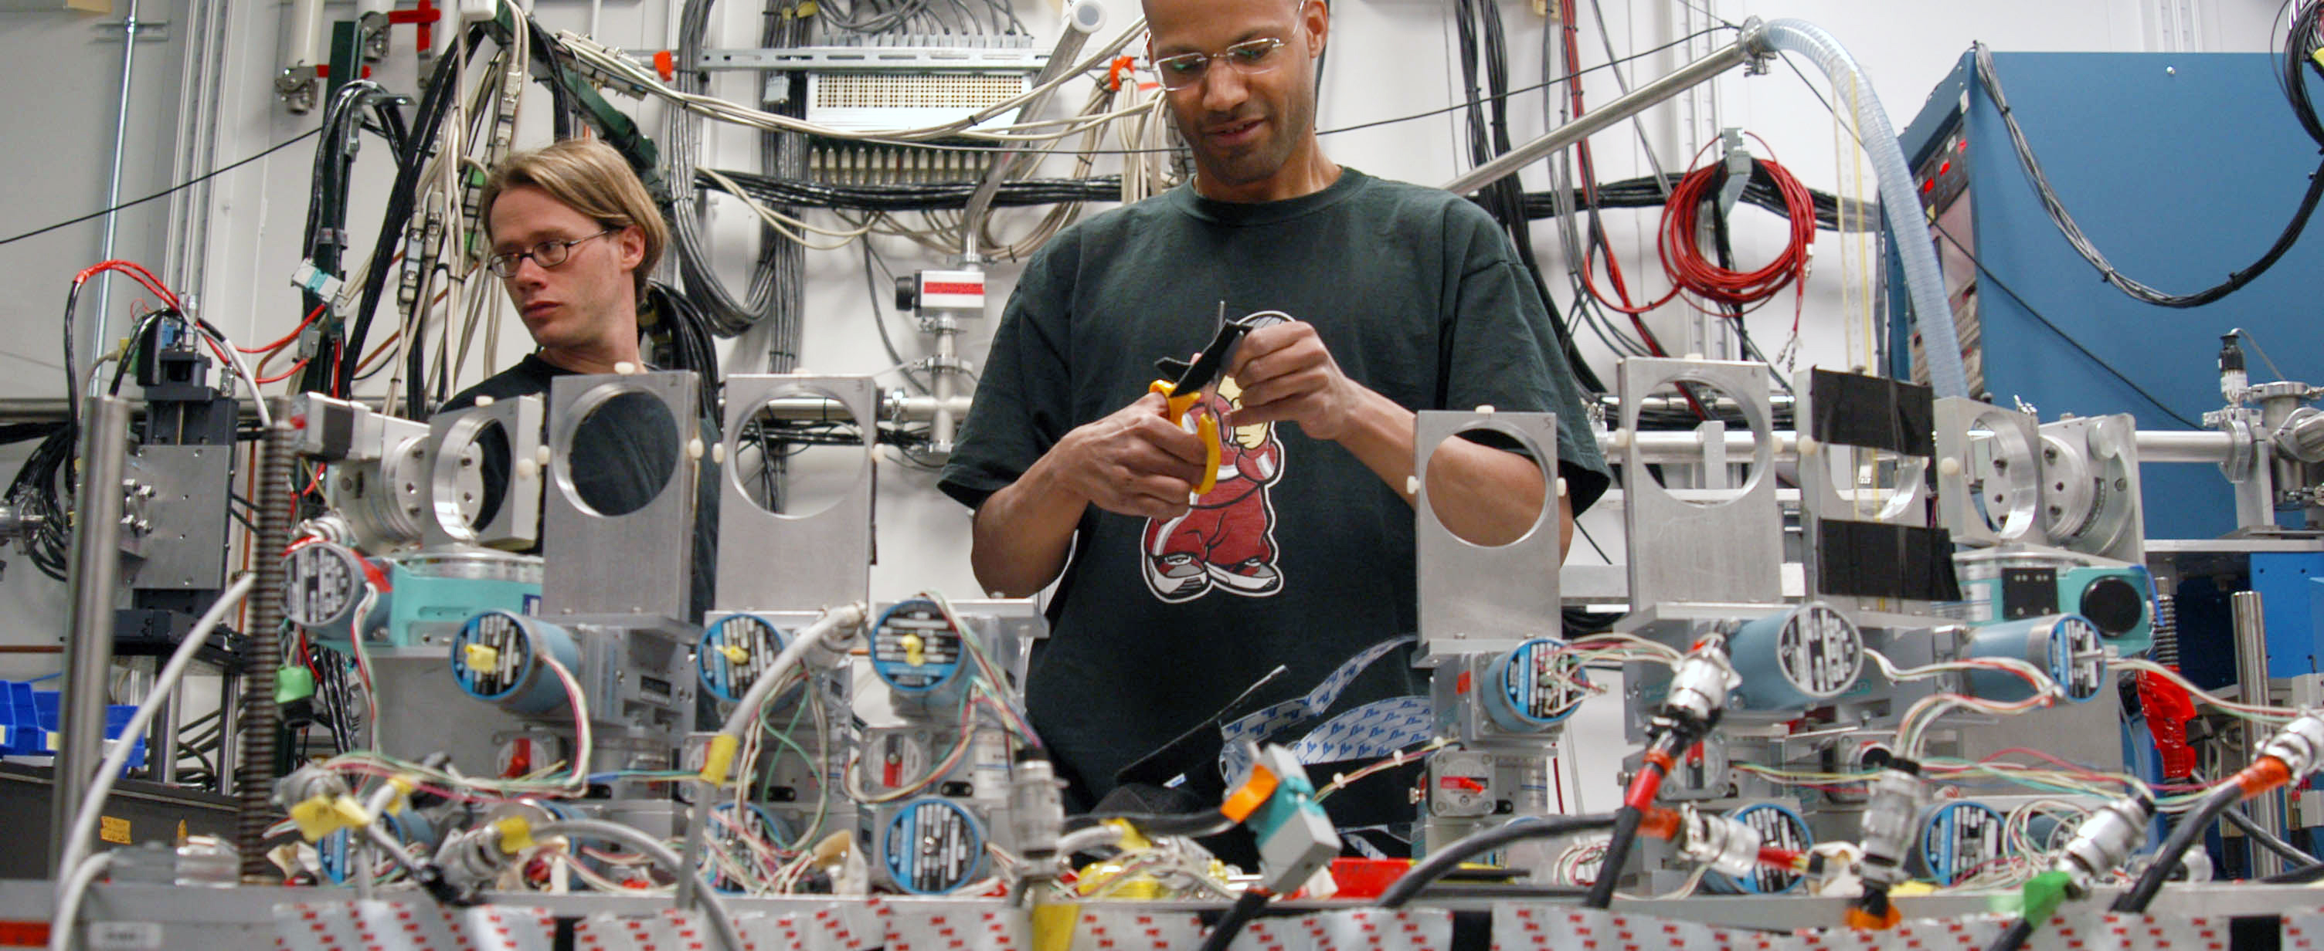
Advanced Photon Source
5300 researchers each year
Researchers come to the APS from:
50 states plus Puerto Rico and the District of Columbia
33 countries
150 companies
250 universities
Notes:
What is it?
The APS is a keystone for state-of-the-art scientific research that brings together experts from labs, academia, and industry. Opened in 1996, the APS is currently undergoing plans for an upgrade that will make it the brightest storage-ring-based X-ray source in the United States.
Why do we care?
The brighter the X-rays are the more detail they can capture, akin to the difference between using a pen light versus a floodlight. The upgrade will make the APS more coherent, which means the X-rays will be focused into smaller spaces so researchers can see even greater detail.
The vastly improved coherence afforded by the APS Upgrade will allow scientists to view the structure of systems and materials at extremely small scales under real conditions, which will increase our fundamental knowledge about ourselves and our world, and revolutionize the development of new materials, new technologies, and new pharmaceuticals.

Slide 10
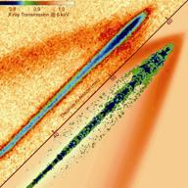
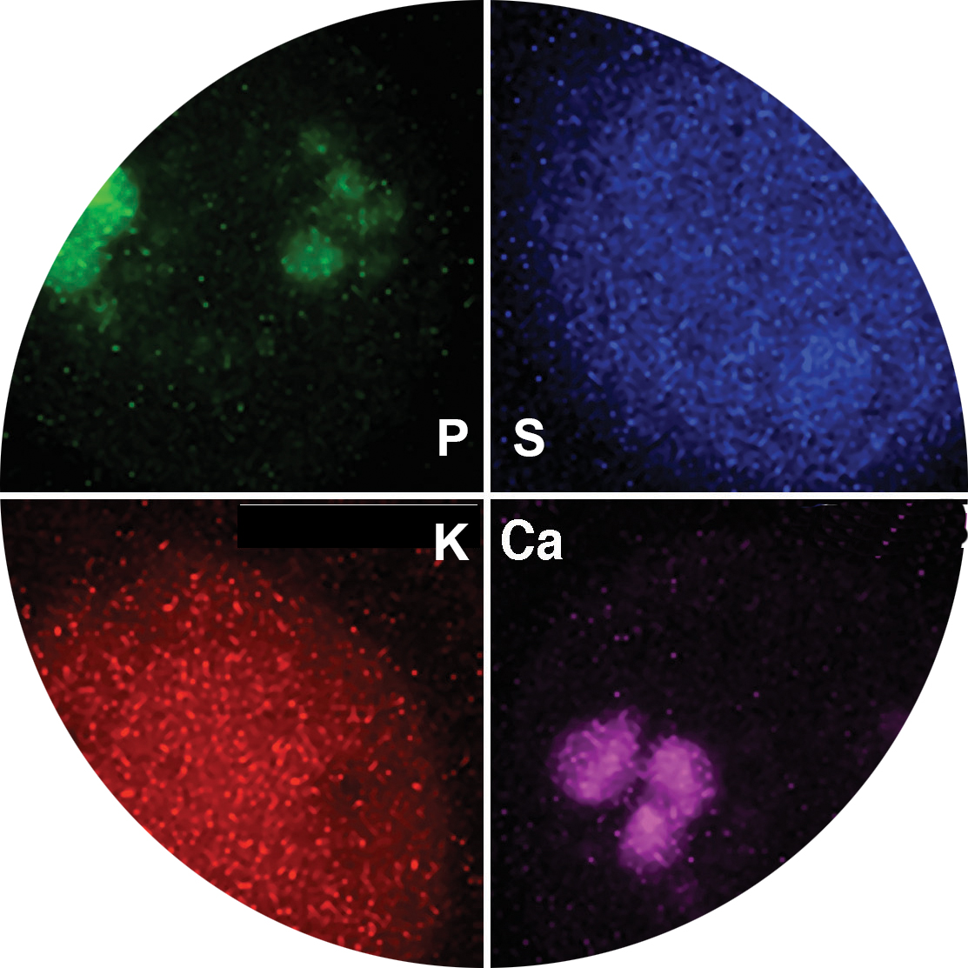
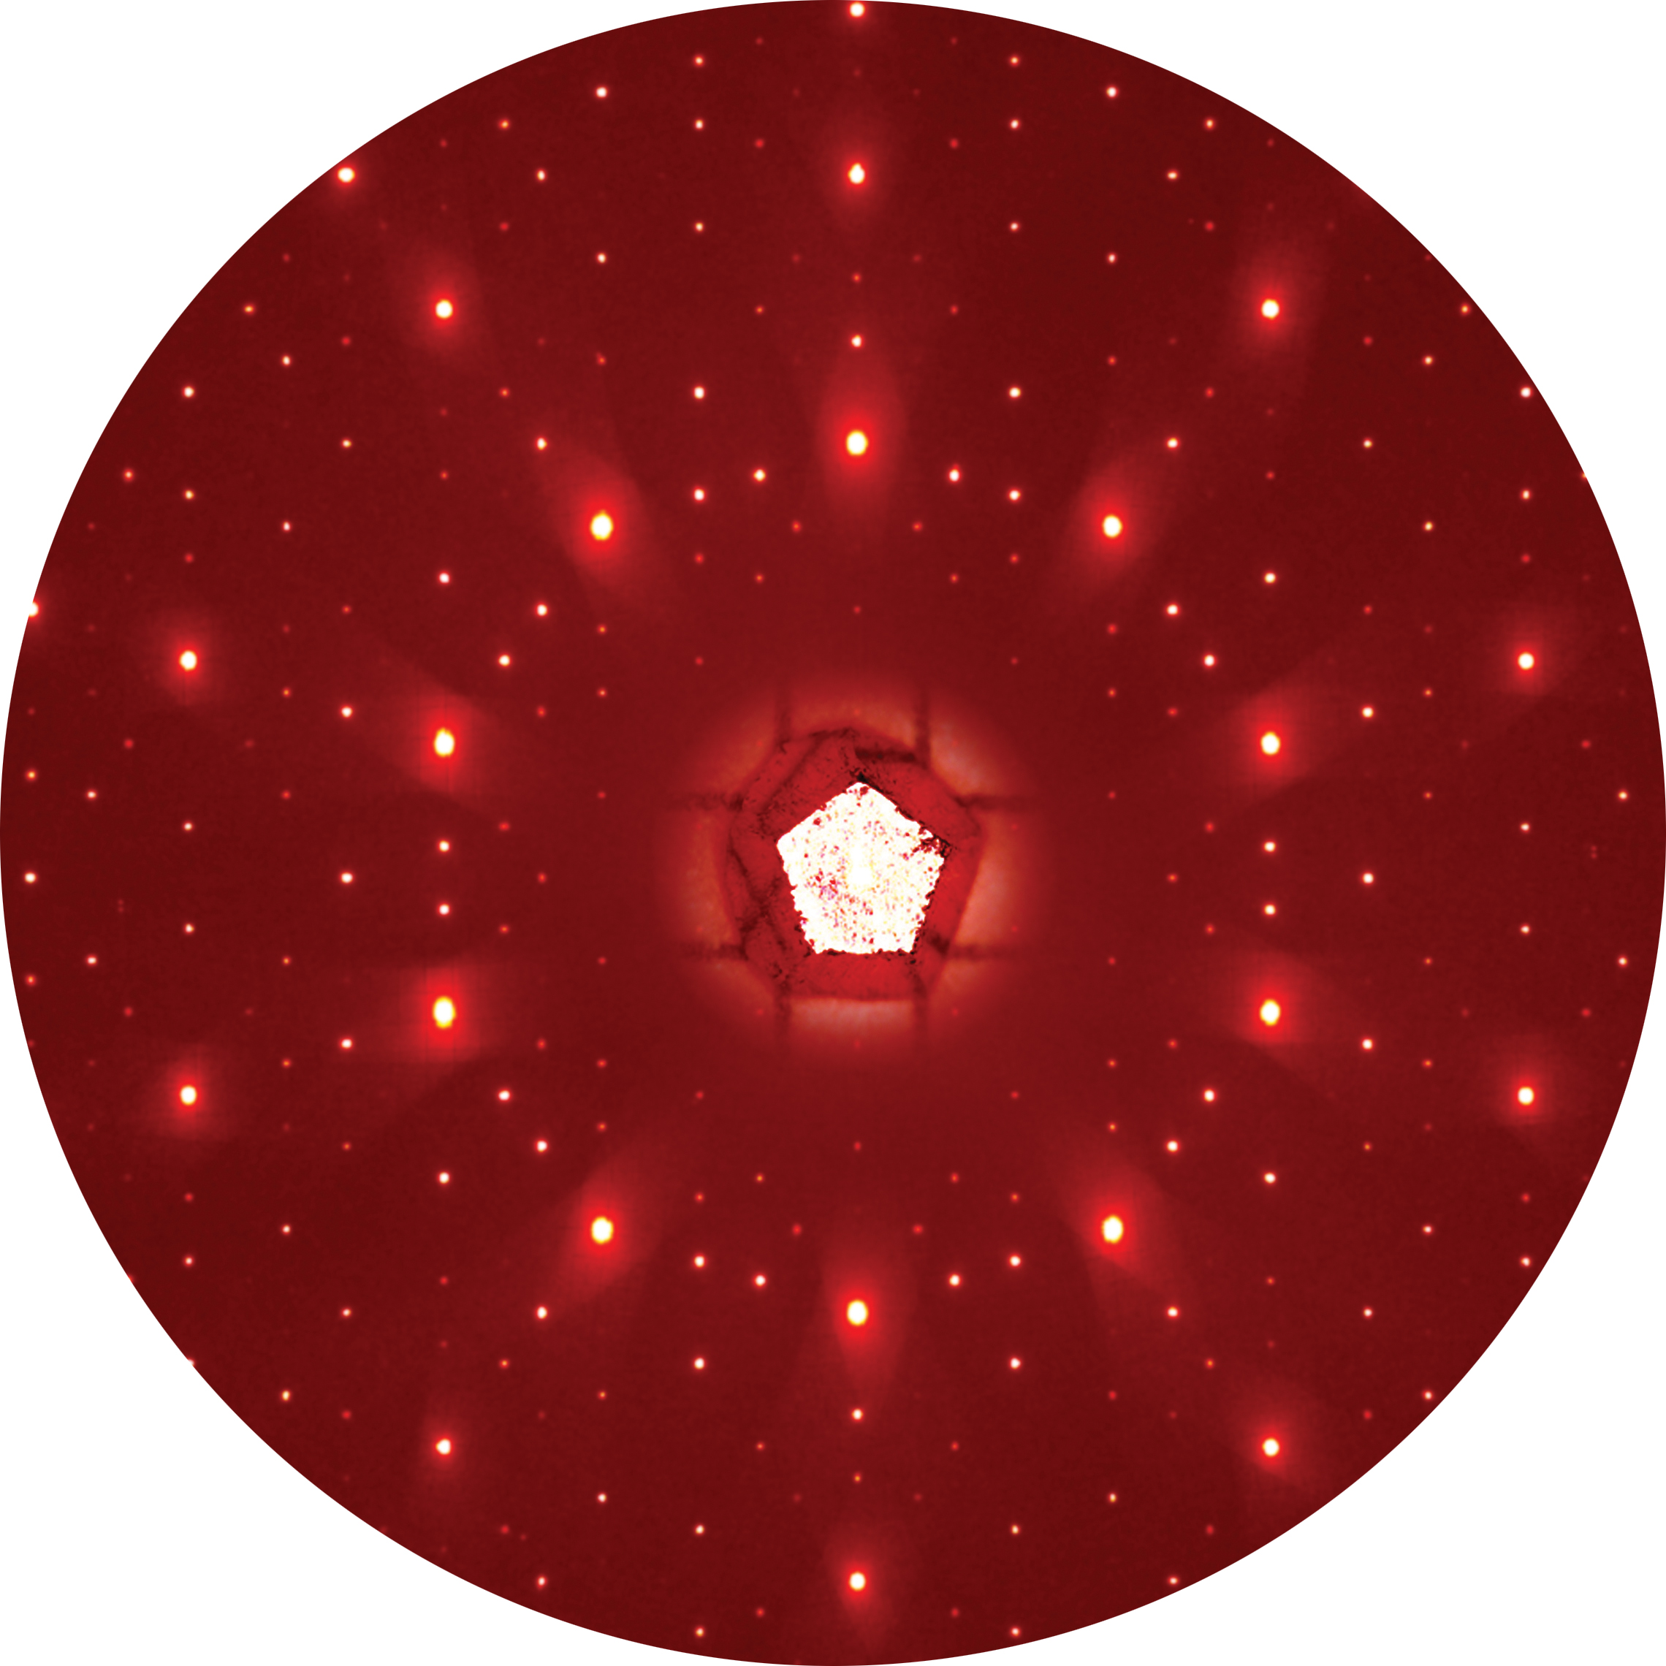
ADVANCED PHOTON SOURCE research –
THREE EXPERIMENT TYPES
A number of techniques can be combined to gain the deepest understanding of a material or a physical or biological system.
Results are increasingly multimodal and track changes as a sample evolves in time.
IMAGING
Spectroscopy
Scattering
A number of techniques can be combined to gain the deepest understanding of a material or a physical or biological system.
Results are increasingly multimodal and track changes as a sample evolves in time.
Notes:
Three main categories of experiment:
Spectroscopy is used to study the energies of particles that are emitted or absorbed by samples that are exposed to the light-source beam and is commonly used to determine the characteristics of chemical bonding and electron motion.
X-ray scattering techniques are a family of non-destructive analytical techniques that reveal information about the crystal structure, chemical composition, and physical properties of materials and thin films. These techniques are based on observing the scattered intensity of an X-ray beam hitting a sample as a function of incident and scattered angle, polarization, and wavelength or energy. Note that X-ray scattering is different from X-ray diffraction, which is widely used for X-ray crystallography.
X-ray imaging collects detailed information from about a sample through either full-field imaging, where the whole sample is illuminated, or scanning, where a small spot of X-rays is scanned across the sample. The high-brightness, high-energy X-rays from the APS allow researchers to image an extensive range of materials and sample thicknesses at extremely high resolution.
The strength of our research program comes from our integrated approach – studies at the APS almost always combine a number of these techniques to gain the most comprehensive understanding of a material or a physical or biological system.
IMAGES:
Spectroscopy: Figure: Data from X-ray fluorescence microscopy of the green alga Chlamydomonas reinhardtii. X-ray fluorescence maps reveal the elemental composition of the alga.
Imaging: Figure: The time evolution of transient fuel sprays from a high-pressure injector, capturing the propagation of spray-induced shock waves in a gaseous medium and revealing the complex nature of the spray hydrodynamics.
Scattering: Figure: A high-energy X-ray diffraction pattern from a single grain of icosahedral rare-earth-cadmium quasicrystal, taken with X-ray beam from the APS superconducting undulator at beamline 6-ID-D.

Slide 11
Advanced photon source – seeks answers to Big questions
What drives a material’s electrical and mechanical properties?
How are new physics revealing secrets of superconductors?
What are the keys to new pharmaceuticals?
How do we gain a complete understanding of plutonium?
What is the Earth’s core made of?
Why do battery electrodes degrade over time?
How do stresses and impurities alter a material’s durability?
Notes:
What are the big questions the APS helps us answer?
Research at the APS will answer big questions about the world we live in. Virtually every field of science is studied at the APS. – think biology, energy, medicine, materials, chemistry, physics, deep earth geology, and environmental science, to name a few.
Researchers use the APS to study the properties of metals, alloys, and large biological molecules like proteins, which make up every part of our bodies. By understanding how the structure of these materials determines their behavior, we hope to learn how to design new materials with new properties and build them one atom at a time, and how to design new pharmaceuticals to fight disease.

Slide 12
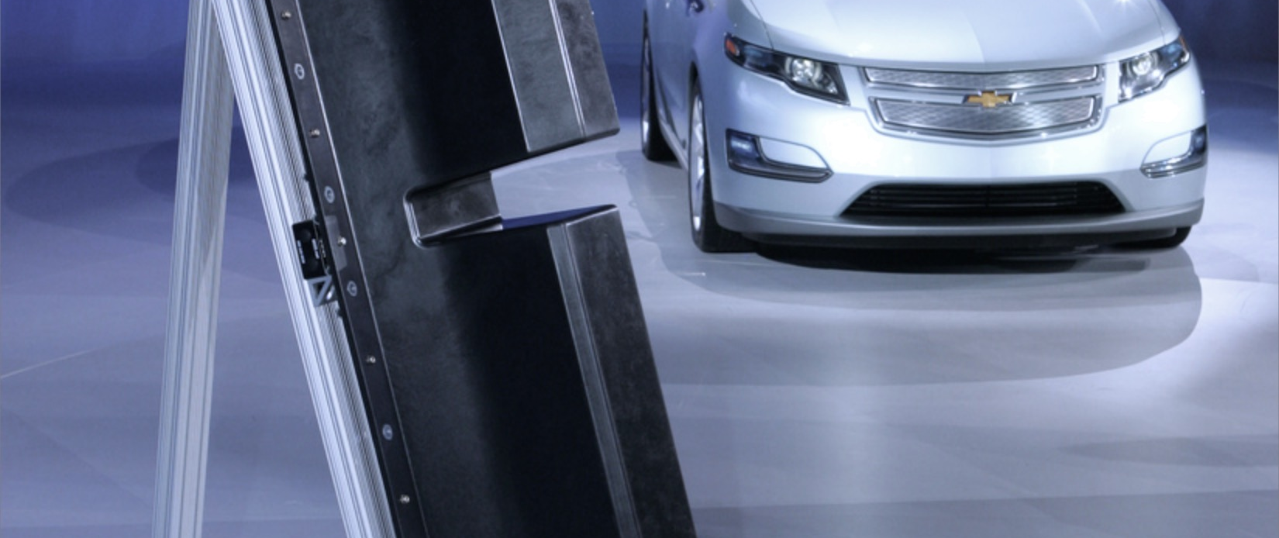
Argonne’s cathode technology in the Chevy Volt battery
APS research contributed to Argonne’s cathode technology in the Chevy Volt battery
50-100 percent increase in energy storage capacity over conventional cathode material
Longer operating time between charges
Longer battery lifetime
Improved safety
50-100% increase in capacity
over conventional cathode material
APS research gave critical information on
cathodes, chemistry in Li-ion batteries
Led to safer, longer-lasting, less expensive
batteries
Notes:
Notable research at the APS
Argonne materials scientists who developed the breakthrough materials technology that is used in the Chevy Volt battery conducted key parts of their research at the Advanced Photon Source.
X-ray analysis at the APS provided critical information on the cathode structures and chemical reactions in operating lithium-ion batteries. This research led to the development of manganese- and lithium-rich cathode materials that made the batteries safer, longer-lasting, and less expensive to manufacture.
In 2011, Argonne licensed the technology to battery manufacturer LG Chem to make and use the laboratory’s patented cathode material technology in lithium-ion battery cells.
Argonne-developed technology offers the longest-lasting energy available in the smallest, lightest package: a 50-100 percent increase in energy storage capacity over conventional cathode materials. Further, its unique lithium- and manganese-rich mixed-metal oxide combination extends the operating time between charges, increases the calendar life and improves the inherent safety of lithium-ion cells.
The cathode material is used in the LG Chem manufactured battery cell that powers the Chevrolet Volt plug-in hybrid car, the first mass-produced plug-in electric vehicle. This material is just one component of Argonne’s sizable suite of patented lithium-ion battery technologies.

Slide 13
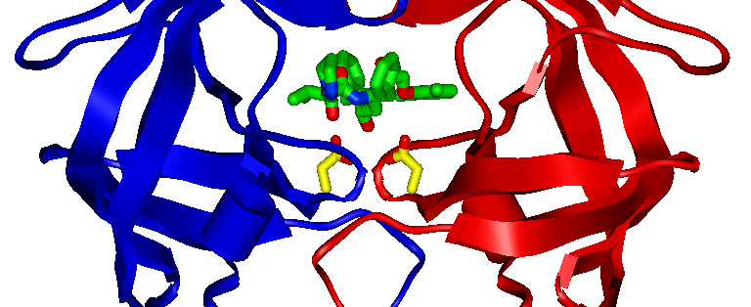
ABBOTT LABS’ KALETRA
World-leading drug to fight AIDS
Atomic-resolution structural research of HIV-drug interactions at APS
Notes:
Notable research at the APS
Structural studies of a portion of the HIV virus helped Abbott Labs develop Kaletra, a world-leading drug to fight AIDS
Kaletra is currently the most prescribed drug in its class for AIDS therapy.
Abbott researchers knew that creating an effective anti-HIV drug requires precise design: The drug must be highly target-specific so that it impacts only the point where the drug can be most effective. Also important are the lock-and-key requirements for drug designers. The news drug's molecular structure must lock tightly to the particular structure of the target molecule, while being flexible enough to accommodate changes in that structure. Using the powerful X-rays at the Advanced Photon Source, researchers found the points of attack of the HIV protease inhibitors, biochemical agents that stop HIV from making new copies of itself by blocking the last step in the process, when the virus attempts to replicate.
The image shows a ribbon diagram of a 99-amino acid protein from the HIV virus called HIV protease. Two identical polymer chains of the protein have a crystallographic 2-fold symmetry relationship, and are represented by blue and red ribbons. The drug molecule, Kaletra®, shown in green, is an organic compound that fits inside of the protein and “plugs a hole” that the virus needs to replicate. Two amino acids of high importance in drug binding to the protein are shown in yellow.

Slide 14
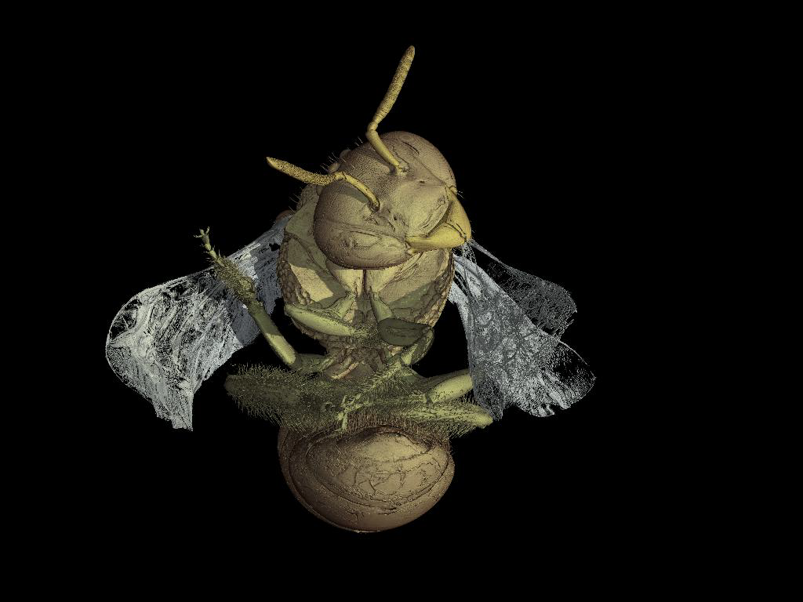
Micro Tomography
Courtesy of Carmen Soriano Hoyuelos
Notes:
bee is from Dominican amber (30 million years old) from the AMNH. American Museum of Natural History

Slide 15

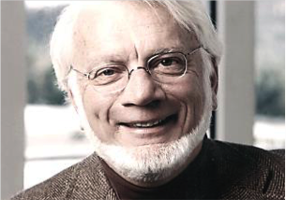

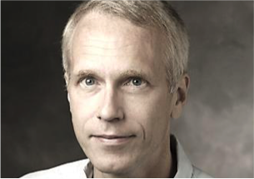

Nobel-Prize winning RESEARCH AT THE APS
 |  |  | 2009 Nobel Prize in Chemistry Structure and function of the ribosome
Ada Yonath Weizmann Institute of Science, Israel | Thomas Steitz Yale University, U.S. | Venkatraman Ramakrishnan MRC Laboratory of Molecular Biology, U.K.
 | 2012 Nobel Prize in Chemistry Studies of G-protein-coupled receptors (GPCRs)
 |  | Brian K. Kobilka Stanford University, U.S. | Robert J. Lefkowitz Duke University, U.S.
Important discoveries about human physiology and clues to new pharmaceuticals to combat disease
Notes:
Nobel-winning research at the APS
Top: All three recipients of the 2009 Nobel Prize in Chemistry published papers on their award-winning work based on data collected at Argonne's Advanced Photon Source.
Between them, biochemists Thomas Steitz of Yale University, Ada Yonath of Israel's Weizmann Institute, and Venkatraman Ramakrishnan of Cambridge, England's Medical Research Center have published more than 60 papers that describe research performed at the APS. The three shared the award for their study of the structure and function of the ribosome.
Argonne was the first place where scientists could visualize this extraordinarily complex combination of macromolecules at the atomic level.
The ribosome works as a protein factory in all organisms from humans to bacteria. As genetic material carrying the code for the protein sequence – messenger ribonucleic acid (mRNA) – passes through the ribosome, transfer RNAs bring a chain of amino acids to the ribosome, creating a protein, which in turn facilitates the vast majority of biochemical processes within the organism.
The X-ray beamlines at the APS were especially suited to the Nobel-winning work because they allowed the researchers to focus their beams to a very small diameter, enabling them to view the assembly's subunits with much finer detail than ever before.
The improved knowledge of the structure and function of the ribosome — especially in bacteria — has opened up a new avenue of medical research as scientists try to identify antibiotics that can interfere with bacterial protein synthesis. This is one of the most important processes that occurs within the cell, and the work done at Argonne provided one of the first opportunities for scientists to truly look 'under the hood' at the biochemical mechanisms that underpin it.
Bottom: Much of the research that led to the 2012 Nobel Prize in Chemistry was conducted at the Advanced Photon Source. The research focused on G-protein-coupled receptors (GPCRs).
GPCRs are a large set of proteins embedded in a cell’s membrane that sense molecules outside the cell and activate a cascade of different cellular processes in response, including breathing and dilating of arteries.
Nearly half of today’s pharmaceuticals work by connecting with many of the 800 or so GCPRs. But this requires knowing exactly how these proteins work and are structured, which is difficult because the long, slender protein chains are folded in an intricate pattern that threads in and out of the cell’s membrane.
Nearly all of the Nobel Prize-winning X-ray research done to unravel and identify how GPCRs work was done at the APS because the scientists needed an X-ray beam that was very stable, intense, and focused to a small spot. This work included discovering the first structure of a human GPCR and, later, the first study of a GPCR in the process of sending signals to activate cellular response.
These studies represent a huge leap forward in understanding how cells work at the molecular level, lay the groundwork for new therapies, and open up new frontiers in biology.

Slide 16
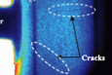
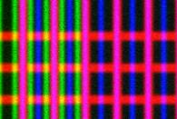
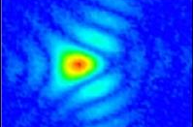
Aps upgrade: the ultimate 3d microscope
A next-generation synchrotron light source for science and industry
High Energy
Penetrating bulk materials
and operating systems
Brightness
Providing time-resolved, macroscopic
fields of view with nm-scale resolution
100 nm
CuAsW
Coherence
Enabling highest spatial resolution
even in non-periodic materials
Notes:
What is the APS Upgrade?
Summary: APS-U opens frontiers inaccessible with today’s instruments
HIGH ENERGY:
World’s brightest source of hard X-rays
3D mapping, deep inside samples
X-ray cinematography in previously inaccessible regimes
BRIGHTNESS
Multi-scale imaging – connecting nanometer features across macroscopic dimensions
Fast sampling with chemical, magnetic, electronic sensitivity
COHERENCE
Extends lensless imaging to hard X-ray domain, with resolution down to <1 nm, localizing atoms
Increases phase contrast for fast full field imaging
Correlation methods improve by 10,000-1,000,000x

Slide 17
Thank you.
www.anl.gov

