Slide 1
Conference Logistics
June 2018 EPICS Collaboration Meeting
drhgfdjhngngfmhgmghmghjmghfmf
Andrew Johnson
Meeting Organizer
June 13, 2018
APS Conference Center, Argonne National Laboratory

Slide 2
Outline
The mostly boring but necessary stuff
Safety, Driving, Site Access
Where/How can I …
Agenda
Sponsors

Slide 3
Safety, Driving, Site Access

Slide 4
In an Emergency, Dial 911
911 calls from a Laboratory phone are answered by the Argonne Fire Department
From a US mobile phone, dial 1-630-252-1911

Slide 5
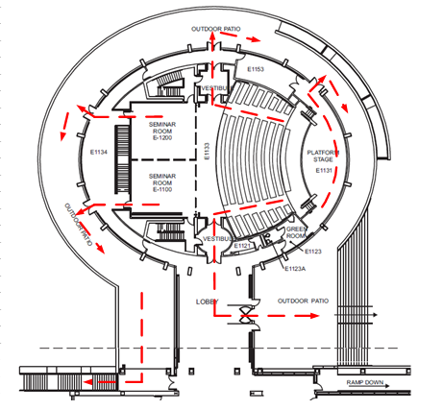
Emergency Evacuation
If told to leave the building
Follow the red arrows to exit the building

Slide 6
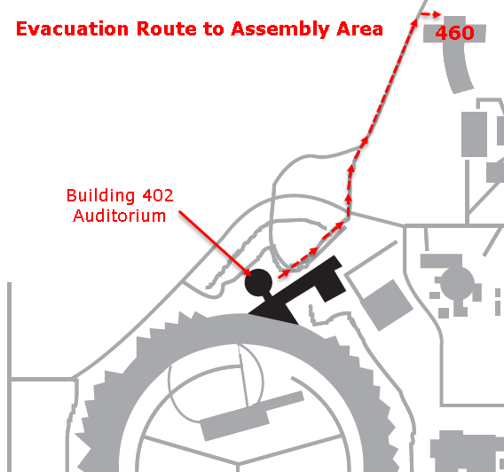
Evacuation Assembly Area
Where to go?
Proceed North-Eastwards along the roadway to the Building 460 (Guest House) parking lot.

Slide 7
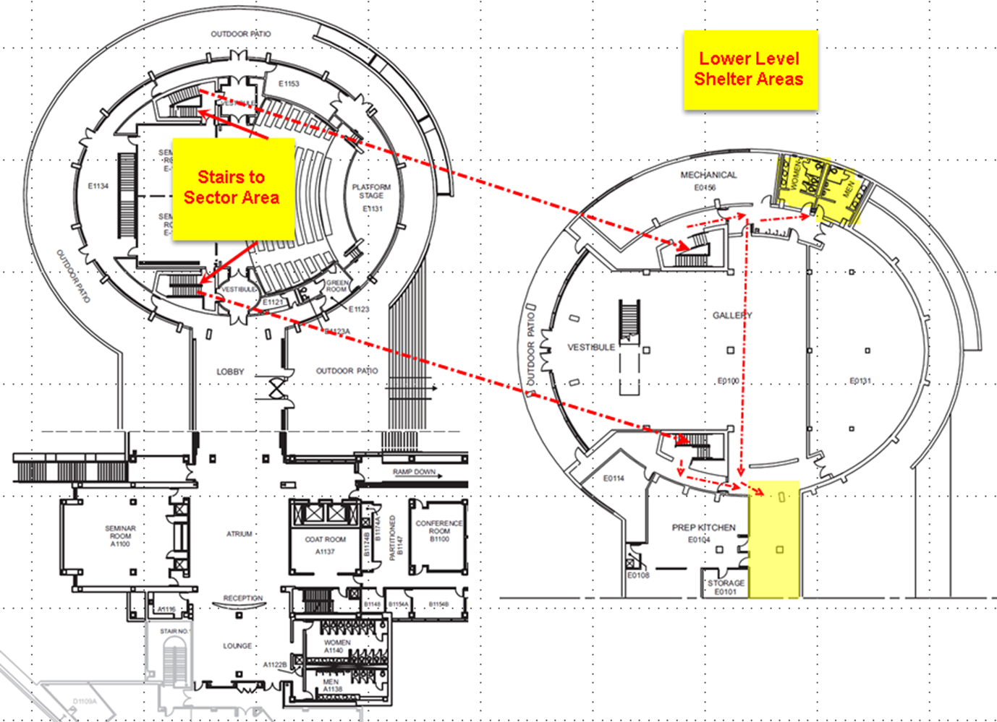
Tornado Shelters (Downstairs)
Some building alarms may direct you to a tornado shelter

Slide 8
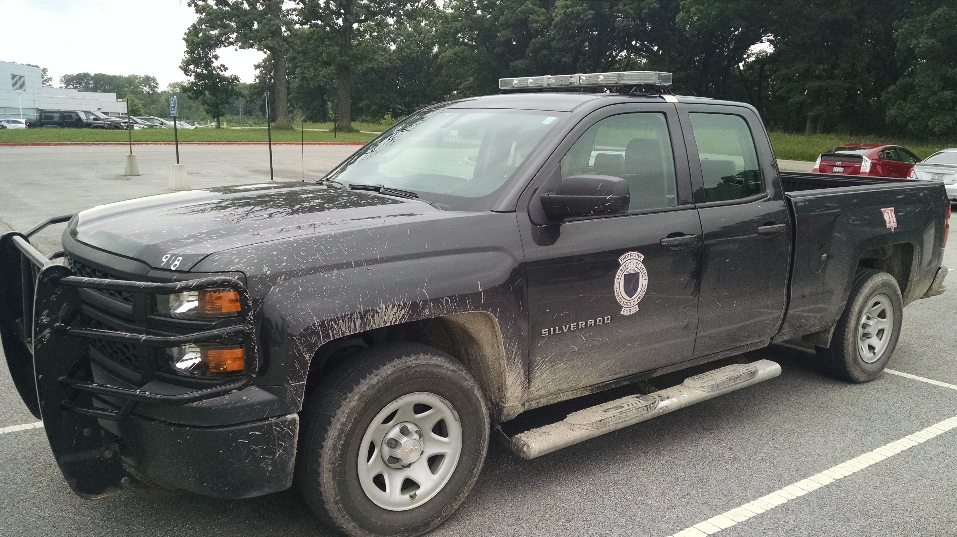
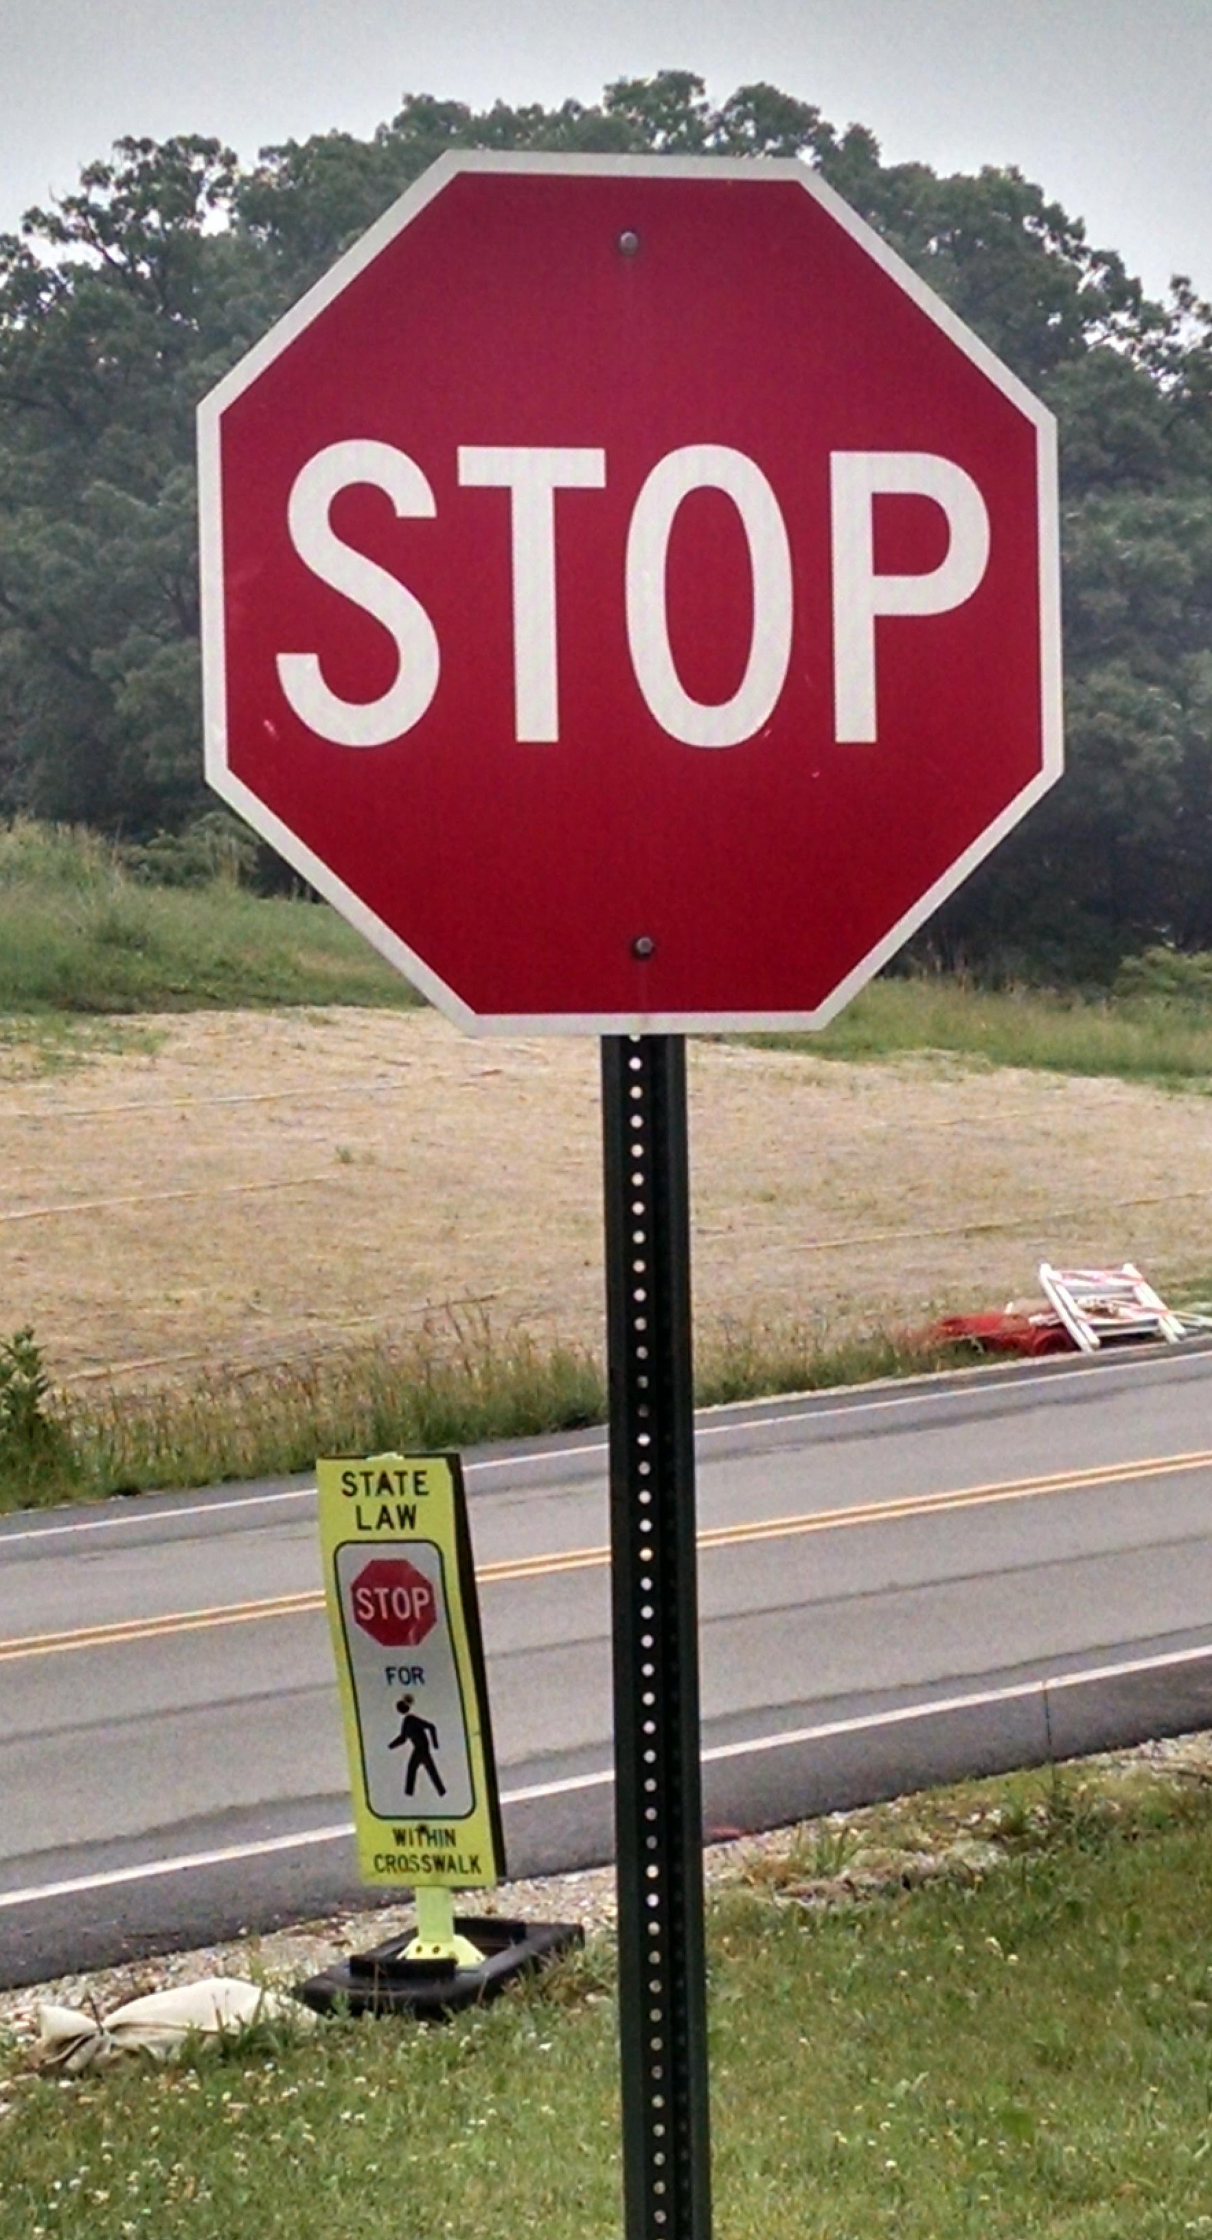
Driving at Argonne
Driving on site is a privilege, not a right
The Argonne Protective Force enforce the Illinois’ Rules of the Road on site
The site speed limit is 30 mph but in some places it is lower
The speed limit through security gates is 15 mph
Stop signs mean come to a complete STOP
No using mobile phones while driving, even with hands-free
Helmets are required for all cyclists and motor-cyclists

Slide 9
Site Access
Don’t get me in trouble!
Visitors: US Department of Energy Rules
I am your host while you’re on-site
You are only allowed to visit:
Buildings 401 & 402 (Conference center), 460 (Guesthouse)
Building 213 Cafeteria
Roadways and outside footpaths that aren’t fenced off or signed
Please:
Don’t go into other buildings unescorted
Talk about subjects that might be Classified
Try to bring prohibited articles onto the site
Firearms, weapons, explosives
Radioactive sources
Open containers of alcohol, illegal drugs
Pets
All vehicles are subject to search

Slide 10
Where/How can I …

Slide 11
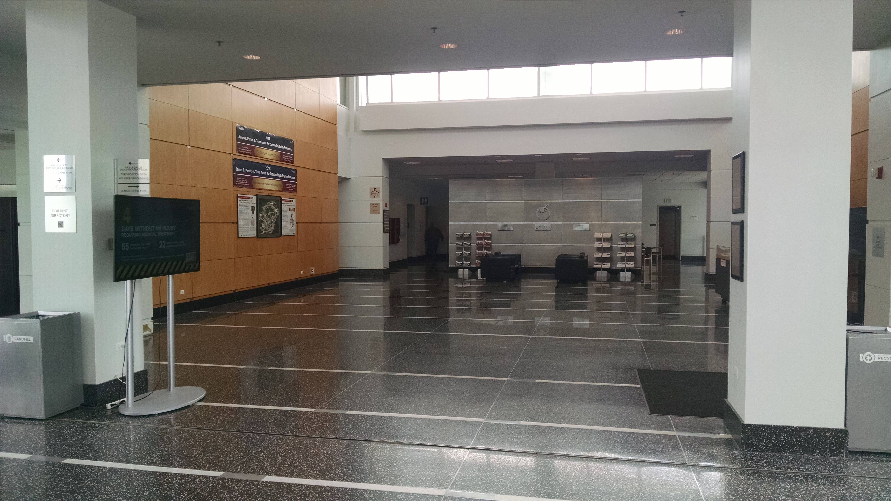
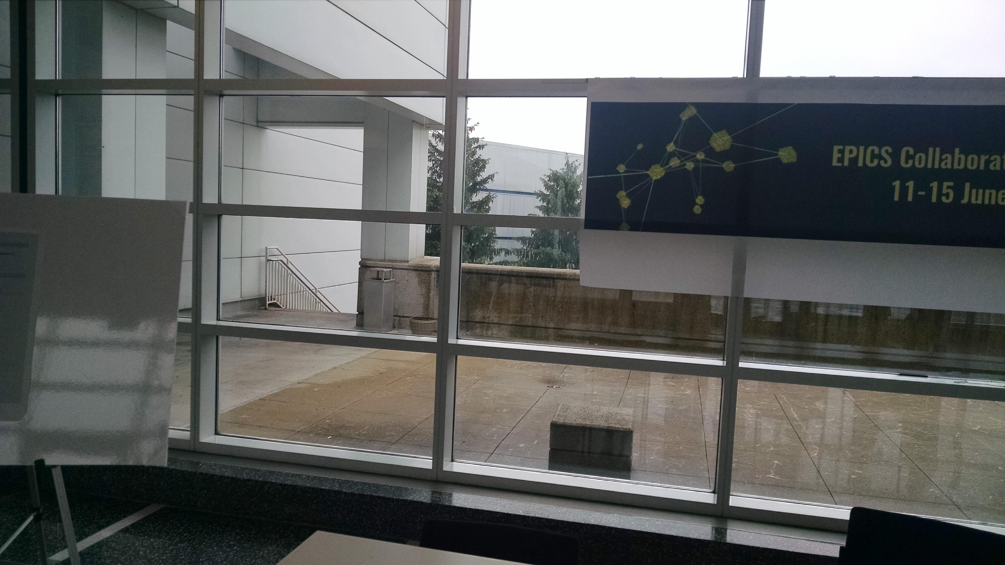
Where can I …
Finding relief
Restrooms are in the opposite corner of the lobby
Smoking is allowed outside on the patio at the back of the lobby

Slide 12
Argonne Network Access
The usual WiFi Dance
Connect to network “Argonne-guest”
Type “example.com” into your browser’s address bar
Read the page that comes up, click “I agree”
Fill out the form
This is the 402 APS Conference Center
You are at the EPICS Meeting
Select “This week only”
Submit form
Don’t usually need to reboot, just turn your WiFi off and on again, reconnect
There are several Apple Mac’s in the “APS User Lounge” near the restrooms which you are also welcome to use for network access

Slide 13
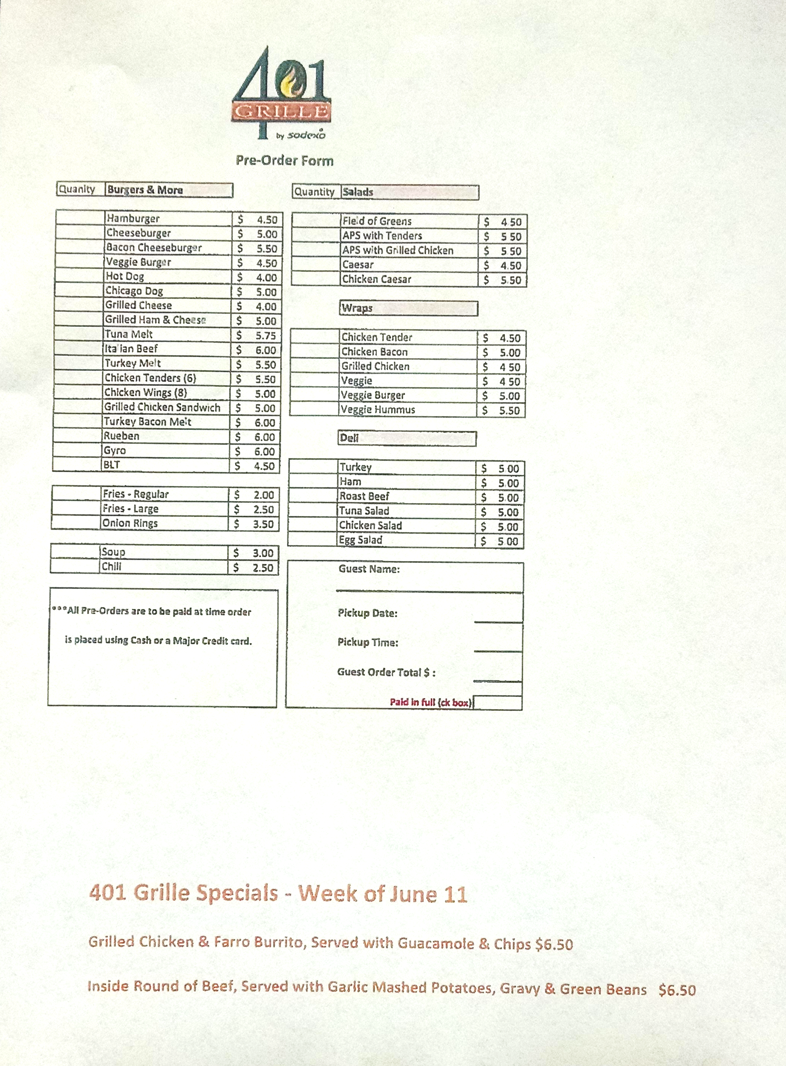
Options for Lunch
401 Grille, downstairs
Order ahead (by 11am) for quicker service
Seating available in the adjacent Gallery
Guesthouse restaurant
Table service, nice food, alcohol
A bit more expensive
213 Cafeteria
Widest choice of food
A 10-15 minute walk

Slide 14
Agenda

Slide 15
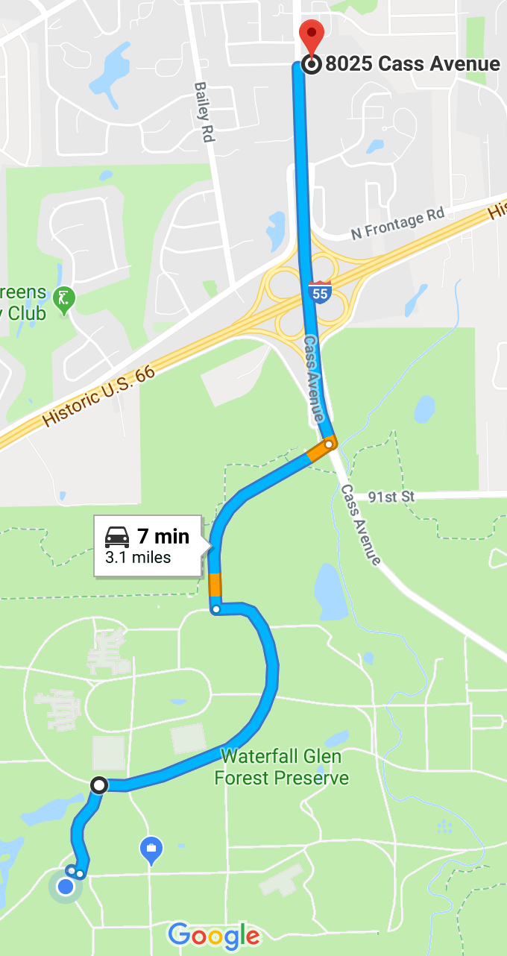
Registration, Conference Dinner
Registration desk hours are limited, final closing tomorrow morning
Conference dinner
Doors open at 6pm for drinks
Free drink tickets were funded by Bob Dalesio, Osprey DCS
Food served at 7pm, “family style”
Extra tickets can still be purchased at $30 each from the registration desk until it closes after lunch today
Please work out how you will get to the restaurant, share rides etc.
Chuck’s/Chateau Orleans Banquets 8025 Cass Avenue, Darien, IL

Slide 16
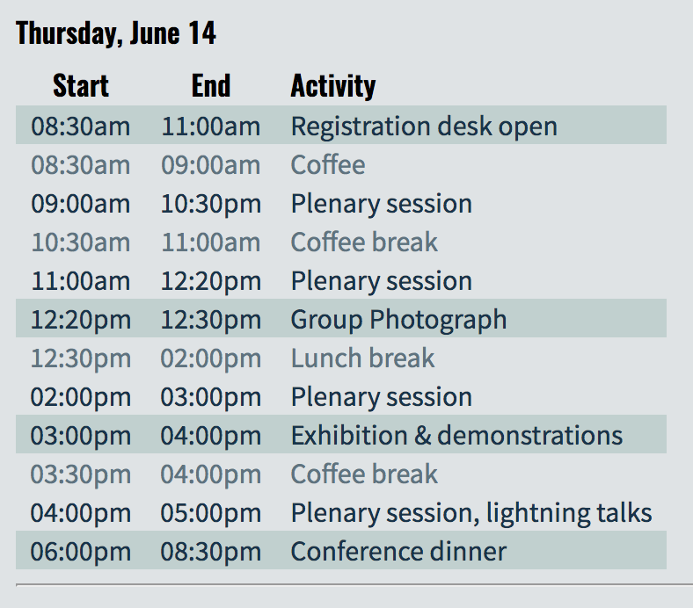
Photo, Exhibition and Demonstrations
“This must be Thursday, I never could get the hang of Thursdays”
Tomorrow coffee and refreshments will be set up downstairs in the Gallery
The group photo will be taken at the end of the morning plenary session
Outside if it’s dry
On this stage if wet
An extended afternoon break gives time to talk to exhibitors and sponsors, and watch live EPICS demonstrations
Other demonstrations welcome!

Slide 17
Lightning Talks
Be warned – be prepared!
Both sessions today and tomorrow from 4-5pm are for lightning talks only
11 talks, each speaker gets an absolute maximum of 5 minutes
No time for audience questions, talk to the speaker later
The order of talks will be different than published
Announced at the beginning of the session
Recommendations to speakers
Don't include too many slides
Practice with a stopwatch/timer beforehand
Upload talks and use the podium laptop
If you use your own laptop, setup and tech time come out of your 5 min’s
Next speaker should be ready to go immediately (your 5 minutes)

Slide 18
Sponsors

Slide 19
Gold Sponsor

Slide 20
Silver Sponsors

Slide 21
Thanks for coming!

