Slide 1
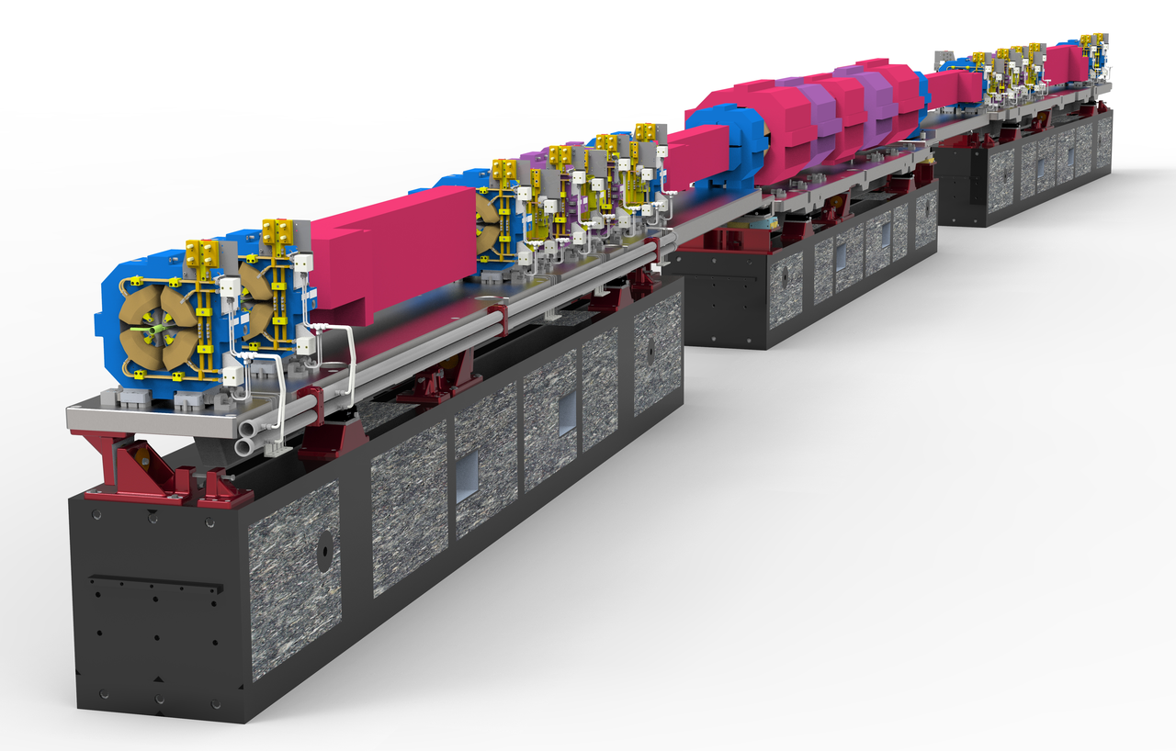
The APS Upgrade
John Carwardine
APS Upgrade
Deputy Associate Project Manager - Accelerator
Argonne National Laboratory
June 13, 2018
Notes:
Univ of Chicago Review, Aug. 30, 2010
1

Slide 2
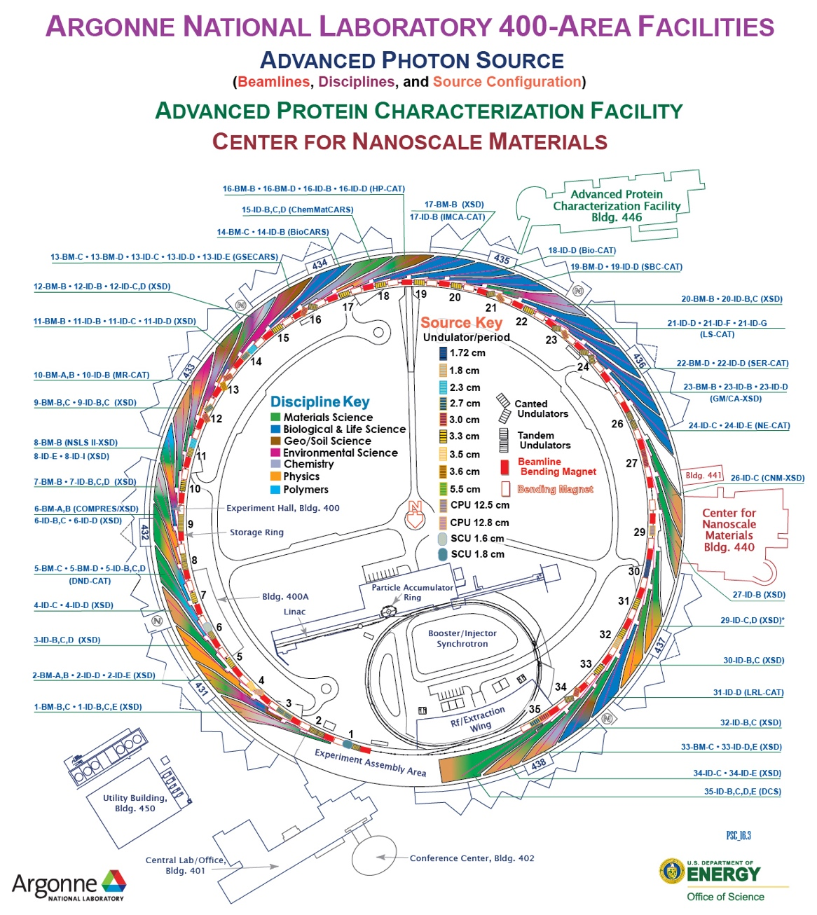
The Advanced Photon Source: BES’s largest user facility
APS is an xray microscope
  In operation since 1995
  7 GeV electron synchrotron
  1104m circumference
  Hard xrays: 1KeV – 100KeV
68 simultaneously operating end stations
5000 operating hours/year, 98% availability
FY17: 5700 unique users, 700 institutions
FY17 operating budget: $134M
The APS Upgrade (J. Carwardine) - EPICS Collaboration Meeting, June 2018

Slide 3
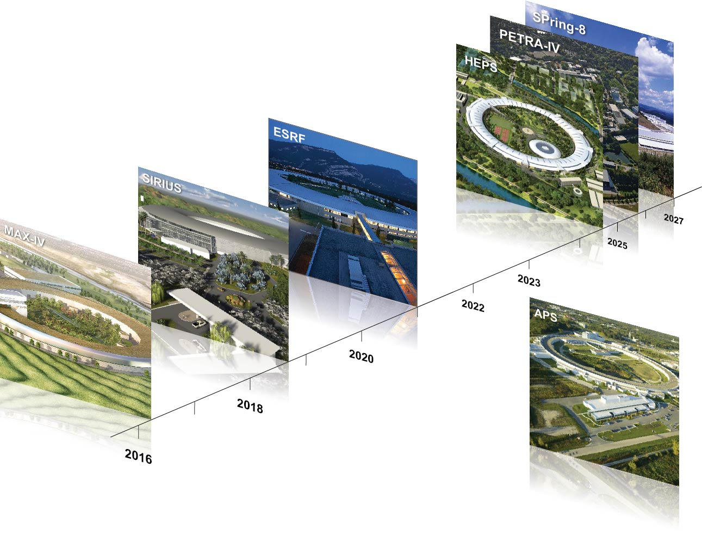
To stand still is to lose ground
HEPS (China)
Greenfield accelerator facility to be built near Beijing; planned completion ~2025
  The push now is for higher brightness and transverse coherence, smaller spot sizes
SPring-8 (Japan)
Upgrading
in 2027 timeframe
  ESRF (France)
  second phase of upgrade incorporates MBA lattice; plans to resume operation in 2020, complete 4 state-of-the-art beamlines by 2022
APS-U
Resume operation
in 2023
MAX-IV (Sweden)
Inauguration June 2016; in operation
The APS Upgrade (J. Carwardine) - EPICS Collaboration Meeting, June 2018

Slide 4
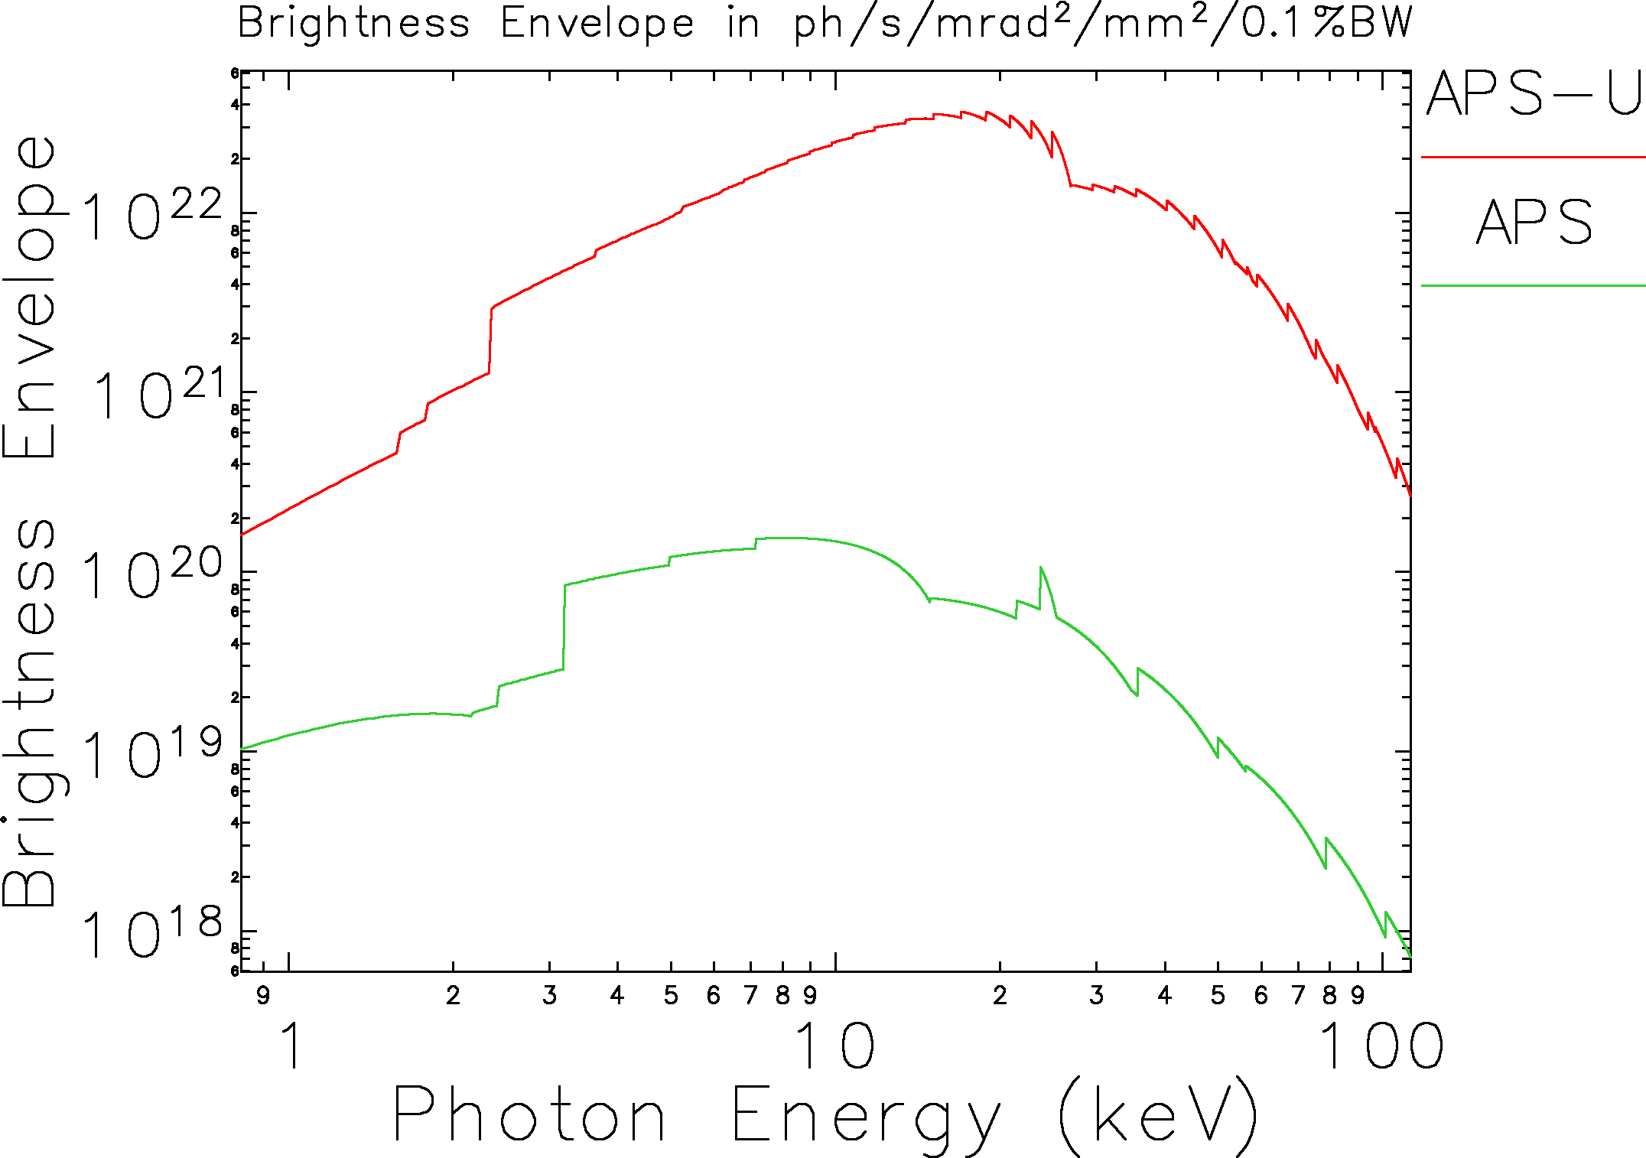
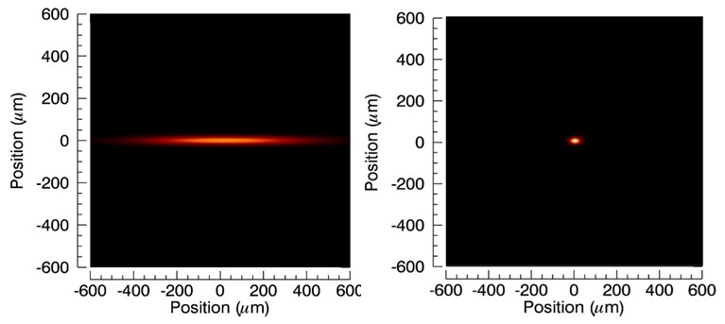
Brightness and coherence scale inversely with emittance
Reducing emittance from 3100 pm-rad (APS) to 42 pm-rad (APS-U)
⇒ 2 orders of magnitude higher brightness and transverse coherence
⇒ smaller spot size for microprobes
⇒ round beams
⇒ New science capabilities
The APS Upgrade (J. Carwardine) - EPICS Collaboration Meeting, June 2018

Slide 5
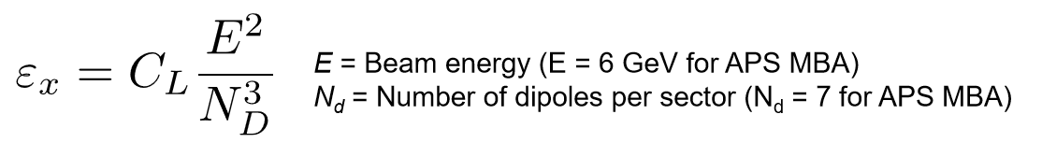
Emittance scaling
APS - 7 GeV, 2-bend lattice
~70-fold reduction in horizontal emittance
APS-U - 6 GeV, 7-bend lattice
APS-U replaces this with this
The APS Upgrade (J. Carwardine) - EPICS Collaboration Meeting, June 2018

Slide 6
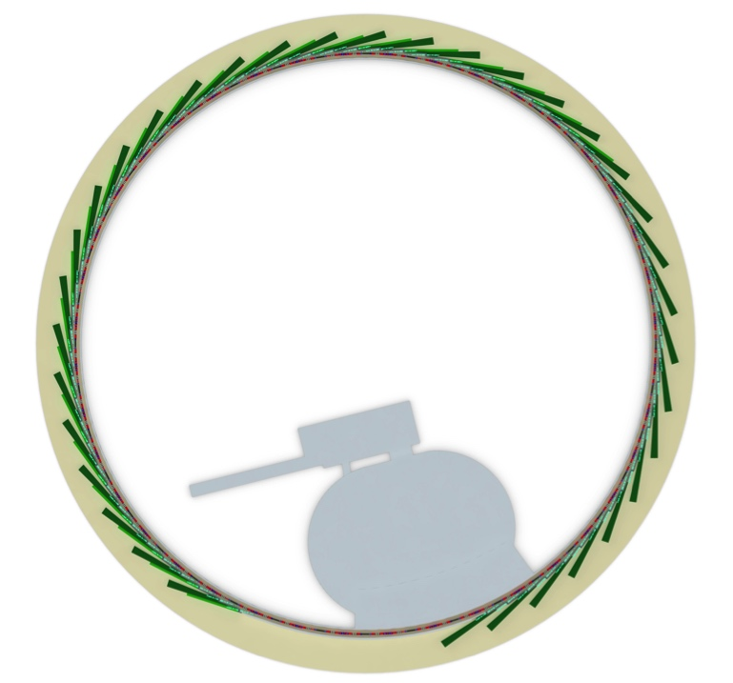
APS-U Project Scope
All existing beamlines incorporated in plans to come back online at conclusion of APS-U
New Storage Ring
6 GeV MBA lattice
42 pm-rad emittance @ 200 mA current
Improved electron/photon stability
Feature beamlines
Suite of beamlines designed for best-in-class performance
New Insertion Devices
Incorporate SCUs on selected beamlines
New/upgraded Front-ends
Common design for maximum flexibility
Integrated hard x-ray beam position monitors
Beamline Enhancements:
improvements to make beamlines “Upgrade Ready”
Injector improvements
Increased performance (high single-bunch charge)
“Do no harm”
Utilizes $1.5B in existing infrastructure
The APS Upgrade (J. Carwardine) - EPICS Collaboration Meeting, June 2018

Slide 7
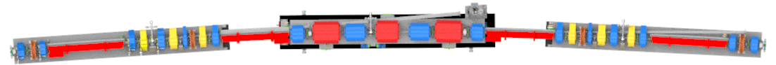
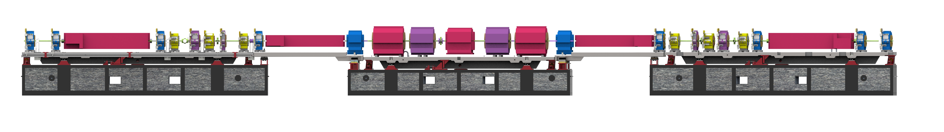
APS-U 42-pm Lattice
Storage ring consists of 40 Sectors. Each with 33 arc magnets; 27.6 meters / sector
Each sector is a hybrid 7BA with four longitudinal-gradient dipole bends, three transverse-gradient dipoles, and six reverse bends.
Vacuum systems integrated with magnets, supports, insertion devices, front ends.
Curved FODO
Section
(BM Source)
ID Beam
Multiplet
L-Bend
L-Bend
Multiplet
L-Bend
BM Beam
Doublet
L-Bend
M3
Q8
M4
Q8
M3
M2
M2
Reverse
Bends
Reverse
Bends
Reverse
Bends
Doublet
Fast Corrector
Q4 Q5
Upstream Doublet / L-Bend / Multiplet (DLM) Module
Beam Direction
Downstream Doublet / L-Bend / Multiplet (DLM) Module
The APS Upgrade (J. Carwardine) - EPICS Collaboration Meeting, June 2018
Notes:
Update with latest FReD cover page

Slide 8
APS Upgrade Project Schedule
CD-1
Approve Alternative Selection & Cost Storage
CD-3B
Approve
Long Lead Procurements
CD-2
Approve Performance Baseline
CD-3
Approve
Start of Fabrication
CD-4
Approve Start of Operations Project Completion
Research & Development
Conceptual Design
Preliminary Design
Final Design
Procurement & Assembly
Installation
& Testing
FLOAT
FY14/
prior year
FY15
FY16
FY17
FY18
FY19
FY20
FY21
FY22
FY23
FY24
FY25
FY26
The APS Upgrade (J. Carwardine) - EPICS Collaboration Meeting, June 2018

Slide 9
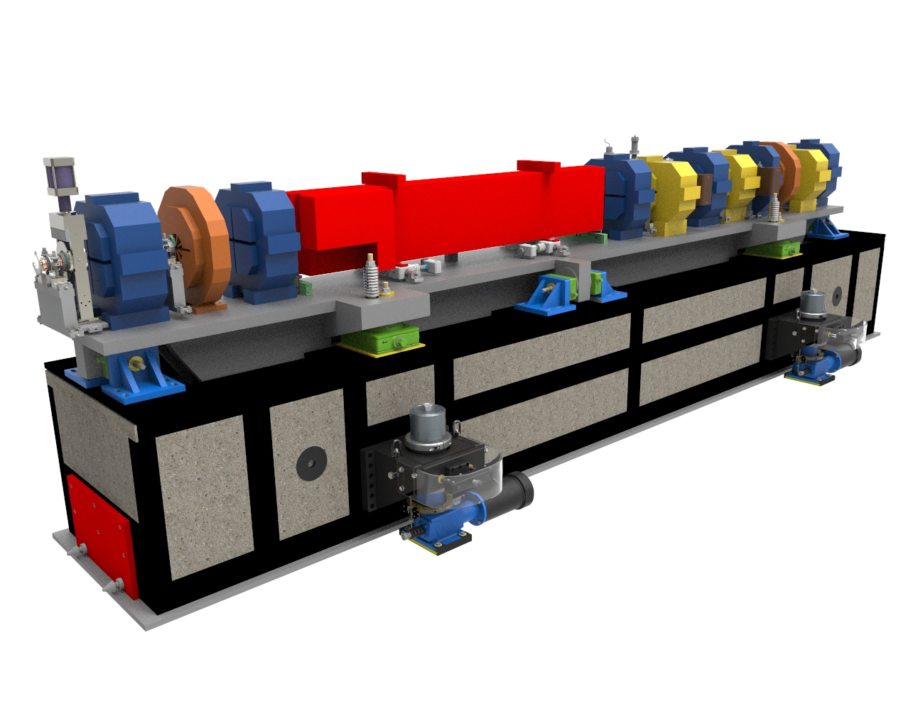
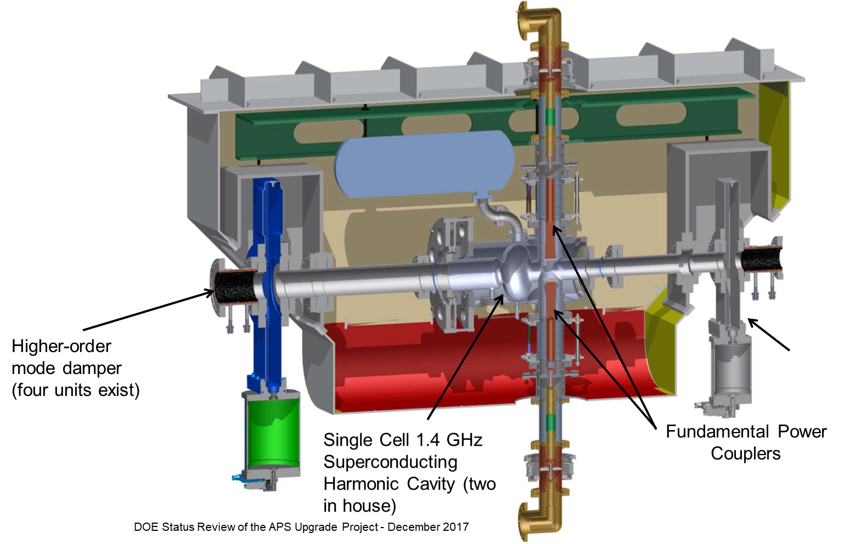
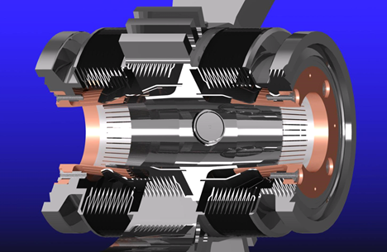
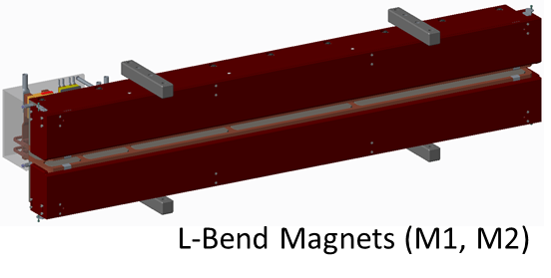
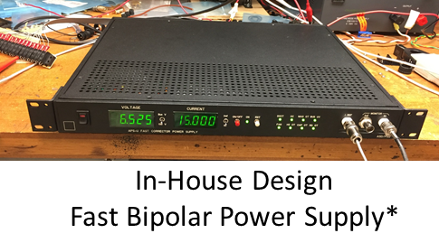
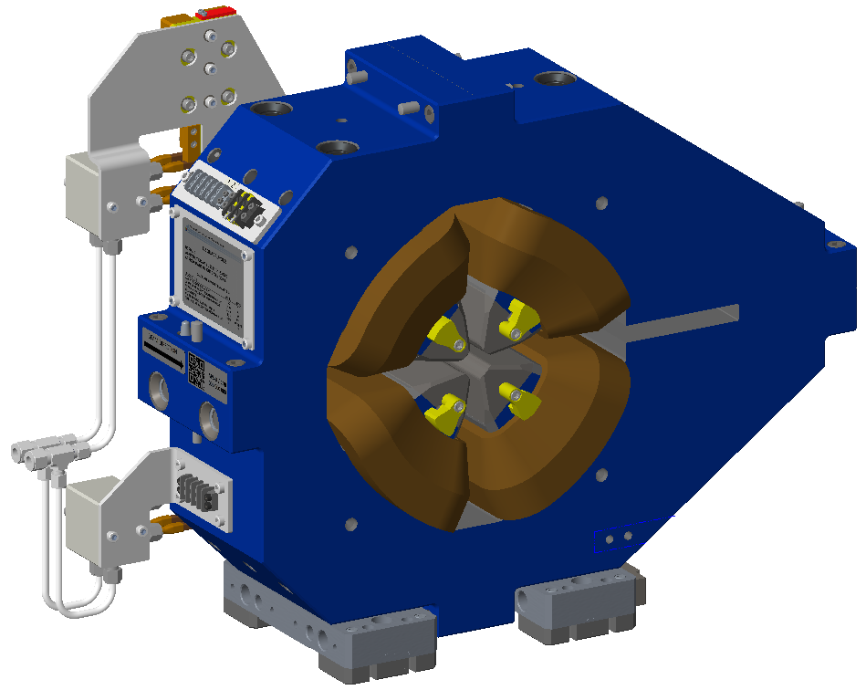
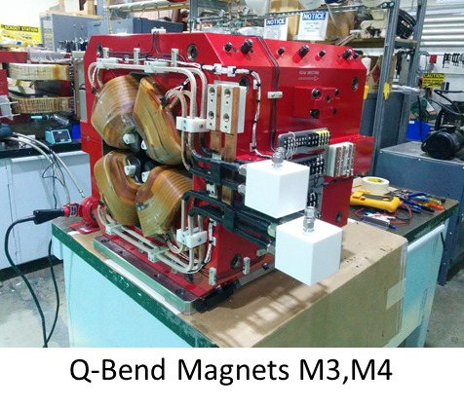
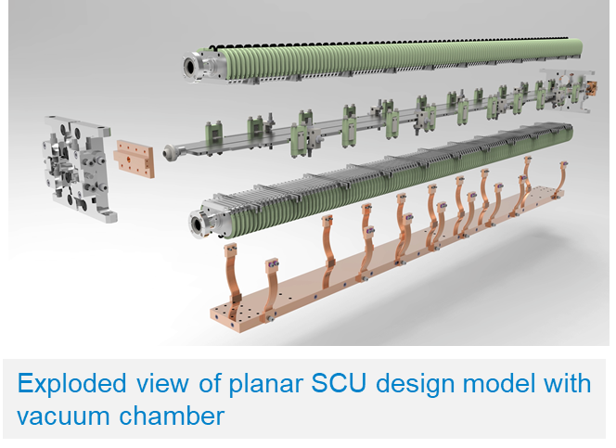
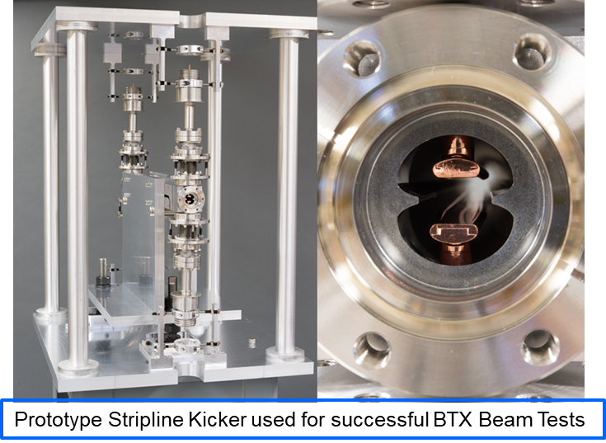
APS-U Technology
The APS Upgrade (J. Carwardine) - EPICS Collaboration Meeting, June 2018

Slide 10
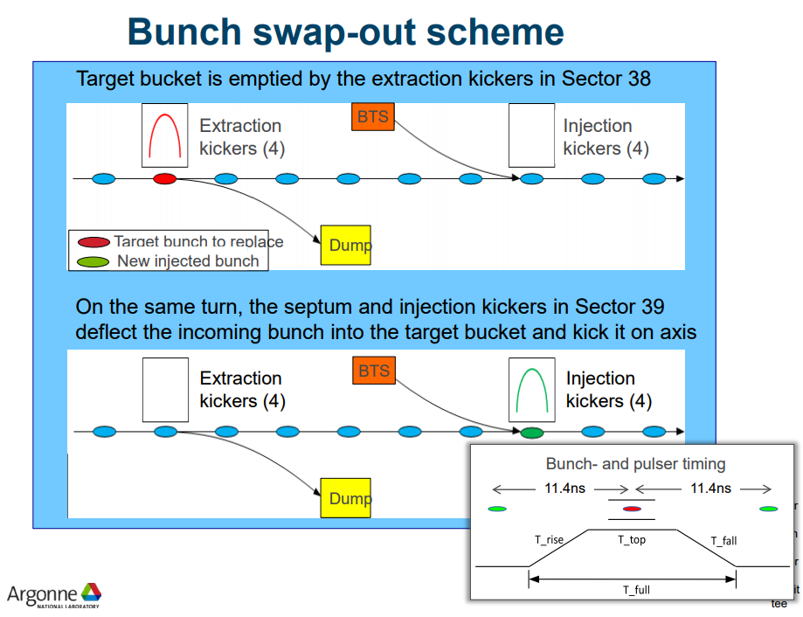
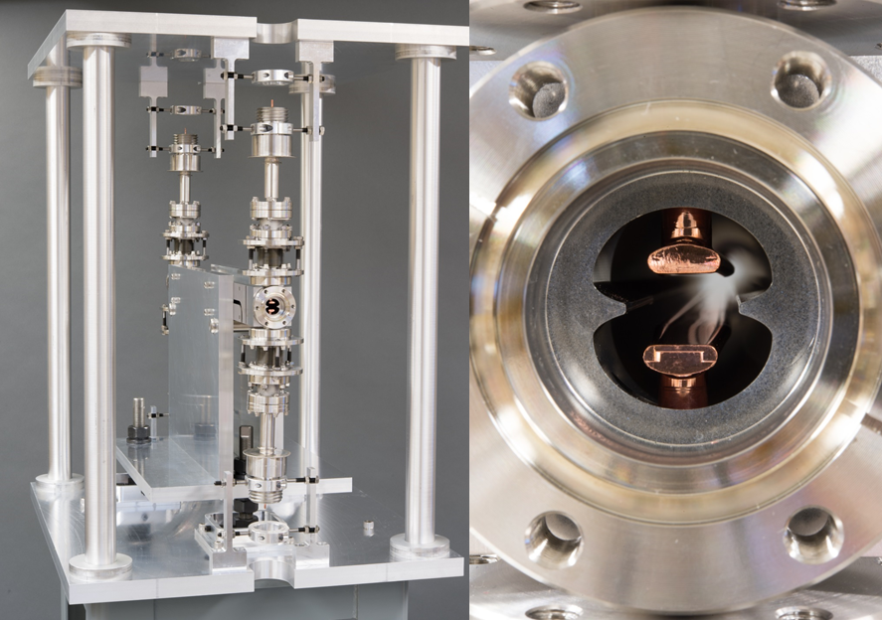
Fast Bunch Swap-Out Injection
Prototype Stripline Kicker* used for successful BTX Beam Tests
Operation demonstrated with beam to 30 kV; double the original requirement.
* Courtesy Z. Conway etal, ANL-PHY
The APS Upgrade (J. Carwardine) - EPICS Collaboration Meeting, June 2018

Slide 11
MBA Control System constraints and challenges
  Control system design retains the underlying APS controls infrastructure
  Enhancements are driven by APS-U technical system needs
        Ubiquitous embedded IOCs, FPGA-based controllers, network appliances
        Substantial increase in number network ports
        Substantial increase in data volume and throughput requirements
      Commissioning time is short for Controls + Integrated Tests + full MBA
        Must be completely integrated/tested/debugged very soon after installation
        All tools must be debugged and ready
        Requires expedient troubleshooting tools
        Early deployment of “virtual accelerator systems” with production PV names
        Early development of integrated tests (using the virtual accelerator and test stands)
      Will need to draw upon the numerous ‘modern’ tools developed by the EPICS community
Notes:
Blue text gives ideas of design approach to address the specific MBA challenges.

Slide 12
Major challenge – 12-month dark-time schedule
  3-month beam commissioning phase begins in Month #9
      Control System will be expected to be ready from the moment it’s needed
      Transferring Controls interfaces from existing technical systems to new will be a daunting task (~500,000 PVs, over 21 new systems)
Notes:
Blue text gives ideas of design approach to address the specific MBA challenges.
DAQ …. Built in from the beginning

Slide 13

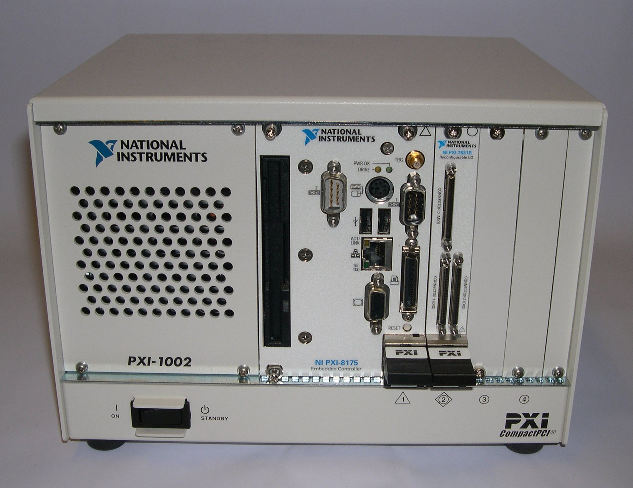
MBA Control System Scope
From PDR
Control System Engineering Applications & Services
  BPM / Orbit Server
Physics Applications & Operation Tools
  Process Variable Database
  Interactive Tools
  Injection Sequencer
  Technical System Database
  (magnet measurements, calibration
  data, installed equipment, etc)
  Subsystem Performance Monitoring
  Convenience Tools for Operators
  AOP Applications
  1000’s of scripts
  MPS Data Review
  Knobs (weights/limits)
  Glitch Logger
  PEM
  sddsexperiment
  BPM Histories
  Subsystem Integration Tests
  Power Supply Synchronous Setpoint Control
  Alarms
  Short Term Data Logging
  Data Acquisition (DAQ) Services
  APIs to other toolkits (e.g. Matlab, Octave, python)
  sdds tools
  Post-mortem analysis
  Long Term Data Logging
  Data Acquisition (DAQ)
  Timing, Bulk Data, Maintenance, …
  Accelerator Control
Controls Hardware & Software Infrastructure
Timing & Synchronization
Interface(s) to Technical Equipment
MPS
Diagnostics
BPMs
X-ray Intensity Monitors
BPLD
Beam Size Monitors
Mechanical Motion System
Current Monitors
Booster / SR 352MHz Sync
Fast Orbit Feedback
Injection / Extraction Timing
Unipolar Power Supplies
Beamline Timing
Existing Systems to Remain
Oscilloscopes
Video Distribution
DCCTs
LNDS
BACNET
Top-off Monitor
Injectors PSS/ACIS
Bipolar Power Supplies
Water Systems
Vacuum Systems
Cryo Plant
Transverse Feedback System
RF Upgrades
Absorbers
13
Longitudinal Feedback System
RF Bunch Lengthening System
The APS Upgrade (J. Carwardine) - EPICS Collaboration Meeting, June 2018

Slide 14
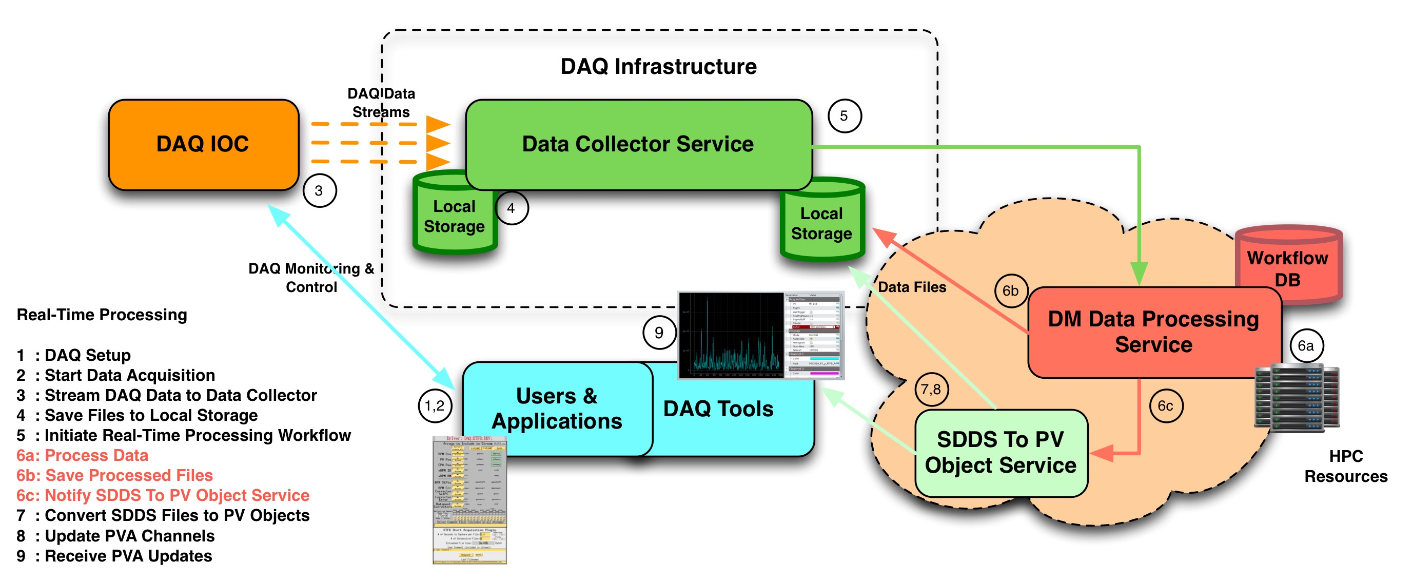
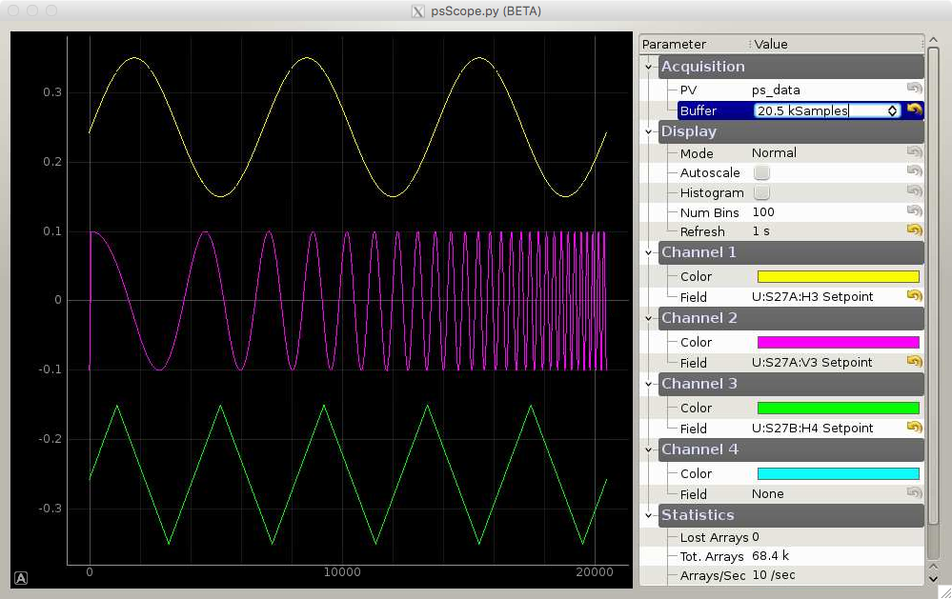
Requirements for high data rates
+
Time-correlation of data from disparate systems
Structured data
(EPICS V7)
APS-U DAQ
High-bandwidth data collector
DAQ IOCs
Real-time processing workflow
Means of processing data
OrbitVectorServices
[method = ACLockin]
[event = beam-loss]
“Fifty-thousand-channel” oscilloscope
Courtesy S. Veseli
The APS Upgrade (J. Carwardine) - EPICS Collaboration Meeting, June 2018
Notes:
Go to ”Insert (View) | Header and Footer" to add your organization, sponsor, meeting name here; then, click "Apply to All"
14

Slide 15
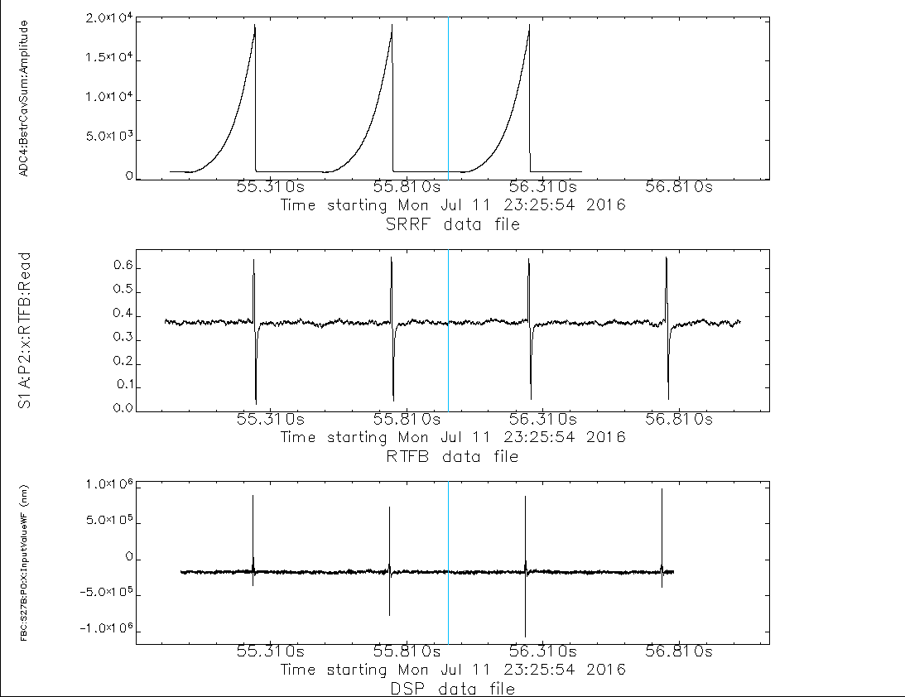
DAQ Use Case: Monitoring SR Injection
Acq. Trigger
Booster RF Cavity Amplitude
(during injection)
[ 8 chan @ 271KHz ]
Pre-trigger
Post-trigger
.5 sec
SR BPM acquired from
Existing Feedback System
[ 2616 chan @ 1.5KHz ]
SR BPM acquired from
APSU Prototype Feedback System
[ 48 chan @ 22.4KHz ]
The APS Upgrade (J. Carwardine) - EPICS Collaboration Meeting, June 2018

Slide 16
APS-U fast orbit feedback
The APS orbit feedback system was the first digital truly global fast orbit feedback system to be implemented at a light source
  In operation since 1995
APS-U fast orbit feedback follows the same architecture and design philosophy (it just uses ‘modern’ technology)
The APS Upgrade (J. Carwardine) - EPICS Collaboration Meeting, June 2018

Slide 17
APS-U Orbit feedback Integrated R&D
Feedback Controller
+ 22kHz DAQ
Fast data network node-to-node datalink
Cut-through switch
Corrector power supplies (8 new fast, 8 existing slow)
1.5kHz RTFB DAQ
MMS
Libera Brilliance+ BPM electronics (4 units, 16 bpms total)
J. Carwardine, N. Sereno, N. Arnold
Notes:
Update with latest FReD cover page

Slide 18
Fast orbit feedback system parameters
Present system (circ. 1995)
Parameter | APS-U design | ‘Datapool’ |  | RTFB
Algorithm implementation | ‘Unified feedback’ algorithm | Separate DC and AC systems for slow and fast correctors
BPM sampling & processing rate | 271 kHz (TBT) | 10 Hz | 1.5 kHz
Orbit correction update rate # | 22.6 kHz | 10 Hz | 1.5 kHz
Signal processors (20 nodes) (one node demonstrated) | DSP (320 GFLOPS) + FPGA (Virtex-7)* | EPICS IOC | DSP (40 MFLOPS)
Num. rf bpms / plane | 570 * | 360 | 160
Fast correctors / plane | 160 * | - | 38
Slow correctors / plane | 320 * | 282 | -
Fast corrector ps bandwidth | 10 kHz | - | 1 kHz
Fast corrector latency | <10 us | - | ~250 us
Closed-loop attenuation bandwidth | DC to 1 kHz** | DC - 1 Hz | 1 Hz - 80 Hz
# Highest demonstrated at any light-source to date
Demonstrated
* Full double-sector demonstrated
** >800 Hz has been demonstrated
The APS Upgrade (J. Carwardine) - EPICS Collaboration Meeting, June 2018

Slide 19
Wrap-up
The APS-U lattice design has the lowest horizontal emittance of all synchrotron light sources currently under consideration (42 pm-rad)
APS will continue operating until mid FY2022
APS-U is due to come on line in FY2023 after a 12-month shutdown
APS-U R&D program has been very successful (for Controls and others)
Early procurements are underway (magnets, power supplies,…)
There are many challenges (for Controls and others)
We have funding (FY2018 budget = $93M)
The APS Upgrade (J. Carwardine) - EPICS Collaboration Meeting, June 2018

