Slide 1




ALS-U: A major upgrade to the ALS
Bob Gunion
Lawrence Berkeley National Laboratory
June, 2018
1

Slide 2
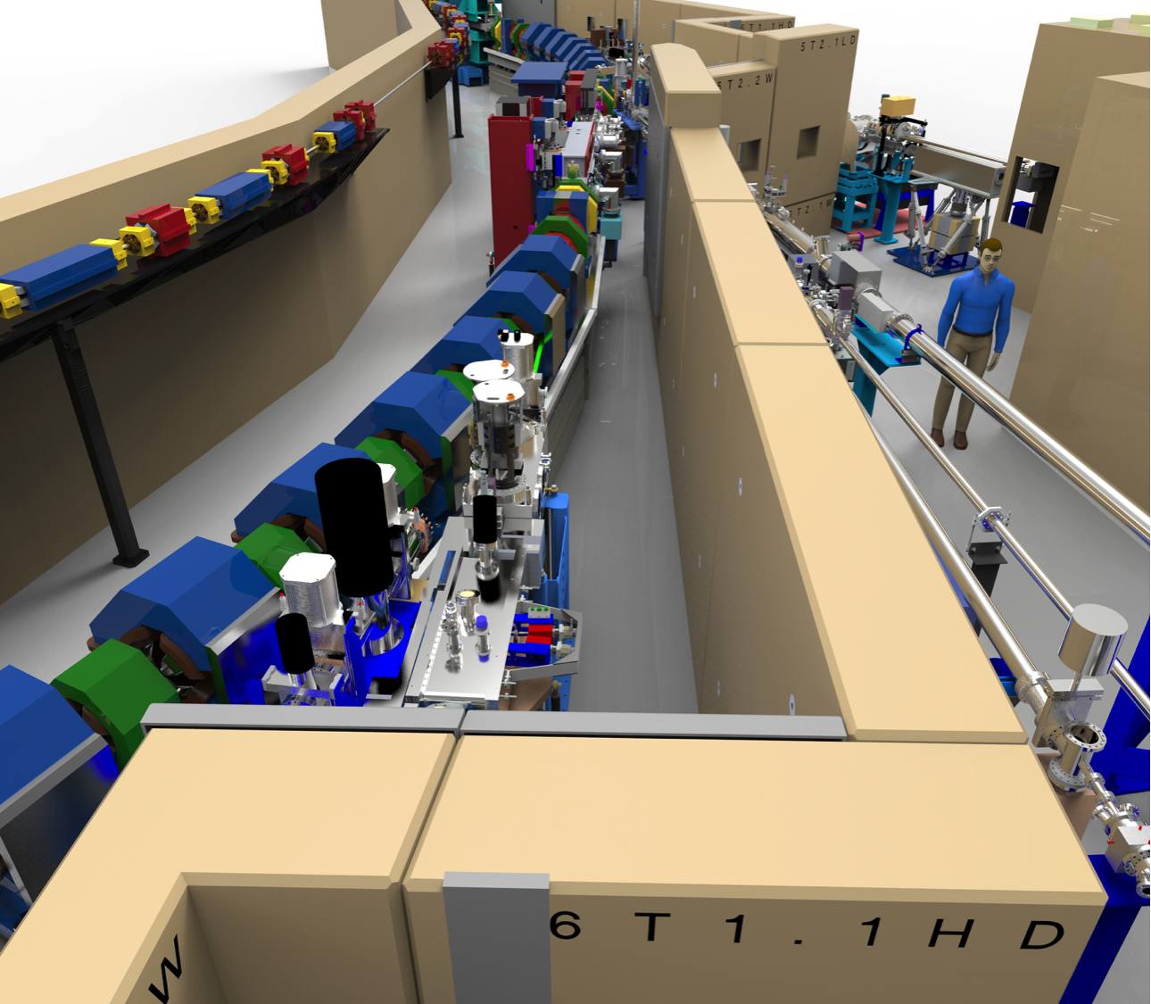
ALS-U Facility Status
Outline
  DOE Approval Status
  What is ALS-U
  Strategy

Slide 3
DOE Approval Status
Currently at Conceptual Design stage, Reviews in progress
CD-2
Performance Baseline
CD-3
Start Construction
AR* Install
Dark Period <1 year
CD-0
Mission Need
Sept. 2016
CD-1
Conceptual Design
Fall 2018
CD-4
Completion
~2026
*AR = Accumulator Ring

Slide 4
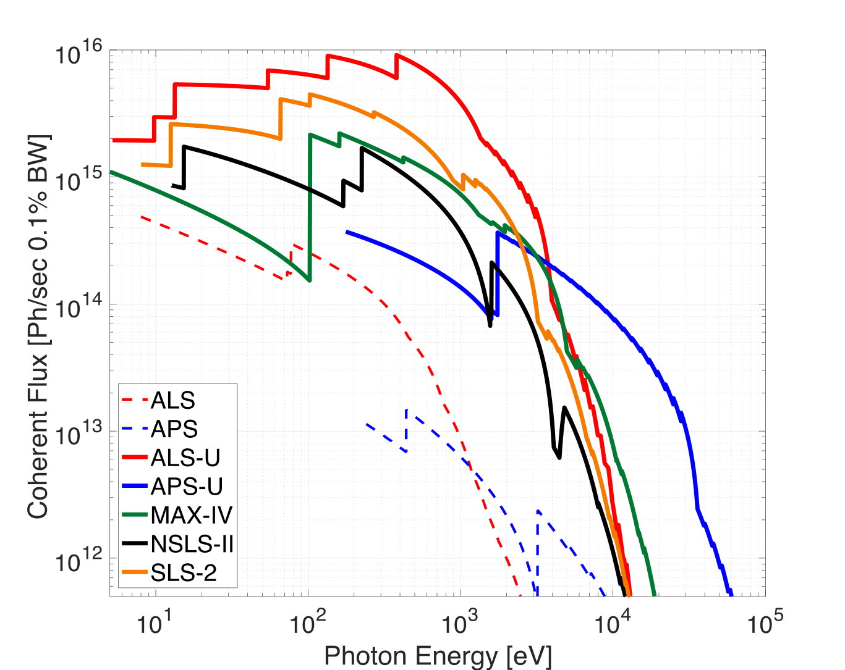
What is ALS-U
2-3 orders of magnitude brighter than ALS
Higher coherence due to lower emittance

Slide 5
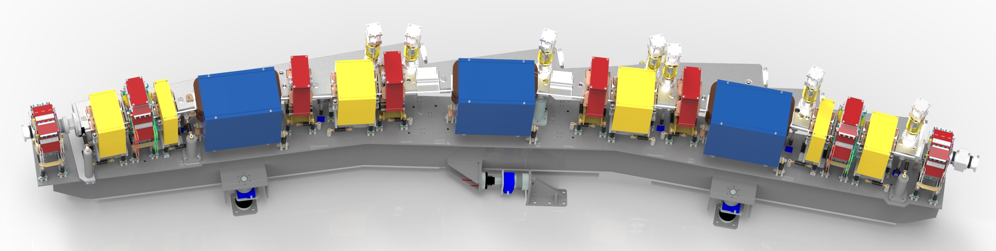
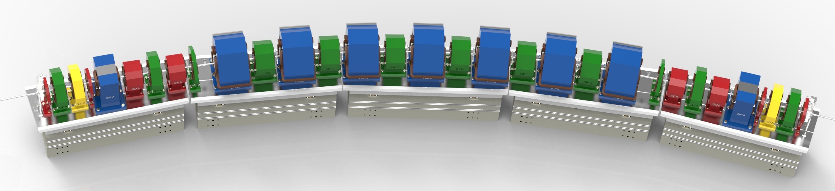
What is ALS-U
ALS today : triple-bend achromat
ALS-U: multi-bend achromat
Beam Size Comparison

Slide 6
Bunch Train Swap-Out
Traditional off-axis injection
On-axis swap-out injection
(initially proposed by M. Borland)
Stored Beam
Stored Beam
Fast Kicker
requires larger
apertures
can use smaller
apertures
Injected Beam
Injected Beam
Only ALS-U and APS-U plan to include swap-out
  Swap-out enables:
  Stronger-focusing MBA lattices with smaller dynamic apertures
  Round beams - more useful shape and reduced emittance growth
  Vacuum chambers with small round apertures → Improved undulator performance
  Swap-out with full energy accumulator enables:
  Bunch train swap-out and recovery of the stored beam current
      Lower demand on the injector
      Very small (~nm) injected emittance
      More flexibility in fill patterns

Slide 7
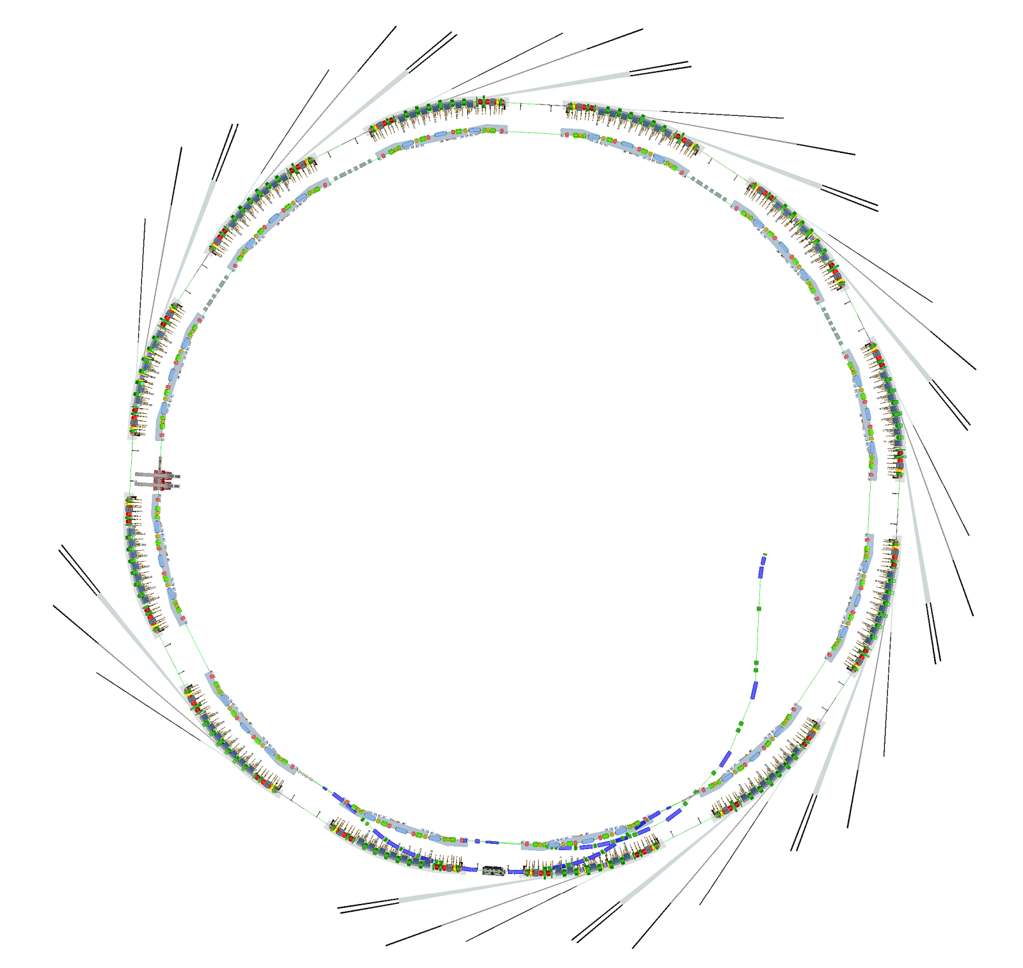

Project Scope
What’s New
Storage Ring (SR)
Accumulator Ring (AR)
Booster to AR Transfer Line (BTA)
AR to SR Transfer Line (ATS)
SR to AR Transfer Line (STA)
BTA
What Doesn’t Change
Gun
Linac
Booster
STA
ATS

Slide 8
ALS-U Strategy
Re-use ALS systems
  Including recent & upcoming upgrades
Use Community Contributions
  EPICS7
  eTraveller & other tools
  Archiver Appliance
Follow other sites’ progress (APS-U)
Build new stuff when necessary
Plan for higher device count
  Possibly >1 million PVs vs. 200k for ALS
  Networking redesign

Slide 9
Conclusions
ALS-U is a large and interesting project
The use of existing tools and expertise will be important for project success
New development will also be required
  We need people!
  http://jobs.lbl.gov, search by keyword

Slide 10
Questions?

Slide 11
Backup Slides

Slide 12
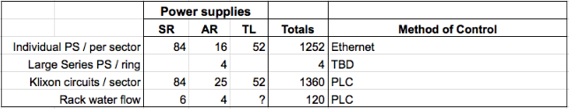
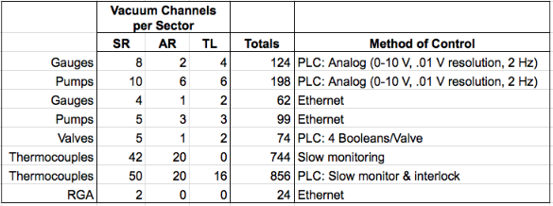
Device Count
Power Supplies and Vacuum
12

Slide 13
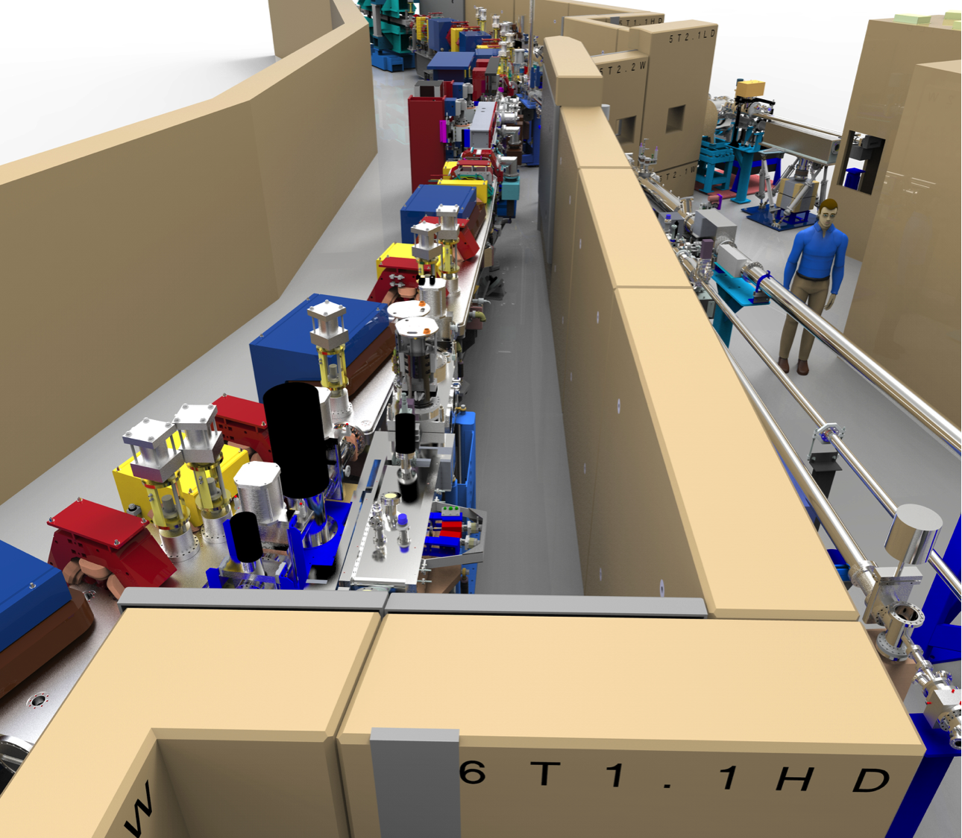
Scope of ALS-U
Retain the existing gun, linac, booster
Replace the existing triple-bend achromat storage ring with a new, high-performance storage ring based on a multi-bend achromat.
Add a low-emittance, full-energy accumulator ring in the existing storage-ring tunnel to enable on-axis, swap-out injection using fast magnets.
Replace the existing transfer line with new lines: BTA, ATS, STA
Existing ALS ring
New ALS-U ring
New accumulator ring

Slide 14
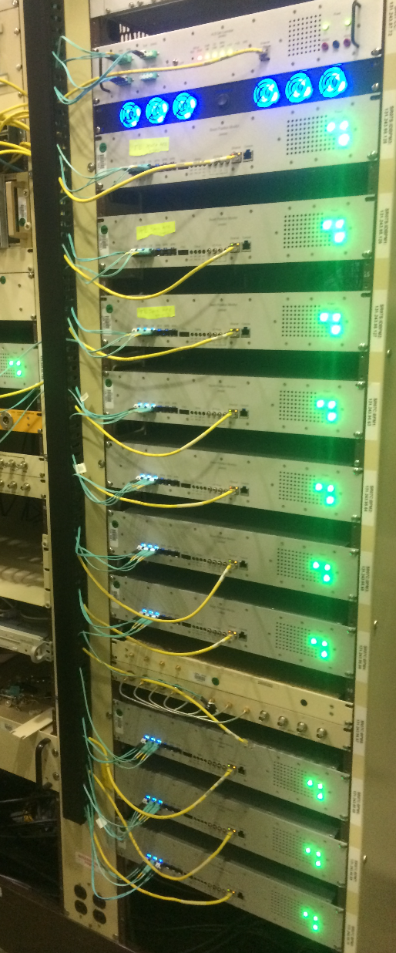
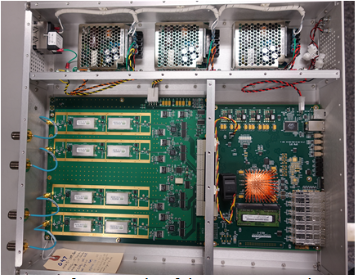
ALS BPM Development
160 built: 114 SR, 37 injector, and a few spares.
The ALS-U needs are,
192 in the storage ring (16 /sector)
72 in the accumulator ring (6 /sector)
~20 in the transfer lines
(We can reuse the present ALS SR BPMs (114) with a VCXO change)
Mike Chin, Eric Norum, Greg Portmann, Jonah Weber at ALS and Kurt Vetter and others at NSLS-II

Slide 15
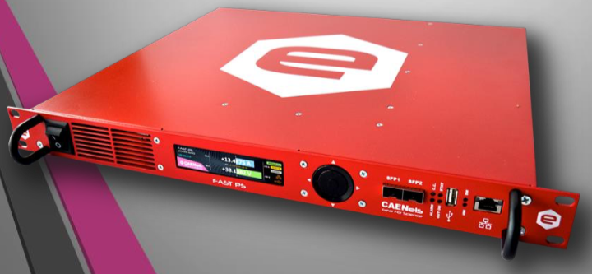
Fast orbit feedback architecture
MRF: Events / Timing Data (fiber fanouts)
Fast Orbit Feedback Network (Dual 3.125 Gb/s fiber links)
Ethernet – pvAccess or Channel Access
1 Gb/s Ethernet fiber links
Cell
Controller
...
Cell
Controller
PS1
BPM1
PS2
BPM2
PS3
BPM3
PS4
BPM4
Dual 3.125 Gb/s fiber links
Candidate Fast Power Supply for FOFB
(Caen Fast-PS Series)
PS5
BPM5
PSn
BPMn
Fast Feedback
Power Supplies
Beam Position
Monitors
Per Sector

Slide 16
Fast Magnet Count
SR
Decoherence kicker
AR kicker
SR kicker
NLK
Thin Septum
Thick Septum
BTA Lambertson
Septa
ATS/STA Lambertson Septa
AR
Monitoring and Control Required
Timing
Controls
  HV Power Supplies (Enet)
  Interlocking (PLC)
Scopes
  6 channels @ 100 MHz
  18 channels @ 500 MHz
BTA
STA
ATS

Slide 17
Standard HW Architecture
Level 2: Operator stations: Displays, Archiving, Alarm Management, Strip charts, Save/Restore Utility
Level 3: Physics or Science Applications Using Stored Data
Events / Timing Data
Fast Orbit Feedback Network
Ethernet – pvAccess or Channel Access
SIOC
Servers
CPU
EVG
NAD
Cell
Controllers
RF
Systems
Level 1: SCADA support over a distributed network
Timing Master
Controls Subnets (VLAN)
PS1
BPM1
PLC
CNET
I /O
I /O
PLC
CNET
I /O
Level 0: High Performance Systems over dedicated networks (blue and orange) or slow control over industrial Ethernet
Power
Supplies
(Ethernet)
PS2
BPM2
PS3
BPM3
PS4
BPM4
...
...
PS5
BPM5
Field I/O
Field I/O
Field I/O
Field I/O
PLCs, Slow I/O, High Reliability, Low Accuracy, High Density. Used in Vacuum, slow EPS, non-FOFB PS, Cryo., Waterflow, Magnets, etc..
PSn
BPn
Fast Feedback
Power Supplies
Beam Position
Monitors
17

