Slide 1
EPICS software upgrade and areaDetector-3-2 deployment at NSLS2 beamlines
Oksana Ivashkevych, 13 June 2018

Slide 2
Summary
New EPICS Debian distribution deployment at the new beamline.
areaDetector training event for beamline scientists.

Slide 3
NSLS2 now
Currently NSLS2 is home to 27 beamlines
+ 2 will be built this year
First 6 beamlines were built 4 years ago, and are taking general users for 3 years
∃ this rule: when something is built, and it works, don’t touch it.
Debian 7 on IOC servers
EPICS 3.14 base and areaDetector-1-9 on most beamlines.

Slide 4
Upgrade decision
At some point maintaining old software becomes expensive
Need new Debian distribution for the very least.
Mid-November 2017 we decided to test new Debian distribution on a real system.
From EPICS community:
Updates pushed to epicsdeb are tested at FRIB
Need to TEST to obtain credibility for a change.

Slide 5
The easiest path to upgrade…is to start from something new
On newly constructed beamline 28ID1 PDF
The right way is to built 2 parallel control systems:
Debian 7 Wheezy + old repo
Debian 8 Jessie + new repo
In reality resources allowed only one deployment.

Slide 6
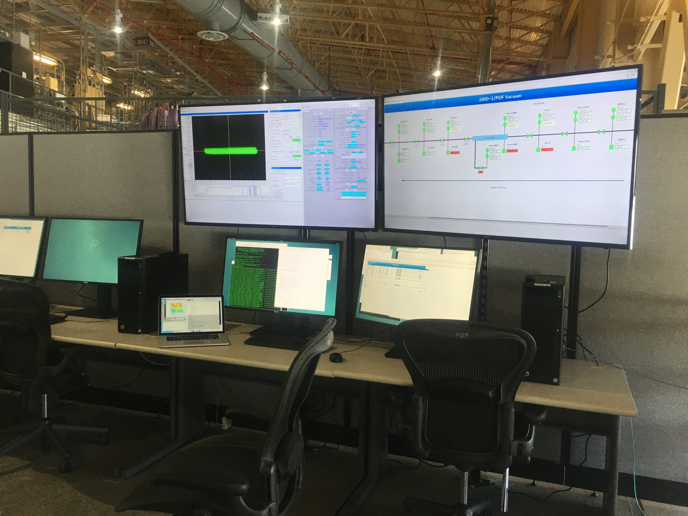
Outcome of the upgrade efforts..
PDF beamline passed IRR with new Debian distribution on Debian 8 built from epicsdeb @ NSLS2.
areaDetector-3-2 was deployed for prosilica diagnostic cameras.
To expose new features new .opi screens for asyn and areaDetector were deployed. These screens were auto-converted by Mark Rivers and are available now in github in ../autoconvert/.
New distribution was tested live, with utmost suspicion and attention to every problem on the top of PDF complexity.
EPICS software upgrade way forward have been established for the interested beamlines.
PDF First Light

Slide 7
areaDetector-3-2 training for beamline scientists
Goals:
Promote EPICS software upgrade
Advertise PVA and EPICS7
Good timing :
New Debian distribution
areaDtector-3-2 with latest Epics7 base.
A real beamline with all above deployed.
Should be on the real HW and a real beamline.

Slide 8
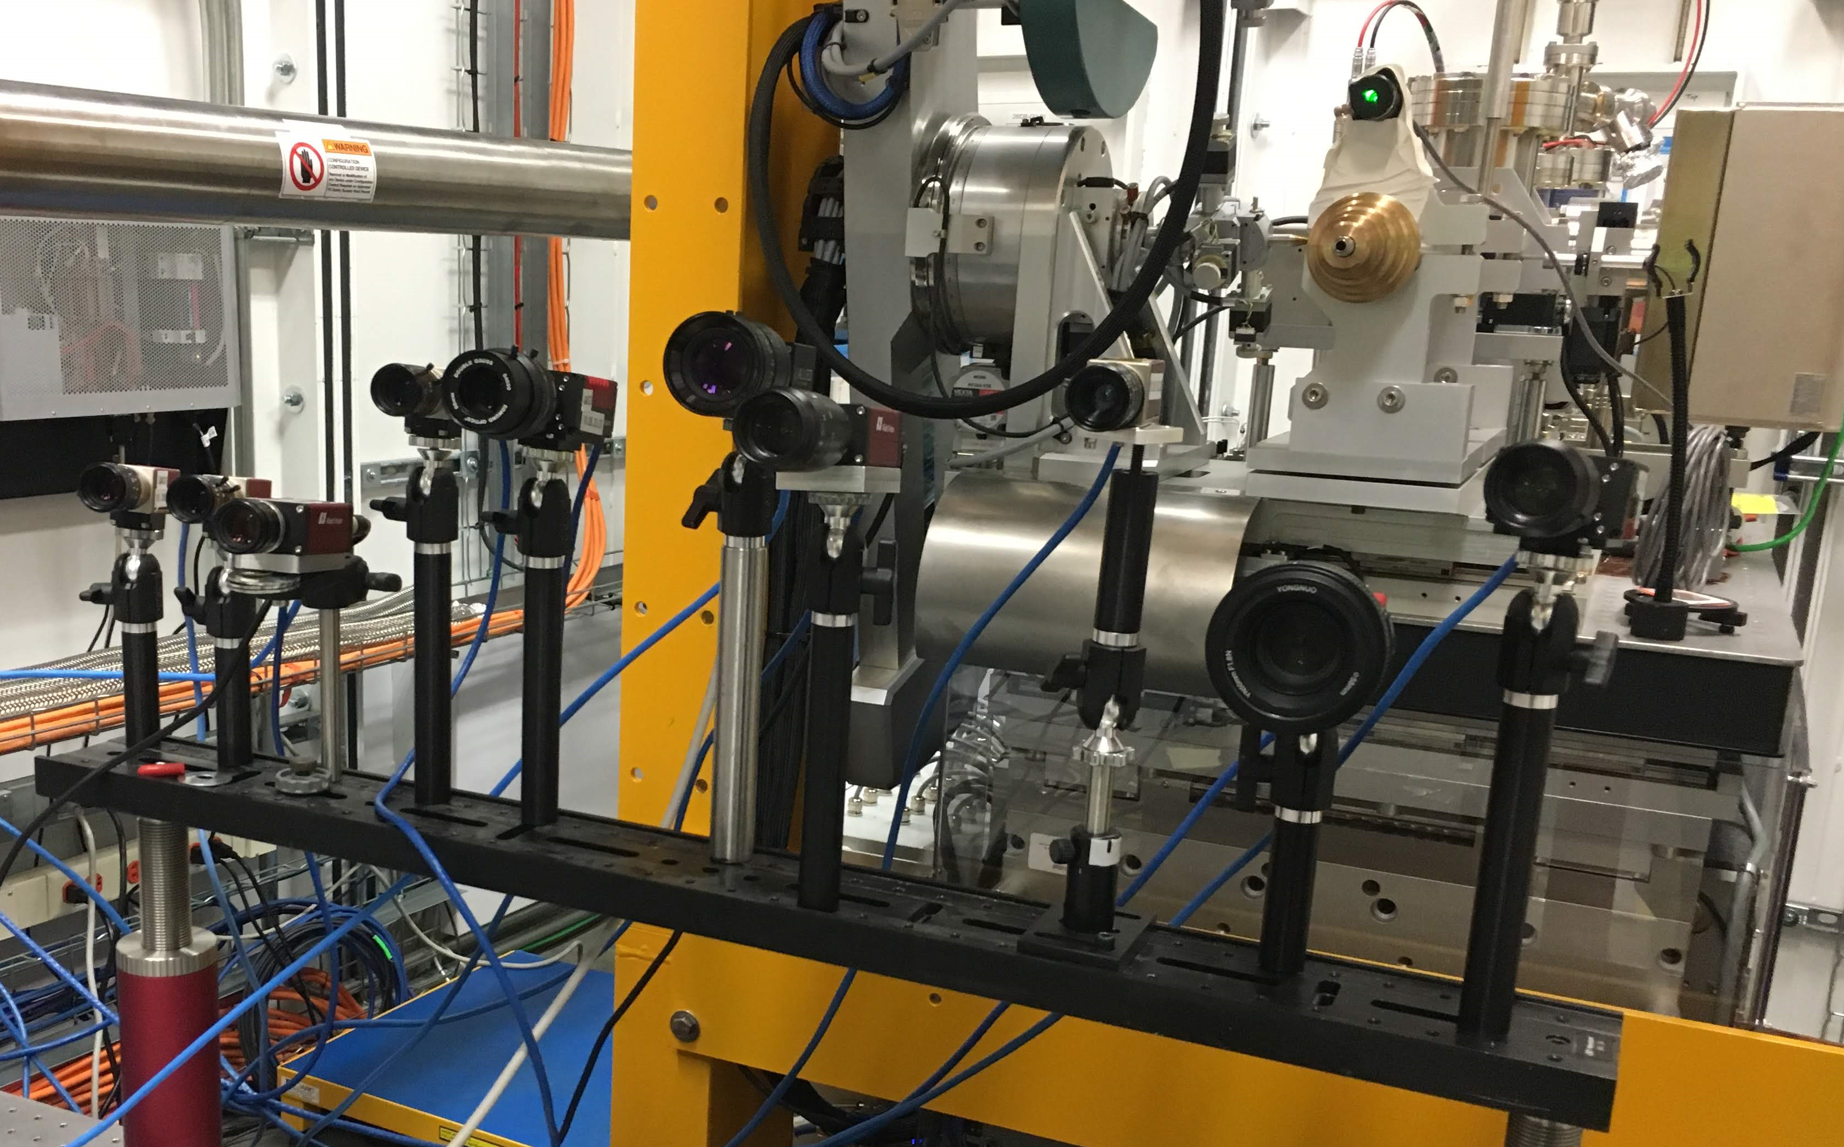
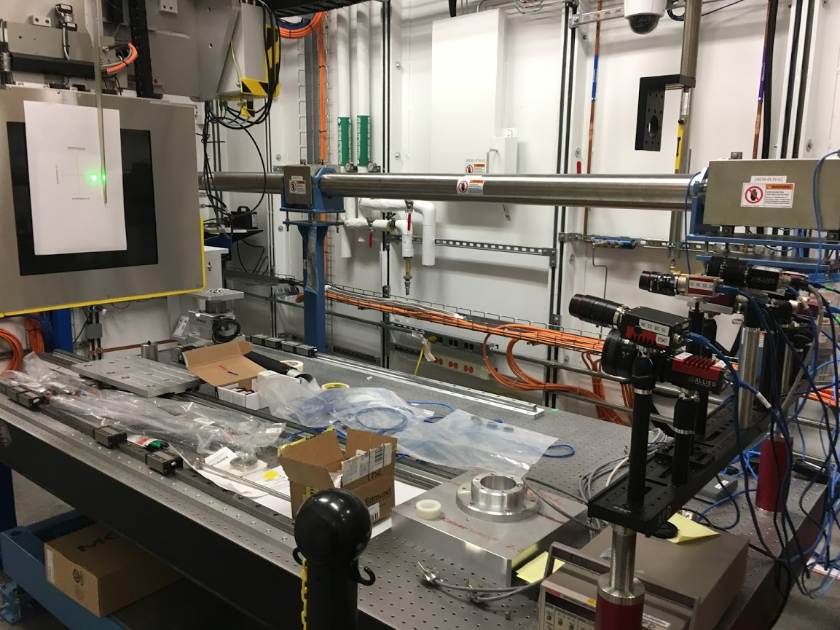
Workshop
Lecture
Hands On Labs hosted by
28ID1(11 cameras)
11ID (13 cameras)
AM + PM (20 + 20)
Everyone had a prosilica camera with IOC at the beamline to play with.

Slide 9
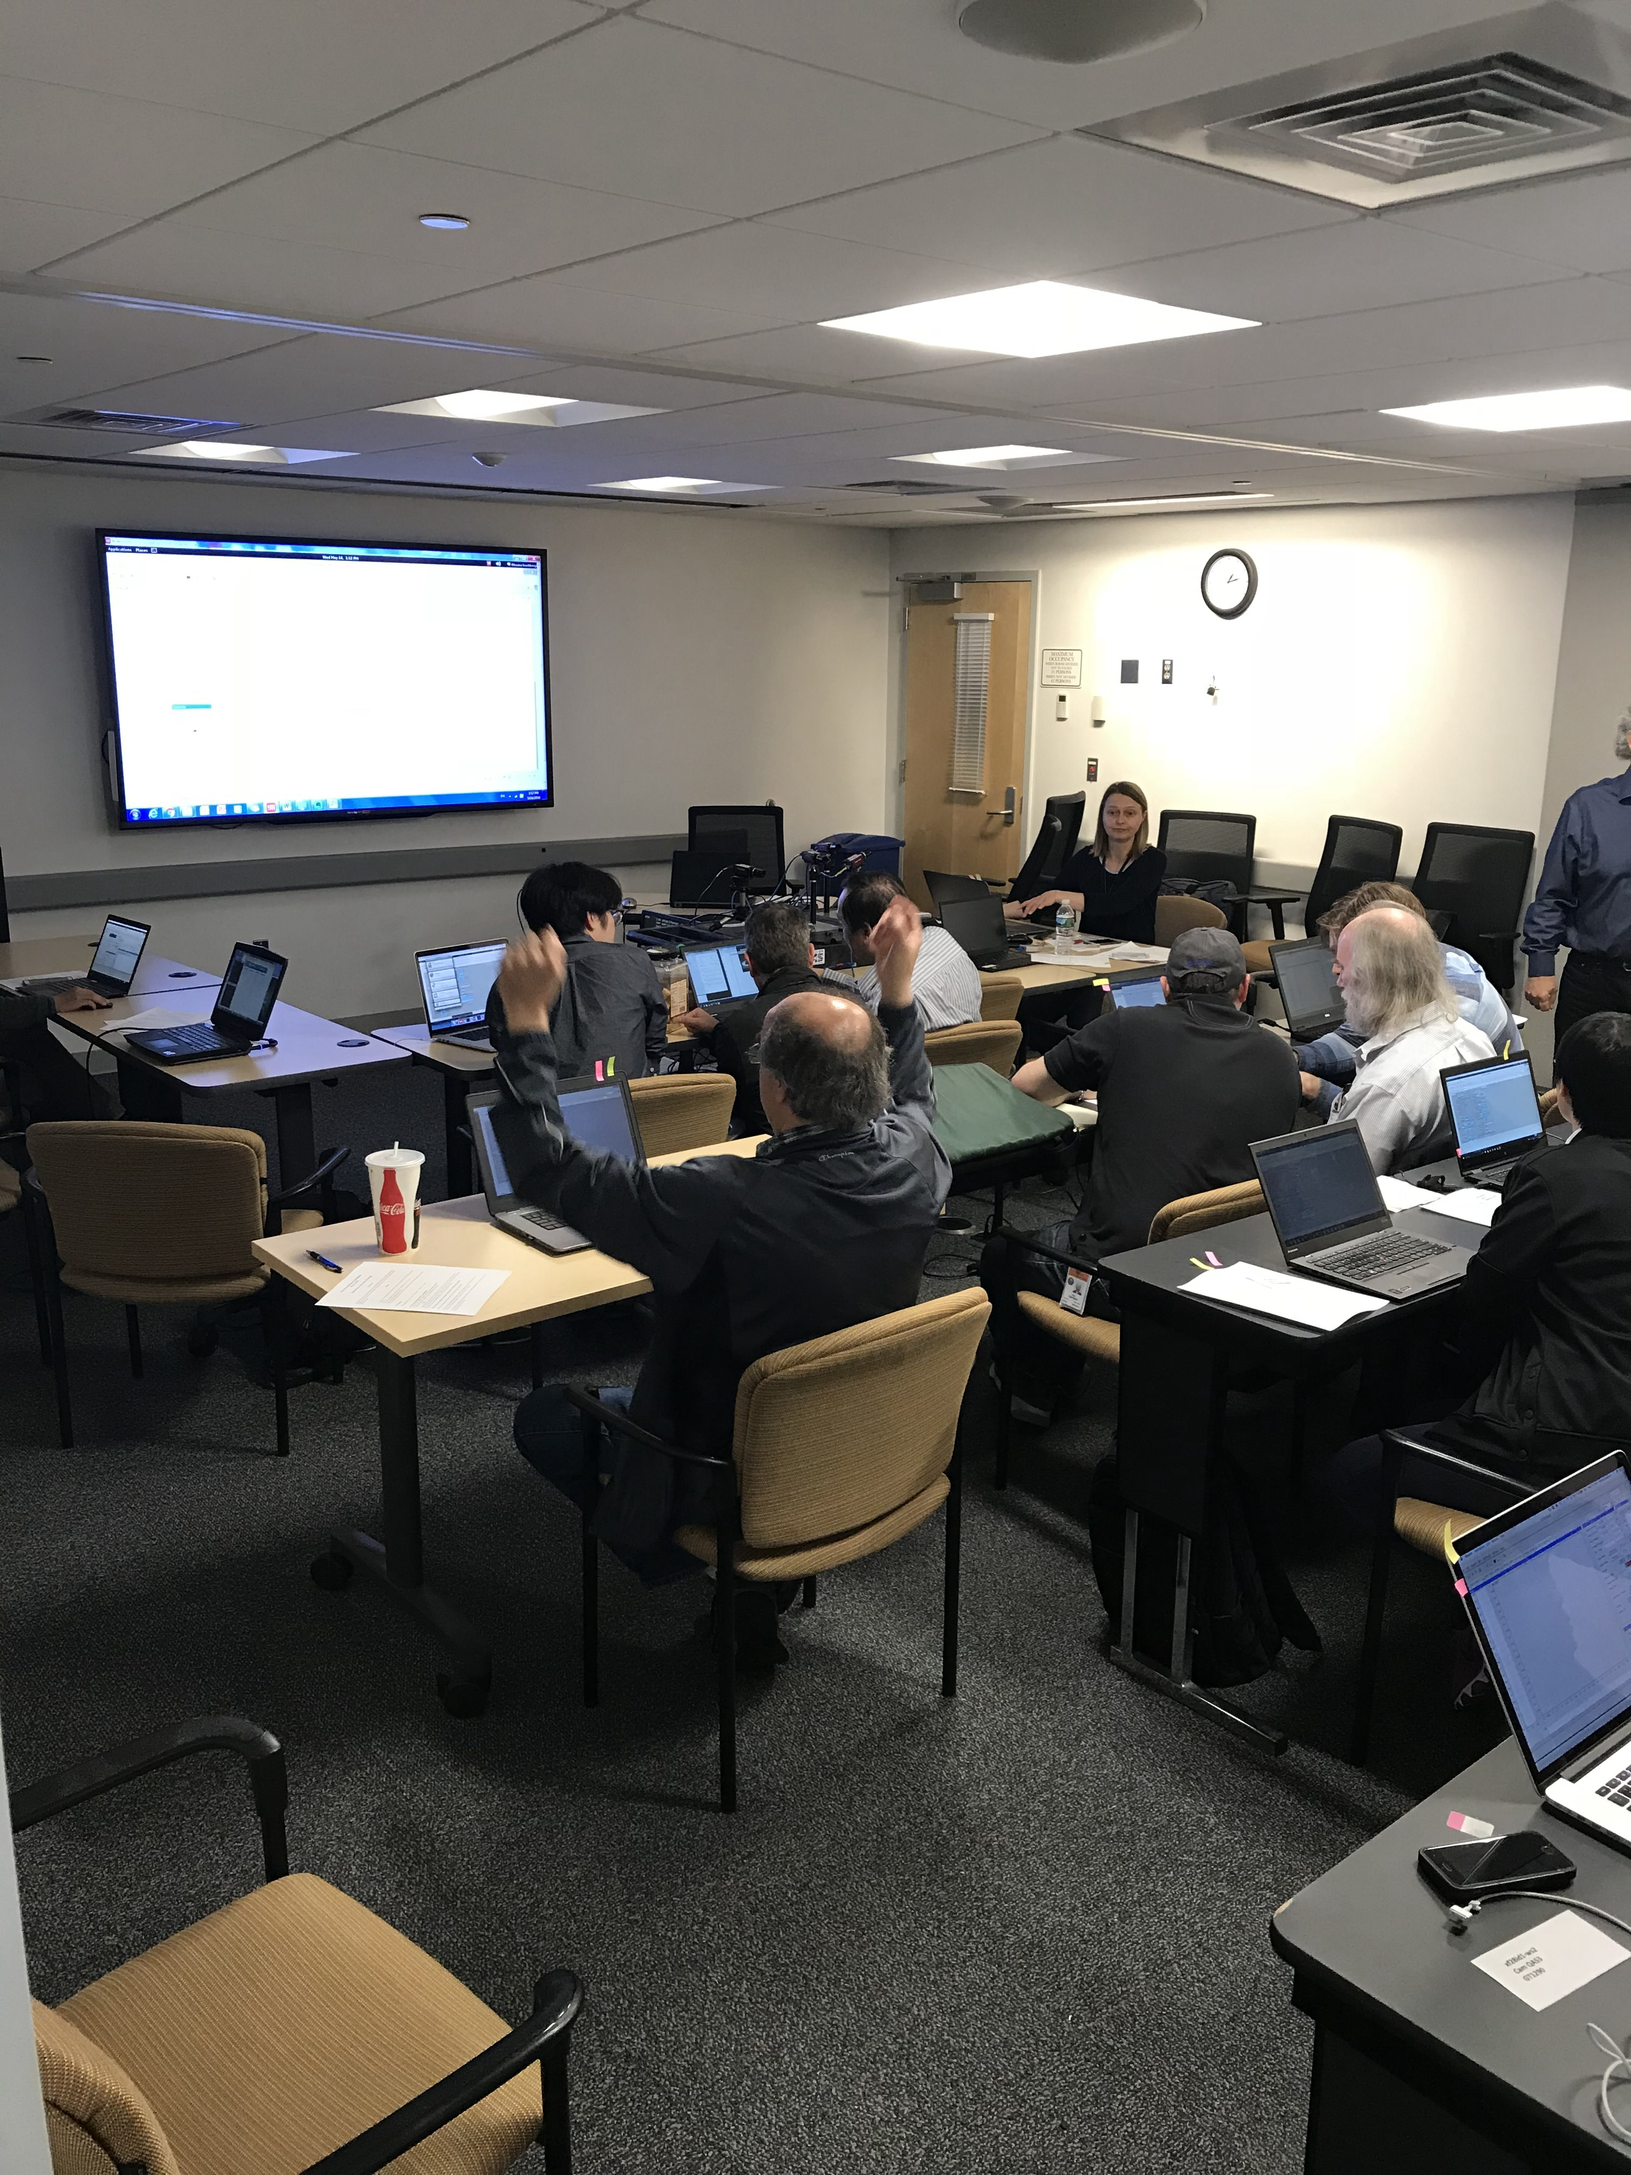
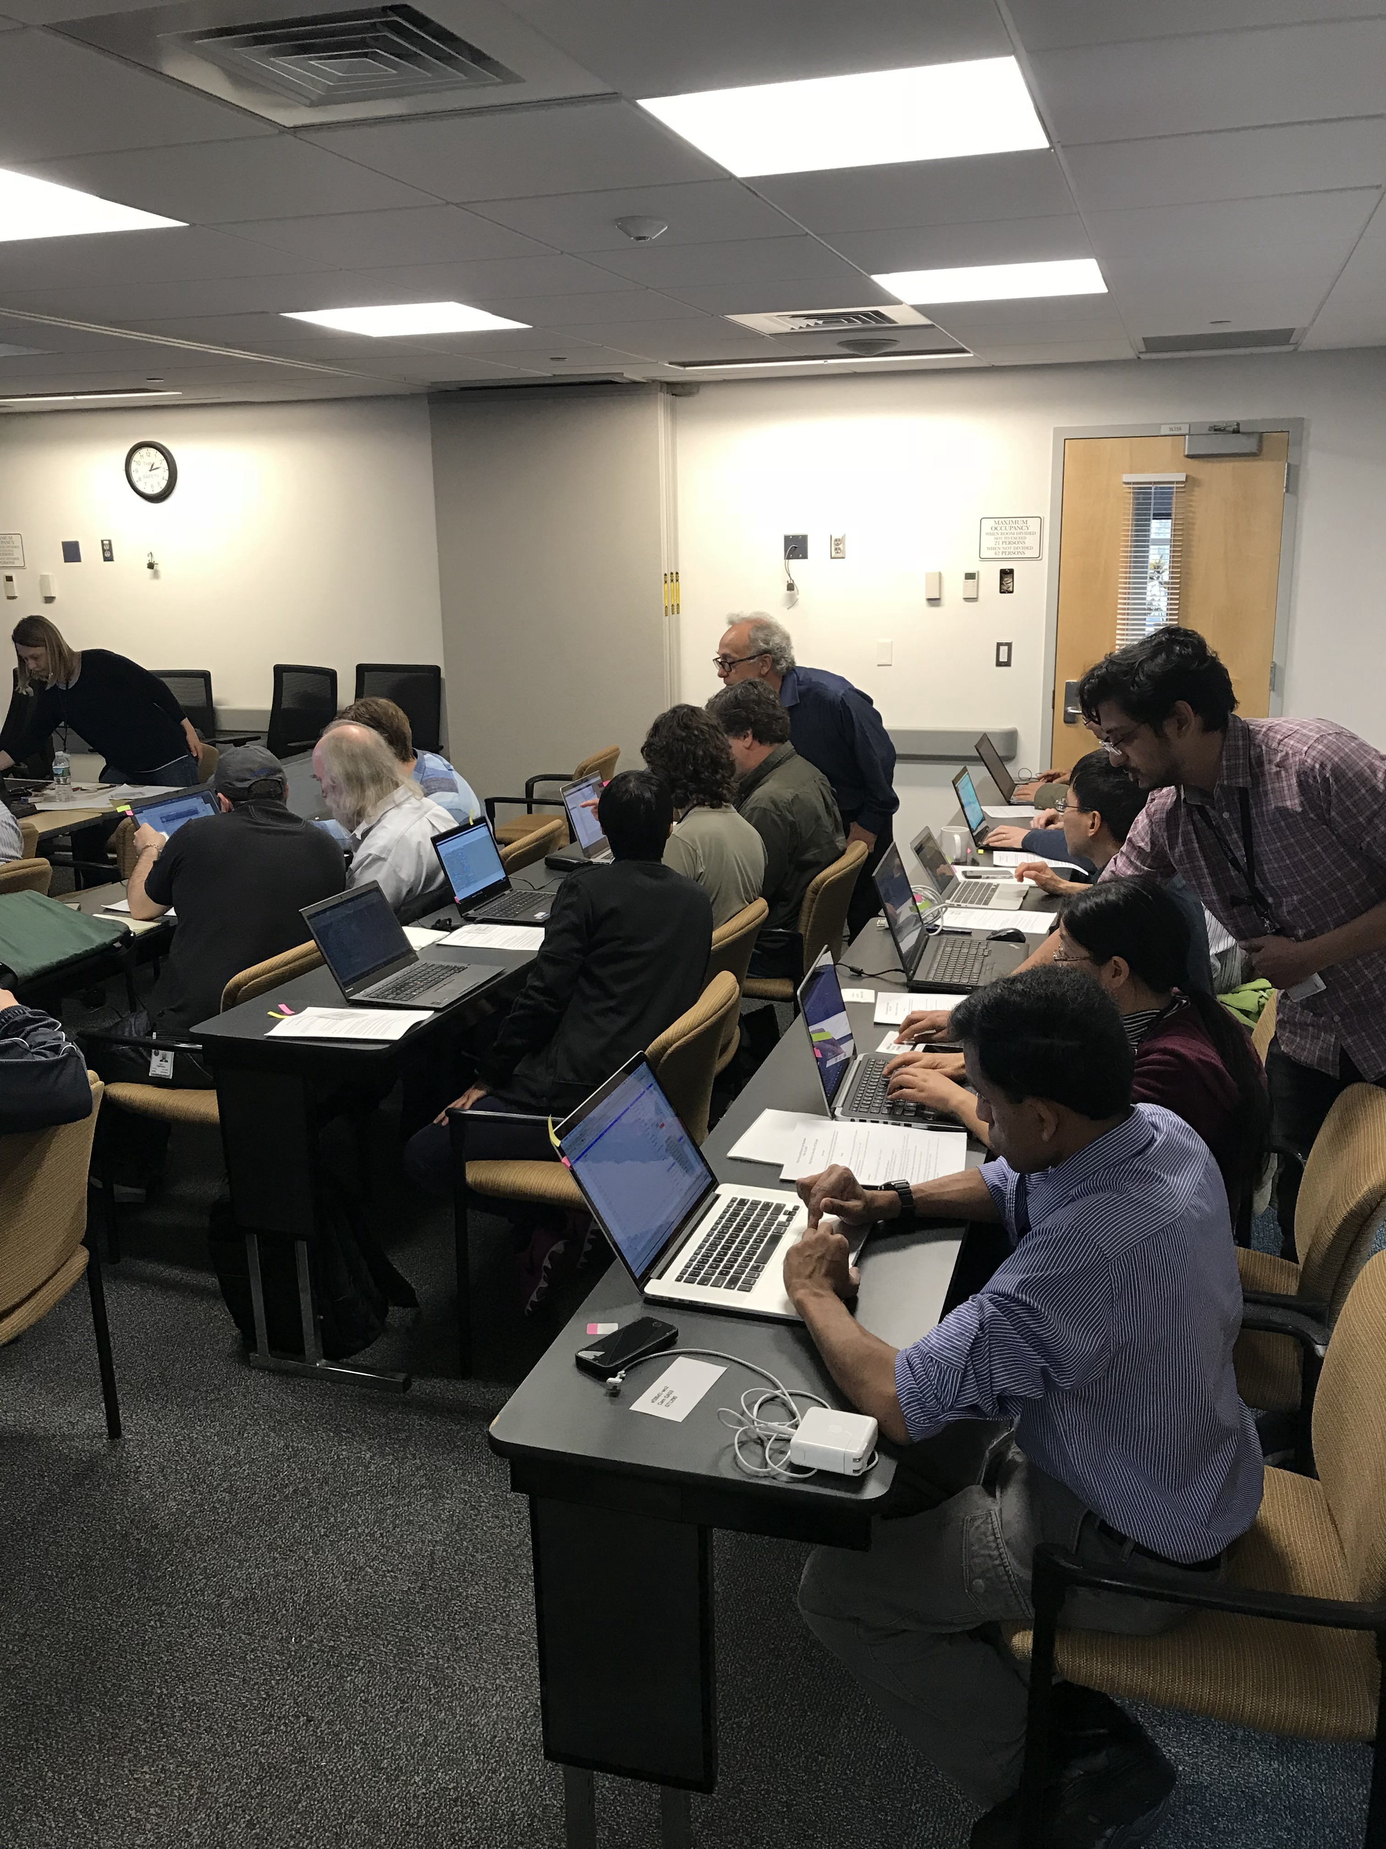
Good bonding time between controls and scientists

Slide 10
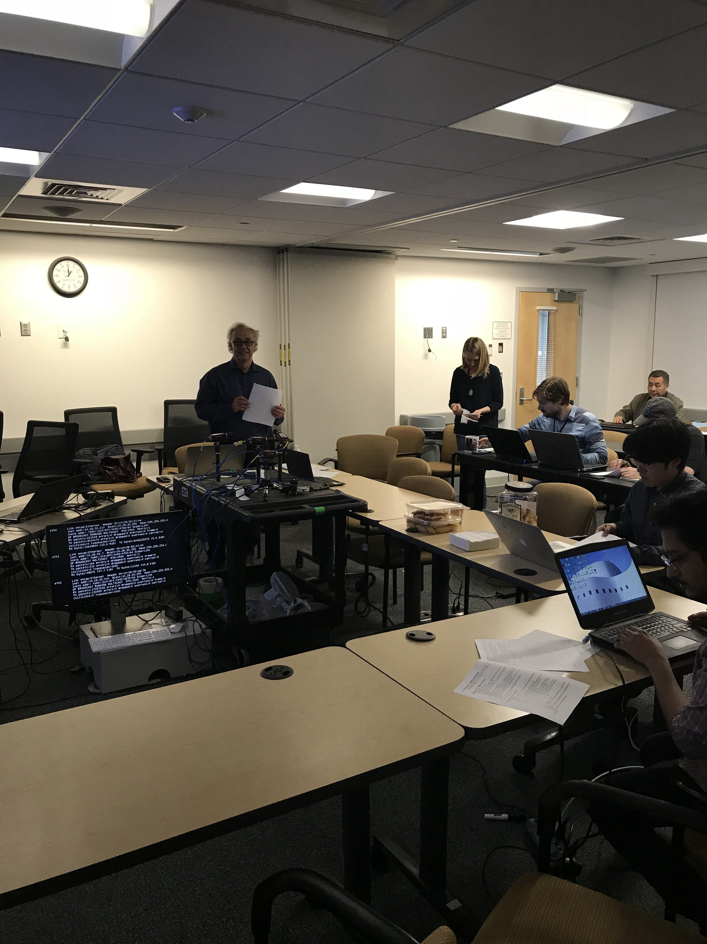
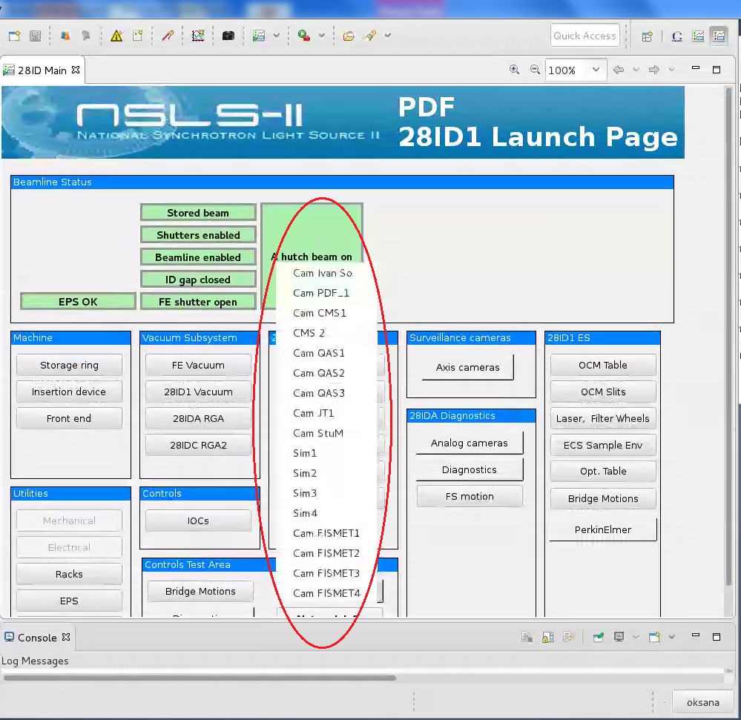
Training details…

Slide 11
Conclusions
Successfully deployed new EPICS Debian distribution on a new beamline. Overcame a potential barrier of a change.
Demonstrated that areaDetector can be upgraded no every interested beamline, running any Debian.
By running a training for beamline scientists advertised benefits of keeping EPICS software updated and did a good job positioning PVA and EPICS7.

Slide 12
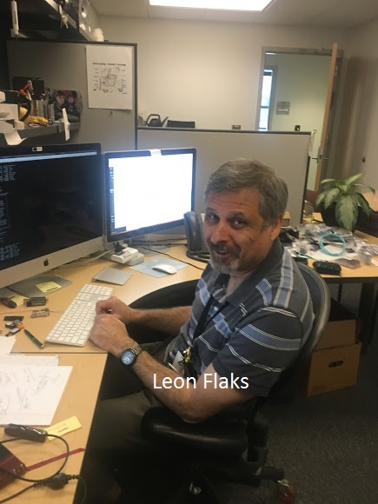
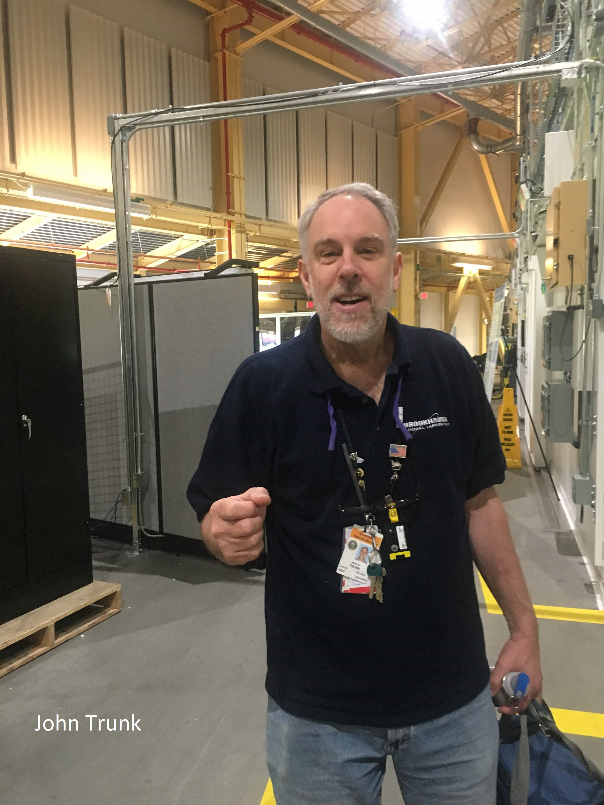
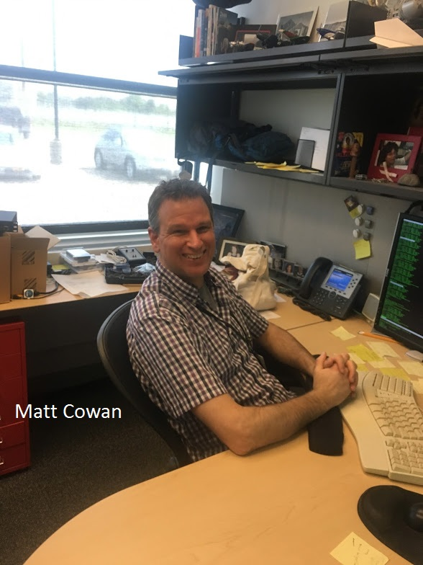
Credits:
Anton Derbenev for NSLS2 new Debian distribution.
Kay Kasemir for perfecting .adl to .opi translator, and BOY fixes along the way.
Leon Flaks for Debian delivery and admin help.
John Trunk for mounting and focusing 10 cameras for the training labs.
Matt Cowan, Kunal Shroff for help running the areaDetector-3-2 labs.
Kazimierz Gofron for media efforts. Video and text are available @ https://www.bnl.gov/ps/epics/
Richard Farnsworth for support including project $$ and Zen Tranquility.
AND …..

Slide 13
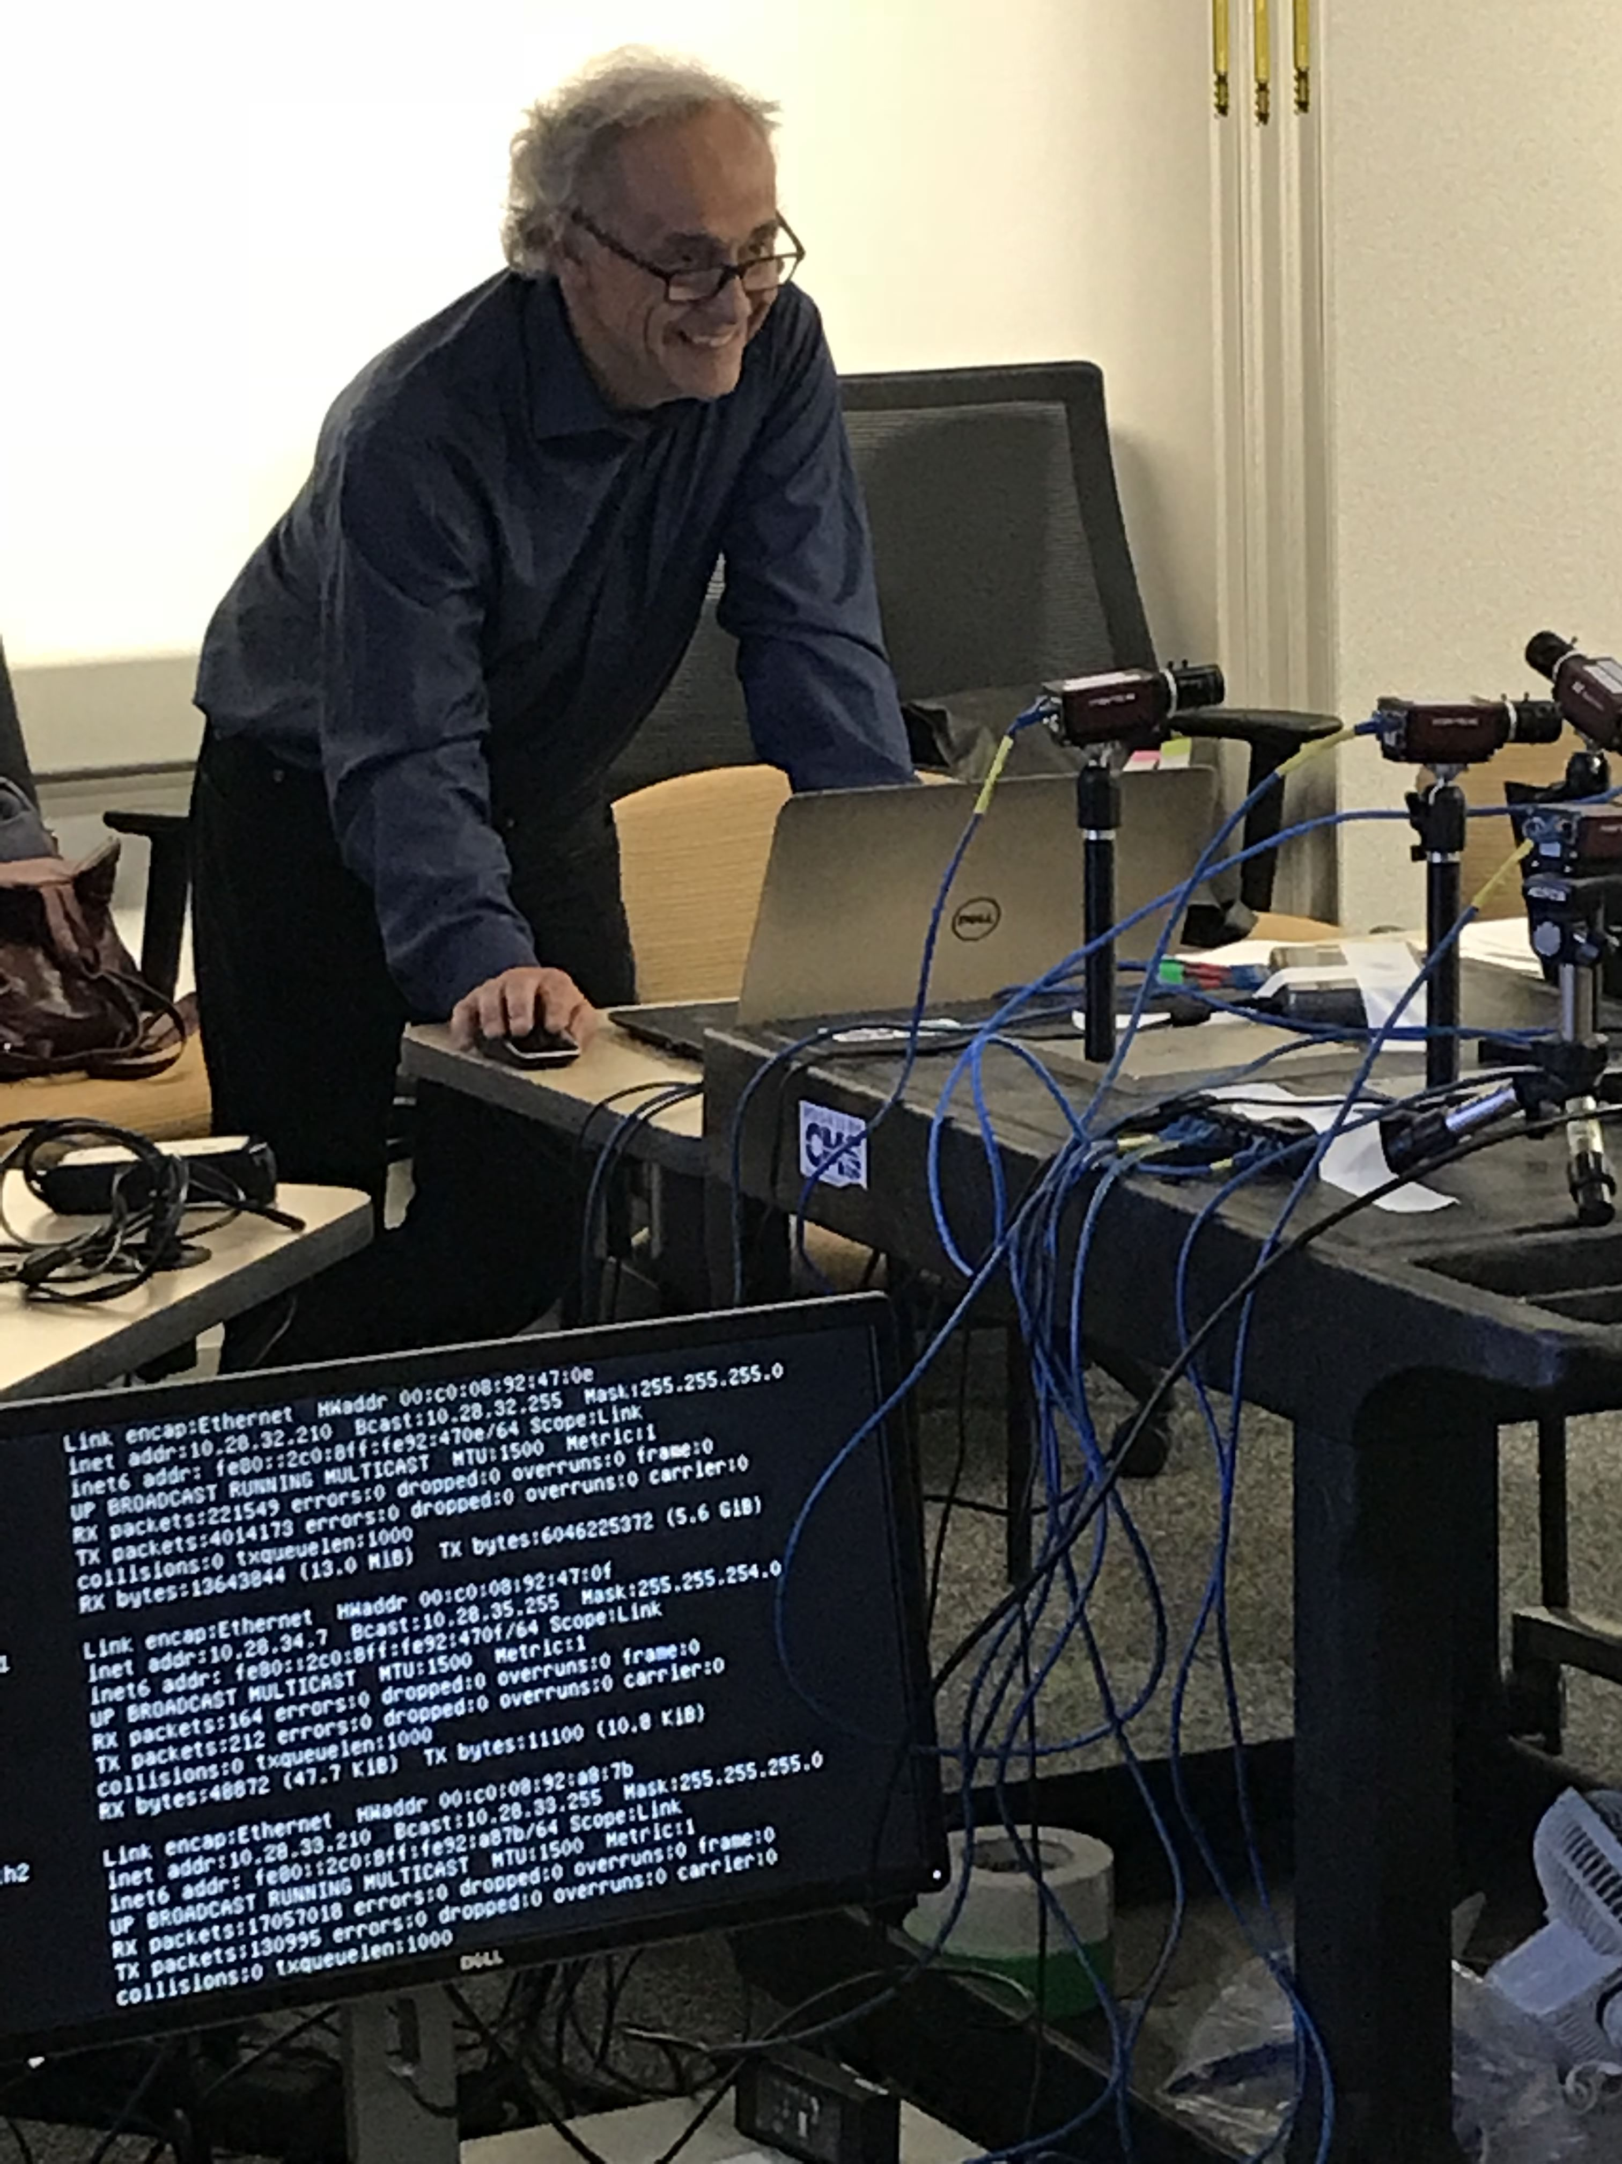
Mark Rivers for
Changing areaDetector make to work with Debian distribution.
Translating areaDetector and asyn .opi screens.
areaDetector workshop and beamline’s visits @ NSLS2.
Adding new features to address NSLS2 needs.
Inspirational
collaborator

Slide 14
Thank you !
Inspirational
collaborator

