Slide 1
EPICS7 at APS
Guobao Shen, Tom Fors, Andrew Johnson, Sinisa Veseli, Ned Arnold
Argonne National Laboratory
June 2018 EPICS Collaboration Meeting
2018-06-13

Slide 2
Content
APS/APSU Controls Software Architecture
EPICS7 and High Performance DAQ
EPICS7 and Digital Video System
PvaPy
Conclusion

Slide 3
Software Architecture

Slide 4
APS/APSU Controls Software Architecture
Current APS Status and APS-U Proposal
Green indicates APS-U Tools currently planned
EPICS 3 + EPICS 4
= EPICS 7
MCR logbook
Physics Applications, Beam Study & MCR Tools
EPICS Extensions
MEDM, alh, burt, StripTool, adt, …
Purple indicates possible upgrades to existing tools
PEM,
sddsexperiment,
1000s of scripts,
…
Save/Compare/Restore,
Archiving, Glitch logger,
MPS Dump Review, …
EPICS 7 (PVA)
Waveform/Image Viewer
Others
SDDS-EPICS Toolkit
SDDS-EPICS 7 Toolkit
Network
EPICS 7 HTTP
Naming & Directory Service
HTTP
Component DB
EPICS 7 HTTP
Infrastructure Monitoring
EPICS IOC
Soft Records
(run control, etc)
Display Manager
EPICS 7 HTTP
Historian Data
EPICS 7 HTTP
Electronic logbook
EPICS 7
Save/Set/Restore
EPICS 7 HTTP
Alarm Service
EPICS 7 HTTP
Logging
CA Gateways
PV List
CA Gateways
PV Gateways
V7
CA Gateways
PV Gateways
EPICS 7
Database
Database
Database
Leverage from / collaborate with the EPICS Community
EPICS 7
Virtual Technical Systems
EPICS 7 IOCs
Technical Systems
EPICS 3 IOCs
Technical Systems
EPICS 7
DAQ Server
EPICS 7
DAQ Data Management
EPICS 7
DAQ Processing
EPICS 7
sdds2pvObject
EPICS 7 IOCs
Technical Systems
EPICS 3 IOCs
Technical Systems
EPICS 7 IOCs
Technical Systems
EPICS 3 IOCs
Technical Systems
EPICS 7 IOCs
Technical Systems
EPICS 3 IOCs
Technical Systems
EPICS 7 IOCs
Technical Systems
EPICS 7 IOCs
Technical Systems
EPICS 7 DAQ IOCs
EPICS 7 IOCs
Technical Systems
EPICS 7 DAQ IOCs
EPICS 7 DAQ IOCs
Technical Systems
Notes:
Current controls system has been used for over 20 years

Slide 5
APS/APSU Controls Software Architecture
APS-U Controls Software Infrastructure
Notes:
APS is upgrading the last IOC to R3.14
APSU will be all on EPICS7 IOC

Slide 6
EPICS7 and High Performance DAQ

Slide 8
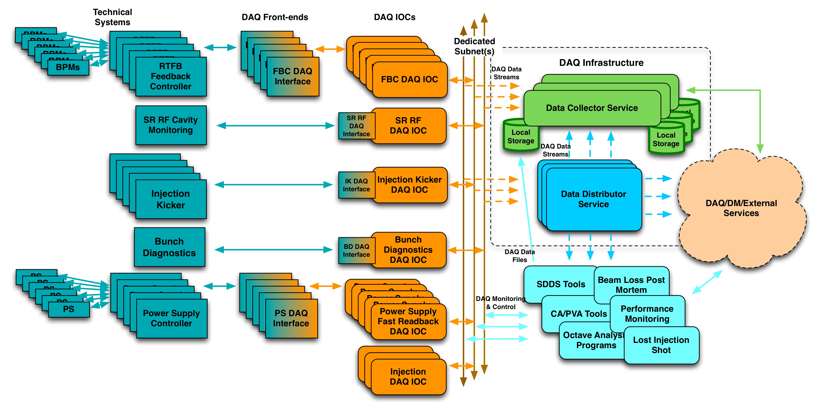
EPICS7 and High Performance DAQ
APSU Data Acquisition System (DAQ)
  Provides time correlated/synchronously sampled data
  Can be used for commissioning, troubleshooting, performance monitoring and early fault detection
  Separated from operational systems to allow troubleshooting during user operations
  Can acquire data from several subsystems at various sample rates
  Supports continuous/triggered acquisition
  Scalability
  Ability to route data to any number of applications
Notes:
The DAQ software interfaces with several technical subsystems to provide time-correlated and synchronously sampled data that can be used for commissioning, troubleshooting, performance monitoring and early fault detection. The key features of the system include capability to acquire data from multiple subsystems at various sample rates, support for continuous data acquisition, and ability to route the data to any number of applications.

Slide 9
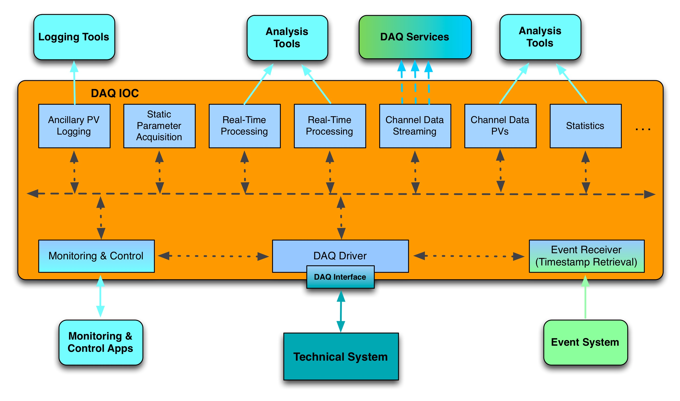
EPICS7 and High Performance DAQ
Typical DAQ IOC Structure (Time-correlated DAQ for APS-U )
  Fast feedback
  Power Supply fast data in FPGA
  BPM turn-by-turn data
  LLRF
  ...
Prototyped several options:
Custom TCP
EPICS V4 PVA
AMQP (QPID)
Area Detector Framework
Uses Asyn/AD Framework:
Data is packed into ND Arrays
Varies by technical system:
MRF Event Receiver
APS Event Receiver
NTP/PTP

Slide 10
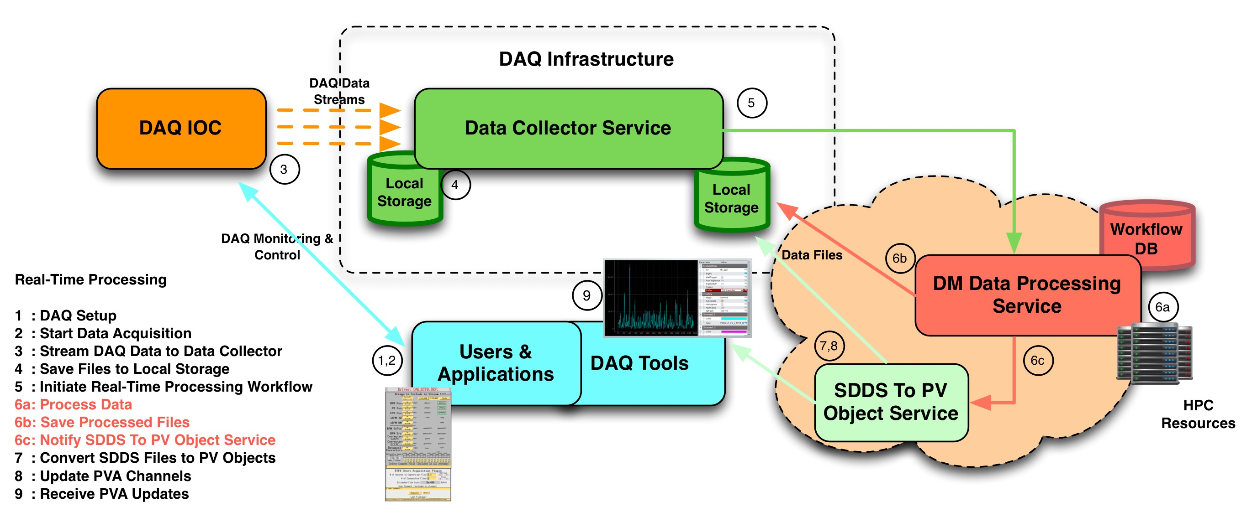
EPICS7 and High Performance DAQ
(Use Case: Automated Real-Time Processing)
10
Notes:
How do we use SDDS tools effectively within the real-time processing framework? How do we easily visualize and share with other applications results of SDDS processing scripts?
SDDS To PV Object Service: converts SDDS file (parameters and data) into an equivalent PV Data (EPICS v4) structure, and exposes that structure via a PV Access channel
Resulting PV structure can be retrieved and monitored via standard EPICS v4 CLI tools and APIs
Service can be accessed using EPICS v4 APIs, or using DAQ command line interface:
daq-sdds-to-pv-object --channel-name xyz --channel-ttl 3600
--file-path /net/helios/ctlsdaq1/…/rtfbStream….sdds
Possible Uses:
Quickly visualize set of SDDS files with the same structure
Distribute results of real-time processing to any interested applications (for example, within DM processing framework)
Go to ”Insert (View) | Header and Footer" to add your organization, sponsor, meeting name here; then, click "Apply to All"
10

Slide 11
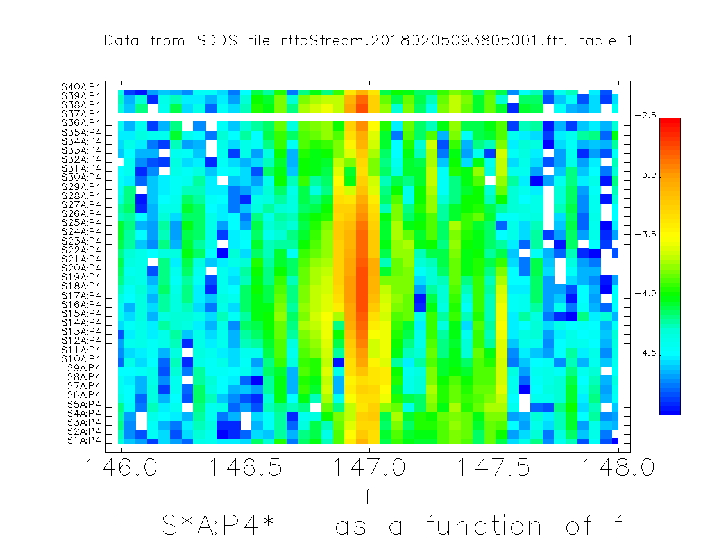
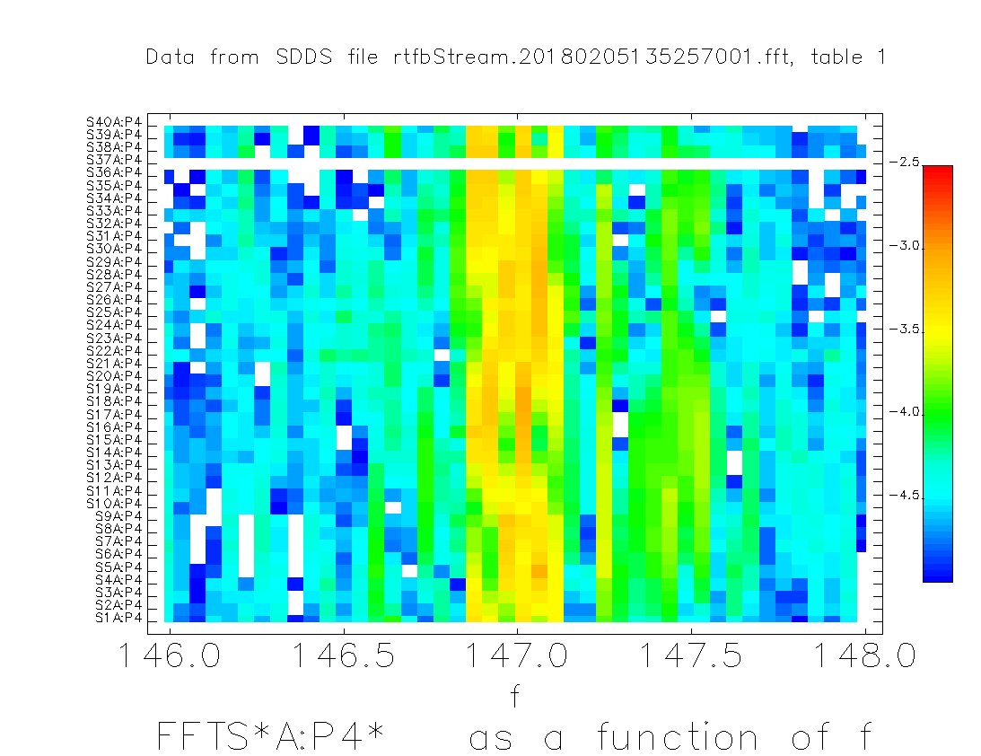
EPICS7 and High Performance DAQ
DAQ Usage Example (L. Emery)
Suppression of 147Hz vibration source in the ring using the DAQ system + post-processing with FFT
Vacuum chamber was vibrating and introduced a Bx field; shims were inserted between poles and vacuum chamber (S37AQ3, S37AQ2)
Identification of the nearest quadrupoles required 400 channels, 20 seconds of continuous DAQ data to get 0.5Hz precision
This allowed separating line frequencies of 20 pumps
Figure on the top is showing data before shimming, while the one on the right is showing results after shimming
11
Notes:
Data source from current RTFB IOC using DAQ
Sequence of events:
Iterate over group of SDDS files, sending requests to update record on a specified PV Access channel
Use daq-scope utility to observe waveform changes for one of the data arrays available as part of the PV structure
Go to ”Insert (View) | Header and Footer" to add your organization, sponsor, meeting name here; then, click "Apply to All"
11

Slide 12
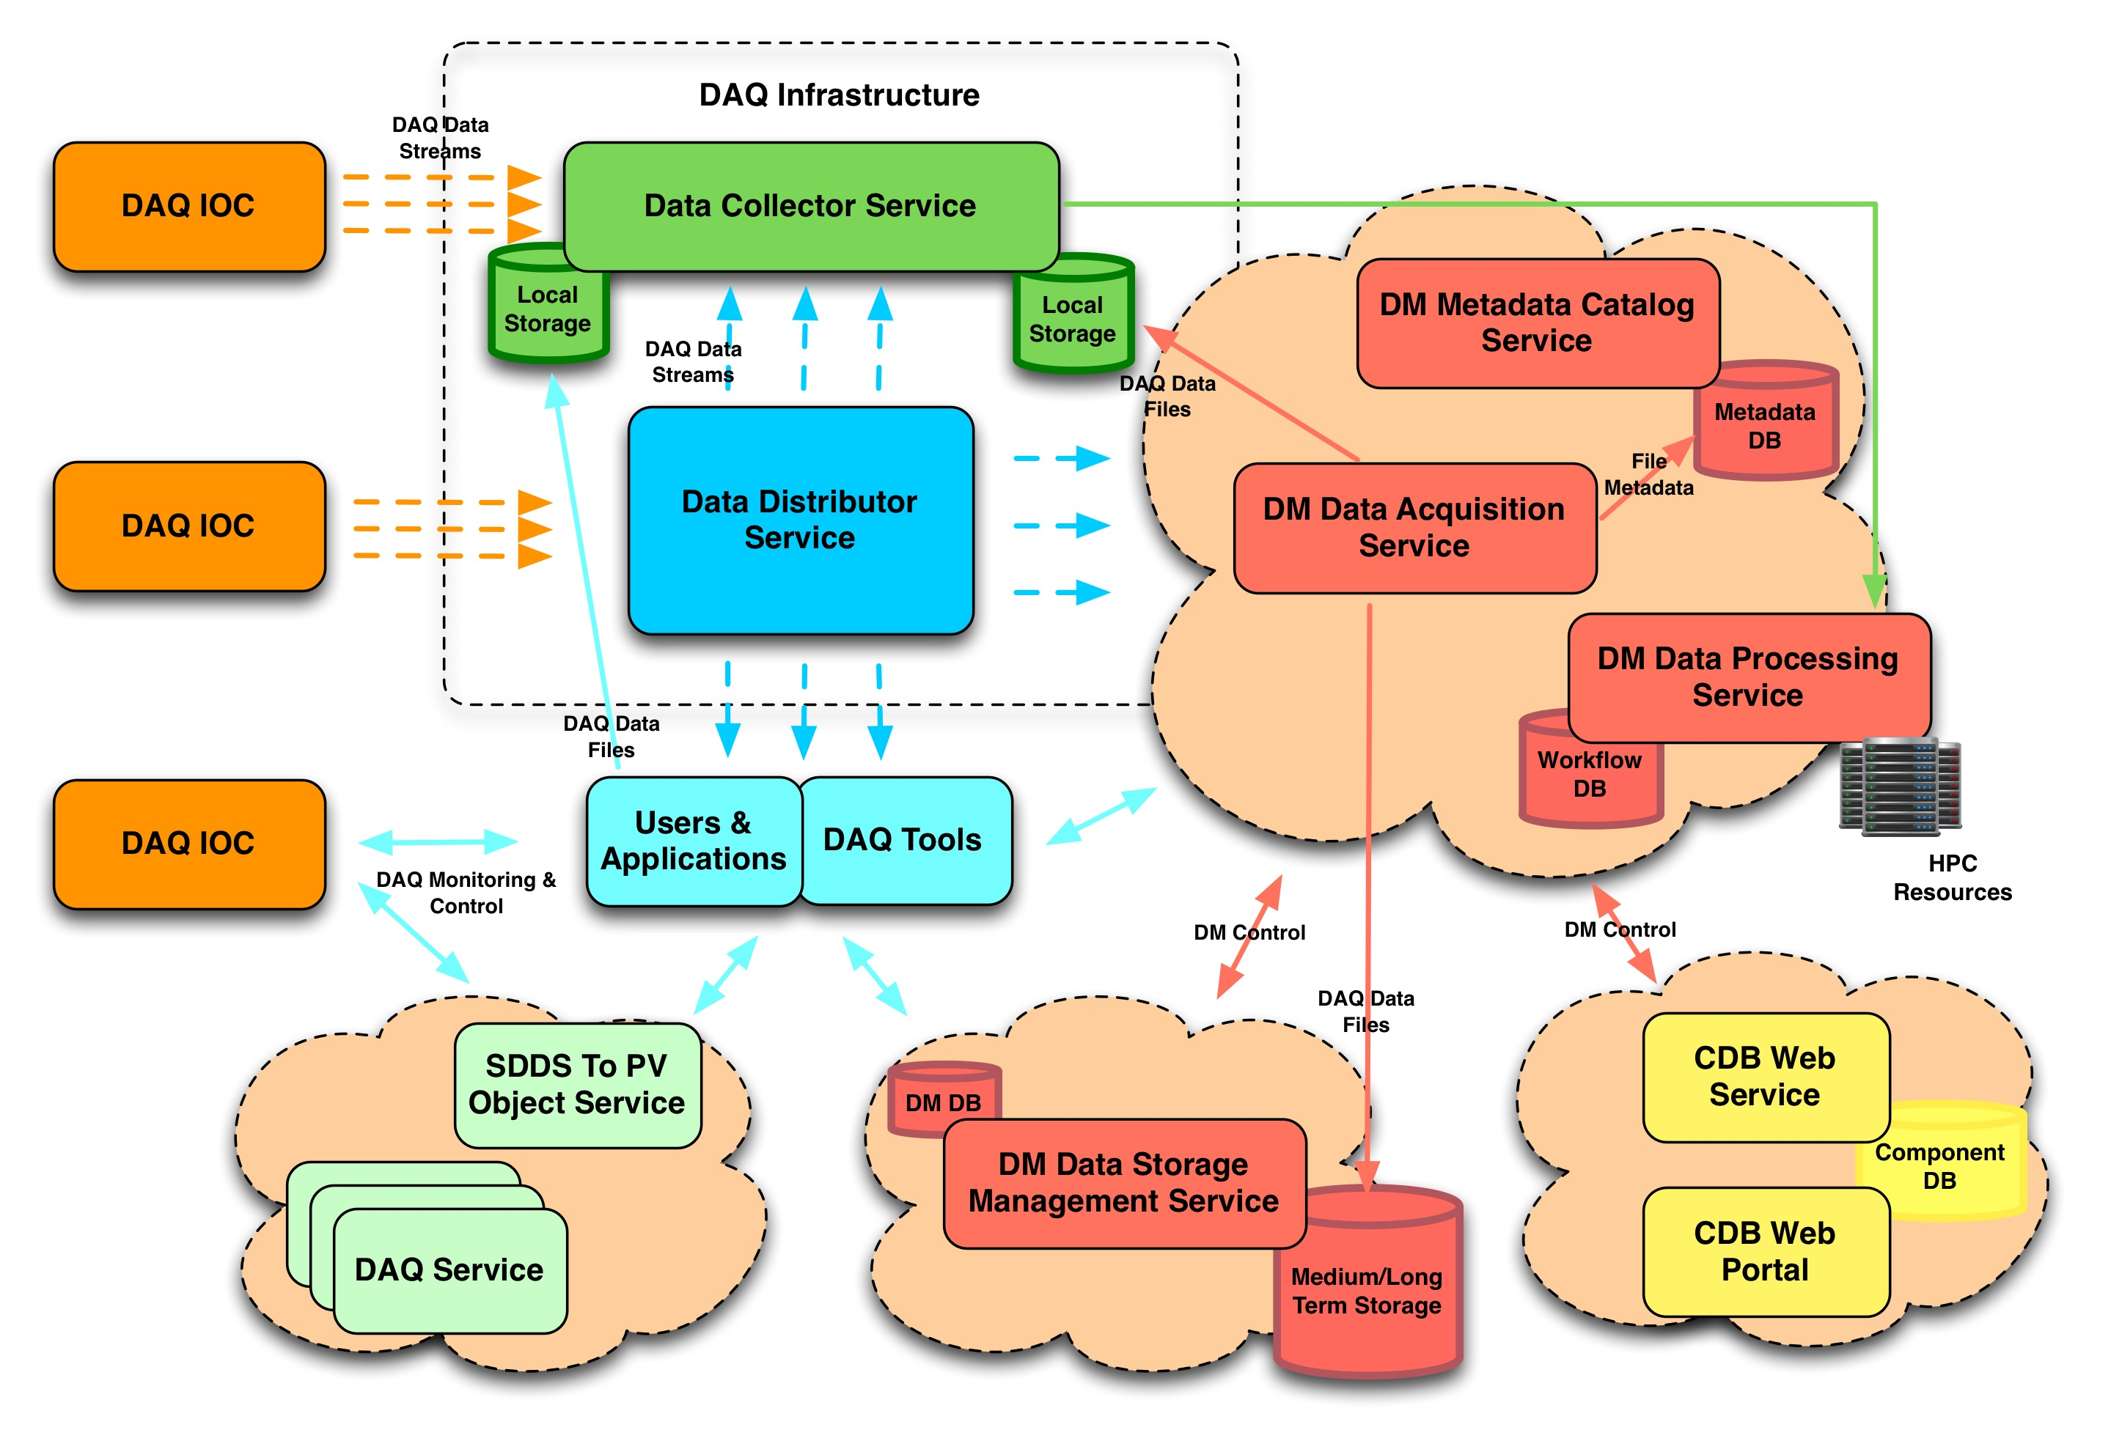
EPICS7 and High Performance DAQ
DAQ and Data Management Integration

Slide 13
EPICS7 and High Performance DAQ
Estimated Data Rates
Current Status & Near Term Plan
  Production deployment for over year
  Software upgrade all in place, tested, ready for production deployment
 |  | Production | Near Term Upgrade
EPICS7 | Base | 3.15.4 | 7.0.1.1
 | V4 | 4.6.0
pvaPy |  | 0.9 | 1.1.x
Area Detector |  | 2.5 | 3.2
Asyn |  | 4-29 | 4-33
Notes:
TBT Data: 4libera boxes per sector, each managing 4 BPMs (16 BPMs per sector), at minimum we need x&y plus timestamp @ 271kHZ: 4 liberas *(4 bpms *8bytes of x&y+4bytes timestamp)*271000=37.2MB/s
For 40 sectors, the system would produce at minimum of 1.5GB/s of TBT data

Slide 14
EPICS7 and Digital Video System

Slide 16
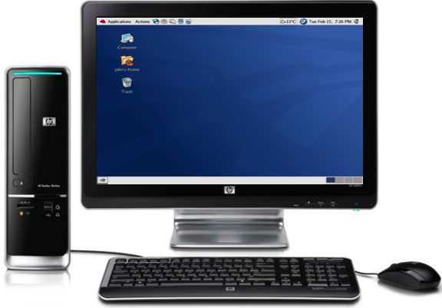
EPICS7 and Digital Video System
APS diagnostics digital camera system requirements
  Canonical needs like most diagnostic camera instruments
  Or high frame rate to observe beam damping time
  Or extreme low e⁻ read noise
System architecture
Console
Edge
Switch
IOC
USB3
USB3
USB3
USB3
10GigE
GigE
USB3
Camera

Slide 17

EPICS7 and Digital Video System
Hardware choices
  FLIR (Point Grey) GigE camera for canonical use case
  FLIR USB3 for high frame rate use case
  sCMOS camera for low e⁻ read noise
Software
Beam damping observation
  Deployed for APS PAR
  500~600 fps
  AD PVA plugin (NtNDArray)
 | Deployment
EPICS7 | 7.0.1.1
pvaPy | 1.1.x
Area Detector | 3.2
Asyn | 4-33

Slide 18
EPICS7 and Digital Video System
Next Plan
  Plan to take 100 seconds data per experiment/study
  3Gbps data rate per camera (or more) to be saved/transferred
    Local HD solution does not sound reasonable
    10GigE Network infrastructure available to use
  Integrate with DAQ Data Management (DM) system
    Directly stream data into DM with new area detector streaming plugin

Slide 19
PvaPY: A EPics7 Python library

Slide 21
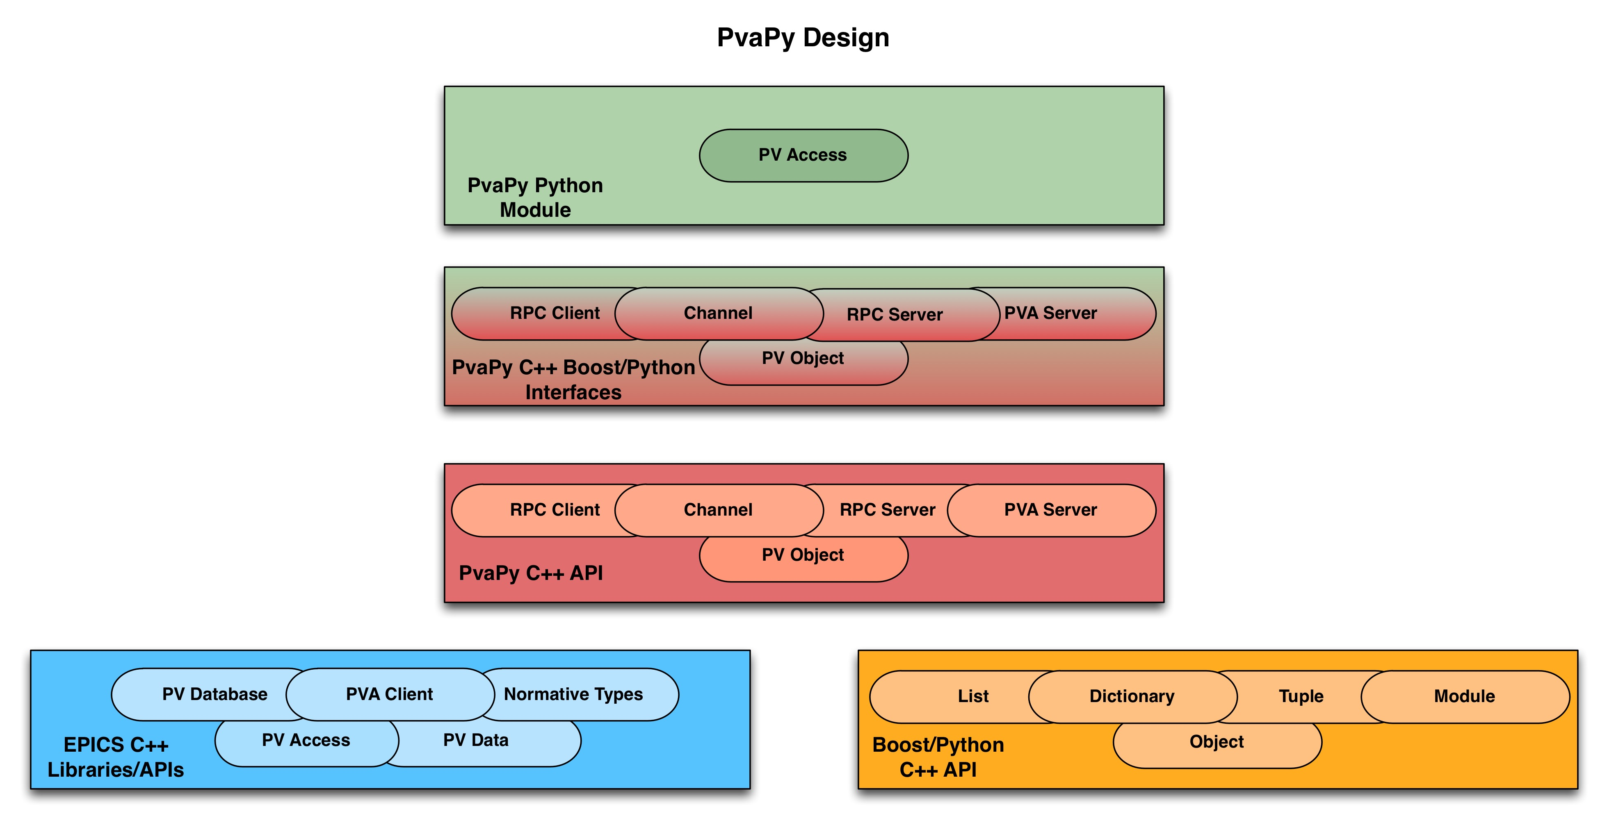
PvaPy – Python API for PV Access
Uses boost.python to wrap EPICS C++ libraries
Works for both CA and PVA
Utilizes EPICS build with automated configuration
Builds against EPICS7 and against all EPICS v4 versions starting with release 4.4
Maintains stable interfaces, backwards compatibility
Easy installation for Conda users
Works on Python 2/3
Works on OSX and Linux
Very good performance
Functionality
Getting Software
Support for scalars, structures and unions (both variant and restricted)
Support for channel monitors, get(), put(), putGet() and getPut() operations
Support for numpy arrays
PVA Server
RPC server/client
Sources: https://github.com/epics-base/pvaPy
Online Documentation: https://epics.anl.gov/extensions/pvaPy/production
Conda packages (Python 2 or 3): epics::pvapy (packages contain documentation)
More Info in lighting talks:
PvaPy Status Update, S. Veseli
From Zero to EPICS7 in 5 minutes, T. Fors
21
Notes:
Performance Notes:
- Faster initial monitor connections result in faster application startup and dynamic addition of new channels
- Monitors connect automatically when channels come online
- Significant improvements in scalability and robustness: PvaPy can now monitor up to 80000 1Hz channels in a single Python application

Slide 22
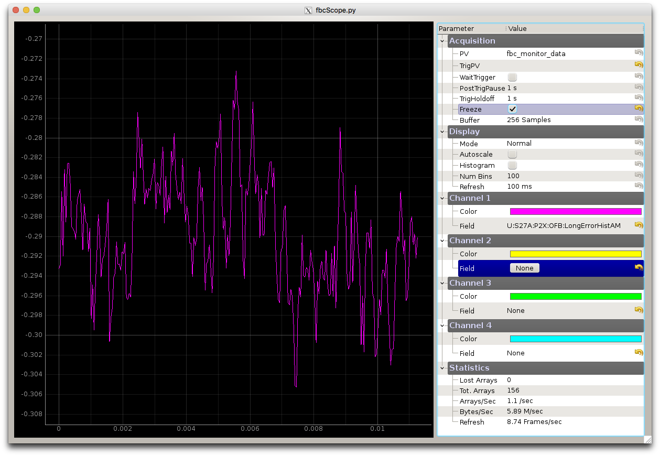

PvaPy Use Cases
Scope Application
Video image
Monitor fast data from DAQ FOFB, PS, BPM TxT, LLRF, ...
Desktop testing 45fps @1920x1200 (~800Mbps)
To be merged with scope application
Python jupyter notebook
Online data analysis, machine controls

Slide 23
Conclusion
APS/APSU software infrastructure clarified, and development strategy established to deliver a modern APS/APSU control system
High performance DAQ system based on EPICS7 in production over year
Digital video system primarily uses EPICS7 for its image data, and planning to develop an area detector plugin to stream image data to DAQ Data Management system directly for post use
EPICS7 Python binding, pvaPy, under active development, and its 1.1.0 version released on 4/30/2018
Client application under active development on top of pvaPy

Slide 24
Thanks
Mark Rivers for all his supports in area detector and various productive discussions
Tim Mooney for his help in assembling synApp modules
Tim Madden @ RF group for his valuable discussions and contributions on the EPICS7 Scope application
Bingxin Yang @ Diagnostics group for his various discussions on digital video system development
All colleagues at Controls Group for their contributions, discussions, helps, and suggestions

