Slide 1
An IoT Peripheral Radiation Monitoring System
James Morad June 13 2018

Slide 2
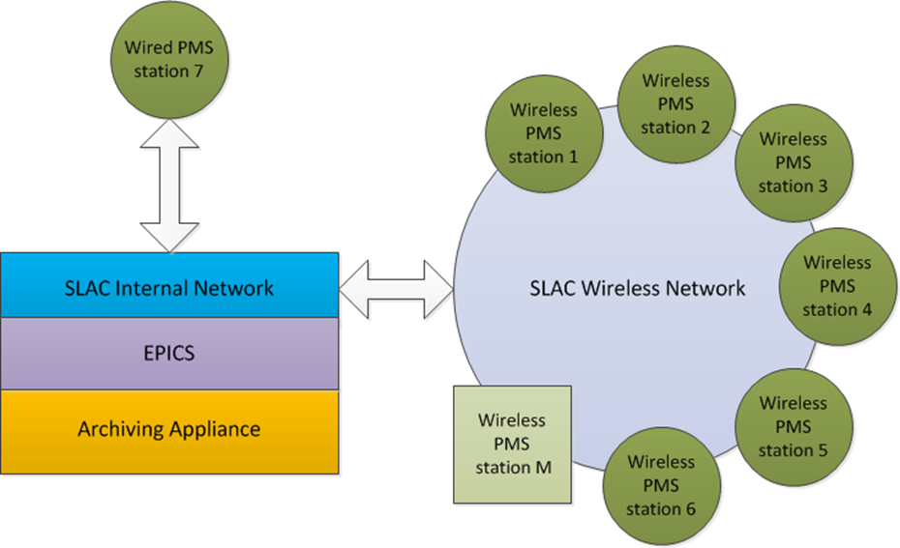
Project overview
Goals
Integration of radiation sensors into central control system.
Archiving and storage of radiation data
Reliable wireless communication
Requirements
Gamma & neutron dose rate must be measured in mrem/hour at 1 minute interval
Dose rates must be stored in a central location accessible to the users.
Device communication through asyn, StreamDevice

Slide 3
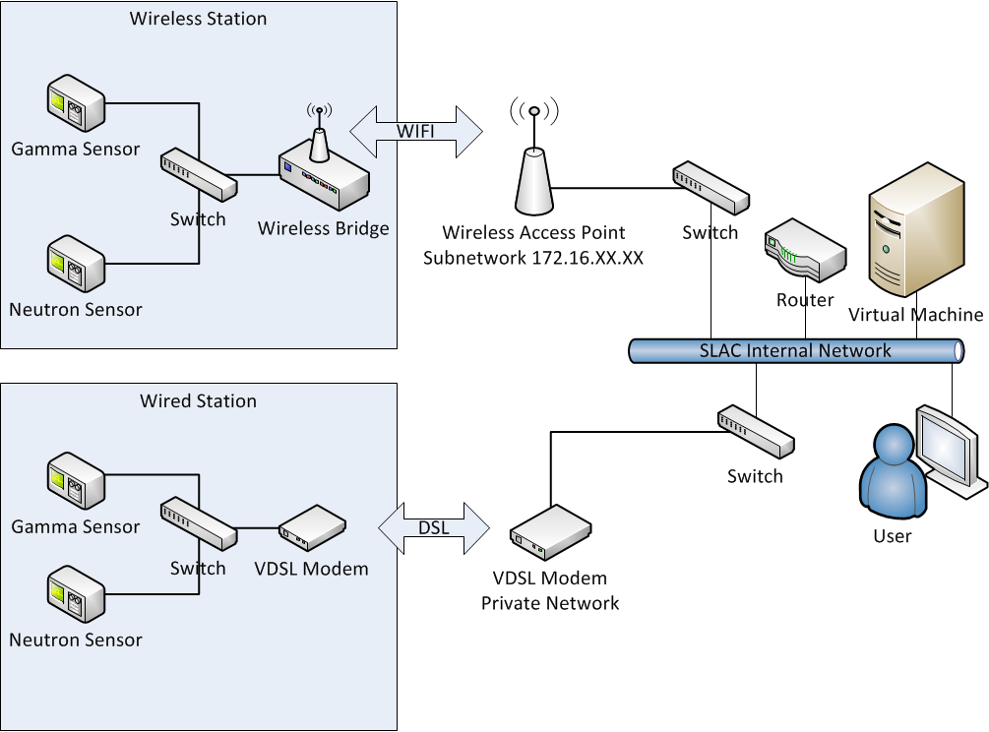
Network design

Slide 4
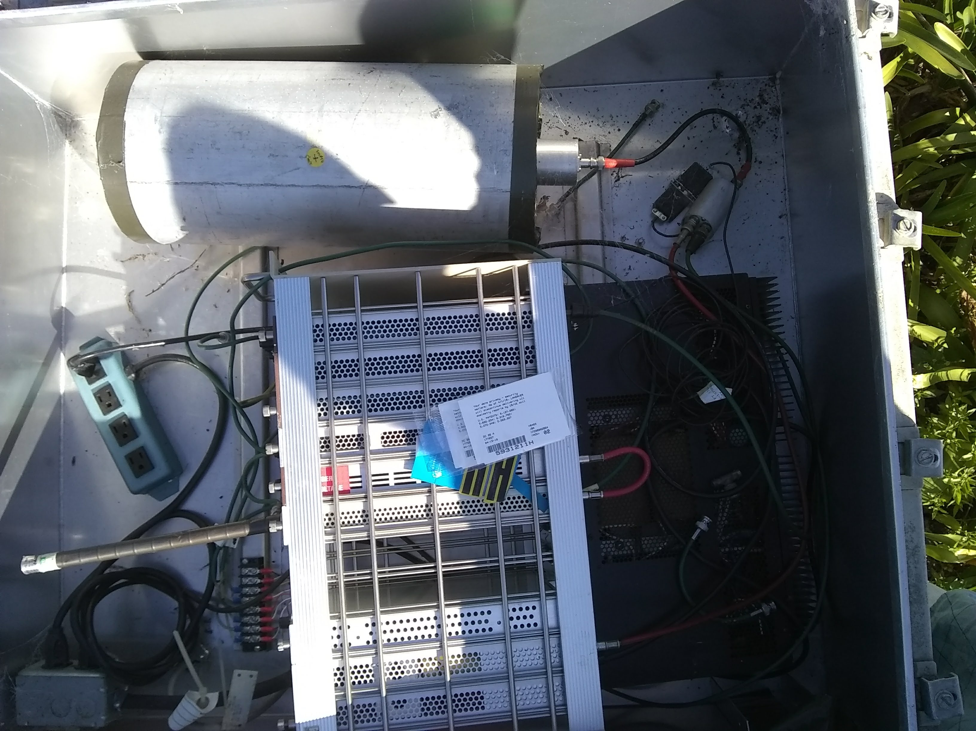
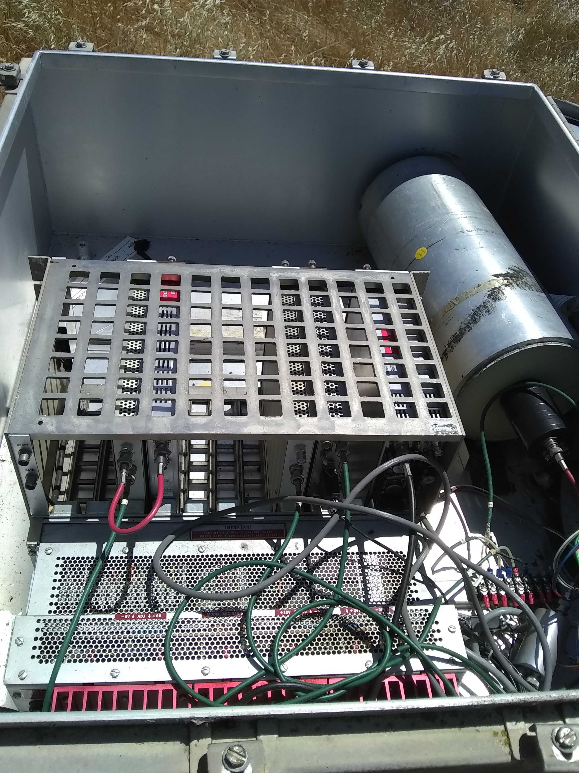
Out with the old…

Slide 5
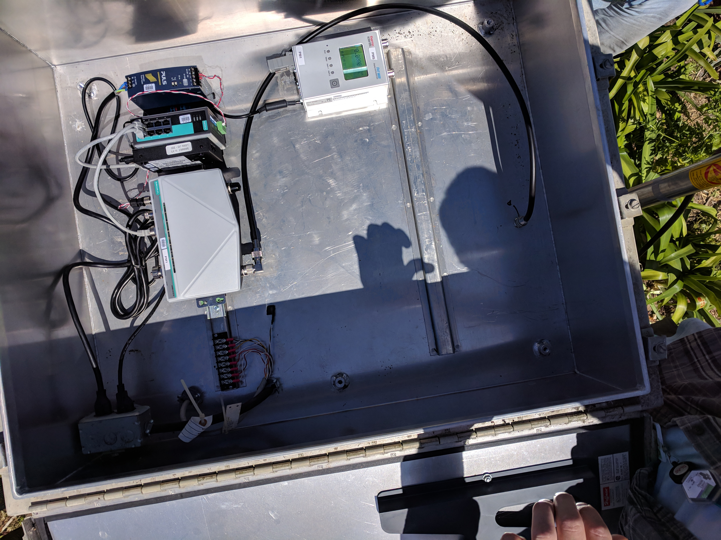
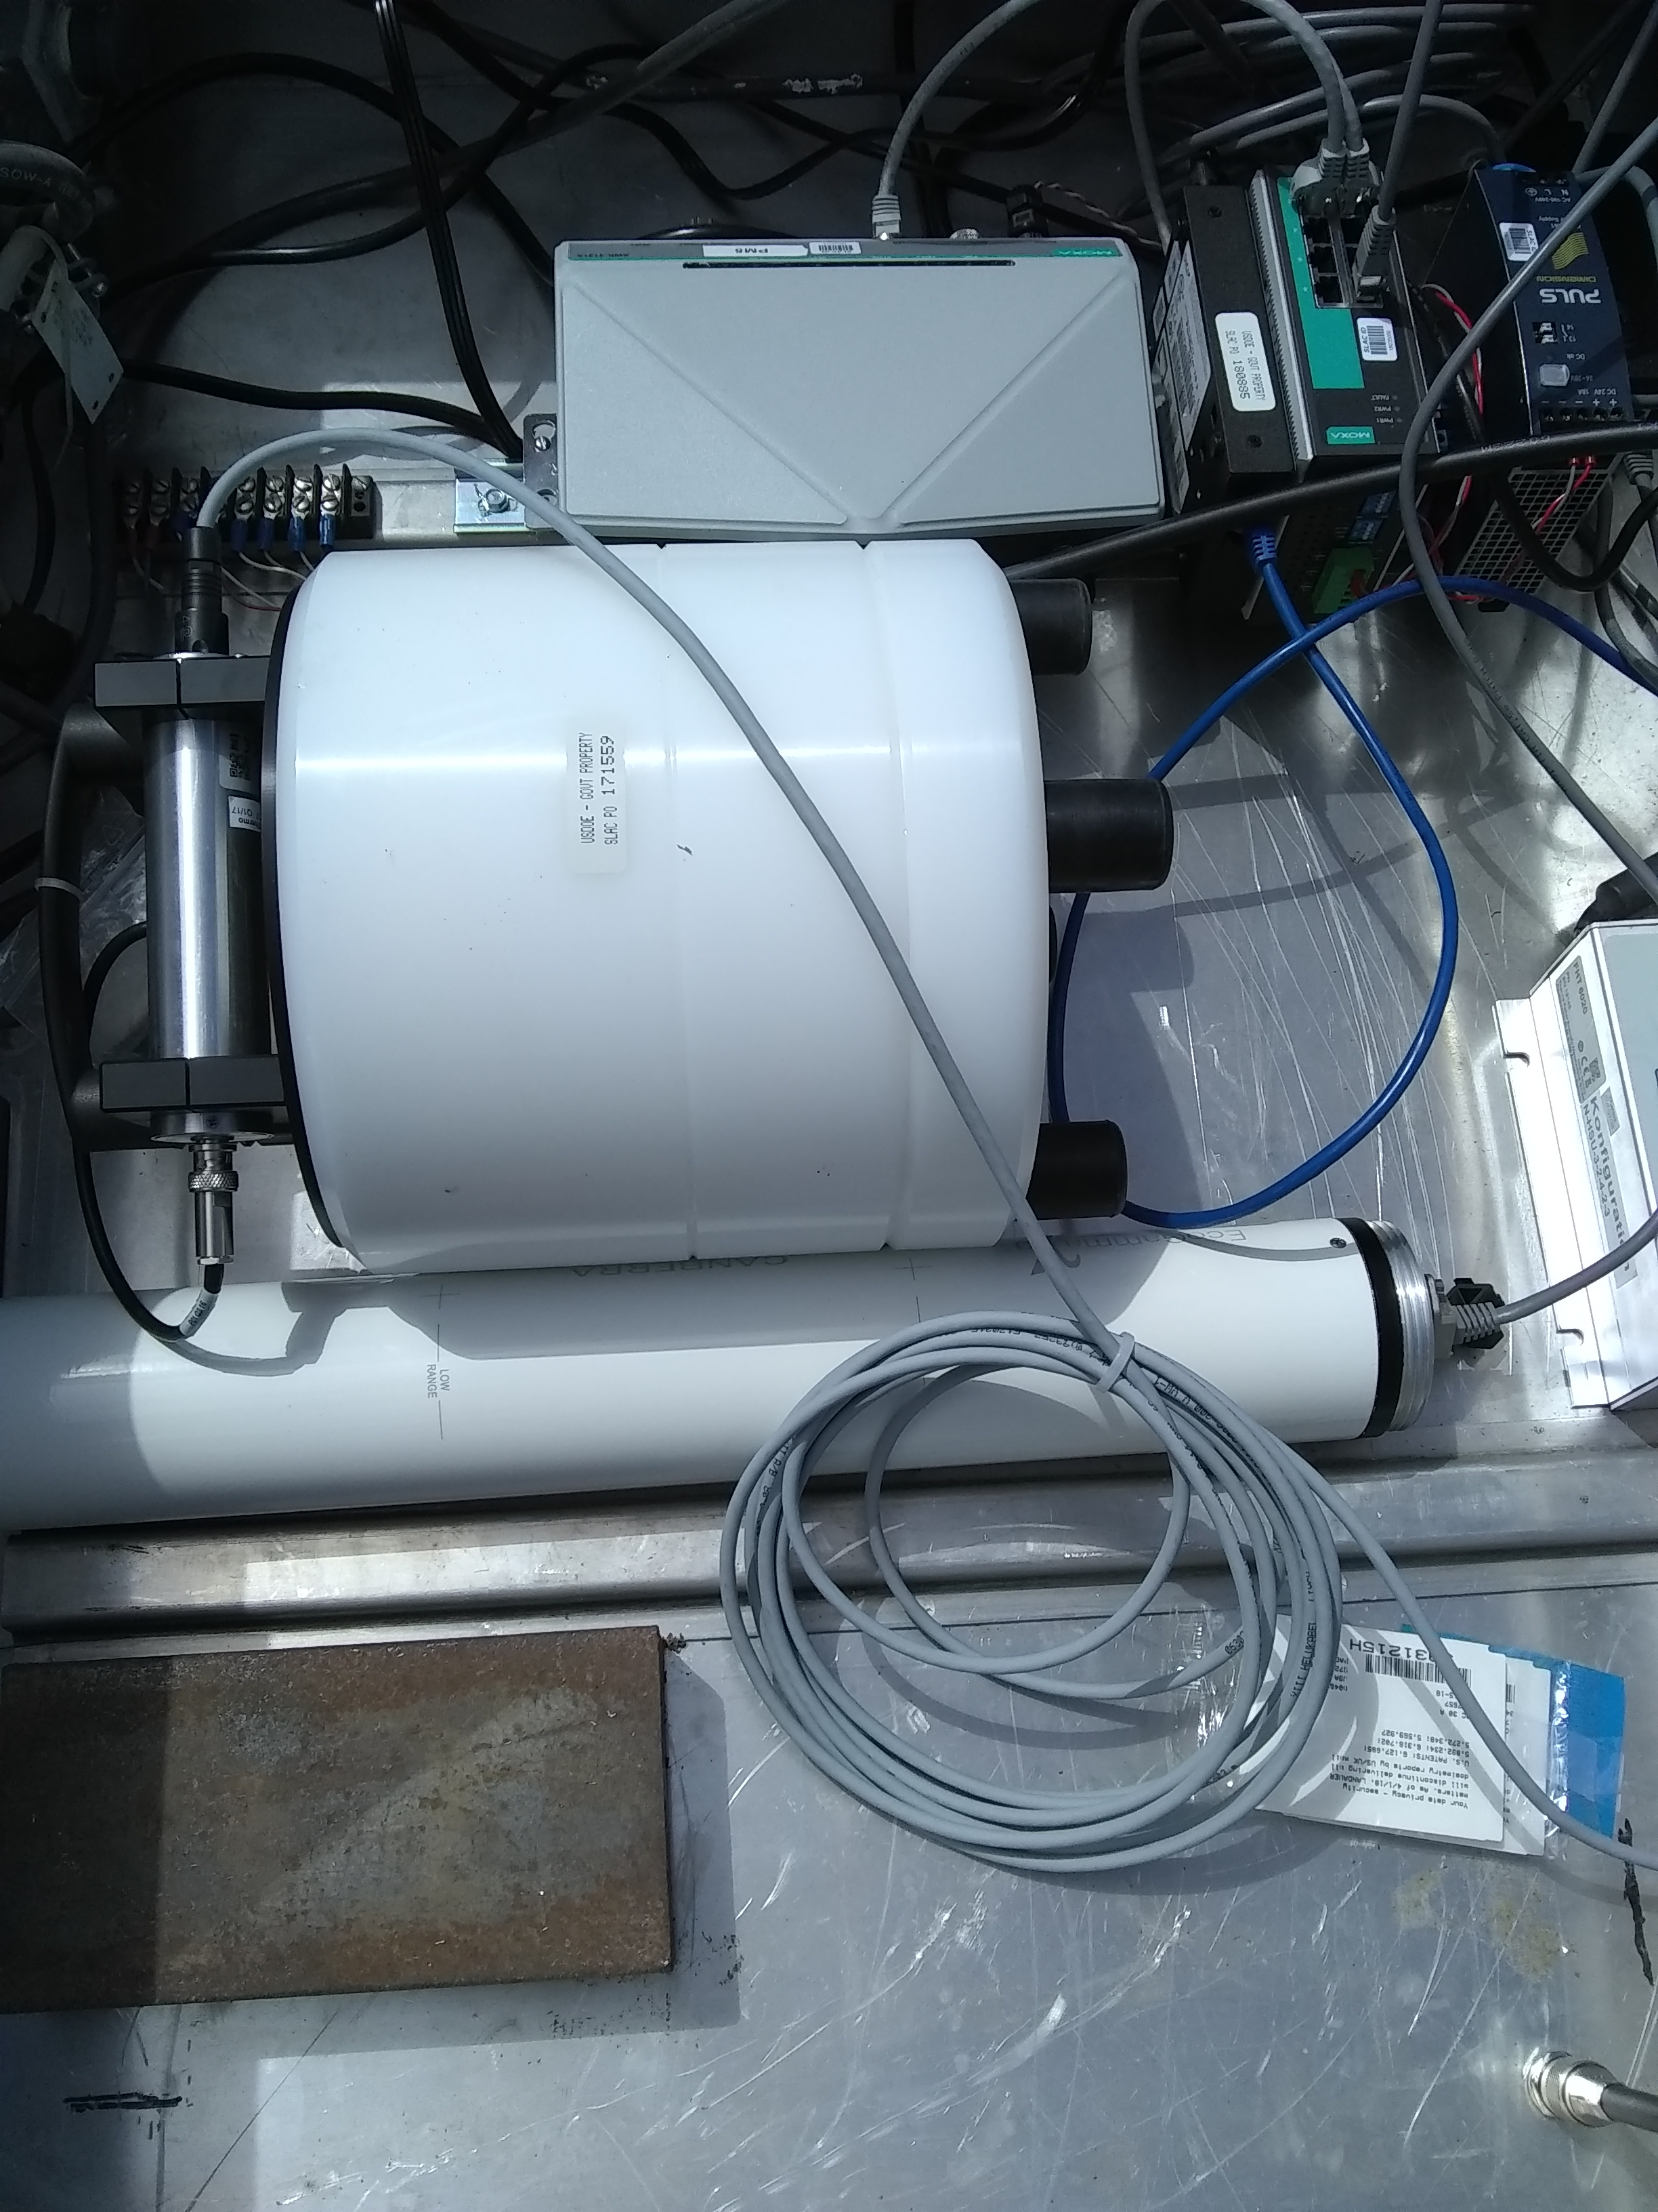
In with the new!
DC Power Supply
N-type Feedthrough to External Antenna
SWENDI neutron detector
RS232 Adapter
Network Switch
WiFi Bridge
EcoGamma

Slide 6
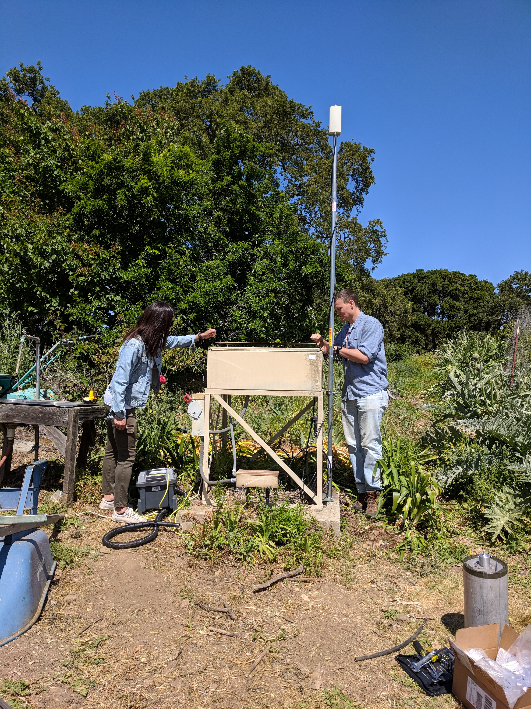
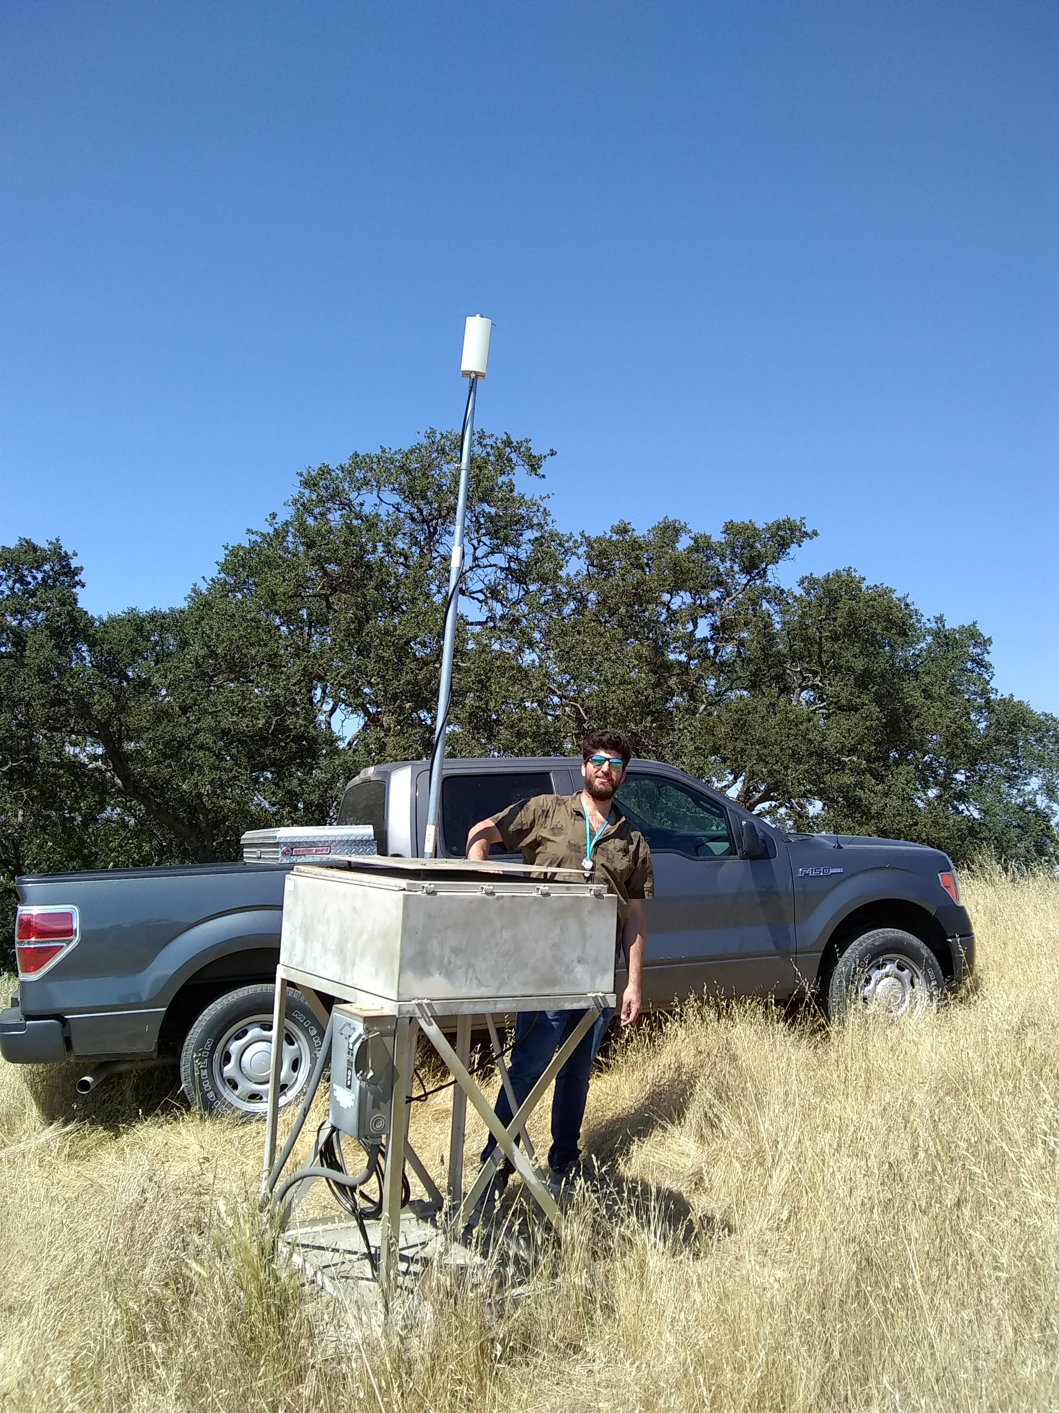
Field installation
PM1 (SLAC garden)
PM2

Slide 7
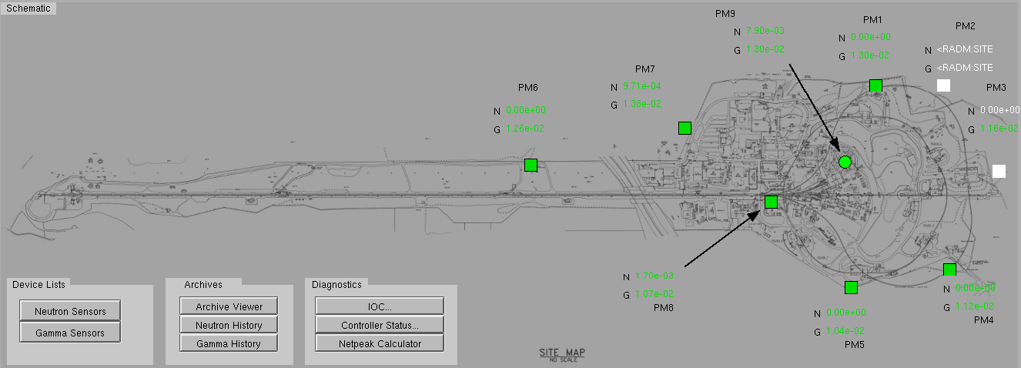
A birds-eye view

Slide 8
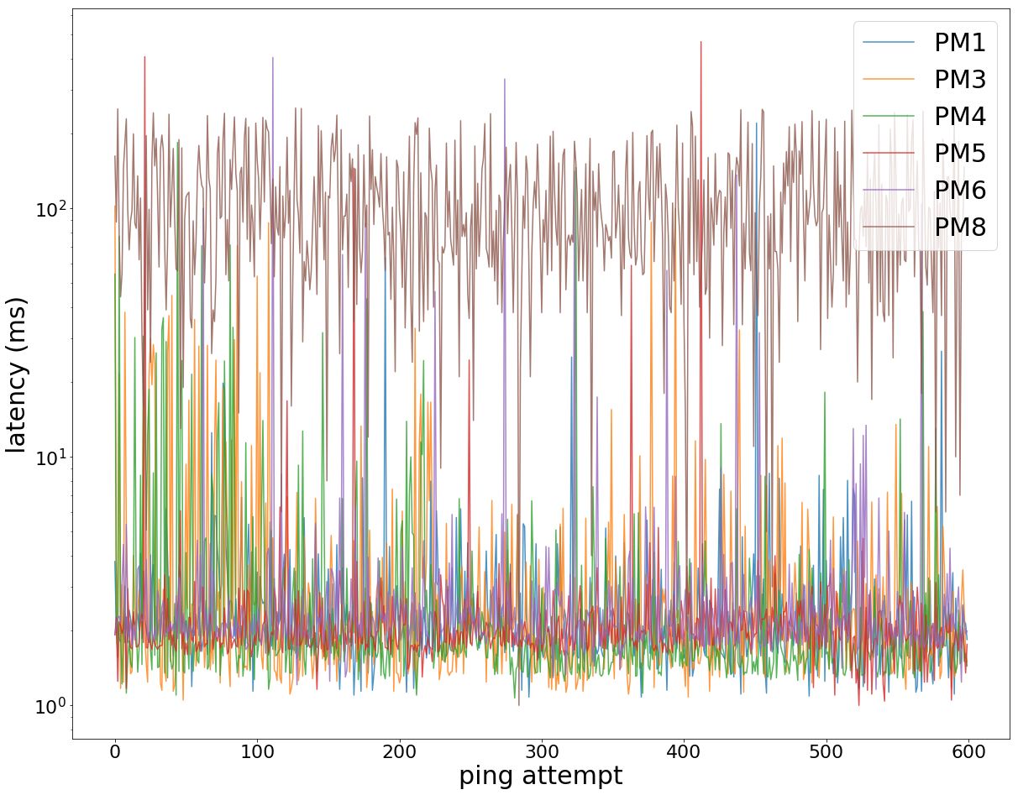
Individual station data
Station | Signal Strength (dB)
PM1 | -78
PM3 | -78
PM4 | -70
PM5 | -78
PM6 | -81
PM8 | -71
Note: PM7 is connected to the network via a DSL modem while PM2 is still a work in progress

Slide 9
Cosylab Loves GDPR!!!
CSL has always treated personal data with respect
GDPR turns such good practice into formal rules
One outcome: it’s not enough you once told us in person you like the great technical articles in our Control Sheet newsletter
You have to sign-up through the webform
https://www.cosylab.com/signup/

Slide 10
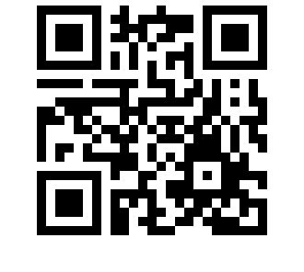
Yes, I want Control Sheet! ☺
https://www.cosylab.com/signup/

