Slide 1
Conversion of medm Screens to CSS-BOY, caQtDM, and edm using Makefiles
medm is the only EPICS display manager with conversion tools to all of the other popular display managers (CSS-BOY, caQtDM, edm)
Goals:
Module developers can create/edit an medm file and type make to automatically convert to other OPI formats producing good-looking, fully-functional displays
Eliminate the need for even minor edits/tweaks.

Slide 2
Solution
Added yyyApp/op/Makefile.
Runs the conversion tools to convert the medm adl files to edl for edm, ui for caQtDM, and opi for CSS-BOY.
RULES_OPI file was added to synApps/support/configure to support this (https://github.com/epics-synApps/configure).
If RULES_OPI file is not found the Makefile does nothing.
If the RULES_OPI file is found then a CONFIG_SITE file in synApps/configure or in EPICS base must define these symbols:
ADL2EDL: path to adl2edl for edm
ADL2UI: path to adl2ui for caQtDM
CSS: path to css. Must be a recent version that supports the command
css -nosplash -application org.csstudio.opibuilder.adl2boy.application

Slide 3
Solution
op/edl/autoconvert, op/ui/autoconvert, and op/opi/autoconvert directories contain new conversions of all of the medm files.
edl, ui, and opi directories should contain only manually converted and edited files.
Many of the files in these directories have been removed, either because they were actually old autoconverted files, or because they are obsolete and the new autoconverted files are better.
areaDetector, asyn, and many synApps modules now have yyyApp/op/Makefile and autoconvert directories.
Need to complete the job of adding to all synApps modules

Slide 4
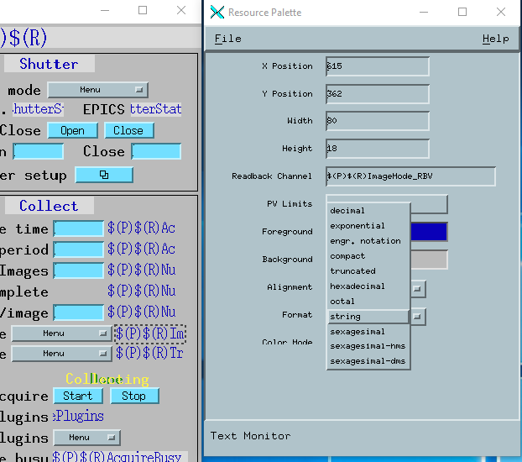
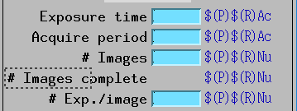
medm File Improvements
Good conversion requires a good medm adl file
Text graphics widget sizes are set to the actual size of the text.
medm will display text outside the widget if it is not large enough, but other display managers will not.
Text update widgets set to the correct datatype.
medm will display an enum widget as a string even if the datatype is set to "decimal" rather than "string", but other display managers will not.

Slide 5
CSS-BOY
Previously CSS provided an adl to opi conversion too, but only available from the GUI
Kay Kasemir added a command line option to do the conversion:
css -nosplash -application org.csstudio.opibuilder.adl2boy.application
Kay also made a number of fixes to the conversion tool and to CSS-BOY itself to greatly improve the quality of the conversion and display.
Works with parallel make, but there is a separate instance of CSS for each adl file to be converted.
Must limit with –jN (N~8) to prevent overloading system.
CSS supports converting multiple files with single command, need to see if RULES_OPI could be changed to use this feature

Slide 6
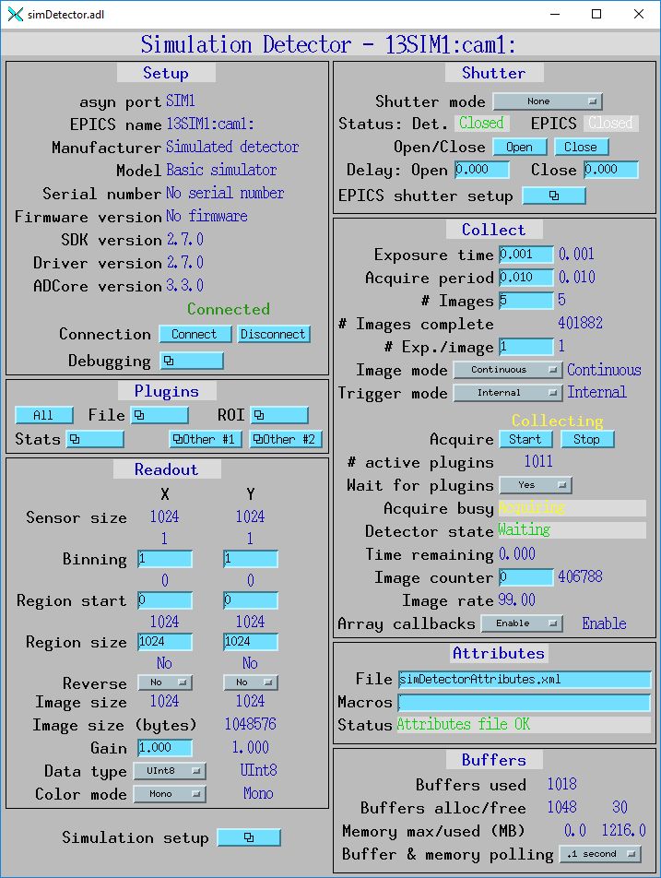
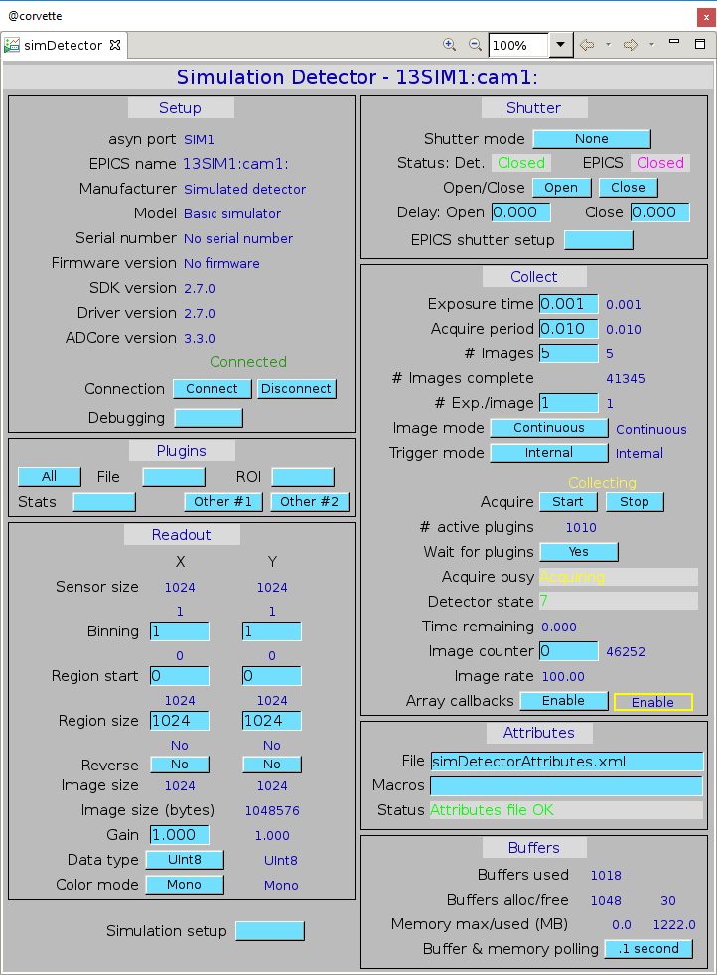
CSS-BOY
medm

Slide 7
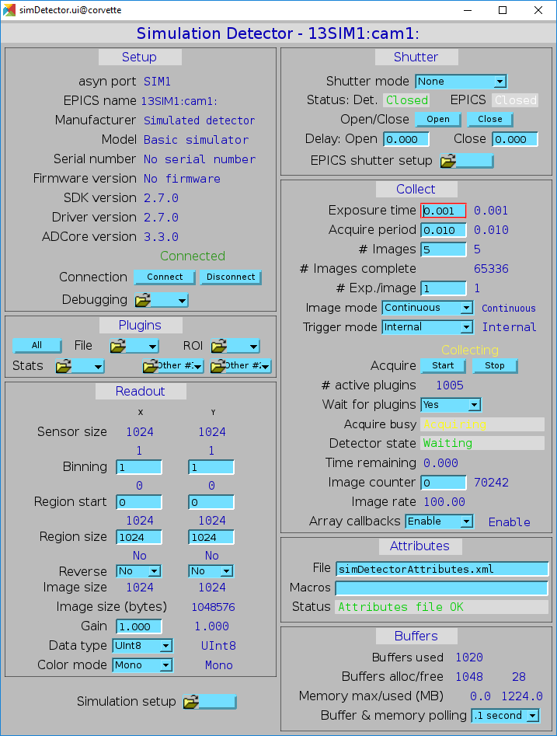
caQtDM
medm
caQtDM comes with a good adl to ui conversion tool, no changes needed

Slide 8
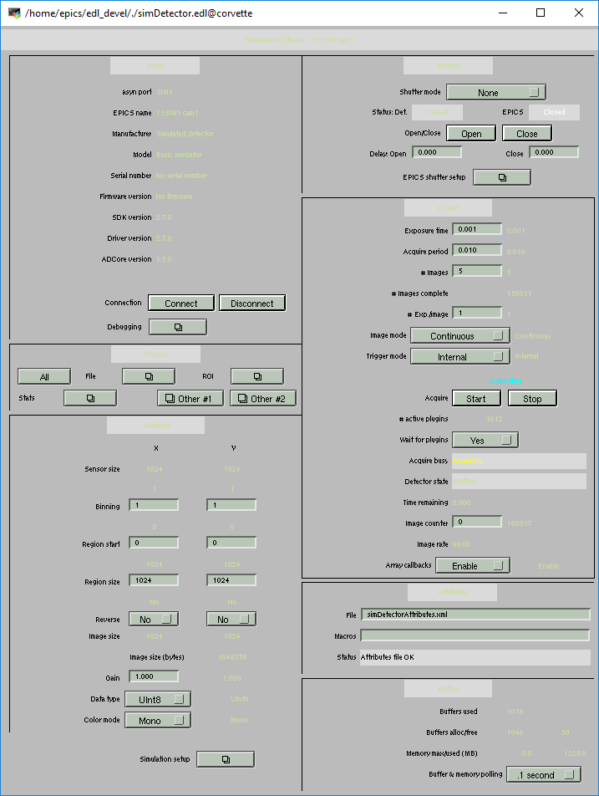
edm
medm
adl2edl required changes for parallel make because it used a hardcoded temporary file name (where to push fix?)
Quality of conversions is poor. adl2edl needs work.

