Slide 1
Development of triggered scaler and its field tests in J-PARC #2
2018/6/13
Kenichi SATO
KEK / J-PARC
Notes:
Hello , my name is kenichi sato, J-Parc control group.
I will talk about ..

Slide 2
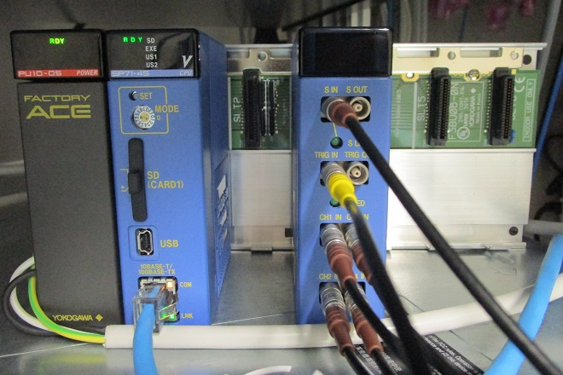
Triggered Scaler in Field Tests
PLC-based CPU
(Linux/EPICS)
Triggered Scaler
with signals in
As a demonstration, two accelerator signals in J-PARC MR are measured
input Ch1: 1) RF signal (MR-ring circulation, ~190kHz), provided by LLRF
Calculate MR energy
input Ch2: 2) MR abort signal, provided by MPS
Display MPS event to show timing in Machine Cycle
Notes:
As a demonstration of the Triggered Scaler, we measured two accelerator signals:
One is a RF signal, provided by the MR LLRF system. The RF signal corresponds to MR-ring circulation.
And another is a MR-abort signal. When a MPS occurs, the MPS system produces a MR-abort signal.
Two signal are fed into a Trigger Scaler module as shown in the photo.

Slide 3
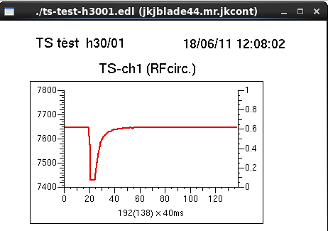
1) RF signal (MR-ring circulation)
Observed RF signal
(during one Machine Cycle, 5.20s)
Input: MR-ring circulation signal from LLRF
MR circumstance is 1567.5m
Counts in a cell (40ms bin) shows that how many beam-turns go round the MR ring in 40ms
At 3-GeV (30-GeV), beam turns 7429 (7647) times in 40ms
RF signal is measured successfully
3->30GeV Acceleration pattern is visualized
3GeV
30GeV
INJ
ACC
Extract
Machine Cycle (5200ms)
Notes:
First, we measured a RF signal. It is generated by a MR LLRF system.
The signal here is a MR-circulation signal. The signal frequency corresponds to proton’ one turn in MR-ring.
The observed RF signal, using a trigger scaler, is shown.
During MR injection, we accept 3 GeV protons, and RF signal frequency is lowest. The counts in 40ms bin
Is 74-29.
Then. protons are accelerated up to 30 GeV. The RF frequency is gradually up, and counts reaches to 76-47.

Slide 4
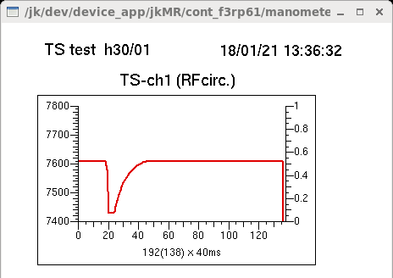
- How to calculate MR-Energy
1) RF signal (MR-ring circulation) (continued)
x : RF signal (counts / 40 ms)
L : Circumstance of J-PARC MR (1567.5 m)
c : speed of light (299792458 m/s)
β : Relative speed
m₀c² : Proton rest mass (0.938 GeV)
$$β=\frac{v}{c}=\frac{x}{0.040}∙\frac{L}{c}$$
$$E=\frac{m_{0}c^{2}}{\sqrt{1−β^{2}}}−m_{0}c^{2}$$
- LLRF patterns (3/8GeV and 30GeV)
- Measurements by a Triggered Scaler, and calculate MR-energy
x = values measured by a Triggered Scaler
E = calculated MR energy
x=7429 @ 3GeV
-> E=2.991
x=7608 @ 8GeV
-> E=8.004
x=7647 @ 30GeV
-> E=31.46
Notes:
So let’s study relativistic theory.
Beta, ratio of proton velocity over the light speed, can be calculated from observed counts.
Then, proton energy can be deduced.
Using the observed count, 7429 at 3GeV RF signal, calculated proton energy is 2.99 GeV.
Using 8GeV counts, calculated 8.0GeV; and using 30GeV counts, energy is 31 GeV
The deduced energies from observed counts roughly agree to expected energies of RF patterns. .
This fact shows that the trigger scaler works well.

Slide 5
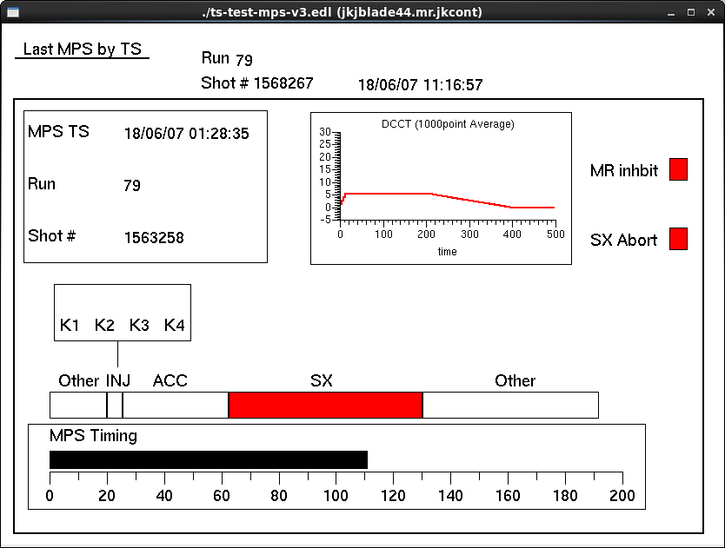
2) MPS signal (MR-abort signal)
MPS event happens
Detected MPS signal
(during Machine Cycle=5.20s)
Input: MR-abort signal
During stable beam operation, no signal exist (all zero)
When a MPS event happens, count 1 appears
Non-zero value is a start to save and show: event timestamp, RUN number, shot number, DCCT (beam current).
mps
. . .
Machine Cycle (5200ms)
INJ
ACC
Extract
Machine Cycle (5200ms)
Notes:
Second measurement is the MR-abort signal.
When an accelerator component meets a serious interlock during operation,
the MPS system produces a MR-abort signal.
Detected MR-abort signal is a start to save : run-number, shot-number, time-stamp, beam DCCT current, and show them in a EDM.
In addition, observed signal is visualized in EDM, which shows the timing of MPS event in Machine Cycle.

Slide 6
conclusion
Using a new module, triggered scaler, we measured real accelerator signals (RF and MPS signals) successfully.
The measurements demonstrated expected functionalities of the module.
More applications, including miss-trigger detection, are planned.

