Slide 1
CS-Studio Collaboration Status
Eric Berryman Controls Engineer

Slide 2
Overview
Collaboration Statistics
Feedback from Issues
Comments Activity
Issues Activity
Milestone Activity
Management Review
Customer Feedback
Follow-up from past Management Reviews
Recommendations for improvement / Actions for improvement
Milestones Status
4.5.x (stable)
4.6.x (testing)

Slide 3
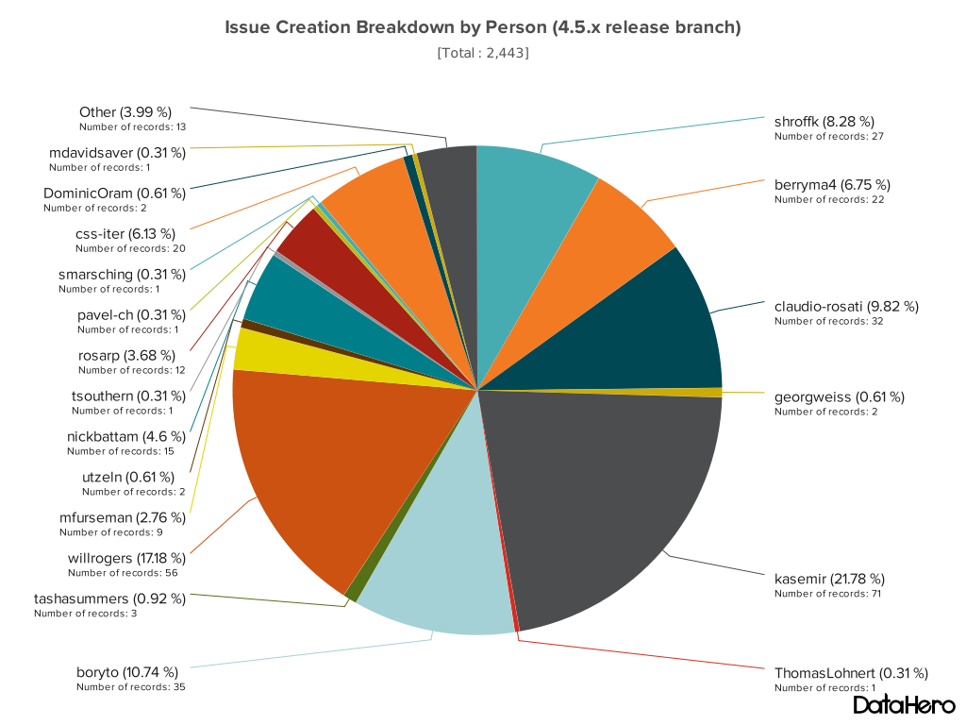
Feedback from Issues

Slide 4
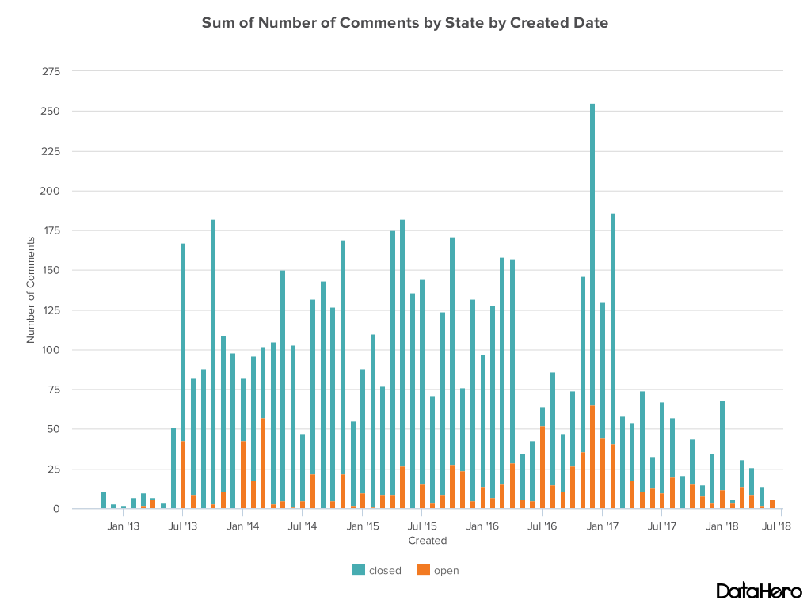
Comments Activity

Slide 5
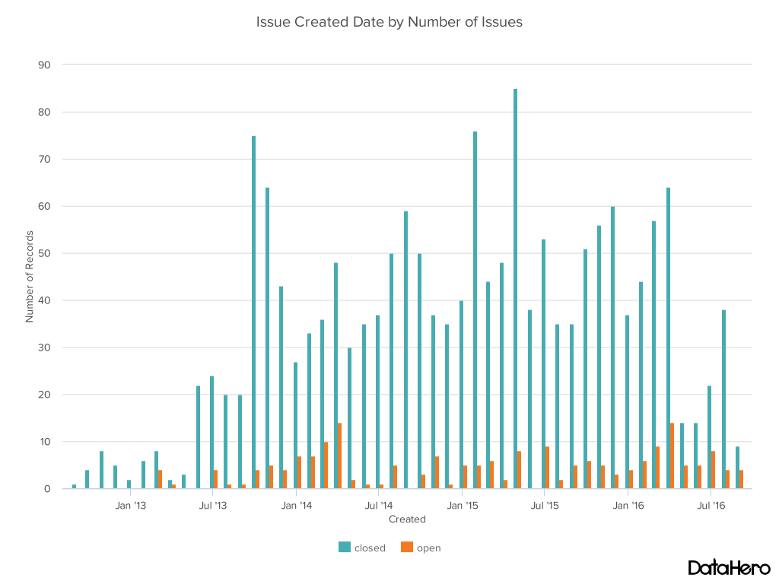
Issues Activity

Slide 6
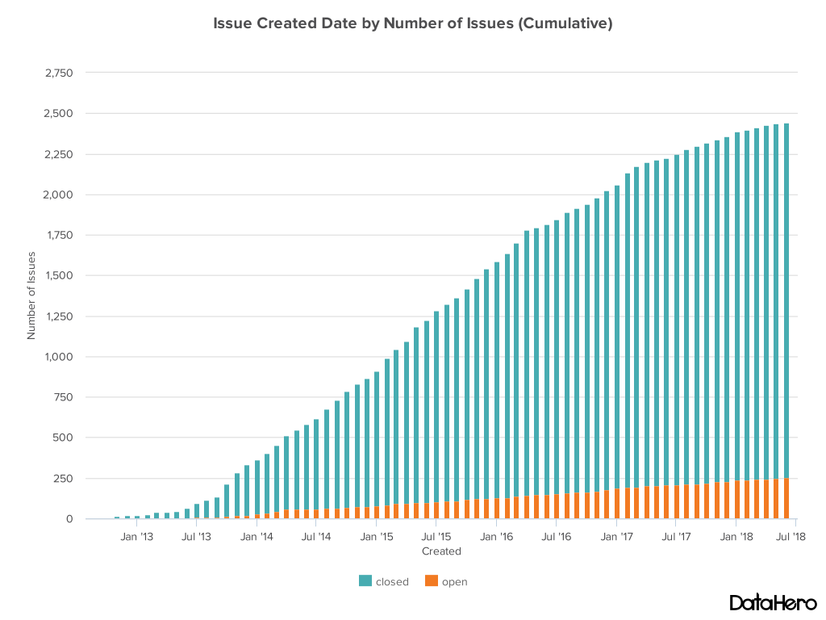
Issues Activity

Slide 7
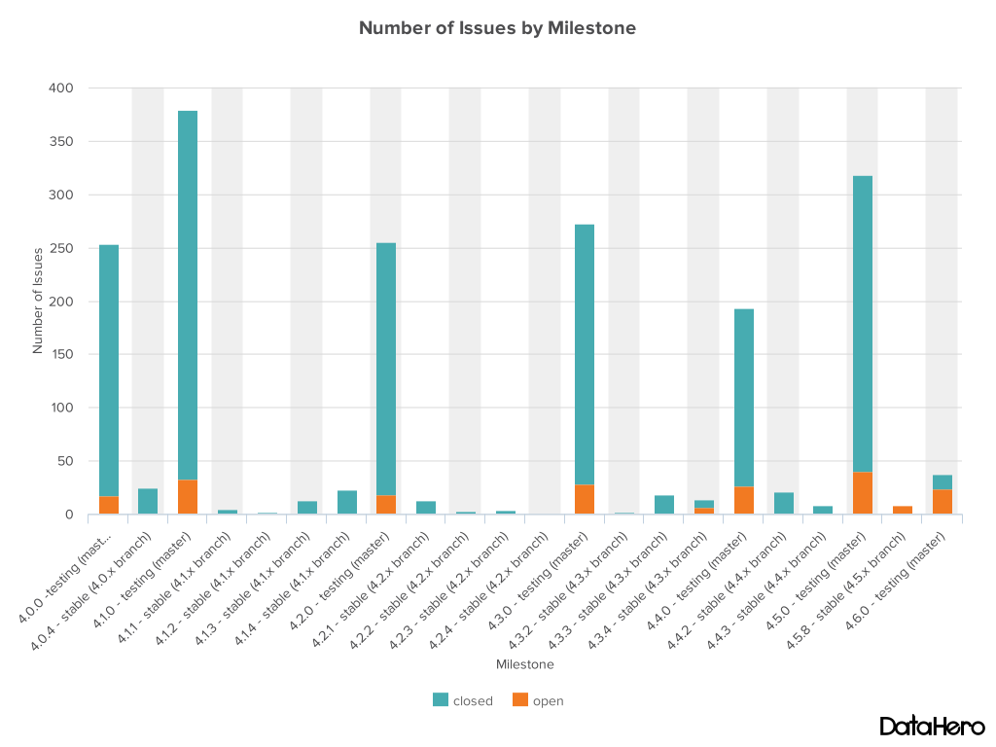
Milestone Activity

Slide 8
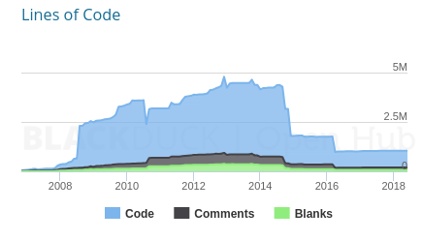
ISO 9001 Quality Standard
Following the ISO 9001 Quality Standard for past 5 years
Processes for continuous improvement are well defined
Finished our fourth Management Review (June 11 2018)
FRIB Quality Engineer will perform audit in October
Code base has gone from 3.8 to ~0.8 million lines of code
Over 500 unit tests, and code format checks, all passing
Collaboration now includes 14 labs that have registered site representatives

Slide 9
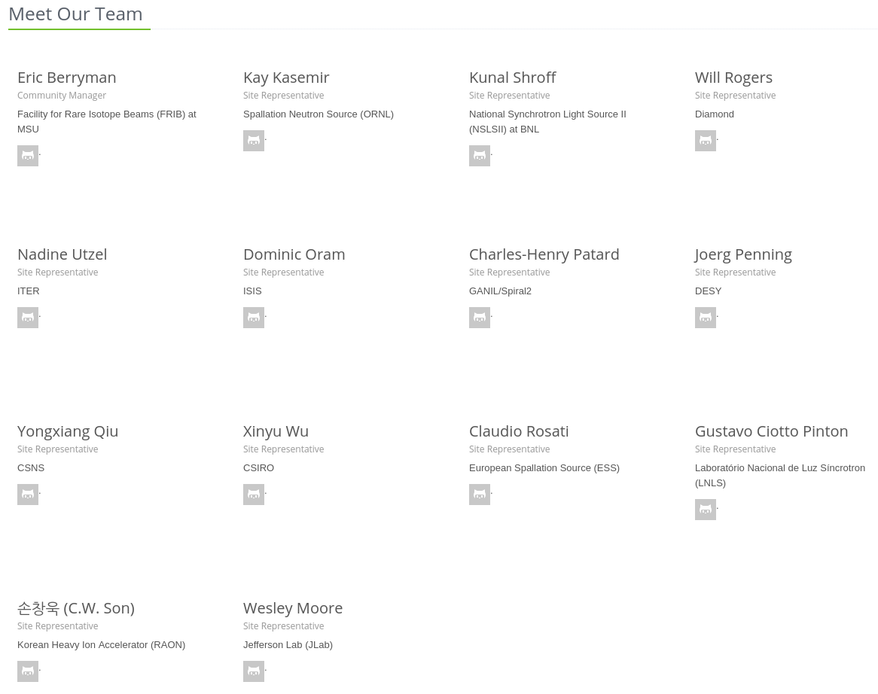
Registered Sites

Slide 10
ISO 9001 Quality Standard
Following as a guideline to improve quality
Management Review
Quality Policy and Objectives
Process Performance and Product Conformity
Status of Corrective and Preventative Actions
Customer Feedback Analysis
Decisions and Actions for improvements
Resource needs
Continual Improvement of the Quality System
Customers
Management Responsibility
Customers
Resource Management
Measurement, Analysis and Improvement
Satisfaction
Requirements
Product Realization
Product
information
activities
taken from ISO 9001

Slide 11
Management Review
Quality Policy and Objectives
Through a strategy of continuous improvement and teamwork, the Control System Studio Collaboration is dedicated to supplying control system tools for machine and experiment operator interfaces, automation and service integration to enable our users to achieve their scientific objectives.
The foundation for achieving our commitment is based on:
understanding and meeting the requirements of our users,
continuously improving all processes related to the Control System Studio product,
effectively utilizing the creative talents in the collaboration,
and meeting statutory, regulatory, and other requirements.
Objective:
90% User satisfaction from registered sites with a site representative
90% Developer satisfaction from registered sites with a site representative

Slide 12
Customer Feedback When it works, I like it
Summary of quotes from feedback
Integrated environment
right click -> send PV name to another plug-in saves me a lot of time
I like the concept of a well-integrated set of tools that can share data
Integration of the olog, channel navigator, and chart/archiver features are useful
Everything in one place
Applications
The editor is really useful. CSS makes it really easy and fast to create prototype UIs
source code free creation of GUIs (we use BOY)
Easy to create GUI's that interact with EPICS PV’s
easy access to PVs, easy search engine, well integrated with archiver and logbook

Slide 13
Customer Feedback When it does not work, I hate it
Summary of quotes from feedback
Managing the Product
Big labs seem to have their experts but I'm under the impression that smaller labs are struggling and so am I when "my expert" is not available
Spend a long time to start a product in Eclipse and Export it. RCP is really hard and sometimes misunderstood technology
Pretty steep learning curve if you want to make code changes yourself, but I guess that is to be expected with such a large product
Slow and crashes
BOY leads to crashes way too often
In general CSS also needs too much resources (disk space, RAM, CPU)
Workspaces and windows
Workspace management is haphazard and inconsistent
The CS-Studio interface is usually larger than the screens being displayed, which wastes monitor space for other applications
Training
There needs to be a better self-guided training process for those that are new to CS-Studio so that the full potential of the tool can be realized more in depth

Slide 14
Follow up from Past Reviews
Management Review 2016
Improvement Actions included investigate Boy replacement (Display Builder), prototype started June 2015
Project made to improve build environment
Management Review 2017
Eclipse issues a constant theme; development/build and unsolved Github issues from users
Improvement Actions included investigate Eclipse replacement (Phoebus)

Slide 15
Evolution
BOY
Display Builder
Display Builder
Data Browser
Data Browser
Data Browser
PV Tree
PV Tree
PV Tree
Probe
Probe
Probe
PV Table
PV Table
PV Table
Alarms
Alarms
Alarms
Channels
Channels
Channels
Scan
Scan
Scan
… more …
… more …
… more …
Eclipse
Eclipse
Phoebus
Java 8
Java 8 (9,10)
Java 9, 10
Since ~2010
Since 2016
End of 2018
SWT
JavaFX

Slide 16
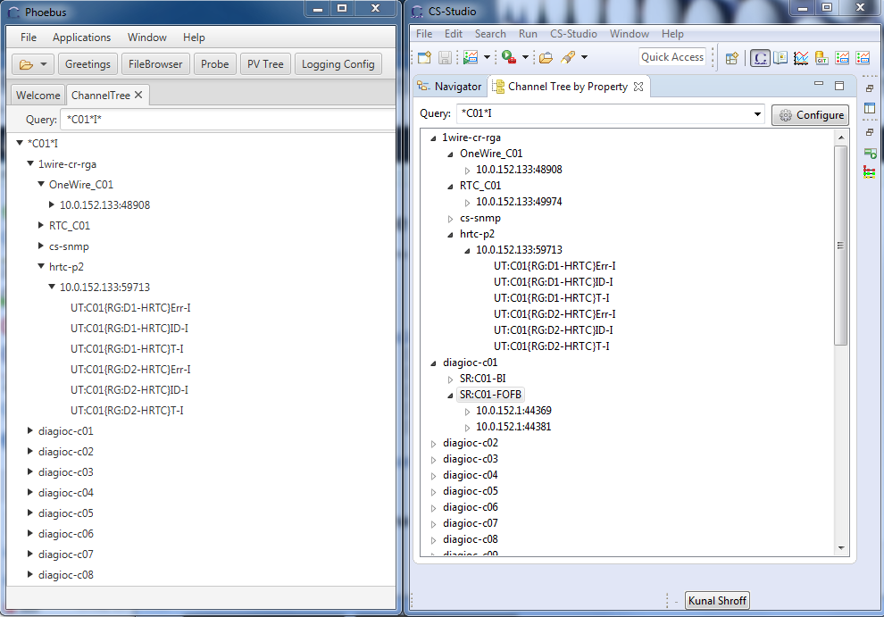
Phoebus vs Eclipse

Slide 17
Recommendations and Actions for Improvement
Improve Customer related processes
66% of customer feedback has been from programmers
Product Realization (requirements) need to be clearer to customer
Actions for improvement
Open project to investigate improvements to customer related processes
Continue with Phoebus as a replacement for Eclipse
Provide single CS-Studio distribution with both Eclipse and Phoebus applications assembled by site developers

Slide 18
4.5.x (stable)
4.5.x release last December
Display Builder available
Databrowser 3 (JavaFX) available
BOY font scaling corrected
Eclipse 4.6 Neon / Tycho 1.0.0
175 closed pull requests
103 closed issues

Slide 19
4.6.x (testing)
4.6.x due date October 2018, projects so far
Java 10
Eclipse Oxygen
Phoebus Integration

Slide 20
Phoebus integration with Eclipse
BOY
Display Builder
Data Browser
Data Browser
PV Tree
PV Tree
Probe
Probe
PV Table
PV Table
Alarms
Alarms
Channels
Channels
Scan
Scan
… more …
… more …
Eclipse
Phoebus
Java 9,10
Java 9, 10
Eclipse product opens specific applications in Pheobus
SWT
JavaFX

Slide 21
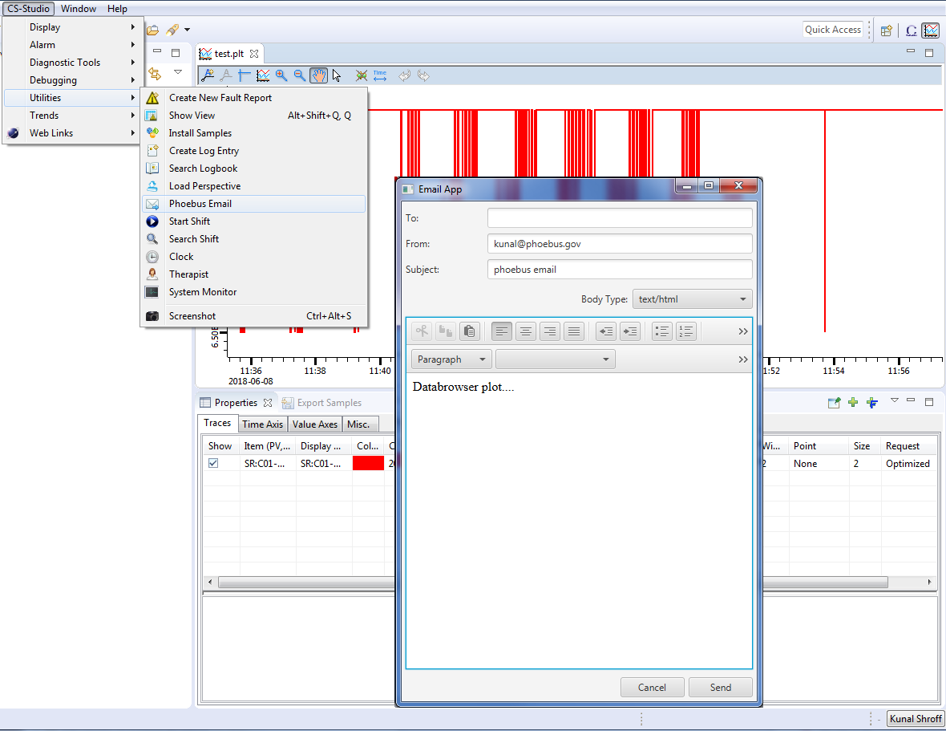
Phoebus with Eclipse

Slide 22
How to Contribute
Fork us on Github
https://github.com/ControlSystemStudio/cs-studio
Pick an issue/feature or make one
https://github.com/ControlSystemStudio/cs-studio/issues
Create a branch in your fork with the fix or feature
Make a Pull Request with the issue number in the title
Attend meetings, know the release schedule, subscribe to mailing list

Slide 23
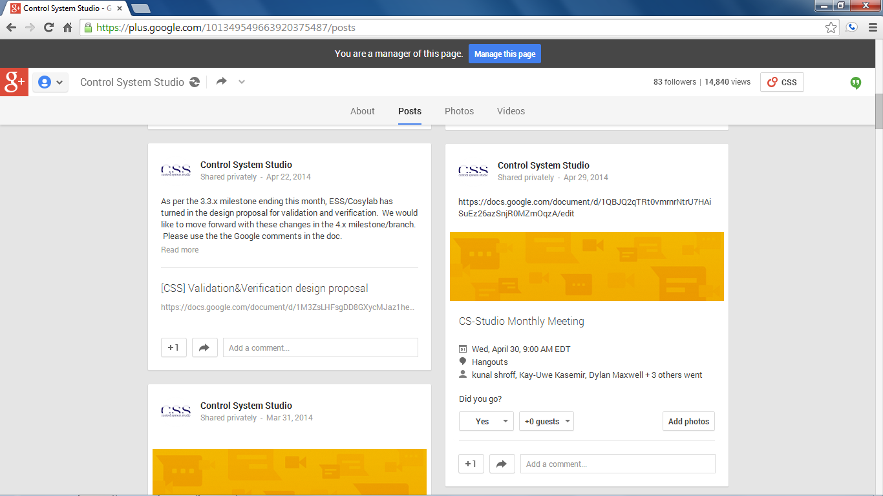
Attend Meetings
We use Google Hangouts to share our progress and discuss issues
Follow us on Google Plus
https://plus.google.com/101349549663920375487/posts
Meetings are posted (viewable after being added to group)
First Wednesday of the month (9am EST)
Project groups meet once a week when actively developing

Slide 24
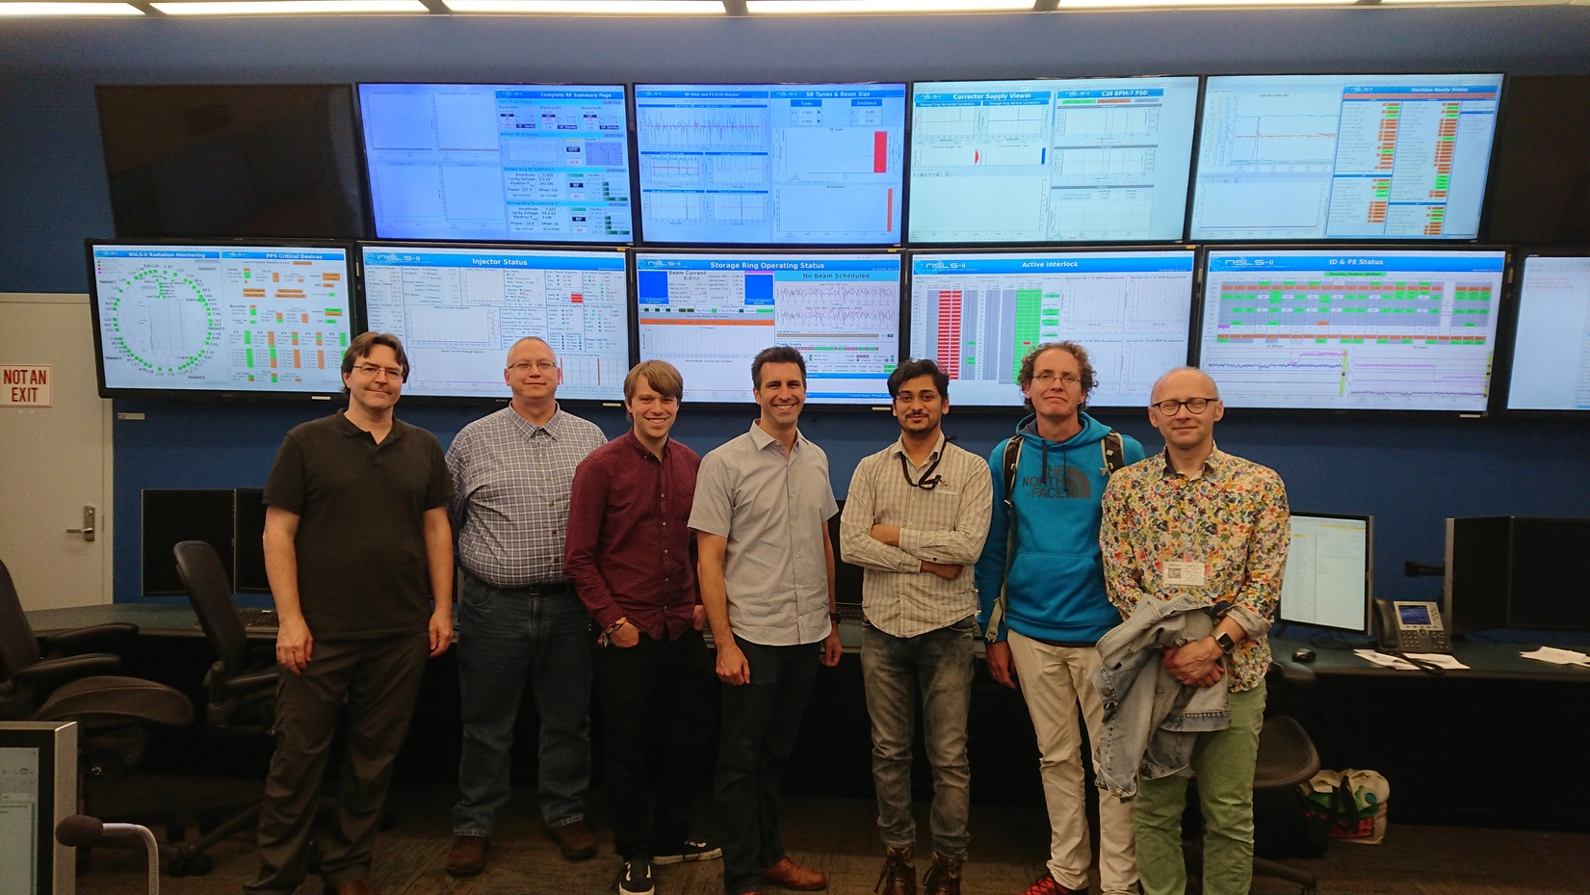
Code a thon
May 7-11 2018 at Brookhaven National Lab

Slide 25
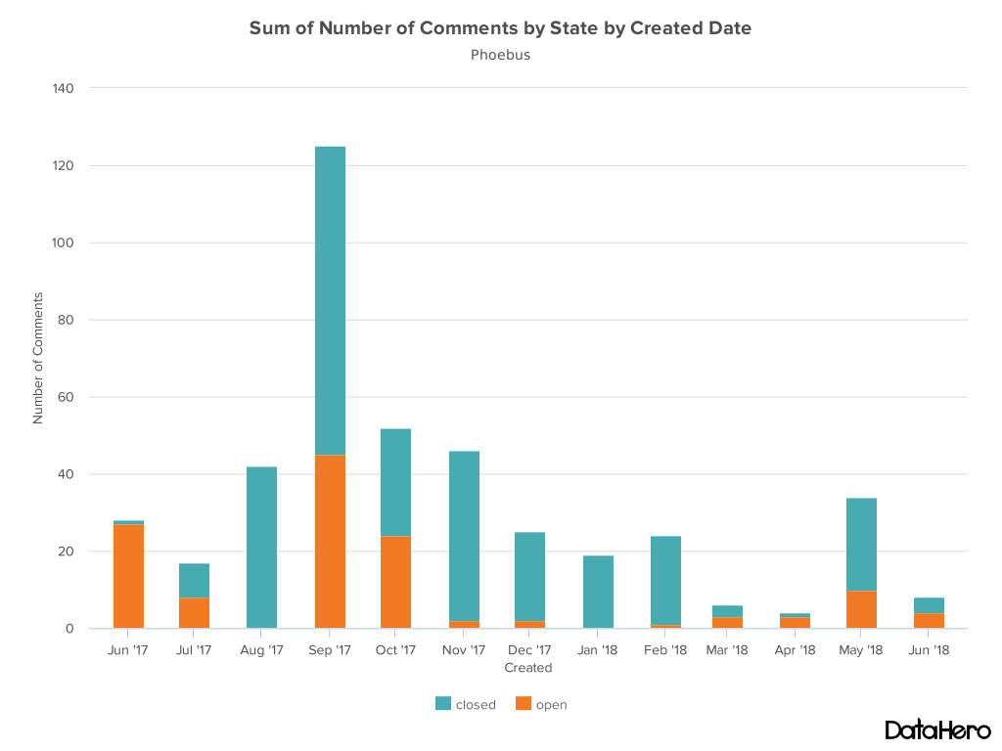
Comments Activity

Slide 26
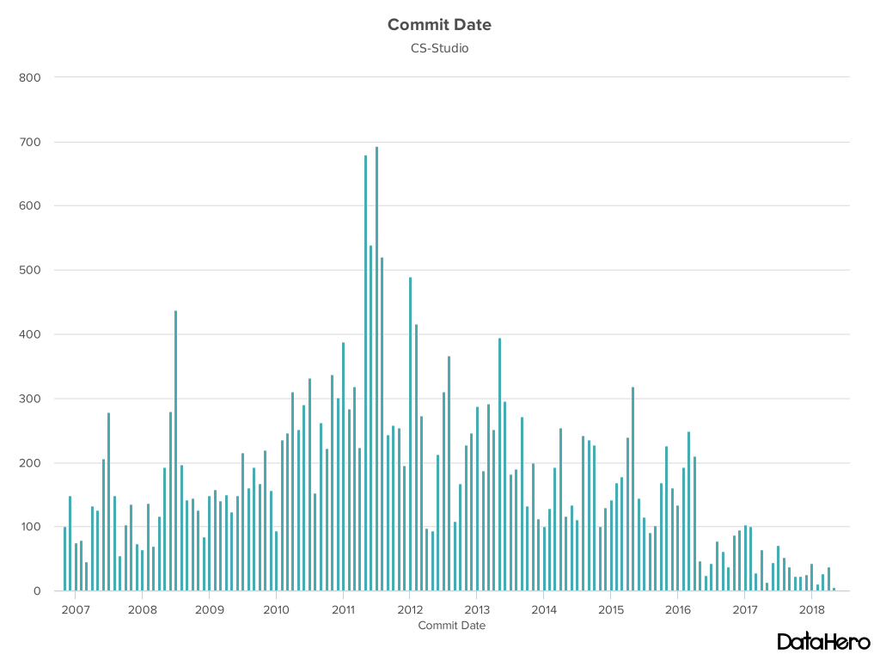
Commits Activity

Slide 27
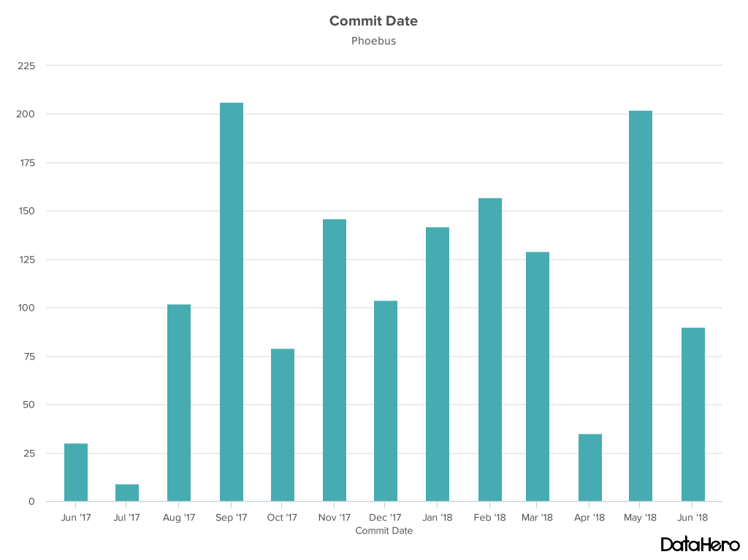
Commits Activity

