Slide 1
Phoebus
June 2018 ANL EPICS Meeting
Kay Kasemir, ORNL
Kunal Shroff

Slide 2
Key CS-Studio Feedback, Developers & Users
Useful Applications
Nice Integration
Fragile, long build process (>30 minutes!)
Hard to create site-specific “Product”
Awkward, haphazard window & workspace environment

Slide 3
Evolution of CS-Studio
JavaFX
SWT
BOY
Display Builder
Display Builder
Data Browser
Data Browser
Data Browser
PV Tree
PV Tree
PV Tree
Probe
Probe
Probe
PV Table
PV Table
PV Table
Alarms
Alarms
Alarms
Channels
Channels
Channels
Scan
Scan
Scan
… more …
… more …
… more …
Eclipse
Eclipse
Phoebus
Java 8
Java 8 (9, 10)
Java 9, 10
Since ~2010: Operational at several sites
Since ~2016
First release end of 2018

Slide 4
Combined Product
One download
Invoking certain functions in CS-Studio/RCP will start that component in CS-Studio/Phoebus
BOY
Display Builder
Display Builder
Data Browser
Data Browser
PV Tree
PV Tree
Probe
Probe
PV Table
PV Table
Alarms
Alarms
Channels
Channels
Scan
Scan
… more …
… more …
Eclipse
Phoebus
Java 9, 10
Java 9, 10

Slide 5
CS-Studio: Since ~2006 based on
Great at the time:
Build Setup
Module System
Preferences
Extensibility
Graphics … but there are now (better) alternatives
Strong ties to IDE
Awkward layout constraints for control system user interface
“Workspace” that’s different from the file system
Odd menu entries that we don’t need

Slide 6
From Eclipse to Phoebus
Tycho/Maven build setup → Maven or ant
OSGi bundles → Jar files, maybe later Java 9 modules
RCP Extension Points → Java Services
RCP Preferences → Java Preferences
SWT → JavaFX
Workspace → File System
RCP Workbench → Phoebus “Docking”

Slide 7
“Phoebus”
shadowed
Phoebus (Greek for “bright”) = Apollo as God of Light

Slide 8
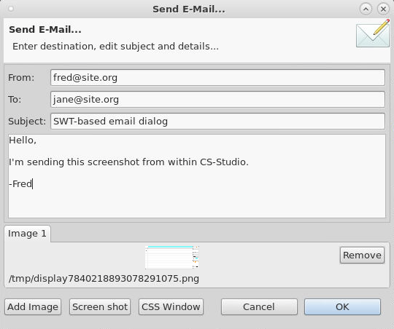
SWT vs. JavaFX
SWT used to be better than AWT
AWT/Swing caught up, SWT now only used by Eclipse
➔ JavaFX is the latest Java-based UI

Slide 9
Building..
CS-Studio on Eclipse
Maven/tycho
Network dependencies
Full rebuild takes >30 minutes
Monthly cannot-build-at-all problems
Must use Eclipse to develop
CS-Studio on Phoebus
Maven or ant
Can build from git clone + 1 ZIP
Full rebuild takes ~20 seconds (!)
Can (& still want to) use Eclipse to develop, but also Netbeans, VI, ..

Slide 10
Startup Times
CS-Studio on Eclipse: 8 secs (details depend on what’s being restored)
Open files from command line: Only display files. Not always finding the running instance because needs to locate window.
Phoebus: 4 secs (for a similar collection of panels)
phoebus.sh -resource .. Open display files, or probe, PV Table, .. with PVs. Succeeds because connects to TCP port.

Slide 11
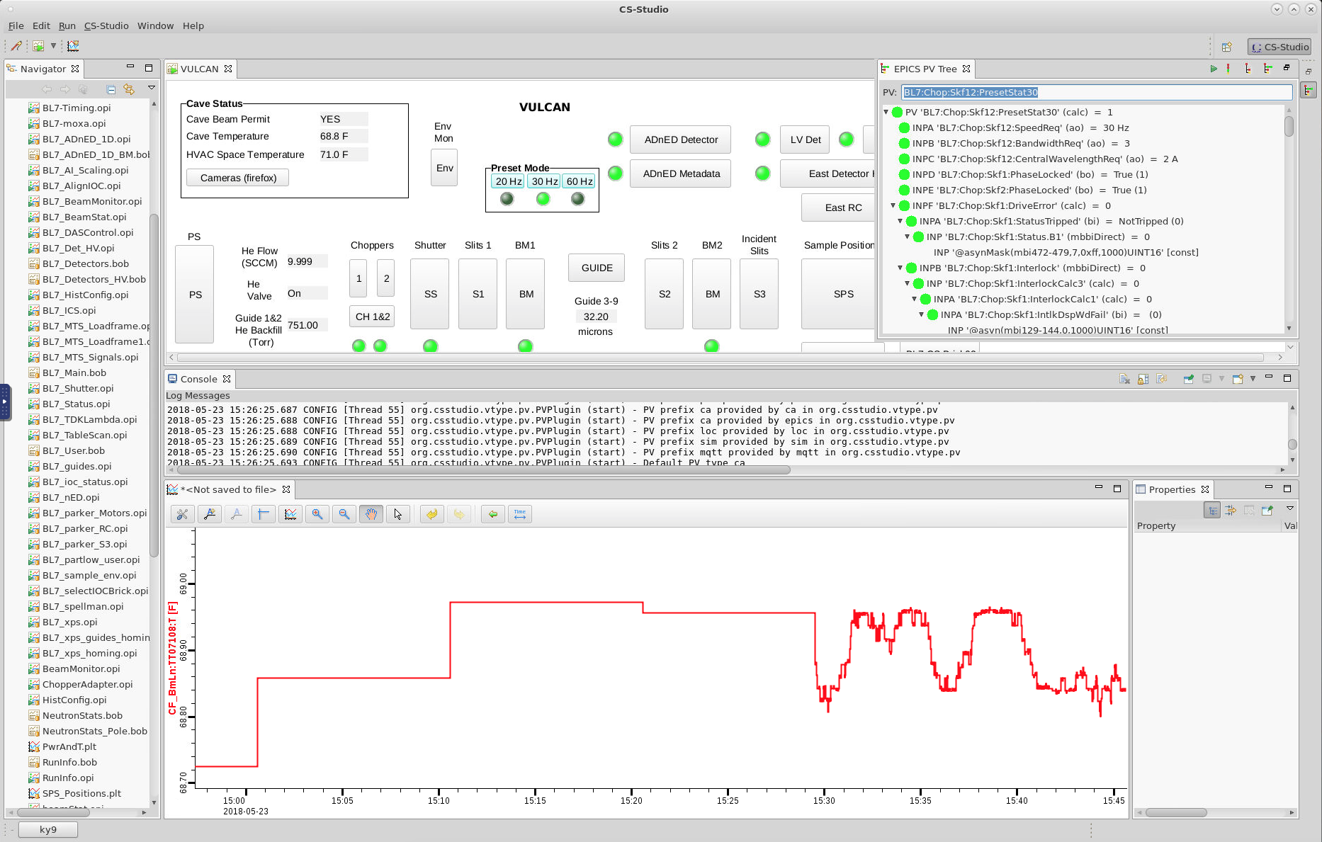
Eclipse: Little control where new panels open
Floating ‘Quick view’ panels?
Console in middle?
Empty Properties?

Slide 12
Docking: Like Tabs in web browser, plus “split” and “detach”

Slide 13
Window with horizontal Split

Slide 14
.. Added tab to new section

Slide 15
Can split further…

Slide 16
Added another tab

Slide 17
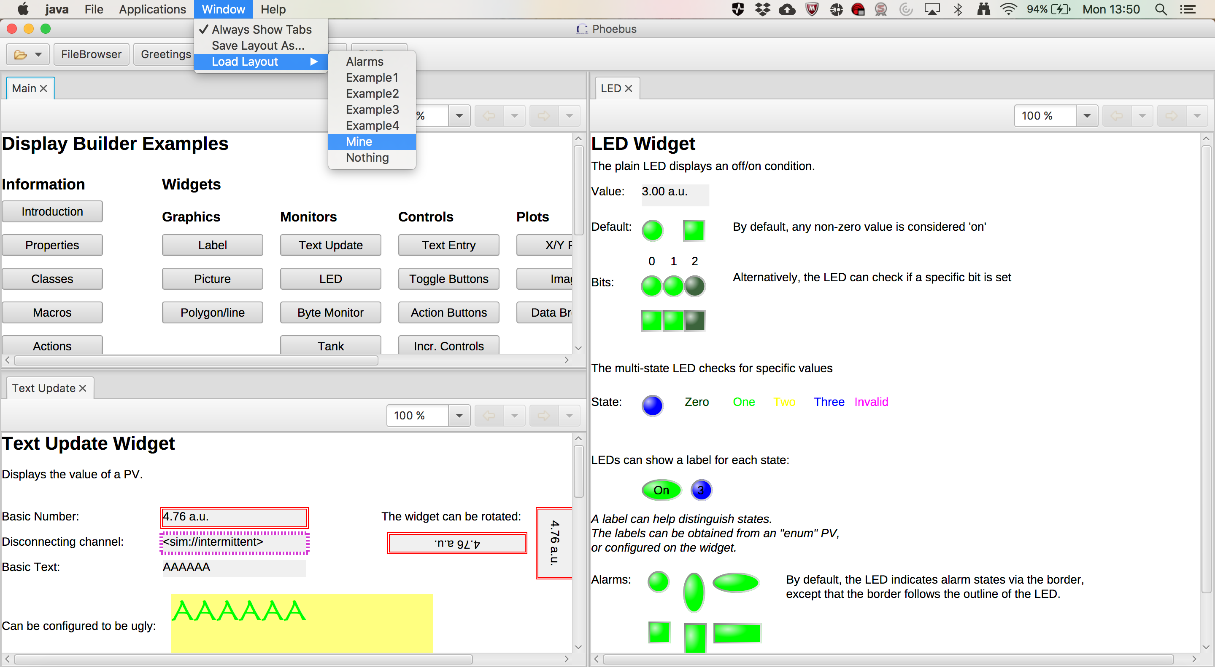
Save and Re-Load Layouts

Slide 18
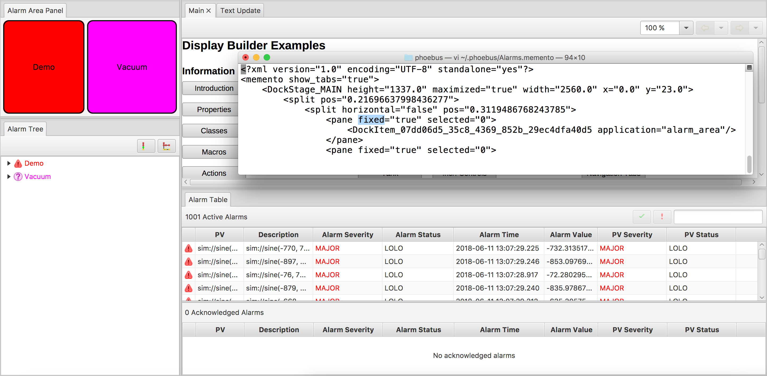
Fixed Layout Sections

Slide 19
Open Tools from Command Line
-resource /path/to/file - Opens that file with the default application.
-resource file:/path/to/file - Same, but makes the 'file' schema specific.
-resource http://my.site/path/to/file - Reads web link, opens with default application.
-resource file:/path/to/file?app=display_runtime& - Opens file with 'display_runtime' app MACRO1=value+1&MACRO2=abc passing macros.
-resource pv://?SomePV&app=probe - Opens the ‘SomePV’ with 'probe'.
-resource pv://?SomePV&OtherPV&app=pv_table - Opens two PVs PV with 'pv_table’.
First call will start phoebus
Follow-up calls can open resource in existing window
Used to integrate RCP-based CS-Studio

Slide 20
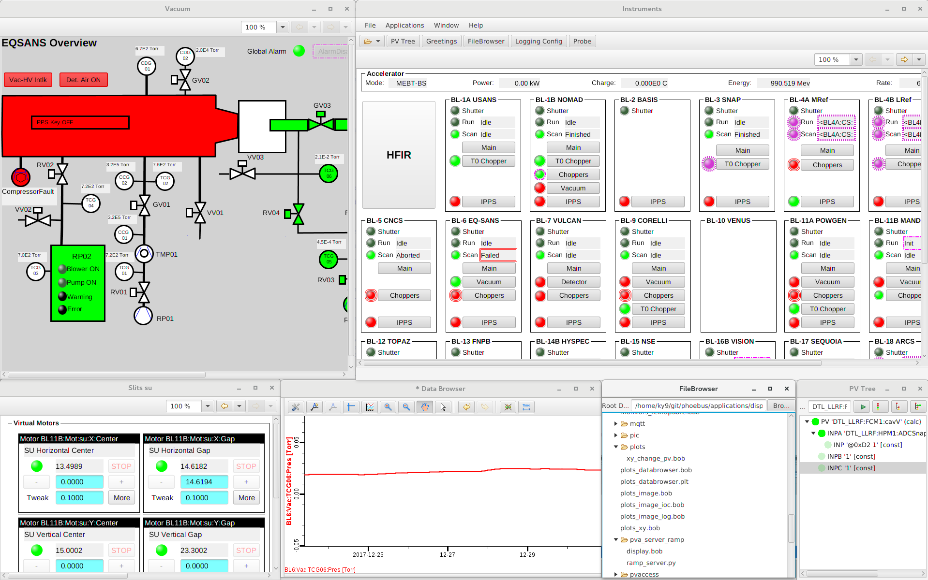
Progress
Completed
Probe
PV Tree
PV Table
File Browser (basic)
Data Browser
Display Builder
Scan UI
Scan Server
.. and infrastructure:
Autocomplete, Macros, ..
Build & Development Environment
99% compatibility with existing PV Table, Display Builder, Data Browser configuration files
Plan (end of 2018)
Alarm UI (required for SNS beam lines)
Channel Finder UI
Logbook Support
CS-Studio/Eclipse integration
Also planned, but not essential
File Browser (better)
Archive Engine

Slide 21
Phoebus based
Channel Finder Tree w/t
Lazy loading
4.5k Loc
Eclipse based
Channel Finder Tree w/t
Lazy loading
11.2k Loc

Slide 22
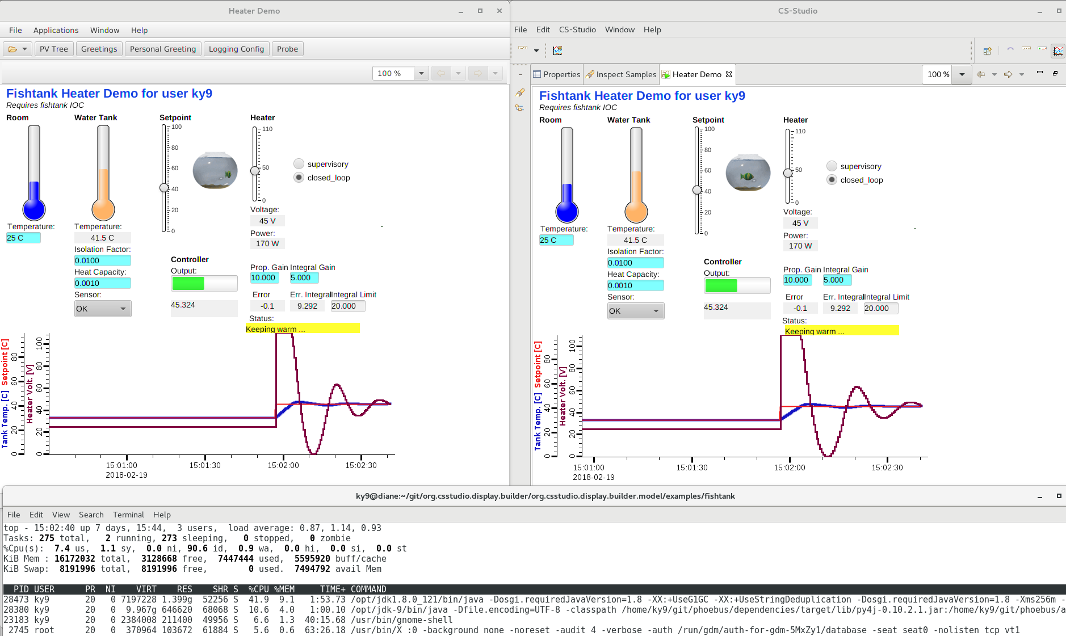
Phoebus:
¼ CPU, ½ Memory
CS-Studio with Eclipse

Slide 23
Phoebus
Display Builder
The next version of CS-Studio
Simpler, faster development setup
Simpler, more obvious panel layout
On track for 1st release end of 2018
Data Browser
PV Tree
Probe
PV Table
Alarms
Channels
Scan
… more …
Phoebus
Java 9, 10

